Slide 1
Social Risk Screening Kick-Off / Staff Orientation
Clinic Name
Date

Slide 2
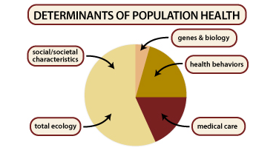
What are Social Risks (also called Social Determinants of Health)?
Social risks are the conditions in which people live and work. They profoundly impact health risks and outcomes, and ability to act on care recommendations.
Only 10-20% of health outcomes are attributed to clinical care; social risks account for 60-80% of health outcomes.
Social risks that impact health include: Housing stability; food security; access to transportation and childcare; ability to pay for basic utilities, etc.
Tarlov, A.R., Public Policy Frameworks for Improving Population Health. Annals of the New York Academy of Sciences, 1999. 896(SOCIOECONOMIC STATUS AND HEALTH IN INDUSTRIAL NATIONS: SOCIAL, PSYCHOLOGICAL, AND BIOLOGICAL PATHWAYS): p. 281-293.

Slide 3
Social Risks
Social risks that you may be able to document in the EHR include:
Household income
Education
Housing status
Food security
Social connection / isolation

Slide 4
Why Collect Social Risk Data?
Understand the factors affecting our patients’ health
Adapt treatment and care planning as needed
Identify needed referrals to community social services
Enable targeted outreach
Demonstrate areas of need for resourcing and advocacy

Slide 5
Our Clinic’s Social Risk Screening Goals
Our clinic will screen the following types of patients for social risks:
____________________________________
We will screen for the following social risks: ____________________________________
We will screen them every _________________ (how often)
Screening will take place: (how/when in workflows and who will conduct screening)
We will use social risk data for: ___________________________
Notes:
Actionability – e.g. more granular housing and food insecurity questions

Slide 6
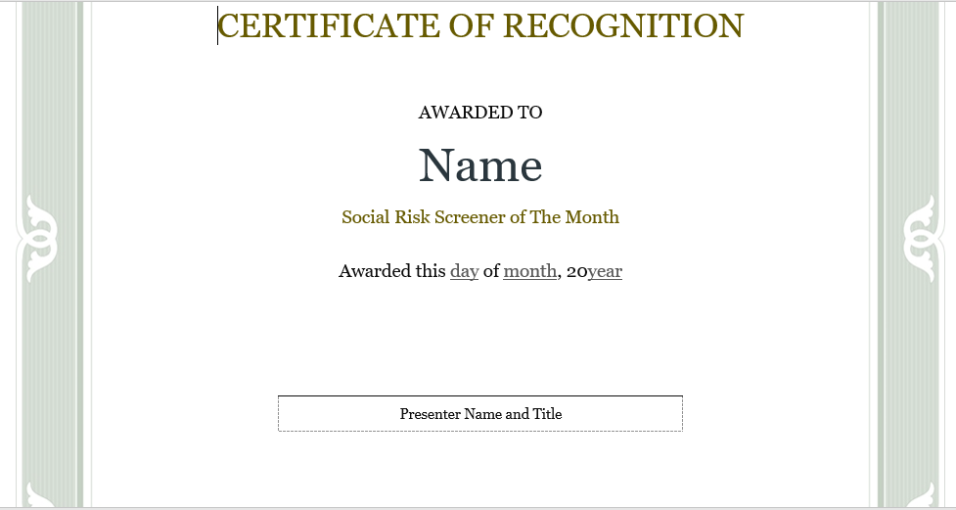
Social Risk Screening Activities Will Include….
Placing patient-facing social risk posters around the clinic
Recognizing staff who complete social risk screens
Tracking our clinic goals

Slide 7
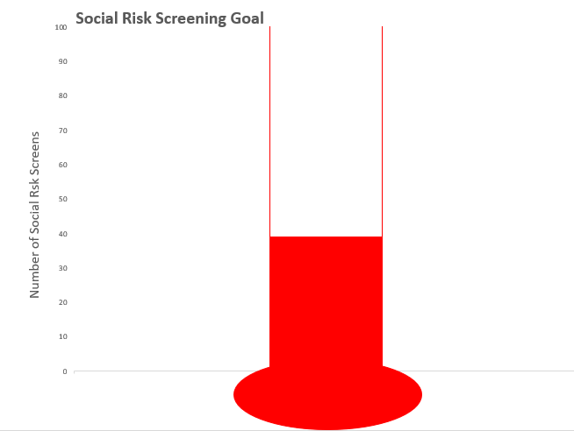
To Track Our Clinic Goals…
….we can use the Goals Thermometer

Slide 8
DISCUSSION
What are potential barriers to adopting social risk
data collection at our clinic?
Examples:
Lack of staff time
Concerns about asking sensitive social risk related questions
Limited ability to act on patients’ identified social needs

Slide 9
THANK YOU!

