Slide 1
What Should the Healthcare Sector’s Role Be in Addressing Adverse Social Drivers of Health?
February 28, 2024
siren

Slide 2
For Today’s Webinar
The webinar is being recorded and the presentation and slides will be sent to all registrants as soon as it is available.
We welcome questions. Please use the Q&A feature to ask your questions. We will try to get to as many of them as possible.
siren

Slide 3
March 11, 2024 SIREN’s New Conceptual Model
April 5, 2024 Lessons from the Camden Coalition’s Care Management RCT
February 2025, Date TBD SIREN National Research Meeting
siren

Slide 4
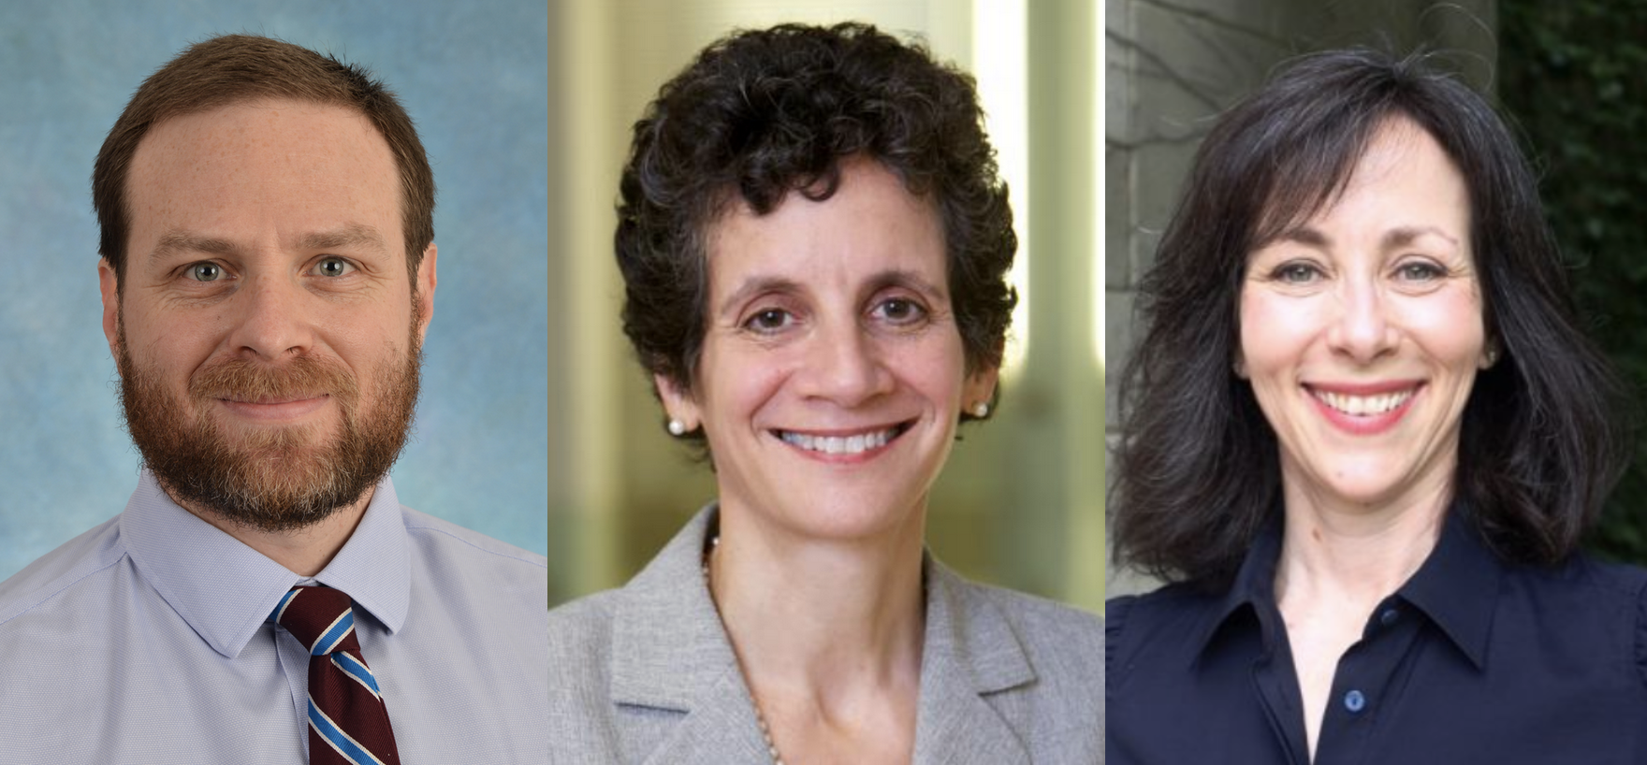
Panelists
Seth Berkowitz, MD, MPH
Sherry Glied, PhD, MA
Stacy Lindau, MD, MA
Moderator: Caroline Fichtenberg
siren

Slide 5
Seth Berkowitz Disclosures
Dr. Berkowitz has received research grants from: NIH, NC Department of Health and Human Services, Blue Cross Blue Shield of North Carolina, Feeding America, the American Diabetes Association, and the American Heart Association
Dr. Berkowitz has received personal fees from: the Aspen Institute, Rockefeller Foundation, Gretchen Swanson Center for Nutrition, and Kaiser Permanente
Dr. Glied serves on the Board of the Milbank Fund and of Geisinger.
Sherry Glied Disclosures

Slide 6
Stacy Lindau Disclosures
Under the terms of Grant Number 1C1CMS330997-01-00 (Stacy Lindau, PI) from the Department of Health and Human Services, Centers for Medicare & Medicaid Services, we were expected to develop a sustainable business model to continue and support the model that we tested after award funding ended. Dr. Stacy Lindau was the founder and owner of a social impact company, NowPow, LLC, which was acquired by Unite USA Inc. in 2021. Dr. Lindau is an unpaid advisor to and holds stock in Unite USA Inc. Neither the University of Chicago nor UChicago Medicine is endorsing or promoting Unite USA Inc. or its business, products, or services.
Dr. Lindau is an editor on Female Sexual Dysfunction for UpToDate and received royalties <$100/year in 2019, 2020 for this work. Subsequent royalties have been paid to the University of Chicago.
Dr. Lindau and her spouse own equity in unrelated healthcare businesses, stocks and mutual funds managed by third parties.
The University of Chicago has filed patents (pending) for the Bionic Breast Project, a project led by S.T.L.
Dr. Lindau serves the following non-profit boards: RISEtoWin, Scientific Network on Female Sexual Health and Cancer, Aspen Health Innovators Fellowship

