Slide 1
Social Needs Referral Kick-Off / Staff Orientation
[Clinic Name]
[Date]

Slide 2
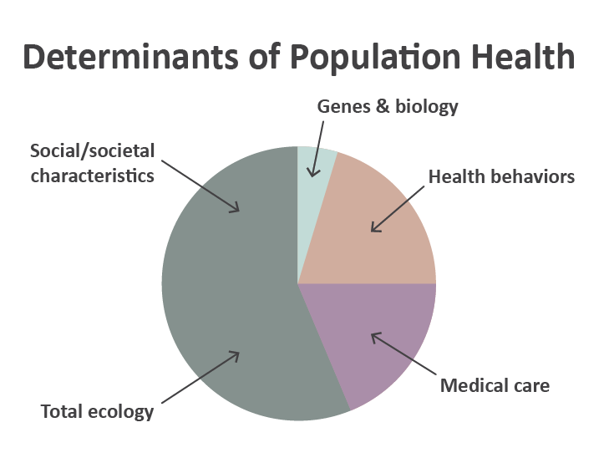
What are Social Risks (also called Social Determinants of Health)?
Social risks are the conditions in which people live and work. They profoundly impact health risks and outcomes, and ability to act on care recommendations.
Only 10-20% of health outcomes are attributed to clinical care; social risks account for 60-80% of health outcomes.
Social risks that impact health include:
Housing stability
Food security
Access to transportation and childcare
Ability to pay for basic utilities
And more
Tarlov, A.R., Public Policy Frameworks for Improving Population Health. Annals of the New York Academy of Sciences, 1999. 896(SOCIOECONOMIC STATUS AND HEALTH IN INDUSTRIAL NATIONS: SOCIAL, PSYCHOLOGICAL, AND BIOLOGICAL PATHWAYS): p. 281-293.

Slide 3
Social Risks
Social risks that you may be able to document in the EHR include:
Household income
Education
Housing status
Food security
Social connection / isolation

Slide 4
Why Collect Social Risk Data?
Understand the factors affecting our patients’ health
Adapt treatment and care planning as needed
Identify needed referrals to community social services
Enable targeted outreach
Demonstrate areas of need for resourcing and advocacy

Slide 5
Our Clinic’s Social Risk Screening Goals
Instructions: fill-in the blanks prior to presenting this slide and delete any unneeded text
Our clinic will screen the following types of patients for social risks:
[Insert types of social risks here]
We will screen for the following social risks:
[Insert types of social risks here]
We will screen them every [insert how often]
Screening will take place:
[Insert how/when in workflows and who will conduct screening]
We will use social risk data for:
[Insert what you will use social risk data for]

Slide 6
Why Conduct Social Needs Referrals?
Address patients’ desire for support with unmet social needs
Improve care quality and clinical outcomes
Reduce cost of care
Enhance relationships with community partners
Demonstrate areas of need for resourcing and advocacy

Slide 7
Social Needs Referral Activities Will Include:
Choose relevant services
Utilize navigation support strategies
Document, track, and followup on referrals
Recognize best practices and lessons learned
Evaluate and iterate our clinic’s referral goals and processes
Sustain social needs referral-making (e.g., systematic training, regional visibility)

Slide 8
Our Clinic’s Social Needs Referral Goals
Instructions: fill-in the blanks prior to presenting this slide and delete any unneeded text
We will conduct social needs referrals for the following social risks:
[Insert types of social risks here]
We will conduct referrals every [insert how often]
Social needs referrals will take place [insert when in workflows] and by [insert who will conduct referrals]
We will use social needs referral data for:
[Insert what you will use social needs data for]

Slide 9
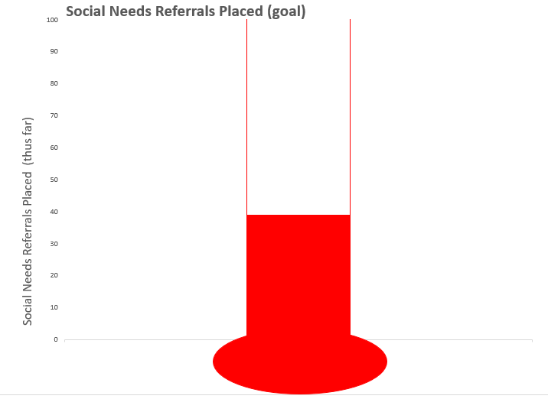
To Track Our Clinic Goals:
We can use the Goals Thermometer

Slide 10
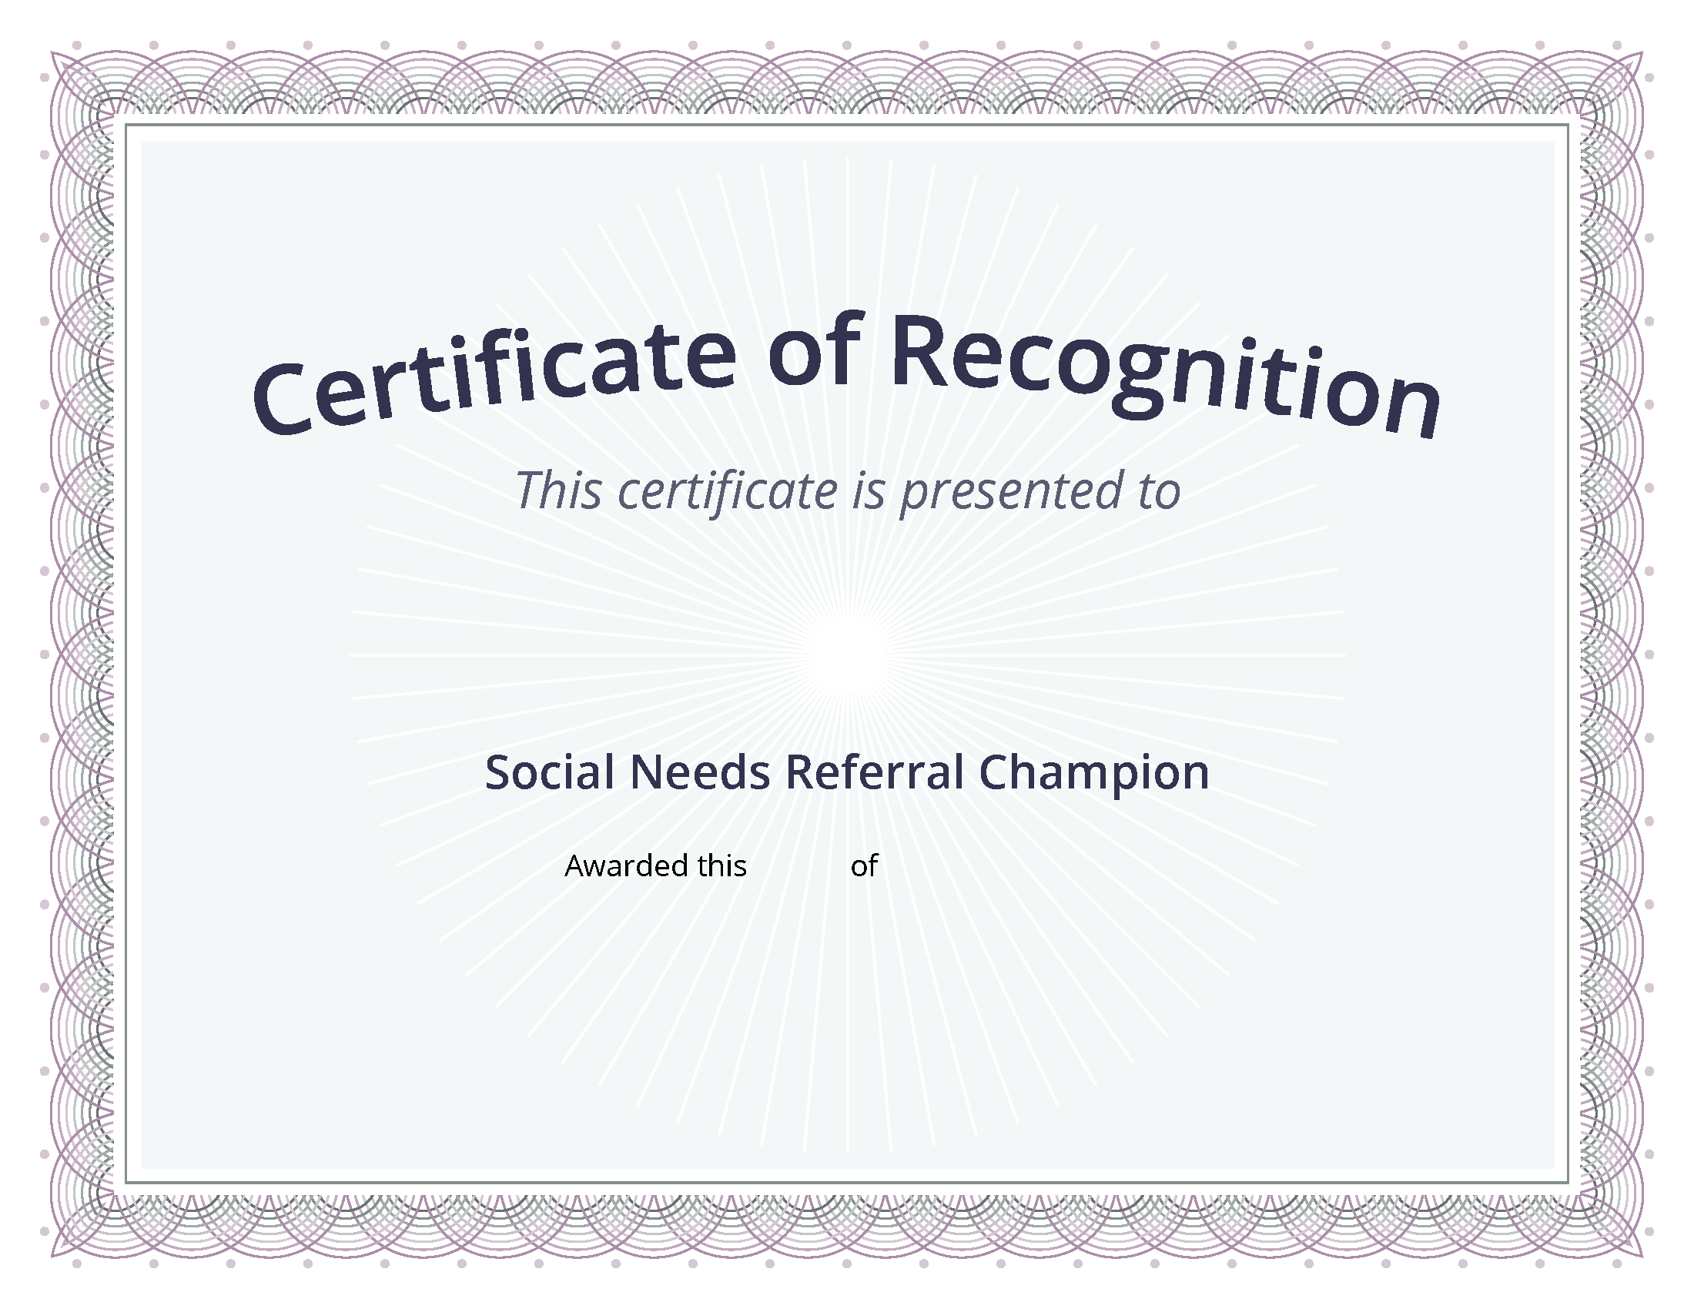
Promote Social Risk Screening and Referral Activities:
Placing patient-facing social risk posters around the clinic
Recognizing staff who complete social risk screens and provide referrals
Tracking our clinic goals

Slide 11
Discussion
What are potential barriers to conducting social risk screening and referrals at our clinic?
Examples:
Lack of staff time
Concerns about asking sensitive social risk related questions
Limited ability to act on patients’ identified social needs

Slide 12
Thank you!

