Slide 1


Unpacking the third AHC evaluation report
May 8, 2025
siren

Slide 2

In Gratitude
This webinar is made possible with support from:
siren

Slide 3

For Today’s Webinar
The webinar is being recorded and a link to the presentation will be sent to all registrants and posted on our website when it is available.
We welcome your questions and comments. Please use the Q&A feature to ask your questions. We will try to get to as many of them as possible.
siren
Notes:
Before we dive in to today’s content, I’ve been tasked with the responsibility of sharing both webinar logistics information and news about upcoming events.
The webinar is being recorded—we will send a link to the recording to all registered participants when it is available.
We also welcome your questions. Please use the Q&A function not the chat function to ask your questions and add comments.

Slide 4


Research and dissemination center at UC San Francisco
Conduct research
Support researchers
Synthesize and disseminate research
sirenetwork.ucsf.edu | siren@ucsf.edu | @SIREN_UCSF
Notes:
I want to start by telling you about SIREN. For those of you who aren’t familiar with us, SIREN stands for the social interventions research and evaluation network. We are a research and dissemination center at the University of California, San Francisco. Our mission is to improve research on social and medical care integration. We do that by synthesizing and disseminating research, by convening stakeholders, and by conducting and catalyzing research.

Slide 5

SIREN Evidence and Resource Library
Searchable database of research and implementation tools about healthcare-based social risk interventions.
Includes 3800 resources; updated monthly.
Available at https://sirenetwork.ucsf.edu/tools/evidence-library
siren
sirenetwork.ucsf.edu | siren@ucsf.edu | @SIREN_UCSF
Notes:
One of our most used resource is our Evidence and Resource Library. Show how to search.

Slide 6


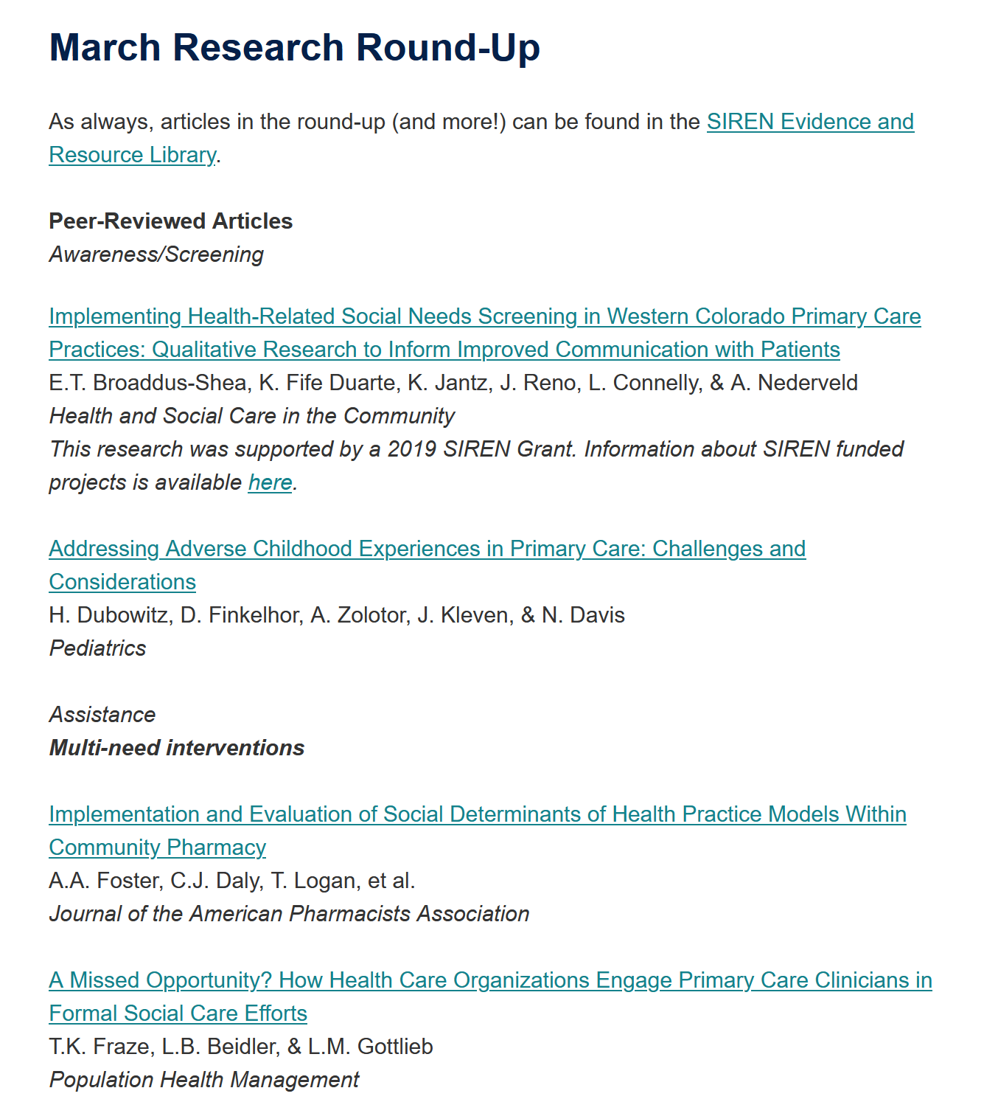
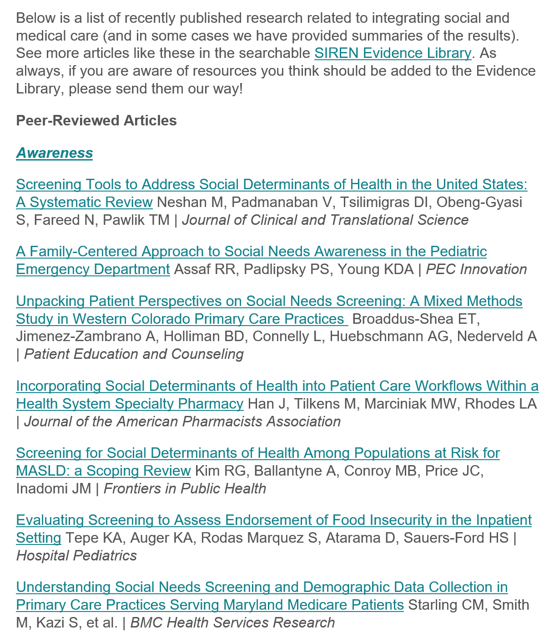
Stay up to date with SIREN’s monthly newsletter
siren
Sign up at sirenetwork.ucsf.edu/news-events/newsletters

Slide 7
Stay tuned for new episodes on the SIREN podcast!
The SIREN podcast is returning every Wednesday for six weeks, beginning June 4th.
Find the SIREN Podcast on your favorite podcast apps including Apple and Spotify.
siren

Slide 8
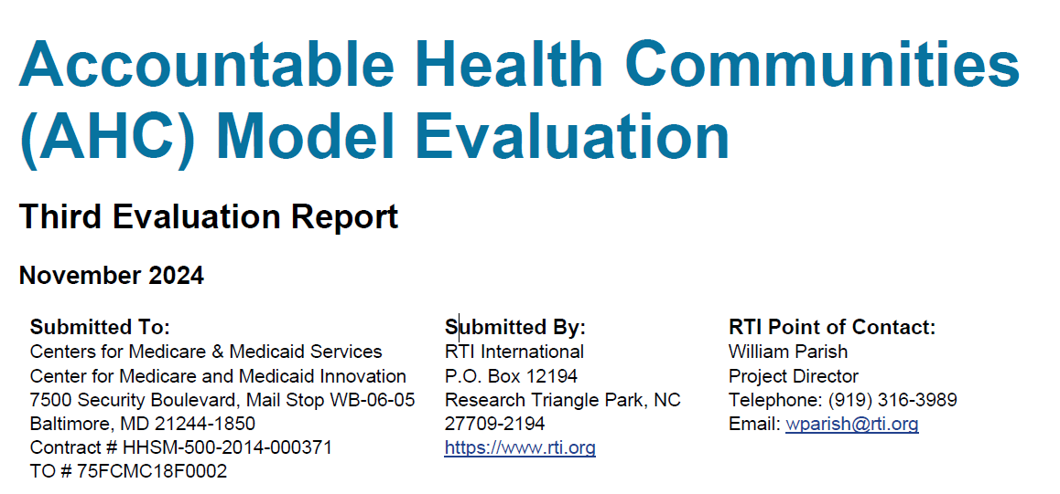
Accountable Health Communities Model
3rd Evaluation Report
https://www.cms.gov/priorities/innovation/innovation-models/ahcm

Slide 9

Panelists
Dawn Alley, PhD
IMPaCT Care
Text
Danielle Hessler Jones, PhD
SIREN
Caroline Fichtenberg, PhD,
SIREN
siren

Slide 10
Overview of AHC

Slide 11
Accountable Health Communities model
Funded by the Center for Medicare and Medicaid Innovation at CMS
Goal: Test whether navigation to community resources could reduce health care costs and/or reduce avoidable health care utilization
Duration: May 2018 – April 2023
28 sites participated for the whole duration
2 slightly different versions:
  Assistance: Tested impact of navigation
  Alignment: Tested impact of navigation + community partner alignment
No funding for social services, just for screening and navigation

Slide 12
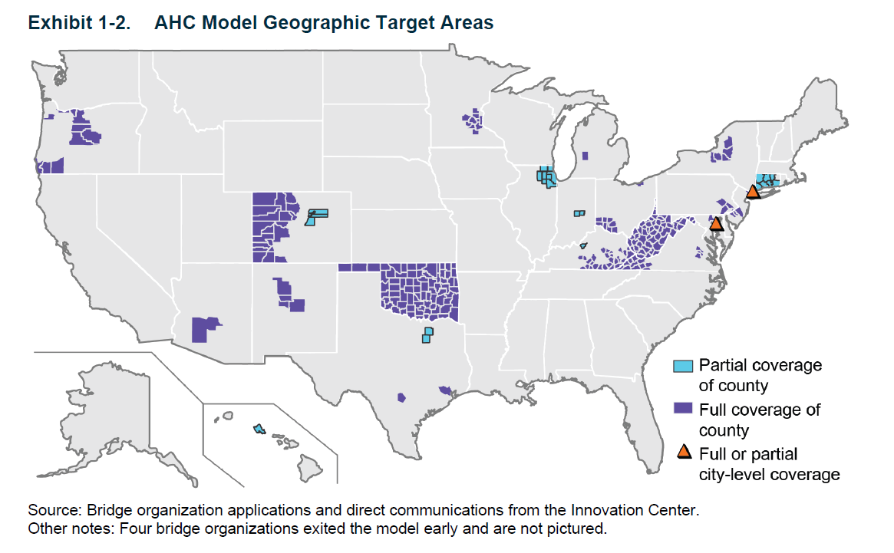

Slide 13

Model eligibility
Medicaid or Medicare beneficiary
At least 2 self-reported ED visits in the past 12 months
Screen positive for at least one of:
  Food insecurity
  Housing instability
  Transportation challenges
  Utility difficulties
  Interpersonal violence
AHC Screening Tool

Slide 14
AHC model tracks
Assistance (10 sites)
Alignment (18 sites)
Positive screen + ≥2 ED visits in past 12mo
Positive screen + ≥2 ED visits in past 12mo
Randomization
Partner Alignment
Multisector Advisory Board
Annual assessment of gaps in community resources
QI plan to address gaps
Tailored list of resources + Navigation
Tailored list of resources
Tailored list of resources + Navigation
+
Intervention Control

Slide 15
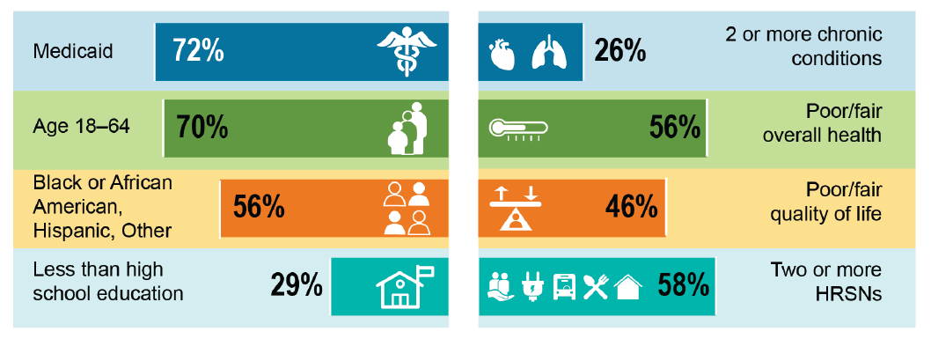
Characteristics of navigation eligible beneficiaries
Over 1 million were screened
18% (205,000) were eligible for navigation

Slide 16
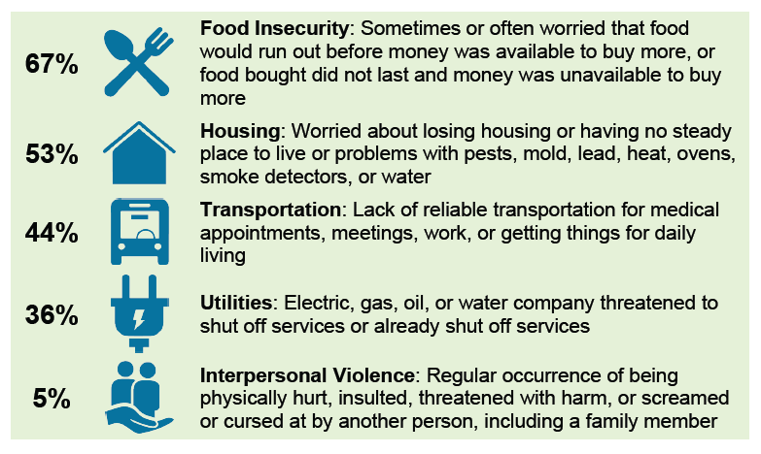
Prevalence of health-related social needs (HRSN)

Slide 17
Needs resolution
~136,000 received navigation
40% had at least one need resolved
28% had all needs resolved
30% could not be reached
30% had needs that weren’t resolved for various reasons

Slide 18
Differences in navigation acceptance and need resolution
 | Accepting navigation | Having at least 1 need resolved
Black or Hispanic | More likely | More likely
With >1 social need | More likely | More likely
With diabetes | More likely | Not more likely
Dually eligible | More likely | More likely
Less than high school education | More likely | Not more likely

Slide 19
Impacts

Slide 20
Methods for impacts on connections to resources and need resolution
Survey of those screened April 2019 – March 2022.
  Program ran May 2018 – April 2023
Survey occurred 6 months after screening.
25% response rate.
Non-responders more likely to be older, more affluent, more rural, Medicare beneficiaries, and with fewer needs.
Data weighted for differences between responders and non-responders.

Slide 21
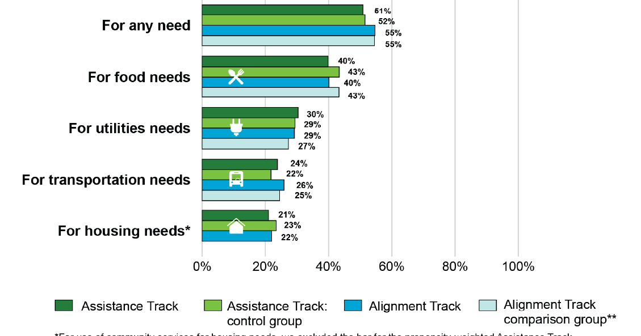
No impact of navigation on connection to resources 6 months post screening

Slide 22
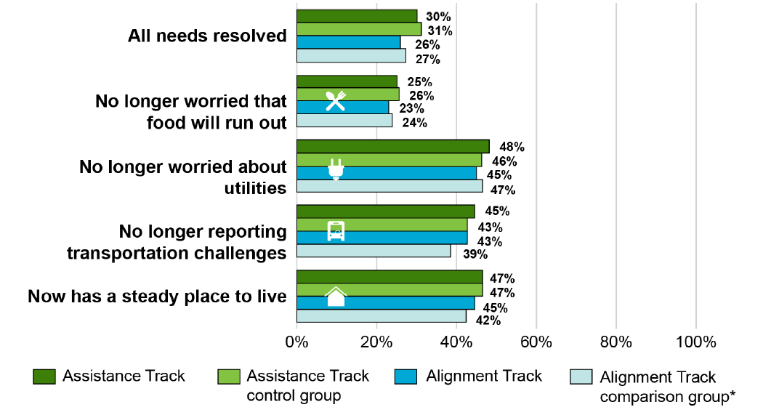
No impact of navigation on need resolution

Slide 23
Methods for costs and utilization analyses
Assistance track:
Differences between intervention and control groups in regression-adjusted post-screening values
Alignment track:
Compared Alignment to Assistance control group
Propensity score weighted difference in differences models
Medicaid: 3 years of post-screening follow up
Medicare FSS: 4 years of post screening follow up
Notes:
Sample Size: 30,452 Medicaid beneficiaries and 10,517 FFS Medicare beneficiaries in the intervention group.

Slide 24
Navigation reduced costs and utilization in the Assistance track
-$116 PBPM
- $54 PBPM
-4 admissions/ 1,000 beneficiaries/year
-26 ED visits/1,000 beneficiaries/year
-18 avoidable ED visits/1,000 beneficiaries/year
Notes:
Sample Size: 30,452 Medicaid beneficiaries and 10,517 FFS Medicare beneficiaries in the intervention group.

Slide 25
Navigation reduced utilization for Medicaid participants in the Alignment track
-7 admissions/ 1,000 beneficiaries/year
-34 ED visits/1,000 beneficiaries/year
-14 avoidable ED visits/1,000 beneficiaries/year
Cost decreases were not statistically significant
No impacts in FFS Medicare
Notes:
Sample Size: 61,815 Medicaid beneficiaries and 20,608 FFS Medicare beneficiaries in the intervention group.

Slide 26
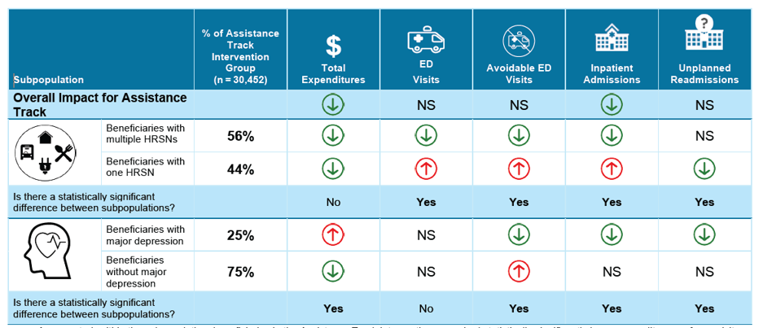
Differences in impacts in Medicaid participants in Assistance track

Slide 27
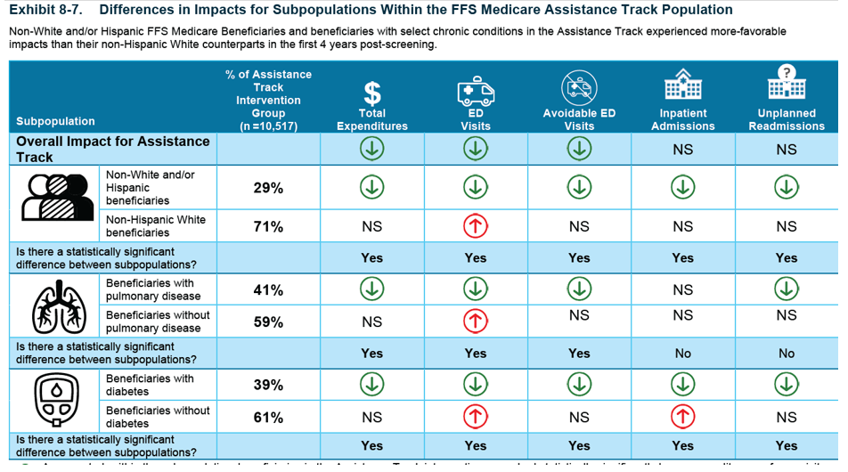
Differences in impacts in Medicare FSS participants in Assistance track

Slide 28
Summary
Navigation reduced costs and utilization
Navigation did not reduce needs or connections to social services
Alignment track did not have higher impacts
Navigation seems to work better for some subgroups
  Medicaid beneficiaries with >1 social need
  Medicaid beneficiaries with depression
  Medicare beneficiaries with pulmonary disease
  Medicare beneficiaries with diabetes

Slide 29
Discussion

