Slide 1
UPMC Health Plan’s Pathways to Work Program

Slide 2

PATHWAYS TO WORK
Approach
The program creates and scales new partnerships and programs and connects individuals who are out of work, underemployed or have barriers to work to employment opportunities at UPMC. Our aim is to increase access to employment through training, education, and dedicated support from UPMC staff.
Tenants of Employment & Workforce
Opportunity
Vision
Why?
Hiring
Direct Referral Service
Most non-disabled adult with Medicaid (62%+) already work. Those not working are often enrolled in school or caregiving for family members.
5 Person Pathways to Work Recruitment team built to help community find training opportunities and jobs at UPMC –
pathwaystowork@upmc. edu
Focus on un(der)employed individuals, families and people with barriers to work
Our mission and hiring needs and overall support of our western PA communities and those across the Commonwealth,.
Partnerships
Public Policy
We have jobs at UPMC with career pathways, education supports and sustainable wages.

Slide 3
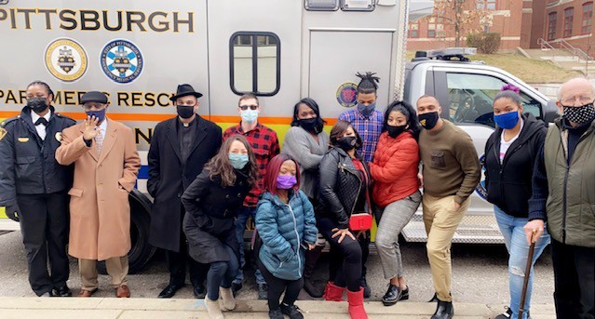


Meeting people where they are, using two pillars
PATHWAYS TO WORK
Job Navigation
Training Programs/Partners
~200 Hires of ACTIVE UPMCFY Medicaid/TANF per month statewide (60% in Pittsburgh)
5 Freedom House Cohorts 1/2021 – 7/2022
10 Workforce Investment Board referral and training partnerships
30+ community partnerships for job fairs and referral pipelines
$1million+ in federal/state dollars into our communities
Freedom House 2.0 is a community-based training program – based on 1960s model – to recruit, train and employ first responders from economically disadvantaged communities, many of which have been impacted by COVID-19.
200+ individuals currently active in pipeline
Future – Maintenance and Radiology apprenticeships given ARPA focus, Pathways for Students and Pathways for Veterans
20+ applications submitted per week
20+ new inquiries per day

