Slide 1




Community resource referral platforms - Lessons from early health care adopters
SIREN Webinar
April 18, 2019
siren

Slide 2



Social Interventions Research & Evaluation Network
SIREN’s mission is to catalyze and disseminate high quality research that advances health care sector efforts to improve health equity by addressing social risks.
Activities include:
Catalyzing and conducting high quality research
Collecting & disseminating research findings
Providing evaluation, research & analytics consultation services
sirenetwork.ucsf.edu | siren@ucsf.edu | @SIREN_UCSF
siren

Slide 3
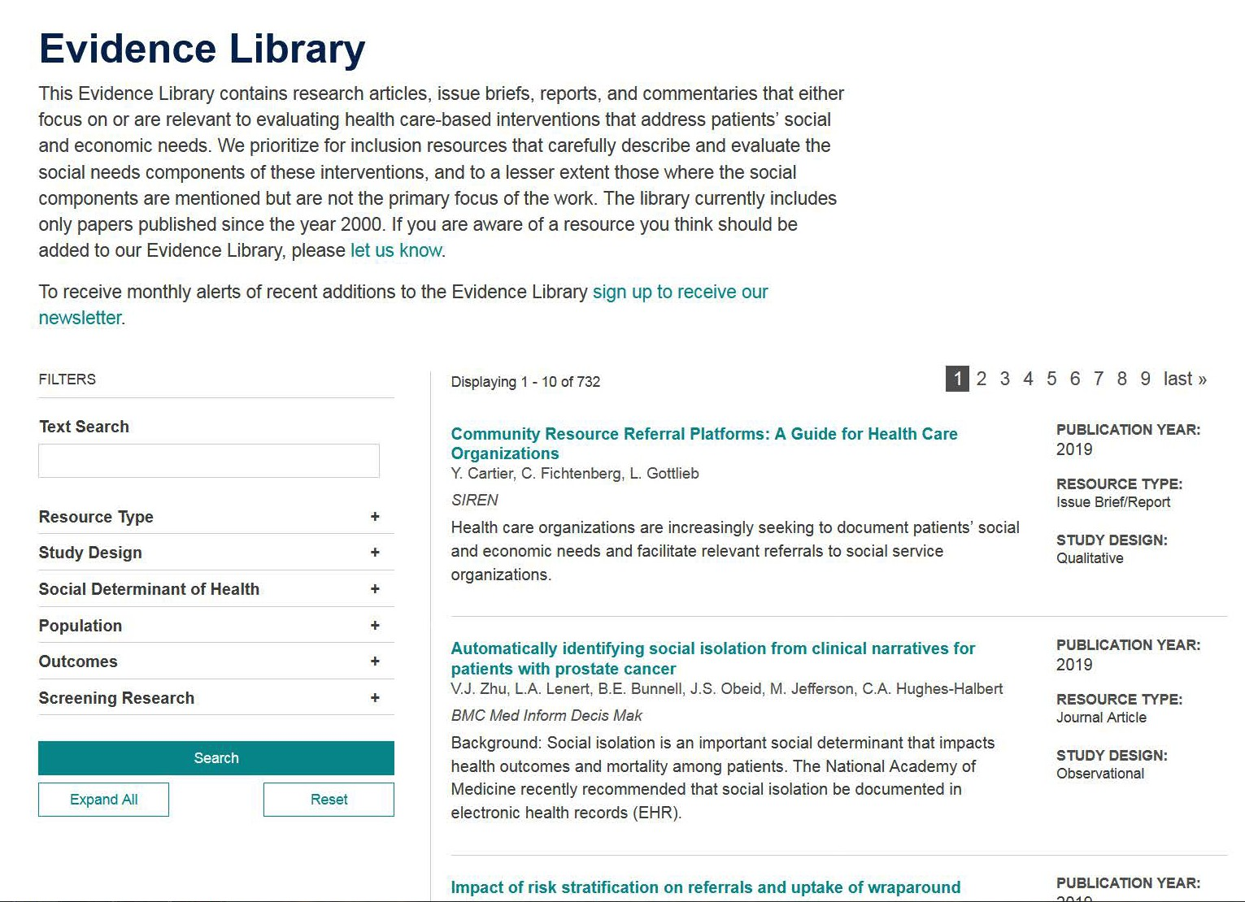
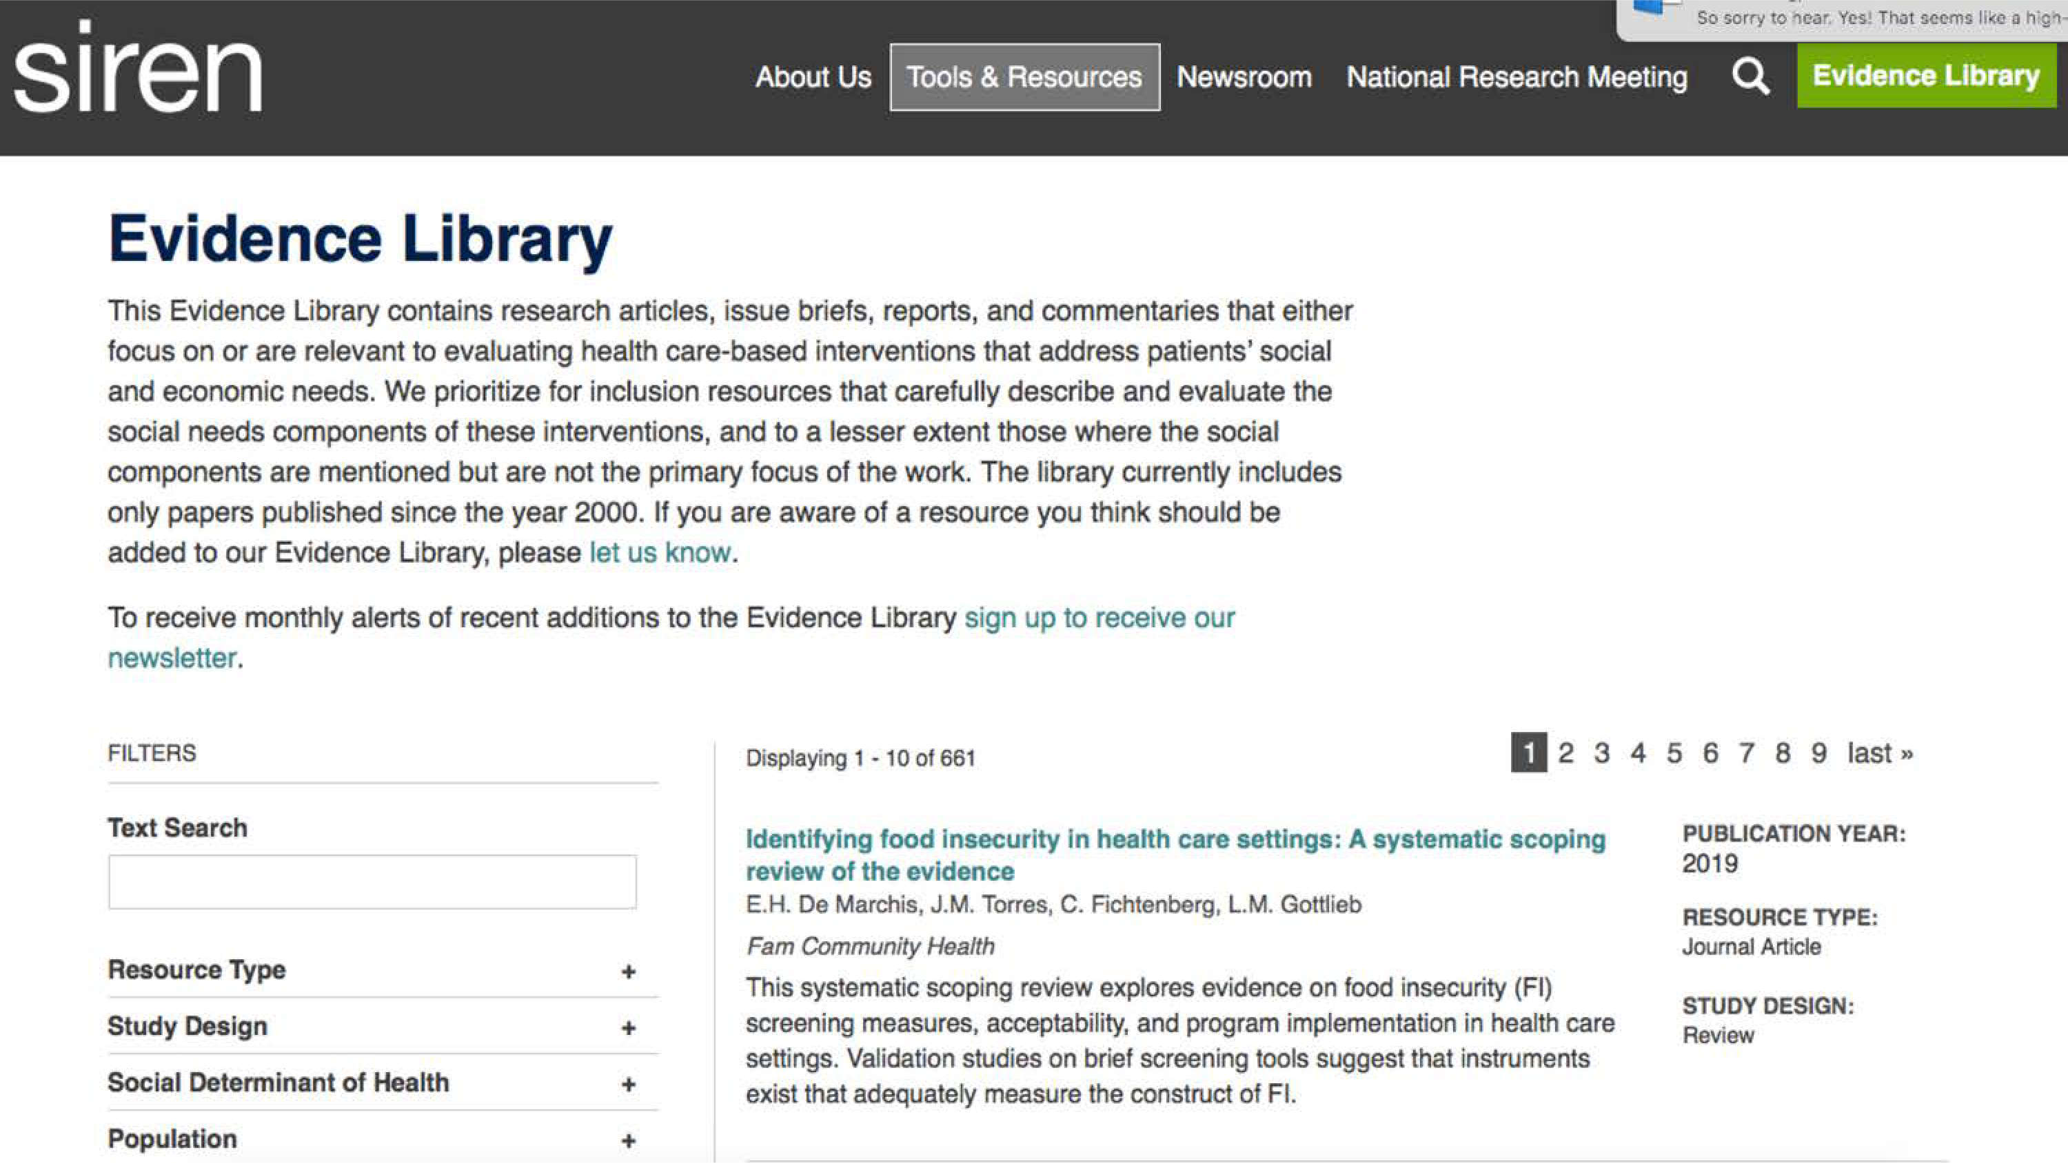
siren
http://sirenetwork.ucsf.edu

Slide 4

How to use ReadyTalk to ask questions
This webinar will be recorded; the recording and slides will be made available in the coming days.
siren

Slide 5


Thank you to our funders
Episcopal Health Foundation
Methodist Healthcare Ministries of South Texas, Inc.
St. David’s Foundation
siren

Slide 6




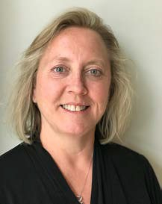
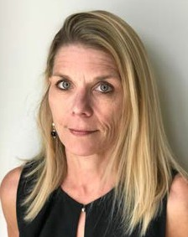
Our speakers today
Caroline Fichtenberg, PhD Managing Director
SIREN
Shao-Chee Sim, PhD VP Applied Research
Episcopal Health Foundation
Yuri Cartier, MPH Research Associate SIREN
Pat Schoenemann Director
Brazos Health Resource Center CHI St. Joseph Regional Health Center
Kristen Scholl
VP Population Health Alliance for Better Health
Lori Petersen Senior IT Business Analyst Alliance for Better Health
siren

Slide 7
Poll Question #1
Where do you work?
Safety net health care organization
Other (non-safety net) health care organization
Social service organization or community-based organization Research institution
Capacity building and technical assistance organization Technology company
Other
siren

Slide 8
Disclaimer
This webinar does not constitute a product endorsement or recommendation by the University of California, San Francisco (UCSF), Social Interventions Research and Evaluation Network (SIREN), Episcopal Health Foundation, Methodist Healthcare Ministries of South Texas, Inc., or St. David’s Foundation.
siren

Slide 9

Community Resource Referral Platforms: A Guide for Health Care Organizations
Webinar
April 18, 2019
Yuri Cartier, MPH
Caroline Fichtenberg, PhD Laura Gottlieb, MD, MPH
SIRENetwork.ucsf.edu
siren

Slide 10
Poll Question #2
Is your organization in the process of implementing a community resource referral platform?
Yes, we’re currently using a platform
No, but we may in the future
Not applicable to our organization
siren

Slide 11
Our Goal
To explore the market of community resource referral platforms and learn about the experiences of health care organizations implementing a platform.
siren

Slide 12
Project Activities
Reviewed commonly used platforms
Interviewed users about their experiences using these platforms
siren

Slide 13

siren

Slide 14









Nine platforms in our review
siren

Slide 15


Key Functionalities
+
A searchable, regularly-updated resource directory
A referral management system that enables closed-loop referrals
siren

Slide 16



Key Functionalities
+
A searchable, regularly-updated resource directory
A referral management system that enables closed-loop referrals
Other Functionalities and Characteristics:
siren

Slide 17

Key Functionalities
+
A searchable, regularly-updated resource directory
A referral management system that enables closed-loop referrals
Other Functionalities and Characteristics:
HIPAA/
Data security
siren

Slide 18

Key Functionalities
+
A searchable, regularly-updated resource directory
A referral management system that enables closed-loop referrals
Other Functionalities and Characteristics:
HIPAA/
Systems
Data security
siren
integration

Slide 19

Key Functionalities
+
A searchable, regularly-updated resource directory
A referral management system that enables closed-loop referrals
Other Functionalities and Characteristics:
HIPAA/
Systems
Social risk
Data security
siren
integration
screening

Slide 20

Key Functionalities
+
A searchable, regularly-updated resource directory
A referral management system that enables closed-loop referrals
Other Functionalities and Characteristics:
HIPAA/
Systems
Social risk
Care
Data security
siren
integration
screening
coordination

Slide 21

Key Functionalities
+
A searchable, regularly-updated resource directory
A referral management system that enables closed-loop referrals
Other Functionalities and Characteristics:
HIPAA/
Systems
Social risk
Care
Reporting &
Data security
siren
integration
screening
coordination
analytics

Slide 22

Key Functionalities
+
A searchable, regularly-updated resource directory
A referral management system that enables closed-loop referrals
Other Functionalities and Characteristics:
HIPAA/
Data security
Systems integration
Social risk screening
Care coordination
Reporting & analytics
Vendor responsiveness
siren

Slide 23








Key Functionalities
$$$
+
A searchable,
A referral management
regularly-updated
system that enables
resource directory
closed-loop referrals
Other Functionalities and Characteristics:
HIPAA/
Data security
Systems integration
Social risk screening
Care coordination
Reporting & analytics
Vendor responsiveness
siren

Slide 24
In our guide:
Side-by-side comparison table of platform features and functionalities (pp.16-18)
Platform profiles (pp.52-96)
siren

Slide 25
Organization Type (N=39)
2
5%
1
3%
Hospital/system
4
10%
Place-based care transformation or health improvement initiatives
Health centers/health center networks
Social service agencies
Health information exchanges
15
38%
10
26%
7
18%
siren

Slide 26

Main takeaway from users
Implementation is slower and more complicated than anticipated, especially with community partners
siren

Slide 27

Recommendations
1. Engage community partners from the beginning
siren

Slide 28
Recommendations
1. Engage community partners from the beginning
“Before you start, make sure your community partner is willing to actually be a recipient of that type of referral. If they’re invited to the table early on, it helps them to understand really what's being asked of them. [...] Engage your partners early on and ask them what their concerns are before telling them what you want to do.”
siren

Slide 29
Recommendations
2. Examine what already exists in the community
siren

Slide 30
Recommendations
2. Examine what already exists in the community
“If I were to do this all over again, I think I would bring key stakeholders from all hospitals across the state to the table, with our community stakeholders, and together figure out what collectively would be the best one, ‘go slow to go fast’ so that everybody is using that same thing.”
siren

Slide 31
Recommendations
3. Have a clear understanding of your goals and needs
siren

Slide 32
Recommendations
3. Have a clear understanding of your goals and needs
“The health centers that have really thought about their care model, and who on the care team is allocated to be addressing social and economic factors, have a better time adopting the tool, because they've thought through some of the larger system and workforce issues.”
siren

Slide 33
Recommendations
4. Don’t assume that if you build it they will use it
siren

Slide 34
Recommendations
Don’t assume that if you build it they will use it
Evaluate the impact and share your learnings
siren

Slide 35

Other approaches
EHR vendors
siren

Slide 36
Other approaches
EHR vendors
Community information exchanges
siren

Slide 37
Other approaches
EHR vendors
Community information exchanges
Pathways HUB Model
siren

Slide 38
Other approaches
EHR vendors
Community information exchanges
Pathways HUB Model
Increasing interoperability
siren

Slide 39


siren

Slide 40
Brazos Health Resource Center
COMMUNICATION, COORDINATION AND NETWORKING
Presented by: Patricia Schoenemann, Director

Slide 41
WHAT IS A HEALTH RESOURCE CENTER?
A local community center
Coordinates, communicates, and assesses situations for community residents in need
Provides information, referral, application assistance, and material assistance to meet needs
Offers meeting place for agencies headquartered outside of the county to hold appointments or meetings with county residents
Hosts educational sessions available to local citizens
A Community Resource Coordination Group (CRCG) facilitator and participant
The attitude of the Health Resource Center when someone calls or comes in is always:
“You’ve come to the right place! If we don’t know it, we will find out about it together!”

Slide 42
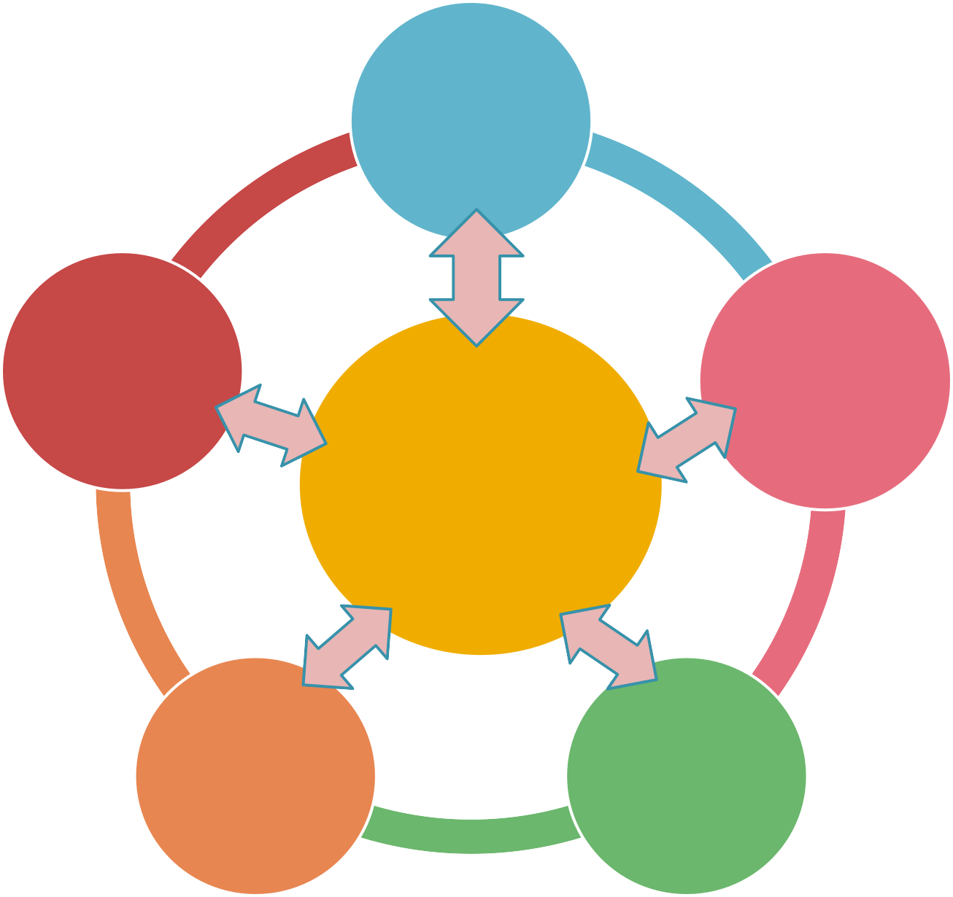
COMMUNITY ASSISTANCE NETWORK MATRIX
HEALTH CARE PROVIDERS
NETWORK COALITION GROUPS
ASSISTANCE AGENCIES
HEALTH RESOURCE CENTER
FAITH BASED MINISTRIES
FOOD PANTRIES

Slide 43
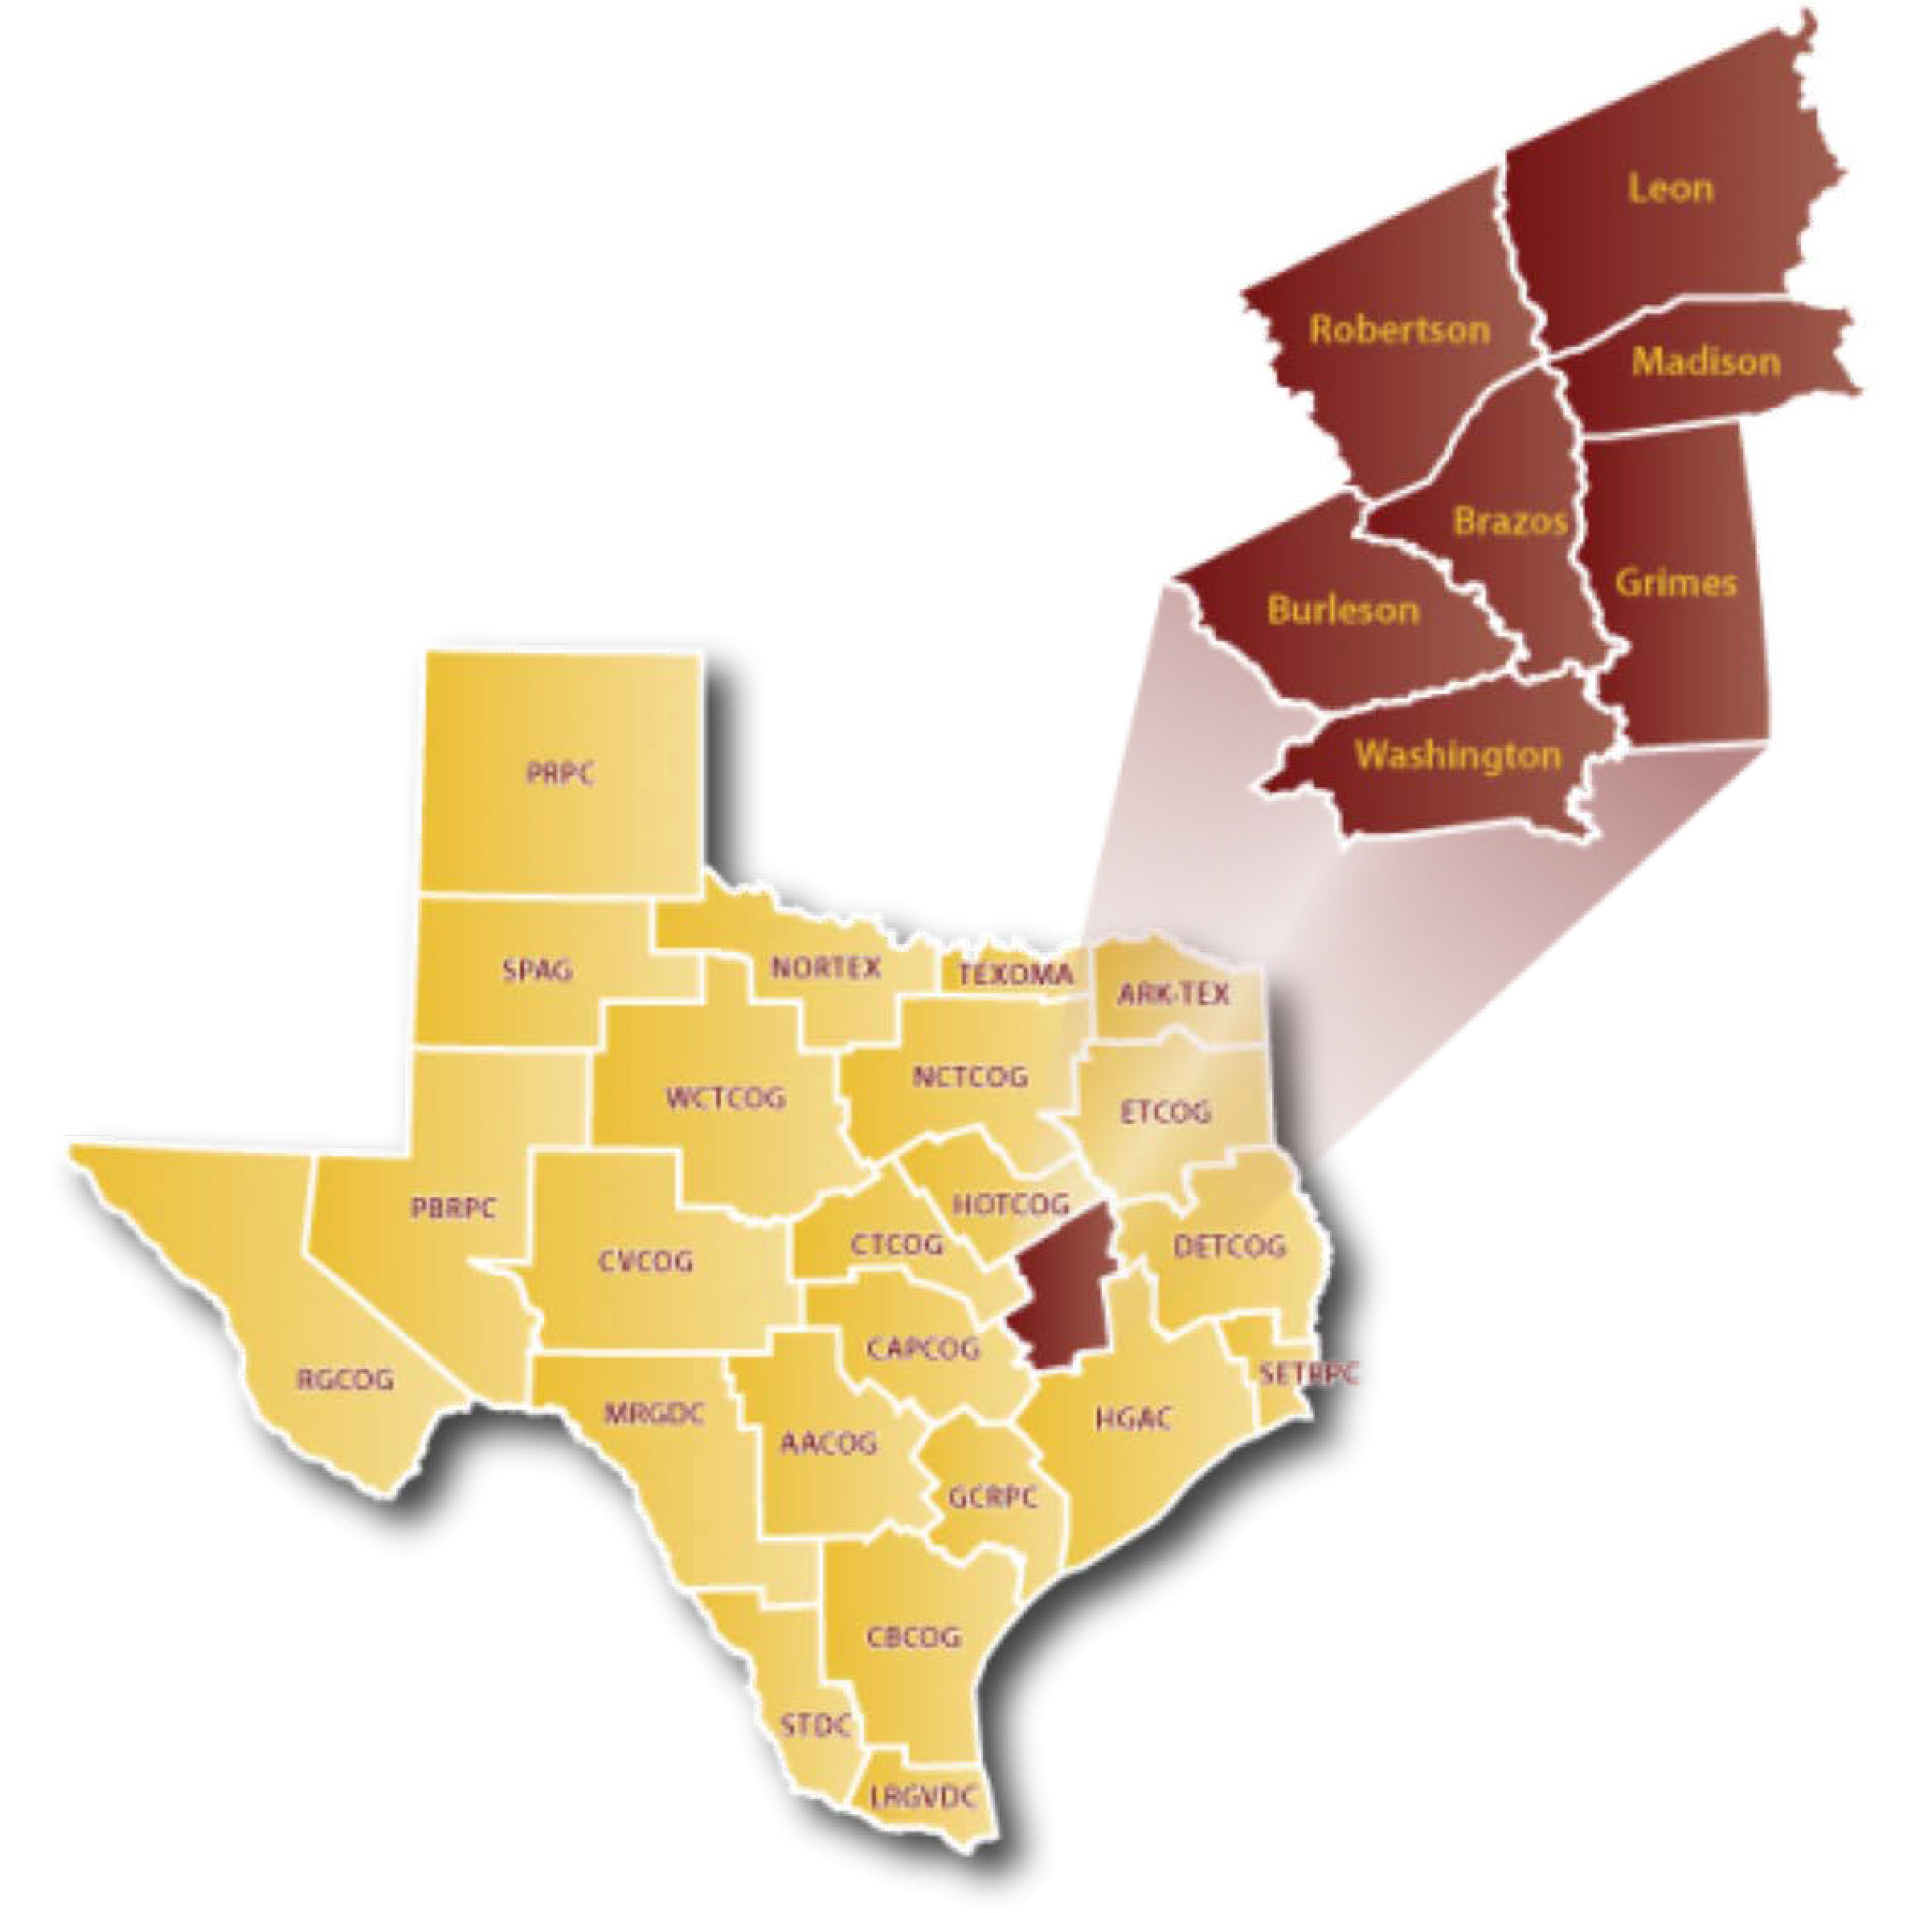
The Brazos Valley
Health Resource Center Locations:
Burleson County (Caldwell & Somerville) Brazos County (Bryan & College Station)
Madison County (Madisonville) Grimes County (Navasota)
Washington County (Brenham) Leon County (Centerville)

Slide 44

Brazos Valley CharityTracker Network
Brazos Health Resource Center
Network Administrator

Slide 45
Brazos Valley CharityTracker Network
Resource information pre-loaded on the service agencies, non-profits, churches in the 7-county Brazos Valley area
Access provided to members at no cost
Release of Information mandatory for client record to be entered
Minimization of detail to maintain HIPAA compliance
Continuous, ongoing updates of services and agency information

Slide 46
Brazos Valley CharityTracker Network
Demonstrations at Brazos Health Resource Center or at the prospective member’s location
Immediate response from our in-house expert to answer questions, solve issues, correct errors or add information
Each agent receives a handbook created specifically for the Brazos Valley CharityTracker network as a user guide

Slide 47
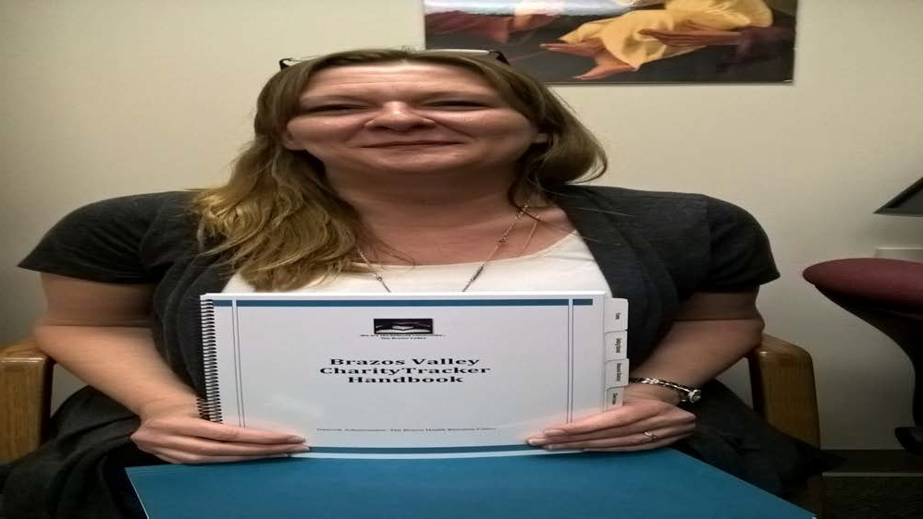
I wrote a book!
Shawndel Blakemore

Slide 48
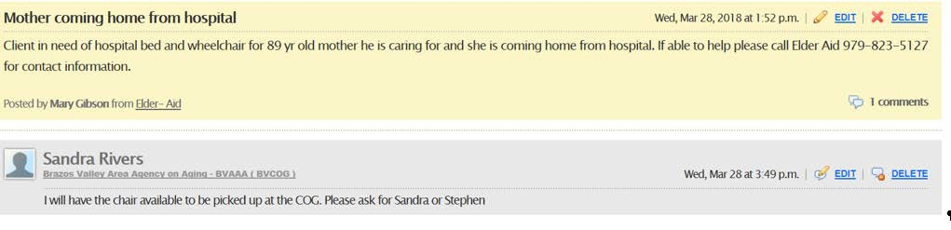
Example Bulletins

Slide 49
Connected to Miracles
BACKGROUND
6 weeks of daily outpatient treatment needed after weeks in hospital
No financial support, no insurance, no car, no family nearby, no in-town friends, no money, no income, no benefits of any kind
PLEASE FIND
Free or Cheap room and board for 6 weeks plus daily transportation to the hospital for therapy to successfully complete her treatment plan
SOLUTION:
Local shelter consented to accept her 6-wk stay; local St. Vincent de Paul funded the weekly $55 Fair Share Rent ($330); local Baptist Church funded the weekend taxi transportation cost (public transit buses run M-F) ($300); bus passes for six weeks of M-F round trips ($90) funded by an Episcopal Church; oral prescription med also covered ($25)
Total funding required to complete treatment as outpatient: $715

Slide 50
LESSONS LEARNED
Initially there were limits to the number of members covered under the subscription fee: the membership costs beyond that slowed the join up process;
Covering a large geographic area is challenging to reach out to remote organizations to join as members;
Switching or adding a new data process is a hurdle for most established resource organizations.

Slide 51

Healthy Together
powered by Unite Us
SIREN Webinar
April 18, 2019
BUILDING HEALTH EQUITY

Slide 52
Agenda:
Who we are
Why Unite Us
Overview of Healthy Together
Post Launch Optimization
Use Case
What’s working
BUILDING HEALTH EQUITY

Slide 53

ALLIANCE FOR BETTER HEALTH
VISION:
A united and collaborative care delivery community, fostering health equity for all
OPPORTUNITY:
Implement phased social care programs➔ expand upon those that have clear ROI in a VBP environment
GOAL:
Support our partners to move from volume to value
MISSION:
Transform care to improve health
BUILDING HEALTH EQUITY

Slide 54


The Opportunity:
➔
BUILDING HEALTH EQUITY

Slide 55
The Process:
Absence of infrastructure to manage referrals
No shared documentation tool, poor communication, no data collection
Identify the problem
Time consuming, cumbersome referral processes
No accountability for referral outcomes – clients are falling through the cracks in the system
Buy versus Build
Issued an RFP – analyzed results
Hosted an Innovation Summit
Issue an RFP
Review options with Alliance IT Committee and Board
Selected Unite Us!
Technology platform and Coordination Center model met our needs
Includes basic elements of a care coordination platform for agencies that need it
Select a vendor
BUILDING HEALTH EQUITY

Slide 56
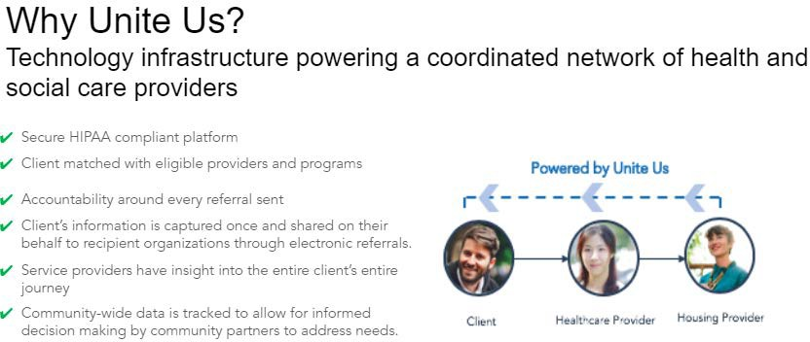
BUILDING HEALTH EQUITY

Slide 57
Introducing Healthy Together!
Develop the network
Train and Onboard Partners
Socialize and Communicate Broadly
Unite Us system set up to identify partner services
BUILDING HEALTH EQUITY

Slide 58

Remember when we used to send referrals by fax or phone..….
BUILDING HEALTH EQUITY

Slide 59

















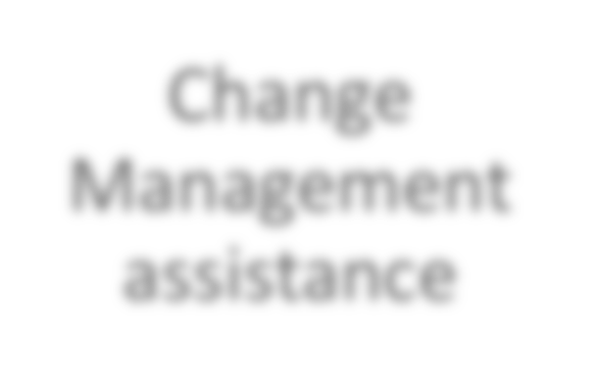



Post Launch Optimization:
Collaborate with AHI
Add Health Leads SDOH Screening
Circulation
Grow the Healthy Together Network!
211
Coordination Center process change
Change Management assistance
Communication!
BUILDING HEALTH EQUITY

Slide 60
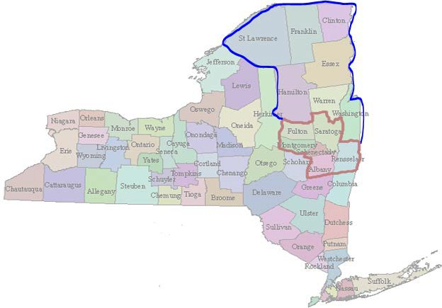
Combined Network:
Healthy Together &
ADK Wellness Connections
200 Organizations across
13 counties
And growing!!
BUILDING HEALTH EQUITY

Slide 61
Clients Served by Month (1,265 Clients Served)
We Continue to Grow Healthy Together
300
251
250
229
200
155
150
118
100
88
67
50
50
35
32
25
27
4
0
Apr-18
May-18
Jun-18
Jul-18
Aug-18
Sep-18
Oct-18
Nov-18
Dec-18
Jan-19
Feb-19
Mar-19
BUILDING HEALTH EQUITY
Healthy Together and ADK Wellness Connections

Slide 62
We Continue to Grow Healthy Together
Referrals by Month (2,110 Total Referrals)
600
540
500
436
400
300
267
201
200
141
100
84
93
49
50
63
52
6
0
Apr-18
May-18
Jun-18
Jul-18
Aug-18
Sep-18
Oct-18
Nov-18
Dec-18
Jan-19
Feb-19
Mar-19
BUILDING HEALTH EQUITY
Healthy Together and ADK Wellness Connections

Slide 63





Bob goes to ED for stomach pain and nausea
A Day in the Life….."Bob"
Bob examined - diagnosed with diabetes
Bob returns to ED one week later.
Bob returns home with no Rx and can't afford healthy food.
Discharged with Rx and diabetic diet info sheet
BUILDING HEALTH EQUITY

Slide 64








A Day in the Life…..SDOH Interventions
Bob referred to local food pharmacy.
Bob receives transportation to
pick up his medicine.
Referred to City Health Works
FQHC conducts SDOH screen.
Bob has food insecurity.
Code Z59.4 entered in EHR.
Bob no longer suffers symptoms of diabetes.
No more ED visits
BUILDING HEALTH EQUITY

Slide 65

What is working:
Integrating the referral platform into a larger social care program
Customized training for each agency by an experienced Care Coordinator
Program adjustments based on community feedback
Provider accountability – network standards
Case conferences for high volume referral agencies
No cost to Healthy Together Program providers
Providing a clear understanding of the sustainability of the program
BUILDING HEALTH EQUITY

Slide 66

BUILDING HEALTH EQUITY

