Slide 1


Lessons from the Camden Coalition’s Core Model RCT
Amy Finkelstein, MIT
Aaron Truchil, Camden Coalition

Slide 2

Camden Core Model & Path to RCT

Slide 3


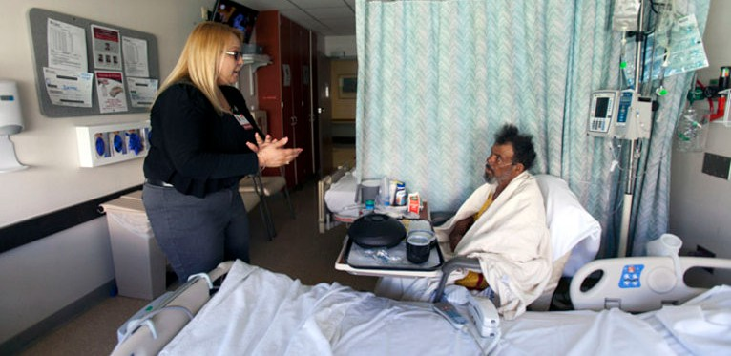

Interdisciplinary (RN, SW, CHW, +), community-based care
management program targeting patients with complex health and social needs
CAMDEN CORE MODEL
Population
18-80yr olds, Camden City residents 2+ hospital admissions in 6 months
2+ chronic conditions
2+ markers of complexity (e.g. mental health, substance use, homelessness)
Predominantly Medicaid & Medicare
Key components
Engage at hospital bedside Frequent home visits
Connection to PCP/specialty care Medication reconciliation Personalized care planning
Broader care coordination and other support
Time limited (~90 days)
Model evolving through continuous quality improvement

Slide 4
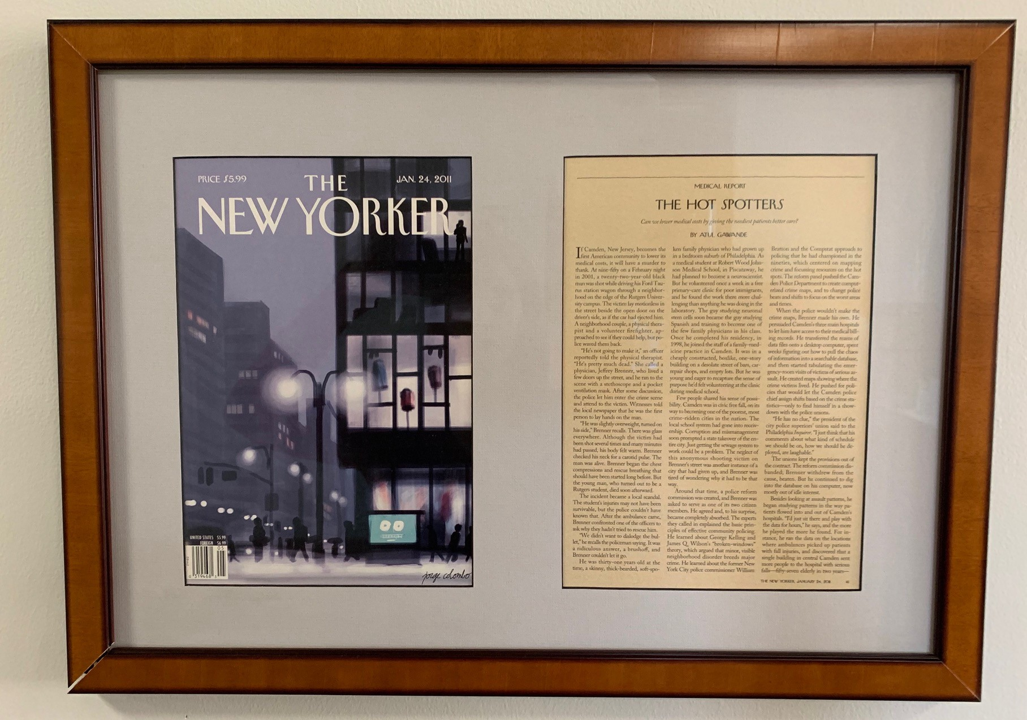
Path to RCT
Significant national attention with proliferation of value-based payment models
Stable multi-year funding (CMMI grant)
Early (non-randomized) evaluation efforts encouraging
Opportunity to partner with J-PAL North America and help promote more rigorous evaluation of social care programs

Slide 5
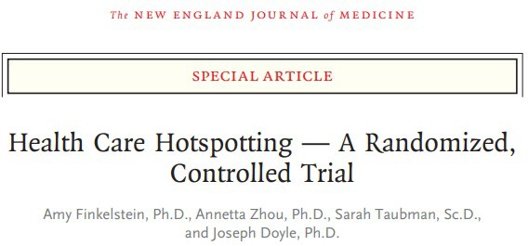
800 patients were enrolled while admitted to the hospital
Primary outcome:
Any readmission within 180 days of discharge

Slide 6
Program participants visited the hospital about 40% less in the six months post-intervention
1.2
Impact?
1
Number of Admissions
0.8
0.6
0.4
0.2
0
-10 -9
Treatment
-12
-11
-8
-7 -6 -5 -4 -3 -2
Quarter Relative to Index Admission
-1
1
2
6

Slide 7
But we saw the same decline in hospital use among those in the control group
1.2
1
Number of Admissions
0.8
0.6
0.4
0.2
0
-12 -11 -10
Treatment
-9 -8
Control
-7 -6 -5 -4 -3 -2
Quarter Relative to Index Admission
-1
1
2
7

Slide 8
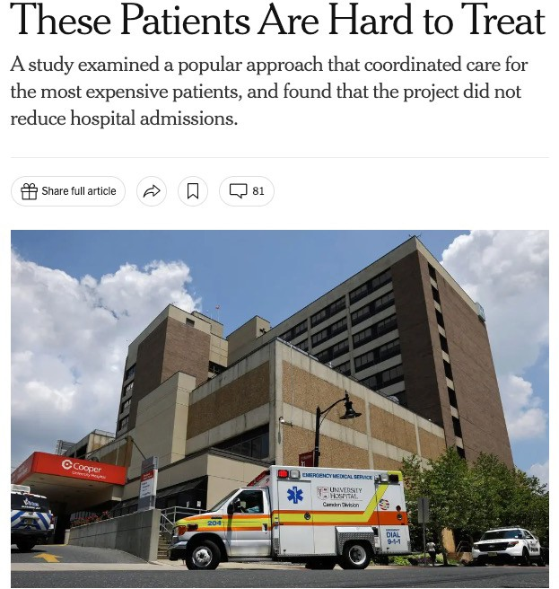

Result: no impact on readmissions

Slide 9





Unanswered questions generated debate

Slide 10






And inspired additional research
Dosage and outcomes in a complex care intervention (June 2023)
- Dawn Wiest, Qiang Yang, Teagan Kuruna, Mavis Asiedu-Frimpong (Camden Coalition)
Hospital readmissions by variation in engagement in the healthcare hotspotting trial: A secondary analysis of a randomized clinical trial (Sep 2023)
-Qiang Yang, Dawn Wiest, Anna C. Davis, Aaron Truchil, John
L. Adams (Camden Coalition, Kaiser Permanente)
The Camden Coalition care management program improved intermediate care coordination: A randomized controlled trial (Dec 2023)
-Amy Finkelstein, Joel C. Cantor, Jesse Gubb, Margaret Koller, Aaron Truchil, Annetta Zhou, Joseph Doyle (J-PAL North America, Camden Coalition, and Rutgers Center for State Health Policy)

Slide 11
Understanding care coordination success
Was the null result a failure of implementation or a failure of the program’s theory of change?
Program was designed to connect patients to care in the community
  Did it?
  Mixed evidence in first paper (looking only at treatment group)
Therefore, we set out to study impacts on office-based care, home care, prescription drugs, and durable medical equipment using new data from NJ Medicaid and Rutgers CSHP

Slide 12
The Camden Coalition care management program improved intermediate care coordination
Program caused an immediate and persistent increase in outpatient office care
  Both primary care and specialty care increased
  The increase in visits was similar to what other care coordination programs have achieved (10-15 percentage points)
  In the absence of the program, very few patients received timely office care (27 percent after two weeks and <75% after 6 months)
Program increased the proportion receiving any DME (but not the amount of DME)
No effect on home health care use
No effect on the quantity of prescriptions drugs

Slide 13
Program caused an immediate and persistent increase in ambulatory office-based care
(Percent)
50
15 percentage point increase in proportion with an office visit 14 days after discharge
This effect persists through 365 days
Equates to about 1.25 additional visits over 365 days
40
30
20
10
0
Control mean
Control mean plus treatment effect
14 Days after discharge

Slide 14
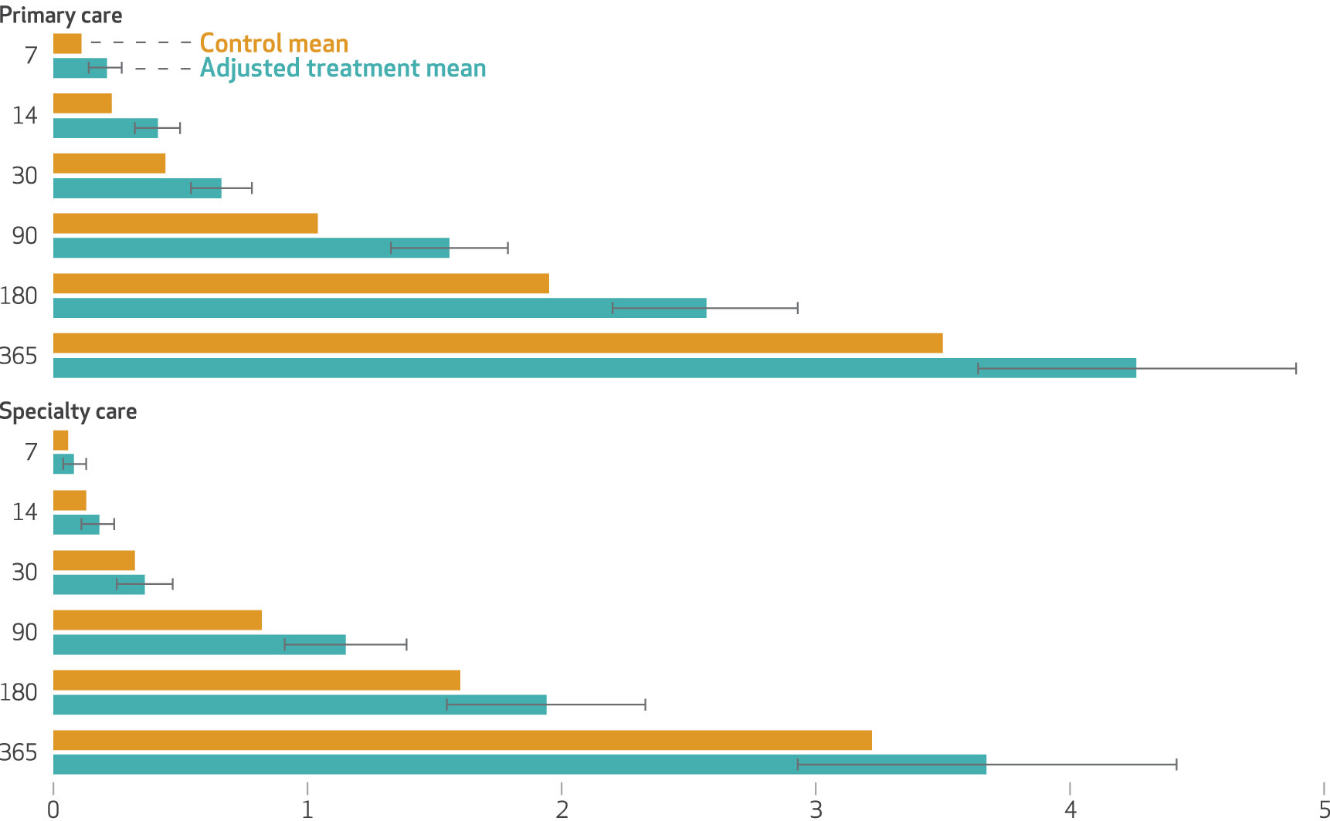
The difference in the number of visits was immediate and increased over time, driven by an increase in primary care

Slide 15
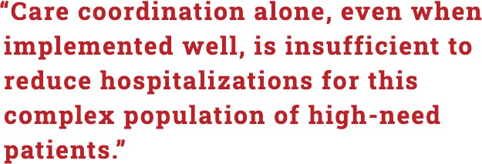

Slide 16





RCT RESULTS
Healthcare hotspotting: A randomized, controlled trial (2020)
Dosage and outcomes in a complex care intervention (June 2023)
Hospital readmissions by variation in engagement in the healthcare hotspotting trial: A secondary analysis of a randomized clinical trial (Sep 2023)
The Camden Coalition care management program improved intermediate care coordination: A randomized controlled trial (Dec 2023)

Slide 17

Effects observed
Null results
Connection to SNAP
Connection to primary care Connection to specialty care
Connection to durable medical equipment
Hospital readmissions
Emergency Department visits Access to prescriptions Home health outcomes

Slide 18
Caveat when analyzing the full RCT population
ADDITIONAL RCT ANALYSIS
Not everyone in the intervention group:
Engaged in the program
Received the same “dosage” of care management

Slide 19
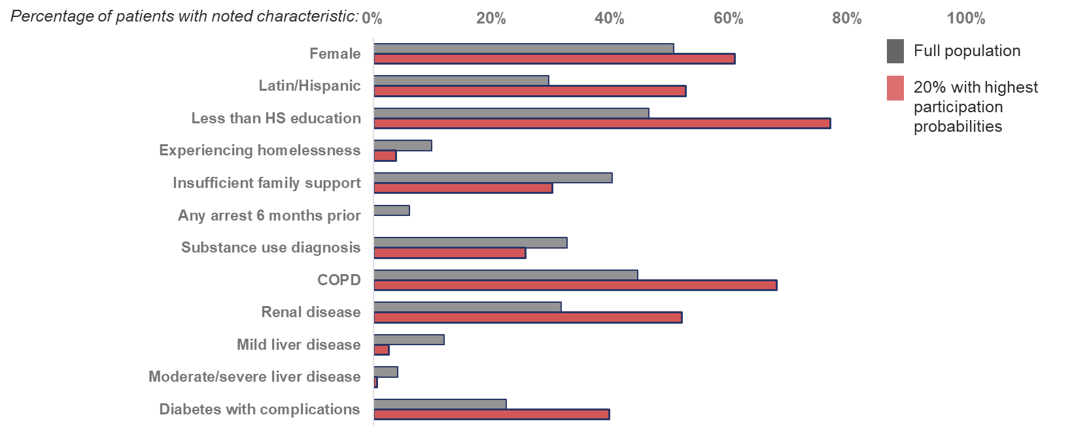
Based on baseline characteristics, who was most and least likely to engage in care management?
ADDITIONAL RCT ANALYSIS

Slide 20
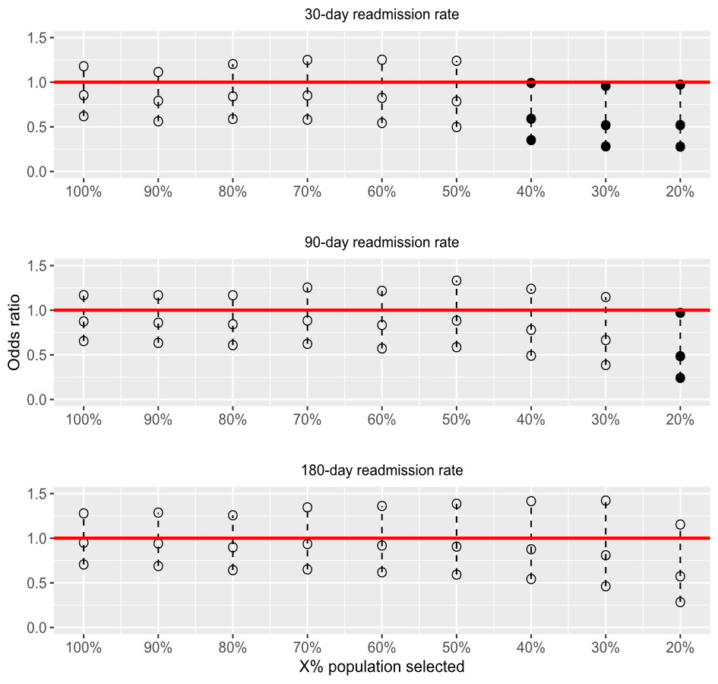
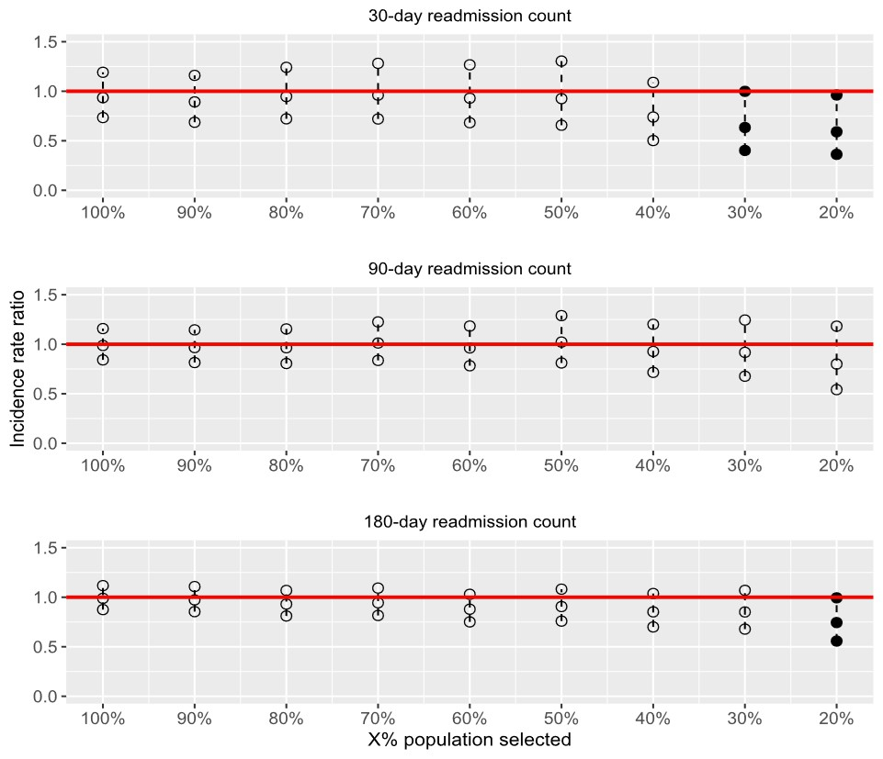
Engagement matters
ADDITIONAL RCT ANALYSIS
Greater intervention participation was associated with:
significantly lower readmission rates 30 and 90 days after hospital discharge
significantly lower numbers of 30- and 180-day readmissions
95% confidence interval of the odds ratio and incidence rate ratio for readmission rates between intervention and control group patients within increasingly distilled samples

Slide 21



Expanded internal teams and supports
NEW ADVANCES
Housing First
Medical Legal Partnership
Deeper partnerships with addiction medicine (including partnership with local jail)

