Slide 1






Cross-sectional assessment of racial, ethnic, and language equity in social risk screening and results in community health center patients
Presented By: Cristina Huebner Torres, Ph.D., M.A
Co-authors: Rachel Gold, Jorge Kauffman, Miguel Marino, Megan
J. Hoopes, Molly S. Totman, Benjamín Aceves, Laura Gottlieb

Slide 2

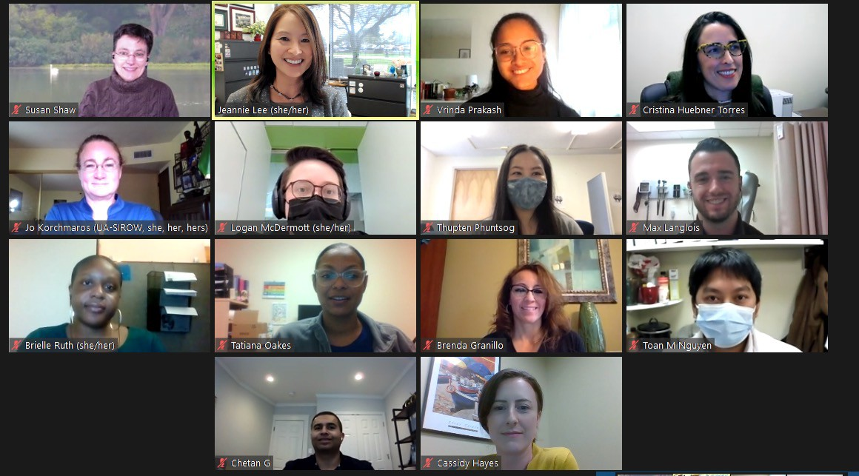
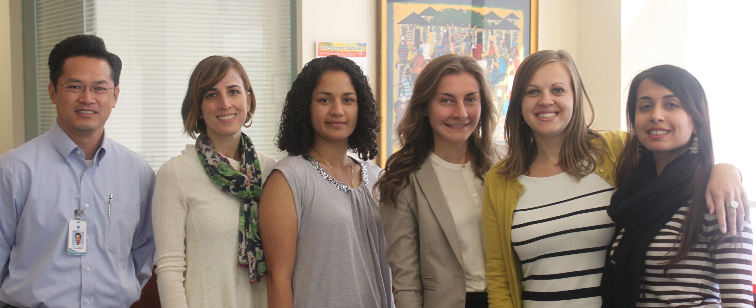
My background
CHC’s Research Teams: 2022, 2014
Puerto Rican & German, bilingual/bicultural
Social epidemiologist, mixed methodologist, ethnographer
Since 2007, translating research into culturally responsive practice and policy improvements
Leading development of FQHC-led research and practice collaboratory
Interprofessional, team-based collaborations with academic, community and other partners

Slide 3




Caring Health Center
Established in 1995
Section 330 federally-qualified health center (FQHC) in Springfield, MA
Largest refugee health assessment site in MA
Serves about 20,000 patients annually
Serve patients in over 35 languages
Hires from the community
Partner on NIH-funded research for 2 decades

Slide 4

Objectives
Describe
Report
Reflect on
Rates of social risk screening by race, ethnicity and language
Patterns in screening and reported risks
Implications of these patterns as they relate to racial health equity and social care

Slide 5

ASCEND - Background
5-year, mixed-methods, stepped-wedge trial
  Aim: To test the impact of providing 30 community health centers (CHCs) with step-by-step guidance on implementing electronic health record-based social determinants of health documentation
Little is known about social risk screening implementation across racial/ethnic/ language (REL) groups
Examined the associations between REL, social risk screening, and patient-reported social risks among adult patients at community health centers (CHC)

Slide 6
Methods
Patient- and encounter-level data from 2016-2020
651 CHCs in 21 U.S. states
Electronic health record (EHR) data were extracted from a shared Epic©
record
Adjusted logistic regression analyses were conducted stratified by language

Slide 7

Social Risk Screening
Dependent Variable
Financial resource strain (FRS) data
Childcare needs, financial strain, food insecurity, health insurance costs, medical costs, transportation access, or utilities insecurity
PRAPARE tool and other frequently used screens are embedded into the electronic health record (EHR)
Documented in the EHR
Workflows for collecting and documenting social risk screenings vary by health center
Among adult community health center patients
Many health centers are mandated to collect social risk screening among all eligible patients annually

Slide 8
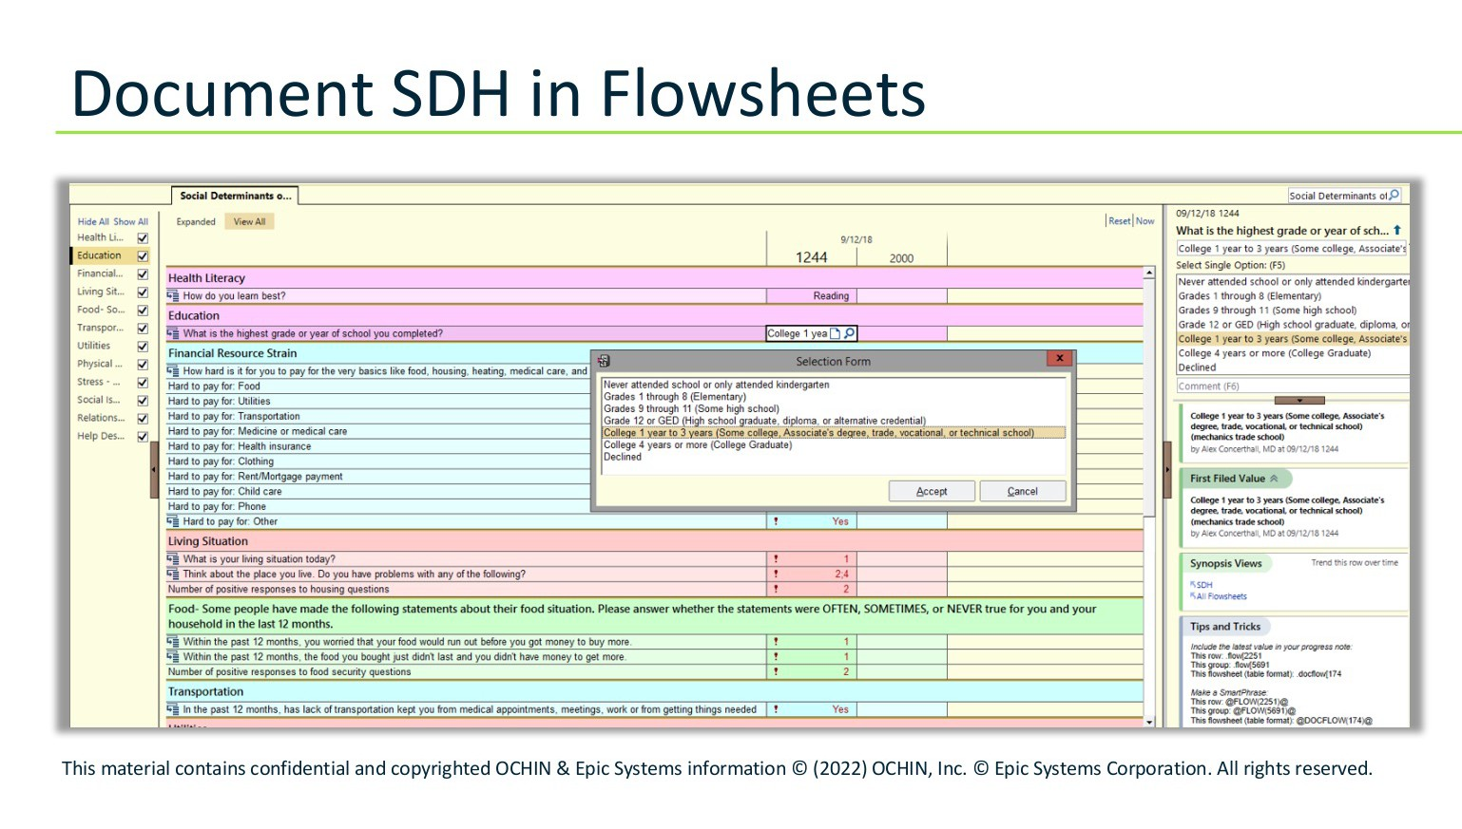

Slide 9
Race / Ethnicity
Independent Variable
Ethnicity:
Non-Hispanic
Hispanic
Race:
Black
White
Other race: a grouping of racial categories with smaller samples
As documented in the EHR (though not always self-reported)

Slide 10
Results: Race / Ethnicity (N=1,551,102)
Hispanic Patients by Race (23%)
Non-Hispanic Patients by Race (77%)
_{5%} 4%
14%
17%
7%
39%
92%
non-Hispanic Black non-Hispanic white
non-Hispanic Other Race Unknown
Hispanic white
Hispanic Black
Hispanic Other race

Slide 11
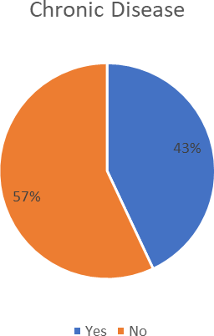
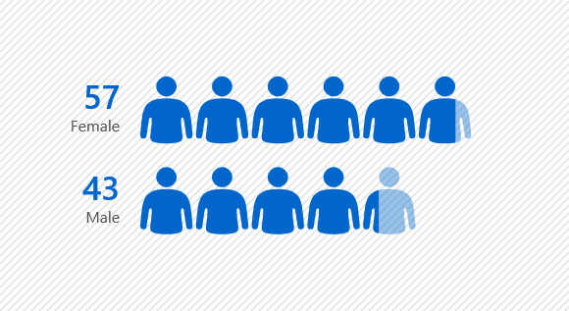
Additional Patient Characteristics
%
Diabetes: 13%,
Hypertension 26%
Dyslipidemia 22%
%

Slide 12



Key Findings
Social risk screening occurred at 30% of
health centers
11% (n=164,586)
of eligible adult
patients were screened
Screening
and reported needs
varied significantly by REL

Slide 13


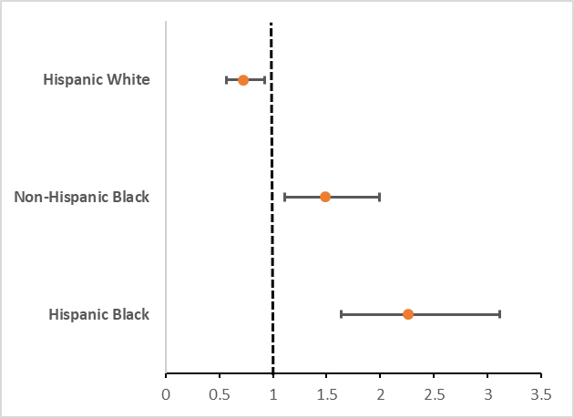
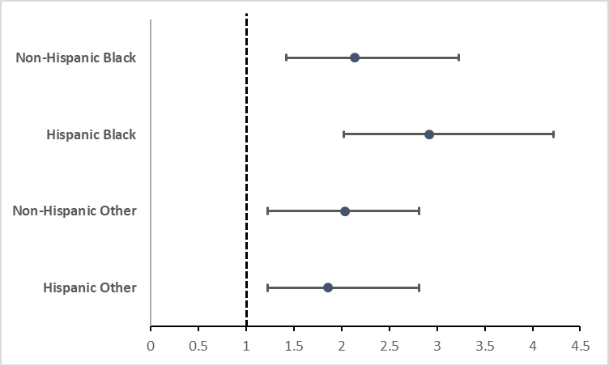
Key Findings: Social Risk Screening
Race & Ethnicity
Among Patients who preferred Spanish
More likely to get screened
OR:2.14[1.42-3.23]
More likely to get screened
OR:0.72 [0.57-0.92]
Less likely to get screened
OR:2.92 [2.02-4.22]
OR:1.49 [1.11-1.99]
OR:2.04 [1.23-2.81]
Black patients: 1.5-2x more likely to get screened
Black and Other patients: 2-3x more likely to get screened
Just as likely
OR:2.26 [1.64-3.11]
Just as likely
OR:1.86[1.23-2.81]
Comparison group: Non-Hispanic White
Comparison group: Non-Hispanic White

Slide 14


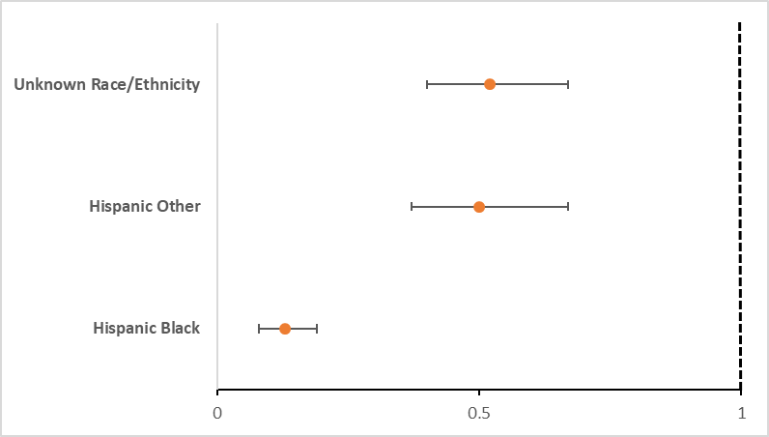
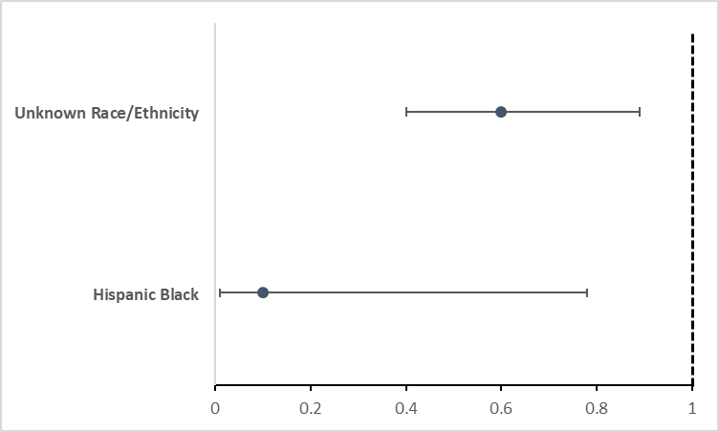
Key Findings: Social Risk Factor Reporting
Race & Ethnicity
Among patients who preferred a language other than English or Spanish
Less likely to report
OR:0.52 [0.4-0.67]
Less likely to report
Patients with unknown race/ethnicity were 50% less likely to report social risk factors
OR:0.60 [0.40-0.89]
Just as likely
OR:0.50 [0.37-0.67]
N=12,430
Just as likely
Hispanic Black and Other patients were nearly 90% and 50% less likely to report social risk factors, respectively
OR:0.10 [0.01-0.78]
OR:0.13 [0.08-0.19]
Comparison group: Non-Hispanic White
Comparison group: Non-Hispanic White

Slide 15
Conclusion
Few published studies have assessed the denominator of total patients eligible for social risk screening or the characteristics of patients completing screening.
Our research provides critical new insights about equity in social risk screening by incorporating both overall patient denominators and REL information
Results indicate low rates of social risk screening overall and differences in screening and report of risk factors by REL factors.

Slide 16




A Call to Action
Collection and documentation of REL data
Need for culturally and linguistically responsive social risk screening implementation strategies
Need to engage community health centers, patients and community members Explore strategies for equitable screening and related interventions

Slide 17
Thank you!
Community Health Centers and patients whose data contributed to these analyses.
SIREN for the opportunity to collaborate in a critical assessment of racial health equity in social care.

Slide 18
Acknowledgements
National Institute of Diabetes and Digestive and Kidney Diseases (NIDDK)-funded ASCEND study (PI Gold, 1R18DK114701-01)
OCHIN
Kaiser Permanente Northwest Center for Health Research Oregon Health and Science University
Accelerating Data Value Across a National Community Health Center Network (ADVANCE) Clinical Research Network (CRN)
(PCORI- RI-OCHIN-01-MC)

Slide 19
Thank you!
Questions? Dialogue…

