Slide 1




Demographic differences in reach of an initiative in the healthcare setting to screen and refer patients for social needs.
Rachel Zucker, Kathleen Albers, Cheryl Kelly, Alex Erkenbeck, Allen Cheadle, James Lagrotteria, Christina Clarke, Michelle Odelberg, Sheridan Green
1

Slide 2
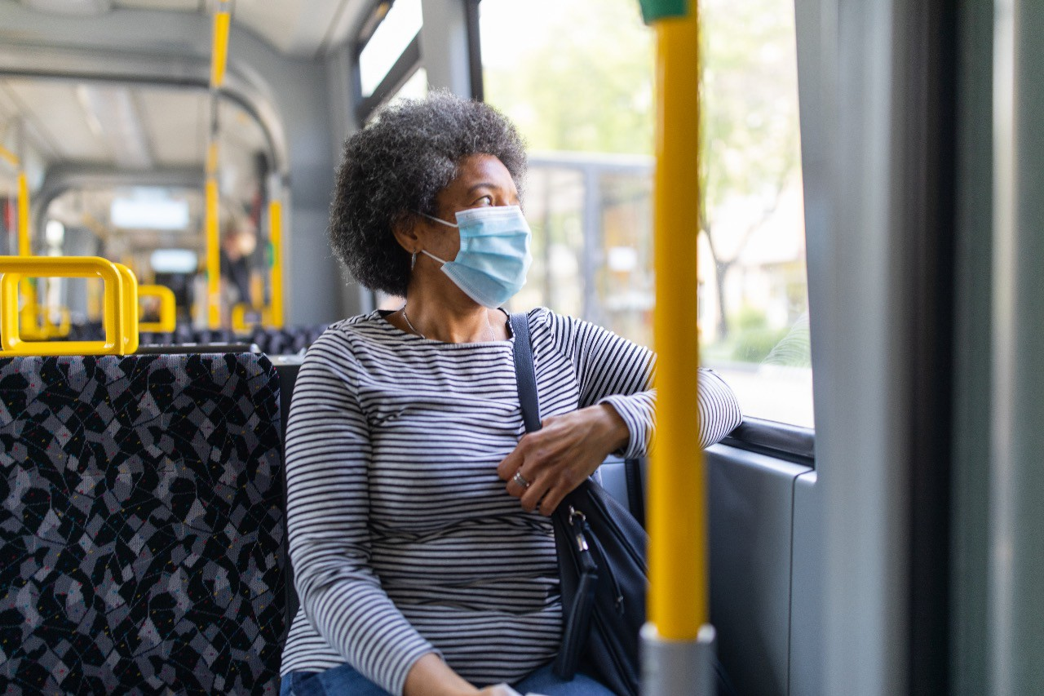


Learning Objectives
Discuss relationship between unmet social needs and health care
Introduce Thrive Local, a closed-loop referral system to address social needs
Share information on need resolution for all needs vs. “Big 4” needs
  Housing, food, transportation, financial
Discuss reach of the Thrive Local initiative across member population
Identify sequential drop-offs at different steps of the referral process for various demographic groups
Explore unintended consequences of differential participation among those receiving assistance through closed-loop referral system

Slide 3




UNMET SOCIAL NEEDS ARE A BARRIER TO HEALTH
Even before COVID-19, people struggled with unmet social needs
68%
Had at least one social factor they needed help with in the past year.
97%
Of respondents want medical providers to ask about social factors during care visits.
People reporting unmet social needs are
2x
as likely to rate their health
as fair or poor.
1 in 4 Americans
Had a social factor they say was a barrier to health in the past year.
3
2019 Social Needs in America Study (national data)

Slide 4








Thrive Local: Kaiser Permanente’s Initiative to Address Members Social Needs
THRIVE LOCAL
Thrive Local is a program for connecting members to community-based programs and services.
The platform (powered by Unite Us) includes:
COMMUNITY NETWORK
Community organizations participate in network and use Unite Us platform to make and track electronic social referrals with Kaiser Permanente
and each other
Resource Directory
Online directory of local community organizations and social service providers. Includes eligibility criteria,
hours of operation, location, and other key information. Search and filter functions help narrow choices to appropriate resources.
Community Network
Many organizations participate with Kaiser Permanente in community networks allowing us to coordinate care by making electronic social referrals with each other and tracking outcomes.
RESOURCE DIRECTORY
Online platform allows users to search for local community resources to share with members
UNITE US
4
4

Slide 5





What happens once a member has a service case initiated?
MRN found in Thrive Local
One (or more) "referrals" created
CBO "accepted referral"
One (or more) "referrals" closed & resolved
Once MRN is added to Thrive Local, the KP user/medical provider can send one or many referrals to one or many CBOs.
Upon receiving a referral, a CBO can accept, review/pending, reject or forward a referral based on CBO eligibility criteria, availability, and ability to contact the member.
After accepting a referral, the CBO updates service as "closed and resolved" when services provided, or "unresolved", if unable to contact patient or provide services.
A member's information is transmitted to Thrive Local when the Thrive Local button is clicked within a patient's medical record in EPIC.

Slide 6

Methods
Three data sources:
Membership data
Referral data from Unite Us
Social needs screening data across a variety of screeners used within the Kaiser Permanente health system
Reminder:
"Big 4 Needs" include Financial, Housing, Food, and Transportation
Limitations:
Current data spans from January 2020 to May 2022, though each region implemented the platform at different times.
This is a snapshot - numbers can change as people move through the system. Participants were given a
minimum of 2 weeks to capture their referral's progress prior to categorization.
The screening and referral initiatives are not always deployed in the same places and
patient populations. Some people in Thrive Local did not have a social needs screener and people who have a social need documented that are not in Thrive Local.

Slide 7
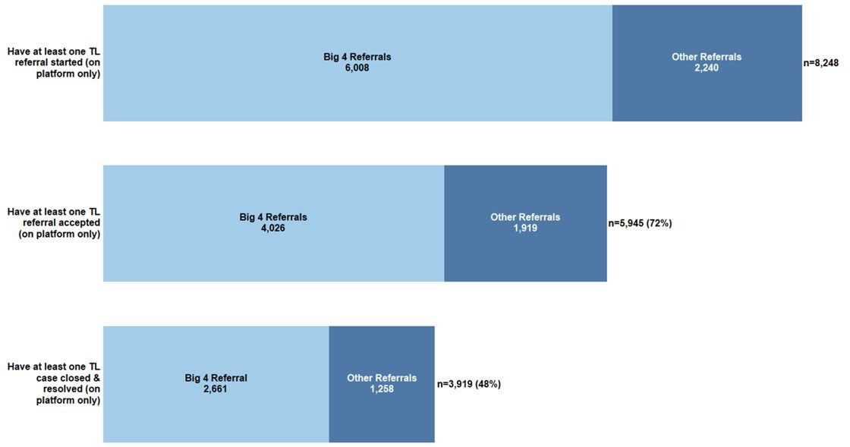
Referral Initiation to Completion
Not everyone who has a referral started moves through the system successfully.
For those with any type of need, about three-quarters of individuals have a referral accepted by a
CBO. Just under half have a closed loop referral that has been resolved.

Slide 8
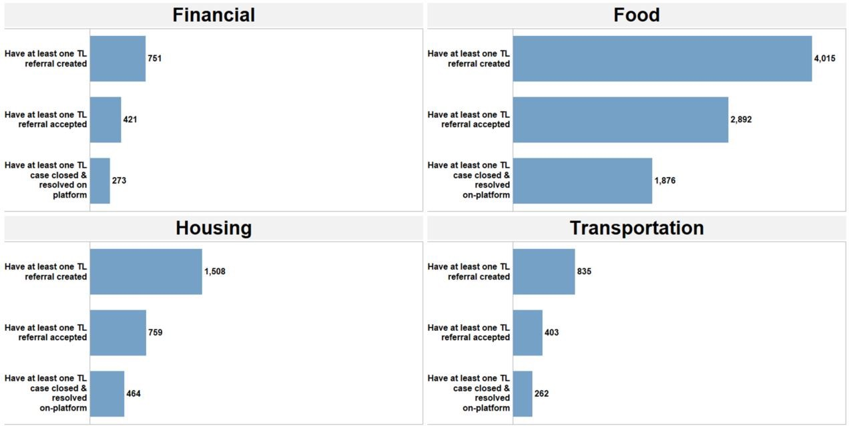

Voltage Drop Among the Big 4 Needs
January 2020-May 2022
Transportation and housing saw the biggest voltage drop in referrals reaching closed status (31%); Food referrals were the most likely to be successfully closed (46%).

Slide 9
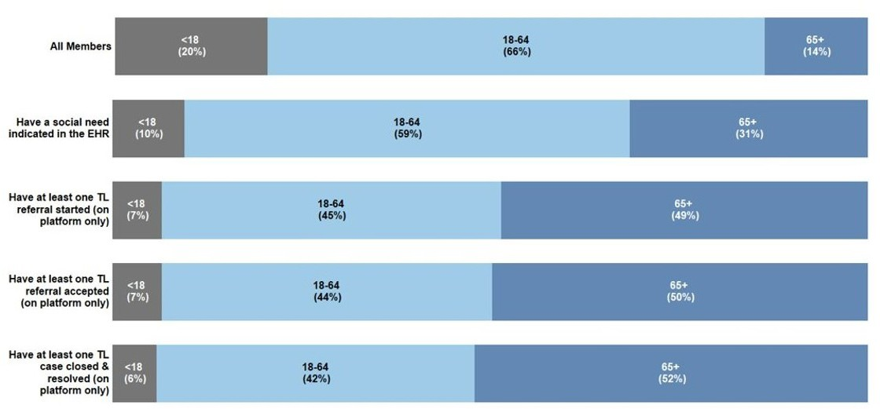
Movement Through Thrive Local System by Age
n = 14,803,136
n = 852,766
n = 8,248
n = 5,945
n = 3,919
18-64 year olds make up 59% of those with social needs but only 45% of Thrive Local referrals and 42% of those who receive help from Thrive Local

Slide 10
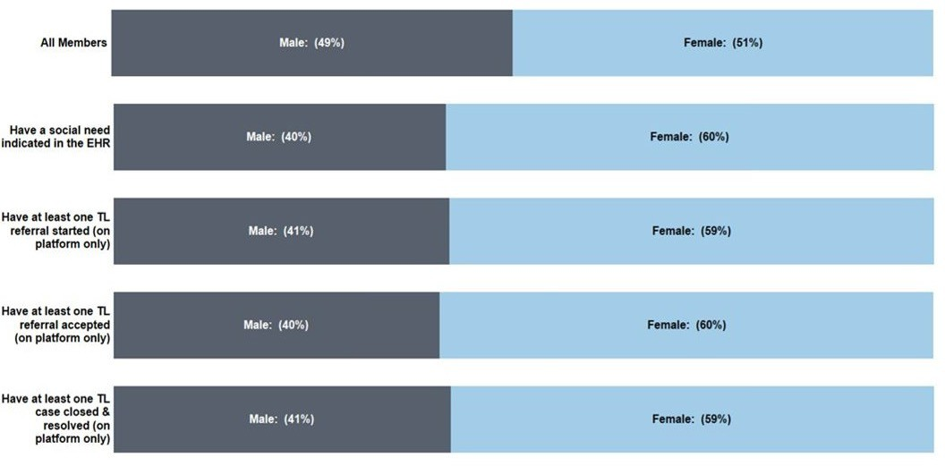
Movement Through Thrive Local System by Gender
n = 14,803,136
n = 852,766
n = 8,248
n = 5,945
n = 3,919
60% of females have a social need. Males and females appear to be making it through the Thrive Local system at equal rates.

Slide 11
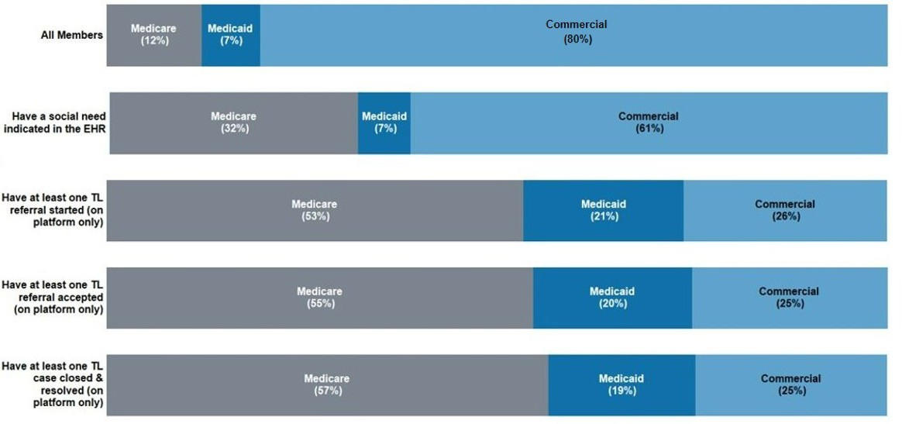
Movement Through Thrive Local by Insurance Type
n = 14,803,136
n = 852,766
n = 8,248
n = 5,945
n = 3,919
Commercial members make up 61% of social needs, but only 26% of started and 25% of resolved Thrive Local referrals.

Slide 12
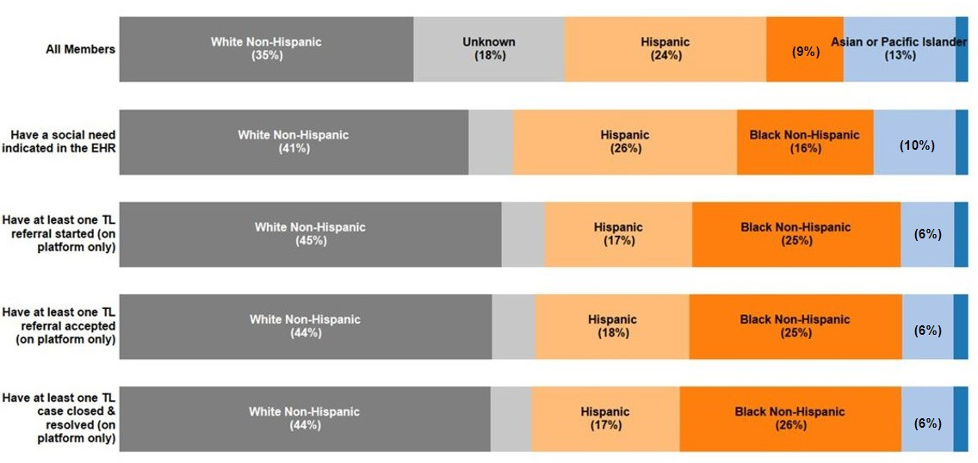
Movement Through Thrive Local by Race & Ethnicity
n = 14,803,136
n = 852,766
n = 8,248
n = 5,945
n = 3,919
Hispanics make up 26% of those with social needs but only 17% of Thrive Local referrals and resolved cases.

Slide 13
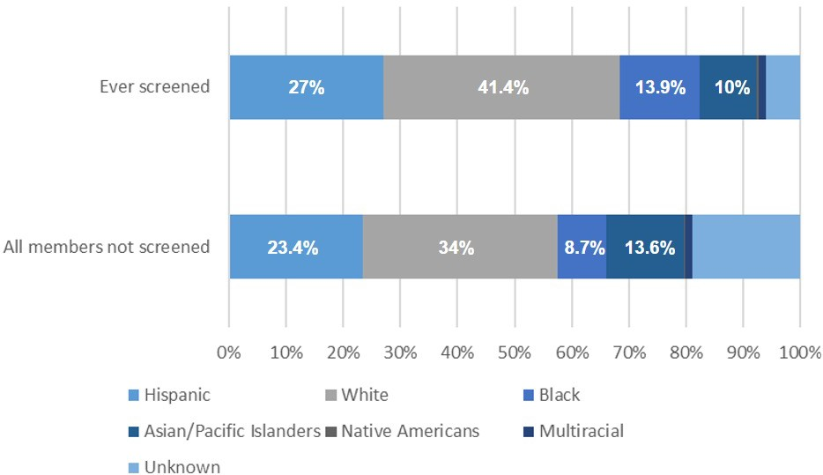
Screening of Kaiser Permanente Members by Race
41.4% of members who were screened were white, compared to 34% of the non-screened group.
p-value: <0.001

Slide 14
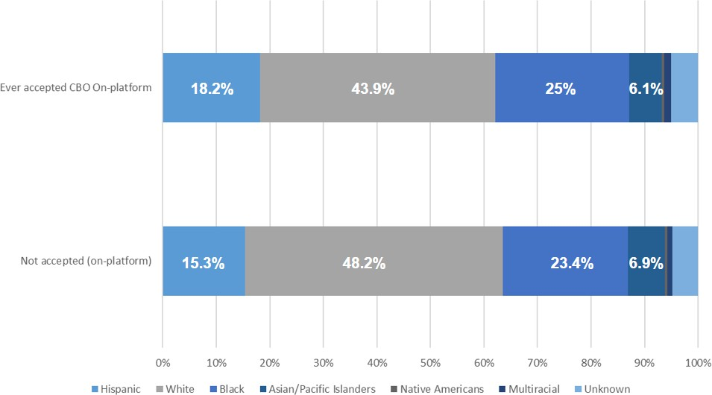
Thrive Local Accepted vs. Not Accepted by Race & Ethnicity
About 18% of those who were ever accepted by a CBO were Hispanic compared to 15% of the not-accepted group. The accepted by a CBO group was 44% white, while the not accepted group was 48% white.
p-value: 0.003

Slide 15
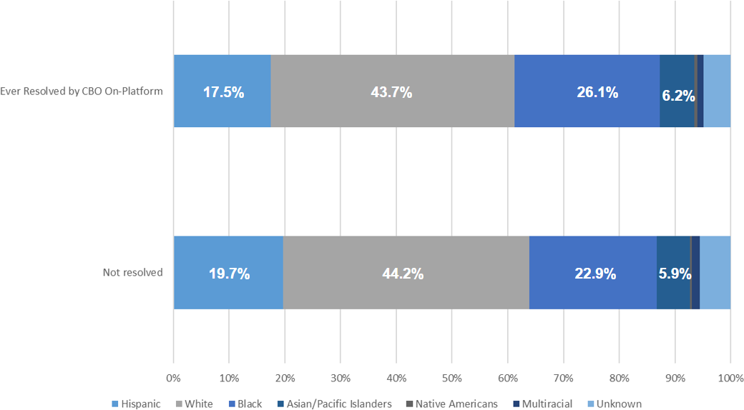
Thrive Local Referrals Resolved vs. Not Resolved by Race & Ethnicity
There are smaller but still statistically significant differences by race and ethnicity in the groups who had their referrals resolved vs. not resolved.
p-value: 0.053

Slide 16
Demographic differences exist in how people move through Thrive Local
Over-represented in a positive social need compared to the general population:
Older
Female
Non-Hispanic black, Hispanic, non-Hispanic white
On Medicare
Under-represented in an on-platform referral started compared to those with a positive social need:
Younger (18-64)
Hispanic, Asian or Pacific Islander
Commercial insurance
Under-represented in an on-platform resolved referral to those with a referral started:
Younger (18-64)
Asian or Pacific Islander
On Medicaid or Commercial Insurance
More investigation is needed but the following could be contributing to these differences:
Robust screening protocols and outreach in some patient groups but not in others
Non-uniform implementation of the Thrive Local system across regions – i.e., targeting certain clinics, specific patient groups
Different availability of community-based organizations to meet certain patient populations' needs
Different use patterns of healthcare among patient populations

Slide 17



Takeaways:
It is critically important to understand how social needs initiatives reach and meet the needs of different demographic groups.
Group differences were clearly observed in how people progress through the
program. It's important to examine the differences to identify potential systemic issues and areas for implementation improvements.
  Differences may relate to cultural, individual, program implementation, and other influences.
  Focused outreach on populations during the drop-offs identified could improve equitable program implementation and resolution of social needs.

Slide 18

Thank you to the CCHE and PiER teams
Allen Cheadle, Maggie Jones, Juno Matthys, Erin Hertel, Diana Charbonneau
Sheridan Green, Cheryl Kelly, Kathleen Albers, James Lagrotteria, Christina Clarke, Michelle Odelberg, Alex Erkenbeck, Rachel Zucker

Slide 19
Contact information
Allen Cheadle
Allen.D.Cheadle@kp.org
Sheridan Green
Sheridan.X.Green@kp.org
Rachel Zucker
Rachel.X.Zucker@kp.org

