Slide 1

Examining the Health and Health-Related Social Needs of Homeless Youth through Photovoice
April Joy Damian, PhD, MSc, CHPM, PMP Vice President and Director, Weitzman Institute
September 2022

Slide 2
Introduction
Youth homelessness as a public health challenge
Photovoice as a CBPR method
Photovoice in action: youth homelessness in New Britain
Ethical and methodological considerations in applying photovoice
Overview

Slide 3

Weitzman Institute Vision and Values
The Weitzman Institute aims to serve as the nation’s premier research, education, and policy institute for promoting quality, efficient, and equitable primary care, particularly among the underserved.
To achieve this vision, we believe that our work must be rooted in:
Excellence: We strive to excel in every aspect of our work, and to deliver the highest quality and value possible. We do not rest on our accomplishments; rather, we build on them, constantly raising the bar on our performance, including in the small things.
Innovation: We think big, challenge current approaches, and see more possibilities than problems. We encourage our staff to think critically about our processes and services, to explore and to share their ideas openly, and to transform their ideas into unique, tangible solutions.
Equity & Inclusion: Equity & Inclusion is a mission-critical component necessary to do our best work in fighting inequality in the world. We know that having varied perspectives--both our expertise and lived experiences-- helps us generate better ideas and solutions to complex health and health-related social problems in an ever-changing, and increasingly diverse society.
2

Slide 4
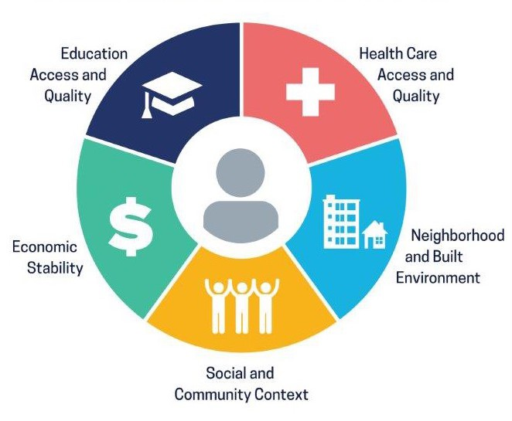


Weitzman Institute Priority Areas
Social Determinants of Health
Health Systems Transformation and Optimization
Workforce Development
Examining and solving for upstream factors
Unpacking historical and structural inequities contributing to ongoing disparities in healthcare access and outcomes
Enhancing responsiveness to efforts to optimize (tighten up current systems), transform, and disrupt healthcare as a means of improving health outcomes, particularly through payment reform and digitalization of healthcare
Promoting a workforce that looks like and/or better relates to underserved patients and communities
Advocating for team-based models of care that integrate all members of the team that can contribute to a patient's overall health (e.g., community health workers, mental health coaches)
3

Slide 5



What We Do
Examine
Understand and anticipate pressing challenges in primary care for the underserved
Assess barriers (e.g., structural, knowledge, training) to providing quality, efficient, and equitable primary care
Explore and test potential levers of positive change
Create
Design “for primary care, by primary care” learning opportunities
Offer a seat at the table for patients and communities to inform our work
Forge cross-sector, mission- aligned coalitions as a means of moving the needle on health equity
Translate
Move from theoretical frameworks and models to actionable findings
Share our knowledge with primary care and public health teams, practices, policymakers, and communities nationwide
Disseminate lessons learned to promote sustainable and scalable best practices
Research, Education, Policy
4

Slide 6
Introduction
Youth homelessness as a public health challenge
Photovoice as a CBPR method
Photovoice in action: youth homelessness in New Britain
Ethical and methodological considerations in applying photovoice
Overview

Slide 7
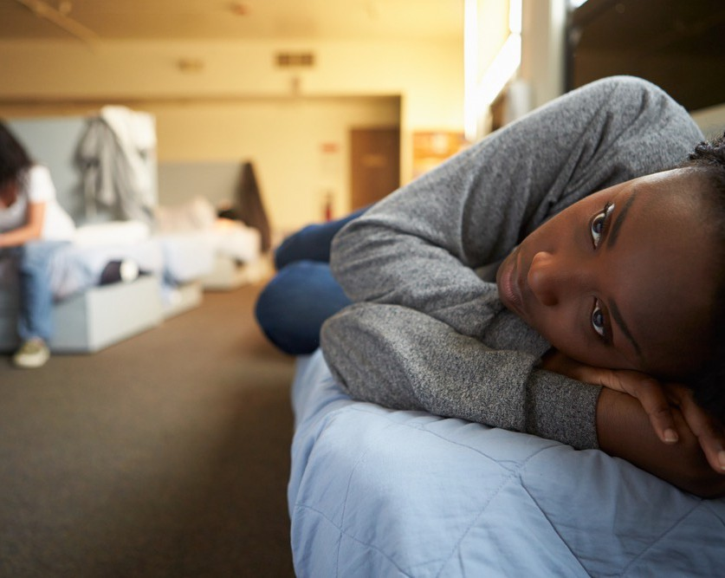
Youth Homelessness as a Public Health Challenge
Directly impacting 4.2 million youth across the U.S.
  Subpopulations disproportionately impacted: Black and Latinx youth, LGBT youth, youth who do not complete high school, and youth who are pregnant/parenting
  LGBT and African American youth are especially likely to experience homelessness, with 120% and 83% higher risk, respectively, compared to their heterosexual/cisgender and racial/ethnic counterparts
One in 10 young adults ages 18-25, and at least one in 30 adolescents ages 13-17, experience some form of homelessness over the course of a year
Reference: U.S. Administration for Children & Families (2016). Definitions of homelessness for federal program serving children, youth, and families.
https://www.acf.hhs.gov/sites/default/files/ecd/homelessness_definition.pdf

Slide 8

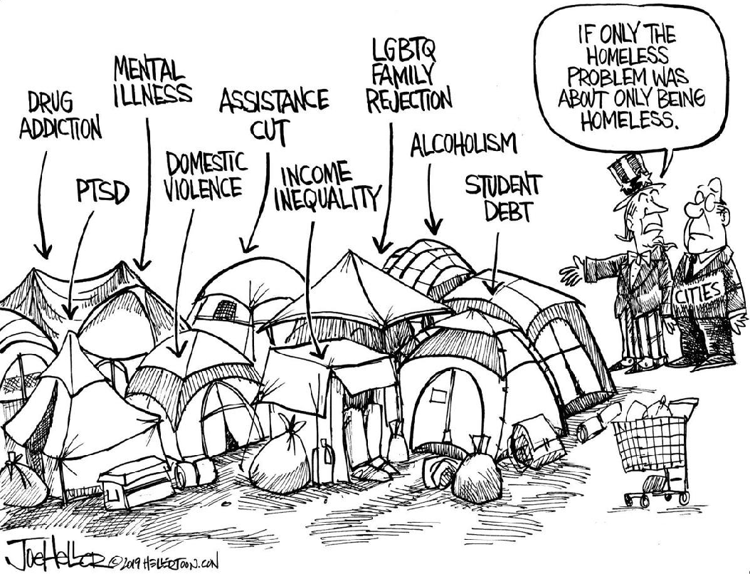
Beyond Homelessness
Educational disruptions
Lower academic achievement
Punitive disciplinary measures
Food insecurity
Interpersonal safety
Physical and mental health problems
Substance use
Stress
Trauma
Early death

Slide 9


Seeking Insights from Trusted Community Leaders

Slide 10
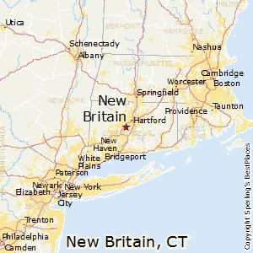
Population of 72.8k people with a median age of 33.8
Median household income of $46,499
Five largest ethnic groups: White (Non-Hispanic)
(40%), White (Hispanic) (29.8%), Black or
African American (Non-Hispanic) (11.2%), Other
(Hispanic) (9.67%), and Asian (Non-Hispanic) (2.8%)
1 out 10 are non-U.S. citizens
New Britain High School’s student population:
  Absenteeism and dropout rates
  STIs
  Teen pregnancy
New Britain, Connecticut

Slide 11
Introduction
Youth homelessness as a public health challenge
Photovoice as a CBPR method
Photovoice in action: youth homelessness in New Britain
Ethical and methodological considerations in applying photovoice
Overview

Slide 12
A community based participatory research (CBPR) method
  Members of community work in partnership with researchers
  Research team is working to act as catalyst for change
A type of participant employed photography
  The process of photographs being taken by participants and used to elicit the participant-photographer’s own narrative
  Allows the participants, rather than the researcher, to
determine both the subject and meaning of the photograph (power sharing aspect)
Goals of photovoice
  Enable people to record and reflect their communities strengths and concerns
  Promote critical dialogue and knowledge about community
issues through large and small group discussion of photographs
  Reach policymakers
What is Photovoice?

Slide 13

Theoretical Underpinnings of Photovoice
Critical consciousness
Feminist theory
Documentary photography

Slide 14
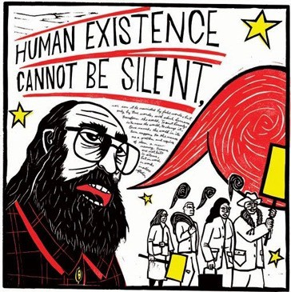
Critical Consciousness
Freire’s work highlights the importance of people’s sharing and speaking from their own experience, and developing solutions and strategies for change
Photovoice connection: A means to support the discussion of the social and political forces that influence people’s lives and contribute to/cause common issues people are facing is through the use of visual images

Slide 15

Feminist Theory
Feminist theory holds that power accrues to those who have voice, set language, make history, and participate in decisions
  “We learn ourselves through images made by men”
Photovoice connection: People with socially marginalized or stigmatized conditions or status have expertise and insight into their own communities and worlds that professionals/outsiders lack

Slide 16

Documentary Photography
Participatory approaches to documentary photography developed by Ewald, Hubbard, Spence, and other activist photographers suggest a grassroots approach to representation, and demonstrate ways in which a variety of populations can use photography as personal voice
Photovoice connection: Created opportunities for people to tell their own stories and construct their own narrative

Slide 17


Slide 18


Concepts of Photovoice (Wang, 2008)
Images teach
Photographs can influence programs and policy
Community members ought to participate in creating and defining the images that shape equity-centered public policy
The process requires that from the outset planners bring to the table policymakers and other influential people to serve as an audience for community members’ perspectives
Photovoice emphasizes individual and community action
Reference: Wang, CC (2006). Youth Participation in Photovoice as a Strategy for Community Change, Journal of Community Practice, 14:1-2, 147-161.

Slide 19
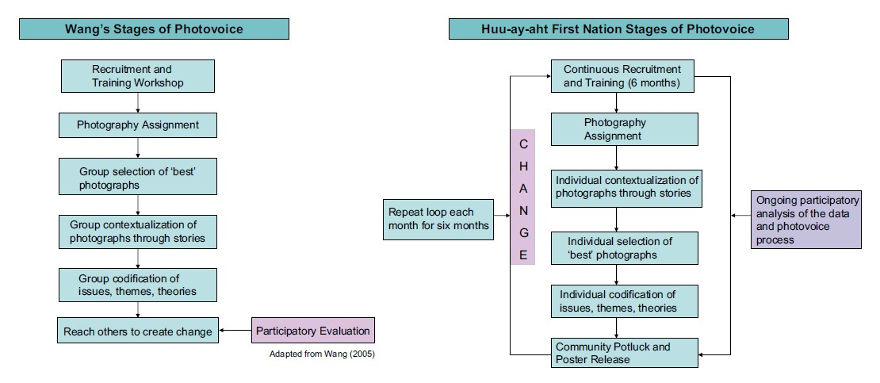
Stages of Photovoice (Castleden & Garvin, 2008)
Reference: Castleden, H. & T. Garvin. (2008). Modifying Photovoice for Community-Based Participatory Indigenous Research. Social Science and Medicine. 66(6): 1393-1405.

Slide 20
Introduction
Youth homelessness as a public health challenge
Photovoice as a CBPR method
Photovoice in action: youth homelessness in New Britain
Ethical and methodological considerations in applying photovoice
Overview

Slide 21
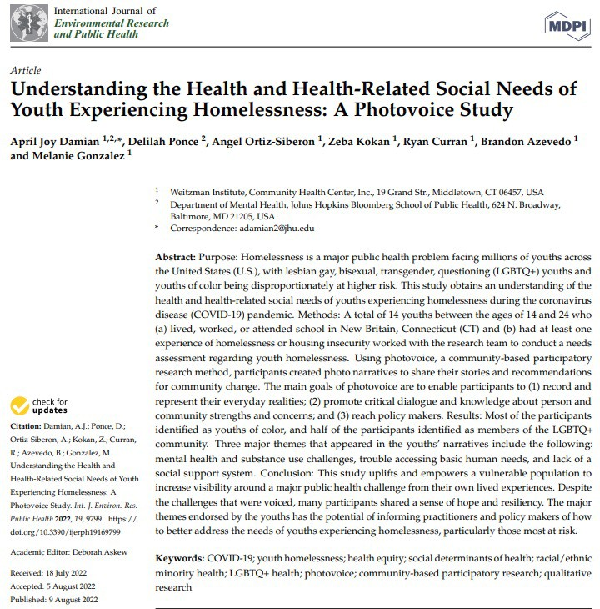

Slide 22
To examine the web of individual, familial,
communal, and systemic factors contributing to youth homelessness through the engagement of
youth in photovoice, with a particular focus on youth of color and LGBT youth
To understand barriers and facilitators to addressing
the health and health-related social needs of
homeless youth by conducting key informant interviews with community leaders from youth serving organizations (YSOs)
To propose youth-driven solutions and key
recommendations for effectively addressing the
health and health-related social needs of homeless
youth through multiple youth-led multimedia advocacy activities and a series of policy briefs
Project Goals
Funded by CVS/Aetna Foundation Strategic Partnership Grant (PI: Damian)

Slide 23
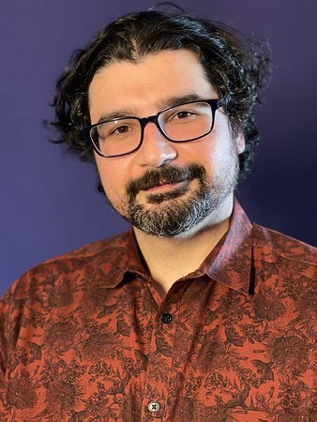
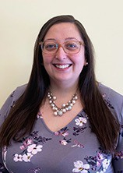
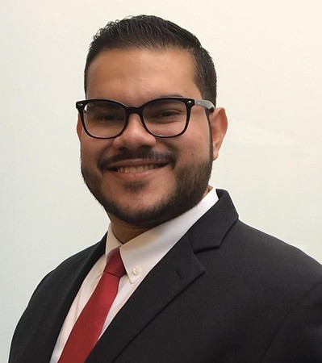
The A-Team

Slide 24
Our Community Partners
Community Health Center, Inc.
New Britain High School
YWCA New Britain
Youth Action Hub
Friendship Service Center
New Britain Boys and Girls Club
Connecticut Coalition to End Homelessness
New Britain Herald
Journey Home CT
Pathways-Senderos Center
City of New Britain
New Britain Police Department
Opportunities Industrialization Center of New Britain
New Britain Public Library
Journey Home
New Haven Pride Center
Trans Lifeline
South Church
Kensington Congregation

Slide 25

Become a better version of yourself
In this photo you can see a bible and a LGBT+ rainbow flag in the background.
I myself was homophobic because I grew up in a homophobic and catholic household. After I went to college when I was around 18-19, I started exploring my sexuality and got into a relationship with a woman. My mom kind of knew what was going on and she would treat me terribly on a daily basis to the point that I started contemplating leaving the house. That was the beginning of me thinking that it was time to completely become independent. This happened a couple of months right before the big hurricane Maria, which pushed me to finally move out of my hometown and come to Connecticut
Schools and other places have to offer more education about sexuality and gender identity. The majority of people that are homophobic is because of lack of education and understanding. I understand that everyone has different opinions and beliefs, but we have to be respectful towards each other regardless of those. Also, since Puerto Rico is technically part of the USA it would be nice if the USA would interfere with this topic and send more federal resources to LGBT+ people in PR.

Slide 26
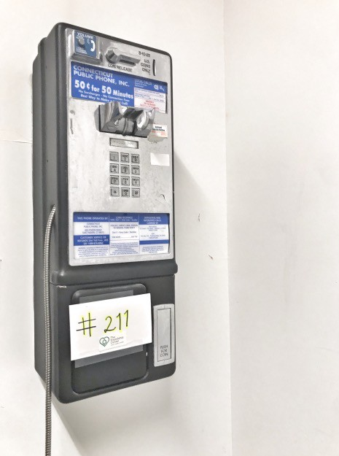
Disconnection
In this picture, you see a payphone with the 211-number attached to it. This photo represents the number of times I tried reaching 211 for help but I never got a response until I was literally sleeping in my car. Since the first time I got to CT everyone would tell me to call 211 so they could assist me with housing services but every time I called, they said since I was a student, I could take a loan so I could have lived in the dorms and that the only way for them to help was if I was literally sleeping in the streets, public place, or in my car.
Probably if they would've assisted me since the first time I called, instead of waiting until I was sleeping in my car (2 years later), I would’ve had a home after graduating. A good change that the state could make is not waiting for people to be in the streets because homelessness does not only mean you are literally in the streets. There is housing insecurity. If they take better care of people confronting housing insecurity, maybe the literal homelessness rates would go down.

Slide 27
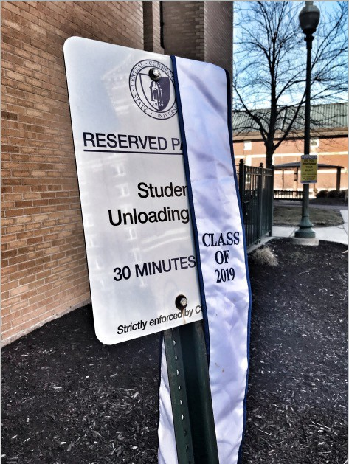
Graduation day! What now?
This picture was taken in the parking lot of the last dorm I lived in while at college before I became homeless. In the picture is a reserved parking sign where students park when they want to move out or in. On the sign, is my graduation sash.
My graduation day was crazy because I was moving out on the day of graduation. The school allowed me to stay later that other students because of my circumstances, but I was not allowed to stay there after graduation. I was moving out, but I did not have a place to move out to. I was taking my stuff out to storage on that day.
Students need more resources after graduation. While I was a student in college I had lots of resources and help. After I graduated, I lost these resources and I did not know- what do I do now?

Slide 28
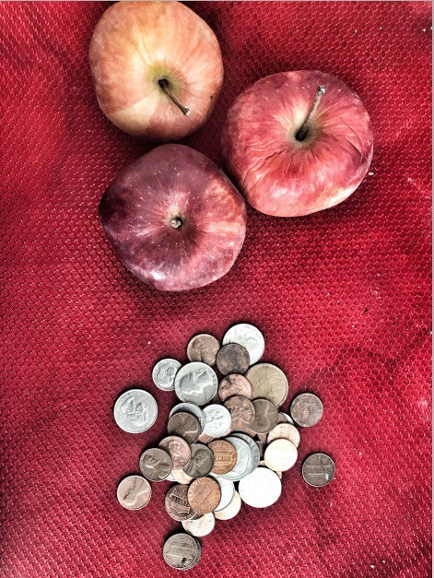
Choices
In this picture you see apples and coins next to each other.
This picture represents the choices you face when you do not have enough money. For example, there are times when you have to decide what to eat, but healthy food like apples costs more. There are times when you want to make healthy decisions, but its hard to make the healthy decision because the unhealthy ones, like a large fries from McDonalds is cheaper. Food is just one kind of choice I have to make. There are times when I have to make a choice to get gas for my car or get food for my cat and when I make these choices to pick one thing, that often means I have to choose to say no to another thing. These are choices I need to make between things I need to survive. It is not making choices between things that I want - like spending my money to go out.
Food stamps should be more flexible with their requirements. There are lots of silly requirements that disqualify you from getting them like having to work at least 20 hours or not being able to get them if you live in shelter. Also, there are times when food stamps gives you a terrible amount of money. When I was in college, they gave me $15 a month. What can I buy for $15 a month?

Slide 29
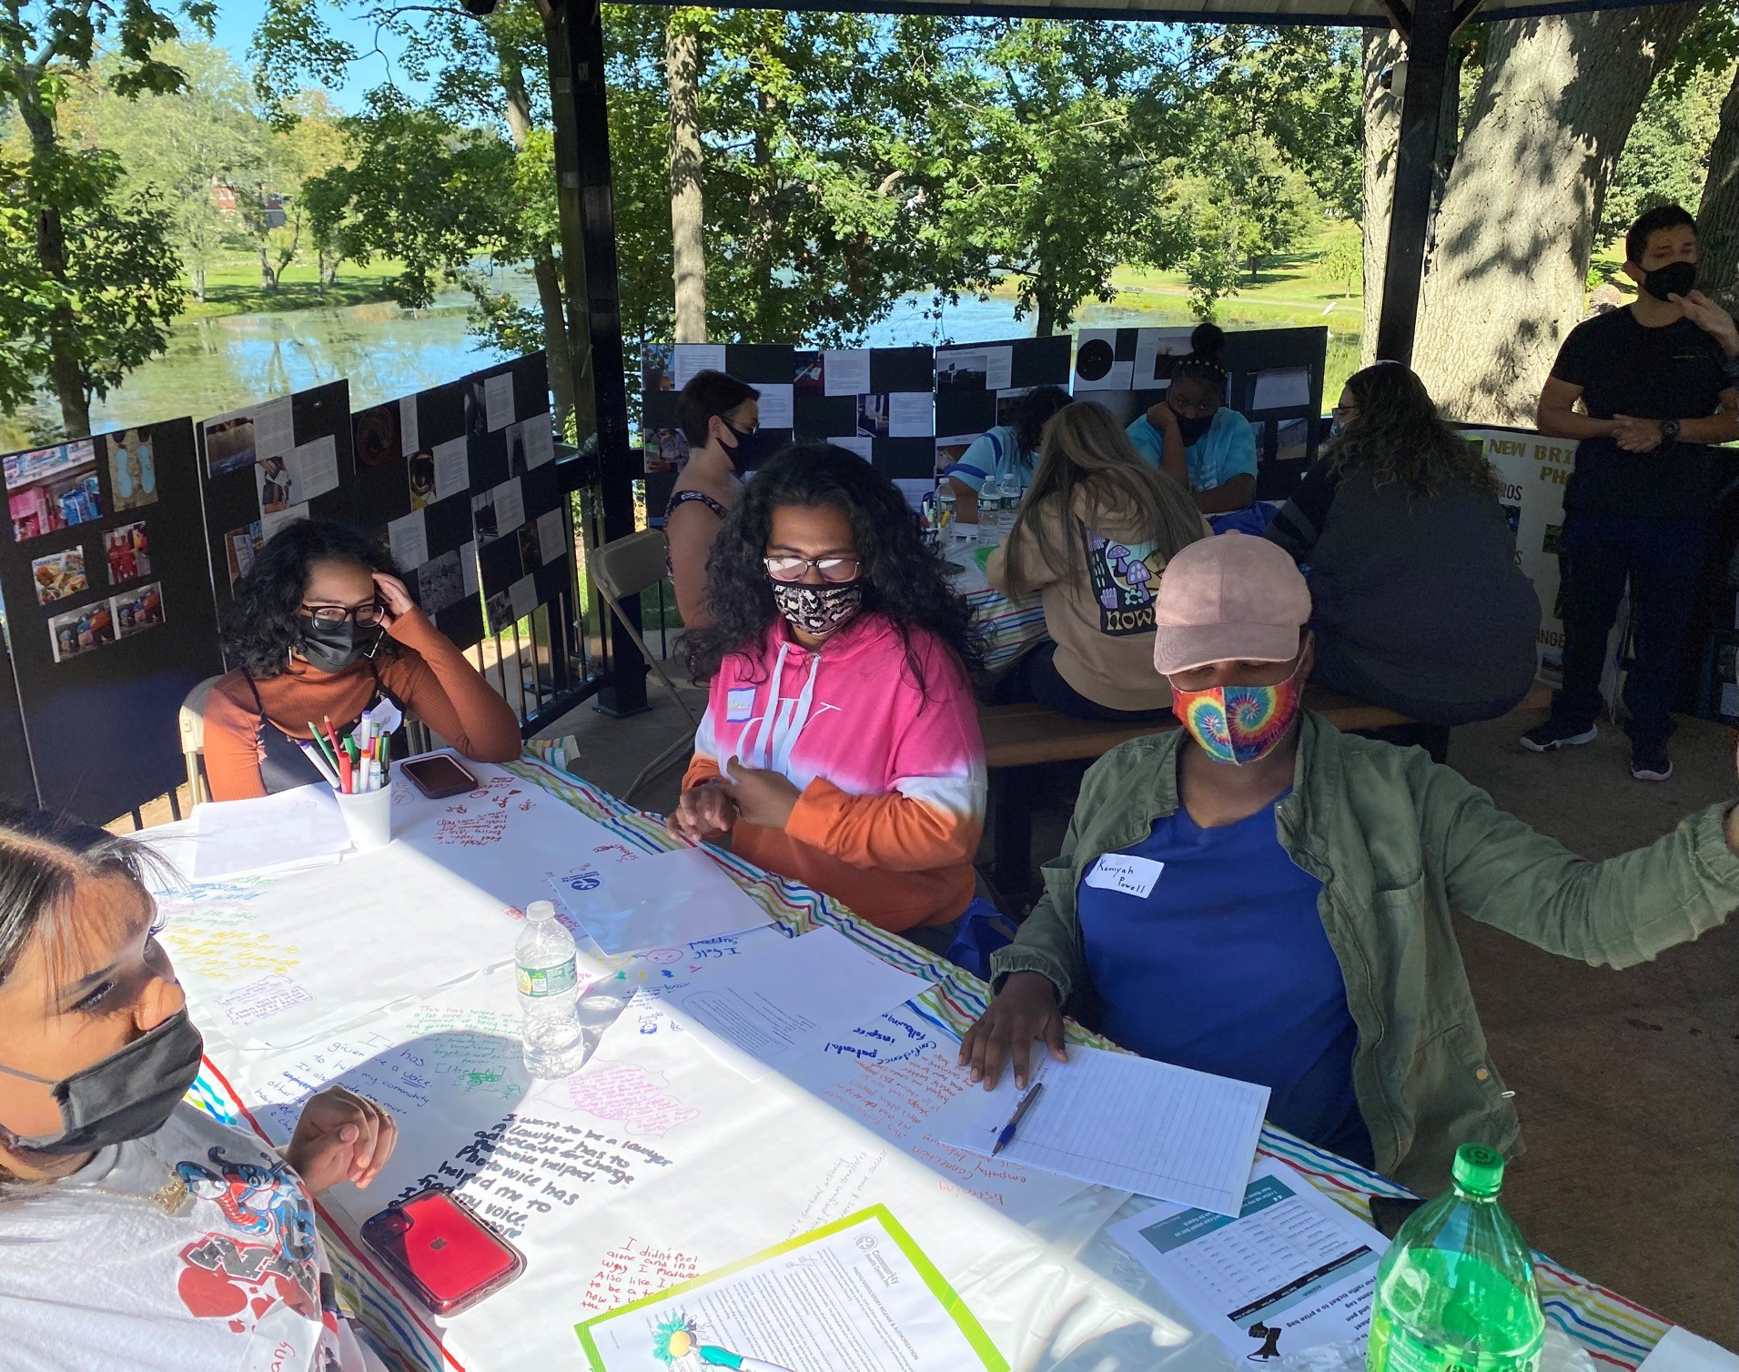
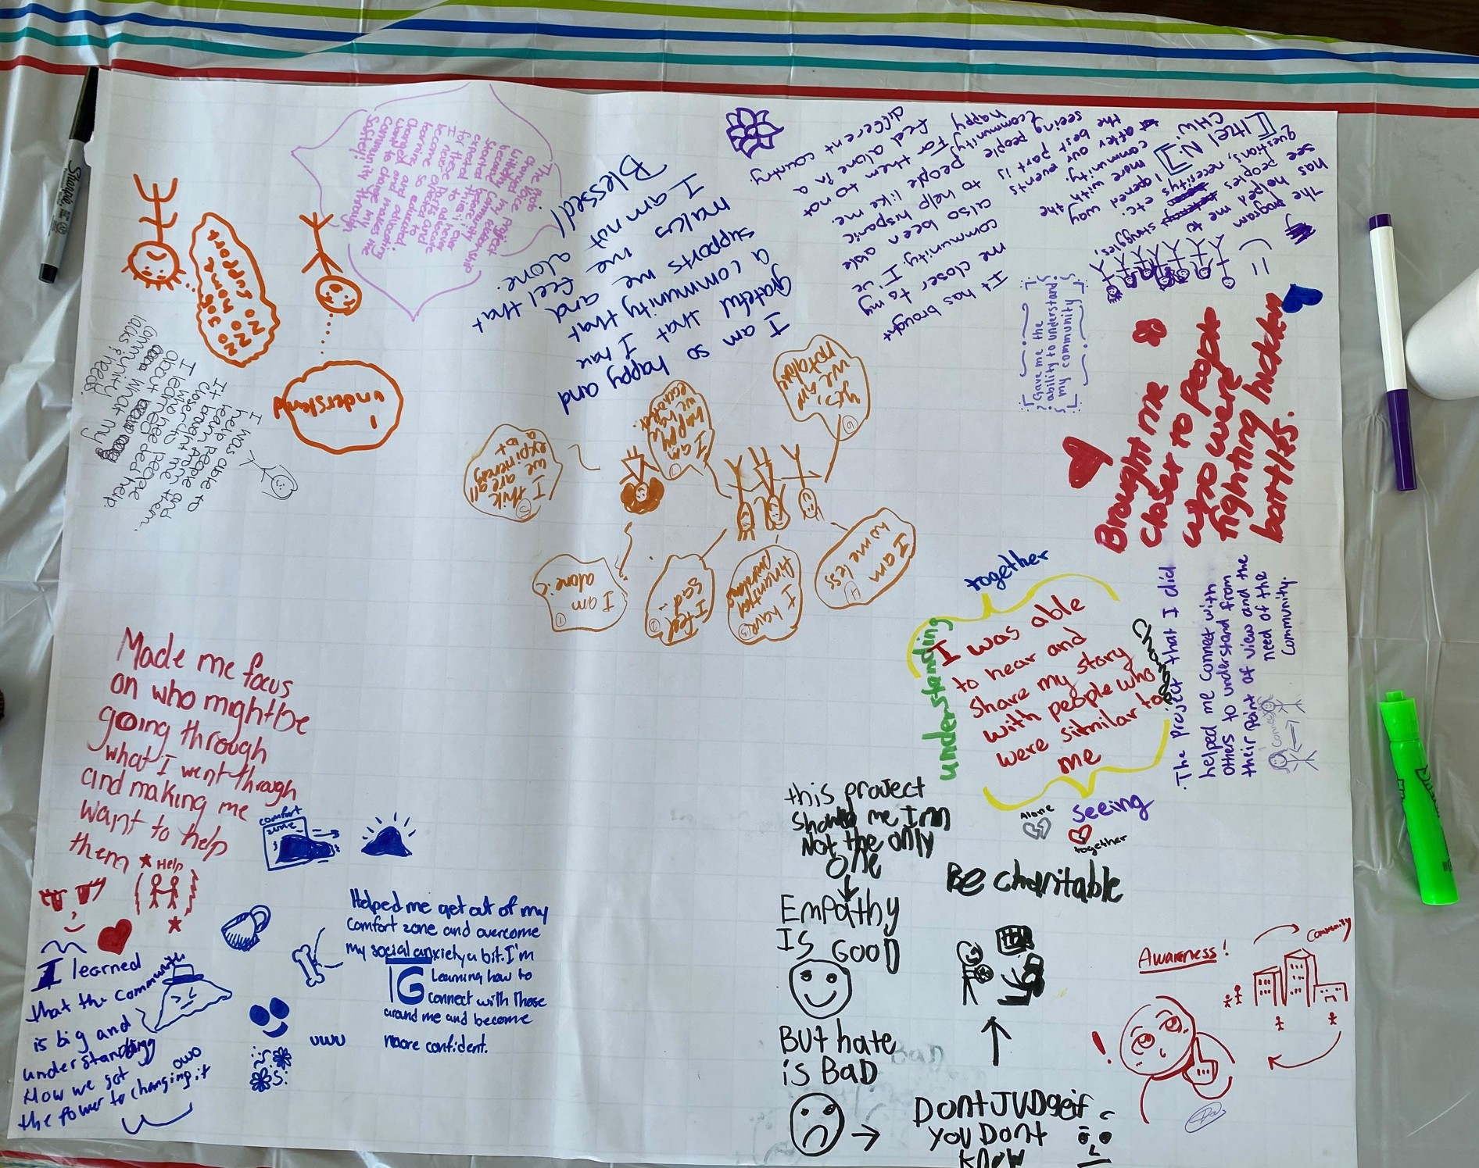
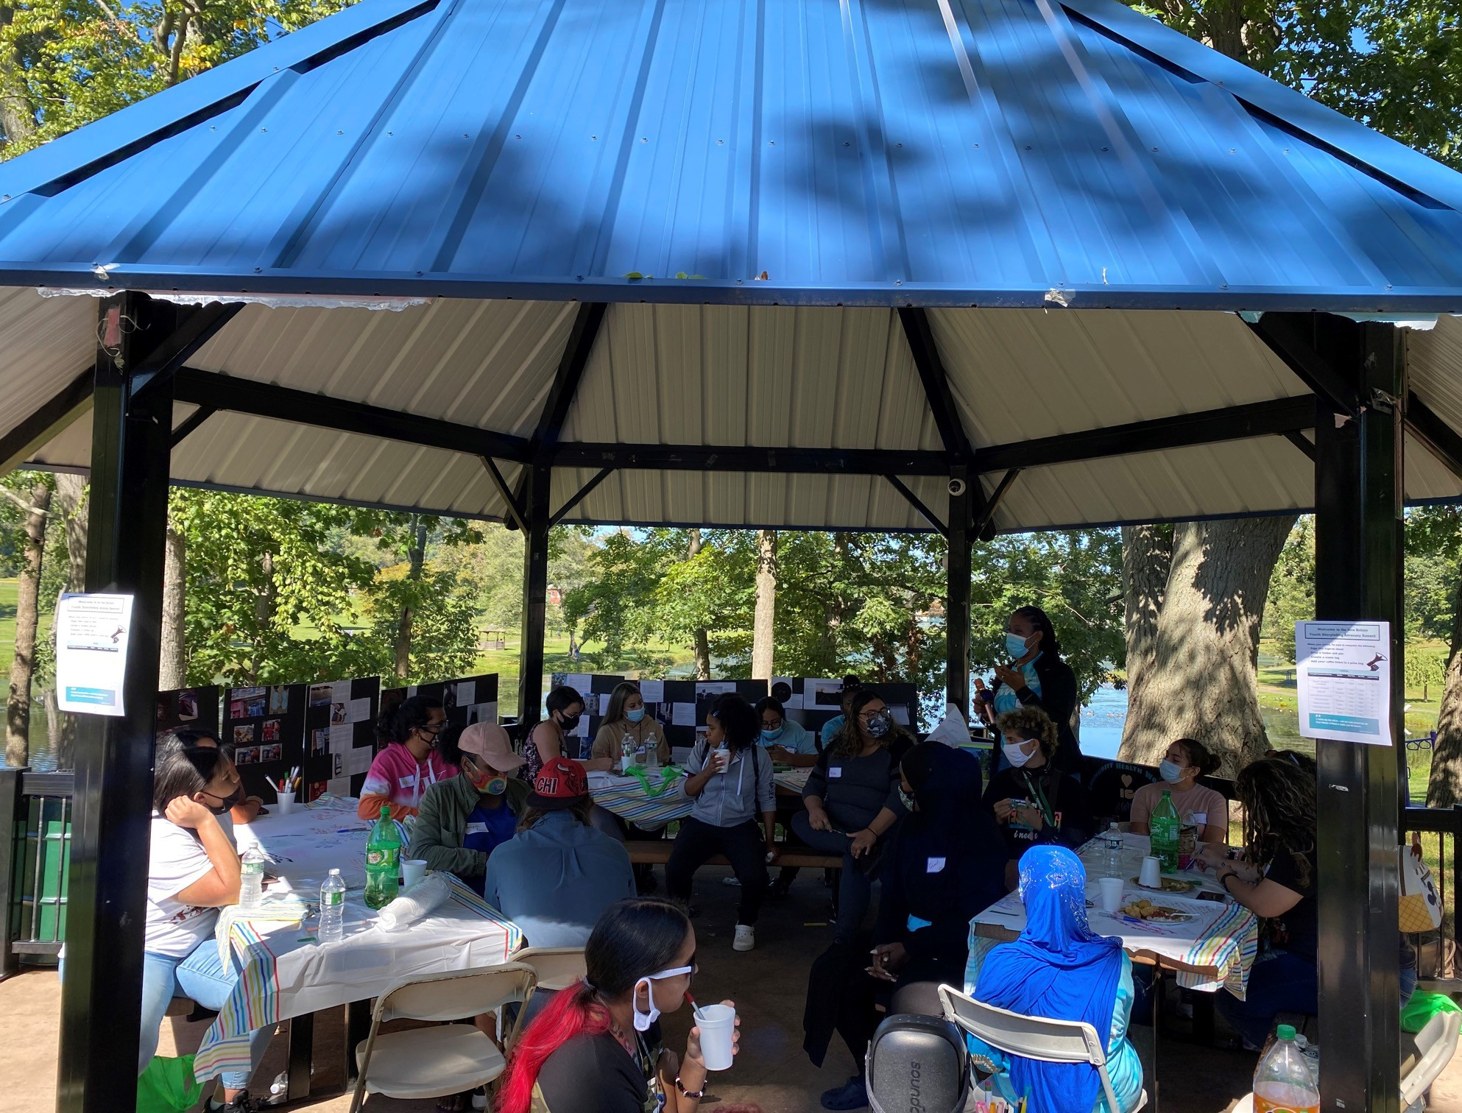
New Britain Youth Advocacy Summit (September 2021)

Slide 30
Introduction
Youth homelessness as a public health challenge
Photovoice as a CBPR method
Photovoice in action: youth homelessness in New Britain
Ethical and methodological considerations in applying photovoice
Overview

Slide 31
Ethics of Photovoice (Castleden & Garvin, 2008)
Anonymity and confidentiality
Conduct training sessions on mechanics and ethics of photography
Signed informed consent forms were required from any individuals who were photographed
Transcription verification by participants
Photograph release consent forms

Slide 32

Factors Influencing Satisfaction with Photovoice (Castleden & Garvin, 2008)
Satisfaction with photovoice stemmed from the method’s success in:
Balancing power
Creating a sense of ownership in the research
Fostering trust
Building capacity
Implementing a culturally appropriate research project in the community

Slide 33
Advantages of Photovoice
Enables health researchers and practitioners to gain “the possibility of perceiving the world from the viewpoint of people who lead lives that are different from those traditionally in control of the means for imagining the world”
Use visual image to identify and understand needs (can compliment or enhance quantitative assessment)
Can affirm the ingenuity and perspective of society’s most vulnerable populations
Facilitates the sampling of different social and behavioral settings that may not be typically available to health professionals and researchers
Can sustain community participation during the period between the needs assessment phase and program implementation
Provides a way to reaffirm or redefine program goals during the period when community needs are being assessed

Slide 34
Advantages of Photovoice cont.
Enables participants to bring the explanations, ideas, or stories of other community members into the assessment process.
Provides tangible and immediate benefits to people and their networks
Enables community members to depict not only the community’s needs but also its assets
The images produced and the issues discussed and framed by people may stimulate social action
Build capacity of the community by training and employing community members in research
Enhance advocacy efforts by equipping advocates with narrative driven policy and program recommendations

Slide 35
Disadvantages of Photovoice
Risk that comes from committing the political act of documenting community reality and discussing community change
Personal judgement may intervene at many different levels of representation: (1) who used the camera, (2) what the user photographed, (3) what the user chose not to photograph, (4) who selected which photograph to discuss, (5) who recorded whose and what thoughts about whose and which photographs
Broader class stratification may be reproduced by the control of resources
Photographs are easy to gather, but difficult to analyze and summarize
Limitations of capital, transportation, and communication

Slide 36
Disadvantages of Photovoice cont.
Methodological ideals of photovoice may not coincide with reality of a community and context
Sampling challenges- are the perceptions expressed representative of the entire community?
Difficulty in photographing things less easily photographed (sensitive nature or abstract concept)
Traditional small sample sizes make pre and post analysis of participant outcomes challenging
Policy change is slow and incremental – unless part of a long term initiative, assessing impact of photovoice is challenging

Slide 37
Thank you!
damiana@chc1.com

