Slide 1

Health-related socioeconomic risks experienced by East and Southeast Asian women during the COVID-19 pandemic
Eva W Shiu, MPH Clinical Trials Manager University of Chicago
Biological Sciences Division
Department of Obstetrics & Gynecology Lindau Lab
Oct 12, 2022 | SIREN National Research Meeting 2022 Racial Health Equity in Social Care
“Minding gaps in health care and social care”
Milkie Vu, PhD, Jennifer Makelarksi, PhD, MPH, Victoria A. Winslow, MPH, Monica M. Christmas, MD, Sadia Haider, MD, MPH, Nita K. Lee, MD, MPH, El A. Pinkerton, MPH, Kristen E. Wroblewski, MS, and Stacy Tessler Lindau, MD, MAPP. “Racial and Ethnic Disparities in Health-Related Socioeconomic Risks During the Early COVID-19 Pandemic: A National Survey of U.S. Women.” JWH, 30(10), 5 Oct 2021.

Slide 2

Disclosures
I have no conflicts of interest to report.
Funding Acknowledgements
NIMDH R01MD012630 NIA R01AG064949

Slide 3
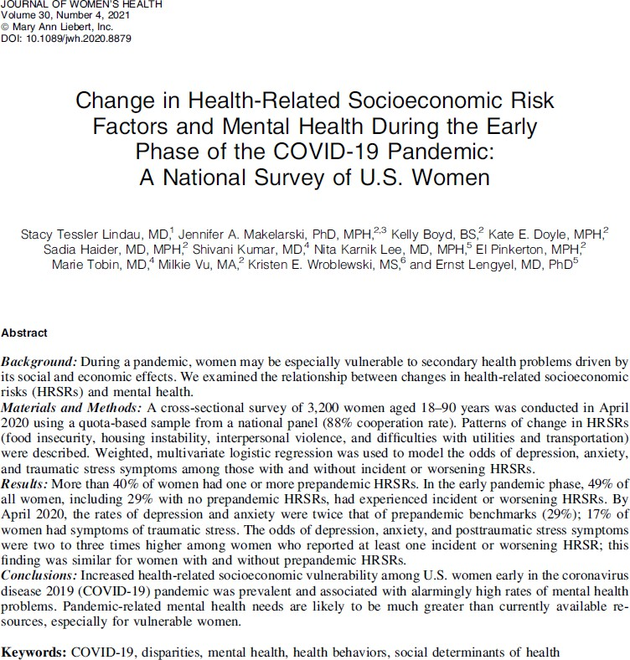

Slide 4
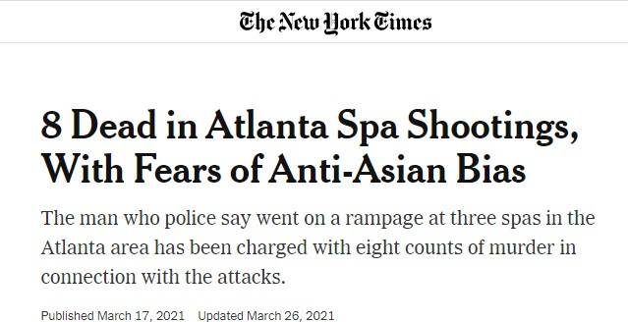
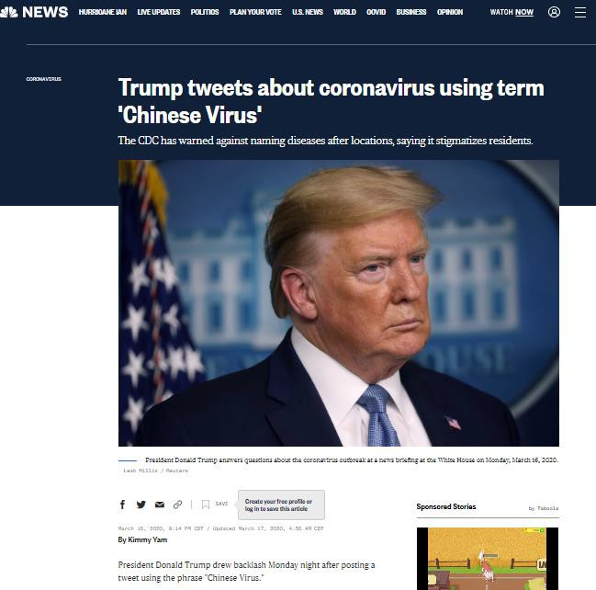
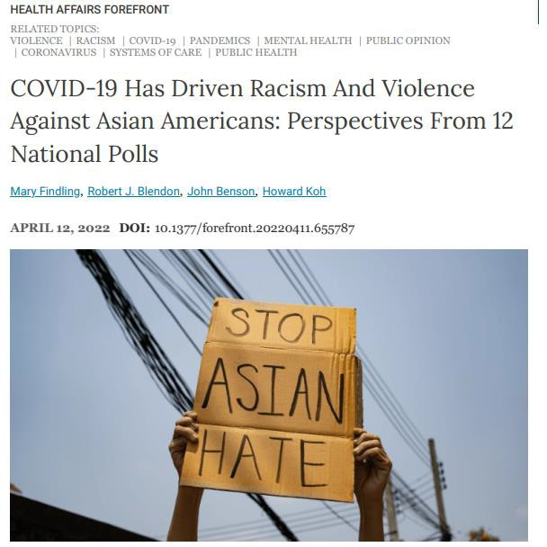
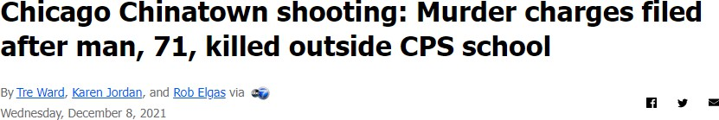
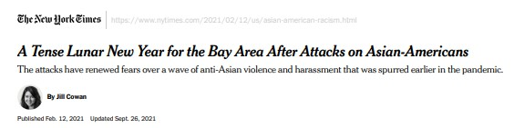
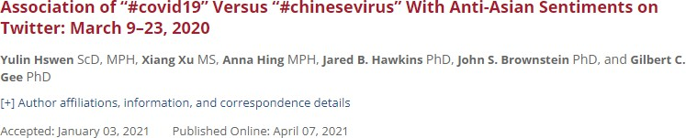
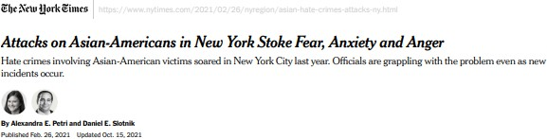
Landscape
4

Slide 5






Landscape
Health-Related Socioeconomic Risks
Model Minority Myth
Image: Nicole Kim (2016) Wong et al 2006; Kawai Y 2005
5

Slide 6
Aims
To examine patterns of change in HRSRs in the early pandemic by race and ethnicity, with an emphasis on East and Southeast (E/SE Asian women).
To fill gaps in our understanding of pandemic-related changes in HRSRs among E/SE Asian women to ensure an equitable and informed approach to pandemic management and recovery.

Slide 7
Methods
Opinions 4 Good (Op4G): national cross-sectional survey of 3200 women (April 2020)
HRSRs were assessed using the Accountable Health Communities screening tool.
Weighted, multivariate logistic regression models generated odds of HRSRs by race/ethnicity adjusted for variables such as household characteristics and socio-demographics.

Slide 8
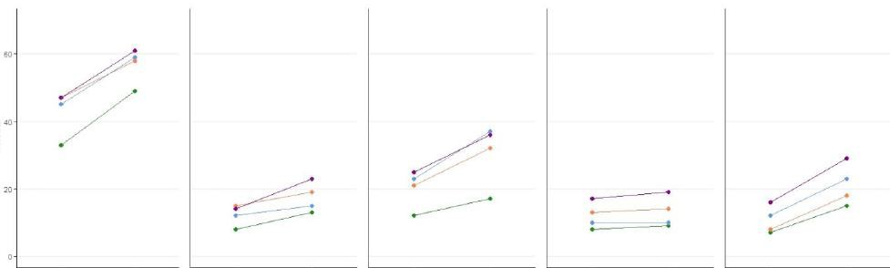





Results: Rates of prevalence of HRSRs in pre-pandemic and early pandemic by race/ethnicity
Race/Ethnicity
• | Non-Hispanic White
• | Non-Hispanic Black
• | Non-Hispanic E/SE Asian
• | Hispanic
Prepandemic
Early pandemic
Prepandemic Early pandemic
Housing Instability
Prepandemic Early pandemic
Transportation Difficulties
Prepandemic Early pandemic
Utilities Difficulties
Prepandemic Early pandemic
Interpersonal Violence
Food Insecurity

Slide 9
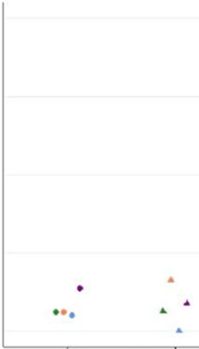
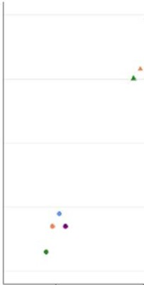
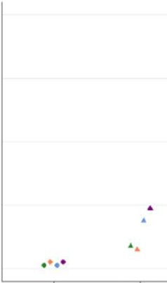
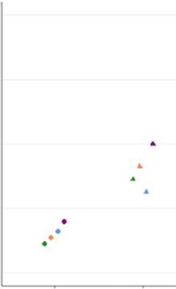






Results: Rates of new and worsening HRSRS by race/ethnicity in pre-pandemic and early pandemic
New | Worsening | Race/Ethnicity
• |  | Non-Hispanic White
• |  | Non-Hispanic Black
• |  | Non-Hispanic E/SE Asian
• |  | Hispanic
80%
80%
80%
80%
80%
60%
40%
20%
0%
60%
60%
60%
60%
40%
40%
40%
40%
20%
20%
20%
20%
0%
Incident (“New”) Worsening
Food Insecurity
0%
0%
0%
Incident (“New”) Worsening
Housing Instability
Incident (“New”) Worsening
Transportation Difficulties
Incident (“New”) Worsening
Utilities Difficulties
Incident (“New”) Worsening
Interpersonal Violence
9

Slide 10
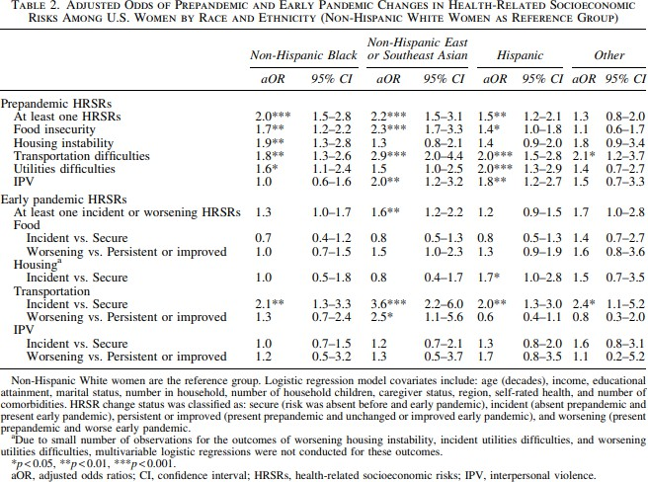
Results
10

Slide 11
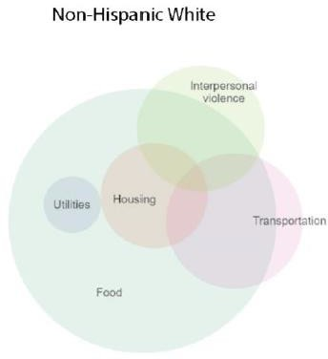
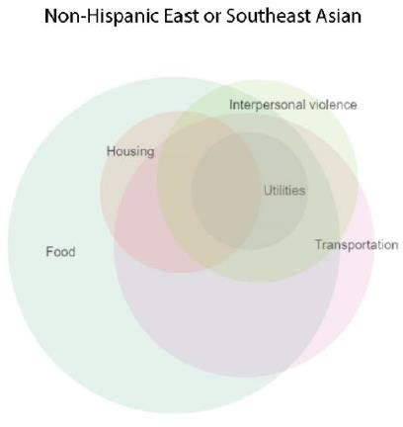
Results: Venn Diagrams of Co-occurrence of HRSRs comparing Non-Hispanic White Women and E/SE Asian Women in our sample
Figure 1. Venn Diagrams displaying co-occurrence of HRSRS by race and ethnicity among US women with >=1 HRSRs in the early phase of the COVID-19 pandemic (Vu et al 2021)
11

Slide 12

Discussion
Patterns:
Health disparities exist across the board for different racial/ethnic groups, especially for E/SE Asians, during the prepandemic and early pandemic
E/SE Asian women experienced higher rates of new and worsening
transportation difficulties
1 in 28 E/SE Asian woman (compared to 1 in 100 White women), experienced all 5 HRSRs, which is an indicator of disparities and vulnerabilities in the extreme.
Gaps and Limitations:
Data collection for E/SE Asian women has been scarce
Model Minority myth can perpetuate a stereotype that E/SE Asians do not experience social risks or have social vulnerabilities
COVID-19 and anti-Asian sentiment have exacerbated social risk vulnerabilities for
this group, especially with the rise experienced violence or fear of violence in the communities where they live
Implications:
To take a closer look at racialized stereotypes and data quality which shape the health of E/SE Asian (Yi et al 2022)
Continue to study changes in HRSRS by race/ethnicity and ethnic sub-groups (dis-
aggregation of data)

Slide 13
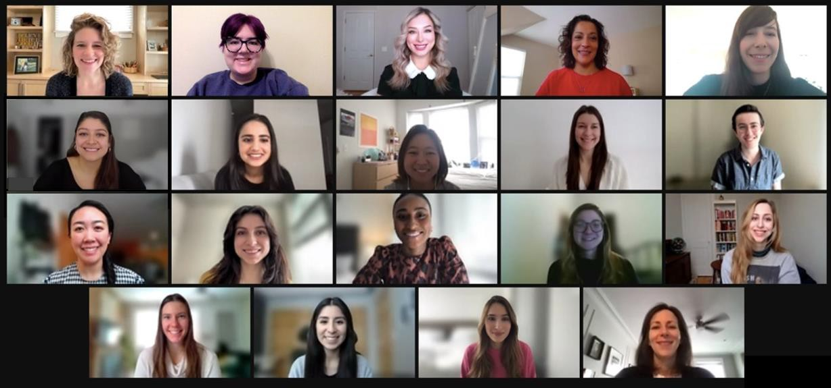
Acknowledgements
I would like to acknowledge the lead author on the JWH 2021 research paper, Milkie Vu, PhD. Special thanks to Milkie Vu, PhD, Jennifer Makelarski, PhD, and Stacy T Lindau, MD, MAPP for their support and feedback on this presentation. I would also like to send a note of appreciation to the members of the Lindau Lab.
Email: eshiu@bsd.uchicago.edu

Slide 14
References
Abrams, 2021, The mental health impact of anti-Asian racism, APA Monitor on Psychology, https://www.apa.org/monitor/2021/07/impact-anti-asian-racism
The Accountable Health Communities Health-Related Social Needs Screening Tool, CMS, https://innovation.cms.gov/files/worksheets/ahcm-
screeningtool.pdf
Croucher 2020, https://www.frontiersin.org/articles/10.3389/fcomm.2020.00039/full
Hahn (2021), Experiences of COVID-19-related anti-Asian discrimination and affective reactions in a multiple race sample of U.S. young adults BMC Public Health, https://bmcpublichealth.biomedcentral.com/articles/10.1186/s12889-021-11559-1
Kawai Y. Stereotyping Asian Americans: the dialectic of the model minority and the yellow peril. Howard J Commun. 2005;16(2):109-30.
Lindau et al (2021), Change in Health-Related Socioeconomic Risk Factors and Mental Health During the Early Phase of the Covid-19 Pandemic: A National Survey of U.S. Women. Journal of Women’s Health 30(4), 19 April, 2021
Model Minority Section, https://depts.washington.edu/sibl/Publications/Model%20Minority%20Section%20(2011).pdf
Ruizetal (2021), One-third of Asian Americans fear threats, physical attacks and most say violence against them is rising Pew Research Center
Vu et al (2021), Racial and Ethnic Disparities in Health-Related Socioeconomic Risks During the Early COVID-19 Pandemic: A National Survey of U.S. Women, Journal of Women’s Health 30(10), 5 Oct 2021
Wong F, Halgin R. The “model minority”: bane or blessing for Asian Americans” J Multicult Couns Devel. 2006; 34(1):38-39.
Yi et al (2022), The Mutually Reinforcing Cycle of Poor Data Quality And Racialized Stereotypes That Shapes Asian American Health. Health Affairs 41(2)
Image: Nicole Kim (2016). https://hwchronicle.com/44771/features/a-is-for-asian/

