Slide 1

Healthcare providers’ perspectives on social screening
De Marchis EH, Brown E, Aceves BA, Loomba V, Molina M, Cartier Y, Wing H, Gottlieb LM
Summer 2022
Read the full SCREEN report here.
De Marchis EH, Brown E, Aceves BA, Loomba V, Molina M, Cartier Y, Wing H, Gottlieb LM. State of the Science on Social Screening in Healthcare Settings. 2022. San Francisco, CA: Social Interventions Research and Evaluation Network. Available online.
https://sirenetwork.ucsf.edu/

Slide 2
Background
There is a strong, consistent, and growing body of evidence documenting the impacts of social factors (e.g., income and education) on health outcomes.
Healthcare organizations are increasingly considering whether healthcare systems should undertake more systematic efforts to identify social and economic factors for poor health.
Understanding healthcare providers’ perspectives about the impact of screening for social risks in clinical settings is critical to equitable and sustainable implementation.
https://sirenetwork.ucsf.edu/

Slide 3

Study Aim
Summarize findings from studies that examine healthcare providers’ perceptions of the acceptability of identifying patients’ social needs in clinical settings.
perceptions
perceptions
perceptions
perceptions
perceptions
perceptions
https://sirenetwork.ucsf.edu/

Slide 4


Methods
Updated 2021 Quiñones-Rivera et al. systematic scoping review that examined providers’ perspectives of healthcare-based social screening and referral activities.
New studies had to evaluate healthcare providers’ perspectives on screening for 2 or more social domains (e.g., food, housing, transportation, social isolation) in any healthcare setting.
https://sirenetwork.ucsf.edu/

Slide 5



Results
The updated search identified 20 additional studies that examined providers’ perspectives on social screening in clinical settings.
Studies identified in 2021 scoping review
N=53
Studies identified in updated search
N=20
Studies summarized
N=73
https://sirenetwork.ucsf.edu/

Slide 6
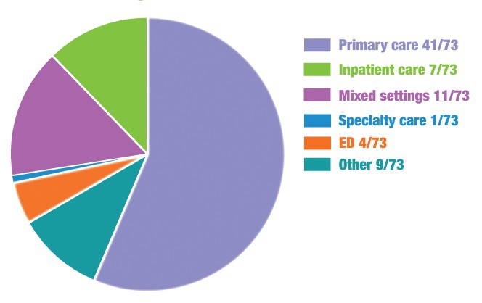
Results: Study characteristics
Provider populations
Study settings
Physicians, residents, and medical students
Advanced practice providers and trainees
Nurses
Social workers
Community health workers
Case managers
Pharmacists
Clinic/hospital staff (including leadership/administrators)
https://sirenetwork.ucsf.edu/

Slide 7



Results: Study characteristics
43 studies took place in the context of a specific social screening initiative or medical education training program.
30 studies presented findings from surveys, interviews, or focus groups generally exploring providers’ perspectives outside the context of a clinical initiative.
https://sirenetwork.ucsf.edu/

Slide 8

Results: Benefits of social screening
Providers perceived a range of benefits of collecting information on patients’ social risks, including:
Improving care delivery
Improving patient health and well-being
Facilitating patient communication/trust
https://sirenetwork.ucsf.edu/

Slide 9



Results: Acceptability of social screening
Healthcare professionals and students—including social workers, nurses, advanced practice providers, and physicians—generally reported believing that social screening was acceptable and appropriate in healthcare settings.
Six studies assessed the perspectives of frontline staff—who were often tasked with administering social screening. Findings from frontline staff were more mixed, including about the acceptability of screening for select risks and the costs/benefits of screening.
Opinions differed across studies about the optimal workforce to conduct screening (e.g., ancillary staff, physicians, social workers).
https://sirenetwork.ucsf.edu/

Slide 10





Results: Implementation concerns/barriers
Providers raised important implementation concerns and noted multiple structural limitations related to integrating social screening into busy clinical settings.
Concerns generally fell into four categories: Insufficient time and workflow disruption
Providers’ discomfort with screening
Patients’ discomfort/negative impacts on provider-patient relationship
Insufficient knowledge or resources to adequately address identified needs
https://sirenetwork.ucsf.edu/

Slide 11
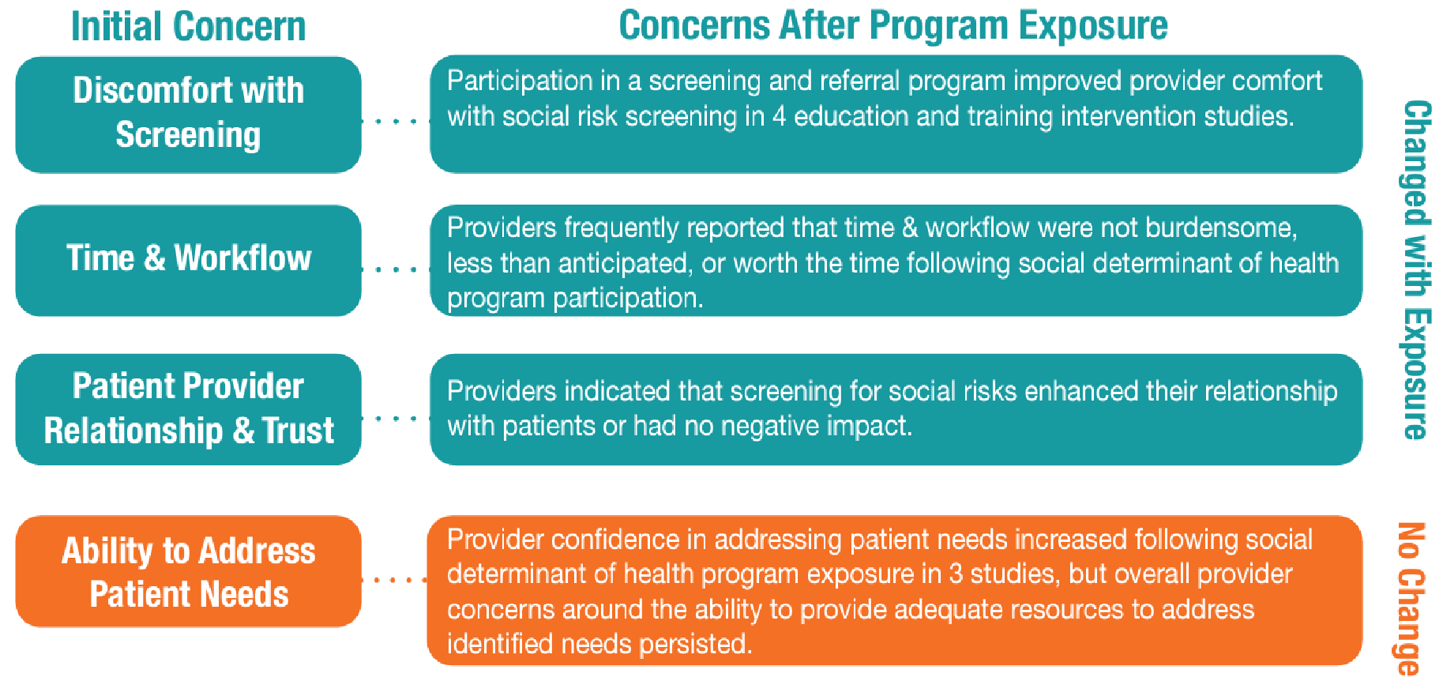
Results: Impact of program exposure on providers’ concerns
In several intervention studies, many provider concerns abated after program exposure.
https://sirenetwork.ucsf.edu/

Slide 12





Summary of key findings
Healthcare professionals and students—e.g. social workers, nurses, advanced practice providers, and physicians—generally believed screening for social needs was acceptable and within their scope of practice.
Few studies included frontline staff (e.g., front desk registration staff), though they were often tasked with administering social screening. Frontline staff perceptions of screening acceptability were mixed.
In real world settings, providers reported that social screening strengthened or had no negative impact on patient-provider relationships.
Participating in a social screening program reduced many perceived implementation barriers to screening, but concerns about the healthcare setting’s capacity to meaningfully address patients’ socioeconomic needs persisted after program exposure.
Health professional education and training initiatives appear to positively impact provider attitudes and behaviors around social screening.
https://sirenetwork.ucsf.edu/

Slide 13
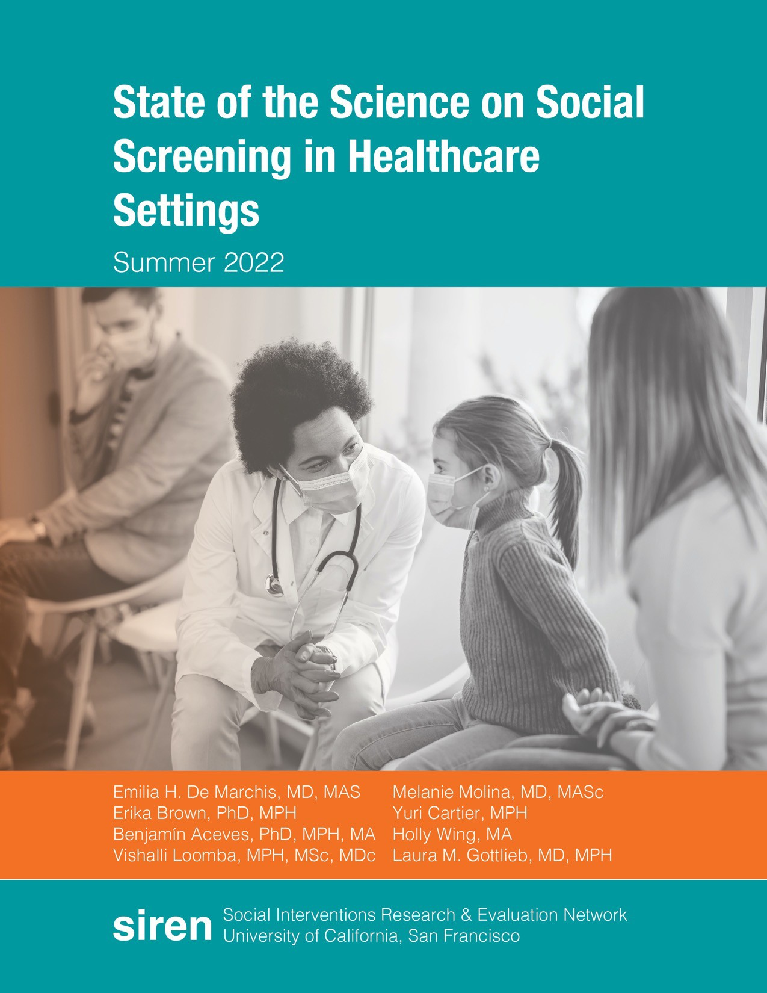
Read the full SCREEN report here.
Questions about this section? Contact: holly.wing@ucsf.edu Laura.gottlieb@ucsf.edu
https://sirenetwork.ucsf.edu/

