Slide 1


How do we put anti-racism into practice in tech-forward SDOH interventions, and what does it mean for the field?
2022 National Research Meeting

Slide 2
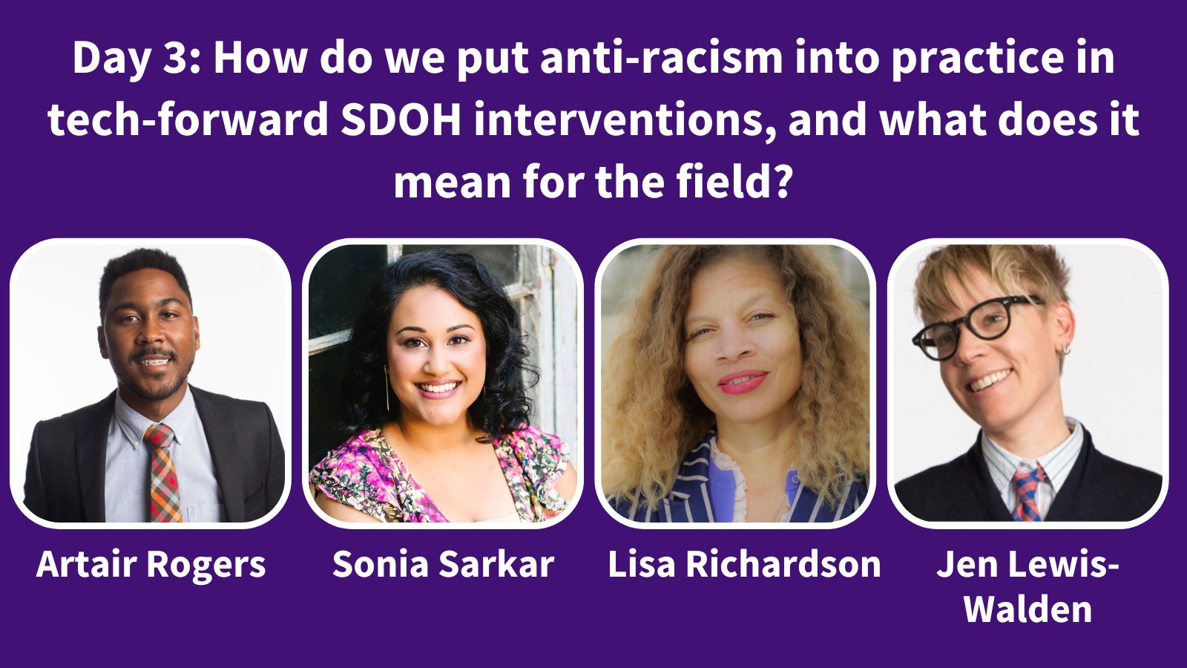
2022 National Research Meeting

Slide 3
Agreements for a safe and brave meeting
Practice active, judgement-free, and empathetic listening
Respect each other’s differences and backgrounds
Agree to disagree – but seek understanding. We are here to learn!
Honor the difference between unsafe and uncomfortable
Be curious about intentions but recognize that impact is more important than intentions
Welcome being called in as a gift and an invitation to learn
Be mindful of positionality and power dynamics
Acknowledge judgments and assumptions (including our own – we all have biases)
Use inclusive language and avoid using derogatory or stigmatizing language
Release control, privilege, and notions of being right
Accept that things may remain unresolved; we might not feel a sense of closure
2022 National Research Meeting
Agreements adapted from Sharon Washington Consulting and those used in the AHRQ Health Equity Summit, as well as internal development

Slide 4
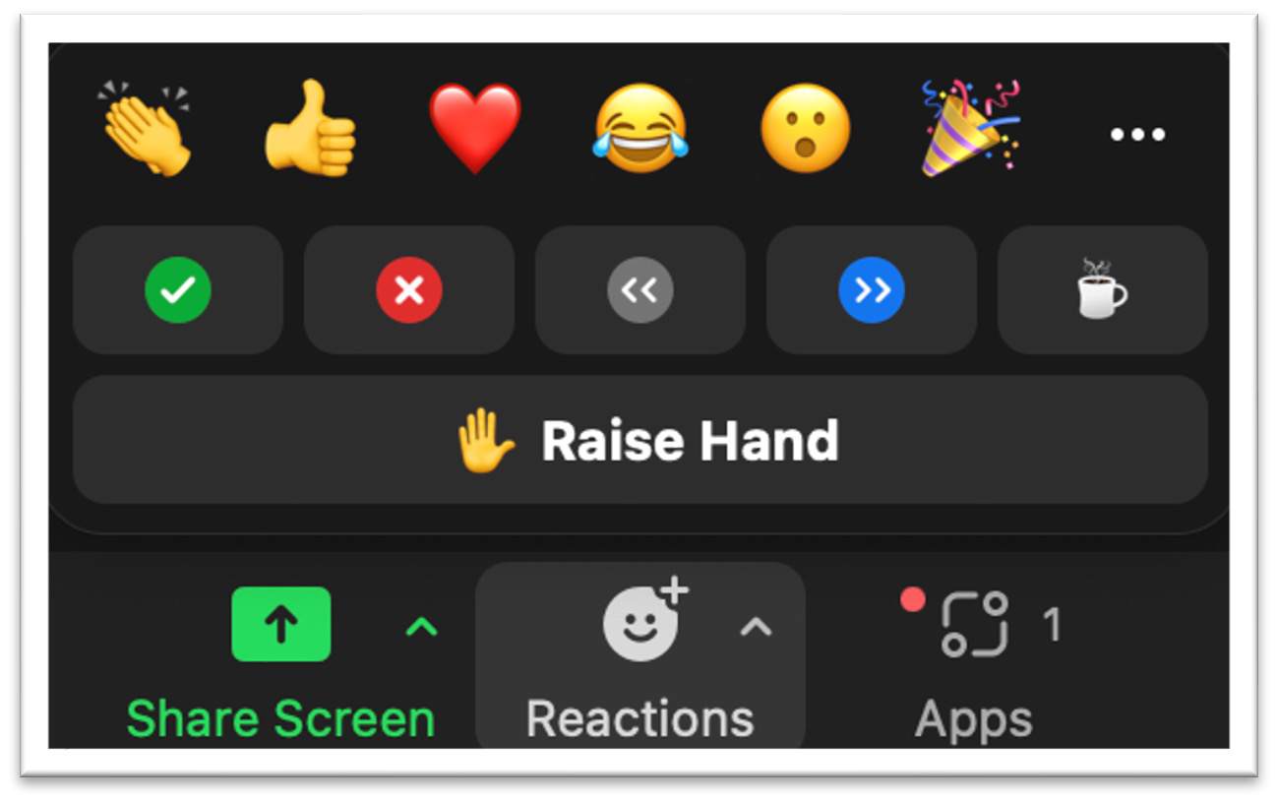




3 Ways to Engage in the Room
Reminder: This session is being recorded. Recordings and slides will be available after the meeting.
2. Emoji Reactions
1. Chat Window
…and on Twitter!
3. Audio and Video
(We encourage you to keep your camera on during the session)
#SIRENRacialEquity @SIREN_UCSF
2022 National Research Meeting

Slide 5
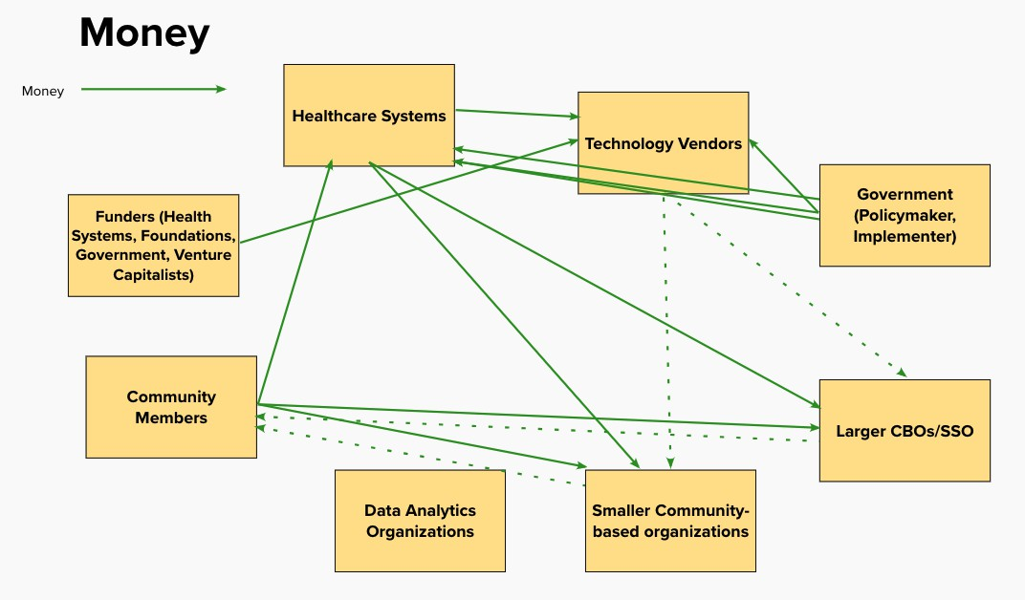
Perception of Tech Forward SDOH Solutions
•
* Special Thanks to Rey Faustino and Stacey Thomas for partnership on this work. Exercise adapted from We All Count framework.
2022 National Research Meeting

Slide 6
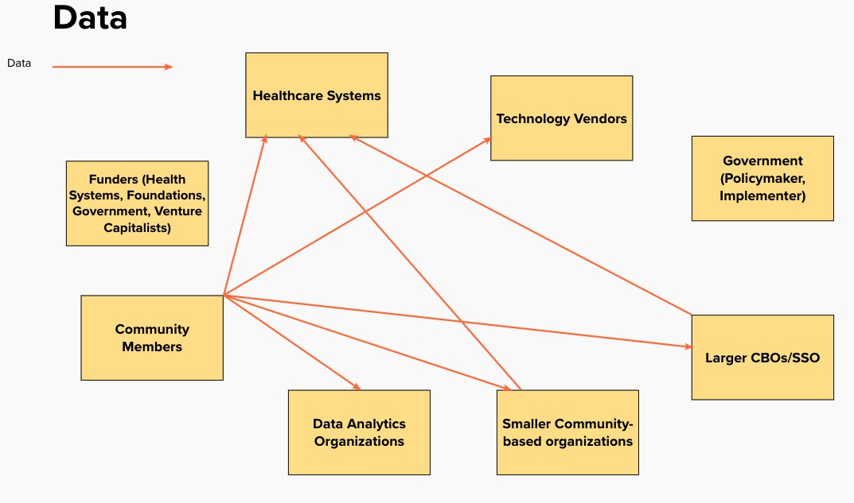
Perception of Tech-Forward SDOH Solutions
* Special Thanks to Rey Faustino and Stacey Thomas for partnership on this work. Exercise adapted from We All Count framework.
2022 National Research Meeting

Slide 7
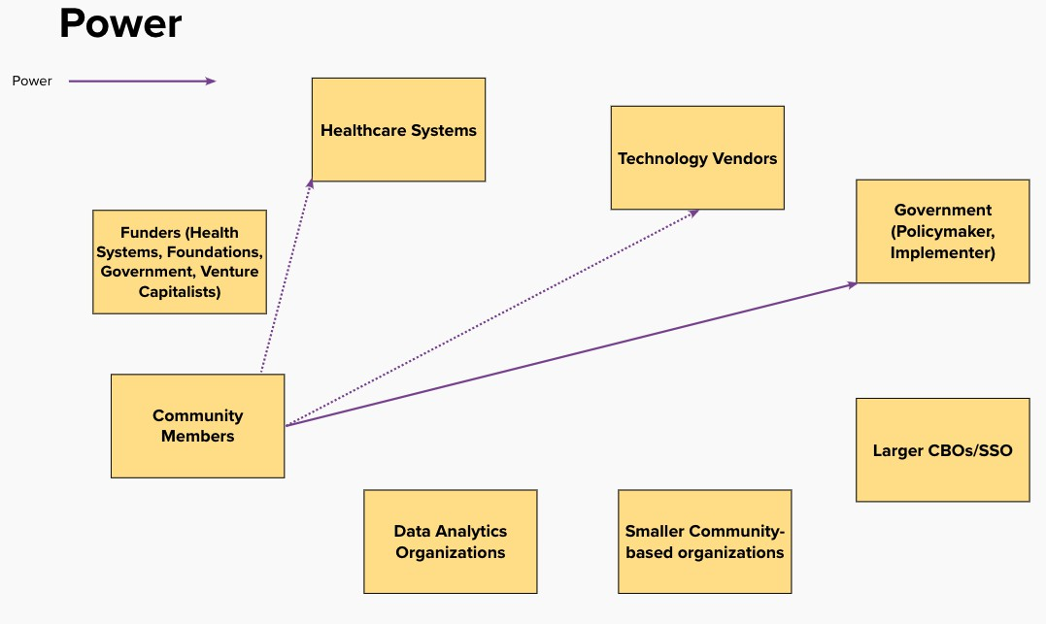
Perception of Tech-Forward SDOH Solutions
* Special Thanks to Rey Faustino and Stacey Thomas
2022 National Research Meeting
for partnership on this work. Exercise adapted from We All Count framework.

Slide 8









Landscape of System Design – Institutional Reflection
Dismantling Unjust Systems
Impacted Community
Equity Empowered
Supporting Client/Community Named Goals and Objectives, Names/Acknowledges Systemic Barriers
Anti-Racism Commitment
Distance
Liberatory Model Eliminating Systemic Barriers, Seeks Justice and Reparations
Deny
Distort
Y₁ Beneficiary of the System
Y₂ Strategy to Address Harm
Do No Harm
Legend
Linear Pathway Limiting Barrier
Anti-Racism Process
Call for Advocacy: Need Massive Overhaul/ Revamping of Oppressive Systems
Savior-Designed Exploits the Oppressed for Secondary Gain
Harm Reduction
Ally-Designed Listens to Feedback to Support Institutional Goals and Objectives
Predatory-Designed Profits from Oppressed
Institution
Passive Ignores the Oppressed
Intentional Harm
Exploitation
Customer Agency
X Impact on Oppressed Community
Community Autonomy
The CIE Data Equity Framework.” CIE San Diego, 16 March 2022, https://ciesandiego.org/data-equity/.
System types partially adapted from the National Institute for Children’s Health Quality.
Chow, R.M. . Phillips, L. Lowery, B.S.. Unzueta, M.M.. Fighting Backlash to Racial Equity Efforts: Understanding the Real Reasons Why Diversity Initiatives Provoke Opposition Can Help You Lead Employees Through https://www.nichq.org/insight/savior-designed-equity-empowered-systems
Cultural Transformation . MIT Sloan Management Review(Summer 2021)

Slide 9
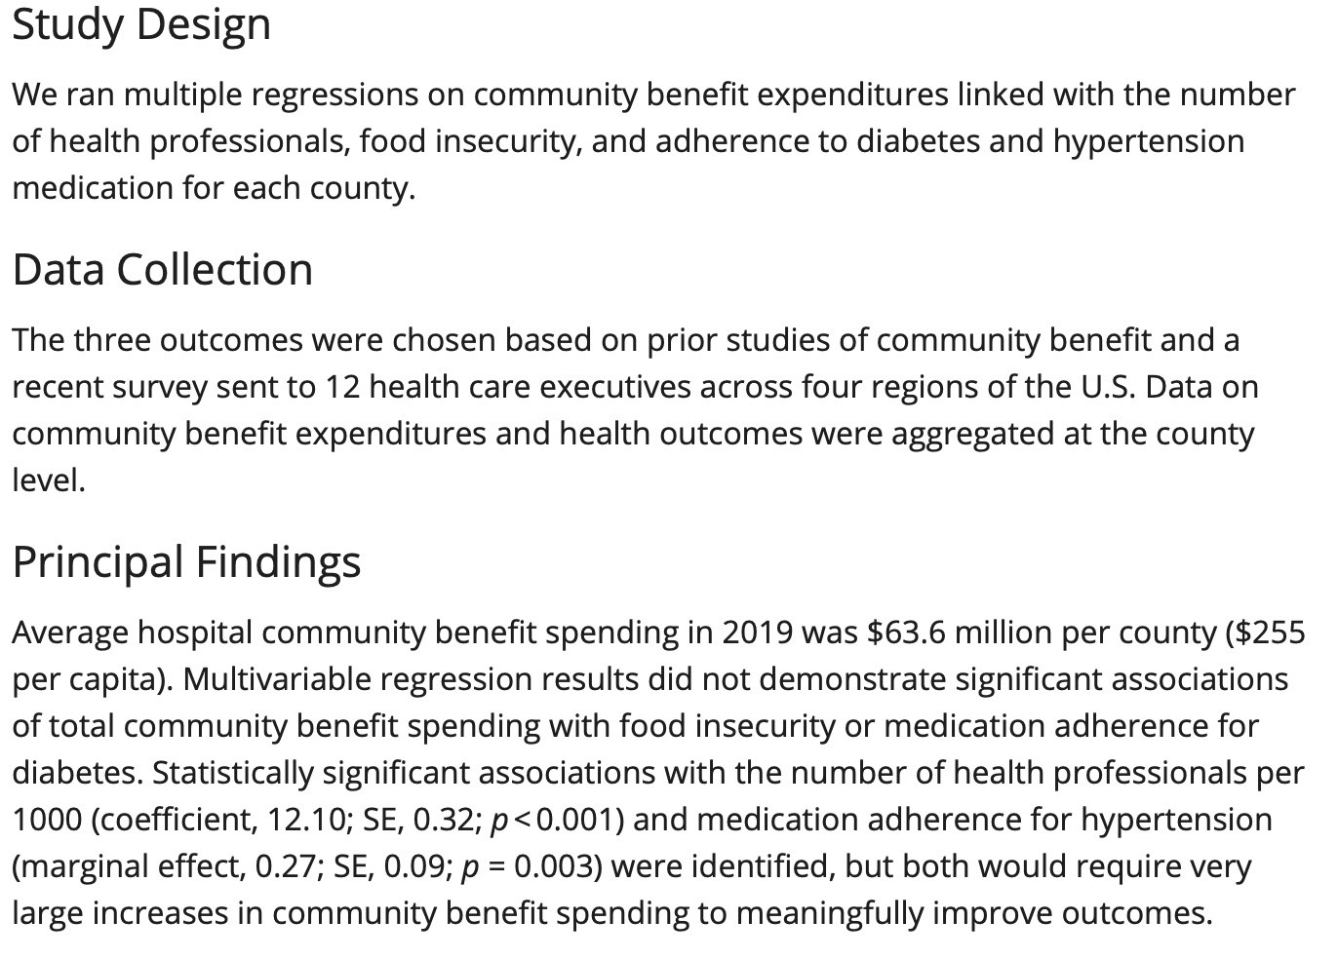
Positivist View of Investment in Addressing Social Needs/Social Determinants of Health
Findings found that community health investment in food security does not yield a statistically significant association with adherence to diabetes and hypertension.
Implications:
Community benefit does not yield ROI desired
within the time dictated by researchers/healthcare leadership.
The investment in food insecurity is questioned due
to lack of statistical association .
Other thoughts:
Who set diabetes and hypertension medication as metric of success? Why?
2022 National Research Meeting

Slide 10
Influx of Investment focused on SDOH
58 Companies
Accountable Health Communities Introduction
$2.4 billion in funding
$18.5 billion valuation (mostly in CA, NY, MA, IL)
SDOH is between 40% to 50% Medicare/Medicaid Cost Structure
2.5 billion dollars of health systems funds are invested in SDOH
5 companies alone have a total valuation between $100 million and $1 billion
Why is funding concentrated in a few companies in a few places?
What does the investment structure say about the SDOH sector landscape?
How does this funding structure correspond with antiracism and equity?
How would community respond to this investment structure?
1 SDOH Technology Company alone has a valuation of $1 billion
Goldberg, Zachary N. and Nash, David B. “For Profit, But
2022 National Research Meeting
Socially Determined: The Rise of the SDOH Industry.”
Population Health Management. 14 October 2021

Slide 11
Moving to a Critical (Antiracism) Lens
Deny
Critical Lens
Generalize from sample to population
Cause/effect
Researcher-focused
Actively interrogates and seeks to transform the social, political, economic forces that create structures that hinder the affected population
Empowerment of the affected population
Distance
Positivist Lens
Distort
2022 National Research Meeting

Slide 12
Institution and/or individual actively or inactively DENIES systemic racism is a significant oppressive force for marginalized communities in SDOH/social needs work.
Structural Racism is not interrogated in SDOH research
Research serves as a gatekeeper to establish the type of evaluation that is important.
ACCOUNTABILITY QUESTIONS
Does work to examine racialized differences in health outcomes explicitly name structural racism as a driver?
Can qualitative data on the lived experience of people most impacted by racism and discrimination improve SDOH work?
How might we use SDOH solutions, including tech-forward ones, to create sound measures of structural racism?
How might we interrogate the positionality of the institution and the institution conducting the research on marginalized communities?
How might we create data narratives that actually highlight the need to invest in marginalized communities and individuals?
How do we ensure that we empower those without formal training who come from marginalized communities (especially folks with lived experience) to be seen and utilized as inquirers and researchers of their own lived experience?
Research serves as a gatekeeper determining what is an effective intervention.
Ignore positionality of institution
Failure to understand and interrogate who profits/benefits from SDOH funding and investment
Ignore positionality of individuals who have power in the SDOH intervention/research
2022 National Research Meeting

Slide 13
The institution and/or individual DISTANCES itself/oneself from the power it has and avoids addressing the power imbalance between those in power and the most affected community.
ACCOUNTABILITY QUESTIONS
Can the perspectives of those most impacted by racism and inequities establish how success is defined and measured?
How might we fully invest in BIPOC-led solutions, including technology? How might technology be framed as a tool for BIPOC leaders to gather data meaningful to the community/community needs?
Is a power analysis incorporated into research and evaluation of SDOH initiatives?
How might the most marginalized shape the research/evaluation agenda and the deliverables of research and evaluation?
How might the community frame and verify the data narrative used in research deliverables, including research journals?
How might we move from framing the community from a deficit framing?
Are you using community based organizations as a proxy for community engagement? How are you reaching the most marginalized? How do you know?
Do institutions and vendors have mechanisms of communicating with, reporting to, and soliciting ideas for improvements from those that the SDOH intervention is intended to serve?
Does not empower affected populations to set research agenda
Research deliverables are set by institutional powers---not affected community
Does not partner and invest in BIPOC-led tech, BIPOC community leaders, and research/evaluation with a critical approach
Community does not play an active role in data narrative
Research narratives characterizes community within a deficit frame if metrics of success are not met
2022 National Res
earch Meeting

Slide 14
Research DISTORTS the value case of SDOH/social needs intervention by prioritizing institutional needs over the most marginalized community.
Implies investment to address impacts of structural racism is not worthwhile due to INSTITUTIONAL OBJECTIVES
Pushes heavily against known/assumed/ implied associations
ACCOUNTABILITY QUESTIONS
Does the data collection process deepen existing harms caused by data surveillance and social service algorithms?
How does this process honor existing community definitions of success and data (oral histories, qualitative data, etc.)?
In what ways are community narratives centered in the design/evaluation of these programs, rather than dominant healthcare institution narratives?
When success defined by the institution is not met, how do we ensure that the evaluation is not used to unintentionally harm the community (i.e. not investing in solutions that address structural racism)?
Are the research products accessible for the community? How can the community, particularly the most marginalized, use the product of the research?
How does the SDOH intervention, evaluation, research facilitate agency for those being studied (the most marginalized)?
Pushes heavily against or dismisses the knowledge of lived expertise of most affected communities
Prioritize data capture for statistical modeling or machine based learning only to characterize marginalized communities
No community verification of data narrative that is created and seeks to be published
Research is used for publication only. There are no research products developed for community use.
2022 National Research Meeting

Slide 15
DISCUSSION QUESTIONS
What narratives or tactics does your organization deploy in the context of SDOH evaluation and research that can be used to DISTORT research aims to institutional priorities over community priorities? What is your role/relationship to those tactics and narratives, and why are they effective?
How are you individually interrogating your positionality and seeking to push back against those narratives and tactics? What are some of the shifts you are leading internally to ensure shared power with community re: evaluation and research?
2022 National Research Meeting

Slide 16
Our Call To DISMANTLE Unjust, Structural Racist Systems
Learning Network Want to Get Involved
Rationale
Feedback from community based leaders that current health equity frames do not enable actual power-sharing.
We would love to invite in this group and other institutions in the sector to investigating their own roles and co-developing accountability standards.
The Work
This network seeks to develop actual standards around healthcare accountability by engaging in political education with healthcare leaders and centering community leader expertise, then executing on actual power-shifting projects
Convening in early 2023
Email Artair Rogers (arogers@g.harvard.edu) or Sonia Sarkar (sar.sonia@gmail.com) for more information.
2022 National Research Meeting

