Slide 1
Impact of experiences of discrimination on self-efficacy among parents and other primary caregivers of hospitalized children: possible implications for downstream food insecurity interventions
Nate Glasser, MD MPP, Research Fellow/Clinical Instructor of Internal Medicine & Pediatrics
University of Chicago, Section of General Internal Medicine
SIREN National Research Meeting, Sept 15, 2022

Slide 2
Disclosures
I have no conflicts of interest
Research reported in this presentation was supported by the National Institute on Minority Health and Health Disparities under award number: RO1MD012630-04 (ST Lindau, PI) and the Health Resources & Services Administration under a Ruth L. Kirschstein National Research Service Institutional Research Training Grant under award number: T32-HP42019 (N Laiteerapong PI)
The content is solely the responsibility of the authors and does not necessarily represent the official views of the National Institutes of Health.

Slide 3
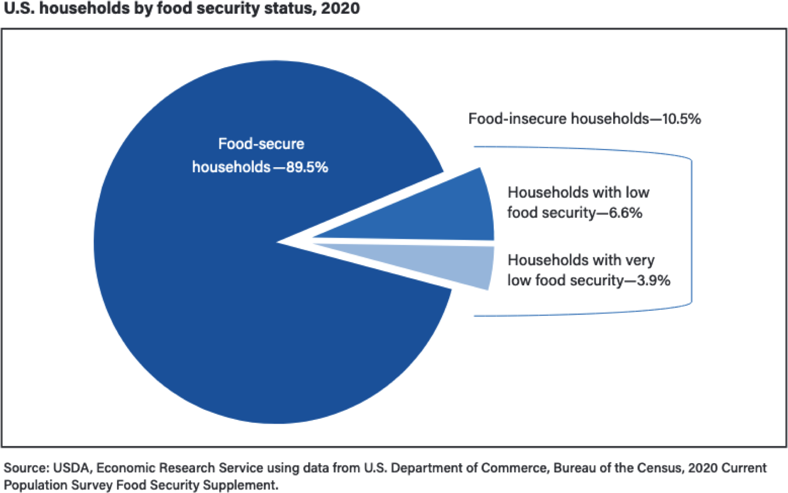
Background: food Insecurity
Definition:
limited or uncertain access to nutritious, healthy food.
Prevalence
  > 10% of American households¹
Relationship between FI and Health² ⁻ ⁴
  Children who experience FI have higher rates of:
    Developmental problems
    Hospitalization
    ED utilization
    Poor overall health
  In adults, FI linked to⁵⁻⁸
    Mental health outcomes (anxiety, depression)
    Diet sensitive disease states (diabetes,
HTN, HLD)
    Poor overall health
    Impaired self care
1.
2.
3.
4.
5.
6.
7.
8.
Coleman-Jensen et a, USDA, 2021 Gundersen et al. Health Affairs, 2015 Jyoti et al. The Journal of Nutrition, 2005 Ryu et al. AJPH, 2012
Whitaker et al. Pediatrics, 2006 Seligman et al. JGIM, 2007
Seligman et al. The Journal of Nutrition 2010
Seligman et al. Journal of Health Care for Poor and Underserved 2010
3

Slide 4
Background: prior scholarship on food insecurity and discrimination:
Fig 1 Stigma and Food Inequity Conceptual Framework (adapted from Earnshaw and Karpyn)
Moderating Contextual Factors: History Culture Human Development
Poverty SNAP WIC
National School Lunch
Structural
Food policy Targeted marketing
Neighborhood infrastructure School food environment
Access to resources
Food availability, quality, visibility, exposure, transportation
Diet quality Food insecurity
Perceiver Stereotypes Prejudice discrimination
Home food environment
Food availability, quality, visibility, portion sizes,
Intersectional Race/ethnicity Nationality Gender Weight status Other
Psychological/behavioral Processes
Stress and coping Resistance
In-group Identity Management
Target
Enacted stigma Anticipated stigma Stereotype threat Internalized stigma
Earnshaw and Karpyn, Translational Behavioral Medicine, 2020
Hatzenbuehler et al. AJPH, 2013
Burke et al. Ethnicity & Health, 2018
Chisolm. Nursing Research. 2021
Phojanakong et al , IJERPH. 2019
4

Slide 5

B ackground: self-efficacy
“Beliefs in one's capabilities to organize and execute the course of action required to produce given attainments.” - Albert Bandura¹⁴
Four sources¹⁵:
Mastery experiences
Vicarious experiences (seeing some who looks like you having
mastery experiences)
Social/verbal persuasion (i.e. encouragement)
Emotional States (i.e. degree of stress, anxiety, etc.)
Associated outcomes:
Medication adherence¹⁶
Cigarette smoking cessation¹⁷
Physical activity and exercise¹⁸
Adherence with prescribed dietary patterns^{19, 20}
Glycemic and metabolic control in patients with iIDDM²¹
ART adherence, independent of cognitive, personal , and
environmental factors such as depressive symptoms and physical limitations²²
Bandura, et al.. 1999
Bandura and Wessels. Self-Efficacy, 1994
Richardson et al. Ethnicity and disease 2014
Speck and Harrell Journal of Cardiovascular Nursing 2003
Schutzer et al. Preventive Medicine 2004
Grossman et al. Diabetes Care. 1987
Alexander et al. Drug and alcohol dependence, 2019 22. Nokes et al. Journal of Nursing Scholarship 2012 5
Resnick Journal of gerontological nursing. 2002

Slide 6
Coping /Self-Management
Experiences of everyday discrimination
General Self-Efficacy
Experiences of discrimination during hospitalization
Self-Efficacy for Finding Resources
Improved Vs. Decreased Health
Fig.1 Conceptual model of relationship between experiences of discrimination, types of self-efficacy, and downstream health behaviors/outcomes

Slide 7

Methods: Setting & Participants
Setting:
  Children’s hospital in South Side of Chicago (155 bed)
  53% of families in service area live below the federal poverty level
  5,300 annual admissions
Participants:
  Parents/caregivers (n = 244) of hospitalized children (< 18
years old), enrolled to the control arm of an ongoing RCT
  Enrolled between November 2020, and April, 2022

Slide 8
Methods: measures & analyses
Exposure Variables
Community-based experiences of discrimination, using the Experiences of Discrimination Scale (baseline)
Hospital-based discrimination, using the Discrimination in Medical Settings Scale (7-days)
Outcomes
General self-efficacy (Likert scale, 10-40)
Self-efficacy for finding resources (Likert Scale, 1-5)
Baseline Food Insecurity:
Classified as secure, marginal, and insecure based on responses to the 18-item USDDA Household Food Security Survey (baseline)
Covariates
gender, race/ethnicity, income, & relationship status (partnered versus un-partnered)
Analysis
Average frequencies and percentage of people reporting experiences of community- and hospital-based discrimination were compared between participants, reporting secure, marginal, and insecure food insecurity status using chi-square tests
Associations between self-efficacy (general and for finding resources) and each type of discrimination (community- and hospital-based
modeled, using multivariate regression, adjusting for covariates

Slide 9
Hypothesis
Hypothesis 1: People with higher levels of food insecurity will report more frequent experiences of community- and hospital-based discrimination and more people with higher levels of food insecurity will report experiences of discrimination.
Hypothesis 2: More frequent experiences of discrimination will be associated with lower self-efficacy (both in general and for finding resources), adjusting for age, sex, race/ethnicity, income, and marital status

Slide 10
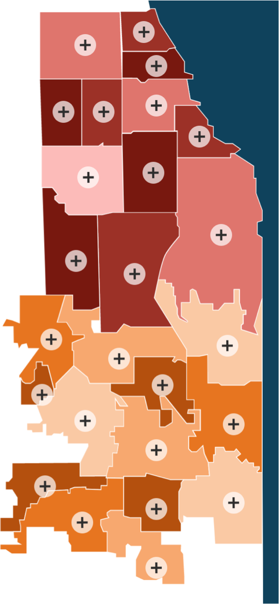
Results: baseline, demographic characteristics of sample
Age:
Average age 35 (SD 9.0)
Education
20% college grad
41% some college or technical school
28% HS grads
11% less than HS Gender:
94% identified as female, the rest as male Race:
80% of sample was Black/African American Employment
55% were employed
43% unemployed Relationship status
53% described themselves as partnered (either married or in a relationship)
47% were un-partnered

Slide 11
Results: baseline, demographic characteristics of sample with significant differences between food security groups
Insurance status:
Higher rates of Medicare/Medicaid among food insecure, though interestingly highest among marginally food insecure
Annual income:
Income < $50k more common among those who were food insecure or marginally food insecure
 | Total | Secure | Marginal | Insecure | p- valu e
Insurance Status |  |  |  |  | 0.0
Private | 25% | 31% | 5.6% | 22%
Medicare/Medicaid | 74% | 68% | 91% | 78 %
Other | 0% | 0% | 3% | 0%
Missing | 0% | 0% | 0% | 0%
Annual income |  |  |  |  | 0.0
<= $50k | 83% | 77% | 92% | 92%
>50K | 14% | 19% | 6% | 6%
missing | 3% | 4% | 3% | 2%

Slide 12
Results: experiences of discrimination by food security status
Average reported frequency of discrimination
Statistically significant difference in Hospital-based and community-based
insecure> marginal > secure
% of Population reporting at least some experience of discrimination
Statistically significant difference in Community-based discrimination
insecure> marginal > secure
 | Total | Secure | Marginal | Insecure | p-value
Freq of discrimination experiences, Mean (SD)
Hospital-based Mean (SD) | 10 (4.5) | 9(3.9) | 11 (4.3) | 12(5.8) | 0.04
Community-based Mean (SD) | 9 (8.7) | 7(7.7) | 11 (8.1) | 13 (9.6) | 0.0
Discrimination experiences (%)
Hospital-based | 56 | 51 | 64 | 64 | 0.12
Community-based | 79 | 70 | 89 | 92 | 0.0

Slide 13
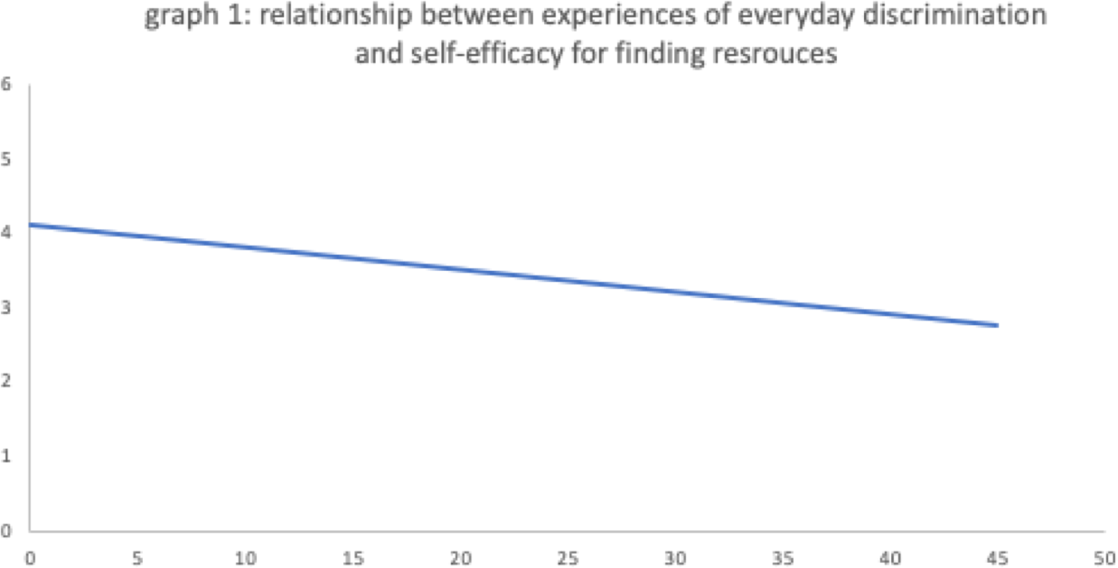
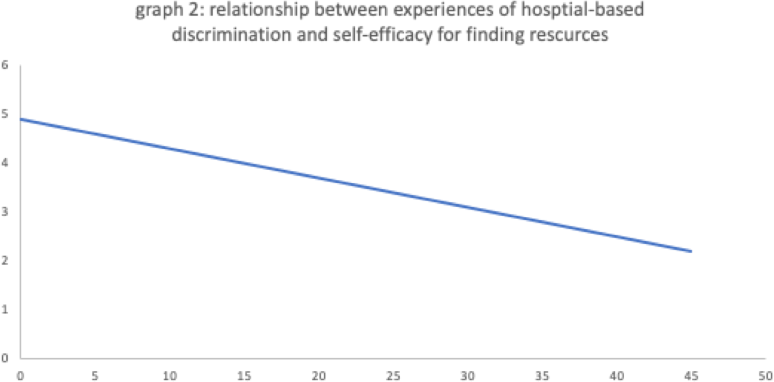
Results: associations between experiences of discrimination and self-efficacy
Self-efficacy for finding resources
Self-efficacy for finding resources
Frequency of self-reported experiences of everyday discrimination
Frequency of self-reported experiences of hospital-based discrimination
Community-Based: β = - 0.03, 95% CI -0.05 - -0.02, p < 0.01
Hospital-based: β = - 0.06, 95% CI -0.09 – 0.03 p < 0.01
Also negatively associated with general self-efficacy, but these results were non-significant:
o Community-based: β = - 2.9, 95% CI -7.4- 1.5, p < 0.2
o Hospital-based: β = - 1.4, 95% CI -5.3 – 2.6, p = 0.50

Slide 14
Conclusion/limitations/next steps
Hypothesis 1: Consistent with prior research we find that experiences of discrimination are more common among those with higher levels of food insecurity
Hypothesis 2: Experiences of discrimination appear to be associated with decreased self-efficacy, in general (non-significant) and for finding community resources (significant).
Associations appeared to be independent of respondents’ age, race, ethnicity, income, or marital status.
Limitations
Temporal dimension of the survey design, where experiences of hospital discrimination and self-efficacy were queried one week following discharge, suggests possible directionality to the relationship, there is no way to make a causal attribution between experiences of discrimination and decreased self-efficacy
Models also do not control for baseline reports of discrimination, which might help isolate, impact of new experiences of hospital discrimination Next Steps
Further data presently becoming available will allow us to expand our analysis to involve possible associations with actual downstream behaviors
such as utilization of community resources, enrollment in SNAP/WIC; and follow-up with medical recommendations
Focus on self-efficacy as link on causal pathway suggests possible future interventions

Slide 15
Acknowledgements
Stacy Lindau, MD, MAPP
Jacob Jameson, MS
Victoria Winslow, MPH
Emily Abramsohn, MPH
Jyotsna S. Jagai, PhD, MPH, MS
Neda Laiteerapong, MD, MS

Slide 16
References
1.
Coleman-Jensen A, Rabbitt MP, Gregory CA, Singh A. Household Food Security in the United States in 2020. Economic Research Report No. (ERR-298) 55 pp: Economic Research Service, U.S. Department of Agriculture; 2021
Gundersen C, Ziliak JP. Food insecurity and health outcomes. Health affairs 2015;34(11):1830-1839.
Jyoti DF, Frongillo EA, Jones SJ. Food insecurity affects school children's academic performance, weight gain, and social skills. The Journal of nutrition 2005;135(12):2831-2839.
Ryu J-H, Bartfeld JS. Household food insecurity during childhood and subsequent health status: the early childhood longitudinal study—kindergarten cohort. American Journal of Public Health
2012;102(11):e50-e55.
Whitaker RC, Phillips SM, Orzol SM. Food insecurity and the risks of depression and anxiety in mothers and behavior problems in their preschool-aged children. Pediatrics 2006;118(3):e859-e868. Seligman HK, Bindman AB, Vittinghoff E, Kanaya AM, Kushel MB. Food insecurity is associated with diabetes mellitus: results from the National Health Examination and Nutrition Examination Survey (NHANES) 1999–2002. Journal of general internal medicine 2007;22(7):1018-1023.
Seligman HK, Laraia BA, Kushel MB. Food insecurity is associated with chronic disease among low-income NHANES participants. The Journal of nutrition 2010;140(2):304-310.
Seligman HK, Davis TC, Schillinger D, Wolf MS. Food insecurity is associated with hypoglycemia and poor diabetes self-management in a low-income sample with diabetes. Journal of health care for
the poor and underserved 2010;21(4):1227.
Earnshaw VA, Karpyn A. Understanding stigma and food inequity: a conceptual framework to inform research, intervention, and policy. Translational Behavioral Medicine. 2020;10(6):1350-1357.
doi:10.1093/tbm/ibaa087
Hatzenbuehler ML, Phelan JC, Link BG. Stigma as a Fundamental Cause of Population Health Inequalities. Am J Public Health. 2013;103(5):813-821. doi:10.2105/AJPH.2012.301069
Burke MP, Jones SJ, Frongillo EA, Fram MS, Blake CE, Freedman DA. Severity of household food insecurity and lifetime racial discrimination among African-American households in South Carolina.
Ethnicity & Health. 2018;23(3):276-292. doi:10.1080/13557858.2016.1263286
Chisolm DJ, Bell BA, Yamoah O, Freedman DA. Racialized Experiences Differentiate Food Security Among African American Adults. Nursing Research. 2021;Publish Ahead of Print.
doi:10.1097/NNR.0000000000000533
Phojanakong P, Brown Weida E, Grimaldi G, Lê-Scherban F, Chilton M. Experiences of Racial and Ethnic Discrimination Are Associated with Food Insecurity and Poor Health. IJERPH. 2019;16(22):4369. doi:10.3390/ijerph16224369
Bandura, A., Freeman, W. H., & Lightsey, R. (1999). Self-efficacy: The exercise of control.
Bandura, A., & Wessels, S. (1994). Self-efficacy (Vol. 4, pp. 71-81). na.
Richardson, Michael P., et al. "Weight-based discrimination and medication adherence among low-income African Americans with hypertension: how much of the association is mediated by self-efficacy?." Ethnicity & disease 24.2 (2014): 162-168.
Alexander, Adam C., et al. "Everyday discrimination indirectly influences smoking cessation through post-quit self-efficacy." Drug and alcohol dependence 198 (2019): 63-69.
Resnick, B. (2002). Testing the effect of the WALC intervention on exercise adherence in older adults. Journal of gerontological nursing, 28(6), 40-49.
Speck, B. J., & Harrell, J. S. (2003). Maintaining regular physical activity in women: Evidence to date. Journal of Cardiovascular Nursing, 18(4), 282–291; quiz 292–283.
Schutzer, K. A., & Graves, B. S. (2004). Barriers and motivations to exercise in older adults. Preventive Medicine, 39(5), 1056–1061
Grossman, H. Y., Brink, S., & Hauser, S. T. (1987). Self-efficacy in adolescent girls and boys with insulin-dependent diabetes mellitus. Diabetes care, 10(3), 324-329.
Nokes, K., Johnson, M. O., Webel, A., Rose, C. D., Phillips, J. C., Sullivan, K., ... & Holzemer, W. L. (2012). Focus on increasing treatment self-efficacy to improve human immunodeficiency virus
treatment adherence. Journal of Nursing Scholarship, 44(4), 403-410.
2.
3.
4.
5.
6.
7.
8.
9.

Slide 17
Appendix: baseline demographic characteristics
Table 1: Characteristics of 244 Survey Respondents
 | Total | Secure | Marginal | Insecure | p-value
 | N =244 | N=144 | N=36 | N=64
Age | 35.0 (9.1) | 35 (9.6) | 34.2 (9.6) | 36.0 (7.7) | 0.6
Education |  |  |  |  | 0.1
Less than HS | 11% | 8% | 16% | 16%
HS grad or GED | 28% | 29% | 33% | 23%
Some college/technical school | 41% | 38% | 42% | 45%
College graduate | 20% | 25% | 8% | 16%
Insurance Status |  |  |  |  | 0.0
Private | 25% | 31% | 5.6% | 22%
Medicare/Medicaid | 74% | 68% | 91% | 78 %
Other | 0% | 0% | 3% | 0%
Missing | 0% | 0% | 0% | 0%
Gender |  |  |  |  | 0.8
Male | 6% | 7% | 6% | 5%
Female | 94% | 93% | 94% | 95%
Ethnicity (self-identified) |  |  |  |  | 0.2
Hispanic, Latino/a/x, or of Spanish origin | 10% | 9% | 11% | 13%
Non-Hispanic, Latino/a/x, or of Spanish origin | 3% | 1% | 8% | 3%
Missing | 87% | 90% | 81% | 84% | 17

Slide 18
Appendix: baseline demographic characteristics
Table 1: continued
 | Total | Secure | Marginal | Insecure | p-value
Race (self-identified) |  |  |  |  | 0.8
White | 11% | 13% | 6% | 9%
Black or African American | 80% | 80% | 81% | 81%
Other | 9% | 7% | 11% | 9%
Missing | 0% | 0% | 3% | 0%
Relationship Status |  |  |  |  | 0.5
Partnered | 53% | 55% | 56% | 57%
Un-partnered | 47% | 45% | 44% | 53%
Annual income |  |  |  |  | 0.0
<= $50k | 83% | 77% | 92% | 92%
>50K | 14% | 19% | 6% | 6%
missing | 3% | 4% | 3% | 2%
Employment Status |  |  |  |  | 0.1
Employed | 55% | 58% | 36% | 58%
Unemployed | 43% | 40% | 58% | 39%
Missing | 3% | 2% | 6% | 3%
Discrimination experiences (Mean Score)
Hospital-based Mean (SD) | 10 (4.5) | 9(3.9) | 11 (4.3) | 12(5.8) | 0.04
Community-based Mean (SD) | 9 (8.7) | 7(7.7) | 11 (8.1) | 13 (9.6) | 0.0
Discrimination experiences (% of pop reporting)
Hospital-based | 56.1% | 50.7% | 63.9% | 64.1% | 0.12
Community-based | 79.1% | 70.1% | 88.9% | 92.2% | 0.0
18

