Slide 1



Measuring Structural Racism
Tongtan (Bert) Chantarat, PhD, MPH
Research Scientist
Center for Antiracism Research for Health Equity
@bertchantarat

Slide 2
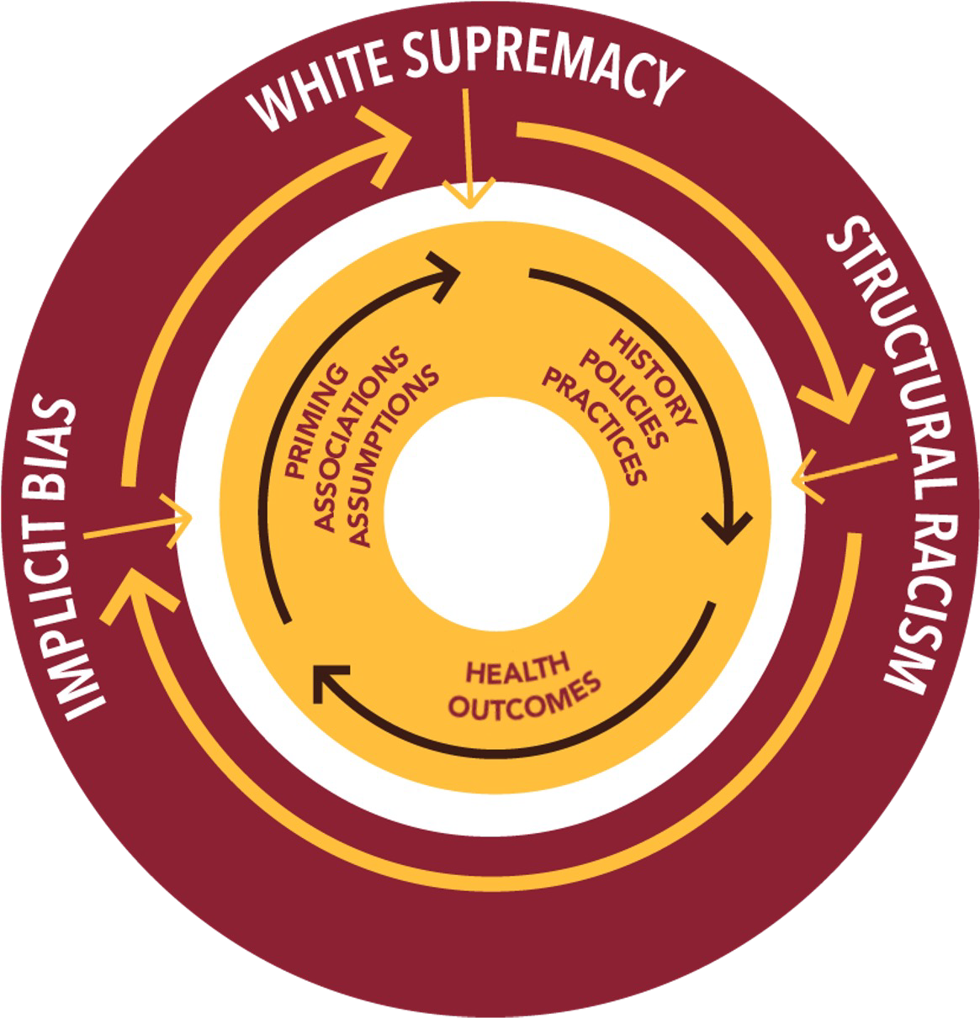
Structural racism is
“the totality of ways in which societies foster racial discrimination, through mutually reinforcing inequitable systems (in housing, education, employment, earnings, benefits, credit, media, health care, criminal justice, and so on) that in turn reinforce discriminatory beliefs, values, and the distribution of resources, which together affect the risk of adverse health outcomes.”
Source: Bailey ZD, Krieger N, Agénor M, Graves J, Linos N, Bassett MT. Structural racism and health inequities in the USA: evidence and interventions. The Lancet. 2017. 389(10077), 1453-1463.

Slide 3
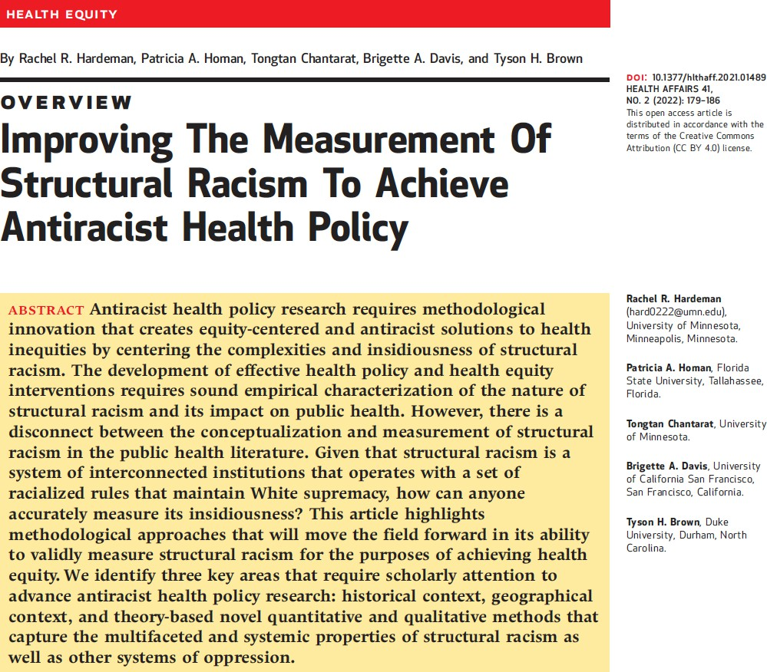
“We cannot change what we cannot measure.”

Slide 4
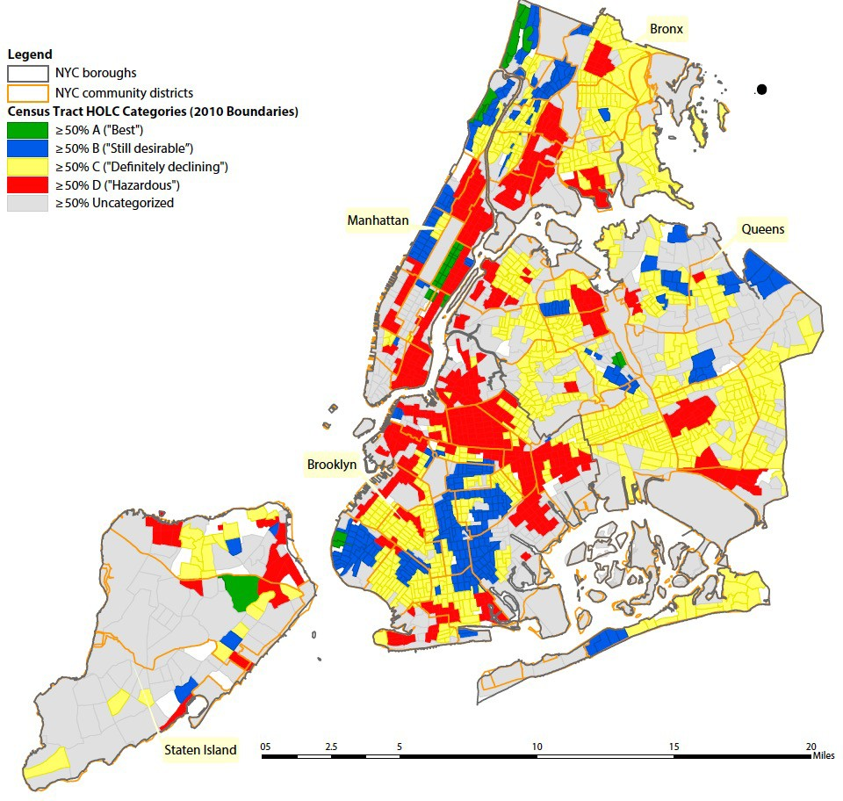
Residential Segregation
Source: Krieger et al. Structural Racism, Historical Redlining, and the Risk of Preterm Birth in New York City, 2013-2017. Am J Public Health. 2020. 110(7): 1046-1053.
5

Slide 5
From Residential Segregation…
“Totality of ways in which societies foster racial discrimination through mutually reinforcing systems of housing, education, employment, earnings, benefits, credit, media, health care, and criminal justice. These patterns and practices in turn reinforce discriminatory beliefs, values, and the distribution of resources.” (Bailey et al. 2017)
Going beyond neighborhoods
Environmental/Area-based exposures to structural racism
  Weathering hypothesis (Geronimus 1992)
  Ecosocial theory (Krieger 1994)

Slide 6
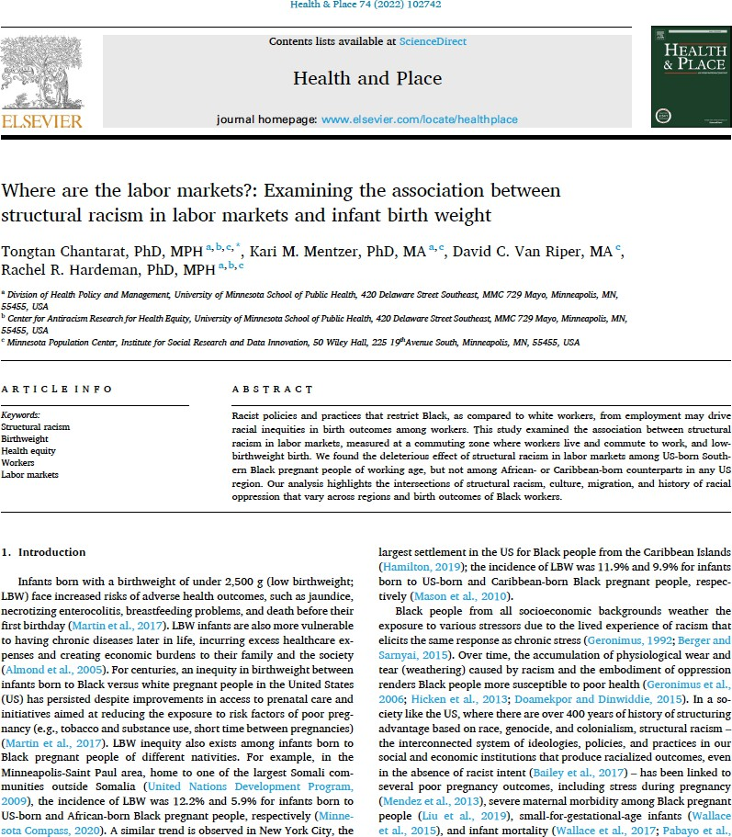
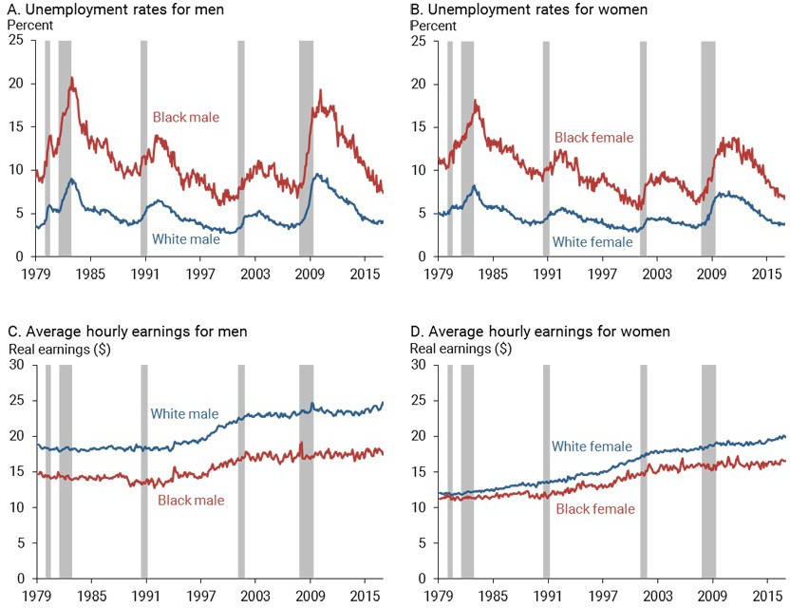
Source: Federal Reserve Bank of Minneapolis

Slide 7
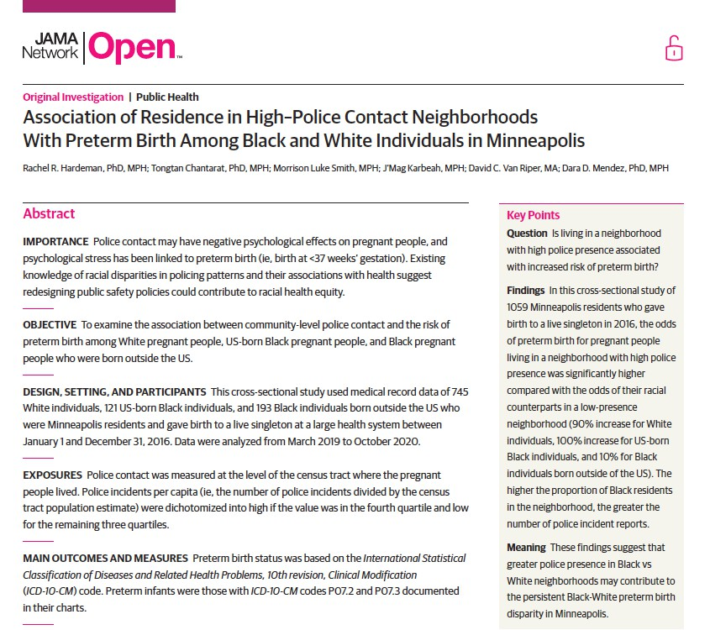
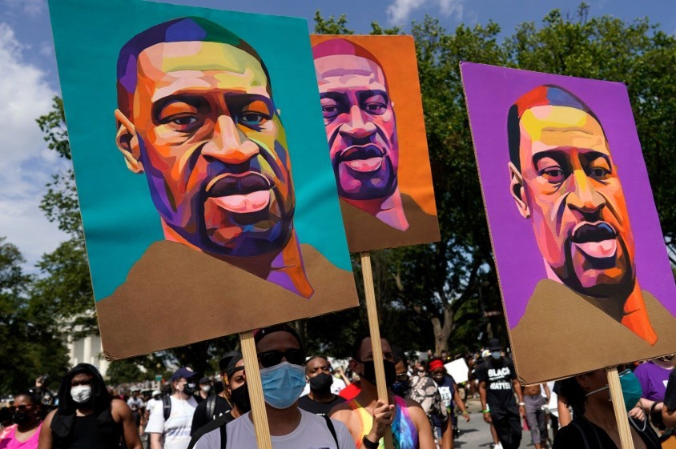
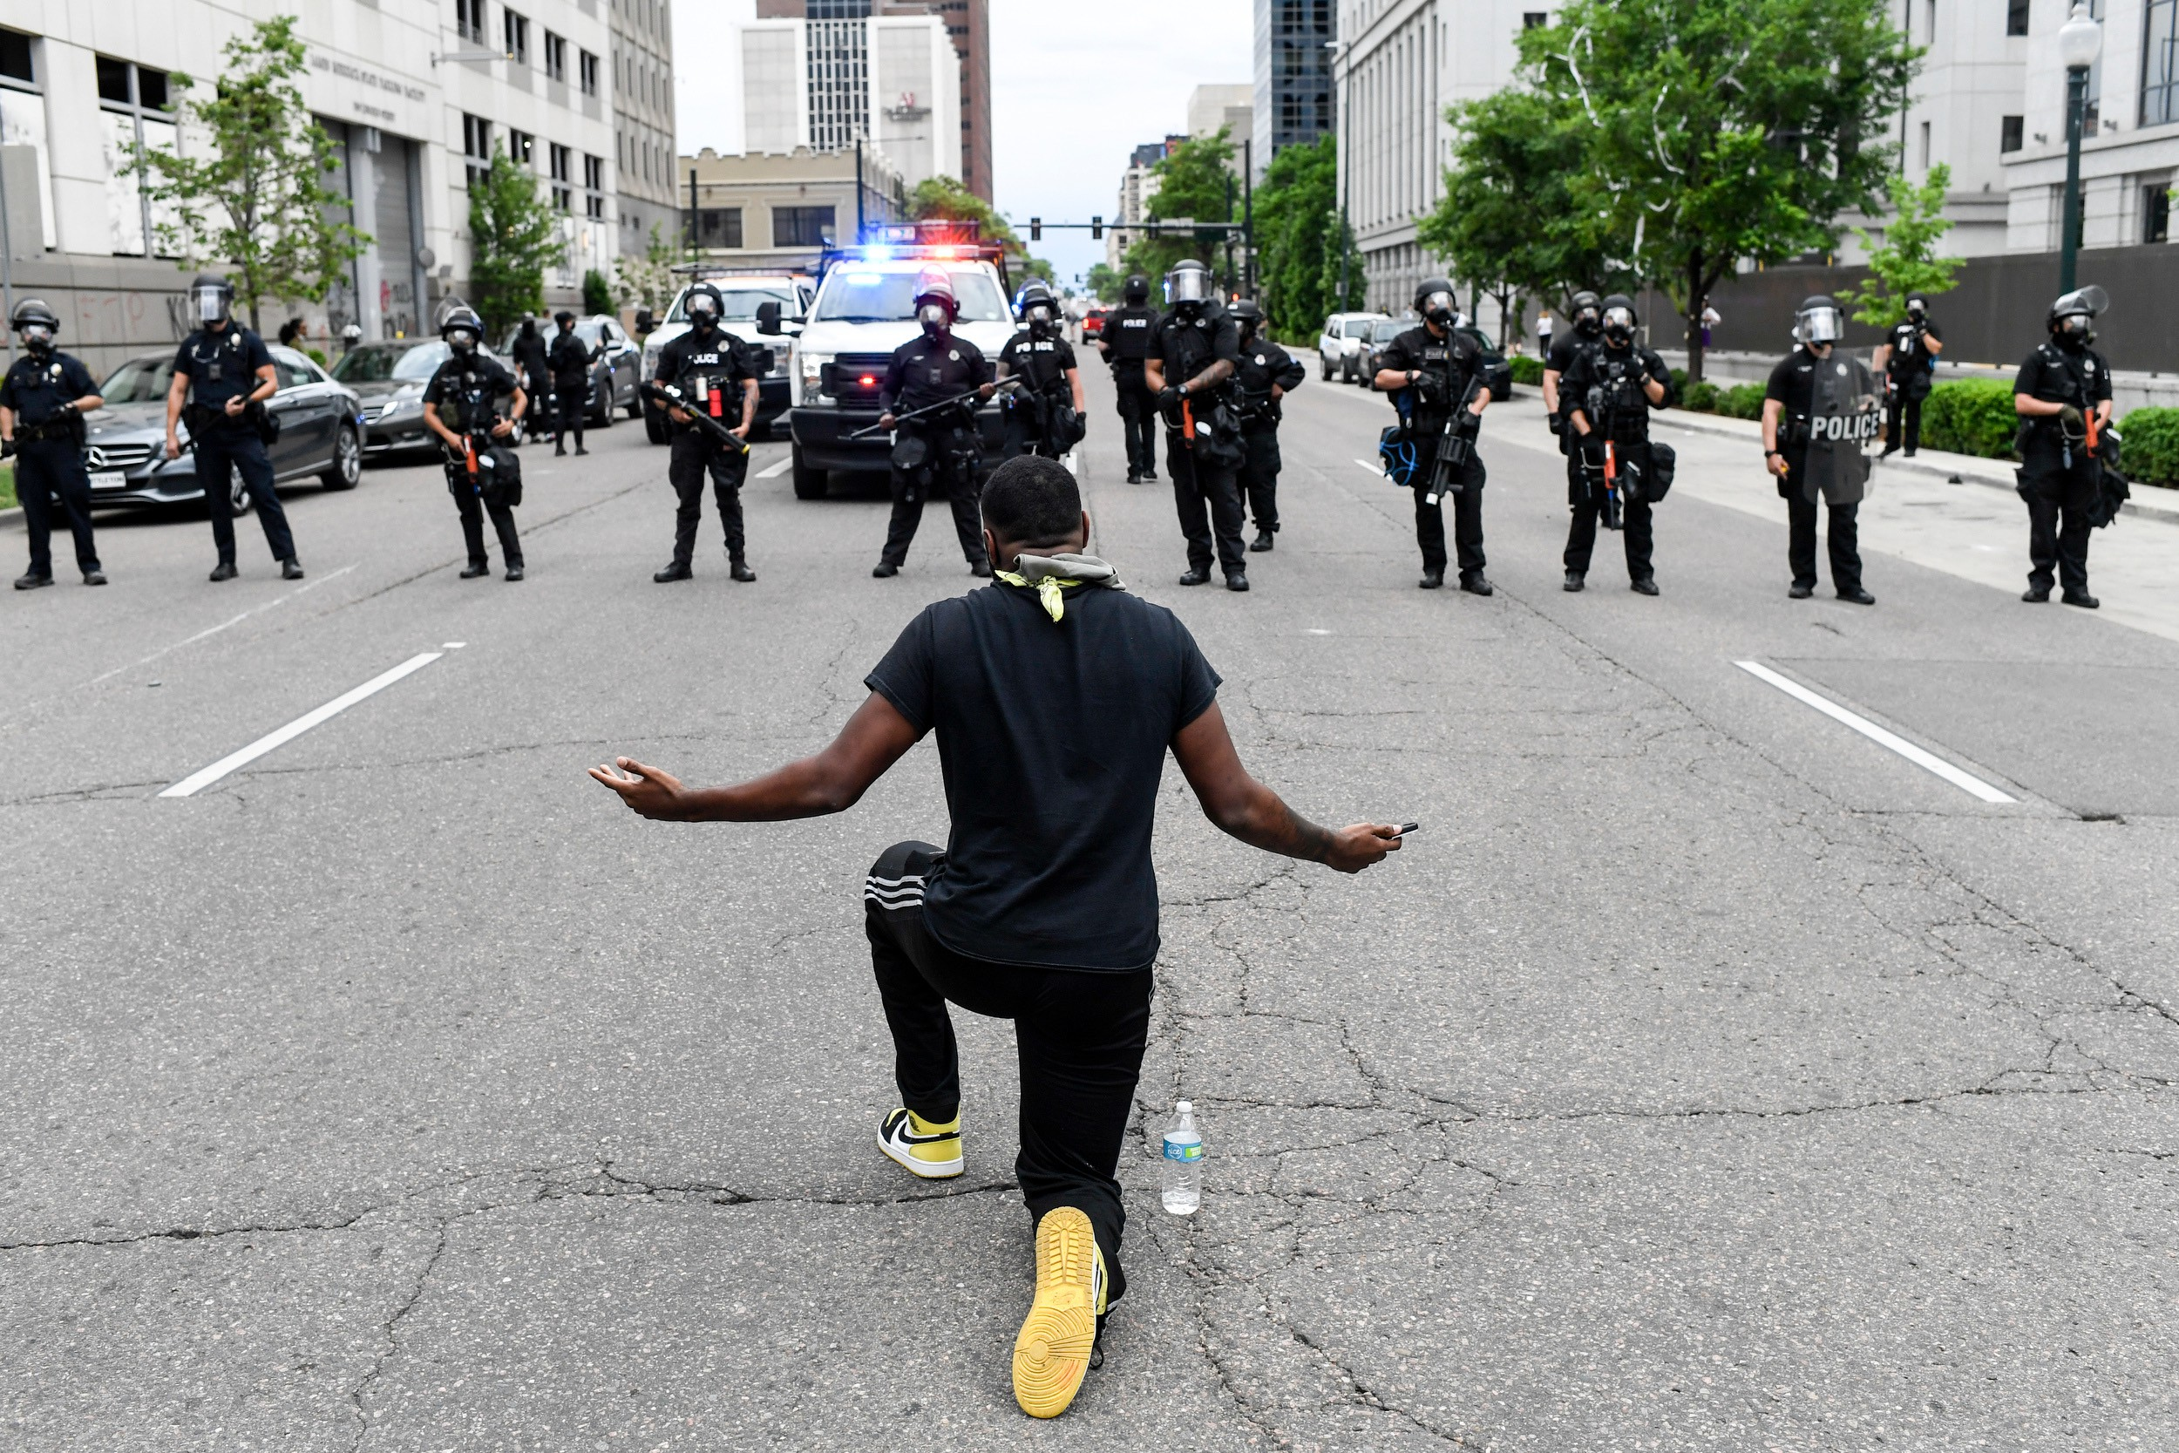
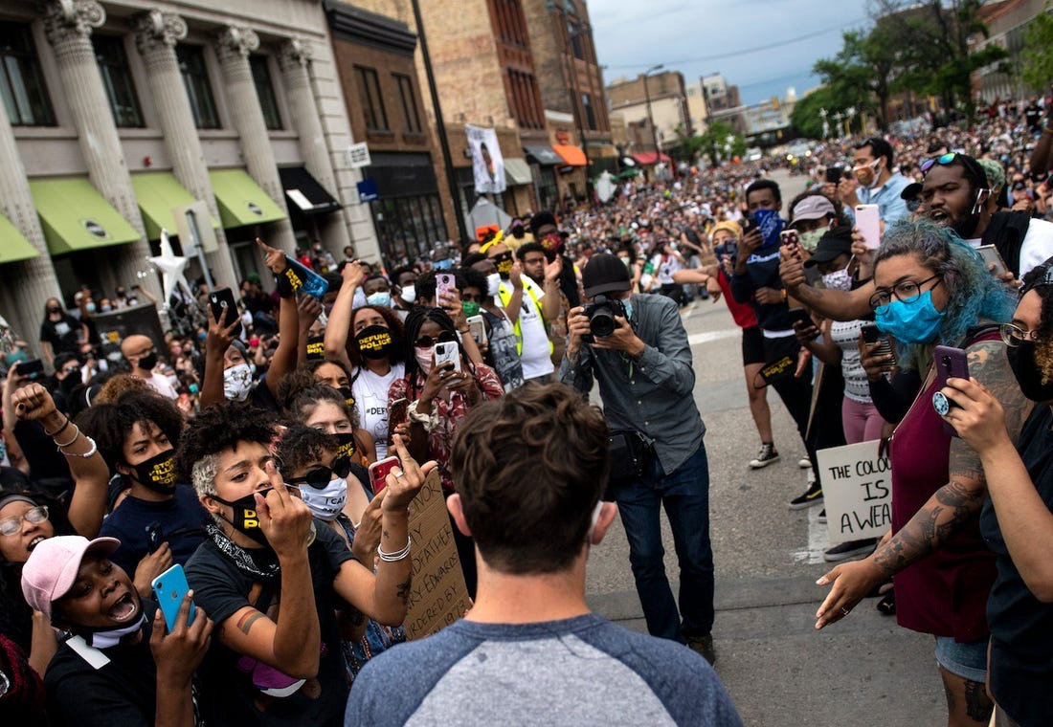
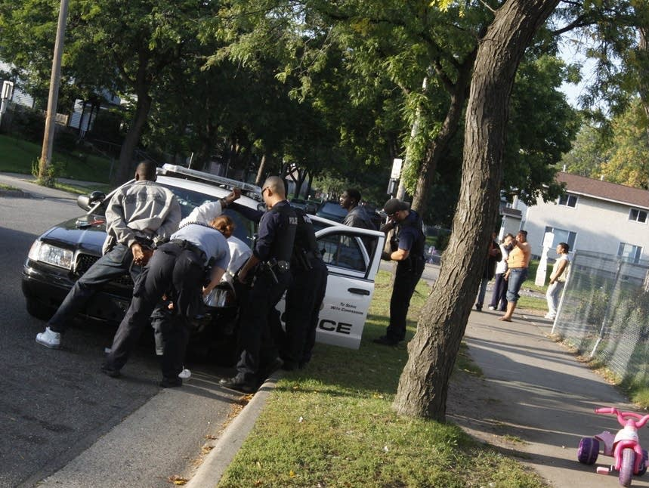

Slide 8





Education
Neighborhood
Media
Health Inequities
Public Safety
Work and Occupation
Healthcare
Other Domains
Political Participation

Slide 9
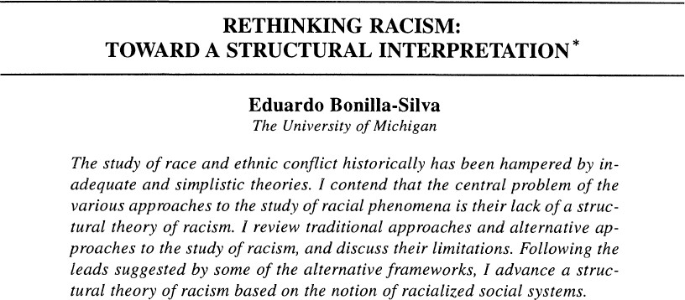
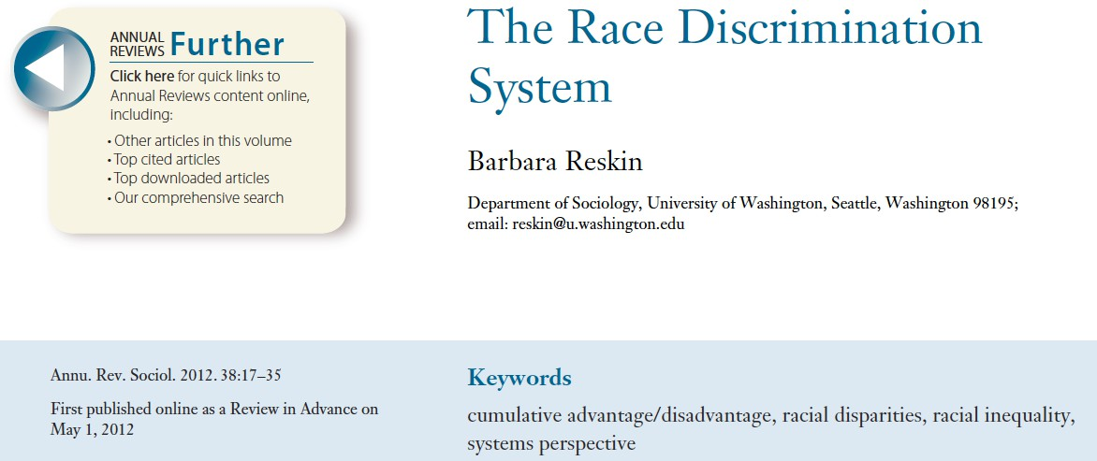
“Racism is a system of structuring opportunity and assigning value based on the social interpretation of how one looks (which is what we call “race”), that unfairly disadvantage some individuals and communities, unfairly advantages other individuals and communities, and saps the strength of the whole society through the waste of human resources”.
Camara Phyllis Jones (2002)

Slide 10






Education
Neighborhood
Media
Structural Racism
Health Inequities
Public Safety
Work and Occupation
Healthcare
Other Domains
Political Participation

Slide 11
The hurdle
𝑆𝑅! = 𝑟𝑒𝑠𝑖𝑑𝑒𝑛𝑡𝑖𝑎𝑙 𝑠𝑒𝑔𝑟𝑒𝑔𝑎𝑡𝑖𝑜𝑛
𝑆𝑅" = 𝐵𝑙𝑎𝑐𝑘 − 𝑤ℎ𝑖𝑡𝑒 𝑒𝑚𝑝𝑙𝑜𝑦𝑚𝑒𝑛𝑡 𝑖𝑛𝑒𝑞𝑢𝑖𝑡𝑦
𝑆𝑅# = 𝑟𝑎𝑐𝑖𝑎𝑙𝑖𝑧𝑒𝑑 𝑝𝑜𝑙𝑖𝑐𝑖𝑛𝑔
𝑌 = 𝛼 + 𝛽!𝑆𝑅! + 𝛽"𝑆𝑅" +𝛽#𝑆𝑅# + 𝛽$𝑆𝑅! ∗ 𝑆𝑅" +𝛽%𝑆𝑅" ∗ 𝑆𝑅# + 𝛽&𝑆𝑅! ∗ 𝑆𝑅# +𝛽'𝑆𝑅! ∗ 𝑆𝑅"∗ 𝑆𝑅#
Higher order of interaction term is difficult to interpret
Estimating multiple regression with highly correlated variables produce biased estimates
  Similar effect direction, wrong effect size
  Wrong effect direction
  Null effect

Slide 12
Structural Racism = Latent Construct
Latent measures assume the shared variance between dimensions represents the construct of structural racism
Structural Racism
Latent class analysis (LCA) identifies qualitative multidimensional typologies
Residential Segregation
Education Inequity
Employment Inequity
Income Inequity
Homeownership Inequity
Common application of LCA: personality types

Slide 13
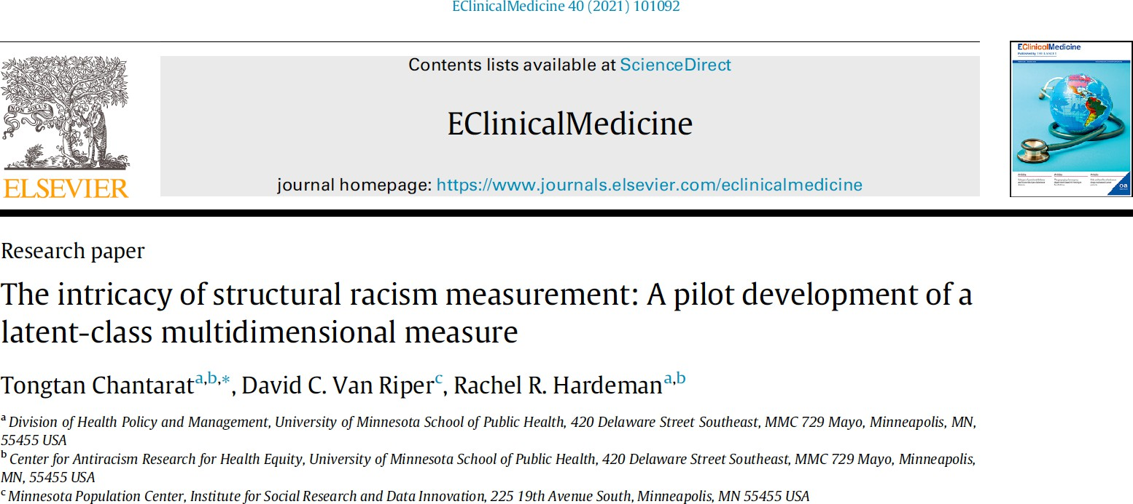

Slide 14
Multidimensional Measure of Structural Racism
Chantarat T, Van Riper DC, Hardeman RR. The intricacy of structural racism measurement: A pilot development of a latent-class multidimensional measure.
EClinicalMedicine. 2021; 101092.
The “MMSR”
Structural Racism
Evaluated single-dimension structural racism at the Public Use Microdata Area (PUMA) level
Multidimensional structural racism “typologies”
  Best fitting based on parsimony (BIC), clustering (standardized entropy), and relative class size
Residential Segregation
Education Inequity
Employment Inequity
Income Inequity
Homeownership Inequity
Index of Dissimilarity
B-W College Education
(25 and older)
B-W
Employment
(16-64)
Index of Concentration at the Extremes
W-B Owned Households
𝑌 = 𝛼 + 𝛽!𝑀𝑀𝑆𝑅

Slide 15
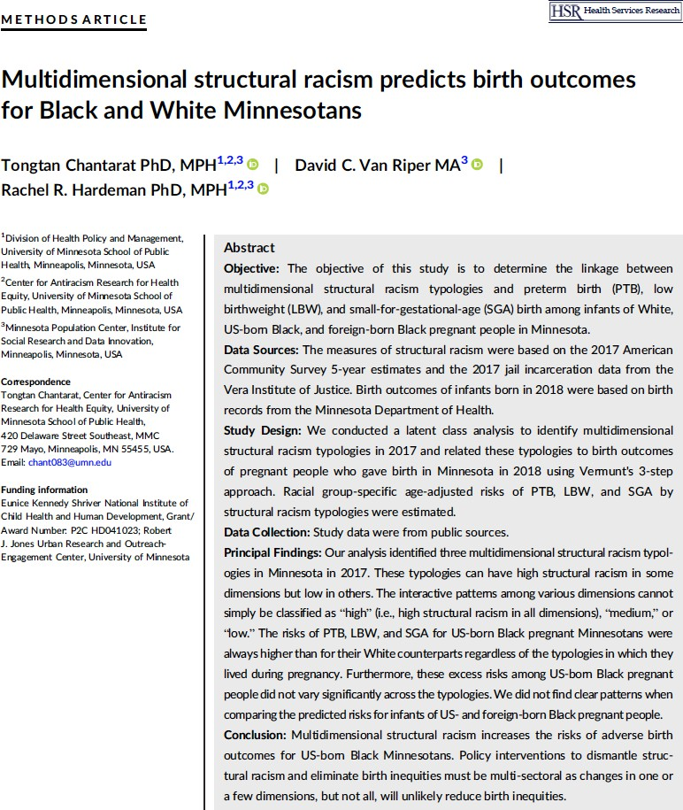
Birth Inequities in Minnesota
10%
9%
8%
7%
6%
5%
4%
3%
2%
1%
0%
% Low Birthweight
2000
2001
2002
2003
2004
2005
2006
2007
2008
2009
2010
2011
2012
2013
2014
2015
2016
2017
2018
2019
Source: Minnesota Department of Health, Minnesota Center for Health Statistics. http://www.health.state.mn.us/divs/chs/

Slide 16
Research Questions
Do the risks of preterm birth (PTB), low birthweight (LBW), and small-for-gestational-age birth (SGA) for white, U.S.-born Black, and foreign-
born Black people exposed to the same structural racism typology (i.e., residence in an area with the same pattern of structural racism) differ?
Do the risks of PTB, LBW, and SGA differ for people of the same racial background in different structural racism typologies?

Slide 17
Analysis
Birth records of singletons of white (n=20,875), US-born Black (n=2,782), and foreign-born Black (n=4,648) pregnant people giving birth in 2018
  Merged with unidimensional structural racism measures
Vermunt’s 3-step approach
Latent class model fitting
Modal assignment of pregnant people to structural racism typologies
Relating structural racism typologies to PTB, LBW, and SGA

Slide 18
Structural Racism
Residential Segregation
Education Inequity
Employment Inequity
Income Inequity
Homeownership Inequity
Criminal Justice Inequity
Index of Dissimilarity
B-W College Education
(25 and older)
B-W
Employment (16-64)
Index of Concentration at the Extremes
W-B Owned Households
B-W Jail Incarceration (15-64)

Slide 19
Structural Racism Typologies
Type A
Type B
Type C
Probability of Structural Racism Being Greater than the US National Median
1.00
0.75
Residential Segregation
Education Inequity Employment Inequity
0.50
Income Inequity
Homeownership Inequity
Criminal Justice Inequity
0.25
0.00
20

Slide 20
Structural Racism Typologies
Type A
Type B
Type C
Probability of Structural Racism Being Greater than the US National Median
1.00
0.75
Residential Segregation
Education Inequity
Employment Inequity
0.50
Income Inequity
Homeownership Inequity
Criminal Justice Inequity
0.25
0.00
20

Slide 21
Structural Racism Typologies
Type B
Type A
Type C
Probability of Structural Racism Being Greater than the US National Median
1.00
0.75
Residential Segregation
Education Inequity
Employment Inequity
0.50
Income Inequity
Homeownership Inequity
Criminal Justice Inequity
0.25
0.00
20

Slide 22
Structural Racism Typologies
Type C
Type A
Type B
Probability of Structural Racism Being Greater than the US National Median
1.00
0.75
Residential Segregation
Education Inequity
Employment Inequity
0.50
Income Inequity
Homeownership Inequity
Criminal Justice Inequity
0.25
0.00
20

Slide 23


Small for Gestational Age
Type A
Type B
Type C
0.00
0.05
0.10 0.15
Age-adjusted Risk
0.20
0.25
white
US-born Black
Foreign-born Black
22

Slide 24
Small for Gestational Age
Type A
Type B
Type C
0.00
0.05
0.10 0.15
Age-adjusted Risk
0.20
0.25
white
US-born Black
Foreign-born Black
22

Slide 25
Small for Gestational Age
Type A
Type B
Type C
0.00
0.05
0.10 0.15
Age-adjusted Risk
0.20
0.25
white
US-born Black
Foreign-born Black
22

Slide 26
Small for Gestational Age
Type A
Type B
Type C
0.00
0.05
0.10 0.15
Age-adjusted Risk
0.20
0.25
white
US-born Black
Foreign-born Black
22

Slide 27
Small for Gestational Age
Type A
Type B
Type C
0.00
0.05
0.10 0.15
Age-adjusted Risk
0.20
0.25
white
US-born Black
Foreign-born Black
22

Slide 28
Small for Gestational Age
Type A
Type B
Type C
0.00
0.05
0.10 0.15
Age-adjusted Risk
0.20
0.25
white
US-born Black
Foreign-born Black
22

Slide 29
Small for Gestational Age
Type A
Type B
Type C
0.00
0.05
0.10 0.15
Age-adjusted Risk
0.20
0.25
white
US-born Black
Foreign-born Black
22

Slide 30
Recap
Dimensions of structural racism interact intricately to create a multidimensional system
US-born Black pregnant people face higher risks of adverse birth outcomes than their white counterparts who residing in the same structural racism typology
The risks of adverse birth outcomes for US-born Black pregnant people are statistically the same across structural racism typologies

Slide 31


Probability of Structural Racism Being Greater than the US National Median
Type A
Type B
Type C
1.00
Type A
0.75
Residential Segregation
Education Inequity
Type B
0.50
Employment Inequity
Income Inequity
Homeownership Inequity
Criminal Justice Inequity
0.25
Type C
0.00
0.05
0.10
0.15
0.20
0.25
0.00
white
US-born Black
Foreign-born Black
24

Slide 32
Type A Type B
Probability of Structural Racism Being Greater than the US National Median
Type C
1.00
Type A
0.75
Residential Segregation
Education Inequity
Type B
0.50
Employment Inequity
Income Inequity
Homeownership Inequity
Criminal Justice Inequity
0.25
Type C
0.00
0.05
0.10
0.15
0.20
0.25
0.00
white
US-born Black
Foreign-born Black
24

Slide 33
Probability of Structural Racism Being Greater than the US National Median
Type A
Type B
Type C
1.00
Type A
0.75
Residential Segregation
Education Inequity
Type B
0.50
Employment Inequity
Income Inequity
Homeownership Inequity
Criminal Justice Inequity
0.25
Type C
0.00
0.05
0.10
0.15
0.20
0.25
0.00
white
US-born Black
Foreign-born Black
24

Slide 34
Key Takeaways
Education
Intricate interactions across structural racism dimensions
Neighborhood
Media
Address all dimensions of structural racism to effectively eliminate racial inequities
Structural Racism
Public Safety
Work and Occupation
Multi-sectoral policy interventions are needed
Healthcare
Other Domains
Political Participation
25

Slide 35

Acknowledgement
This research was funded by the Robert J. Jones Urban Research and Outreach-Engagement Center
Additional support was provided to us by the Minnesota Population Center, which is funded by the Eunice Kennedy National Center for Child Health and Human Development (Grant number P2CHD041023).
Funders were not involved in the design, data analysis, interpretation of the study results, drafting of the abstract, or the decision to submit this study for presentation.

Slide 36


Thank you!
► Robert J. Jones Urban Research and Outreach-Engagement Center
► Minnesota Population Center (NICHD:P2C HD041023 )
► Alyssa Fritz and Miamon Queegley
Tongtan (Bert) Chantarat, PhD, MPH chant083@umn.edu
@bertchantarat
Tongtan (Bert) Chantarat, PhD, MPH chant083@umn.edu
@bertchantarat
Source: https://iaphs.org/

