Slide 1



North Carolina’s COVID-19 Support Services Program:
Lessons for Other Health Policy Programs to Address Social Needs and Reduce Health Inequity
Moderator: William K. Bleser, PhD, MSPH, Duke-Margolis Center for Health Policy
Panelists:
Amanda Van Vleet, MPH, North Carolina Department of Health & Human Services
Fred Johnson, MBA, Duke School of Medicine and Population Health Management Office
Shemecka McNeil, SLICE 325
healthpolicy.duke.edu
Subscribe to our monthly newsletter at dukemargolis@duke.edu

Slide 2
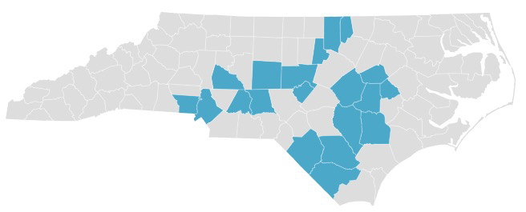




North Carolina’s COVID-19 Support Services Program
North Carolina’s COVID-19 Support Services Program to deliver needed social supports to those in COVID-19 isolation or quarantine
August 2020 to February 2022
4 parts of state
Prioritized organizations staffed by and serving marginalized populations
Worked with statewide CHW program
>43,400 households served
Food
Financial relief
Private transportat ion
Medication + COVID supply delivery

Slide 3

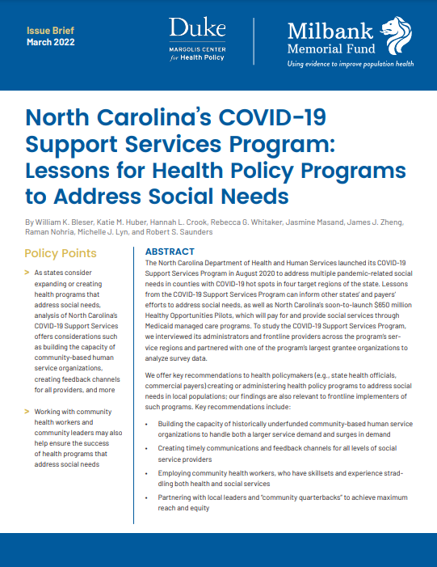
Research Goals
We interviewed the SSP’s administrators and frontline providers to gain a sense of major challenges and interesting solutions.
We also heard some potential ways in which technical challenges could be solved.

Slide 4
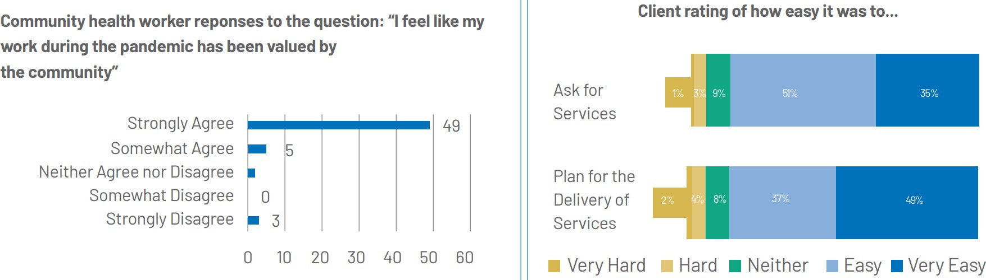
Key Takeaways: Provider & Client Satisfaction

Slide 5

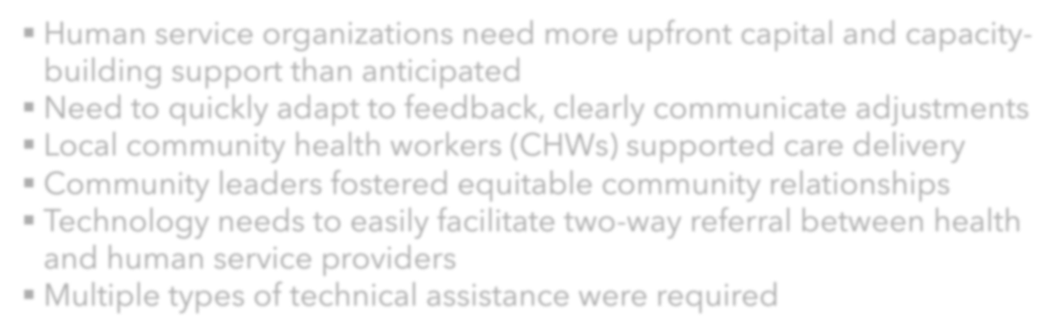
Key Takeaways: Program Administration
Human service organizations need more upfront capital and capacity-building support than anticipated
Need to quickly adapt to feedback, clearly communicate adjustments
Local community health workers (CHWs) supported care delivery
Community leaders fostered equitable community relationships
Technology needs to easily facilitate two-way referral between health and human service providers
Multiple types of technical assistance were required

Slide 6
Panel Discussion
healthpolicy.duke.edu
Subscribe to our monthly newsletter at dukemargolis@duke.edu

