Slide 1

Patient and patient caregivers’ perspectives on social screening
De Marchis EH, Brown E, Aceves BA, Loomba V, Molina M, Cartier Y, Wing H, Gottlieb LM
Summer 2022
De Marchis EH, Brown E, Aceves BA, Loomba V, Molina M, Cartier Y, Wing H, Gottlieb LM. State of the Science on Social Screening in Healthcare Settings. 2022. San Francisco, CA: Social Interventions Research and Evaluation Network. Available online at https://sirenetwork.ucsf.edu/tools-resources/resources/state-science-social-screening-healthcare-settings.
https://sirenetwork.ucsf.edu/

Slide 2
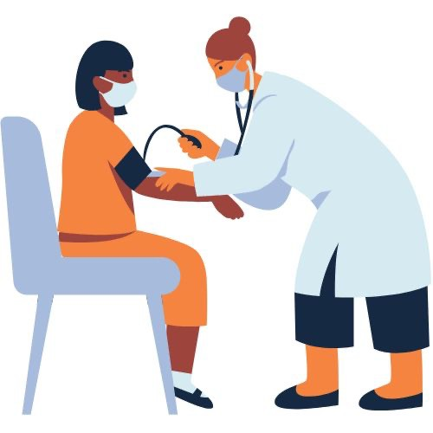
What do we know about patient/caregiver perspectives on social screening?
Rationale: Understanding patient and patient caregiver perspectives on social screening in clinical settings should inform future healthcare policies and practices on screening.
Aim: We synthesized existing research and notable evidence gaps on patient and patient caregiver perspectives about multi-domain social screening in US healthcare settings.
https://sirenetwork.ucsf.edu/

Slide 3





Methods
We conducted a systematic scoping review of peer-reviewed literature
Included studies assessed patient and/or caregiver perspectives about multi-domain social screening in United States healthcare settings
Two reviewers abstracted each included article to capture patient / caregivers’ perspectives about the following topics:
Perceived rationale for social screening
General acceptability of social screening
Factors influencing social screening acceptability
Acceptability of social screening domains
Social screening data documentation/sharing
https://sirenetwork.ucsf.edu/

Slide 4


Results
We identified 18 studies that explored patient and/or patient caregiver perspectives about social screening
Findings must be interpreted in light of methodological limitations of included studies:
Descriptive study designs
Small sample sizes
Participant selection bias
Different measures used to assess similar constructs across studies
https://sirenetwork.ucsf.edu/

Slide 5


Results: Perceived rationale for social screening (N=8)
Most patients believed their clinician or healthcare system should use social risk information to improve care (N=5)
Patients who identified as Hispanic or Black (vs. White, Asian, or Pacific Islander) and females (vs. males) were more likely to agree (N=1)
https://sirenetwork.ucsf.edu/

Slide 6

Results: General acceptability of social screening (N=12)
The majority of patients and patient caregivers thought social screening in healthcare settings was acceptable (N=8)
9 studies explored healthcare-related factors that affected acceptability
5 studies examined differences in overall acceptability by select demographic factors
https://sirenetwork.ucsf.edu/

Slide 7



Results: Healthcare factors influencing social screening acceptability (N=9)
Primary care settings (vs. ED settings) and environments in which ≥80% of patients were publicly insured or uninsured (vs. < 80%) were associated with greater acceptability (N=1)
Participants’ trust in their provider(s) positively influenced perceived acceptability (N=8); prior experiences of discrimination in healthcare settings negatively impacted it (N=1)
Prior experiences with social screening increased odds of patient acceptability of screening (N=1)
https://sirenetwork.ucsf.edu/

Slide 8



Results: Demographic factors influencing social screening acceptability (N=5)
Findings about differences in acceptability of screening by race/ethnicity
were inconsistent across studies (N=3)
Findings about differences in acceptability of screening by gender were inconsistent across studies (N=3)
No difference in acceptability of screening was identified by preferred language (N=1), socioeconomic status (N=2), age group (N=3), education (N=2), or high vs. low literacy status (N=1)
https://sirenetwork.ucsf.edu/

Slide 9



Results: Acceptability of screening domains (N=5)
A majority of participants across studies found it acceptable to screen for:
Food security (N=2)
Housing stability or quality (N=3)
Social isolation (N=2)
Transportation (N=1)
Financial constraints (N=2)
Employment status (N=1)
Immigration (N=1)
Human trafficking (N=1)
https://sirenetwork.ucsf.edu/

Slide 10



Results: Acceptability of social data documentation and sharing (N=9)
Participants expressed concerns about with whom their data would be shared, as well as how it would be stored and updated (N=6)
A sample of Latinx caregivers expressed concerns about oversurveillance of communities of color (N=1)
https://sirenetwork.ucsf.edu/

Slide 11



Looking forward
Social screening was generally considered acceptable by a majority of participants in most studies; there was less consensus about data documentation and sharing.
Methodological limitations and insubstantial information about the perspectives of diverse patient populations prevent us from generalizing these findings.
Deeper and more rigorous research is needed to better inform patient-centered approaches to social screening.
https://sirenetwork.ucsf.edu/

Slide 12
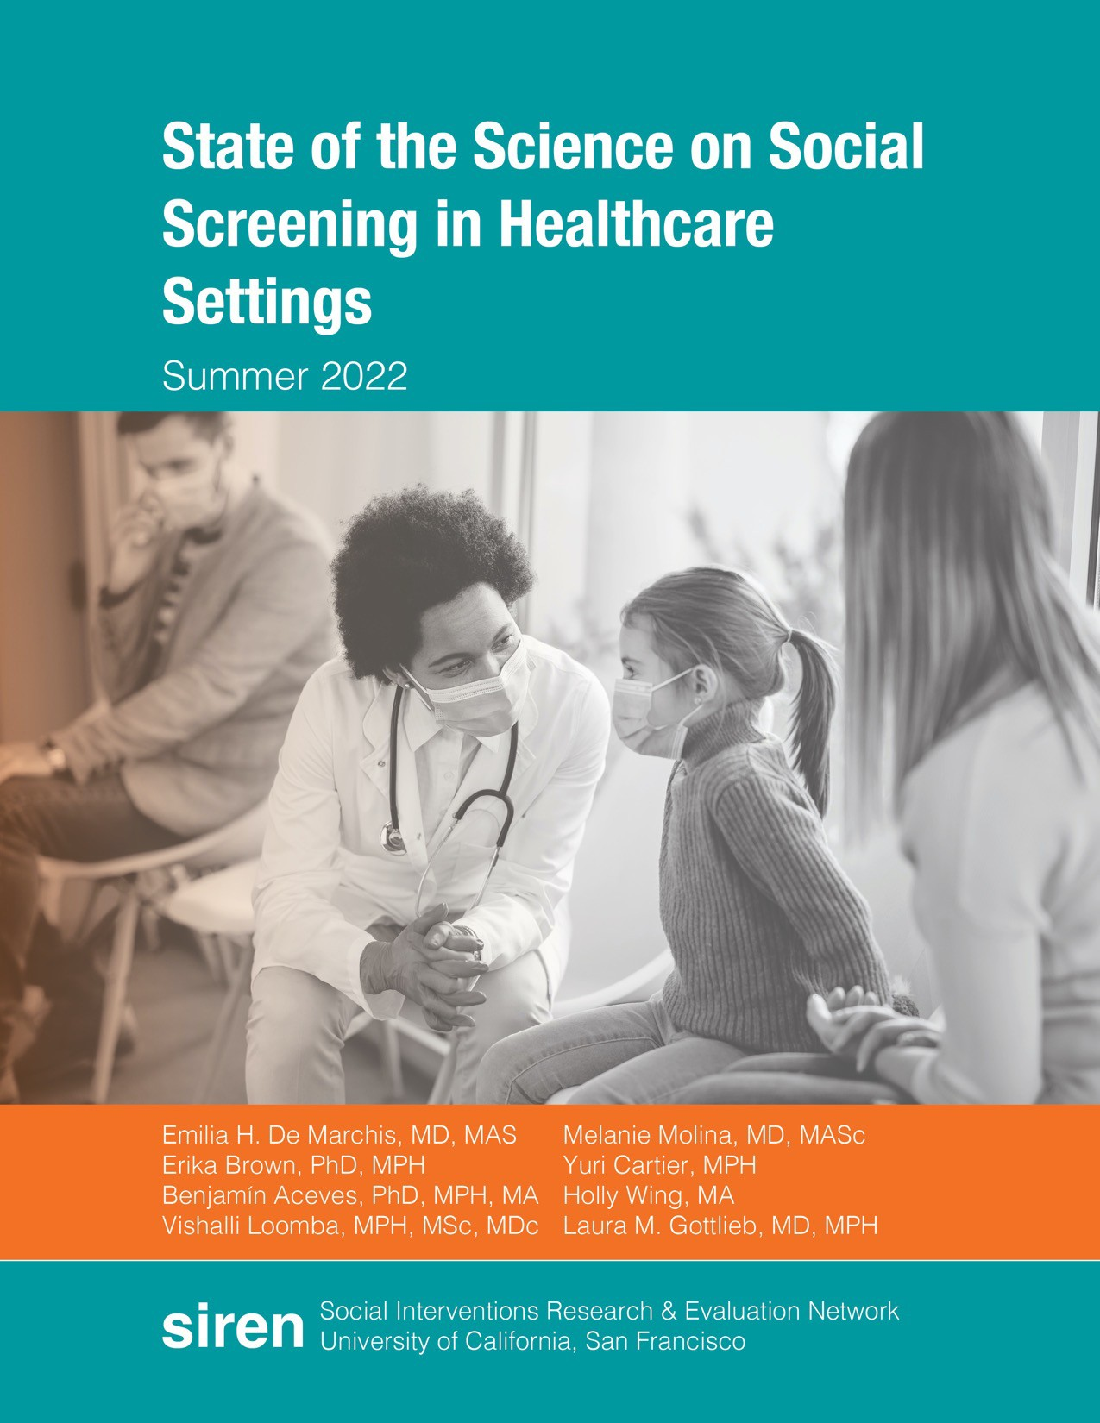
Download the full SCREEN report and executive summary on the SIREN website.
Questions about this section? Contact: Erika.brown@ucsf.edu Laura.gottlieb@ucsf.edu
https://sirenetwork.ucsf.edu/

