Slide 1



How Do Community Resource Referral Platforms Work for Social Service Organizations?
Lessons Learned in Trenton, New Jersey
A collaboration between Trenton Health Team and the Social Interventions Research and Evaluation Network at the University of California, San Francisco
March 1, 2023

Slide 2
Webinar Logistics
Use Q&A for questions. Upvoting and commenting are active!
Use chat to communicate tech issues with host.
The recording, slides, and resources will be sent to you after the webinar.

Slide 3
Poll Questions
What stage are you in of implementing a community resource referral platform?
I’m new to this/just starting to learn about them
We’re in the process of selecting a
platform/just selected a platform
We’re in the early stages of implementing (for less than a year)
We’ve been implementing our platform for over a year
Not implementing but am a researcher in
this area
Vendor
Other
If you’ve selected a platform or are working with a platform, which one(s)?
Check all
Findhelp (Aunt Bertha)
Unite Us/NowPow
Wellsky (Healthify)
Other
Homegrown

Slide 4



SIREN: Social Interventions Research & Evaluation Network
SIREN’s mission is to improve health and health equity by advancing high quality research on healthcare sector strategies to improve social conditions.
Catalyzing high quality research
Collecting & disseminating research findings
Convening researchers and practitioners

Slide 5


SIREN Speakers
Caroline Fichtenberg, PhD Co-Director
Yuri Cartier, MPH Senior Research Associate

Slide 6
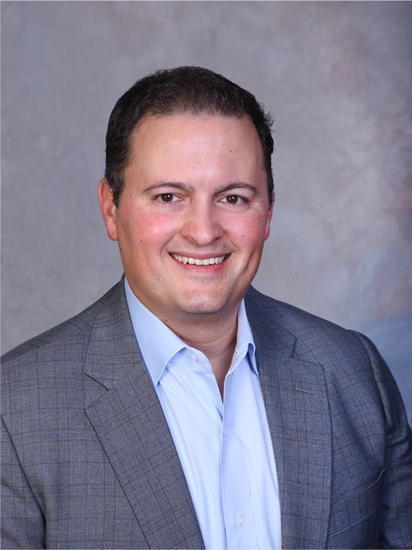
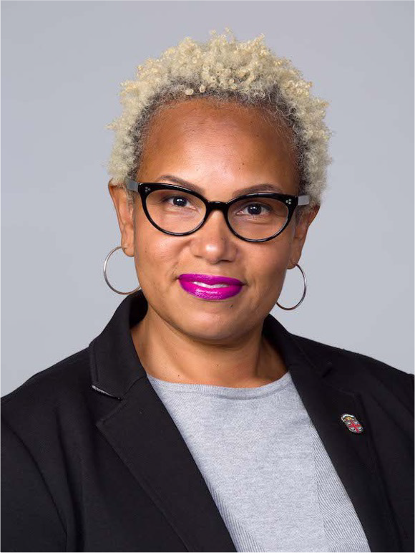

Trenton Health Team Speakers
Gregory Paulson Chief Executive Officer
Coiel Ricks-Stephen Director of Population Health
Jessica Burnett Former Population Health
Program Manager

Slide 7
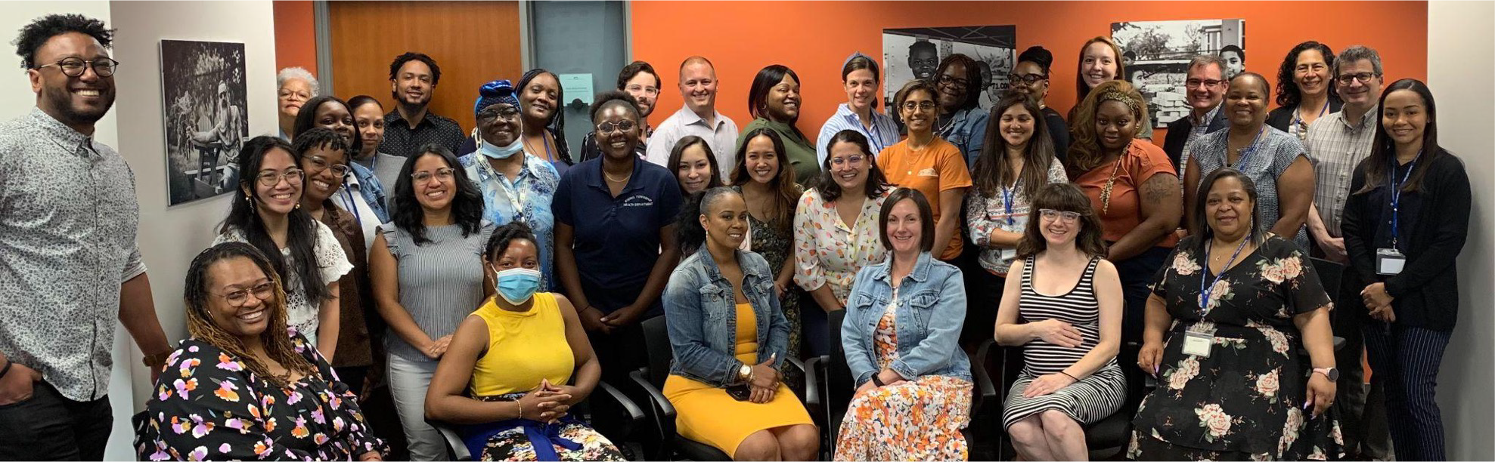

Trenton Health Team:
Who we are and what we do
THT is a community-based non-profit dedicated to improving the health and well-being of the greater Trenton community.
Having achieved national recognition since our founding in 2006, THT is now one of NJ’s four State-designated Regional Health Hubs focused on addressing the social determinants of health and achieving equitable health outcomes.

Slide 8

Our Community: Trenton, New Jersey
Demographics
83,412 population
50% African-American
38% Hispanic/Latin
25% families living below the poverty line (NJ: 7.2%), with median household income of $35,402 (NJ:
$82,545)
Data reflects the most recent available ACS data, which is the 5 year estimate from 2015 - 2019
Disease Prevalence
Hypertension 41%
Diabetes 16%
Clinically Obese 43%
Data reflects adults 18+ from CDC’ PLACES project

Slide 9
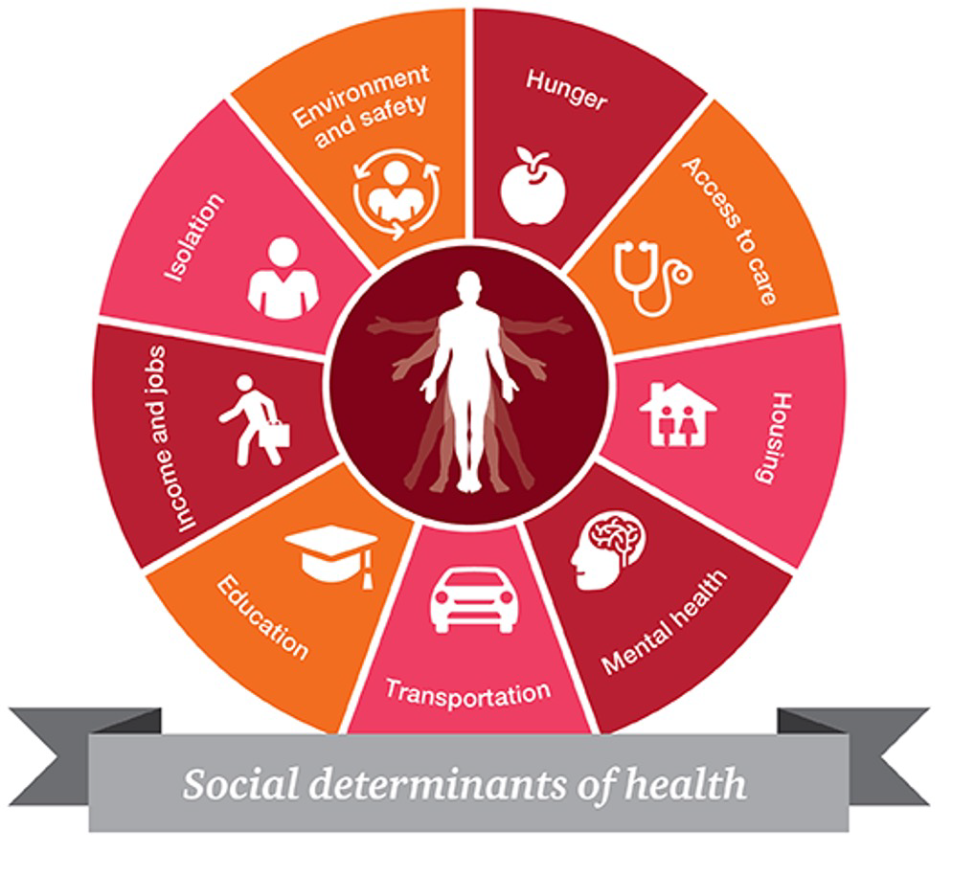
Creating a Technology-Powered Social Service Network in Trenton, New Jersey
Goal: To create a referral network where referrals are more accessible and outcomes are measurable
NowPow provides an online community resource directory and electronic referral functionality.

Slide 10
Rolling Out NowPow in Our Community
2016
June: Aunt Bertha launched in Trenton with support from New Jersey Health Care Quality Institute
July: Aunt Bertha implementation pivoted to Mercer County
Attended an initial demonstration of NowPow for interested NJ coalition groups
2017
July: Convened community stakeholders for an initial NowPow demonstration
Decided to implement NowPow in Trenton
2018
January: Public launch of NowPow in Trenton
Held a series of NowPow introductory meetings with CBOs
Built a network of partners (26 organization by Dec. 2019)
July: NowPow expansion, THT provides no-cost access to all CBOs x 2 years
​March: Obtained funding from the Robert Wood Johnson Foundation to conduct a research study with SIREN to understand the challenges CBOs have in adopting NowPow into their workflows.
2019
2020

Slide 11


Highlighting and Assessing Referral Program Participation (HARP)
A project funded through Aligning Systems for Health, an initiative of the Georgia Health Policy Center supported by the Robert Wood Johnson Foundation

Slide 12
Objectives of HARP
Identify barriers preventing community organizations in Trenton from fully participating in NowPow, as well as strategies to address these barriers.
Design and test solutions to encourage and expand platform participation in order to optimize use of community resources and improve cross-sector care coordination for Trenton residents.

Slide 13
Project Timeline
Phase I
Phase II
Phase III
May 2020 –
Oct. 2020
Oct. 2020 –
Jun. 2021
Jun. 2021 –
Apr. 2022
Apr. 2022 –
Oct. 2022
Interview CBOs in Trenton to understand barriers to NowPow participation
Interview individuals in external communities that have successfully engaged CBOs in NowPow-like networks
Develop and refine possible engagement strategies based on learnings from Phase I
Design Phase III
Formally test engagement strategies
Conduct interviews w/ CBOs
participating in strategies
Analyze quant+qual data
Disseminate research findings

Slide 14
Phase One - Methods
Semi-structured interviews with staff and leaders at Trenton-area organizations that used NowPow to varying degrees, as well as leaders at a small number of CBOs that had declined to adopt the tool.
We complemented these local insights with interviews conducted with communities around the country who were using similar platforms and contacts from two vendors.
Interviews were recorded, transcribed, and analyzed for key themes relating to CBO barriers to uptake and promising engagement strategies, including monetary incentives.
16
Organizations in Trenton
16 leaders/
managers
12 frontline staff
9
Other
Communities
2
Vendors

Slide 15




Findings from Phase One
Low perception of added value
Community resource directory is valued more than electronic referrals
Those who expressed a need for & value of the platform still
faced barriers to adopting it and using it regularly
Negative reactions to monetary incentive for platform use

Slide 16







Phase Two: Strategy Design
Methods
NowPow
Synthesized ideas from Phase One interviews, local NowPow Steering Committee and national Project Advisory Committee.
Phase I Interviews
Steering Committee
Project Advisory Committee
Design Constraints
Financial incentive strategies were perceived negatively by Trenton CBOs
Mandating the use of the tool was not within our reach
Feasibility and sustainability
Time restrictions

Slide 17
Phase Two: Survey Results
51%
46%
Referral Hub Communications Campaign Monthly Data Insights Report Tailored Training
Grant for Services
Endorsements Reimbursement for Training
41%
39%
34%
18%
15%

Slide 18




Phase Three: Implementing engagement strategies
Monthly Data Insights Reports
Referral Hub
Tailored Training
Communications Campaign
6/11/21 - 9/28/21
10 organizations
7/16/21 - 10/31/21
2 organizations
8/4/21 - 1/4/22 5 organizations
1/19/22 - 4/18/22
All network partners

Slide 19


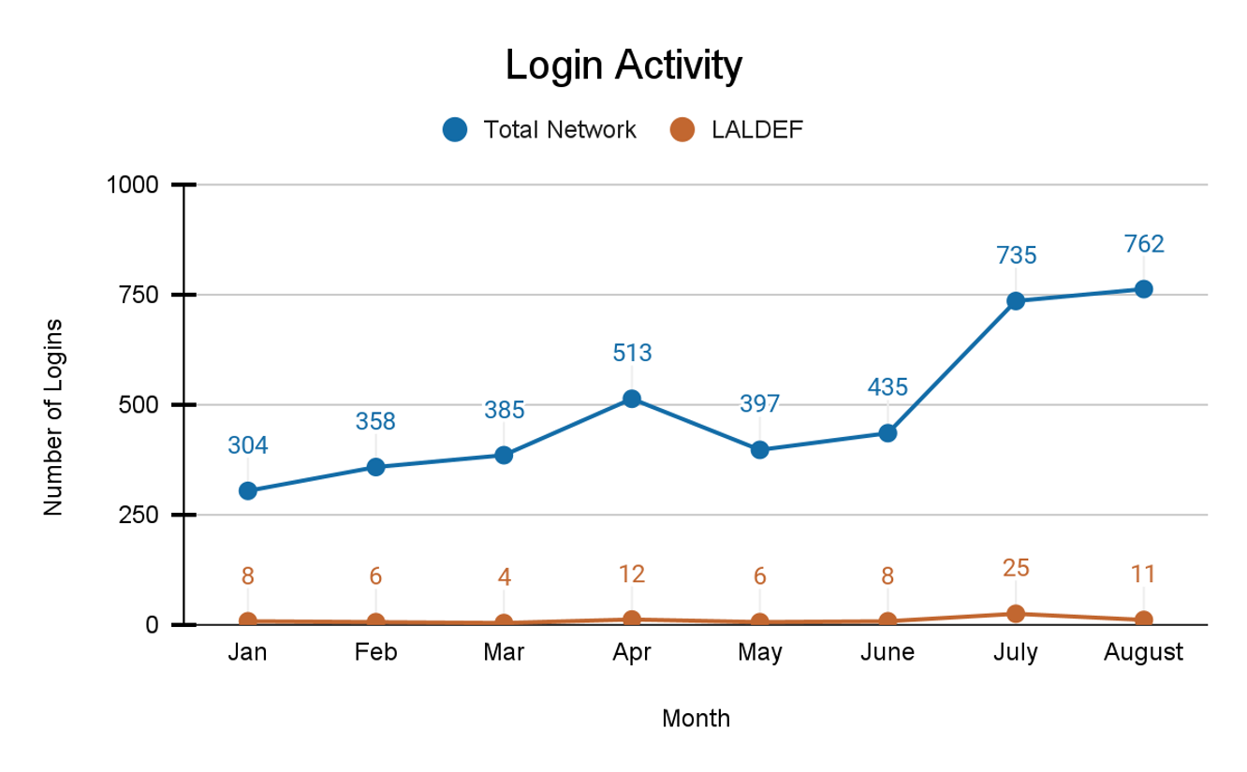
Findings from Phase Three
Monthly Data Insights Report - Hypothesis
By…
Receiving a monthly email
With accessible visualizations of their platform use metrics
And comparisons between their use and that of the entire network
We thought that organizations would be prompted to…
Remember NowPow and log in
Feel a little “community FOMO”
Send staff to get trained
Encourage their staff to use it more

Slide 20
Findings from Phase Three
Monthly Data Insights Report - Results
Impact on Platform Use
Reach/Adoption
Little to no impact on login activity.
Reach: 10 orgs for 4 months.
Average open rate of 27%; last report had lowest open rate (21%)
Moderate awareness of reports
Low perceived value in reading a report that confirmed what they already knew.
Other Impacts
For one interviewee (out of 9), reports prompted them to consider new ways to encourage more use of the tool by their staff

Slide 21


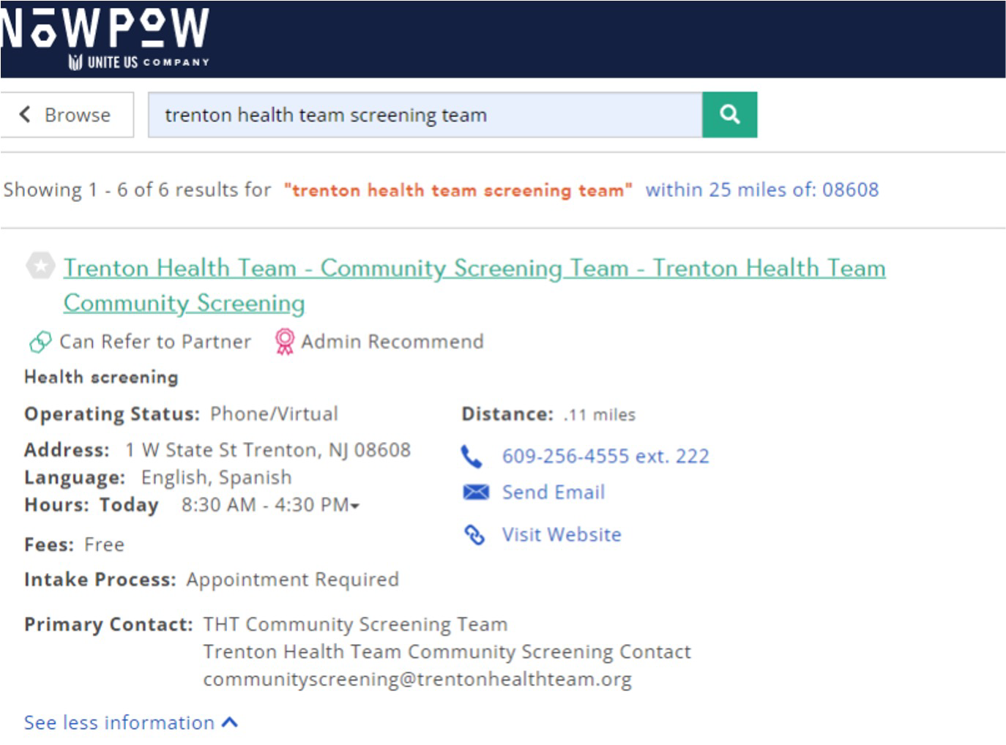
Findings from Phase Three
Referral Hub - Hypothesis
By…
Having an on-call social needs screening and navigation team accessible via
A single NowPow referral to the THT
hub
We thought that organizations would be prompted to…
Anticipate how this service could save
their staff time and/or allow them to help people with multiple needs not met by the organization
Log in and send referrals to the hub

Slide 22
Findings from Phase Three
Referral Hub - Results
Impact on Platform Use
Reach/Adoption
There was no significant uptick in logins or electronic referral activity.
2 of the 3 organizations invited to participate did so.
Many challenges with timing / staff turnover.
Attempted, but ultimately unsuccessful, adoption.
Other Impacts
One CBO realized how easy it was to make electronic referrals and decided to make referrals directly to organizations.

Slide 23

Findings from Phase Three
Tailored Training - Hypothesis
By…
We thought that organizations would be prompted to…
Spending significant time communicating the value of NowPow with select leadership,
Spending time helping team leads + end users think about workflows
Conducting a more interactive end-user training and
Doing more frequent follow-up post-training, including sending a utilization snapshot
Buy in more deeply at every level of the organization on NowPow value and expected benefit
Develop one or more clear use cases and workflows to support those uses
Use NowPow immediately after training
Sustain use of NowPow in the months following

Slide 24
Findings from Phase Three
Tailored Training - Results
Impact on Platform Use
Reach/Adoption
No discernible impact
5 of the 14 organizations invited to receive tailored training accepted the invitation.
Only 1 senior leadership buy-in conversation happened
7 workflow planning sessions 36 individuals trained
3 data snapshots sent
Other Impacts
Points of intervention were highly appreciated (welcome emails, follow up emails, data snaps of end user engagement).
Interactive trainings with searching and sharing resources that match their client needs was well received.

Slide 25

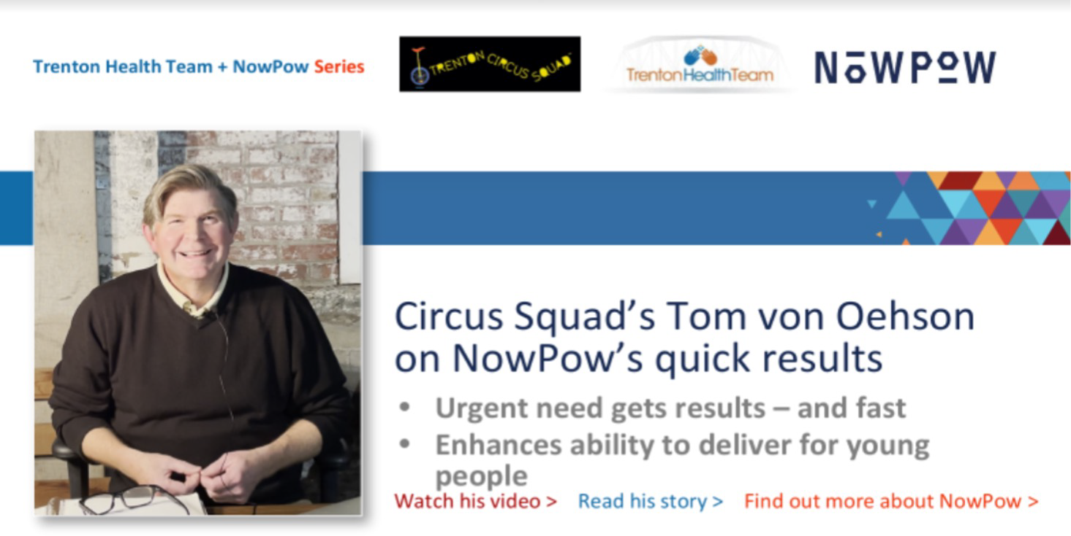
Findings from Phase Three
Communications Campaign - Hypothesis
By…
Sending monthly emails that included testimonials of peers using and finding value in the platform
Offering multiple modalities to access
testimonials (video and blog)
And organizing convenings at both the leader and end-user levels
We thought that organizations would be prompted to…
Remember NowPow and log in
Connect their peers’ positive experiences to their own work
Feel like the platform was a community
effort with community buy-in

Slide 26
Findings from Phase Three
Communications Campaign - Results
Impact on Platform Use
Reach/Adoption
None detected
Emails:
7 campaigns w/3 videos were sent to >400
individuals
Open rates: 26-38%
Click rates: 0.5-3.6%
Video views: 43-49 per video
Leadership convening: 28 participants from 18 organizations
End user convening: 41 participants from 18 organizations
Other Impacts
Interviews confirmed:
Low awareness of emails
Deprioritizing emails because of low use of
the tool and overload of daily email
Convenings confirmed:
Community resource directory highly valued
Must protect client/patient confidentiality in electronic referrals
Importance of interoperability

Slide 27
Monthly NowPow Logins/Organization, 2019-2022
25
20
15
10
5
0
Jan 19
Feb 19
Ma r 19
Apr 19
Jun 19
Jul 19
Oct 19
Jan 20
Feb 20
Ma r 20
Apr 20
Jun 20
Jul 20
Oct 20
Jan 21
Feb 21
Ma r 21
Apr 21
Jun 21
Jul 21
Oct 21
Jan 22
Feb 22
Ma r 22
Apr 22
July 22
Nov 19
Dec 19
Nov 20
Dec 20
Nov 21
Aug 19
Dec 21
Sep 19
Aug 20
Sep 20
Aug 21
Ma y 19
Ma y 20
Ma y 21
Sep 21
Ma y 22
June 22
August 22
Monthly data insights reports
Referral hub
Tailored training
Tailored Training Rest of Network
Communications Campaign
Data Insights
Referral Hub

Slide 28
Monthly NowPow Logins/Organization, 2019-2022
25
Produce Rx Cohort 3
New referral partnership btw 2 orgs
Produce Rx Cohort 2
Produce Rx Cohort 1
20
Pandemic started
15
10
5
0
Jan 19
Feb 19
Ma r 19
Apr 19
Jun 19
Jul 19
Oct 19
Jan 20
Feb 20
Ma r 20
Apr 20
Jun 20
Jul 20
Oct 20
Jan 21
Feb 21
Ma r 21
Apr 21
Jun 21
Jul 21
Oct 21
Jan 22
Feb 22
Ma r 22
Apr 22
July 22
Nov 19
Dec 19
Nov 20
Dec 20
Nov 21
Aug 19
Dec 21
Sep 19
Aug 20
Sep 20
Aug 21
Ma y 19
Ma y 20
Ma y 21
Sep 21
Ma y 22
June 22
August 22
Monthly data insights reports
Referral hub
Tailored training
Tailored Training Rest of Network
Data Insights
Referral Hub

Slide 29




Overall Impact of Strategies
Monthly Data Insights Reports
Little to no impact
Referral Hub
Very limited uptake
Tailored Training
No discernible impact
Communications Campaign
No discernible impact

Slide 30

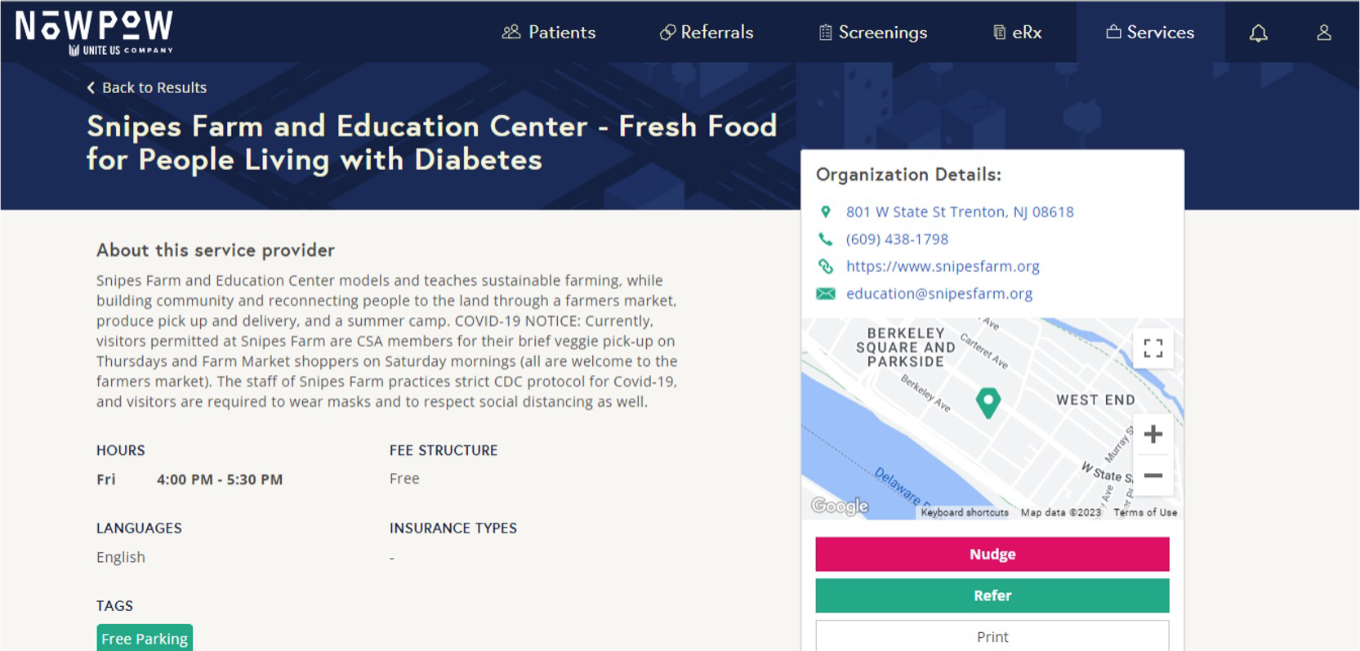
Fresh Food for People Living with Diabetes/Pre-diabetes
A Produce Rx Program
The intervention only accepts referrals through NowPow
Outcomes
Care providers requested access to NowPow to make electronic referrals
Five cohorts served from 2020 - 2022

Slide 31

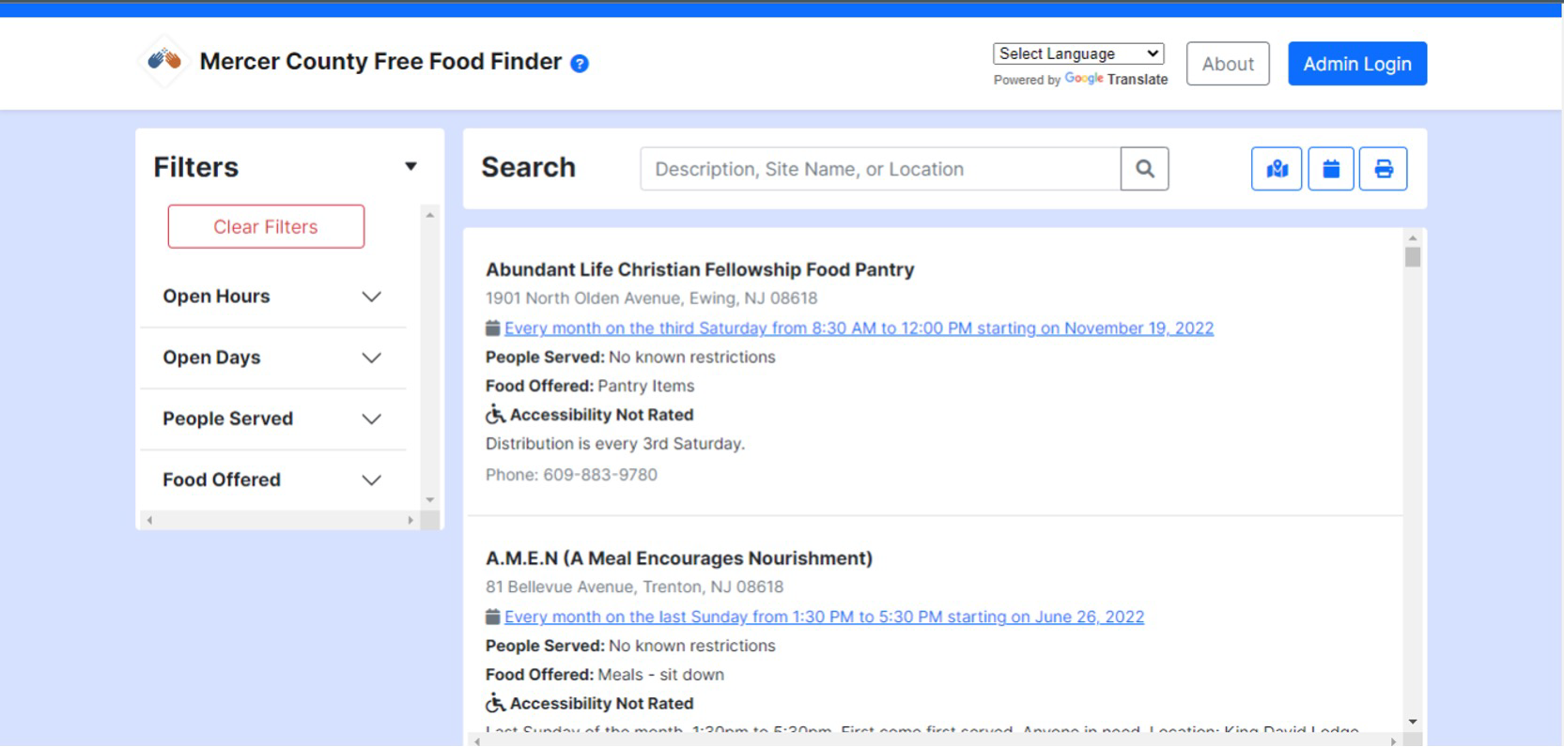
Mercer County Free Food Finder
Developed from a need for more tailored filters and real time updates.
Stakeholders from our community’s food sector
identified the gap and decided on the best way to fill it
There was shared ownership
of the tool and it increased in sophistication overtime

Slide 32

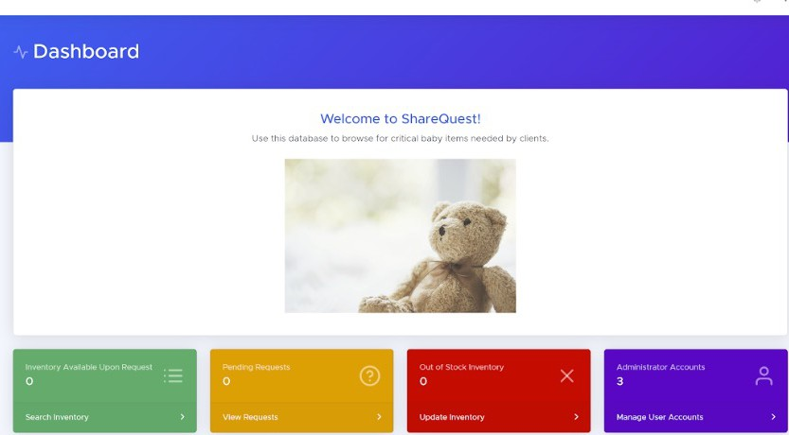
Baby Item Inventory Database
Designed by stakeholders looking for a practical solution to monitor needed baby supplies
NowPow search feature and
filters did not meet the needs of stakeholders
Stakeholders wanted more control over listings and a place to share information

Slide 33
Overall, what did we learn?
Strong interest in resource directory; little interest in tracked referrals
Lots of barriers to use, esp. for tracked referrals
  Existing referral processes
  Existing mandated tracking tools (e.g., HMIS)
  Lack of comfort with e-referrals or with technology
  Platform limitations (e.g., limited geographic reach)
  Lack of time to learn how to use
Enthusiasm >> actual use
Most useful for:
  Organizations that make lots of referrals
  People new to the community
The strategies we tested did not work; but requiring use (e.g., Produce Rx program) did drive usage.
Tools developed to meet very specific need had much higher adoption (e.g., Mercer County Food Finder, Baby Item Inventory).

Slide 34




What might work?
Implement slowly
Pilot specific use cases
Gather community to assess the need, design solutions together and decide if technology is the solution
Assess organizational readiness
Share successful pilots to build community interest

Slide 35




Mandate use AND provide funding to cover costs associated with use of tool.
OR
Learn from EMR adoption!

Slide 36
However.
Your integration might be my fragmentation. (Leutz 1999)
Might homegrown solutions work better? The technology is not the network.
Leutz W. Five Laws for Integrating Medical and Social Services: Lessons from the United States and the United Kingdom.
Milbank Quarterly. 1999; 17(1): 77-110.

Slide 37



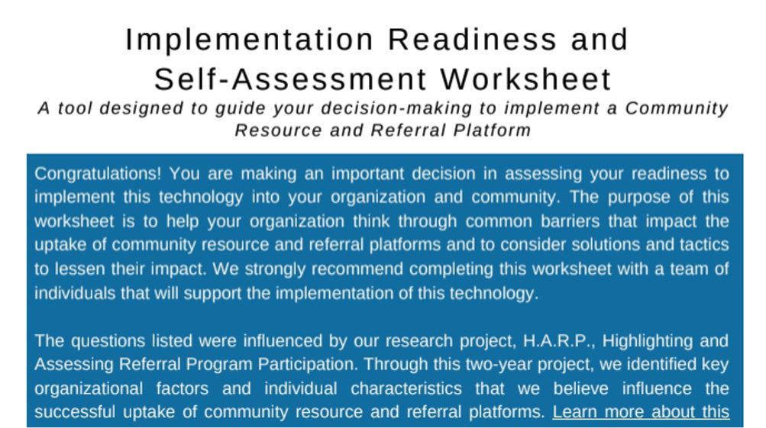
Questions?
SIREN: siren@ucsf.edu
Trenton Health Team: gpaulson@trentonhealthteam.org

Slide 38
The End

