Slide 1
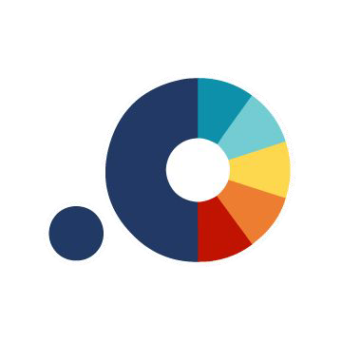
Leveraging Qualitative Research to Highlight Social Determinants of Health:
Introducing the Health Experiences Research Network (HERN)
SIREN Webinar on Sept 10, 2025 @ 9am PT / 12pm ET

Slide 2
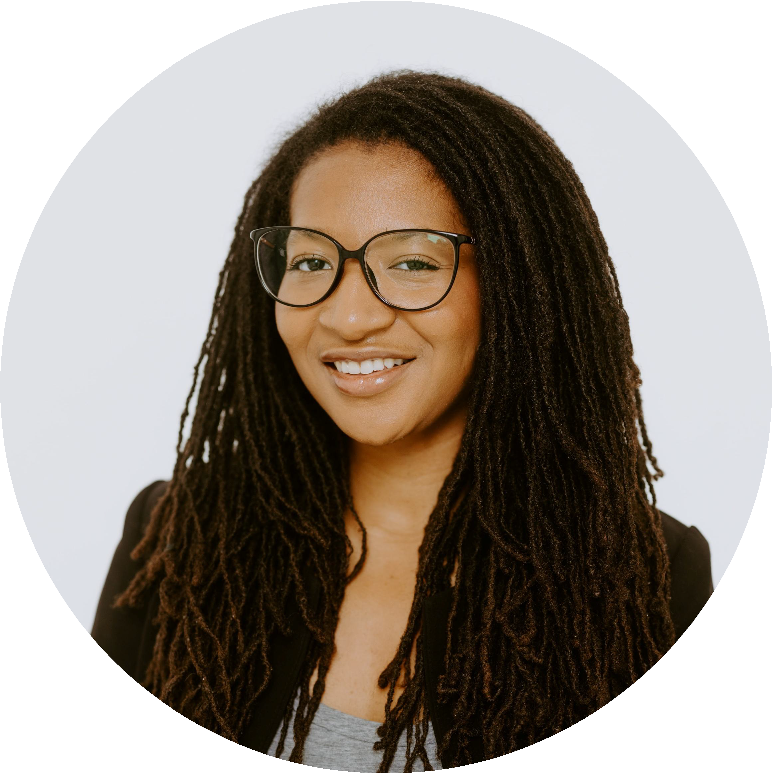
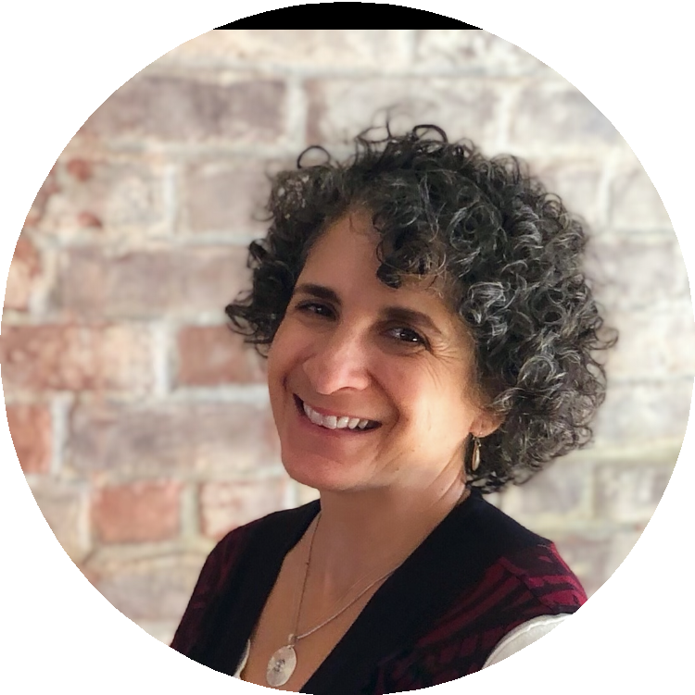
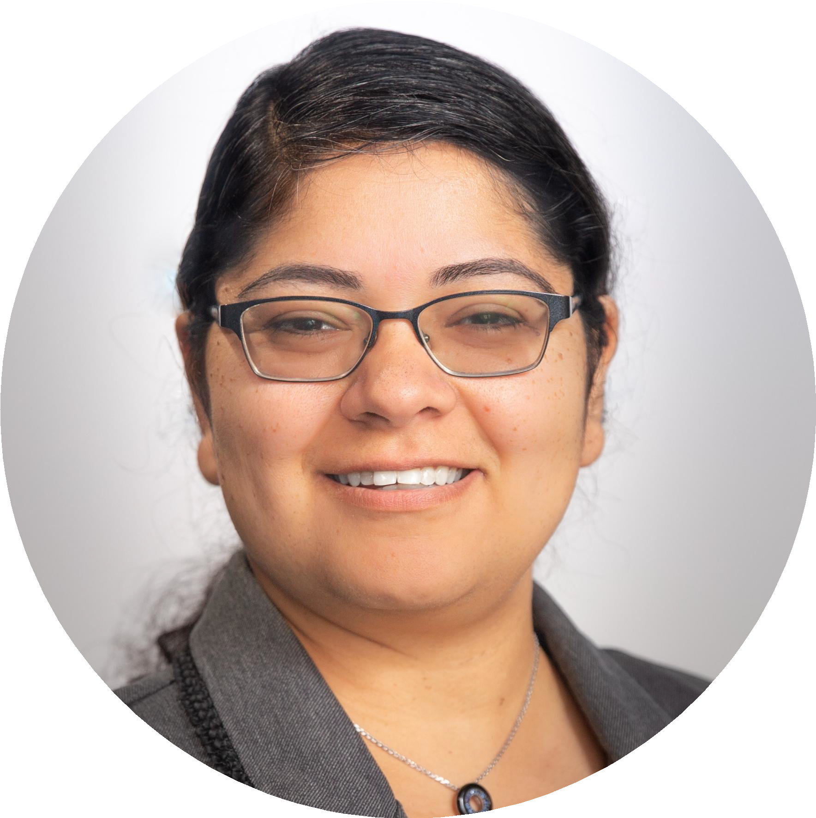
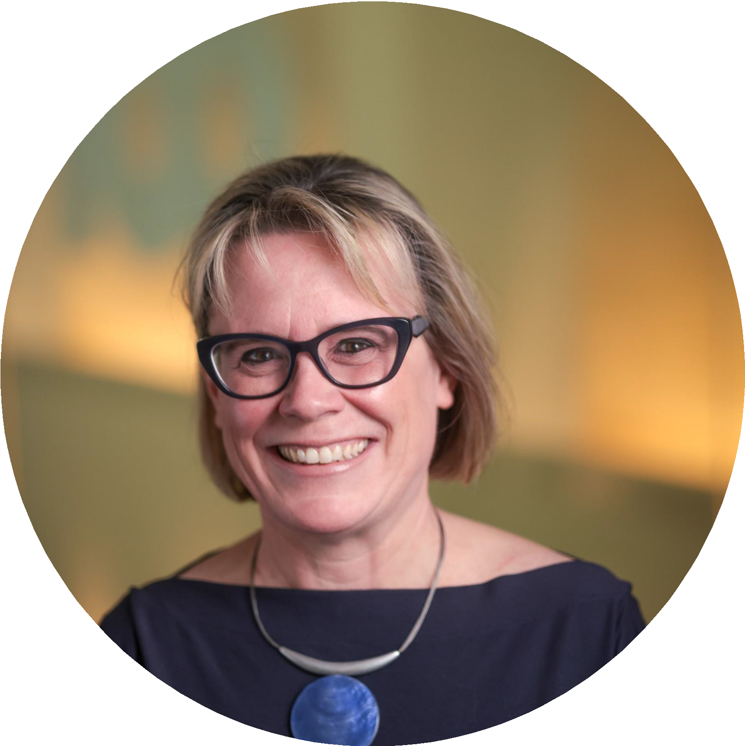
Representatives from HERN
Njeri Grevious (she/they)
Rachel Grob (she/her)
Nancy Pandhi (she/her)
Kate Smith (she/her)

Slide 3
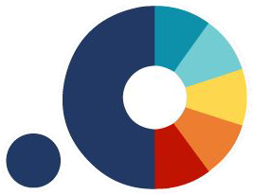
Overview
Brief History & Context

Slide 4
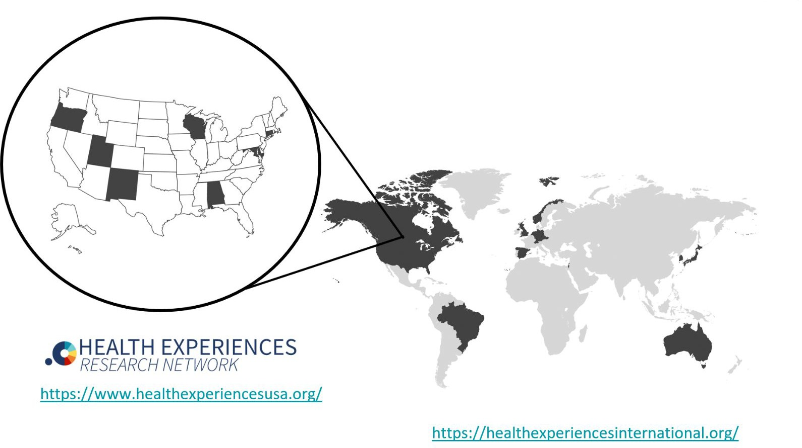
HERN in Context
We are also part of an international group of 14+ countries using a similar health experiences research methodology, Health Experiences International (formally DIPEx) methodology.
Health Experiences International is an internationally vetted qualitative approach to rigorously eliciting, synthesizing, and disseminating health experience narratives; it is considered the gold standard for health experience research.

Slide 5
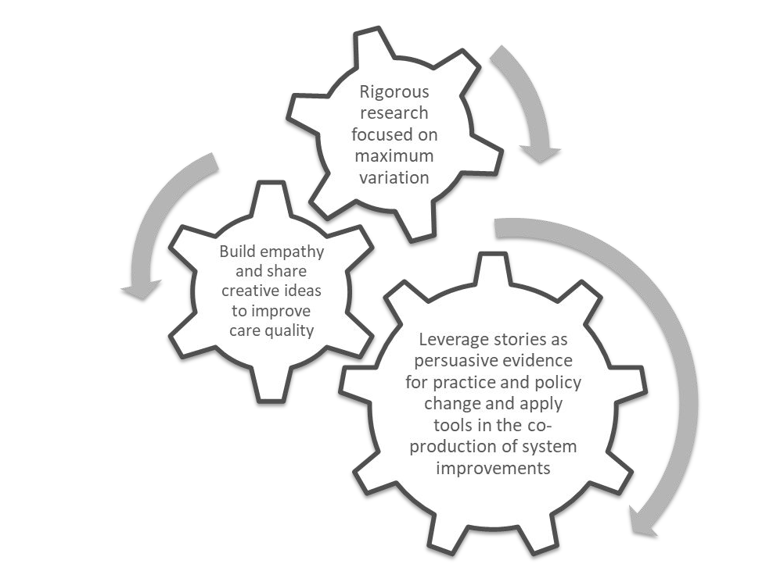
What is HERN?
Founded in 2014, HERN is a research consortium dedicated to elevating patient voices through Health Experiences International (formerly DIPEx) methodology.
This methodology stems from UK’s Oxford Health Experiences model whose approach emphasizes deep, narrative-based qualitative interviews (typically 30–50 per module). Our research is conducted across the U.S.
We use maximum variation sampling to capture a wide range of lived experiences, not just demographics, but social and structural context.

Slide 6
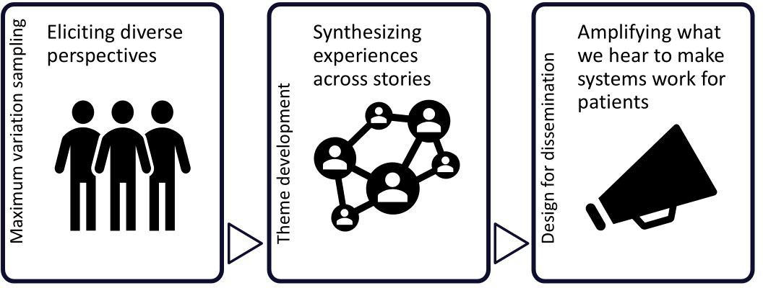
Social Determinants of Health (SDOH) @ HERN
HERN research complements social determinants of health (SDOH) research by elevating rigorously analyzed narratives in the US to surface the lived realities behind different lived experiences of social determinants.

Slide 7
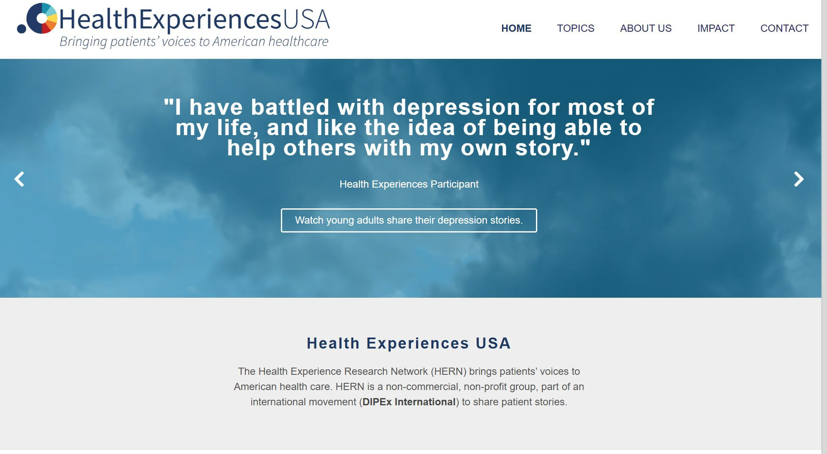
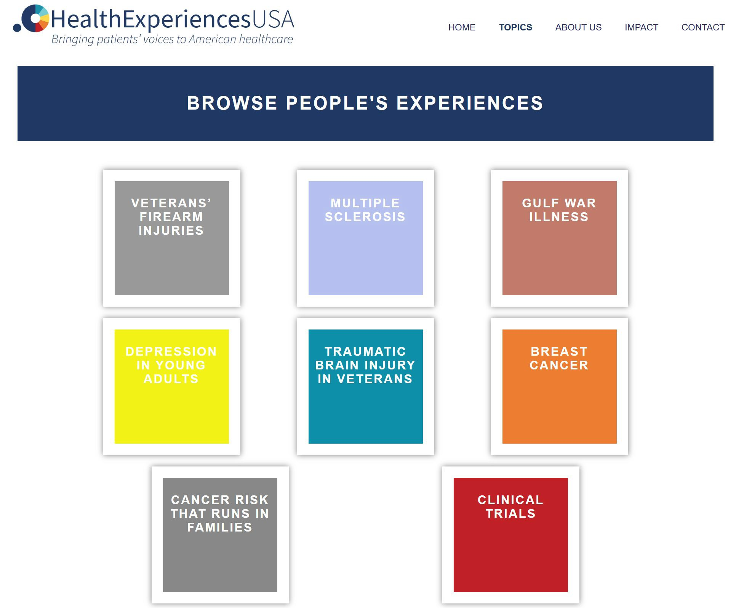
Mission and Mechanisms
Mission: Elevate and disseminate rigorously collected patient narratives to shape clinical practice, policy, and research.
Publicly Accessible Web Content:
Organized thematically with transcript excerpts, audio and video clips
8 Modules, 6 Catalyst Films, 1 Pilot (and counting!)
Cumulative Impact (as of July 2025): ~447K new users and
~504K total sessions (and counting!)

Slide 8


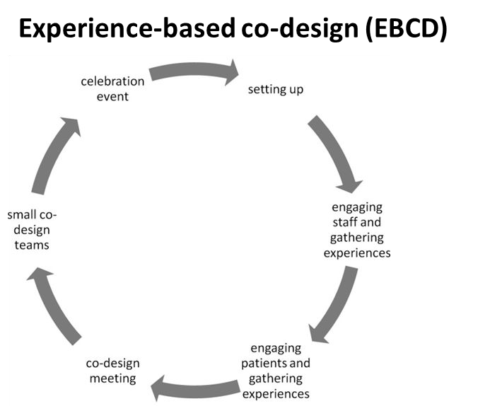
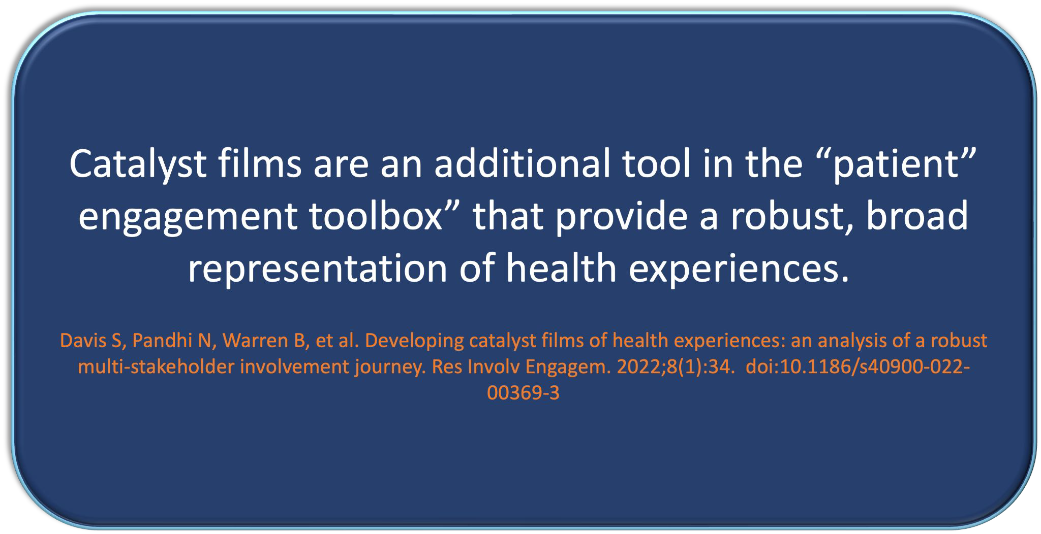
Catalyst Films leveraging EBCD in US health context
Catalyst films are a powerful complement to HERN’s web modules and use EBCD to offer immersive, thematic storytelling that highlights the structural and social forces shaping patient experiences.
The Depression Catalyst Film examines mental health through a social and structural lens, highlighting real patient stories that are often overlooked in traditional clinical settings. It challenges common assumptions and brings attention to the broader social factors that shape mental health outcomes.
These films allow us to spotlight particularly complex or underexplored issues within a module, often surfacing key Social Determinants of Health (SDOH) including housing, access, and stigma.

Slide 9

HERN is not just “a person with a camcorder” interviewing patients.
What sets HERN apart
It’s a rigorous, co-produced methodology
What sets HERN apart is the intentionality
that’s not just storytelling

Slide 10
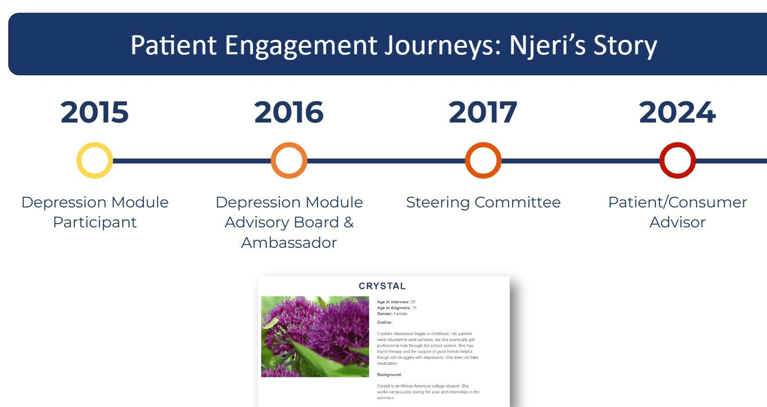
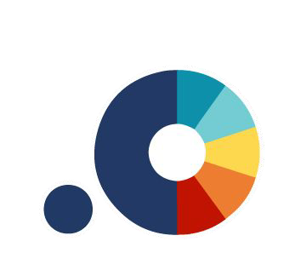
Njeri’s Story
I’ve believe in HERN work as a model of bi-directional engagement and community-building that echoes themes important to SIREN and that were highlighted at this year’s NRM such as trust and accountability.

Slide 11
Our motivations
Why we love this work

Slide 12
Modules with SDOH
Where Social Determinants of Health Appear

Slide 13
Examples of SDOH Themes
Lived Experiences
Health, not just health care
Context within which illness/disease occurs
Experiences with:
  work, education, and managing family responsibilities
  housing and transportation
  bias and discrimination
  support, community, advocacy, learning
Insurance and financial issues
HIGHLIGHTING CONTENT FROM OUR BREAST CANCER MODULE
Carrie, Kawanna, Maria, Katrina

Slide 14
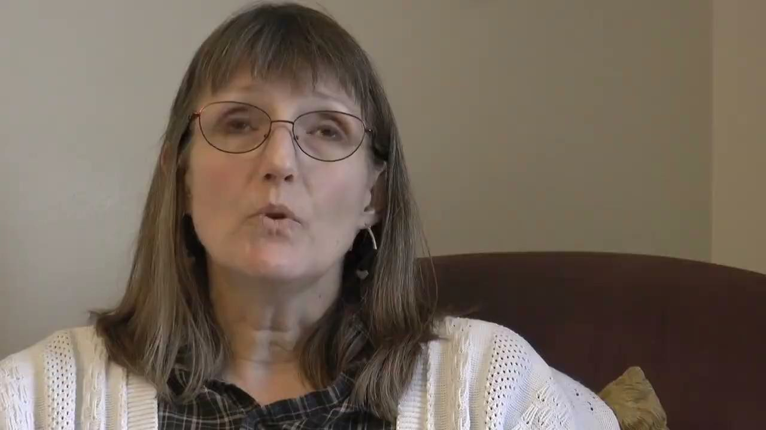
Lived Experiences
Even though Carrie had insurance, undergoing treatment led to bankruptcy.

Slide 15
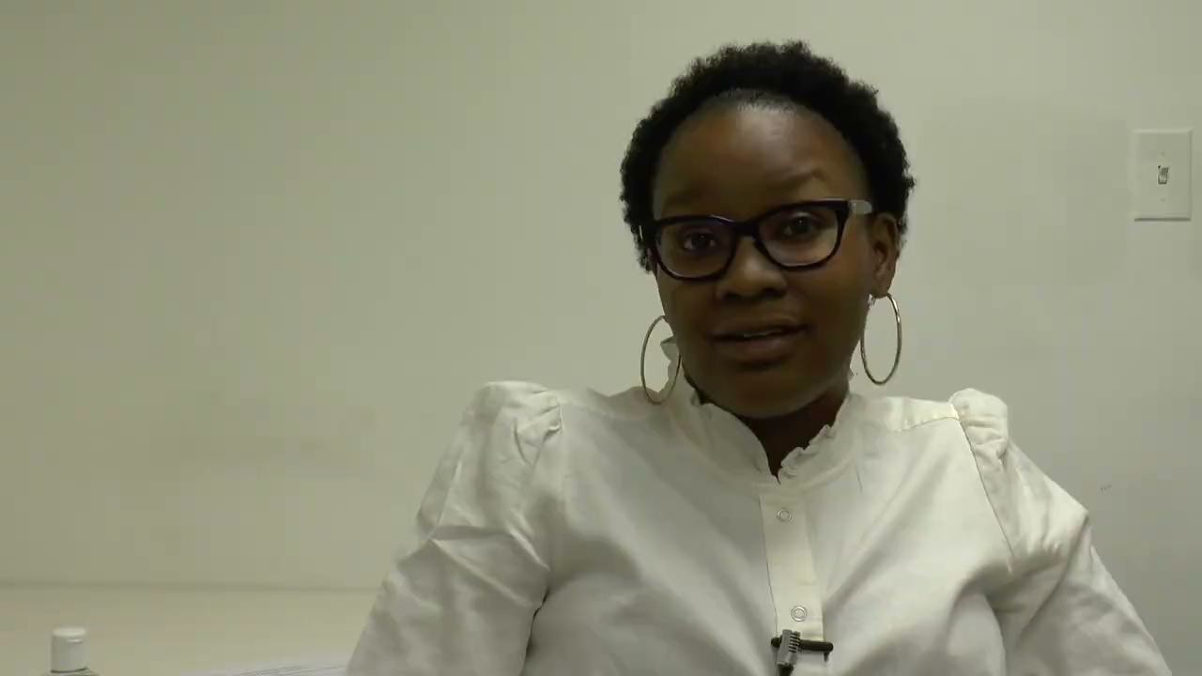
Lived Experiences
Kawanna worked throughout her illness to stay afloat financially.

Slide 16
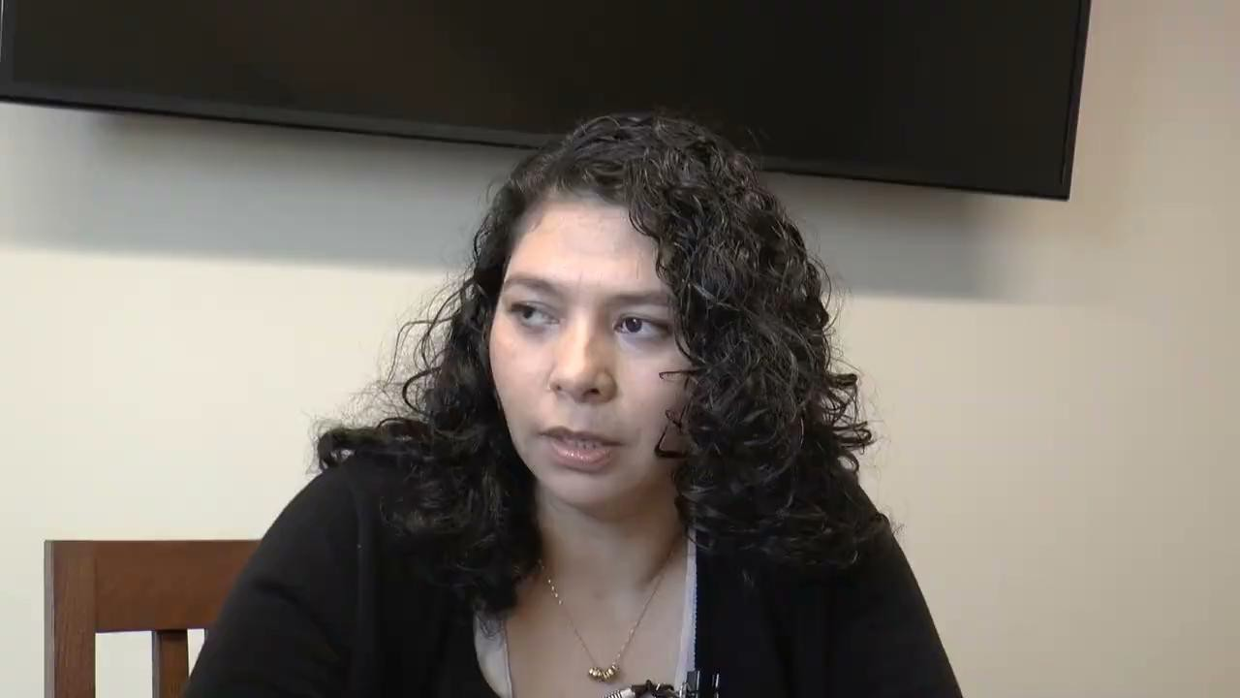
Lived Experiences
Maria de Los Angeles was turned away from a clinic because she was uninsured.
English translation: So, I waited a few weeks for the results, and they called me and said that they wanted to speak with me in person, and then they told me that it was cancer.
Yes, it was hard. I was worrying because we didn’t have the means, the money. And as a Hispanic or Latino, well, one worries, right? That what if the medical insurance… We searched for information. They sent us to a clinic where, by the way, since I didn’t have insurance, they rejected my first appointment.

Slide 17
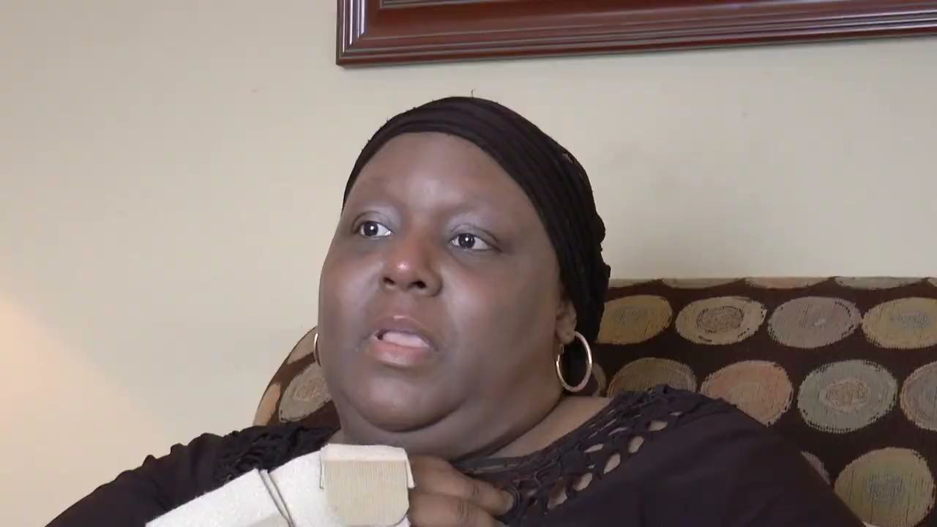
Lived Experiences
Katrina worries that being on Medicaid means receiving lower quality care.

Slide 18
Exploring SDOH in HERN Modules
Living with Gulf War Illness: Messages, Lessons, and Recommendations for other Veterans and Service Members
https://www.healthexperiencesusa.org/Gulf-War-Illness/Messages-Lessons-and-Recommendations-for-Other-Veterans-and
-Service-Members
“Messages and recommendations primarily fell under these categories: accessing resources, coping with life after the military…obtaining support, and education”
Traumatic Brain Injury in Veterans: Services & Programs for Veterans
https://www.healthexperiencesusa.org/Traumatic-Brain-Injury-in-Veterans/Getting-Care-at-VA
“One Veteran talked about using services provided for rental assistance and food stamps. A Veteran from the Vietnam era we interviewed said he did not know about all of the services available to him when he was first struggling with his condition”
Living with MS: Work and School
https://www.healthexperiencesusa.org/Multiple-Sclerosis/Work-and-School
“Grace worried about the long-term ramifications of not working on saving for retirement and Kara described being eager to return to her job after her diagnosis because she has bills to pay. Despite the impact of symptoms on their job experiences, many people discussed the need to work”.

Slide 19
HERN Applications
Education

Slide 20
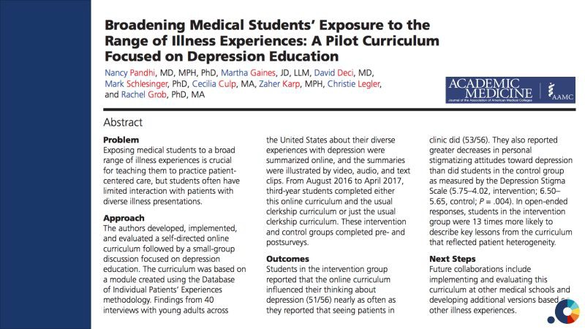

Slide 21
Helping all UNM Residents Think about SDOH
Case-Based workshop offered on the first day of Graduate Medical Education orientation
Illustrated by vignettes from the HERN website
View cases as a large group
Discussions facilitated by experienced Faculty
Materials developed by and displayed with permission from the current UNM GME leadership team: Drs. Miranda Aragon & Natalie M. Salas
Gratitude also to Dr. Suman Pal, now at UMN, who initially fostered this collaboration and participated in curricular development

Slide 22
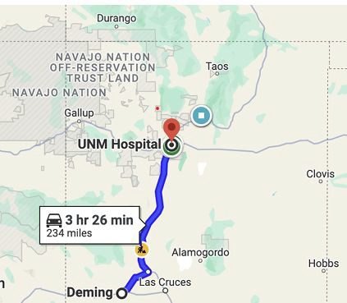
Vignette Example
Zoe lives in Deming, New Mexico (see map) and her daughter Sofya has kidney failure from post streptococcal glomerular nephritis.
Sofya was approved for a kidney transplant, but few family members were available to test for donor eligibility. Sofya’s biological father has had no contact with the family for several years and Zoe has no other children.
Luckily, Zoe was found to be a donor match! She was initially elated that her ability to be a donor would spare her daughter months of dialysis.

Slide 23
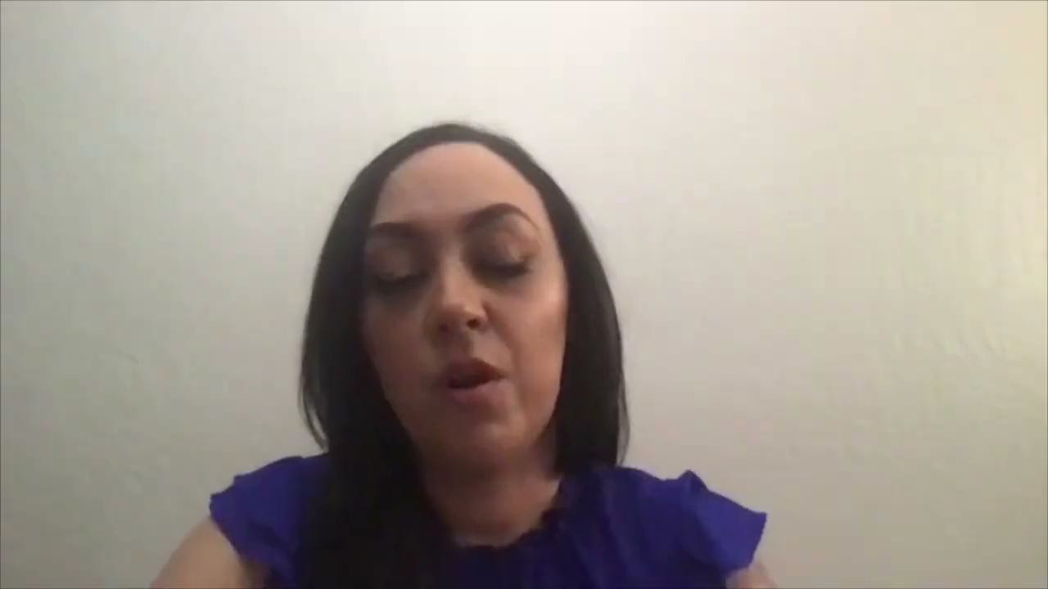
Lived Experiences
Travel barriers and delays in testing

Slide 24
List of Zoe’s appointments required prior to kidney donation
Primary care appointment for physical exam
Primary care appointment for cervical cancer screening
Laboratory appointment for testing
Mammogram appointment
Dental appointment for routine evaluation (able to do in Deming)
Dental appointment for filling for cavity found on evaluation
Behavioral health appointment for psychological assessment
Echocardiogram
Appointment with Nephrology
Kidney Ultrasound
Interventional radiology appointment for kidney biopsy

Slide 25
Facilitated discussion questions
When a patient is scheduled for several appointments at a tertiary center, what assumptions are we making about the patient for them to be able to adhere to the care plan?
What if Zoe and Sofya were from Gallup and had Indian Health Service insurance
What ideas do you have about how we could redesign outpatient health care to better support New Mexico’s large rural population?

Slide 26
Closing
After several months on dialysis, Sofya undergoes an uncomplicated
live kidney transplant surgery with a kidney donated by Zoe. While
recovering from surgery in the hospital, they share a hospital room.
Zoe shared that this was hard for her because she did not want Sofya to see her in pain.
The hospital coordinated a hotel room for them to stay in for the
month after discharge, and this helped significantly with
transportation and making it to their many appointments in the post-op period.
Sofya has not required dialysis since transplant.

Slide 27
Call to Action
We want to partner with you!

Slide 28

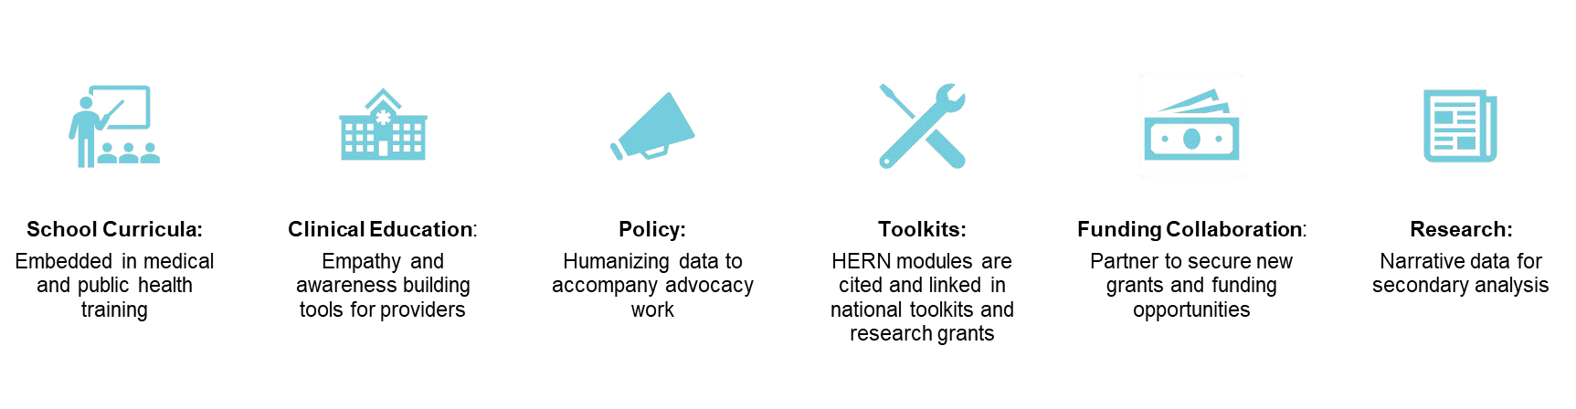
How to Get Involved

Slide 29



Save the Date!
HEALTH EXPERIENCES RESEARCH
2026 Training Tentative dates: May 18-21
For updates, please contact HERNTraining@salud.unm.edu
Hosted by the University of New Mexico Southwest Center for Advancing Clinical and Translational Innovation (Southwest CACTI)
Instructors from: University of Wisconsin-Madison · Oregon Health & Sciences University · University of New Mexico · University of Utah School of Medicine · John Hopkins Bloomberg School of Public Health · Yale School of Public Health

Slide 30
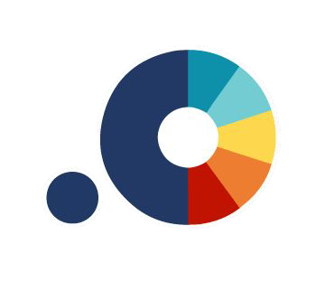

THANK YOU!
Follow us on Instagram @healthexusa
Check out our website:
HealthexperiencesUSA

Slide 31

Discussion

