Slide 1



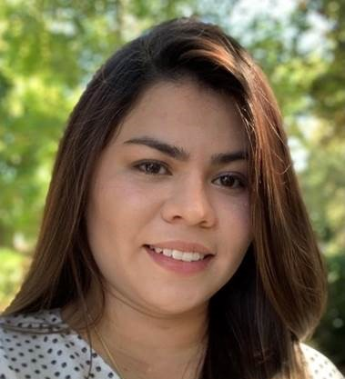
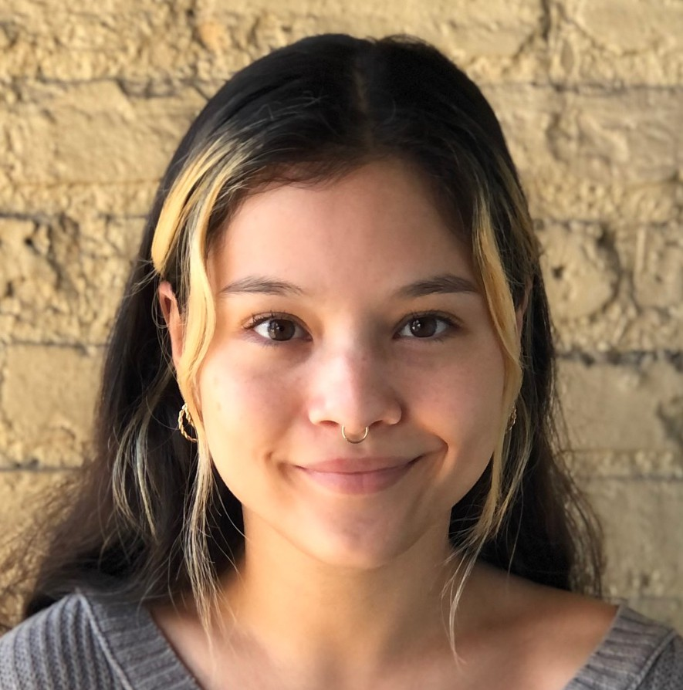
Assessing and Improving Patients’ Experiences During Phone-Based Social Needs Screening & Referral Interventions
June 22, 2023
Anna Steeves-Reece, PhD, _{Melissa Frangie} MPH, MA, OCHIN
Katherin Gómez OHSU
Minnie Kang

Slide 2


Assessing and Improving Patients’ Experiences During Phone-Based Social Needs Screening & Referral Interventions
SIREN Research and Dissemination Series June 22, 2023
Anna Steeves-Reece Melissa Frangie Katherin Gómez Minnie Kang

Slide 3

Accountable Health Communities (AHC) Model
AHC Eligibility:
Community dwelling Medicare & Medicaid beneficiaries accessing health care at participating clinical delivery sites
AHC Screening Tool:
Food insecurity
Housing instability & quality
Utility needs
Transportation needs
Interpersonal violence

Slide 4

AHC Model Implementation
28 “bridge” organizations implemented the AHC Model nationally
Oregon Rural Practice-based Research Network (ORPRN)
  Recruited clinical delivery sites to participate
  Aligned partners to optimize community capacity to address needs
  Responsible for data collection & management
https://www.ohsu.edu/oregon-rural-practice-based-research-network

Slide 5
Study 1
Steeves-Reece A, Davis M, Hiebert Larson J, Major-McDowall Z, King A, Nicolaidis C, Goldberg B, Richardson D, Lindner L. Patients’ willingness to accept social needs navigation after in-person vs. remote screening: a cross-sectional study. JABFM.
https://www.jabfm.org/content/jabfp/36/2/229.full.pdf

Slide 6
Eligible Participants
Participated in the AHC Model (10/2018 through 12/2020)
Were offered resource navigation assistance
Offered Resource
Navigation Assistance
Accepted Assistance
Declined Assistance

Slide 7
Analytic Approach
Testing whether two people presenting with the same number of social needs would be equally likely to accept navigation assistance whether they were screened in person or remotely.
Variable Name | Model | Variable Type
Willingness to Accept Social Needs Navigation | Dependent Variable | Binary
Interaction Term – Total # Social Needs + Screening Mode | Predictor Variables | Categorical
Total # of Social Needs – From 1 to 5 |  | Ordinal
Screening Mode – In Person vs. Remote |  | Binary
Ethnicity | Confounding Variables | Binary
Race |  | Categorical
Sex |  | Binary
Rurality |  | Binary
Age |  | Categorical
Proxy |  | Categorical
Income |  | Categorical

Slide 8
Study Sample – Medicare & Medicaid Beneficiaries
October 2018 through December 2020
14,691 participants with ≥1 screen
2,741 qualified for navigation assistance AND had outcome data
1,504 were included in the final model
653 screened in person 851 screened by phone

Slide 9
Social Needs & Navigation Acceptance (N=1,504)
Total # Social Needs
Remote (n=851)
In Person (n=653)
26% |  | 31% |  |  | 24% |  |  |  | 15% |  | 4%
39% |  |  | 28% |  |  |  | 20% |  |  | 10% 3%
0%
20%
2 needs
40%
3 needs
60%
4 needs 5 needs
80%
100%
1 need
% Accepted Navigation Assistance
Remote (n=851)
In Person (n=653)
77%
63%
0%
20%
40%
60%
80%
100%

Slide 10
Ethnicity and Race (N=1504)
% Yes – Question: “Are you Hispanic, Latino/a, or of Spanish origin?”
Remote (n=851)
15%
In Person (n=653)
12%
0% 20% 40% 60% 80%
% Yes – Question: “Which one or more of the following would you say is your race?”
100%
2%
Remote (n=851)
1%
In Person (n=653)
2%
4%
8%
12%
8%
66%
1%
2%
9%
8%
4%
76%
 | 0% |  | 20% | 40% | 60% |  | 80% | 100%
NHPI | Asian | AIAN |  | Black or African American | Other | Multiple | White

Slide 11
Additional Demographics (N=1,504)
Mean Age
% Male
Remote (n=851)
In Person (n=653)
Remote (n=851)
38%
40
In Person (n=653)
32%
43
0%
20%
40%
60%
80%
100%
% Annual Household Income <$10,000
% Rural or Frontier
Remote (n=851)
39%
Remote (n=851)
16%
In Person (n=653)
40%
In Person (n=653)
54%
0%
20%
40%
60%
80%
100%
0%
20%
40%
60%
80%
100%

Slide 12
Additional Demographics
% Yes – Question: “I am answering this survey about…”
3%
Remote (n=851)
13%
84%
2%
In Person (n=653)
2%
8%
88%
0% | 20% | 40% |  | 60% |  | 80% | 100%
Other | Another Adult |  | My Child |  | Myself

Slide 13



Logistic Regression Results
Adjusted OR of Accepting Navigation Given the # of Social Needs
1 need
1
2 needs
1.4
3 needs
2.9
4 needs
3.2
5 needs
5.2
0
1
2
3
4
5
6
7
8
9
10

Slide 14
Logistic Regression Results
Adjusted OR – Screening Mode & Interaction Terms
Variable aOR (95% CI) P value
Screening Mode
In Person | 1 [Reference] | NA
Remote | 1.3 (.6 – 2.9) | .50
Interaction Term (Total # Social Needs * Screening Mode)
1 need * remote | 1 [Reference] | NA
2 needs * remote | .9 (.5 – 1.7) | .78
3 needs * remote | .5 (.3 – 1.0) | .06
4 needs * remote | 1.3 (.5 – 3.4) | .60
5 needs * remote | .4 (.16 – 1.2) | .10

Slide 15
Healthcare organizations may…
Conclusions & Implications for Practice
Screen patients for social needs remotely, knowing there is not evidence that doing so will adversely impact patients’ willingness to accept navigation.
Screen patients for social needs remotely, knowing that it may also have advantages from a health equity perspective.
However, remote screening may also have health equity disadvantages (e.g., for those with limited English proficiency and technological barriers).

Slide 16
Study 2
Steeves-Reece A, Nicolaidis C, Richardson D, Frangie M, Gomez-Arboleda K, Barnes C, Kang M, Goldberg B, Lindner S, Davis M. “It made me feel like things are starting to change in society:” a qualitative study to foster positive patient experiences during phone-based social needs interventions. IJERPH.
https://www.mdpi.com/1660-4601/19/19/12668

Slide 17
AHC Model Interviewees
Interviewees:
Medicare & Medicaid Beneficiaries
Participated in the AHC Model in Oregon
Qualified for resource navigation assistance
Accepted resource navigation assistance
Offered Resource Navigation Assistance
Accepted Assistance
Declined Assistance
Clinical Delivery Sites:
Emergency Department & Federally Qualified Health Center
Phone-based screening & referral

Slide 18
Pragmatic Qualitative Study
Interview Guide Development
Purposeful Sampling Strategy (Maximum Variation)
Recruitment, Data Collection, and Information Power
Reflexive Thematic Analysis

Slide 19
Interviewee Demographics (N=34)
Race and Ethnicity (Combined)* | n (%)
American Indian or Alaska Native | 2 (6%)
Asian | 1 (3%)
Black or African American | 5 (15%)
Hispanic, Latino/a, or of Spanish Origin | 10 (29%)
Native Hawaiian or Other Pacific Islander | 1 (3%)
White | 17 (50%)
Other | 7 (21%)
No Response | 3 (9%)
Spanish Language Interview | n (%)
No | 29 (35%)
Yes | 5 (15%)
Sex | n (%)
Female Male | 20 (59%) 14 (41%)
Age | n (%)
<20 | 2 (6%)
20-29 | 7 (21%)
30-39 | 3 (9%)
40-49 | 4 (12%)
50-59 | 7 (21%)
>60 | 11 (32%)

Slide 20
Interviewee Social Needs (N=34)
Types* | n (%)
Food | 27 (79%)
Housing | 26 (76%)
Transportation | 16 (47%)
Utilities | 8 (24%)
Interpersonal Safety | 3 (9%)
Quantity | n (%)
1 | 8 (24%)
2 | 10 (29%)
3 | 12 (35%)
4 | 4 (12%)
5 | 0 (0%)

Slide 21
Interviewees’ AHC Model Outcomes (N=34)
100%
80%
60%
40%
20%
0%
26
20
14
9
Remembered Received Social Outreached to
Accessed ≥ 1 Resource for Social Needs
Social Needs Screening Call
Needs Resources Information
Yes
≥ 1 Social Needs Resource

Slide 22
Theme 1 – Patients were likely to be initially skeptical and/or have reservations about the social needs questions.
“I’m very inquisitive when it comes to that … At first [I ask], ‘Where are you calling me from? Why are you calling me?’ Not just anyone is going to be helping a person. Sometimes they just do it to grab your information.”
45- to 54-year-old Hispanic female (translated from Spanish)
“With my daughter’s disability there was [Department of Human Services] involved quite a bit in our household. Maybe it would cause her more problems to admit to some of this stuff.”
65- to 74-year-old White female

Slide 23
Theme 2 – Immediate transparency and ongoing respect for autonomy were fundamental.
“It seemed like a scam at first, but because I know [the healthcare organization] and I’ve been going there since I was like two years old, I was like, ‘No, there’s no way it’s a scam.’”
<25-year-old White female
“I mean, I don’t want to be hassled if I tell them that everything is good … If I’m not in a good place, I’ll ask them. I don’t want to be pressured or hassled.”
45- to 54-year-old Black male

Slide 24
Theme 3 – Showing kindness for the patient through one’s demeanor was important.
“The tone of voice she maintained the whole time was also really helpful … Just maintaining maybe a soft, it doesn’t always have to be soft, but just like a calming [voice] … It’s very stereotypical, but it does work.”
<25-year-old Hispanic female (a)
“She wasn’t very kind, too. Just quick and short … The tone in her voice, it seemed like she was in a big hurry … I had the feeling she didn’t have her morning coffee … There was just no life and no concern, no personal interest in what she was saying.”
55- to 64-year-old White female

Slide 25
Theme 4 – Demonstrating a genuine intention to connect patients with resources mattered.
“As long as I think it’s gonna help me and not hurt me, I’m willing to answer the question.”
45- to 54-year-old American Indian or Alaska Native female
Interviewer: “Is it okay to ask [about social needs], even when help or resources cannot be guaranteed?” Interviewee: “It depends on the person. Look, there are times when, if they are going to help you, that’s fine! But if they are one of those people who doesn’t want to help, they will not explain it to you. Interviewer: “So, more like what are the intentions [of the person]?” Interviewee: “Yes.”
45- to 54-year-old Hispanic male (translated from Spanish)

Slide 26
Theme 5 – The degree of attentiveness & responsiveness to patient circumstances & requests impacted their experience.
“I’m just really anxious about stuff like that, especially in regards to paperwork and legal stuff, I would have been too afraid of doing it wrong.”
<25-year-old Hispanic female (b)
“Well, I told him, ‘I live in [County A], so do you [have] anything in [County A]?’ But they gave me the [number for County B] … That’s the problem … I don’t need [County B].”
45- to 54-year-old Asian male

Slide 27
Theme 6 – Patients could be left feeling appreciative or hopeful, whether they accessed resources or not.
“I was happy [to be asked the social needs screening questions] because it made me feel like things are starting to change in society … I really felt important and like things are starting to change.”
25- to 34-year-old Hispanic female (Didn’t Access Resources)
“The way that my situation was handled … [it] went above and beyond what I needed even … Honestly, I didn’t’ know that it was something that healthcare organizations took care of. I mean, it’s more of a well-being business, you know, as opposed to just health. And that’s something that I didn’t realize that you guys did.”
<25-year-old White male (Didn’t Access Resources)

Slide 28
Theme 6 – Patients could be left feeling appreciative or hopeful, whether they accessed resources or not.
“It’s giving so much hope and kindness … Because of COVID … because of my heart condition and health condition … I have to stay away from people, I don’t have the vaccine yet because of my heart and everything. So, I’m not as social as I used to be. And some people, their lights go dim. And you guys are like the lighthouse on the beach, saying, ‘Here’s the light, I’m trying to shine it to you.’”
45- to 54-year-old Multiracial female (Accessed Resources)

Slide 29


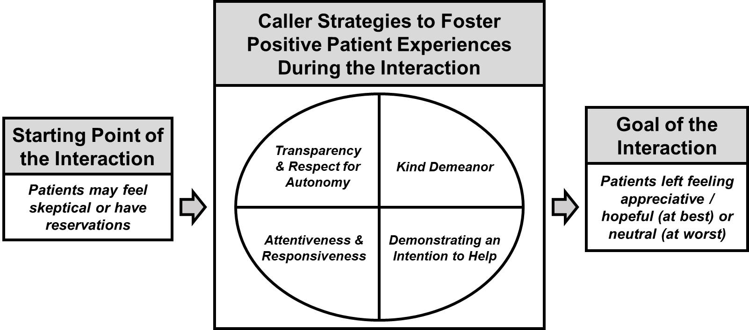
Framework for Fostering Positive Patient Experiences During Phone-based Social Needs Screening & Referral Interactions

Slide 30




Conclusions & Implications for Practice
Healthcare organizations may…
Use our framework to train those who will be calling patients for social needs screening & referral interventions.
Create conditions in which callers can do this work most effectively.

Slide 31
Thank you! Questions?
Contact Information:
Anna Steeves-Reece, PhD (she/her) Investigator I | OCHIN, Inc. steevesreecea@ochin.org https://ochin.org/research

