Slide 1



blueshieldcafoundation.org
mathematica.org

Slide 2





Partners
2
2

Slide 3










blueshieldcafoundation.org

Slide 4




Slide 5

















Slide 6























•
•
•
•

Slide 7























Slide 8








Slide 9


Slide 10


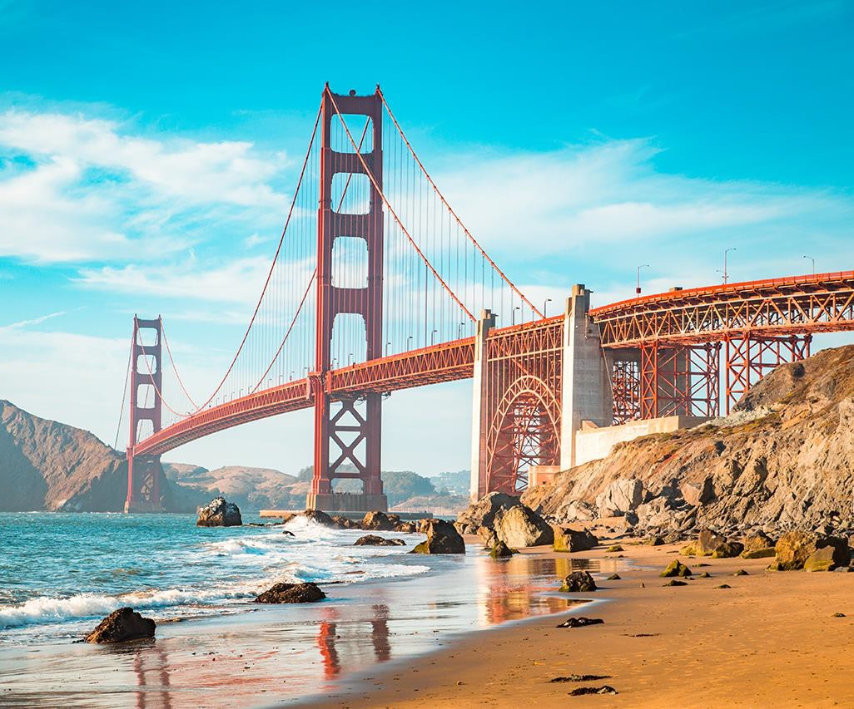



















•
•
•
•
•
•
•

Slide 11
















Environmental scan process
•
•
•
•
•
•
•
Review literature, conduct interviews
Develop draft policy options
Engage experts
Solicit feedback
Publish policy briefs
11

Slide 12


Slide 13
1. Promote universal IPV education, assessment and response
13

Slide 14














•
•
•

Slide 15





























Slide 16






Slide 17





















Slide 18




18

Slide 19









19

Slide 20





20

Slide 21




21

Slide 22




22

Slide 23














23

Slide 24




Slide 25








































Slide 26


Slide 27




























•
•
•
•

Slide 28









•
•
•
•
28

Slide 29


Slide 30


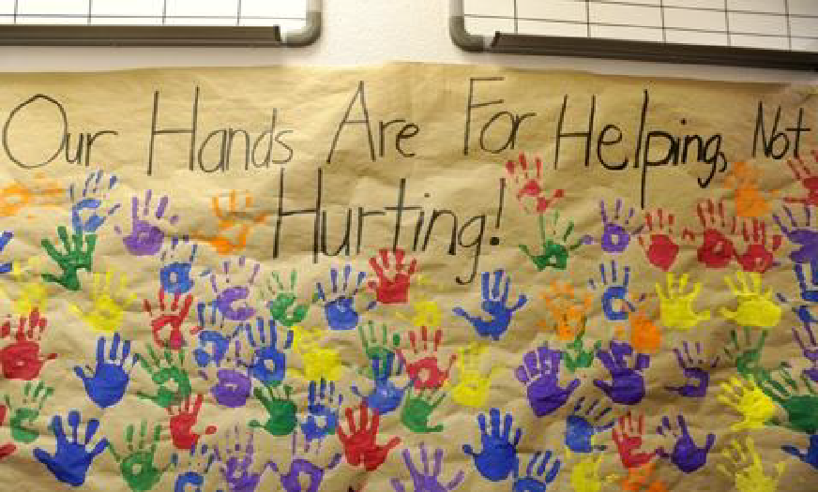





















Slide 31






Slide 32





Slide 33







Slide 34










Slide 35












•
•
•
•
mathematica.org

