Slide 1


Separating the dimensions of network performance for coordinated care networks
Zachary Bridgewater Joshua-Paul Miles Catherine Annis
Gilly Cantor Michelle Shumate
© 2025, IVMF at Syracuse University. This content may be distributed freely for educational and research uses as long as this copyright notice is attached. No commercial use of this material may be made without express written permission.

Slide 2
Overview
A semi-fictitious story
Performance measures in care and service delivery
Study methodology
Preliminary results
Next steps

Slide 3
Ann’s care journey
The navigator reaches out to different organizations that could provide Ann the services she is seeking
Ann speaks to a care navigator
The navigator also uncovers an additional need (benefits enrollment).

Slide 4

Ann’s care journey
It took a couple weeks, but Ann found a doctor she likes who offers the care she needs
The county VSO is now working with Ann on her benefits application, but she’ll likely wait several months for a determination
Ann has met with several different therapists and is still searching for one she feels will get her military experiences
The navigator helped Ann find a local budgeting class in just a couple days
Ann applied to a local community college and should start classes in a little over a month

Slide 5
How can we evaluate coordinated care networks?

Slide 6
Performance in Service & Care Networks

Slide 7
Evaluation is context-dependent
Healthcare
Mental Health
Housing
Cost of services
Patient count
Drug efficacy
Wait time
ER visits
Inpatient time
Pain level
Cost of services
Patient count
Drug efficacy
Screener scores
Suicidality
PIT count
Literally homeless count
Shelter count
Bed count

Slide 8
The context of coordinated care networks
Coordinated care networks (CCNs) typically are:
groups of organizations providing different services
by referring clients with concurrent needs
via a central navigator organization
and that use a common intake to identify needs
Carboni et al. (2022); Shumate (2021)

Slide 9
Community
Effectiveness and levels of analysis
Cost to community
Public perception that problem is being solved
Changes in the incidence of the problem
Aggregate indicators of client well-being
Network membership growth
Range of services provided
Absence of service duplication
Cost of network maintenance
Network
Organization
/ Client
Cost of services
Service access
Client outcomes
Drawn from Provan and Milward (2001)

Slide 10
The value of operational approaches
Referral management systems are more commonplace (Goldberg & Nash, 2021)
Most referral management systems collect and store data relevant to coordinating care (SIREN, 2019)
Organizations and staff have greater control over and can respond more quickly to data related to their daily operations (Carboni et al., 2022)

Slide 11
What metrics already exist?
Type | What does it assess? | Examples
Quality Control | Interaction between a client and members of the network | Types of questions asked Was an appropriate referral made?
Demand | Who is seeking what services and from where | Count of clients requesting services Client demographics Client geography
Supply | What services are available and to what extent | Count of providers Capacity of available services
Referral | The efficacy of the system at referring clients to services | Count of rejected referrals Wait time until services start Count of resolved referrals
System Impact | Broader changes to community experience and system utility | Cost of care Community health outcomes
Drawn from Shumate (2021)

Slide 12
Our research objectives
Type | What does it assess? | Examples
Referral | The efficacy of the system at referring clients to services | Count of rejected referrals Wait time until services start Count of resolved referrals
Identify distinct performance patterns among CCNs tracking referral metrics
Generate recommendations for practitioners building out their evaluation efforts

Slide 13
Study Methodology

Slide 14
Sample information
Network model: AmericaServes Timeframe: 2015-2023 Platform: Unite Us
# Networks: 11
# Clients: 28,697
# Requests: 71,991

Slide 15
Performance data in Unite Us
Time to service: the time in days between when a request began and the client received a response
Accuracy: whether a request experienced one or more rejections (accurate requests = 1)
Resolution: whether a request resulted in services provided to the client (resolved requests = 1)

Slide 16
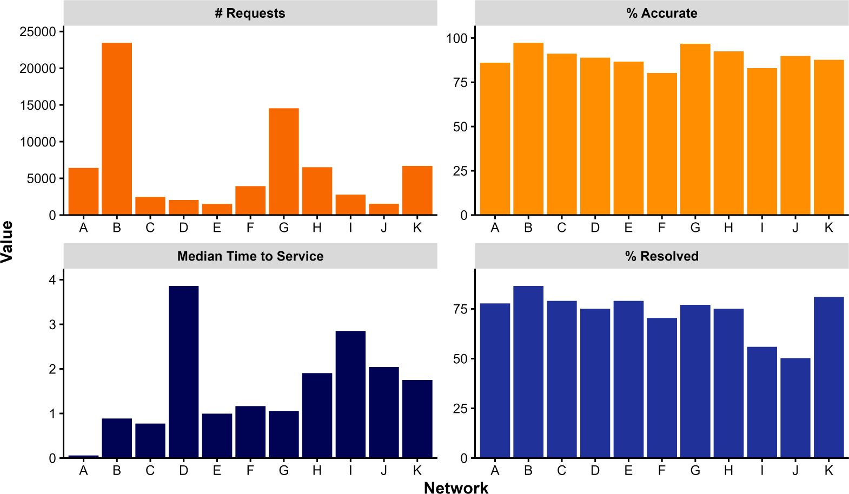
Sample descriptives
Overall
# Requests: 71,991
Median Time to Services: 0.99 days
% Accurate: 93%
% Resolved: 79%

Slide 17
Preliminary Results

Slide 18
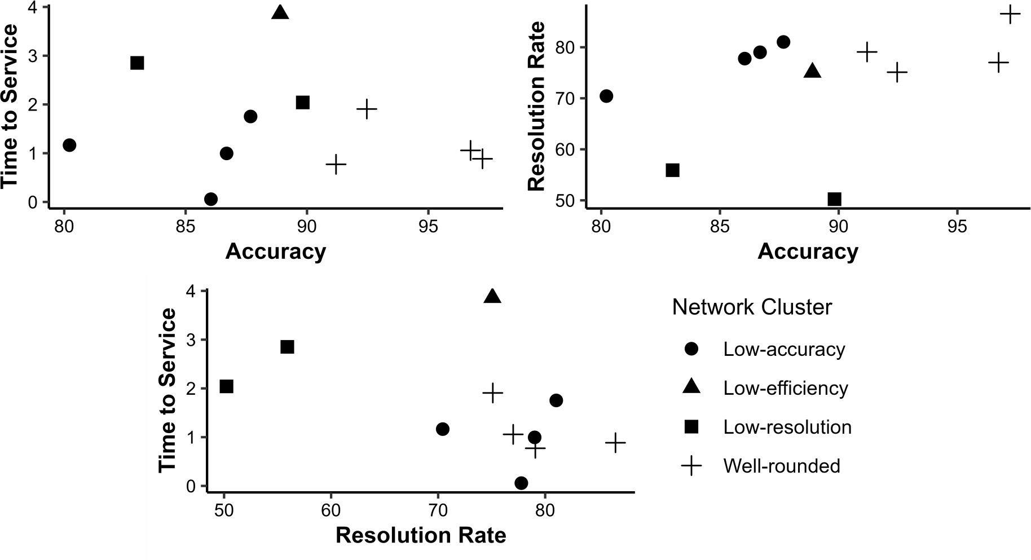
Cluster analysis

Slide 19
Correlation matrix
Network | TTS x Accuracy |  | TTS x Resolution |  | Accuracy x Resolution
A | -0.08 | *** | -0.03 | † | 0.43 | ***
B | -0.02 | *** | -0.03 | *** | 0.13 | ***
C | -0.17 | *** | -0.11 | *** | 0.25 | ***
D | -0.06 | * | 0.01 |  | 0.19 | ***
E | -0.16 | *** | 0.00 |  | 0.23 | ***
F | -0.10 | *** | -0.01 |  | 0.43 | ***
G | -0.07 | *** | -0.07 | *** | 0.17 | ***
H | -0.10 | *** | -0.07 | *** | 0.16 | ***
I | -0.04 |  | -0.17 | *** | 0.16 | ***
J | -0.04 |  | 0.03 |  | 0.27 | ***
K | -0.14 | *** | -0.16 | *** | 0.02 | *
Overall | -0.08 | * | -0.06 | *** | 0.22 | ***

Slide 20
Recommendations for practitioners
Decide network goals. Speed, accuracy, and resolution
appear to be distinct performance markers.
Collect data on those goals. Data is an asset – it can enable
more targeted, actionable interventions.
Review network procedures. Aggregate performance
ultimately builds from small, daily efforts.
Revisit data framework. Regularly review collected data and
its utility for network purposes.

Slide 21
Next steps for research
Explore distinctiveness of performance metrics
Examine performance variations arising from service differences
Develop framework for comparing coordinated care networks

Slide 22
Thank you!
zabridge@syr.edu
ivmf.syracuse.edu
315.443.0141
@IVMFSyracuseU

