Slide 1

Take the next step on deepening lived
experience expertise in
social care research
SIREN National Research Meeting
February 4, 2025

Slide 2
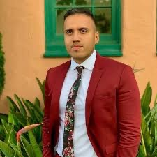


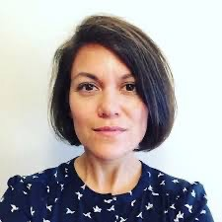
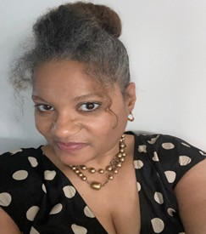
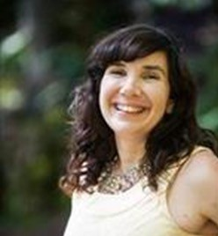
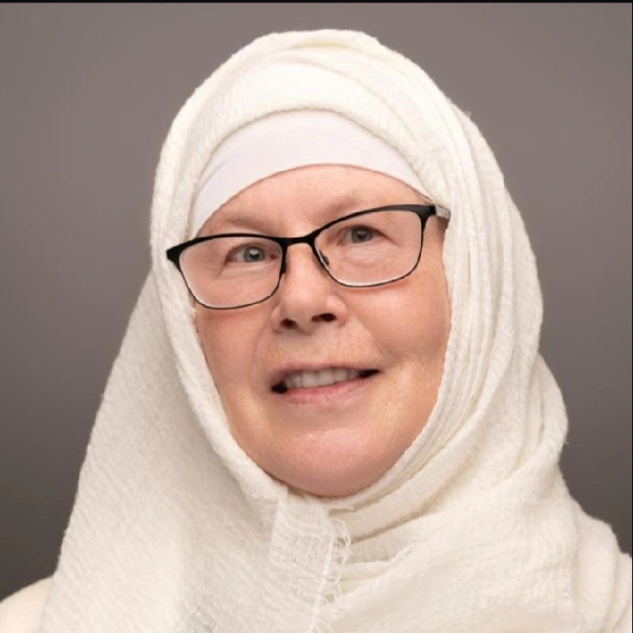
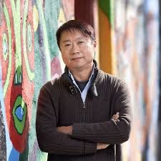

Who are we?
Benjamín Aceves San Diego State University
Rebekah Angove Patient Advocate Foundation
Sheree Boulet, DrPH Vice Chair of Research Department OB/GYN Boston University
Yuri Cartier, MPH Sr. Research Associate
SIREN
Tia Francis Lived Experience
Advisor
Danielle Hessler Jones Co-director
SIREN
Janice Tufte Lived Experience Advisor
Whitney Thurman UTexas Austin
Eric Wat Independent Consultant

Slide 3
Workshop Goals
Make connections and share learnings among individuals with a shared interest in deepening lived experience expertise in social care research.
Whether that be...
  Taking the first step today
  Connecting around specific challenges or barriers
  Identifying the next step along the continuum of engagement

Slide 4
Agenda
Introductions and level-set (15 min)
Breakout groups (30 min)
Room discussion (25 min)
Closing (5 min)

Slide 5
Why lived experience expertise is critical to social care research
Social care research aspires to address inequities, however achieving this requires researchers to improve and deepen their partnerships with individuals and communities impacted by social needs and interventions.
Those most affected by these issues are the experts of their lived experiences and should play an active role in designing solutions.
There is a larger movement with increasing energy to engage individuals with lived experience across all stages and activities of the research continuum.

Slide 6
SIREN’s engagement odyssey
SIREN’s first National Research Meeting (NRM) in 2019: panel about engaging patients in social care research
Surprising reactions
Internal discussions @ SIREN: how can we engage individuals with lived experience of social needs / social care?
2021 Partnership with PAF – Social Needs & Health Equity Learning Community of Experts by Experience (ExEs)
Deep involvement of ExEs in 2022 SIREN NRM
What’s stopping others?
Lack of funding, infrastructure, mentorship
Robert Wood Johnson Foundation funds SIREN Engagement Grants + Preconference

Slide 7
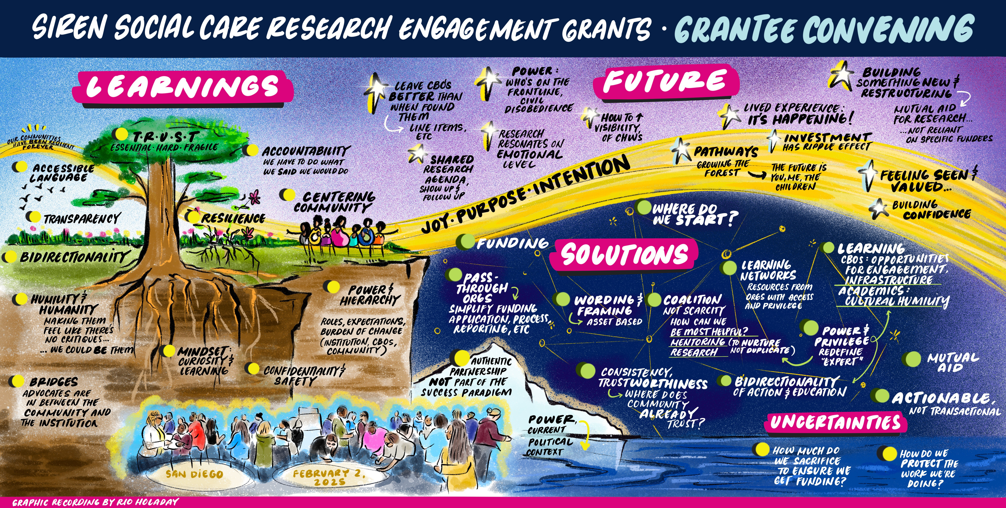

Slide 8
QUICK POLL
What’s your experience level?
What are your burning questions?

Slide 9
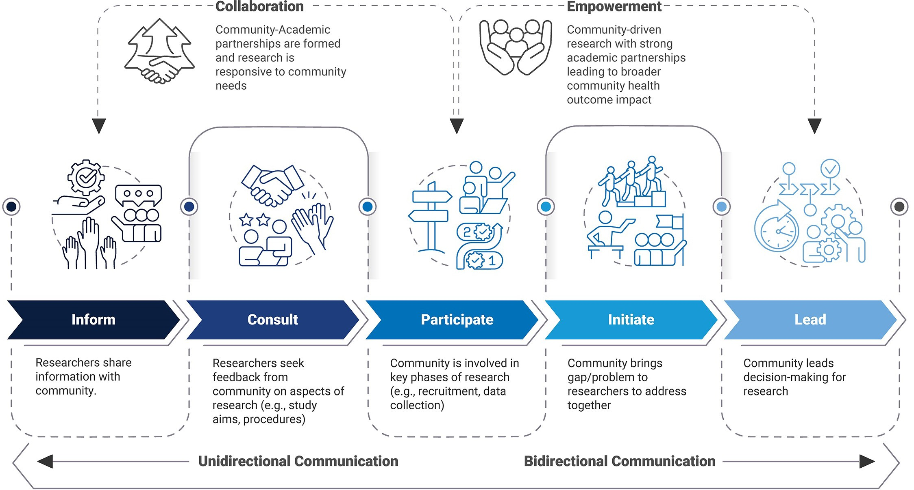
The engagement continuum
https://ctsi.psu.edu/cheer/researcher/community-engaged-research/

Slide 10
What are some of the different forms “engagement” can take?
Focus group or key informant interviews
Community advisory/advocacy board or workgroup
Equal partner in developing and conducting research
  Develop research question
  Review questionnaires and interview guides
  Advise on recruitment and retention strategies
  Interpret findings
  Design infographics
  Co-author publications and other communications
What to avoid: tokenism
  Strive to maintain environment of openness & learning, transparency & trust

Slide 11
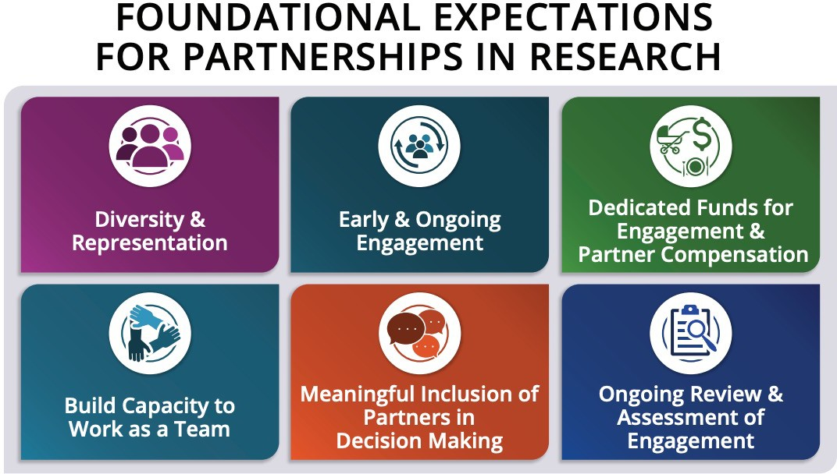
PCORI is committed to Patient and Community involvement. They emphasize that interest holder engagement in research is early, ongoing, sustainable and meaningful.
https://www.pcori.org/sites/default/files/PCORI-Foundational-Expectations-for-Partnerships-In-Research.pdf

Slide 12
Recommended resources
SIREN antiracism guidelines - https://tiny.ucsf.edu/SIRENantiracism
Fair market value calculator or SOL wages https://nationalhealthcouncil.org/fair-market-value-calculator/
PCORI Foundational Expectations - https://www.pcori.org/engagement-research/engagement-resources/foundational-expectations
UCSF community engagement toolkit - https://communityengagement.ucsf.edu/
Detroit Community-Academic Urban Research Center - https://detroiturc.org/

Slide 13
Time for breakouts!
Sit at the table that best represents your experience level or interest!
Table facilitators will guide the discussion.

Slide 14
Post-Breakout Discussion
Something that challenged your way of thinking
Something you didn’t agree with or felt some tension about
Something that felt inspiring or empowering
Try to stick to sharing about just one thing and going deeper – this is not a report-back!

Slide 15
Closing exercise
- Write on your postcard:
- What’s one thing you are going to apply to your work?

