Slide 1

San Diego Interoperability & Data Integration
Alana G. Kalinowski, MSW 211/CIE San Diego
Director of Interoperability & Collective Impact

Slide 2



Nonprofit organization
San Diego County Region
Maintains free online searchable database of trusted, free or low-cost health and social services
Listed services are categorized by 211 Huaman Services Indexing System (211HSIS.org)
Operates a multilingual contact center available 24 hours a day
Information & referral services are provided in alignment with Inform USA standards
Approx. 200,000 unique clients served annually
Documented community needs
and referrals
Access to CIE ford care
Nonprofit Initiative/Program of 211 San Diego
Ecosystem of multidisciplinary network partners
Integrated technology
Including 211 San Diego's Resource Database
Shared language using Comprehensive Social Continuum Assessment which captures actionable social services information
Fosters collaboration across networks – community care coordination
Whole person/person-centered care
Goal is to improve health and wellness for individuals, systems, and populations
Nonprofit organization
Subsidiary of 211 San Diego
San Diego and Imperial County's
Health Information Exchange
Qualified Health Information Organization (QHIO), helping California healthcare providers comply with the CalHHS Data Exchange Framework (DxF)
FHIR-enabled interoperability platform
Efficient, interconnected, and patient-focused
Reduced interface costs for organization
Improved care coordination
Timely access to records for physicians
Community information Exchange® and CIE® are registered trademarks of 211 San Diego.

Slide 3
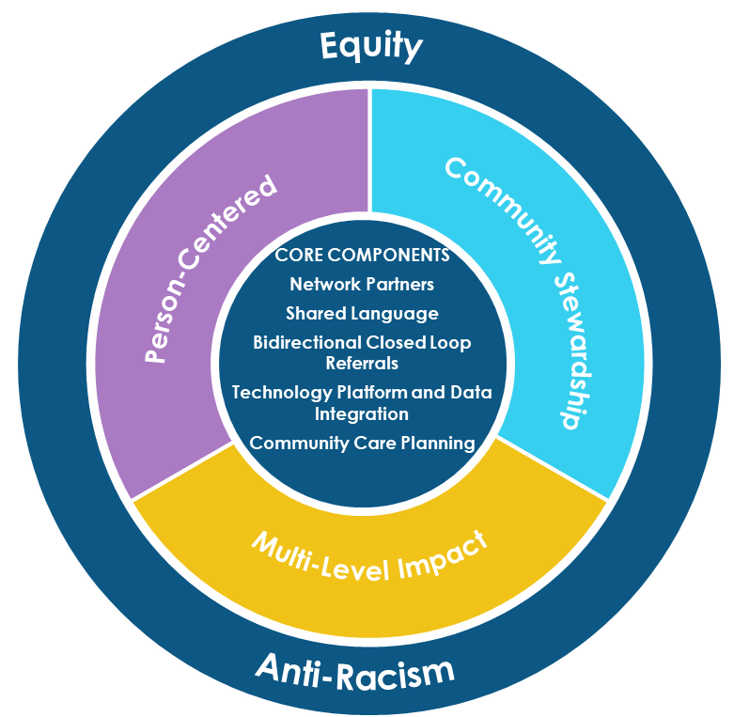
What is a Community Information Exchange (CIE)?
A CIE is community-governed
infrastructure that enables information
to be effectively and responsibly shared among many organizations, using different, interoperable technologies, in support of holistic coordination of care and equitable systems change. Specifically, a CIE enables the sharing of data among multiple kinds of stakeholders – such as providers who need to share data to provide more holistic care, people in need who must navigate complex systems of care, and researchers and decision-makers.
As critical infrastructure that supports many stakeholders, using many different technologies, a CIE can enhance understanding of individuals' and communities' needs, improving
service accessibility, service outcomes, and the health
and well-being of a community.

Slide 4
Types of Data in CIE San Diego
Client/Patient Demographics
Standardized Screening Tools
Strengths-based screening tools
Comprehensive assessments by Domain - Nature and immediacy of situation, barriers and supports in play, a person’s knowledge and ability to utilize resources
Alerts (e.g. EMS, Jail, SDoH Status Changes)
Program Enrollments
Referral sent, referral status, and referral outcomes (both hand off and client engagement), associated z-codes
Care Teams
Standardized Codes (ICD-10 Z-codes)
Relationships - Household structures
Eligibilities
Note and Attachments
Program Screening tools
Client Data Source - Who is contributing to this records
Field-level tracked history
Services, with encoded service descriptions - 211 HSIS (211LA Taxonomy)
Real-time “Bed count” availability
(CalAIM Recuperative Care)

Slide 5


















CIE-HIE-211Resource Database Interoperability
FQHC
Resource Database
HIE
API
CBO
Hospital
FHIR
API
API
CBO
Health Plan
Repository of shared client records
API
SFTP
CBO
File upload

Slide 6


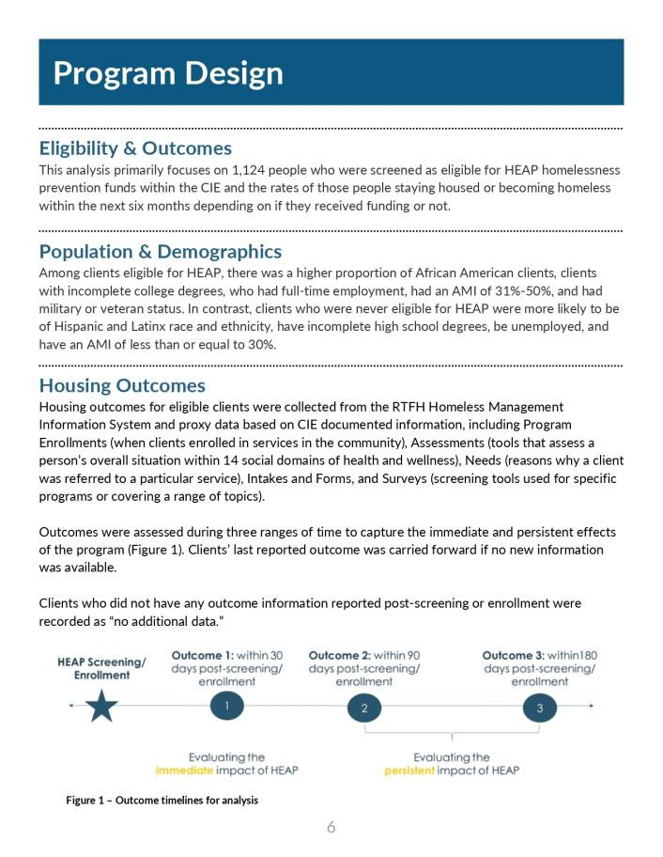
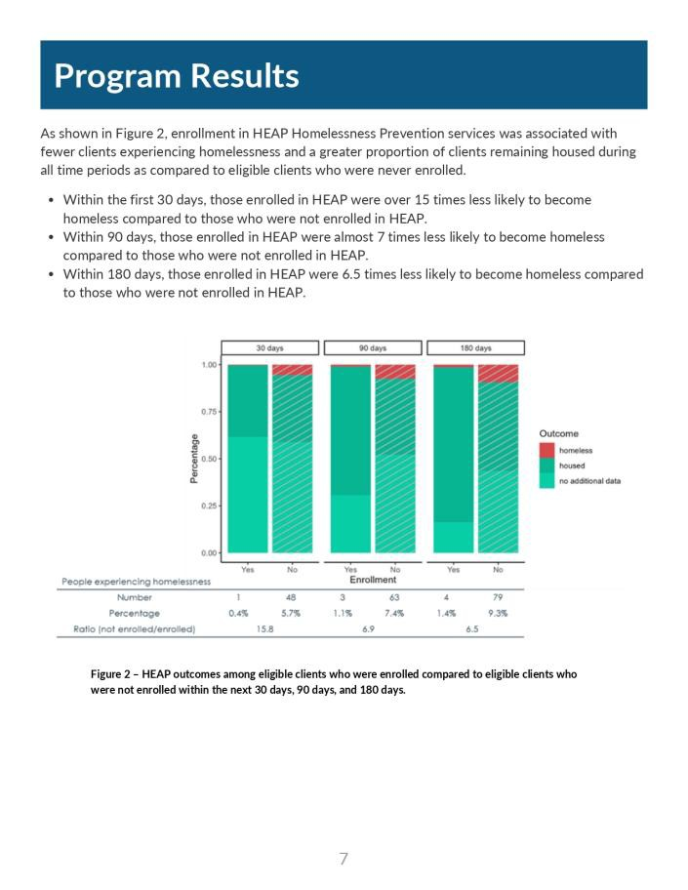
HEAP Summary
https://ciesandiego.org/2024/11/04/leveraging-collaboration-to-demonstrate-how-to-effectively-prevent-homelessness/

Slide 7
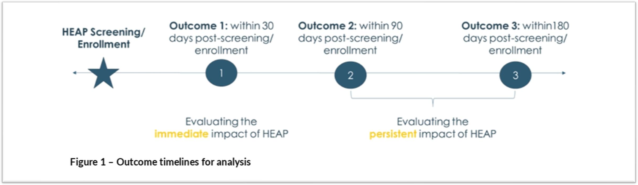
HEAP Summary
https://ciesandiego.org/2024/11/04/leveraging-collaboration-to-demonstrate-how-to-effectively-prevent-homelessness/

Slide 8
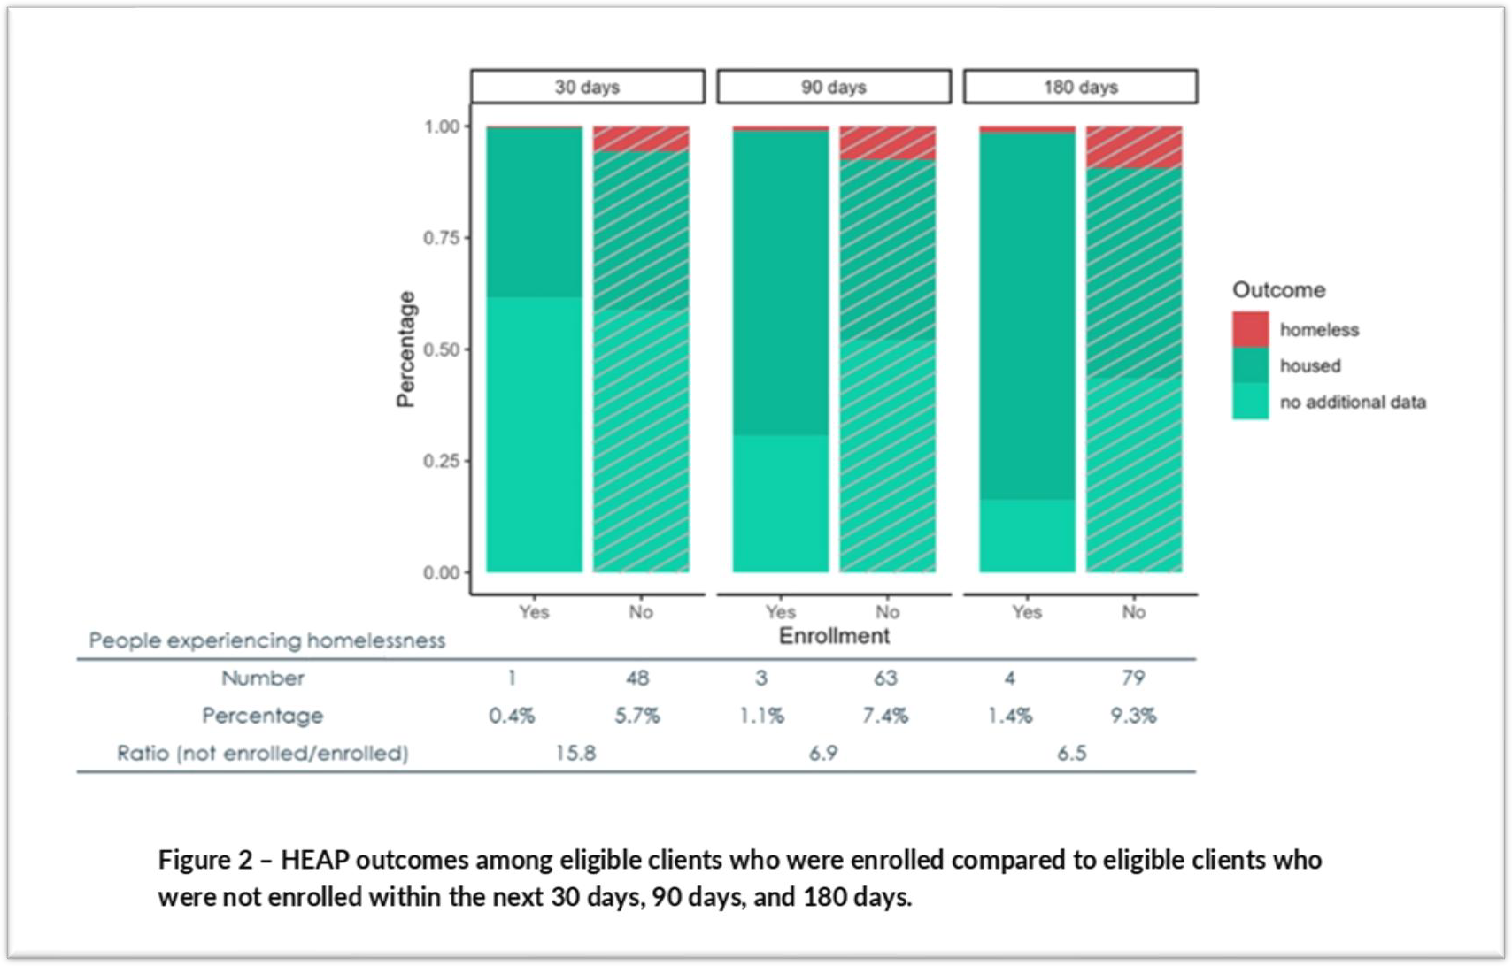
HEAP Summary
https://ciesandiego.org/2024/11/04/leveraging-collaboration-to-demonstrate-how-to-effectively-prevent-homelessness/

Slide 9

HEAP Homelessness Prevention Screening Tool
Source | Screening Questions | Logic/Notes | Definition
CIE | Screening Date
CIE | First Name
CIE | Last Name
CIE | Full DOB | Age automatically calculates
CIE | Household size
CIE | Zip code
SSVF/SDHC | Annual or Monthly Gross Income Amount? | If greater than 70% AMI, inappropriate (Automatically calculates AMI and FPL) | Income or wages before taxes
 | Current Monthly Rent
 | If applicable, are you willing to make adjustments to your living situation so that your rent is more affordable? | Yes No NA If no, inappropriate | Persons with a high rent burden who are unwilling to explore alternative living arrangements, are not appropriate for homeless prevention funds.

Slide 10
HEAP Homelessness Prevention Screening Tool
Source | Screening Questions | Logic/Notes | Definition
SDHC | Will you have verifiable income in the next 30-60 days? | Yes No Declined to state Data not captured If no, direct to other services | Proof of stable form of income can include: disability, retirement income, unemployment, self-employment income, employment pay stubs, bank deposits, etc.
SSVF | Approximately how much money do you currently have available in savings, liquid assets or other accounts? | Under $2,000 Over $2,000 Declined to state Data not captured If over $2000, inappropriate | This pertains to available liquid assets such as savings or 401K retirement accounts, and not items such as a person’s primary vehicle used for activities of daily living.
SDHC | Are you a veteran? (y/n) | Yes No Declined to state Data not captured No logic

Slide 11
HEAP Homelessness Prevention Screening Tool
Source | Screening Questions | Logic/Notes | Definition
SDHC | What is your discharge status? | Honorable General under honorable conditions Under other than honorable conditions (OTH) Bad conduct Dishonorable Uncharacterized Declined to state Data not captured N/A No Logic
SDHC | Are you safe in your current living situation? | Yes No Declined to state Data not captured If no, direct to other services | If a person is experiencing intimate partner violence or other threats to their safety, they should access resources specifically designed to assist in those situations. In instances of an unsafe situation due to home disrepair, client should seek tenants' rights or legal advocacy

Slide 12
HEAP Homelessness Prevention Screening Tool
Source | Screening Questions | Logic/Notes | Definition
SDHC | Are you currently housed? | Yes No Declined to state Data not captured If no, direct to other services | This can include lease, mortgage, non-lease, couch surfing, subletting, hotel/motel (non-voucher based) situations. Excludes anyone who is currently homeless.
SSVF | Sudden and significant decrease in cash income (employment and/or cash benefits) AND/OR unavoidable increase in non-discretionary expenses (e.g., rent or medical expenses) in the past 6 months | Yes No If no, direct to other services | This includes COVID-19 disruptions, and documentation providing proof of COVID-19 financial impact. You can find a list of documentation on the Legal Aid Society website.
SDHC (modified) | Do you currently have a rental subsidy? | Section 8 Permanent Supportive Housing VASH Project-based subsidy (is your rent amount based on your income) Other No subsidy (JR-9-13) Declined to state Data not captured No Logic | Client should first exhaust all potential supportive services associated with their rental subsidy before utilizing HEAP flexible funds. Client should exhaust all other available veteran related supports before accessing HEAP flexible funds (such as VASH vouchers)

Slide 13
HEAP Homelessness Prevention Screening Tool
Source | Screening Questions | Logic/Notes | Definition
SDHC | Have you been asked to leave or move out of your current resident in the next 14 days? | Yes No If no, direct to other services | This includes notice of a “3 day pay or quit” and if client has a 30-day or 60-day notice, it must be expiring within 14 days,
SDHC | Do you have a written notice from your landlord? | Yes No Declined to state Data not captured If no, direct to other services | If client does not have a written notice, instruct client to request something in writing from landlord, roommate, couch surfing situations, etc.
SDHC | Date of written notice | Date field (no logic)
SSVF | Approximately how much money would you need to pay immediately in order to keep your housing OR obtain other housing? | <$3,500 If more is owed, inappropriate | If client owes more than $3,500, they are considered not appropriate for funds. Potential expense types: arears, deposit, utilities, move in costs, car repair, medical bills, etc.

Slide 14
HEAP Homelessness Prevention Screening Tool
Source | Screening Questions | Logic/Notes | Definition
SDHC | Have you been paying the full rent amount on your own for 3 or more consecutive months within the past six months? | If no, direct to other services | This question aims to identify households that upon receiving one-time, limited funds for a specific expense, will be able to continue living independently without additional or ongoing financial support.
SDHC (modified) | What have you already tried to cover your past due costs? If yes, how? | Yes No Declined to state Data not captured Extension or payment plan with landlord Borrow from friends, immediate family, extended family Re-engage rapid re-housing support Decreased expenses Faith community If veteran, tried accessing veteran resources Other (text box) If all options have not already been explored, direct to other services | This question aims to identify all possible avenues for financial support available to client outside of HEAP flexible funds, and confirm that client has already exhausted those options for potential support.

Slide 15
HEAP Homelessness Prevention Screening Tool
Source | Screening Questions | Logic/Notes | Definition
RTFH | Have you ever experienced homelessness in the past? | No Logic | Indication of a past experience of homelessness can be used as a point of prioritization due to client’s increased vulnerability.
CIE | Gender Identity | Data not captured Intersex Man Woman Transgender Man Transgender Woman No Gender/ Gender non- conforming Other Declined to state No Logic

Slide 16
HEAP Homelessness Prevention Screening Tool
Source | Screening Questions | Logic/Notes | Definition
CIE | Sexual Orientation | Heterosexual or Straight Lesbian Gay Bisexual Pansexual Asexual Queer Questioning/unsure of sexual orientation Another sexual orientation Declined to state Data not captured No Logic

Slide 17
HEAP Homelessness Prevention Screening Tool
Source | Screening Questions | Logic/Notes | Definition
CIE | Health Condition | Cancer Cardiovascular Disease Dementia/Traumatic Brain Injury Dental Diabetes HIV/AIDS Mental Illness/Emotional Disability No health condition Obesity Physical and Cognitive Developmental Disability Physical Disability Sensory Disability Substance Abuse/Dependency Other Declined/Did not ask No Logic | Be sure to select all that apply. Failure to capture health conditions will result in a loss of previously captured health data

Slide 18
Questions
Contact information
Alana Kalinowski, MSW, Director of Interoperability & Collective Impact
Email: akalinowski@211sandiegi.org Phone: (616) 581-8680
CIE website: https://ciesandiego.org/
211 San Diego Website: https://211sandiego.org/ San Diego Health Connect: https://www.sdhealthconnect.org/

