Slide 1
The importance of role and setting in health system social determinants of health screening results
Dana M. Parke, Jaye Clement, David Fuller, Jr., Emily Morrow, Stephanie Robinson, Kimberlydawn Wisdom Henry Ford Health, Detroit, MI
Presentation to SIREN Conference February 3, 2025

Slide 2

Background
With recent regulations requiring health systems to conduct social determinants of health (SDOH) screening among patients, more information is needed on screening best practices.
Objective
Analyze differences in SDOH screening rates by screener role and setting at Henry Ford Health based in Detroit, Michigan.

Slide 3
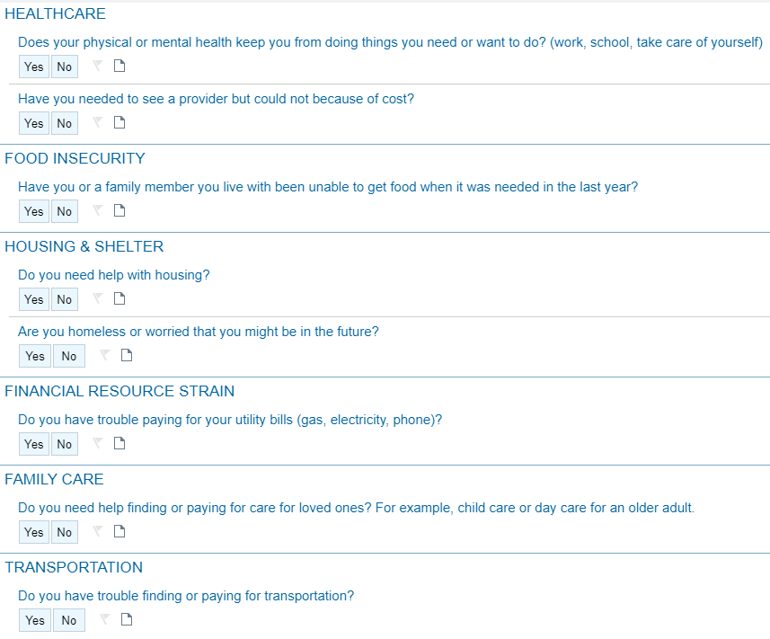
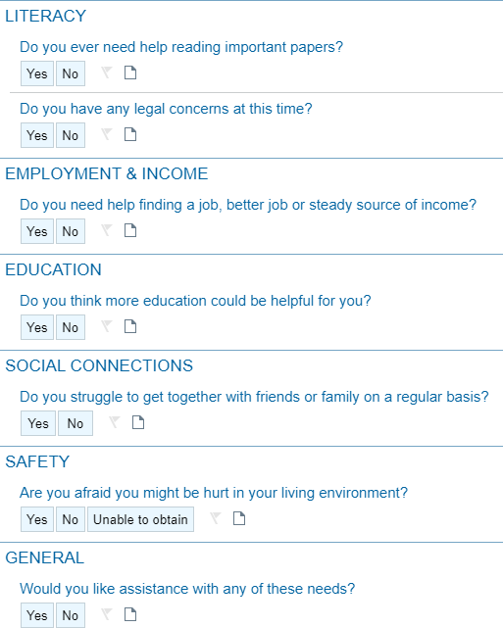
SDOH Screening Questionnaire

Slide 4
Methods
A report of all 2023 SDOH screening data was generated and analyzed
– Data Fields: ScreeningsAtEncounter_RowNumber PatientDurableKey PatientKey PrimaryMrn FirstName LastName BirthDate EncounterKey EncounterDate FlowsheetTakenInstant TakenByEmployeeDurableKey TakenByEmployeeName TakenByEmployeeJobTitle DocumentationSource SDOHCompletedViaMyChart SocialResponse SocialYesResponse HomelessResponse HomelessYesResponse HealthResponse HealthYesResponse HealthcareCostResponse HealthcareCostYesResponse FoodResponse FoodYesResponse IncomeEmploymentResponse IncomeEmploymentYesResponse HousingResponse HousingYesResponse UtilitiesResponse UtilitiesYesResponse CareAssistanceResponse CareAssistanceYesResponse EducationResponse EducationYesResponse LegalResponse LegalYesResponse SafetyResponse SafetyYesResponse ReadingResponse ReadingYesResponse TransportationResponse TransportationYesResponse AssistanceWithNeedsResponse AssistanceWithNeedsYesResponse PrimaryCareProviderDurableKey PatientPcp PcpNpi PcpTitle ScreeningAdministeredByPcp Race PatientHomeZip PatientHomeCity PatientSex PatientDOB EncounterType PrimaryDiagnosisKey Diagnosis DepartmentName ServiceAreaEpicId
Informational interviews & participant observation (April-May 2024)
  3 Medical Assistants
  2 Community Health Workers
  1 Embedded Case Manager

Slide 5
SDOH Screening Data Overview
1,066,651 SDOH screenings were conducted in 2023
All SDoH Screenings (2023)
Category | Q1 | Q2 | Q3 | Q4 | 2023 TOTAL
# Total Screenings | 246,668 | 269,535 | 277,889 | 272,559 | 1,066,651
# Screenings with Identified Need | 22,954 | 33,839 | 34,965 | 32,211 | 123,969
# Screenings with Identified Need and Wanted Assistance | 5,263 | 6,056 | 7,227 | 6,845 | 25,391
Main Takeaways:
Out of all screenings in 2023, 11.6% of screens indicated 1+ SDOH need
Of those, 20.5% of screens also wanted assistance for their SDOH need(s)

Slide 6
Who conducted SDOH screens in 2023?
240 unique job titles conducted 1+ SDOH screens
  175 job titles conducted 5+ screens
  101 job titles conducted 100+ screens
  38 job titles conducted 1,000+ screens
4,278 individual people conducted 1+ SDOH screens
  3,032 people conducted 5+ screens
  1,273 people conducted 100+ screens
  249 people conducted 1,000+ screens
    Top person conducted 6,474 screens
Selected job titles:
Medical Assistant Case Manager RN – Ambulatory
Eye Care Assistant
Emergency Room Technical Assistant Diabetes Care & Education Specialist Family Practitioner
Contact Center Advocate Community Health Worker Respiratory Therapy Assistant Genetics Counselor – Certified Research Recruitment Coordinator Athletic Trainer
Radiographer Housekeeper Dental Assistant
Concierge Coordinator

Slide 7
Selected roles & success in SDOH screens
Screening Completed By | # SDOH Screenings Conducted | % of Total Screenings | % with Identified Need | % Wants Assistance with Need
ALL | 1,066,651 | 100% | 11.6% | 20.5%
Medical Assistant | 540,625 | 50.7% | 4.3% | 18.5%
MyChart (Self-Reported Online) | 370,916 | 34.8% | 15.6% | 17.7%
Case Manager | 41,885 | 3.9% | 74.3% | 67.1%
Community Health Worker | 1,284 | 0.1% | 78.7% | 40.9%
Mobile Integrated Health Paramedic | 712 | 0.1% | 70.6% | 22.9%
Source: David Fuller, Emily Morrow, Stephanie Robinson

Slide 8




Medical Assistant (MA) Shadowing
MAs within Primary Care clinics currently only ask Food Security and Safety questions
MAs aren’t always confident to answer subsequent patient questions
High MA turnover rates reduce the impact of previously provided training
Insights on why patients express need and then
say “No” to wanting
assistance

Slide 9




Community Health Worker (CHW) Shadowing
SDOH screen is conducted like a conversation with the patient
Focus on empowering patient to reach out to CBOs, but assist as needed
CHWs have their own list of trusted CBOs and contacts
Ensure follow-up to close loop as best as possible with detailed next step
CBO: Community-Based Organization
9

Slide 10
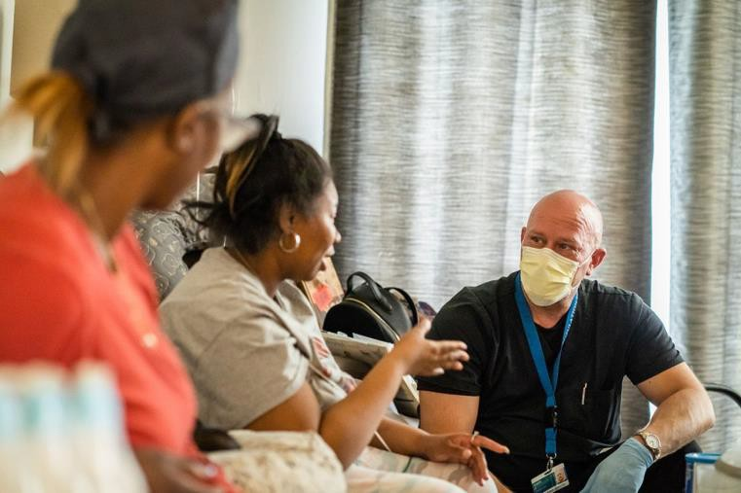
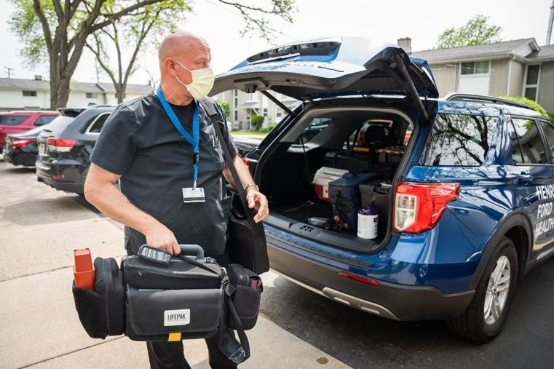
Staff Highlight: Rob Barron,
Mobile Integrated Health Paramedic
“Sometimes you have to see it.”
  Bare kitchen cupboards
  Noticing a patient glance down the hall when asked about safety
Empathy principles: mimic body language; eye contact; listen
Explains to patient why he is asking SDOH questions
Can ask all SDOH questions from memory; rephrases some
Establish a bond as a friend, not just as a healthcare worker
  Visiting a patient on his day off to bring them flavored water packs to support hydration and an aquarium for their turtle
Always asks “Is there anything I can do to make you more comfortable before I go?” – includes making breakfast
Bridge Michigan photos by Valaurian Waller

Slide 11
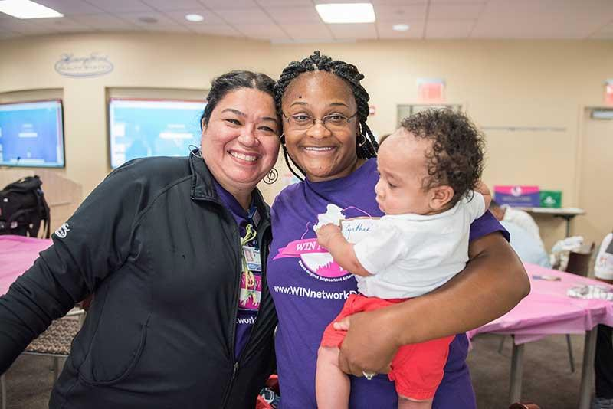
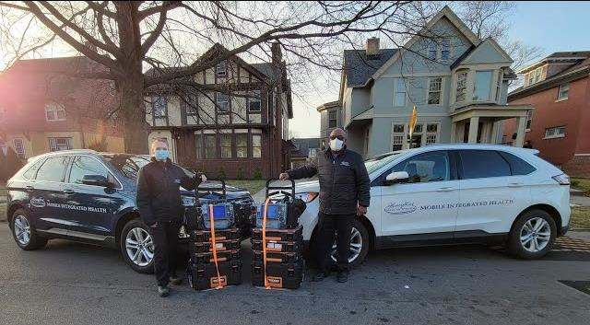
Conclusions
Roles that traditionally better establish trust with patients (i.e. CHWs, CMs) are well placed to obtain honest answers regarding needs
  However, staffing resources are limited
Patients are also more likely to reveal needs when they are in a comfortable setting or when they self-report via MyChart
  MIH screens occur in patients’ homes
  Address inequities in digital access and technology literacy
Training in empathic inquiry would benefit MAs to obtain more accurate screens
See SIREN poster #23

Slide 12
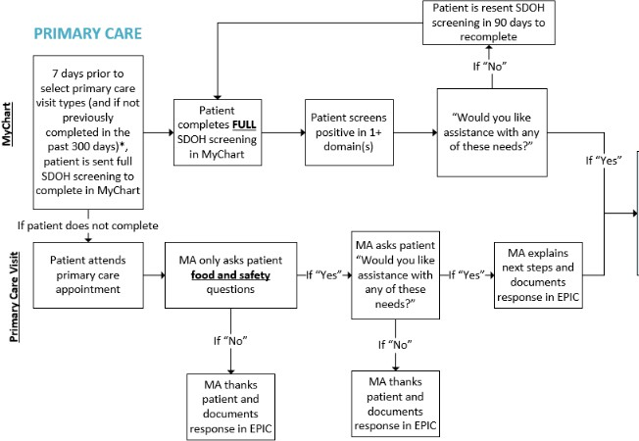
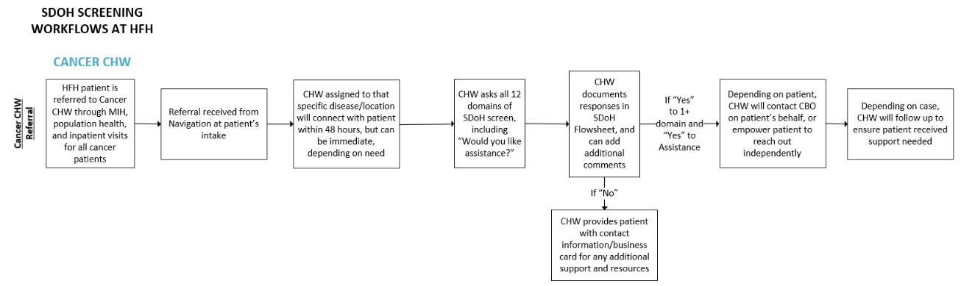
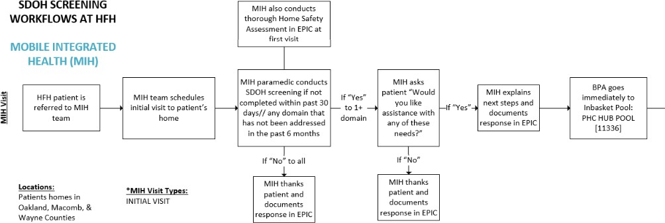
Future Directions
Henry Ford Health’s SDOH Council has set a 2025 goal:
“By December 31, 2025, Henry Ford Health will institute a system-wide policy with standards around SDOH screening and referral interventions.”
We will incorporate these lessons around the importance
of role and setting into this policy.

Slide 13

Thank you!
Contact:
Dana M. Parke, MA
Program Manager,
Clinical & Social Health Integration
Primary Health Department Henry Ford Health
Detroit, MI dparke1@hfhs.org

Slide 14
Appendix

Slide 15

SIREN
Poster #23

