Slide 1


Center for Medicare and Medication Innovation
Dawn Alley, Ph.D. Director, Prevention and Population Health Group Acting Director, State Innovations Group
February 2019

Slide 2
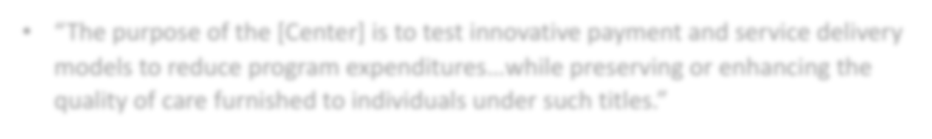




The CMS Innovation Center Statute
“The purpose of the [Center] is to test innovative payment and service delivery models to reduce program expenditures…while preserving or enhancing the quality of care furnished to individuals under such titles.”
Three scenarios for success from Statute:
Quality improves; cost neutral
Quality neutral; cost reduced
Quality improves; cost reduced (best case)
If a model meets one of these three criteria and other statutory prerequisites, the statute allows the Secretary to expand the duration and scope of a model through rulemaking.
2

Slide 3

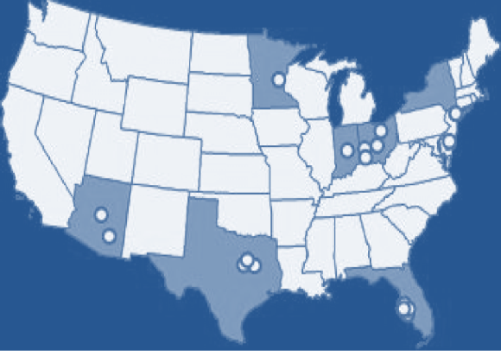



Medicare Diabetes Prevention Program (DPP) Expanded Model
MDPP is a structured behavioral intervention with the goal of preventing progression to type 2 diabetes in individuals with an indication of pre-diabetes.
Timeline:
2012 – CMS Innovation Center awarded Health Care Innovation Award to The Young Men’s Christian Association of the USA (YMCA) to test the DPP in >7,000 Medicare beneficiaries with pre-diabetes across 17 sites nationwide.
2016 – DPP announced as the first ever prevention model to meet statutory criteria for expansion. The Secretary determined that DPP:
Improves quality of care beneficiaries lost about five percent body weight
Certified by the Office of the Actuary as cost-saving projected net savings of $186
Million to the Medicare Program over a 10 year period
Does not alter the coverage or provision of benefits
2016 - 2017 – National expansion established through rulemaking, with policies to create a new supplier class finalized in CY 2017 PFS Final Rule and additional policies related to performance-based payment proposed in CY 2018 PFS Proposed Rule.
April 2018 – National availability of MDPP set of services to Medicare beneficiaries.

Slide 4


Maryland All-Payer Model reports $429 million in Medicare hospital cost savings over three years
Maryland has the nation’s only statewide all-payer hospital global budget model
The model tests whether hospital global budgets can achieve improvements in quality and reduce per capita hospital cost growth
The All-Payer Model has positive results to date (2014-2016)
  The state reports approx. $429 million in Medicare hospital cost savings
  All-payer total hospital per capita cost growth significantly below the 3.58% target
  30-day all cause readmission rate fell from 1.2% to 0.4% above national rate
Hospitals began moving into All-Payer Global Budgets in July 2014
  95% of Maryland hospital revenue will be in global budgets
  All 47 MD hospitals have signed agreements
Model was initiated in January 2014; five year test period
Maryland has proposed building on existing global budgets, towards a population-based total cost of care model.

Slide 5



Maryland Total Cost of Care Model
New Model in Maryland Covering Full Continuum of Care
Components of Maryland Total Cost of Care Model
Benefits of TCOC Model
Adds new providers and settings into care transformation effort
Links disparate providers to create more patient-centered care
Aligns incentives across providers to reduce hospitalizations and total cost of care
Hospital Global Budgets Population-based payments for Maryland hospitals; Continuation of policy from Maryland All-Payer Model
Care Redesign Program Gainsharing between hospitals, hospital-based specialists, non-hospital providers
Maryland Comprehensive Primary Care Program
Financial support for primary care providers performing care
management for high-risk patients
Hospital only Inpatient and outpatient settings Primary care and community settings
Performance Period begins January 1, 2019 and continues through 2026

Slide 6
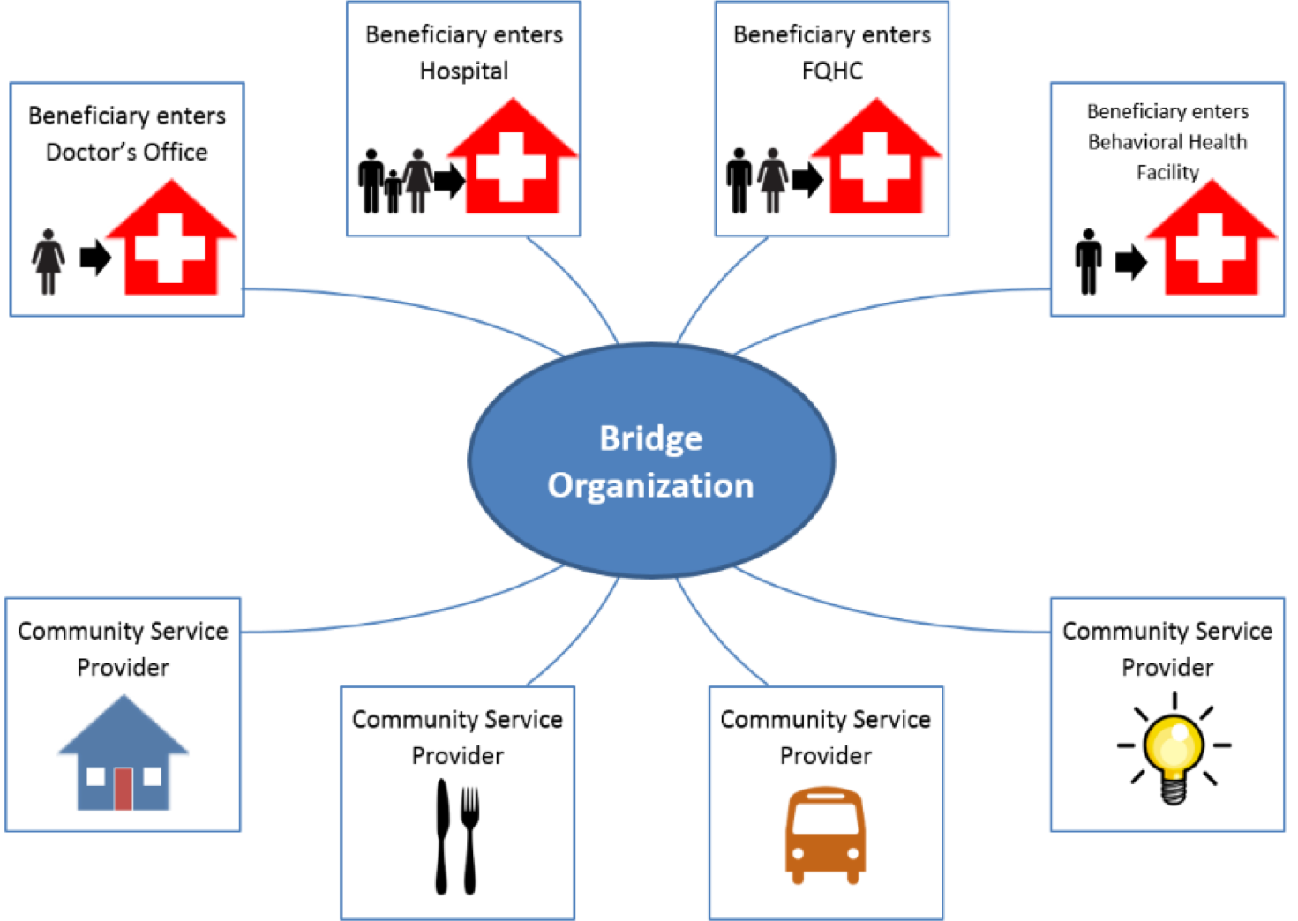
Accountable Health Communities Model addresses health-related social needs
Key Innovations
Systematic screening of all Medicare and Medicaid beneficiaries to identify unmet health-related social needs
Tests the effectiveness of referrals and community services navigation on total cost of care using a rigorous mixed method evaluative approach
Model Tracks
Assistance Track
Bridge Organizations in this track provide community service navigation services to assist high-risk beneficiaries with accessing services to address health-related social needs
Alignment Track
Bridge Organizations in this track encourage partner alignment to ensure that community services are available and responsive to the needs of beneficiaries
Partner alignment at the community level and implementation of a community-wide quality improvement approach to address beneficiary needs

