Slide 1

EVALUATING A HEALTH-RELATED SOCIAL NEEDS INTERVENTION: RESULTS AND LESSONS LEARNED
Seth A. Berkowitz, MD MPH
Division of General Medicine & Clinical Epidemiology University of North Carolina at Chapel Hill

Slide 2
DISCLOSURES
I have received research funding from NIH, USDA, Robert Wood Johnson Foundation, and Feeding America
I have no conflicts of interest to disclose

Slide 3
BACKGROUND
Health-related social needs are known to have adverse effect on health
Addressing health-related social needs has not historically been a focus of the healthcare system
Growing interest in trying to do so
Mixture of formal research and clinical innovations

Slide 4
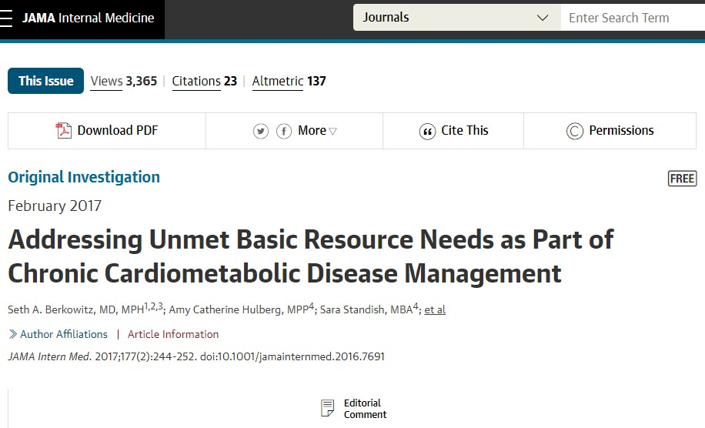
HEALTH LEADS STUDY
Health Leads Program
Comprehensive screen for unmet needs
Healthcare, employment, financial, food, transportation, utilities, housing, legal
Advocate works with patient to:
Determine ‘resource landscape’ for needs
Equip patient with needed resources

Slide 5
HEALTH LEADS STUDY
2 primary care practices
Paper-based screening
Then referred for intake interview

Slide 6
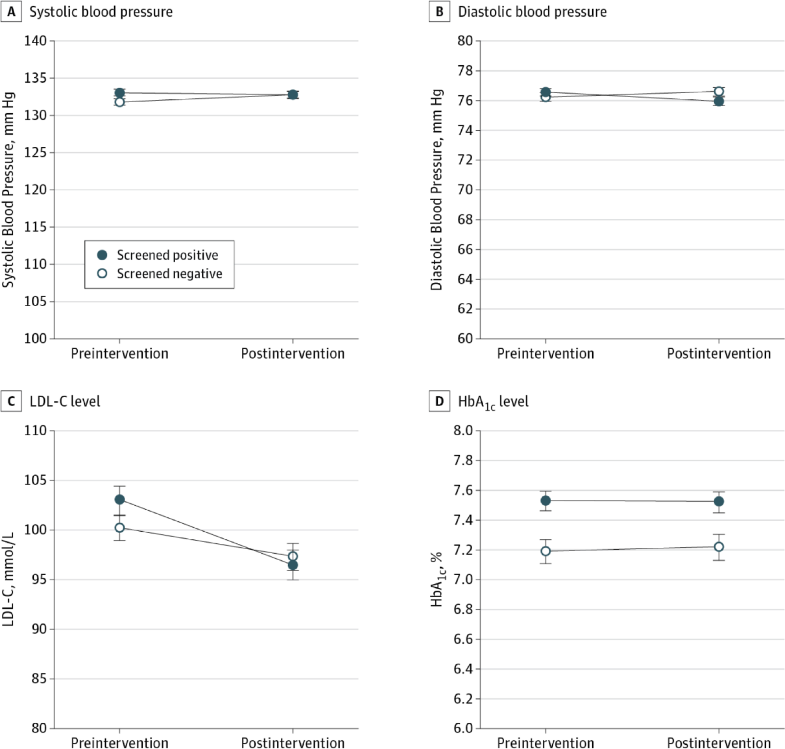
HEALTH LEADS STUDY
Found improvements in:
  Blood Pressure
  Cholesterol
No improvement in:
  Hemoglobin A1c

Slide 7
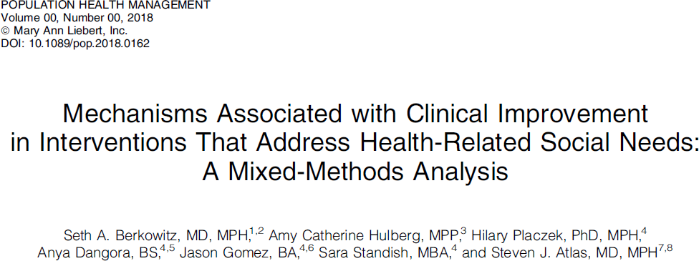
QUALITATIVE FOLLOW-UP
What did and didn’t work?
What are the mechanisms?

Slide 8
QUALITATIVE FOLLOW-UP
Examined case records of intervention participants
  40 who improved
  40 who did not

Slide 9
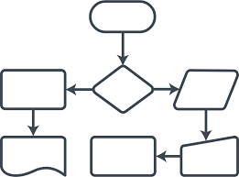
QUALITATIVE FOLLOW-UP
Improvement connected with adequacy of resource landscape
  Needed to get every step of the process ‘right’

Slide 10

QUALITATIVE FOLLOW-UP
Path from presenting need to clinical improvement was often ‘non-linear’
Food Needs
BP
Improves
SNAP

Slide 11
QUALITATIVE FOLLOW-UP
Path from presenting need to clinical improvement was often ‘non-linear’
BP
Improves
SNAP
Food Needs
High Medication $$
Pharmacy Assistance

Slide 12
IMPLEMENTATION LESSONS
Work closely with staff to help understand reasons for process
  Ex: retaining negative screens, case finding
Search for narrow set of ‘high yield’ needs may be quixotic
Close attention to all the steps in the process
Resource landscape is local
Coordination with multiple organizations needed

Slide 13

THANK YOU!
Questions?
  seth_berkowitz@med.unc.edu
  While you query, please enjoy a cute picture of my daughter:

