Slide 1

Interventions to Improve Access: Lessons from a Transportation Trial
State of the Science: A National Research Meeting on Medical & Social Integration February 4-5, 2019 // Portland, Oregon
Krisda H. Chaiyachati, MD, MPH, MSHP
Assistant Professor of Medicine at the University of Pennsylvania
Medical Director, FirstCall Virtual Care at Penn Medicine’s Center for Connected Care Innovation Manager at Penn Medicine’s Center for Health Care Innovation

Slide 2
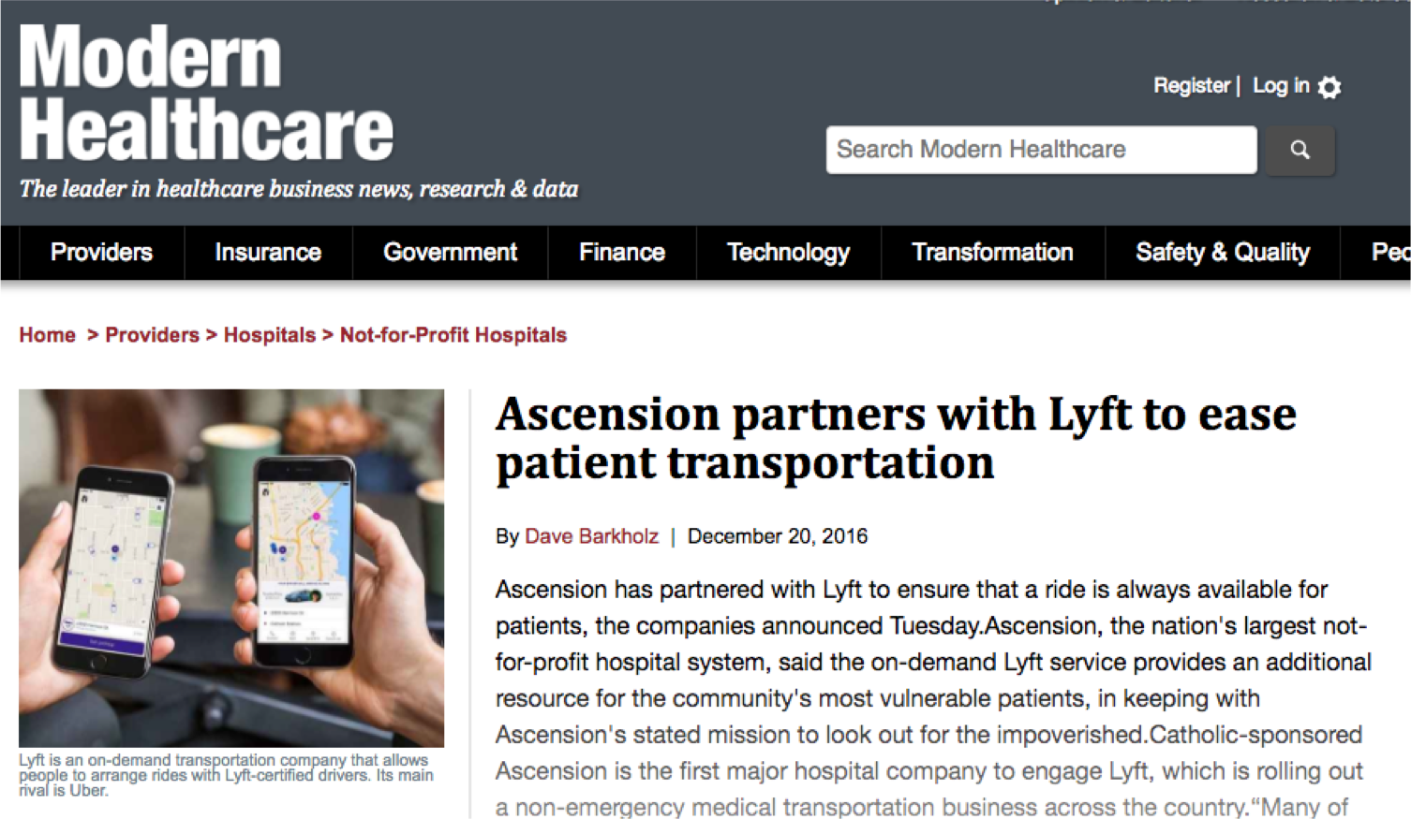
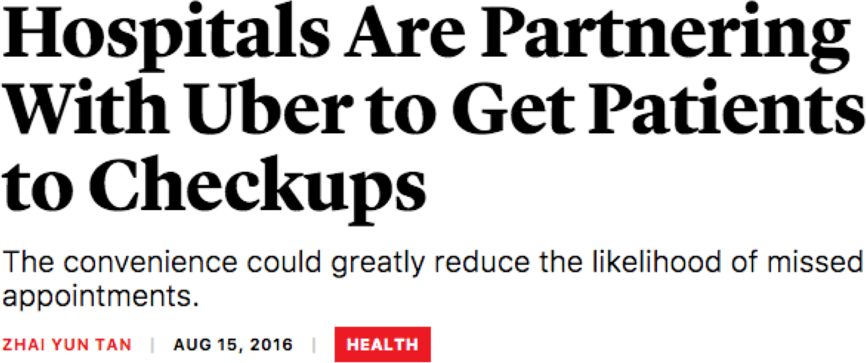

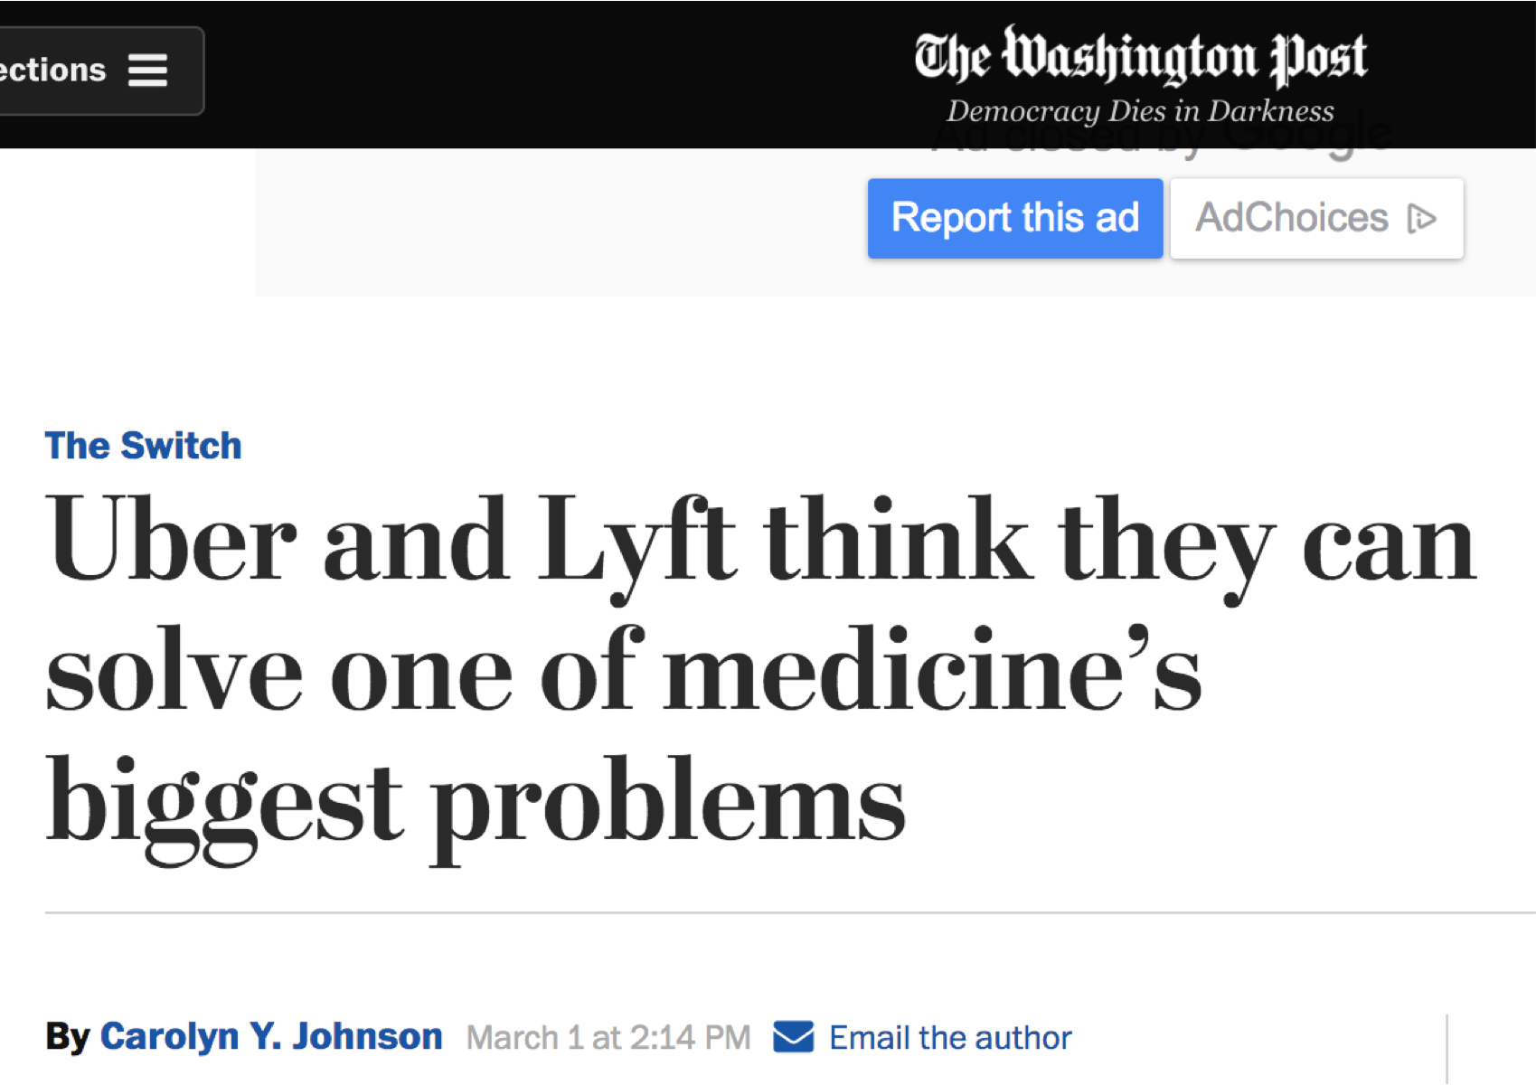
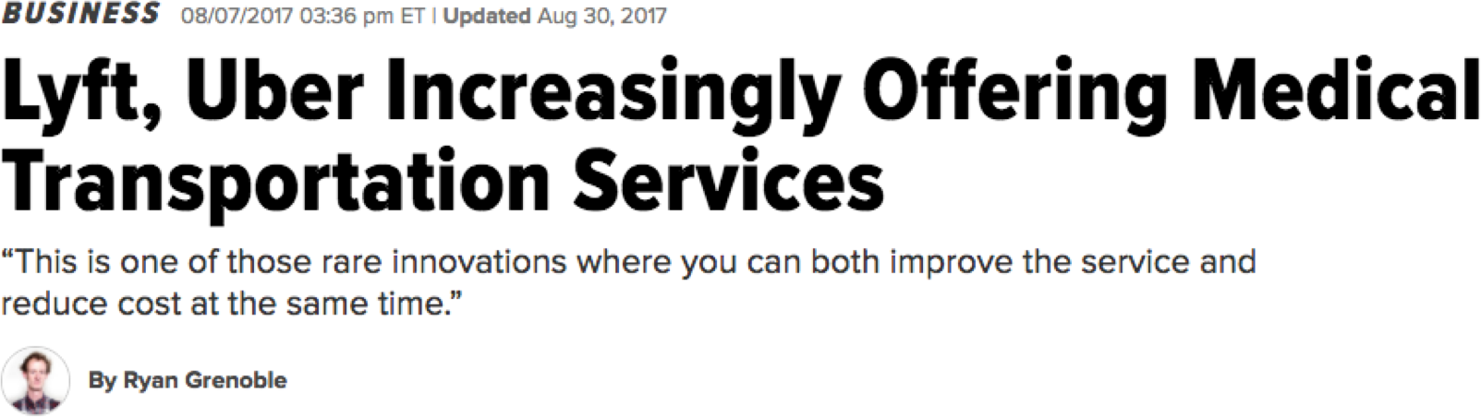
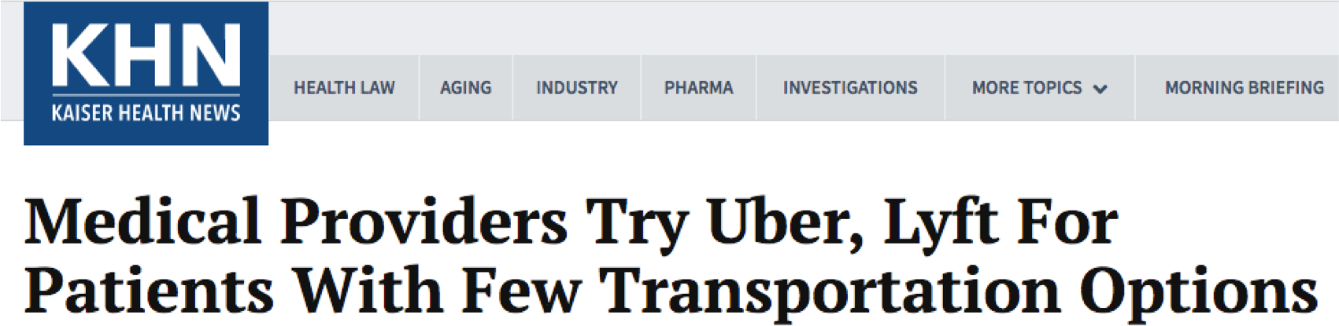

Slide 3
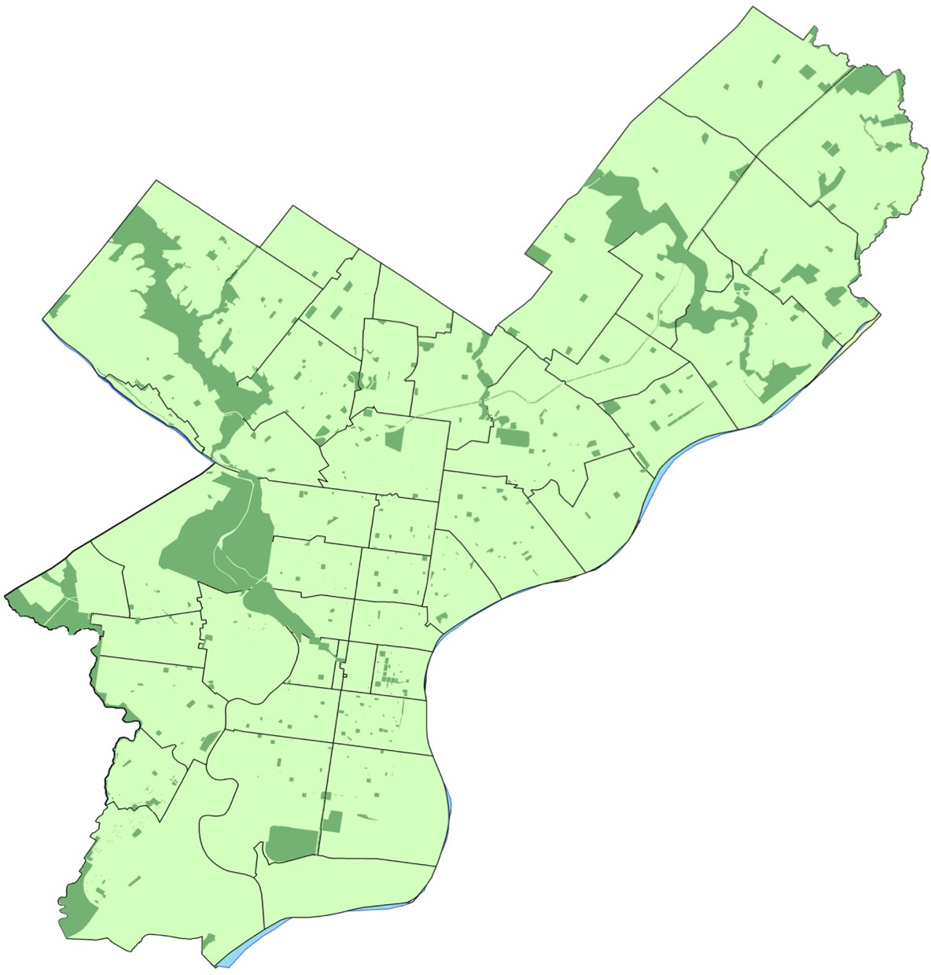
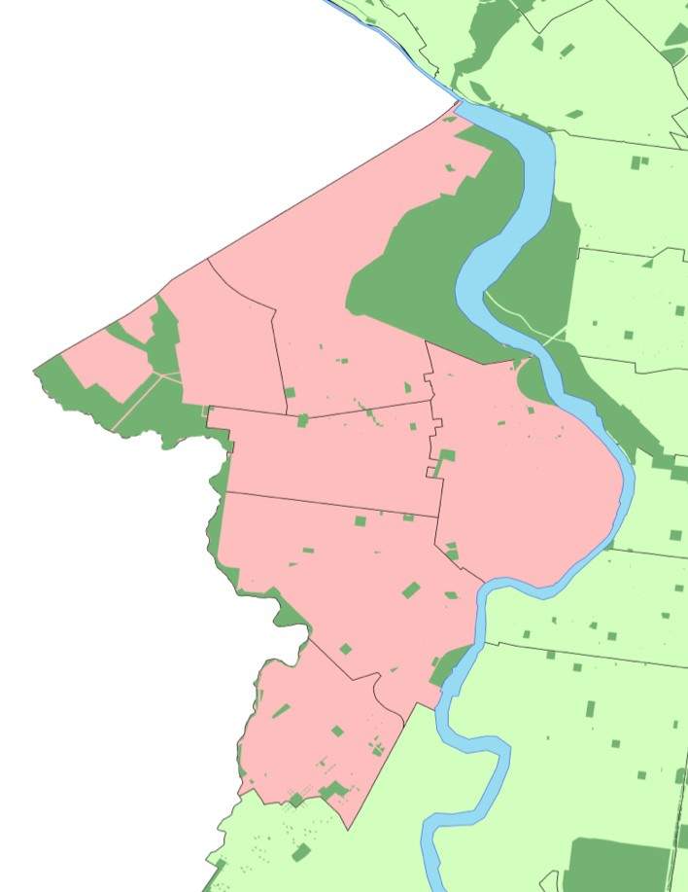


Missed appointments
1/3
Patients with Medicaid
West Philadelphia
Primary care practice location
Penn Internal Medicine Patients

Slide 4


Missed appointments
+ Same Day Cancellations
1/2
Patients with Medicaid
West Philadelphia
Primary care practice location
Penn Internal Medicine Patients

Slide 5
Transportation for Medicaid
Non-emergency medical transportation (NEMT) option
Cost $2.7 billion annually
Current NEMT - often inconvenient and unreliable
  Wait times can ~60 minutes
  Vehicles routinely do not show
  Require advanced scheduling
Source: Government Accountability Office. Nonemergency medical transportation: Updated Medicaid guidance could help states (2016)

Slide 6


Rideshare and Digital Transportation Networks
Curb-to-curb service
Meets real-time demand
Digitization of travel & payment

Slide 7
The Pilot Phase

Slide 8
Eligibility criteria
Adults (> 18 years old)
West Philadelphia ZIP
Insured by Medicaid
Established primary care patients at two academic, internal medicine practices within Penn Medicine
West Philadelphia
Primary care practice location

Slide 9


Pre-Appointment: Two Days Before
CONTROL Arm
Appt.
Reminder
Research Assistant
Established Patient

Slide 10

Pre-Appointment: Two Days Before
INTERVENTION Arm
Offer Ride
Consent
Appt.
Reminder
Pre-schedule Ride
Restricted from scheduling a ride Non-English speaking
Need wheelchair assistance Cannot receive text messages
Research Assistant
Established Patient

Slide 11
















Day of the Appointment
INTERVENTION Arm
Transport to clinic
Ride is dispatched at pre-scheduled time
Patient is notified that driver is en route
Patient is transported to clinic
Transport home
Research Assistant
At the end of clinic, patient calls for ride
We dispatch the ride
@khchaiyachati
Patient is transported home

Slide 12
Average show rates over time
1
Start of intervention
0.8
0.6
0.4
0.2
0
-9
-8
-7
-6
-5
Weeks
-4
-3
1
2
Control practice Rideshare practice
Δ Adjusted Odds Ratio: 2.52 (95% CI: 1.09-5.85); p=0.03

Slide 13
The Clinical Trial

Slide 14

Uptake of intervention: Trial Phase
All Patients (n=394) Scheduled Rides (n=93)
100%
24%
75%
3%
46%
61%
50%
42%
15%
25%
31%
30%
0%
Scheduled Rides Not interested
Not offered ride Did not answer
No rides
One direction Both directions

Slide 15






Transportation trial
Will a convenient, on-demand transportation option reduce missed appointments to primary care?
Goal: 10% absolute reduction in missed appointments among Medicaid population (baseline 49%)
Sample size target*
Allocation
(2d before appointment)
Procedures
Control group | Intervention group
390 | 390
Called ODD # day (appointment reminder) | Called EVEN # day (appointment reminder)
Usual travel mode (blinded) | One-time, rideshare-offer (not blinded)
Chaiyachati et al., JAMA Internal Medicine (2018)

Slide 16





Results: Missed appointments
Control group | Intervention group
36.7% | 36.6%
34.8% | 30.6%
Better post-hospital discharge (Odds ratio: 0.31)
Control group
Intervention group
Intent-to-Treat* (All called)
Treatment-as-provided (Answered phone call)*
Subgroups*
*Not significant
Chaiyachati et al., JAMA Internal Medicine (2018)

Slide 17
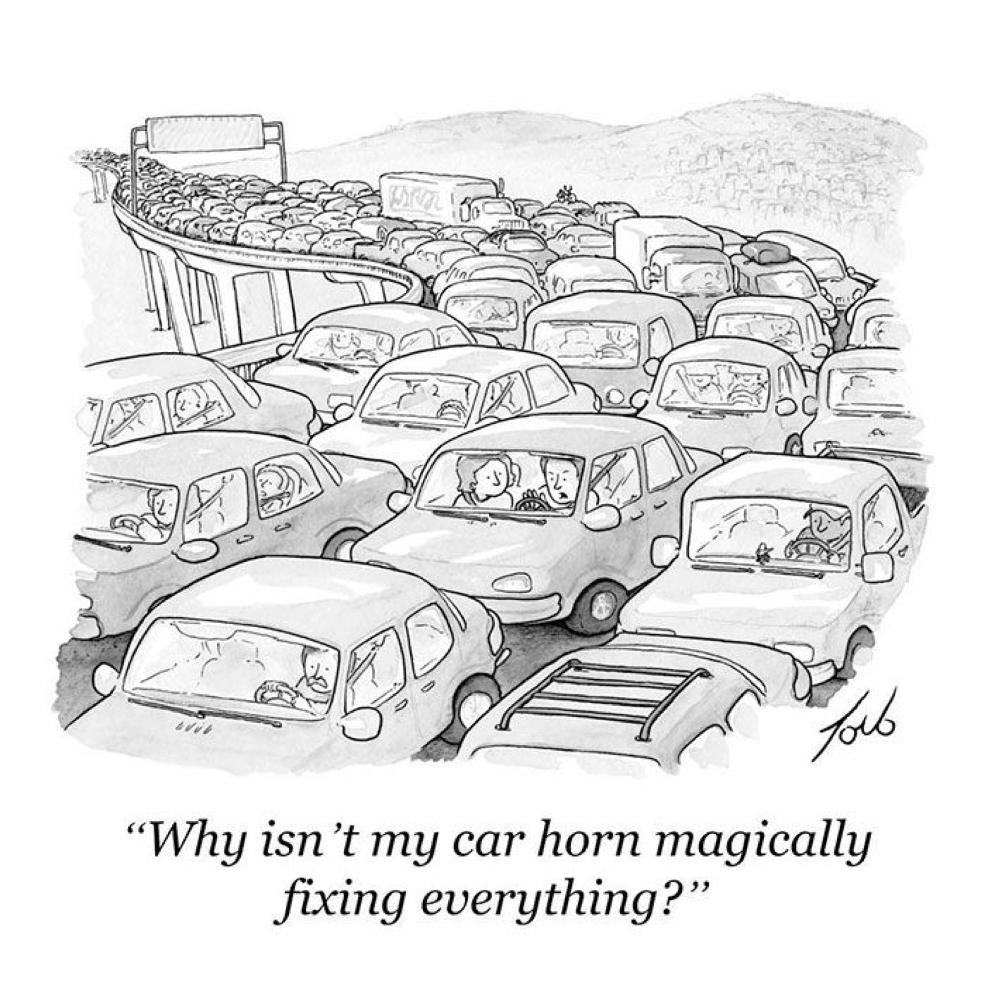

What happened?
@khchaiyachati

Slide 18

Transportation
Transportation is a significant barrier for low income patients to attend appointments.
Limited options in traveling
“If you don’t have the money [to take the bus], then you can’t get there. It
[doesn’t] really cost that much because I’m not that far, but a lot of times, when you don’t have a lot, a little bit is a lot.”
Unreliable or undesired current transportation modes
“There is one [transportation] agency that everybody has a problem with, and I
missed two appointments messing around with them...I was not happy because
I didn't get a chance to take care of my medical situation and had to find somebody else to take me to the doctor.”
Under review

Slide 19

External forces
Social and external obligations to employers and family members complicate travel logistics further.
“My sister's very sick, and she needs a lot of care and a lot of attention. I'm the only one that's available to her a lot of the time when she needs help… so sometimes something comes up where I cannot make my appointment."
Under review

Slide 20

Personal health
Personal health factors negatively impact patients’ ability to get to appointments.
"I didn't feel good, and I wanted to make my appointment, but I just didn't feel good [enough] to get there.”
“It's not that far, but I can't make it. I'm heavy and I'm sickly.”
Under review

Slide 21
Stratified thematic analyses
Themes |  | No missed appt (n = 22) | Missed one or more (n =21) | P-value
Transportation |  | 64% | 76% | 0.37
 | Limited options | 41% | 71% | 0.04
 | Undesirable modes | 36% | 76% | <0.01
External forces Personal health barriers
59% | 62% | 0.85
50% | 57% | 0.64
Under review

Slide 22
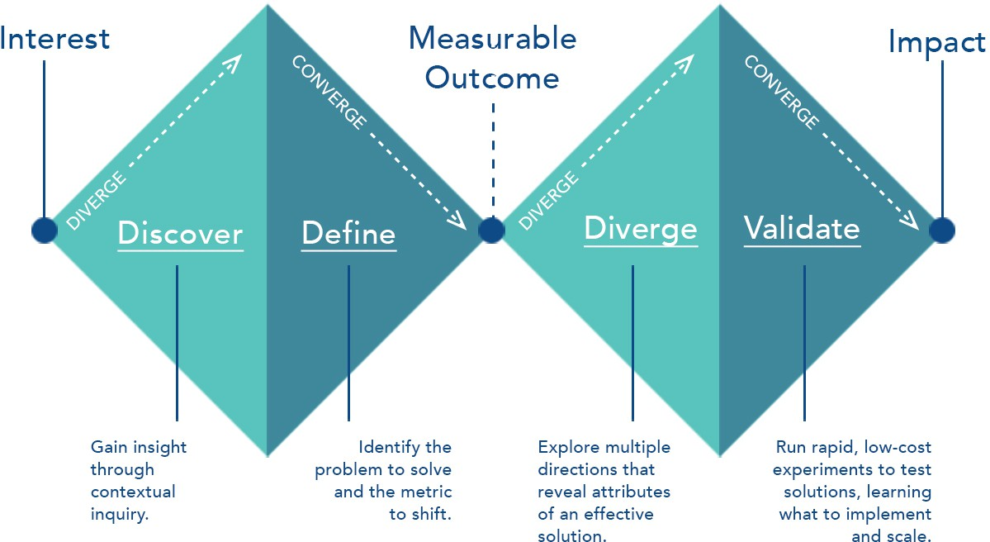
Source: Penn Medicine Center for Healthcare Innovation

Slide 23
Take Home for Studying Social Interventions
Experimental study designs have a role
Iteratively design interventions
Be open to finding the right “problem"
Don’t stop with a one-off study

Slide 24
Project Team
Mentors
  David Grande, MD, MPA
  Judy Shea, PhD
  Rebecca Hubbard, PhD
  Roy Rosin, MBA
Field Team
  Alyssa Yeager
  Brian Mugo
  Samuel Rauch
  Stephanie Lopez Hayna
Lyft, Incorporates
The Office of General Counsel at
the University of Pennsylvania
Penn Health System & Penn
Internal Medicine Clinics
Penn Medicine Center for
Healthcare Innovation
Catherine Shi
Cheryl Garfield – Community Health Worker
Tamala Carter – Qualitative Interviews

Slide 25

Extra Slides

Slide 26
Limitations
Generalizability
  Single center study
  Urban environment
  Low-SES population
Change in attendance rate among study population
  Missed appointments decreased from 49% (historical) to 36% (trial controls)

Slide 27
Uptake of intervention: Pilot Phase
All Patients (n=60) Scheduled Rides (n=19)
100%
18
75%
9
5
72%
50%
4
22
25%
15
5
0%
Scheduled Rides Not interested
Not offered ride Did not answer
No rides Both rides
One ride

