Slide 1


Studying Oregon’s Alternative Payment Methodology Pilot
Erika K. Cottrell, PhD, MPP
Investigator, OCHIN
Research Assistant Professor, OHSU

Slide 2
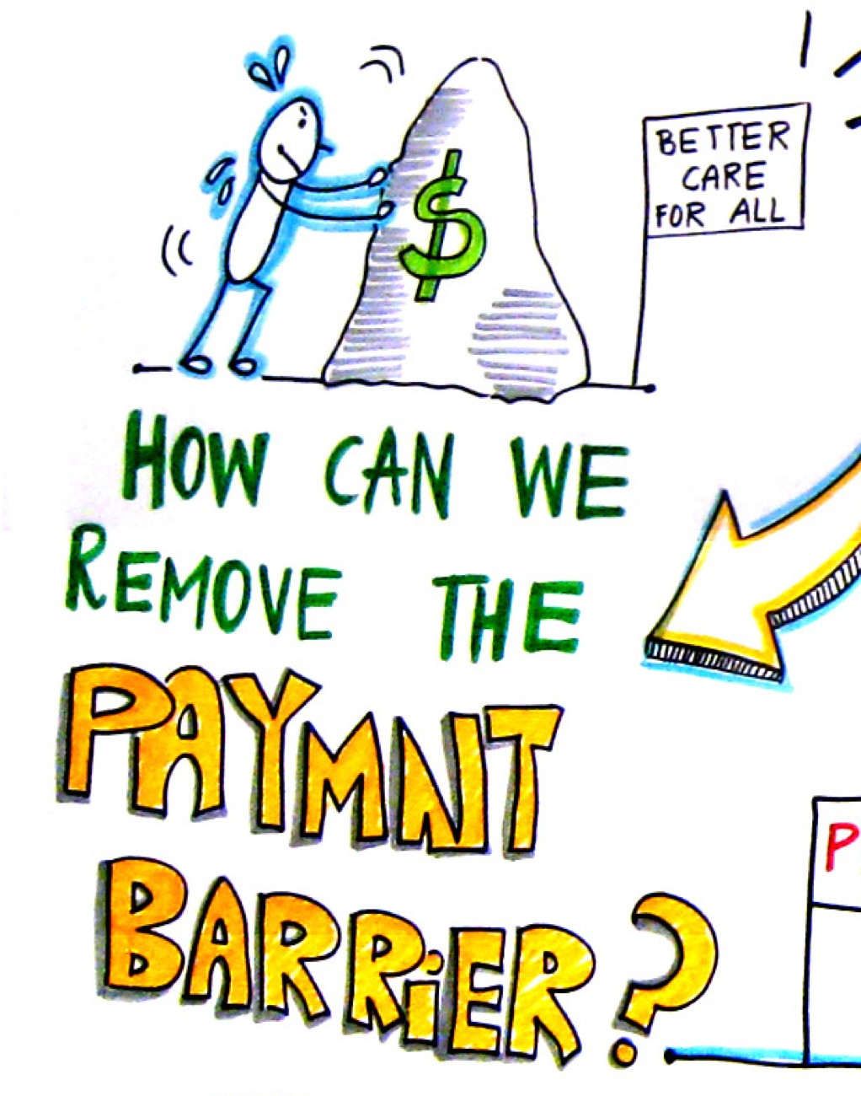
Oregon’s APM Pilot
In 2013, OPCA and the State launched the the the APM demonstration pilot in 3 health systems
Goal: Shift incentive from volume of visits toward provision of high quality, patient-centered care
Visit-based rate (PPS) converted to a capitated per-member per-month rate
Since 2013, 5 additional phases of clinics have joined APM; now includes 13 of Oregon’s 32 CHCs

Slide 3
Aligning payment with care
Alternative Payment and Advanced Care Model (APCM)
“…encourages care teams to address root causes of illness and well-being in the lives of their patients.”
(Oregon Primary Care Association)
“…allows clinics to innovate the model of care and engage patients in ways not billable under PPS.”
(Oregon Health Authority)
“The hope is that APM will enable us to make the clinic a place people come to stay healthy…rather than a place they come only when they are sick.”
(CHC clinician)

Slide 4
APCM and social care integration
APCM allows CHCs to understand and respond to the non-medical circumstances that influence their patients’ health.
Focus on quantifying prevalence of social needs and actions taking to address those needs.
  Social needs screening (PRAPARE)
  Actions taken to address social needs (enabling services, Care STEPs)
OCHIN created EHR tools to capture these data

Slide 5
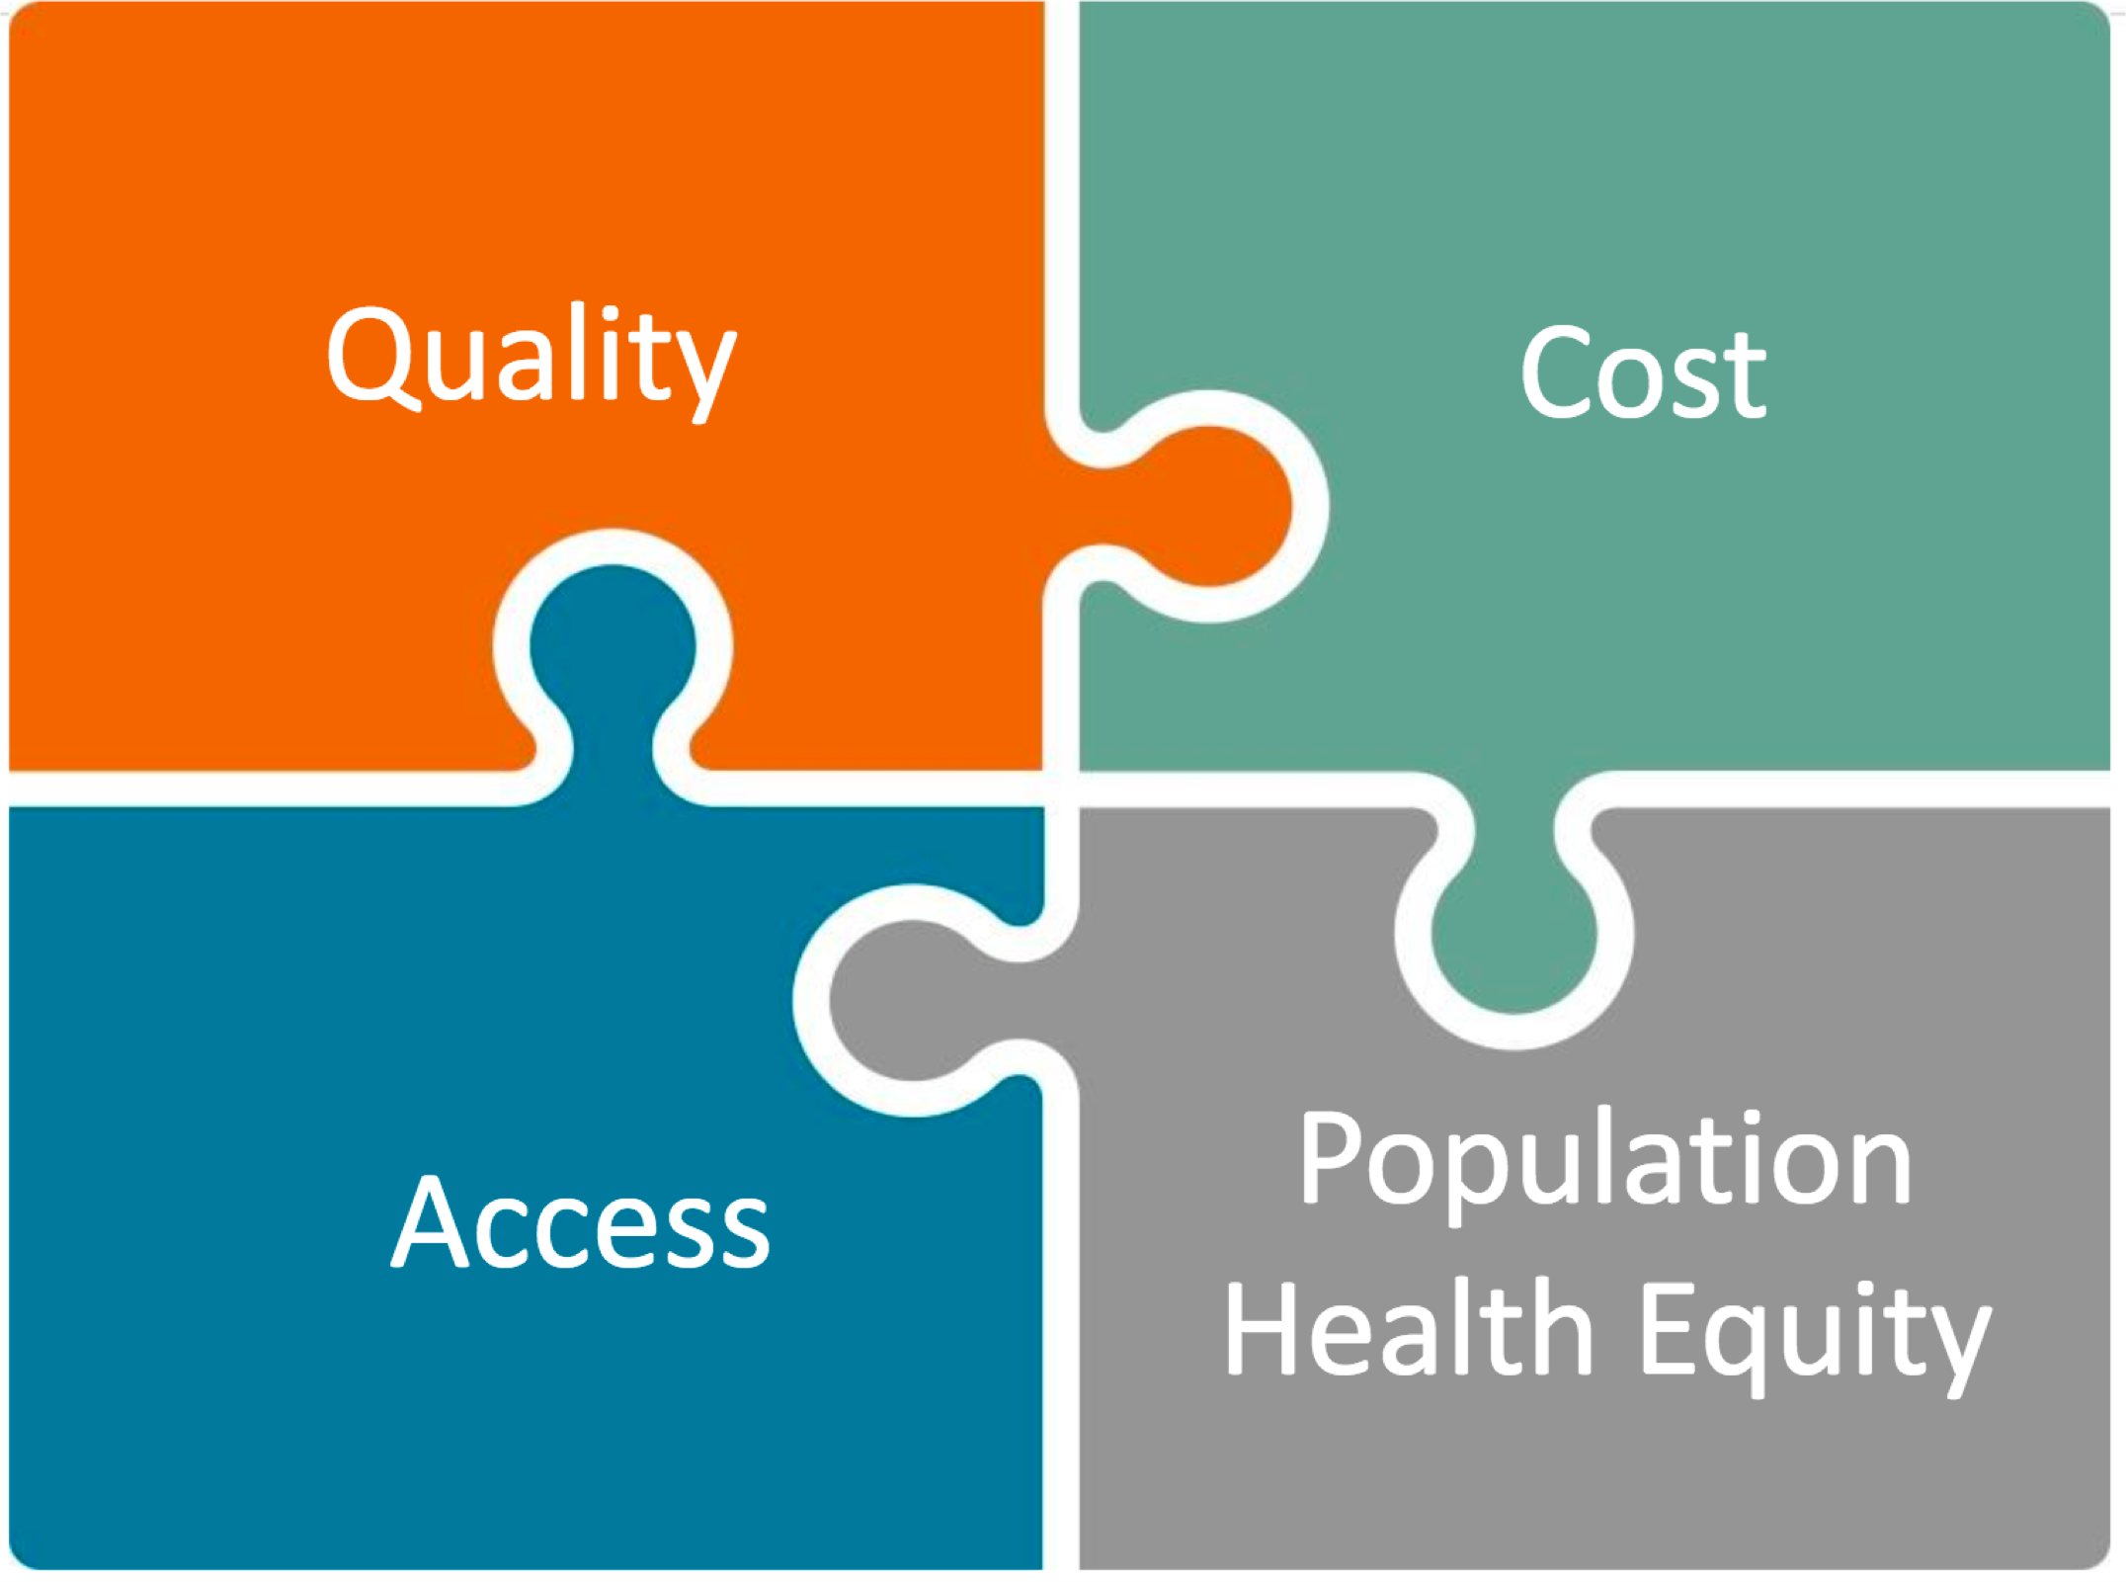
Oregon APCM metrics
For more information: https://www.orpca.org/APCM/Jan%20F2F%20-%20Intro%20Slides.pdf

Slide 6
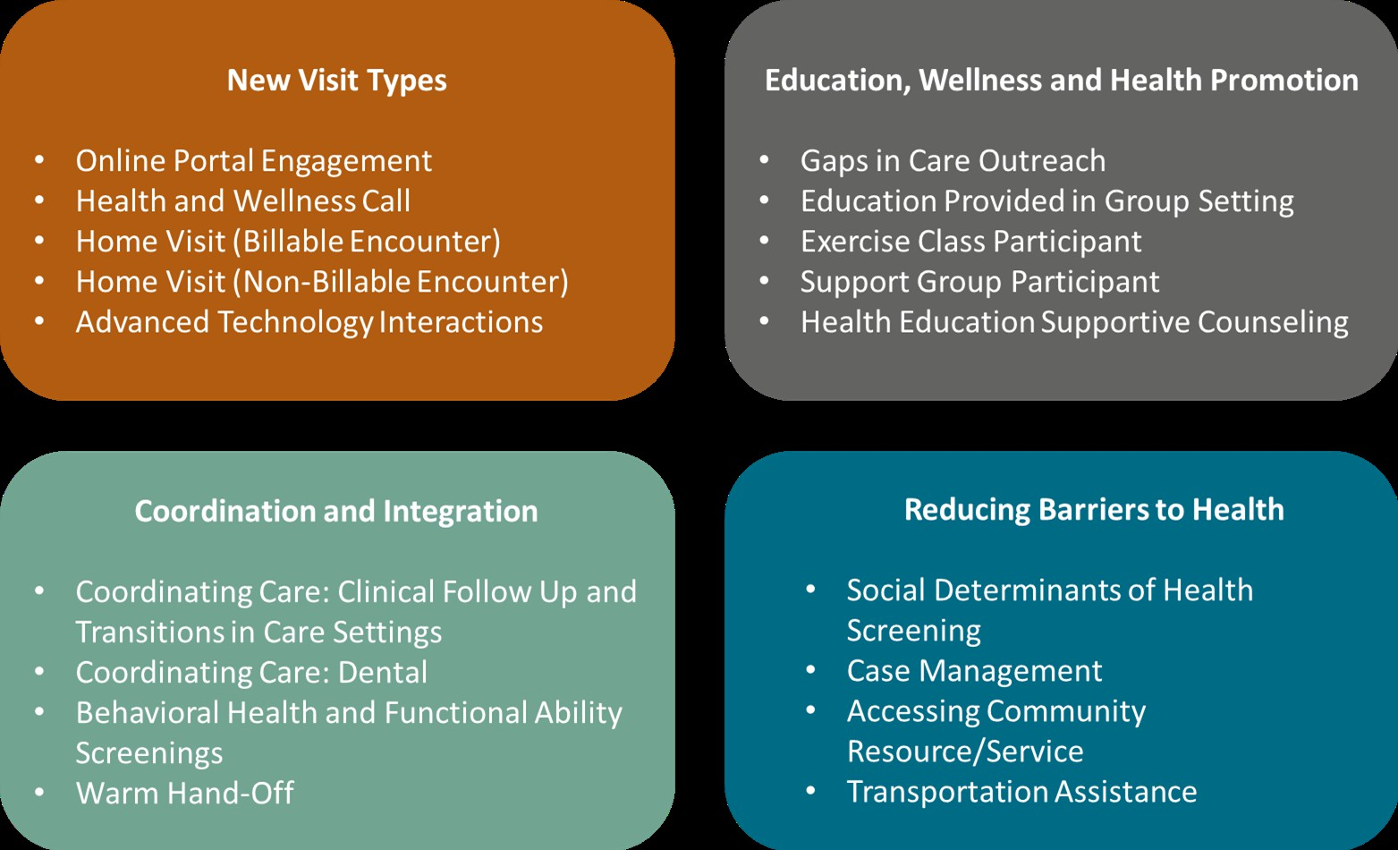
Documenting alternative ways of providing care:
Care Services that Engage Patients (Care STEPs)

Slide 7
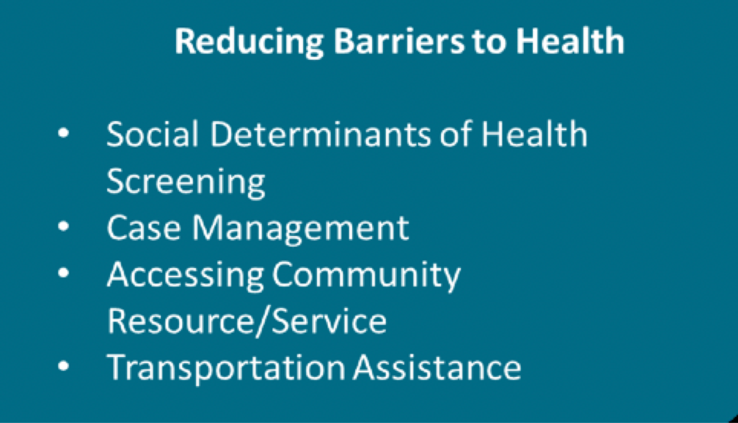
Documenting alternative ways of providing care:
Care Services that Engage Patients (Care STEPs)

Slide 8

Studying APCM in Oregon

Slide 9
A Mixed-Methods Evaluation of Payment Reform in Oregon’s Community Health Centers
Goal: To study real-time changes happening in Oregon Community Health Centers as a result of APM implementation
Setting: Phase 1 APM CHCs (3 health centers, 10 practices)
Methods: Site visits, qualitative interviews, practice-change surveys, observation of OPCA APCM Learning Collaborative
Funding: Robert Wood Johnson Foundation
Cottrell EK, Hall J, Kautz G, Angier H, Likumahuwa-Ackman S, Sisulak L, Keller S, Cameron D, DeVoe J, Cohen D. Reporting from the Front Lines: Implementing Oregon’s Alternative Payment and Care Model in Community Health Centers. The Journal of Ambulatory Care Management. 2017 Oct/Dec;40(4):339-346.

Slide 10
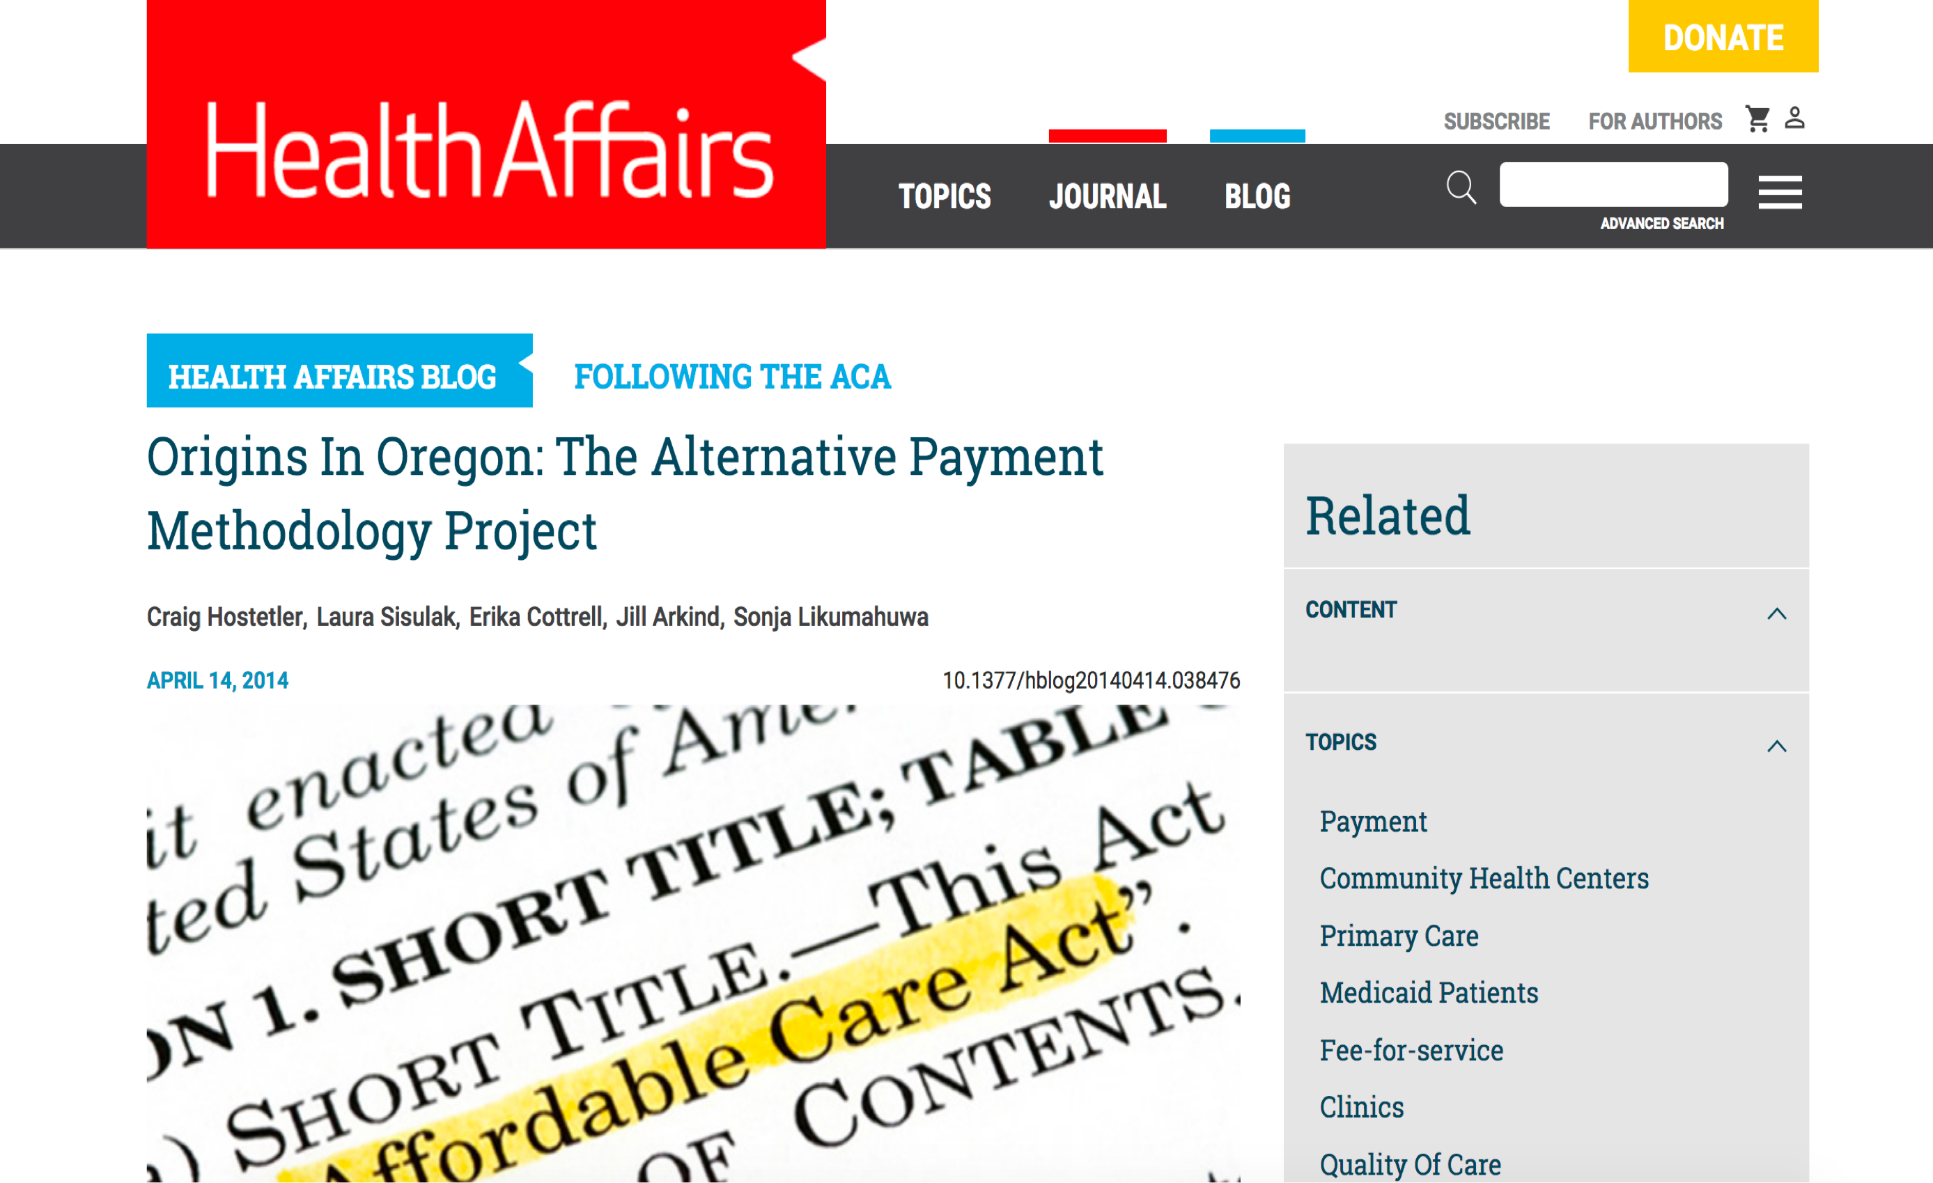

Slide 11




Findings: Practice-level changes (Phase 1 clinics)
Attributing patients, documenting care delivery
Adding new roles,
re-organizing care teams
Re-designing schedules, diversifying patient encounters
Changes in Payment ➔ Changes in way that care is organized and patients are engaged

Slide 12
Findings: APCM implementation is hard
Changing payment doesn’t automatically translate into changes in care
  Need for leadership and vision
  Resistance to change (on part of clinic and patients)
  Need for training and education about new model
New reporting requirements
  Patient attribution
  Documenting Care STEPs
    Variation between clinics (and even within clinics)
    New workflows, figuring out what counts, remembering to document

Slide 13

Next steps: Quantitative study (eCHANGE)
Goal: To assess pre-post changes in measures of utilization and quality and overall costs to the Medicaid program
Setting: Phase 1-3 APM CHCs
Methods: Prospective observational design using matched controls Funding: Agency for Healthcare Research & Quality (AHRQ) Principal Investigator: John Heintzman, MD, MPH, OHSU
Angier H, O’Malley JP, Marino M, McConnell KJ, Cottrell EK, Jacob RL, Likumahuwa-Ackman S, Heintzman J, Huguet N, Bailey SR, DeVoe JE. (in press) Evaluating Community Health Centers’ Adoption of a New Global Capitation Payment (eCHANGE) Study Protocol. Contemporary Clinical Trials. 2017;52:35-38.

Slide 14

Challenges of APCM research
Hard to isolate impact of APM from other policy changes (e.g. ACA, PCMH initiatives)
Selection bias (clinics volunteered to adopt APM)
As more CHCs adopt APM, harder to find matched controls for comparison
Limitations of EHR data
Additional qualitative data collection would be useful, but harder to fund
Policy and research timelines are different

Slide 15
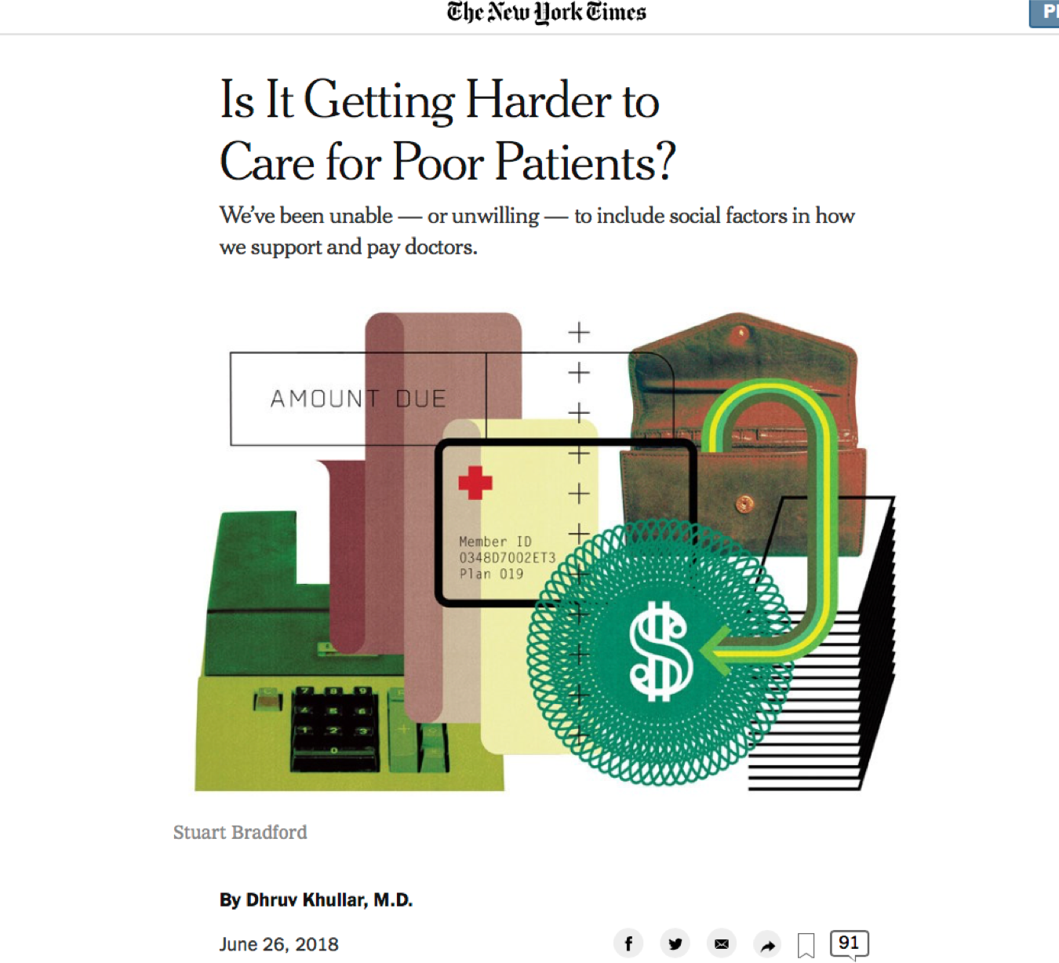
Oregon APCM is a “bridge to value-based pay”
“Putting in place value-based pay, without a way to account for patient differences beyond how severe their medical condition is, could set up a rush away from serving homeless or other complex patients.”
(APCM leader)

