Slide 1

Shaping the Future of Medical and Social Care Integration
SIREN Research Meeting February 4, 2019
Karen B. DeSalvo, MD, MPH, MSc
Professor of Medicine and Population Health, Dell Medical School
Co-Convener, National Alliance to Impact the Social Determinants of Health

Slide 2
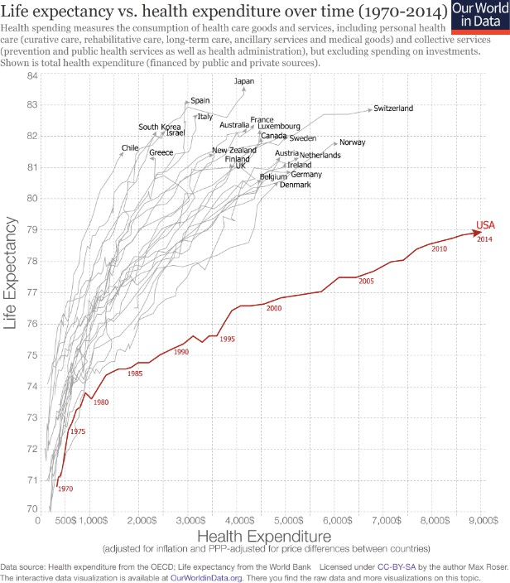
THE PROBLEM WE ARE TRYING TO SOLVE

Slide 3
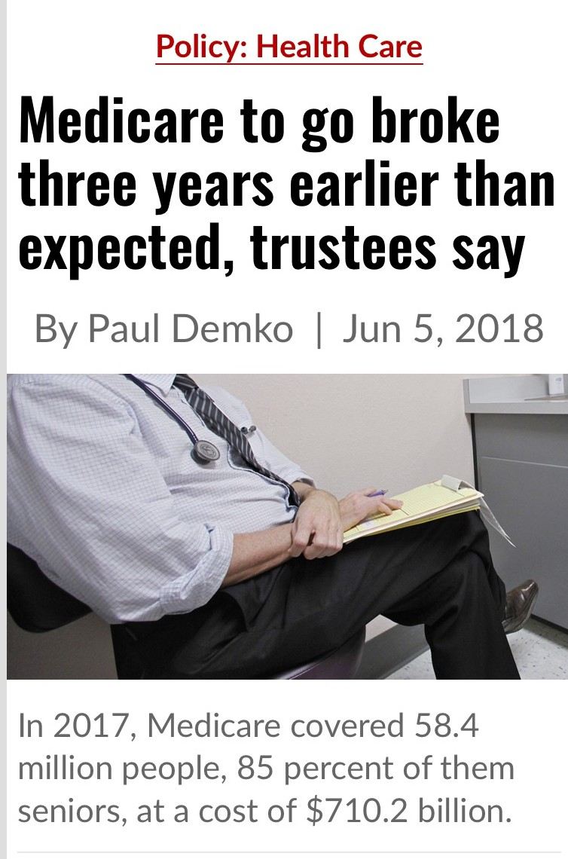
MOVE TO VALUE
Health care cost uncontrollable
  Frame action in the Triple Aim
  Significant Progress in move to value
  Bent the cost curve
  Created a data foundation to track progress and identify gaps
Still a burning platform
Pressure to identify new solutions
Finding the answers in the data
  High cost, high need
Fryhofer SL, Seshmani M, DeSalvo KB, Conway PH. “Progress and a Path Forward”. N Engl J of Med Catalyst. 2017

Slide 4
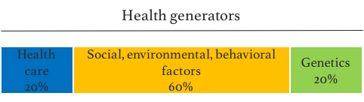
HEALTH IS MORE THAN HEALTH CARE
www.healthypeople2020.gov; Leavitt and DeSalvo, Modern Healthcare, 2017; adapted from James Rubin, TAVHealth
4

Slide 5
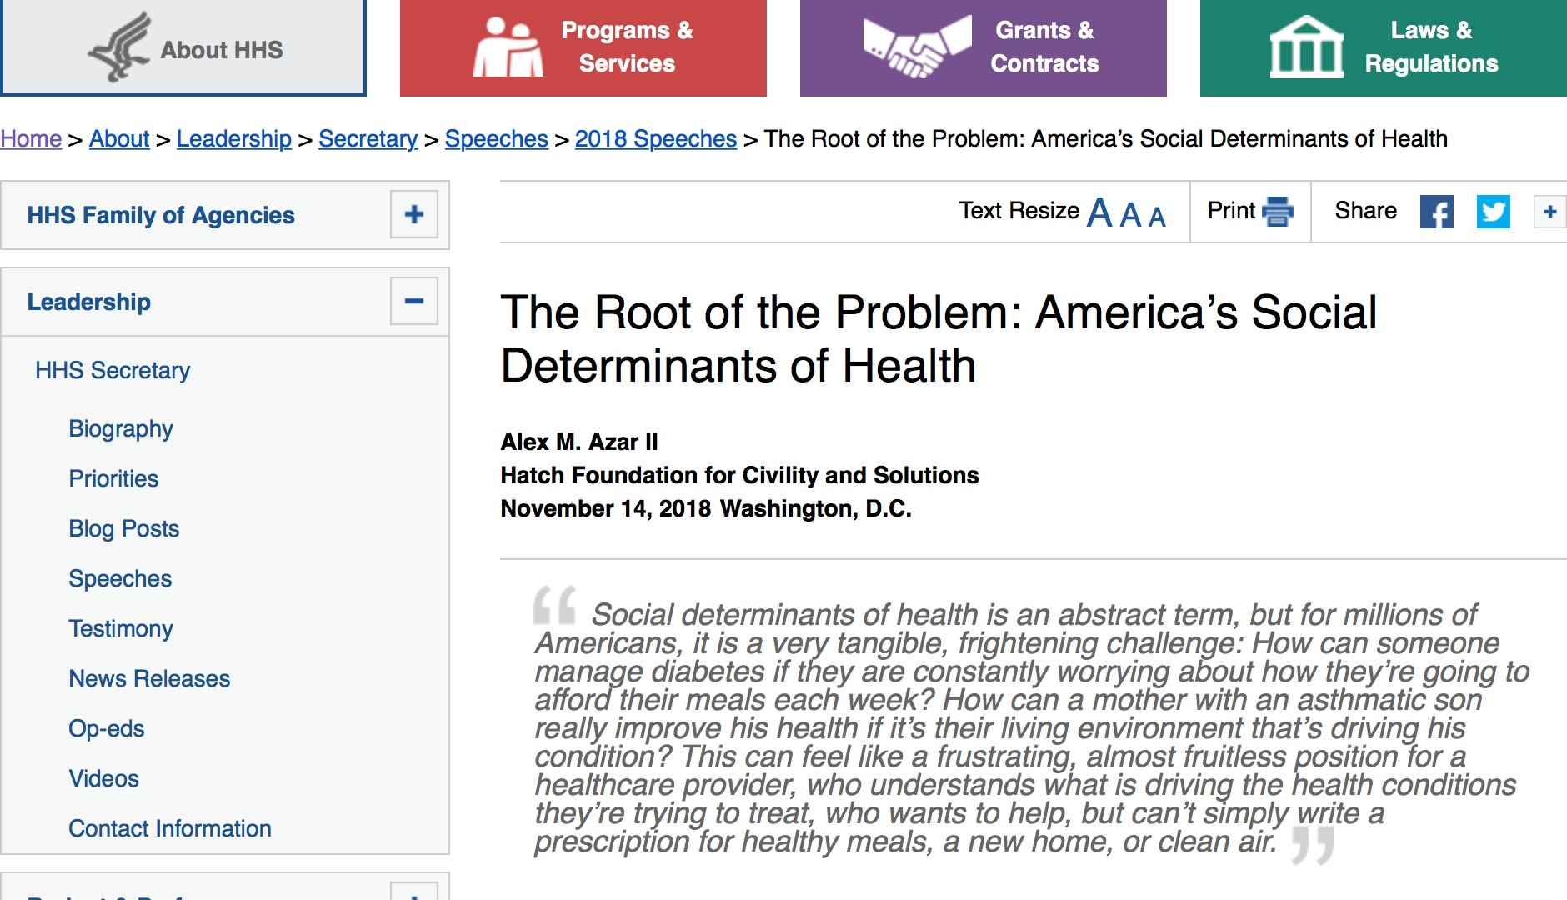

Slide 6


Slide 7
FIELD ISSUES

Slide 8


HEALTH SYSTEM ACTIVE
Cottage Health
University of Arkansas Med Center
Awareness
Children’s Mercy
People’s Community Clinic
Humana
Assistance
Oklahoma Route 66
Utah Alliance
Louisville Air
Alignment
Payers, providers, integrated delivery systems, employers, other sectors…of all shapes and sizes

Slide 9
CHALLENGES WITH SCREENING
Scalability
Screening Goals
Social Care System Referrals
Utility & Reliability of Screening Data
The Scientific Grounding of Screening Instruments
http://www.nasdoh.org/wp-content/uploads/2019/01/NASDOH-Social-Risks-Issue-Brief.pdf

Slide 10
RECOMMENDATIONS FOR EXPLORATION
Screening Integration
Tool Refinement
Systematic, Peer Reviewed Assessment
Informed Consent
Patient Trust and Safety
Social Determinants of Health Data Standards
Shared Learning
Community Data Commons
http://www.nasdoh.org/wp-content/uploads/2019/01/NASDOH-Social-Risks-Issue-Brief.pdf

Slide 11
POLICY ISSUES

Slide 12
FINANCING
Health care dollars
  What is allowable
  Streamline Medicaid experimentation
  All-payer models
Alignment with other health care dollars
Alignment with non-health care dollars
Creation of shared pools of funds
12

Slide 13
MEASURING RETURN ON INVESMENT
No clear lead entity to define the pathway
Measurement industrial complex
Begin with end in mind and mitigate new burden on people served and the system
At least agree on principles to guide our work

Slide 14
FRAMEWORK FOR ASSESSING ROI
Converge on a parsimonious set of measures.
Balance the goals and interests of all involved sectors and impacted people and communities.
Capture the ecologic complexity of SDOH reflecting the impact of interventions on health and well-being, on individuals and the communities in which they live.
Capture the individual’s perspective on health and well-being.
Minimize additional burden to the clinical or social services setting but rather should be drawn from existing data when available.
Align with standardized quality metrics, when available, including those used for value-based contracting and payment.
Reflect the cascade of actions to address the social determinants of health
Provide information about near term outcomes to accelerate learning and inform and expedite appropriate changes.
Allow for population stratification, evaluating risk reduction, and to inform payment and outcome measurement.
Evaluate the added value of developing new outcome measures to reflect the impact of SDOH interventions such as a measure of Social Care Sensitive Conditions.

Slide 15
IMPLEMENTATION & ACTION STRATEGIES
“Rifle shot” approach v. systemic
Are some needs “gateway”?
Build a stronger system of supports
Potential to demonstrate no impact
The science is complicated

Slide 16
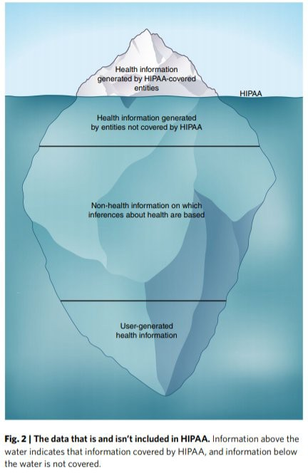
DATA AND TECHNOLOGY
Automating the process and leveraging analytics
Linking to resources and closing the loop
Assessing individual risk and need
  Predictive analytics
  Social Risk Scores
Is HIPAA enough?

Slide 17
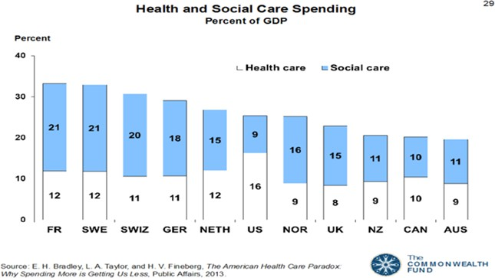
RETHINKING THE RESOURCES

Slide 18
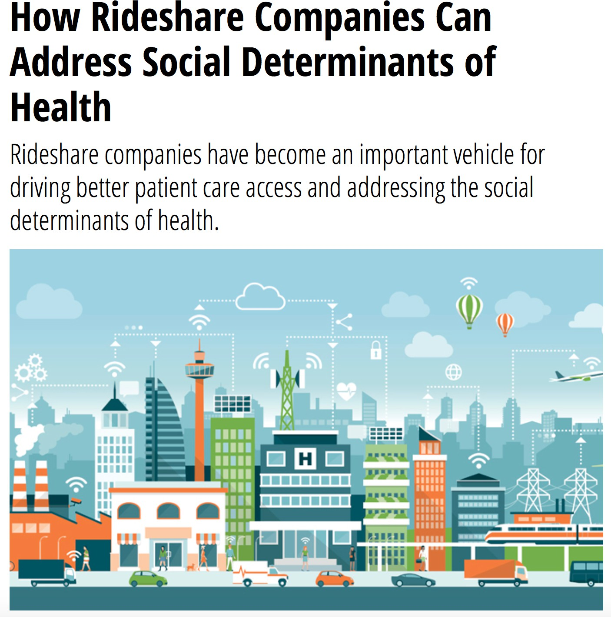
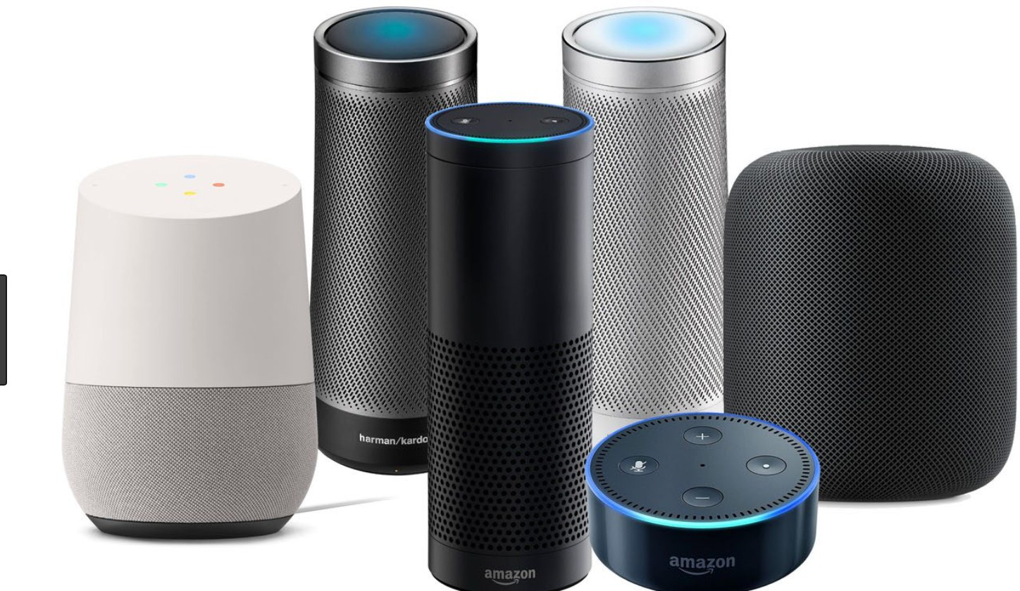
Alexa will see you now...

Slide 19
KEY MESSAGES FOR YOU
Policymakers are engaged
Looking for solutions
Need to channel interest and excitement
Avoid unintended consequences like:
  Medicalizing the social determinants of health
  Exacerbating inequity
  Harming those we want to most help
  Adding complexity to the already too complex system
SDOH has now and will continue to gain many “mothers” – avoid snatching defeat from the jaws of victory
Work smart. Work quickly. Work collaboratively. The nation counting on us.

Slide 20

THANK YOU
@kbdesalvo

