Slide 1
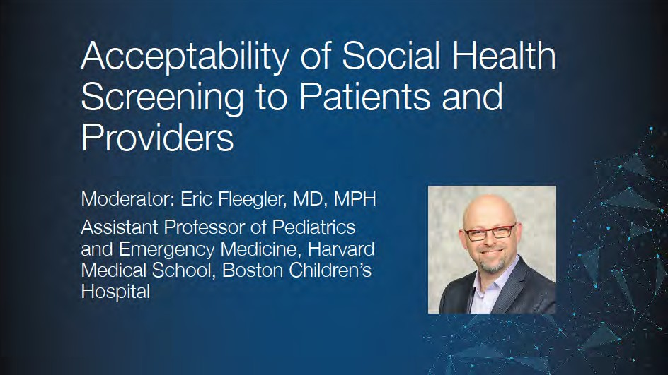

Slide 2
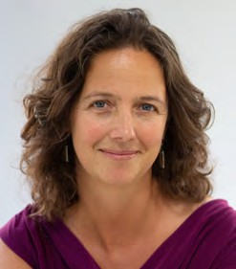
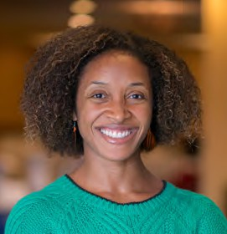
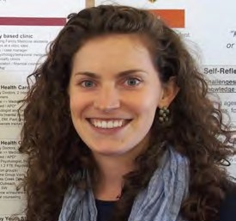
Panelists
Arwen Bunce, MA
Lead Qualitative Research Associate, OCHIN
Aisha Lofters, MD, CCFP, PhD
Family Physician and Assistant Professor, St. Michael's Hospital and University of Toronto
Emilia De Marchis, MD
Clinical Research Fellow, UCSF School of Medicine

Slide 3
Sending in your questions
Go to menti.com and enter 51 39 94
Alternative: Point your smartphone camera at the QR code in your program
If your question is for a specific presenter, please include their name before your question

Slide 4
Disclosures
Eric Fleegler is a consultant to Veta Health, which develops chronic disease management tools and supports HelpSteps which was developed by Dr. Fleegler
Author for UpToDate (PALS)
Honorariums for Grand Rounds and other speaking engagements related to firearms, social determinants of health, sedation.
Editor of book in development: “Pediatric Firearm Injuries and Fatalities – The Clinician’s Guide to Approaches, Policies and Harm Prevention”

Slide 5
Drugs and Alcohol
Patient: “How comfortable do you feel telling your HIV provider about using drugs or alcohol?” (High comfort 5/5)
Non-problematic drinkers | 78% | Problematic drinkers | 56%
Non-drug users | 79% | Drug users | 66%
Provider: ”indicate your level of comfort discussing illicit drug use with patients” (High comfort 5/5)
Physicians | 65% | RN/NP/PA | 100%
Patients and their providers must have the freedom to openly discuss substance use issues in primary care.
Ray et al. Patient and Provider Comfort Discussing Substance Use. Fam Med . 2013

Slide 6
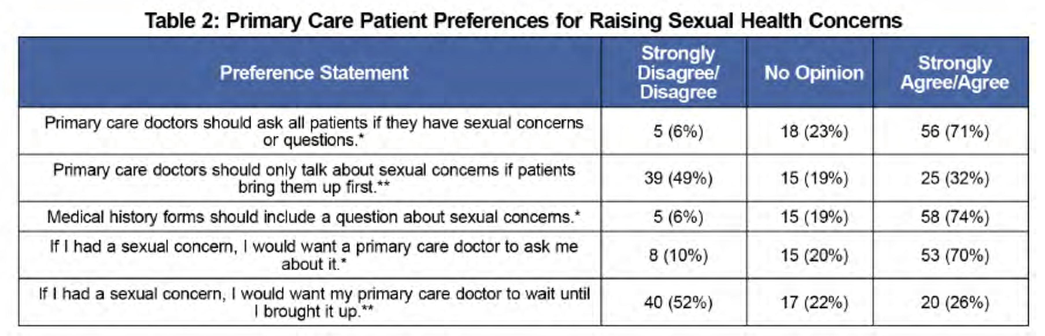
Let’s Talk about Sex
Ryan et al. Let’s Talk About Sex: A Survey of Patients’Preferences When Addressing Sexual Health Concerns in a Family Medicine Residency Program. Primer 2018.

Slide 7
Patient’s Perspective on Tobacco Screening
Expectation: “Smoking’s important it should be every time a person comes in like when they take my blood pressure”
Trust: “The only person who is in the position to help me is that doctor because I trust him”
Respect: “You sit in the waiting room fill out 15 minutes worth of paper work. You go in and they’ll ask you the exact same questions. Did you read it? No they didn’t”
Positively and Targeted Messaging: ”Listen just say the word we have plenty of things for you to help and just let me know this is what works”
Halladay et al. Patient Perspectives on Tobacco Use Treatment in Primary Care. Primary Care Prev Chronic Dis. 2015

Slide 8



Do Patients Think its OK to Discuss Firearms?
46
70%
54%
29
30
30
Always Usually Sometimes Never
26
14
13
11
Non-owner
Owner
Betz, et al. Ann Int Med. 2016

Slide 9
Families with Health-related Social Problems
5 problems
(3%)
4 problems
(6%)
0 problems
(18%)
3 problems
(13%)
1 problem
(28%)
2 problems
(32%)
82% of families had one or more health-related social problems
Fleegler et al. Families Health-related Social Problems and Missed ⁹Referral Opportunities. Pediatrics 2007

Slide 10
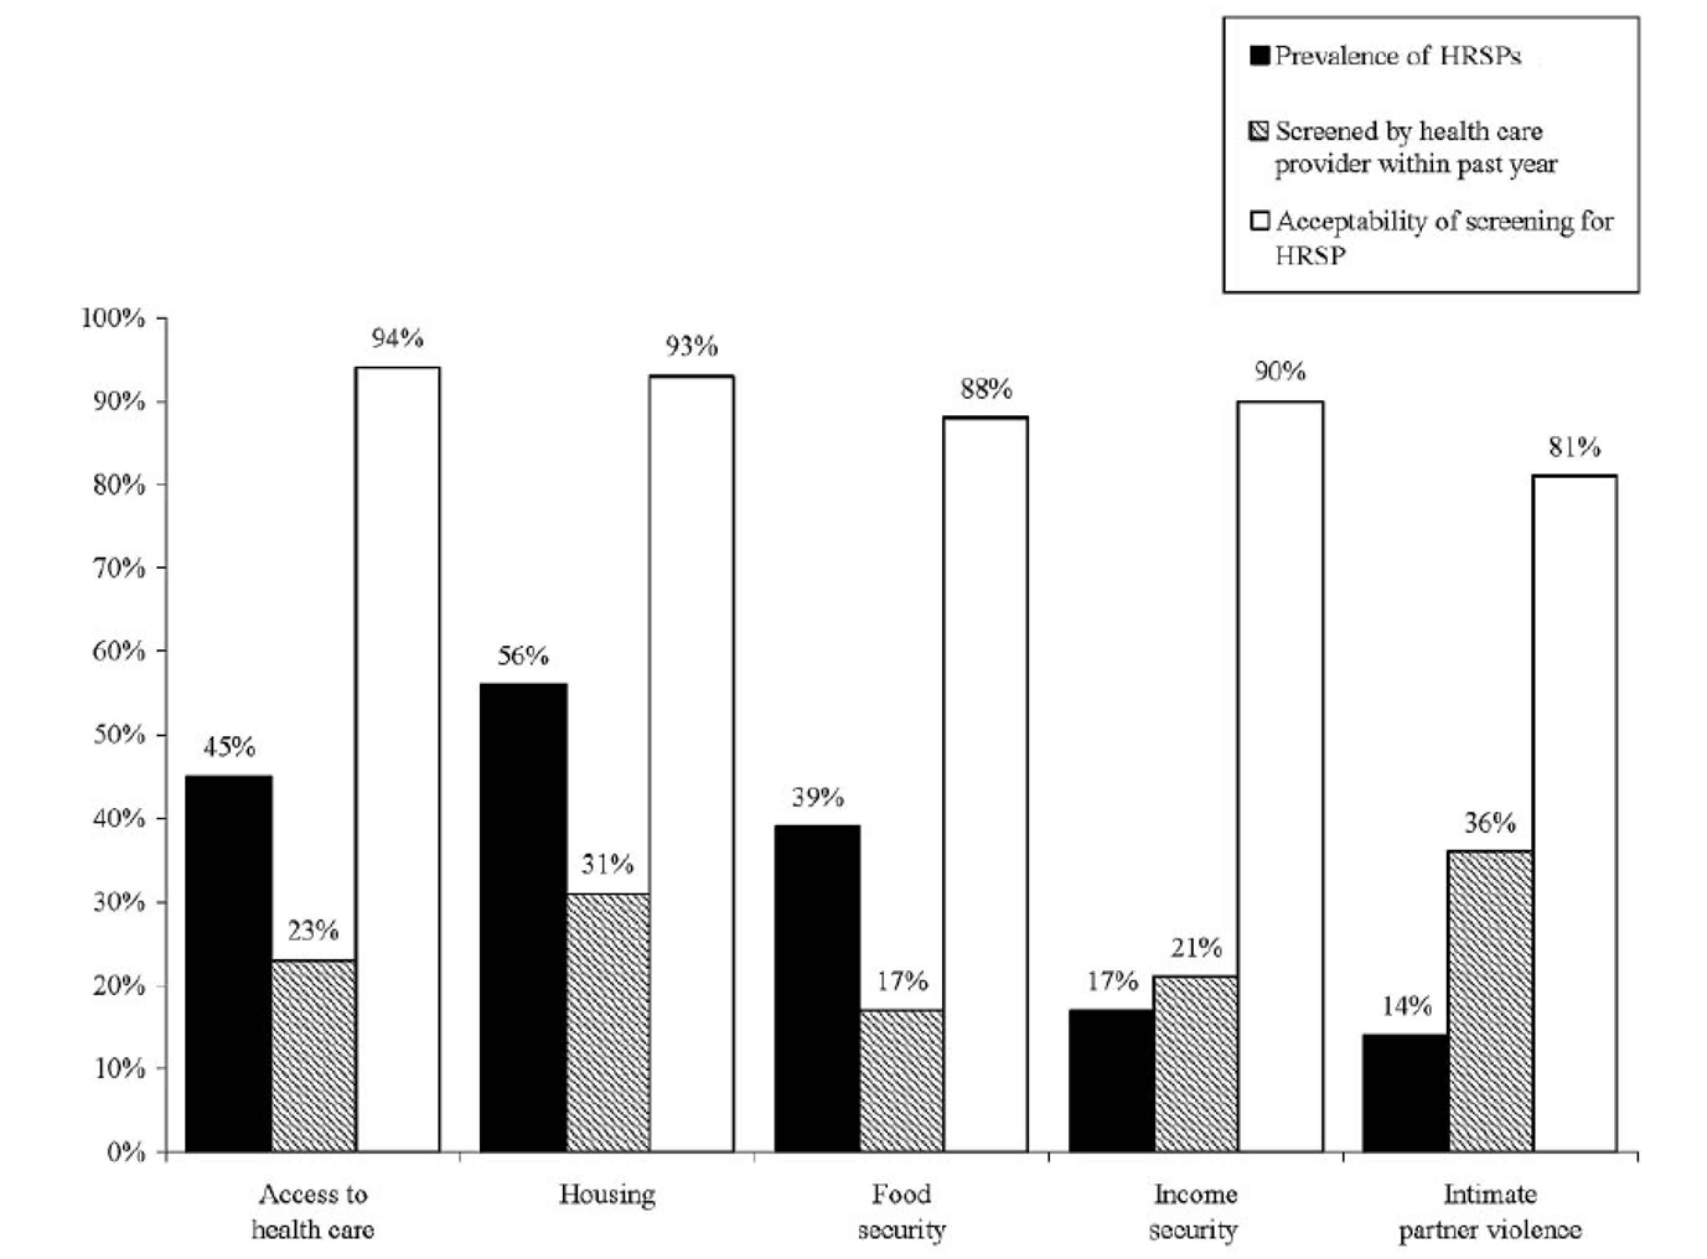
Fleegler et al. Families Health-related Social Problems and Missed Referral Opportunities. Pediatrics 2007

Slide 11
Determining Acceptability
"How would you feel about taking a computer-based survey in your doctor’s waiting room that evaluated a family’s social issues and made referrals to local agencies?"
Acceptance and interest: 92%
Fleegler et al. Families H¹e¹alth-related Social Problems and Missed Referral Opportunities. Pediatrics 2007

Slide 12
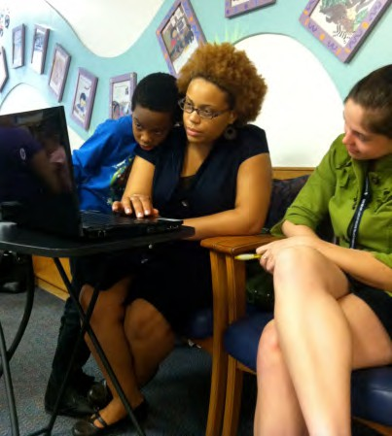
HelpSteps: Patient Perspective
“… [HelpSteps] actually turned out to be a good survey because it showed that somebody was trying to care about what I needed and they really tried to pinpoint all of my specific needs. I liked that.”
- Patient in Young Adult Clinic
Sarah Wylie et al. J Telemed Telecare. 2012
12

Slide 13












































HelpSteps & Nutrition Study 340 Families in CHPCC
Food insecure 31%
Requesting food help 32%
Food secure 69%
Not requesting help 68%
Bottino et al. Academic Peds 2017

Slide 14




























Food insecure
Not requesting help 14%
Food insecure Requesting help
Food secure Requesting help 15%
17%
Food secure
Not requesting help 54%
Bottino et al. Academic Peds 2017

