Slide 1
Addressing Social Risk in Pediatric Health Care Settings:
A Tale of Two Interventions
Danielle Hessler Jones, PhD University of California, San Francisco
1

Slide 2
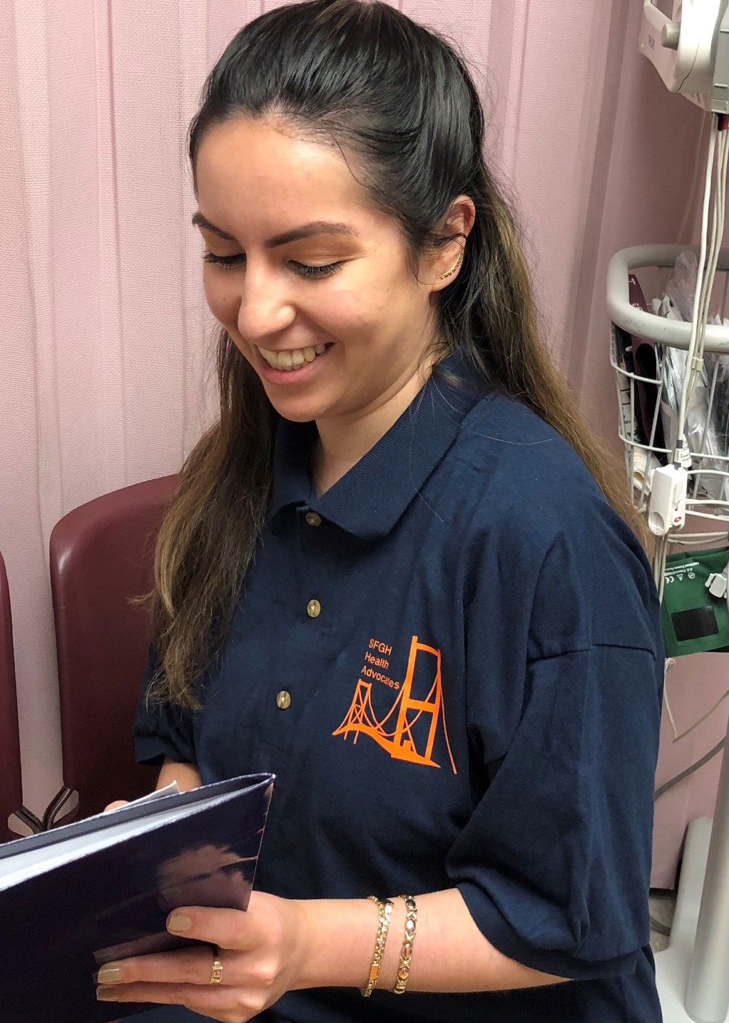
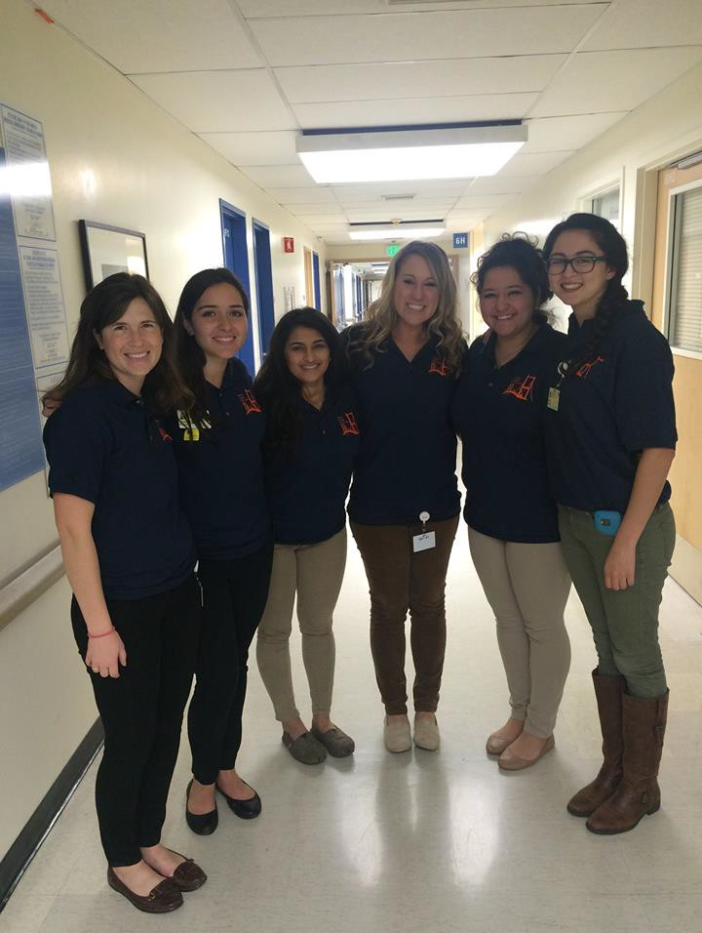
Resource Navigation Intervention
Assessed family social risks
Used algorithms to provide targeted resource referrals
Connected to resources
Created intervention plans
Provided case management
Followed-up (phone, text or in-person) every 2 weeks

Slide 3


Interventions
Written Community Resources
SCREENING
Do you need...?
0 Food
0 Housing
0 Help with benefits
0 Legal services
Resource Navigation & Follow-up

Slide 4
Study I

Slide 5
Methods: Study Design
Two hospitals serving low-income, diverse patients
Primary Care and Urgent Care settings
Randomization by day: Navigation vs. written resources
Caregivers: English/Spanish, ≥ 18 yrs., no acute illness
Key Question: Can addressing social issues during pediatric care visits decrease social risks and improve children’s health?

Slide 6
Participant Characteristics
Children
5 years (SD 5 years)
51% Female
51% Hispanic, 26% Black
1809 Families
872 Navigation Services
937 Written Resources
Caregivers
84% Mother
35% Primary language Spanish
34% > High school education
75% Household income <35k
68% Urgent Care
32% Primary Care

Slide 7















Prevalence of social risks (% of total sample)
Running out of food Difficulty paying utility bills Difficulty finding a job
Not having a place to live Unhealthy living environment
Medical bills No health insurance
Other housing concerns
Cut off or denied from benefits programs No primary care or regular doctor Disability interfering with ability to work Mental health care for adult in household Problems with a current or former job Pregnancy-related work benefits
41.2
41.1
31
29.2
22.8
21
17.6
16.5
14.3
13.8
9.7
7.3
6.1
2.5

Slide 8
Results
Change in total number of social risks
0.80
0.60
0.40
0.20
0.00
-0.20
-0.40
-0.60
-0.80
*
Written Resources
Navigation Intervention
Active Control
* p < .05
Gottlieb, Hessler, Long et al., 2016

Slide 9
Results
Change in total number of social risks
Change in caregiver - reported child health
0.80
0.60
0.40
0.20
0.00
-0.20
-0.40
-0.60
-0.80
0.50
*
0.40
*
0.30
0.20
0.10
0.00
Active Control
Navigation Intervention
Written Resources
Navigation Intervention
Written Resources
Active Control
* p < .05
Gottlieb, Hessler, Long et al., 2016

Slide 10
Study II

Slide 11
Methods: Study Design
Urgent care setting
Randomization by family: Navigation vs. written resource
Broadened health outcomes and process measures
Key Question: Can addressing social issues during pediatric urgent care visits decrease social risks and improve child and caregiver health?

Slide 12
Participant Characteristics
Children
6 years (SD 5 years)
51% Female
79% Hispanic, 8% Black
Caregivers
88% Mother
70% Primary language Spanish
51% > High school education
88% Household income <35k
614 Families
310 Navigation Services
304 Written Resources

Slide 13

Preliminary Results: First Look!

Slide 14
Preliminary Results: First Look!
Change in total number of social risks
92% reported ≥ 1 social risk area
0
-0.5
-1
4.2 social risks (from 18) reported on average
-1.5
-2
*
-2.5
-3
Written Resources
Navigation Intervention
* p < .05

Slide 15
Preliminary Results: First Look!
 | Written Resources | Navigation
Food insecurity | x | x
Unstable housing | x | x
Bills (utility) | x | x
Housing Quality |  | x
Difficulty finding job | x | x
Denied income support programs |  | x
Medical bills |  | x
Childcare | x | x
Transportation | x | x
Legal issues |  | x
Primary care provider |  | x

Slide 16



Pending analyses
Self-reported health outcomes
Child health (general health, PedsQL)
Caregiver health (PROMIS, PHQ-8, Perceived Stress)
Biomarkers (intermediate health outcome)
Hair cortisol
Salivary Inflammatory markers (IL-6, CRP)
DNA methylation and genotyping
Health Care Utilization
Process measures (dose, resource connections) Qualitative study of resource navigation

Slide 17
Discussion

Slide 18
Summary & Significance
Social health outcomes
  Navigation intervention in both studies led to decrease in social risk factors.
  Findings for written resources are less clear.
Physical health Outcomes
  Improved general health on single item measure
  Pending analyses will deepen our understanding of the impact of both interventions on a range of health outcomes and mechanisms.

Slide 19
Acknowledgements
Our study participants, whose resilience in the face of social adversity is humbling.
SFGH-Children’s Hospital Oakland Help Desk Study Research Team
Bay Area Regional Help Desk Consortium (BARHC), including SFGH Health Advocates, UCSF Benioff Children’s Hospital Oakland FIND, Alameda Medical System/Highland Medical Center Health Advocates
Lisa and John Pritzker Family Fund

Slide 20

Thank you!
Danielle Hessler Jones
Danielle.hessler@ucsf.edu

