Slide 1



Health Related Quality of Life and Health Status
Robert M. Kaplan Stanford University Dennis G. Fryback
University of Wisconsin (Retired) Prepared for
State of the Science: Medical and Social Care Integration Portland
February 4, 2019
www.healthmeasurement.org

Slide 2


Measuring Effectiveness
What is the meaning of life?
www.healthmeasurement.org

Slide 3
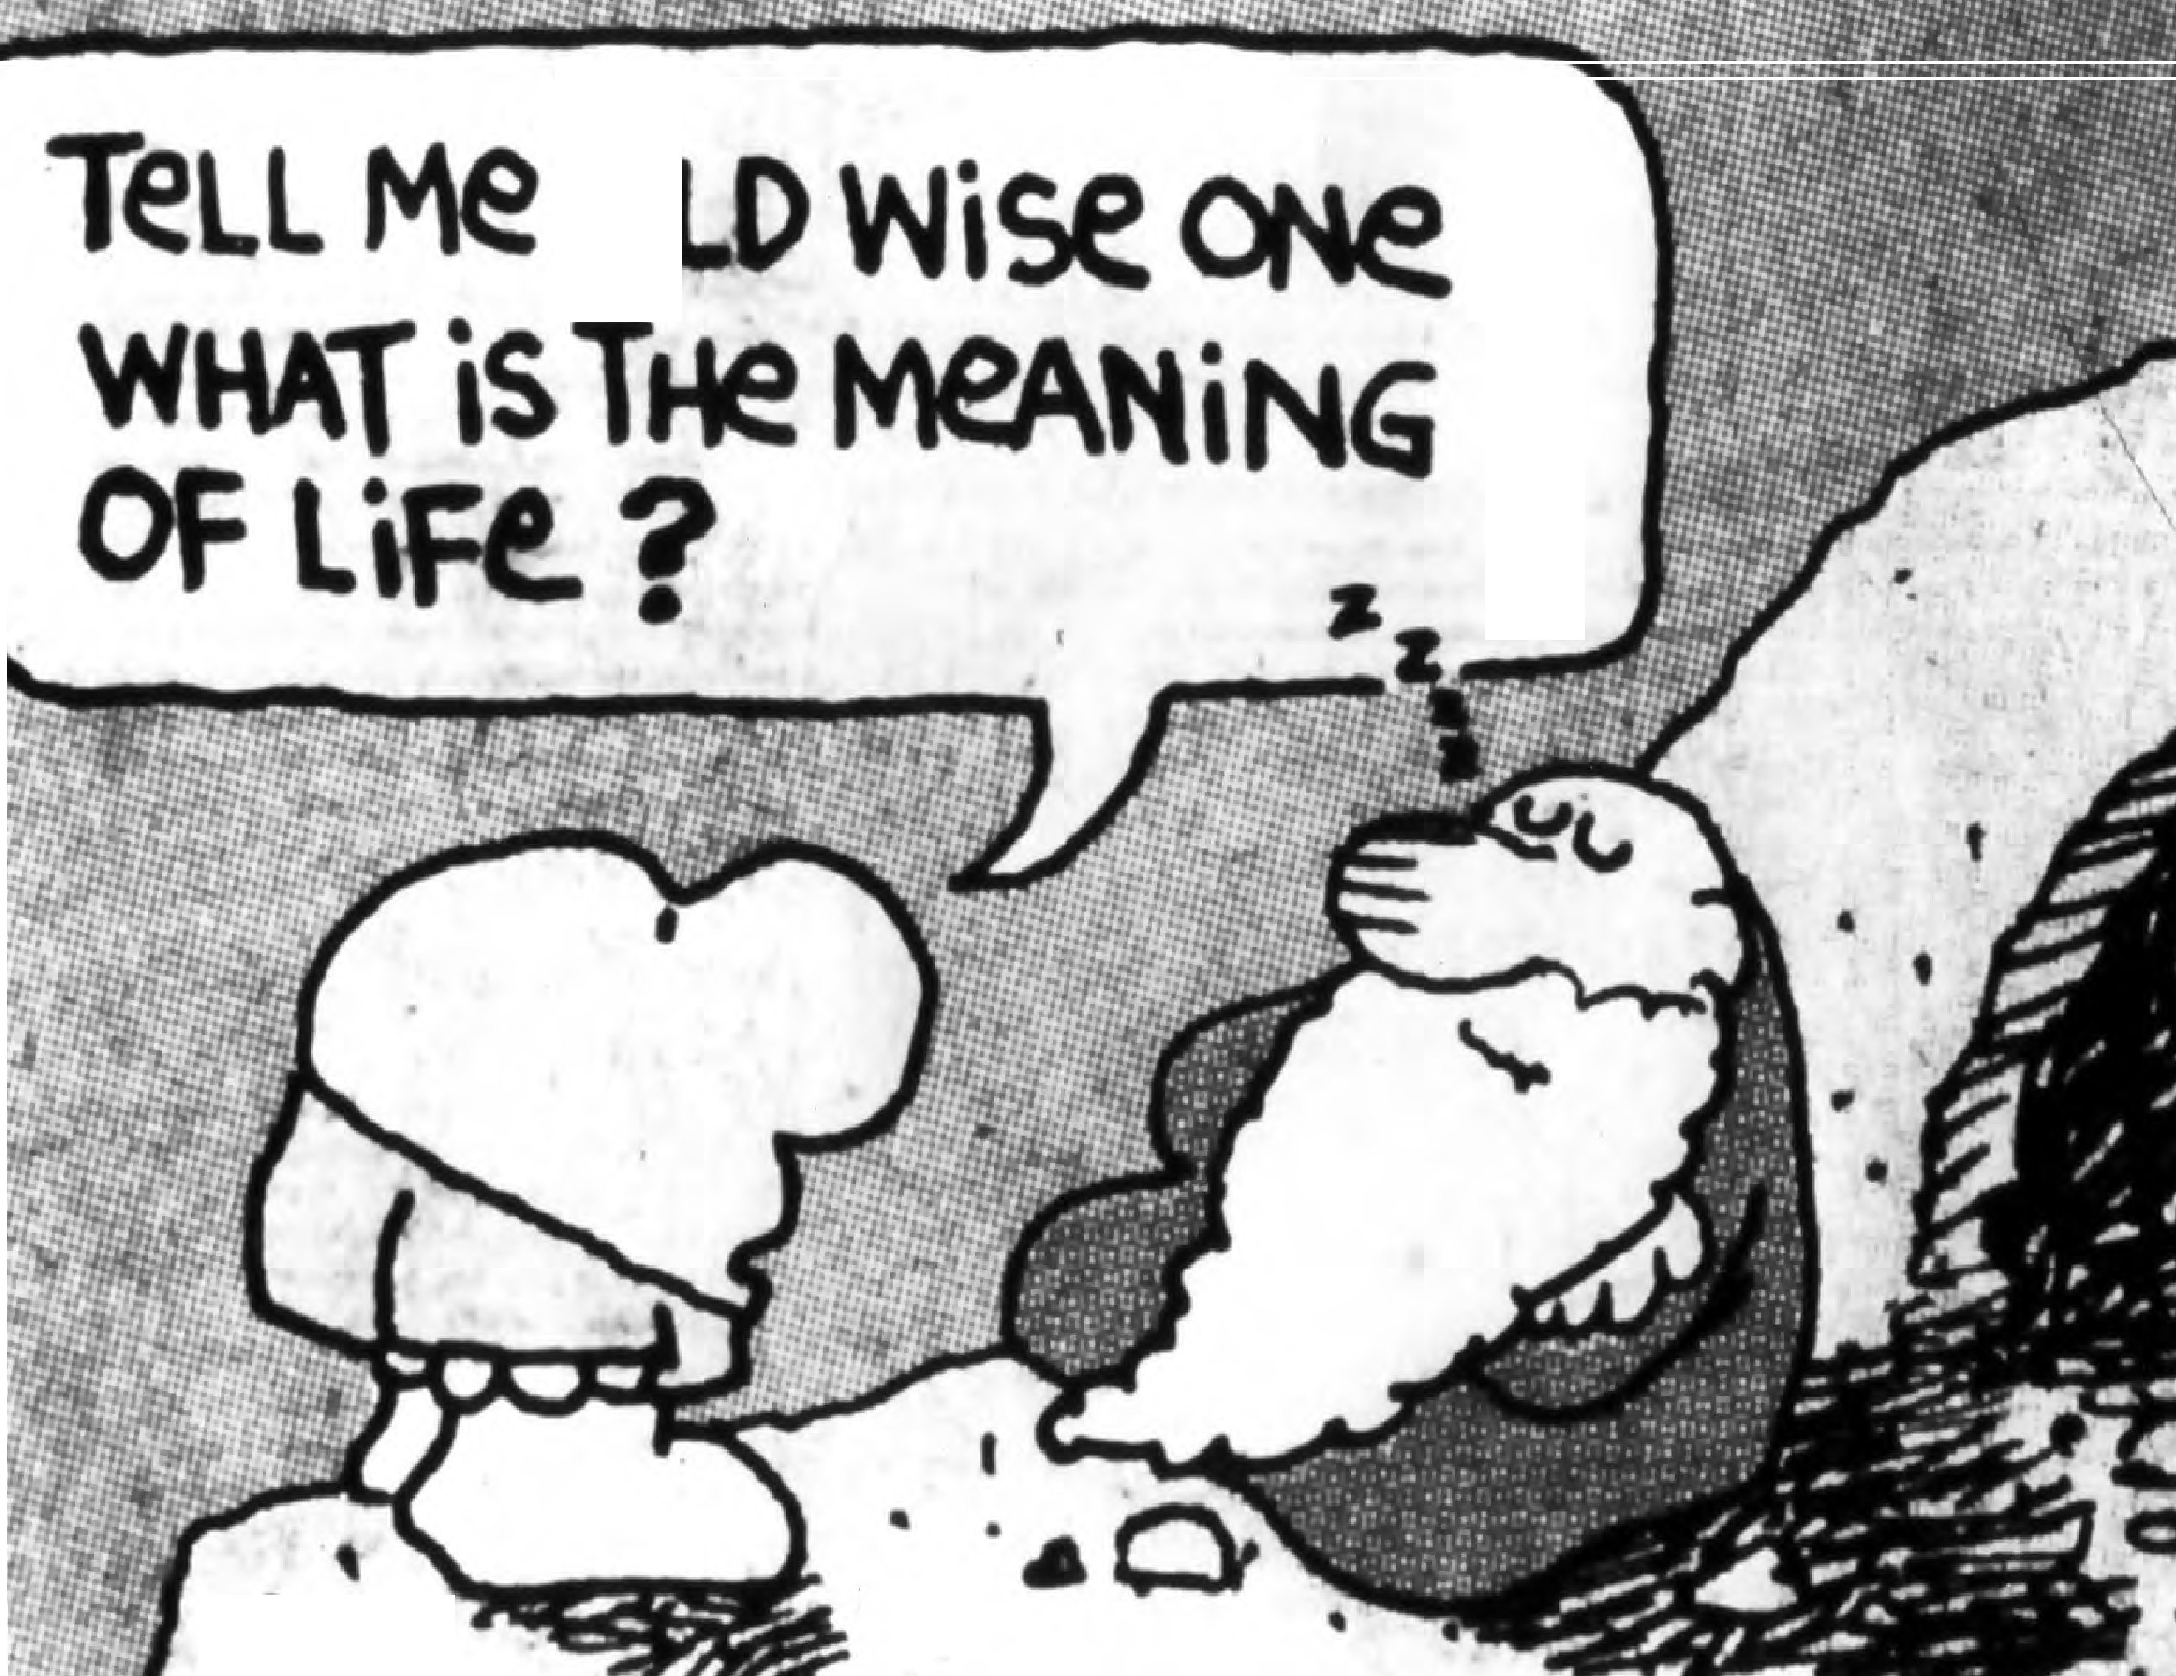
0
•••
•

Slide 4
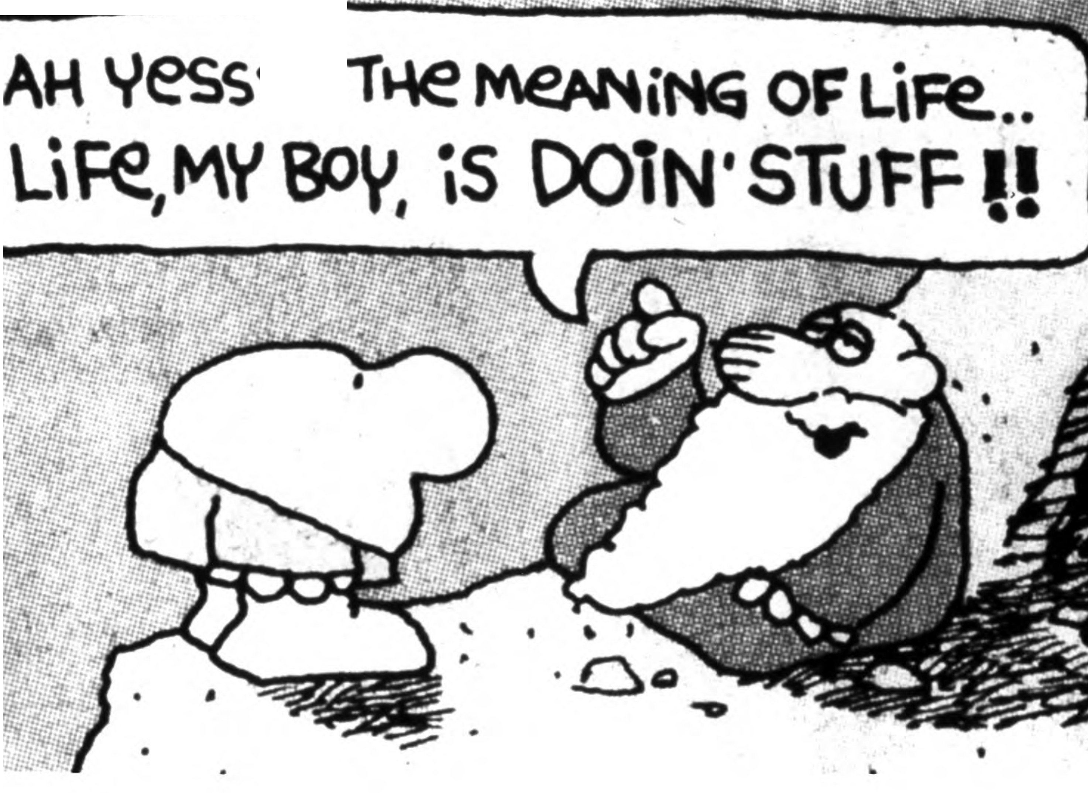
s...

Slide 5
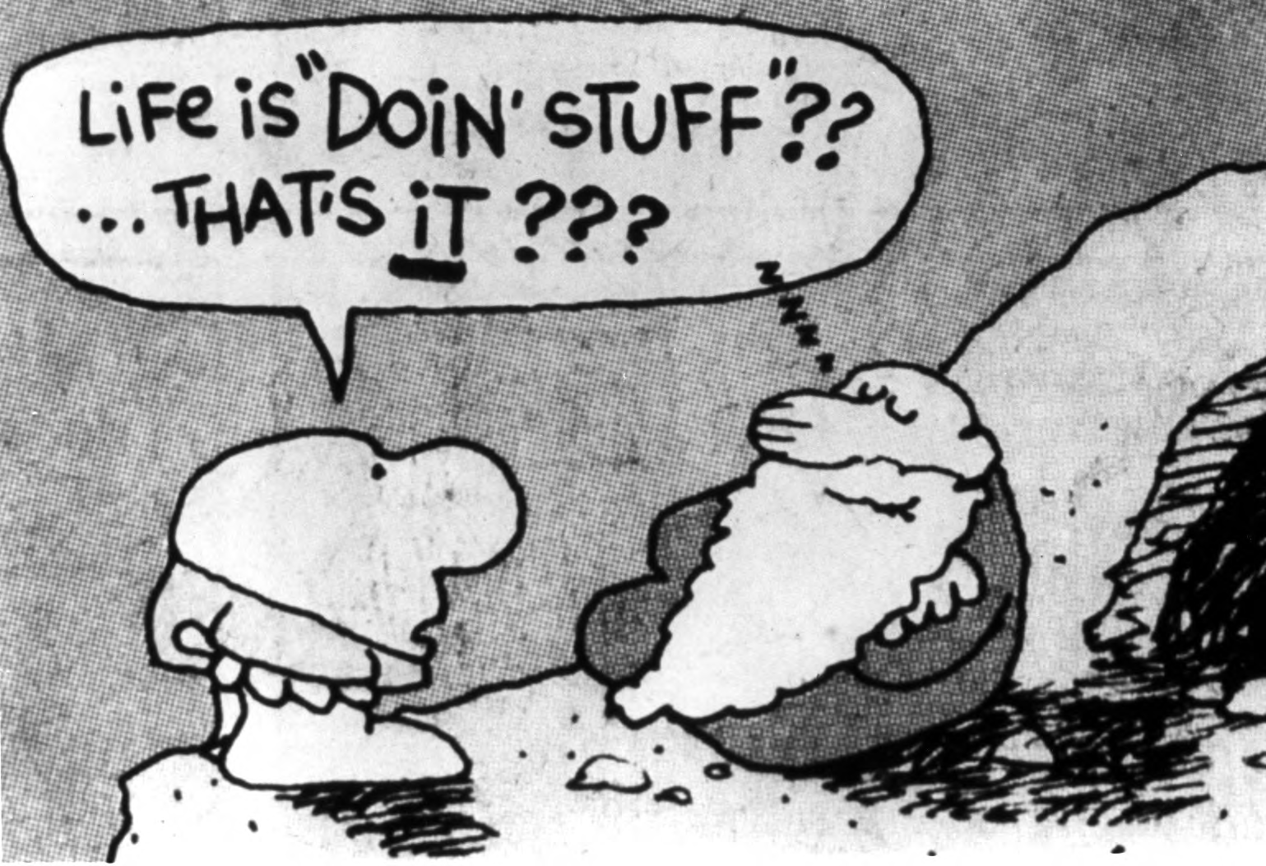
www.healthmeasurement.org

Slide 6
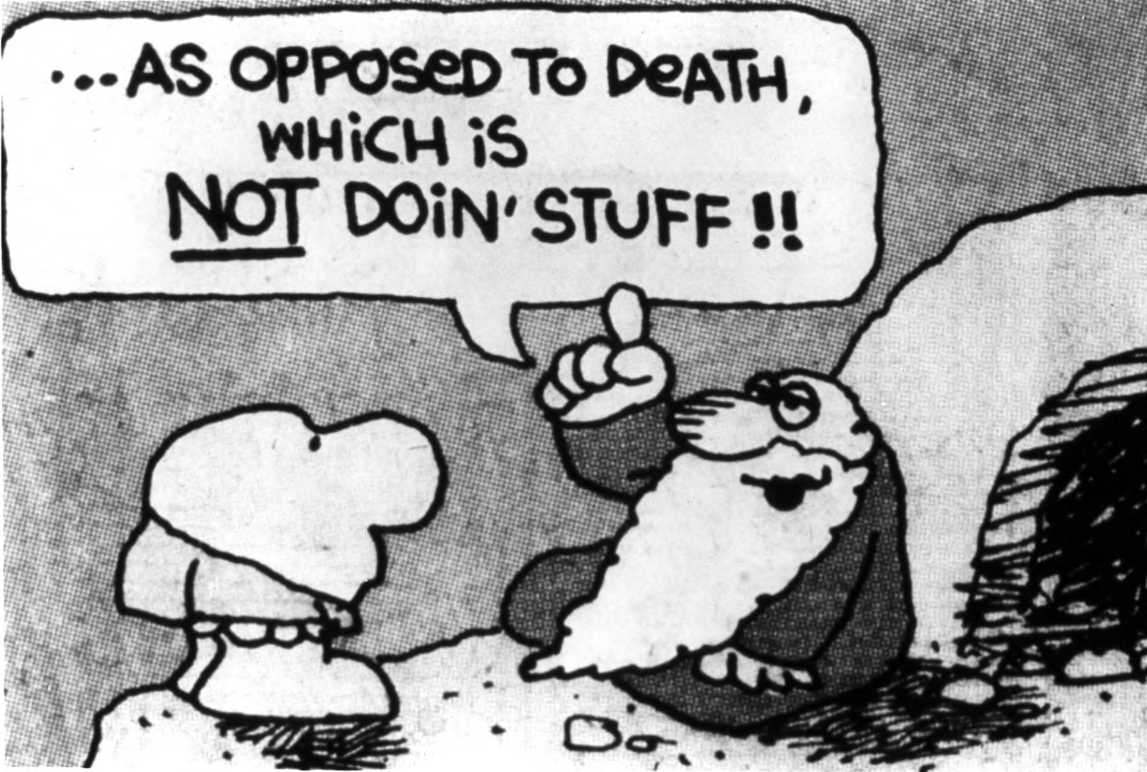
www.healthmeasurement.org

Slide 7
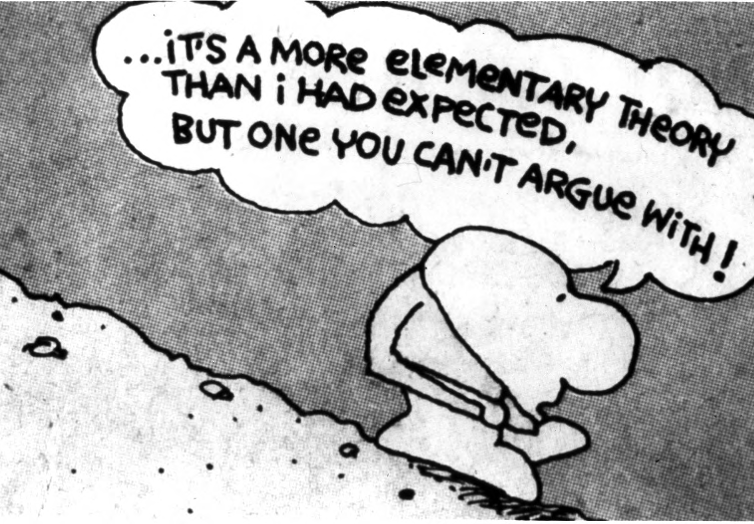
www.healthmeasurement.org

Slide 8
Overall Goals of DHHS Healthy People 2000, 2010, 2020
Our Primary Goal: Improve Quality-Adjusted Life
#1 Overall Objective for Health People 2000
  To increase the span of healthy life (quality-adjusted life expectancy)
#1 Overall Objective for Healthy People 2010
  Increase the quality and years of life
Healthy People 2020:
4 overall goals, including
– Promote quality of life, healthy development, and healthy behaviors across all life stages
www.healthmeasurement.org

Slide 9
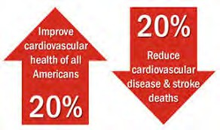
New Mission of the American Heart Association
To be a relentless force for a world of longer, healthier lives
– Note: Does not mention heart disease
www.healthmeasurement.org

Slide 10

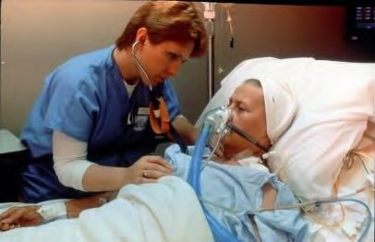

“Science in pursuit of fundamental knowledge
NIH: Steward of Medical and Behavioral Research for the Nation
about the nature and behavior of living syste..m. s and the application of that knowledge to extend healthy life and reduce the burdens of illness and disability.”
www.healthmeasurement.org

Slide 11
What Methods Can Be Used to Measure Health?
www.healthmeasurement.org

Slide 12
40 years of making the same argument
Kaplan, Bush & Berry, 1976
  Argued that health outcome has just two major components
    Length of life
    Quality of life
  Other physiological measures gain their validity through evidence of association with these two constructs
  Demonstrated validity of general health measures
Kaplan & Bush (1982)
  Offered model for estimating the cost/effectiveness of health care using the using these methods and proposed cost/utility methods using QALY
Kaplan (1990)
  Behavior as the central outcome in heatlhcare
www.healthmeasurement.org

Slide 13
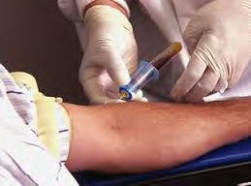
What Do Our Colleagues Prefer to Measure?
…. Blood pressure
Weight
Glycosylated Hemoglobin
Cortisol
Avoid self report
Information is meaningful if it comes from your veins
Not from your mouth
www.healthmeasurement.org

Slide 14

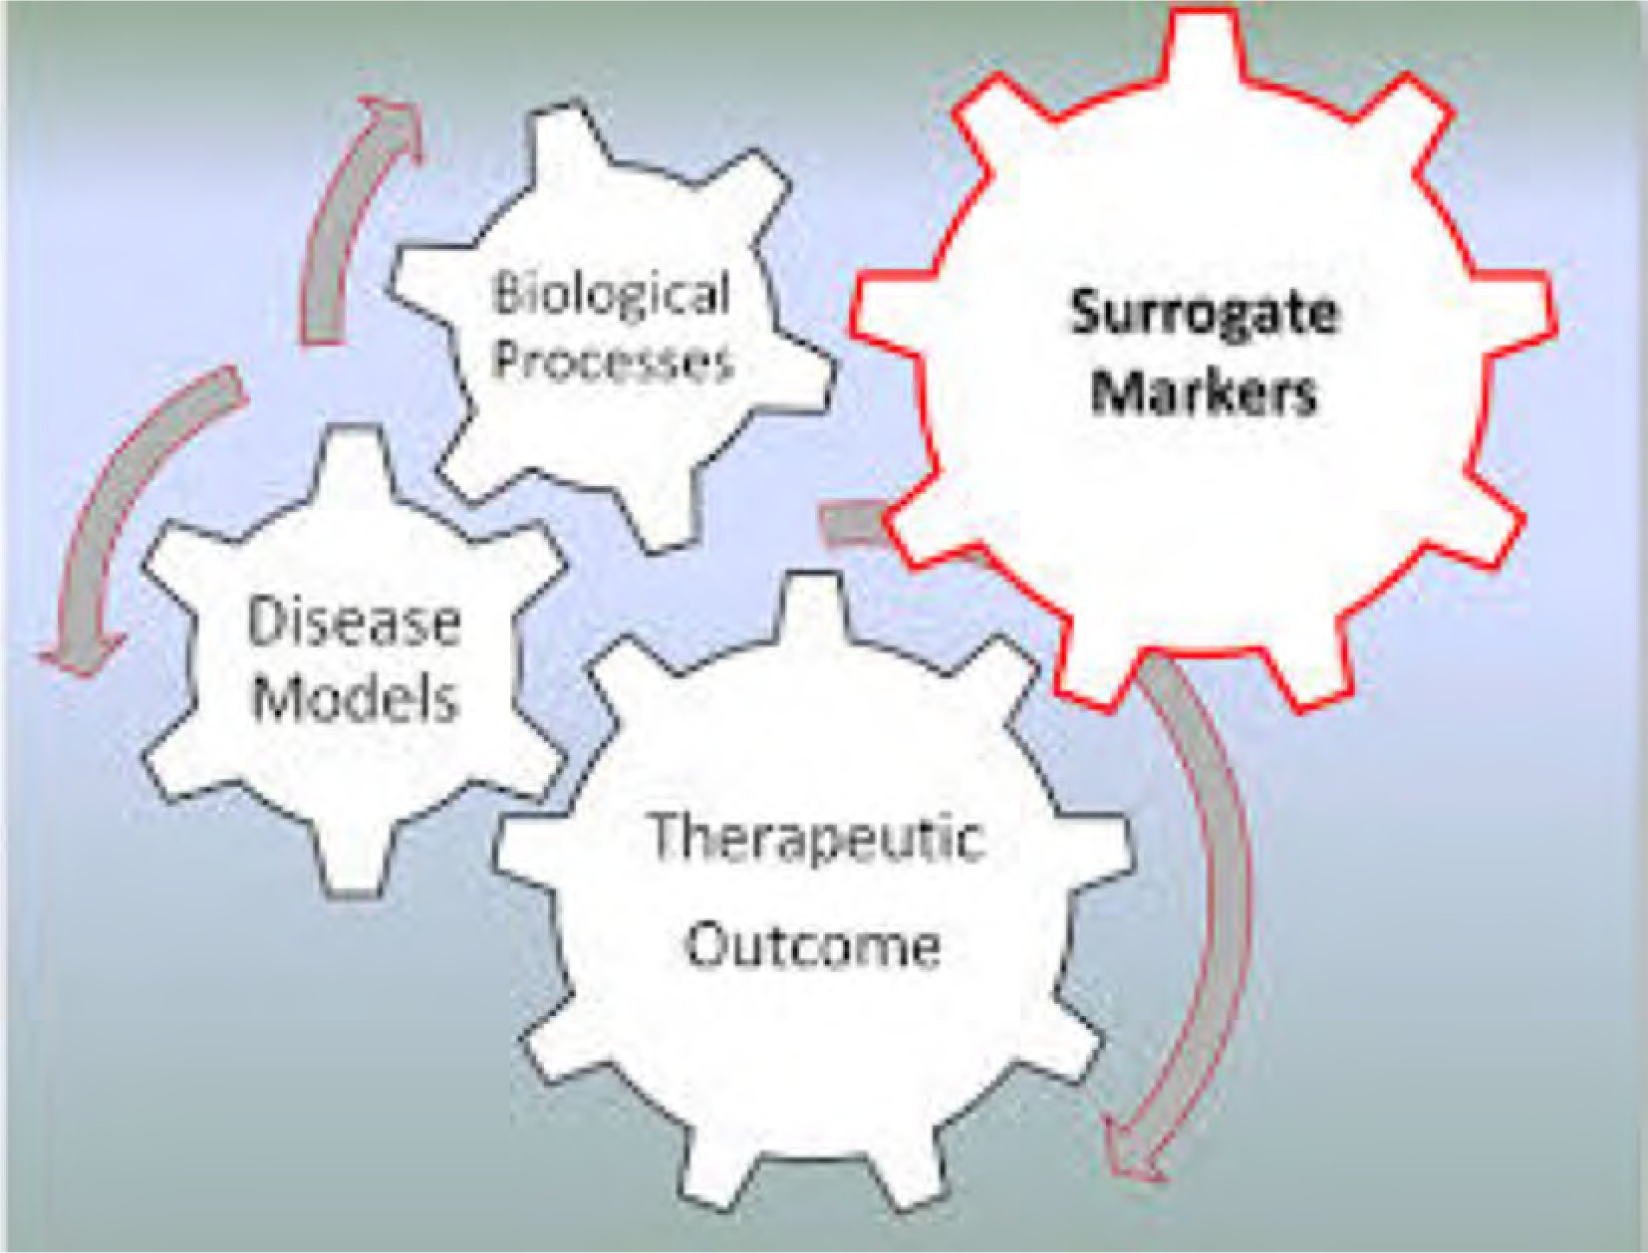
The Surrogate Marker Problem
USPSTF focuses on health outcomes rather than on intermediate markers

Slide 15
What is a surrogate endpoint?
NIH defines a surrogate endpoint as "a biomarker intended to substitute for a clinical endpoint" John JN (2004). "Introduction to Surrogate Markers". Circulation (American Heart Association) 109
(25 Suppl 1):
Examples of surrogate endpoints
  Blood pressure
  Serum Cholesterol
  Blood glucose
  HbA1C
  Cortosol
  FEV 1.0
  FMRI
  EEG
www.healthmeasurement.org

Slide 16

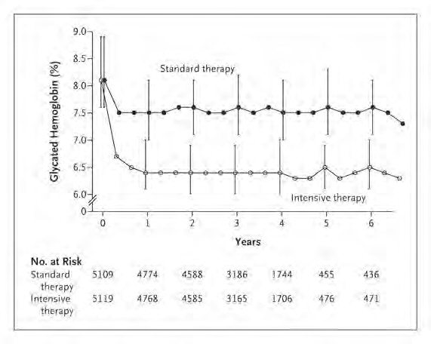
Median Glycated Hemoglobin Levels at Each Study Visit ACCORD Trial (NEJM, 358:2545-2559)
www.healthmeasurement.org

Slide 17
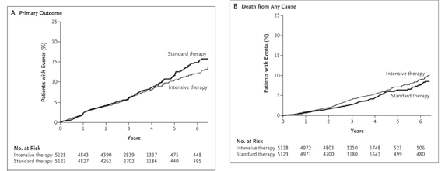
Kaplan-Meier Curves for the Primary Outcome and Death from Any Cause ACCORD Trial (NEJM, 358:2545-2559)
www.healthmeasurement.org

Slide 18
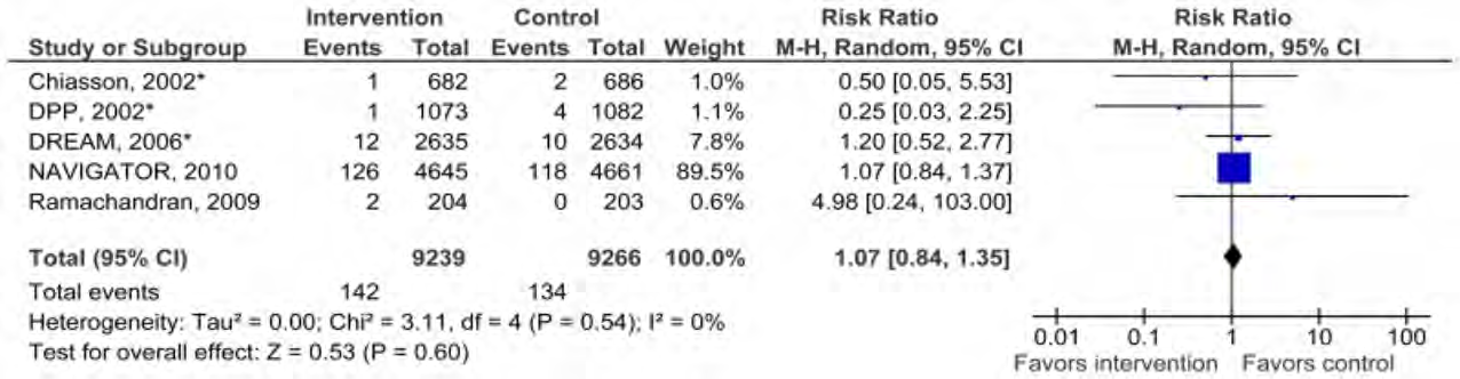
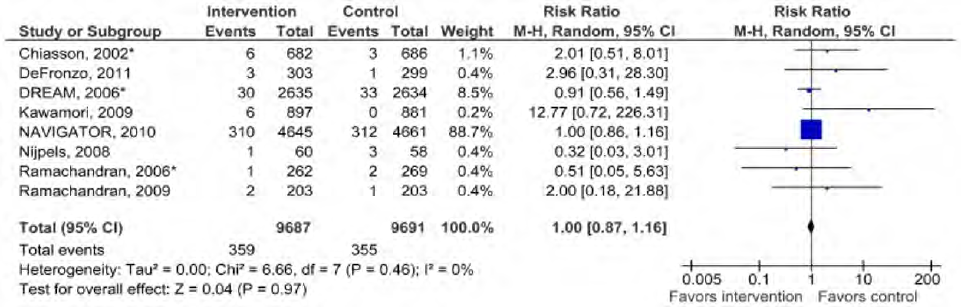
Meta Analysis of Glucose Lowering on CVD Mortality (Top) and All Cause Mortality (Bottom)
Cardiovascular Mortality
All Cause Mortality
www.healthmeasurement.org

Slide 19
Measures of Health – a quick typology
Mortality-based measures
– death rates, life expectancies, etc.
All the familiar stuff
www.healthmeasurement.org

Slide 20
Measures of Health – a quick typology
Mortality-based measures
  death rates, life expectancies, etc.
Morbidity-based measures
  indicators
Indicators:
  Single, countable things
    TB rate
    C-section rates
    % population who exercise
  Examples:
    Healthy People 2010 “Leading Indicators”
    WHO “Core Health Indicators”
    America’s Health Rankings
    Wisconsin County Health Rankings
www.healthmeasurement.org

Slide 21
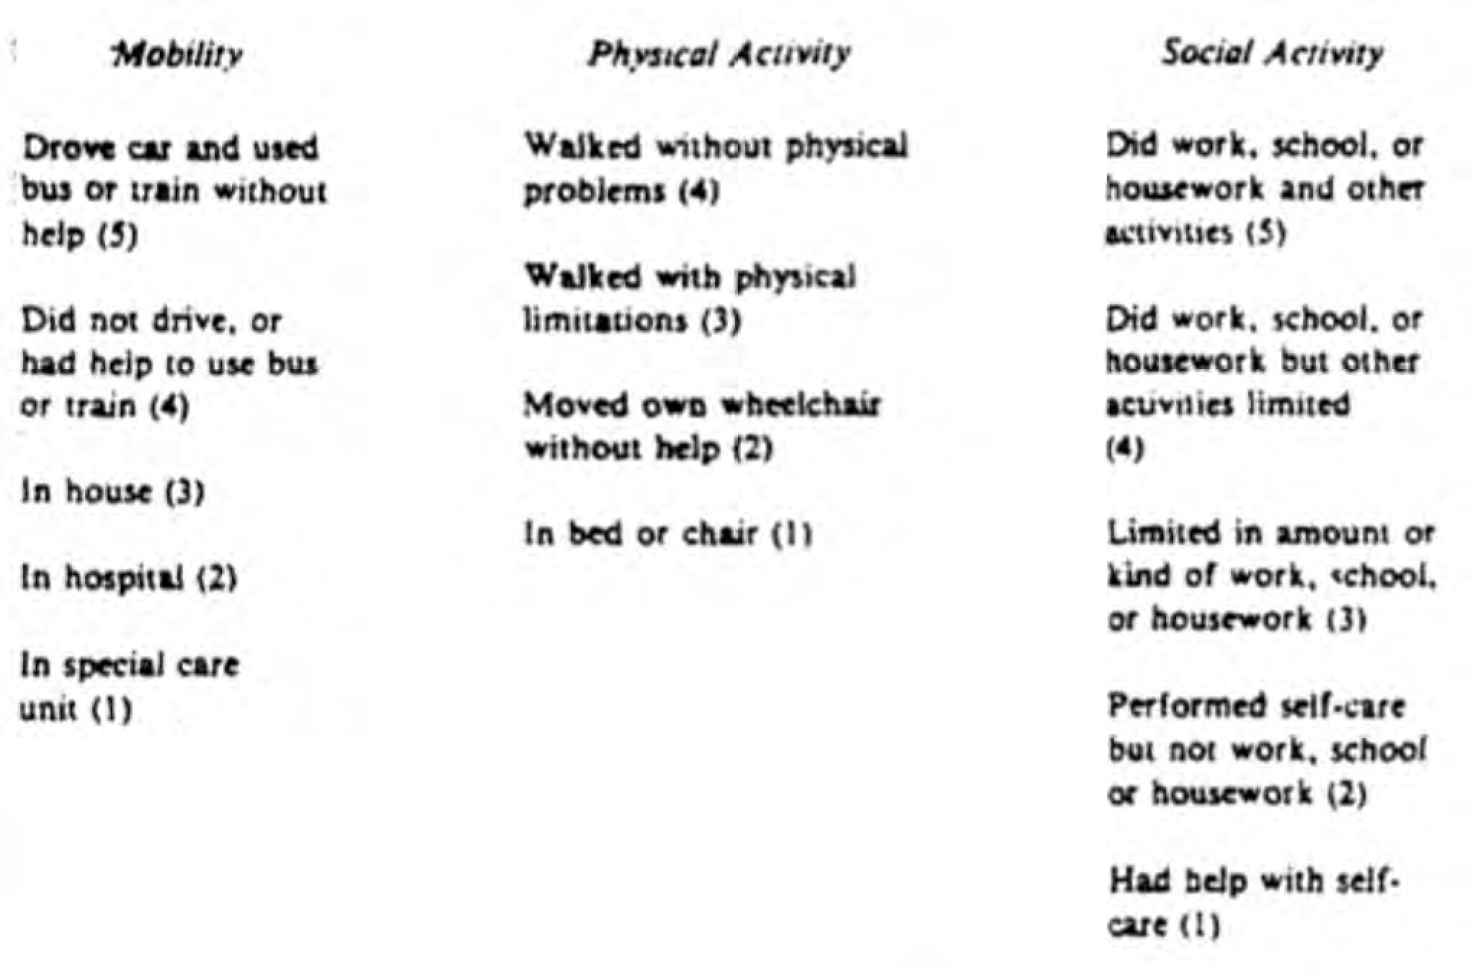
From Kaplan, Bush, & Berry, 1976
www.healthmeasurement.org

Slide 22
Measures of Health – a quick typology
Health Status Measures: point in time summaries of state of a person’s health
Disease-, organ-specific....
Created to be sensitive to changes in symptoms or functional impairment due to a particular disease process
Examples:
Arthritis Impact Measurement System (AIMS)
Vision Function Questionnaire (VFQ-25)
McGill Pain Questionnaire
NY Heart Association Classification
Some physician-reported, others patient-reported
*Many of these are scored by summing across questions in a questionnaire*
Mortality-based measures
  death rates, life expectancies, etc.
Morbidity-based measures
  indicators
  health status measures
    disease-, organ-specific
www.healthmeasurement.org

Slide 23
Measures of Health – a quick typology
Mortality-based measures
  death rates, life expectancies, etc.
Morbidity-based measures
  indicators
  health status measures
    disease-, organ-specific
    “Generic” health status
Generic Health Status Measures Most famous: SF-36 health profile
One questionnaire with 36 questions ➔
Several questions about each of 8 different domains of health
KEY: multiple scales to cover broad scope of health, not tied to one disease or organ system
multiple scales to cover broad scope of health, not tied to one disease or organ system
Scoring:
Psychometric scales based on summing responses to multiple questions
Separate scores for each subscale or health concept
PF, RP, BP, GH, VT, SF, RE, MH
PCS MCS
www.healthmeasurement.org

Slide 24
Measures of Health – a quick typology
HRQoL indexes
Like generic health status – try to comprehensively cover conceptual basis of health with multiple questions about health
Scoring
not simple sums--these are not
psychometric scales!
econometric methods used to elicit utility weights (“preferences”) for health states
0 = dead, 1= perfect health
average preference weights from community sample of people
Mortality-based measures
  death rates, life expectancies, etc.
Morbidity-based measures
  indicators
  health status measures
    disease-, organ-specific
    “generic”
  health-related quality-of-life (HRQoL) indexes
www.healthmeasurement.org

Slide 25
Data Pyramid for Population Health (after Wolfson)
more aggregated = summarization,
evaluation
HRQoL Indexes
preference-weighted aggregate scores summarizing overall health
Generic Health Status Profiles
Vector of health status domain scales
Disease-specific Scales
Do not necessarily cover all health domains
more disaggregate
= explanation, description
Multitude of health indicators
www.healthmeasurement.org

Slide 26
Survival Analysis
Alive 1.0
Dead 0.0
www.healthmeasurement.org

Slide 27

Problem with Survival Analysis
Tennis player 1.0
Man in coma 1.0
www.healthmeasurement.org

Slide 28
The concept of a QALY
1.0
 |  |  | 0.9
 | 0.7
 |  | 0.3
2 3.5 4.5
QALYs = 2x1 + 1.5x0.7 + 1x0.3 + 2.5x0.9 = 5.6
from Peter Neumann, Tufts Medical Center
time 0
7
www.healthmeasurement.org

Slide 29
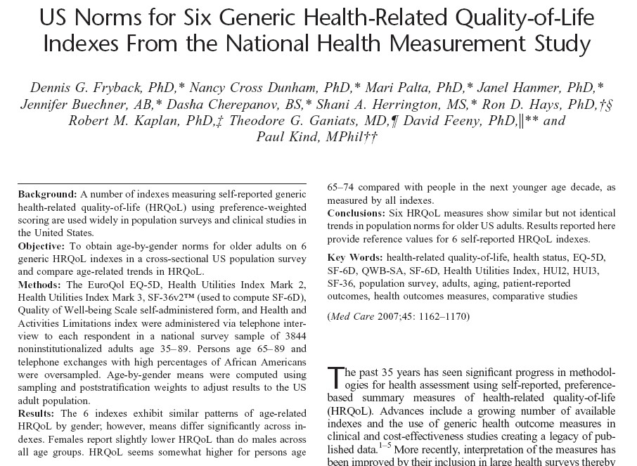
www.healthmeasurement.org

Slide 30
Data from the NHMS –population sample (n=3844) in US
Women Men
EQ-5D HUI2 HUI3
SF-6D QWB-SA
0.90
0.90
0.85
0.85
0.80
0.80
Group Mean Index Score
0.75
0.75
0.70
0.70
0.65
0.65
0.60
0.60
35-44
45-54
55-64
65-74
75-89
35-44
45-54
55-64
65-74
75-89
Age Group
Age Group
www.healthmeasurement.org

Slide 31
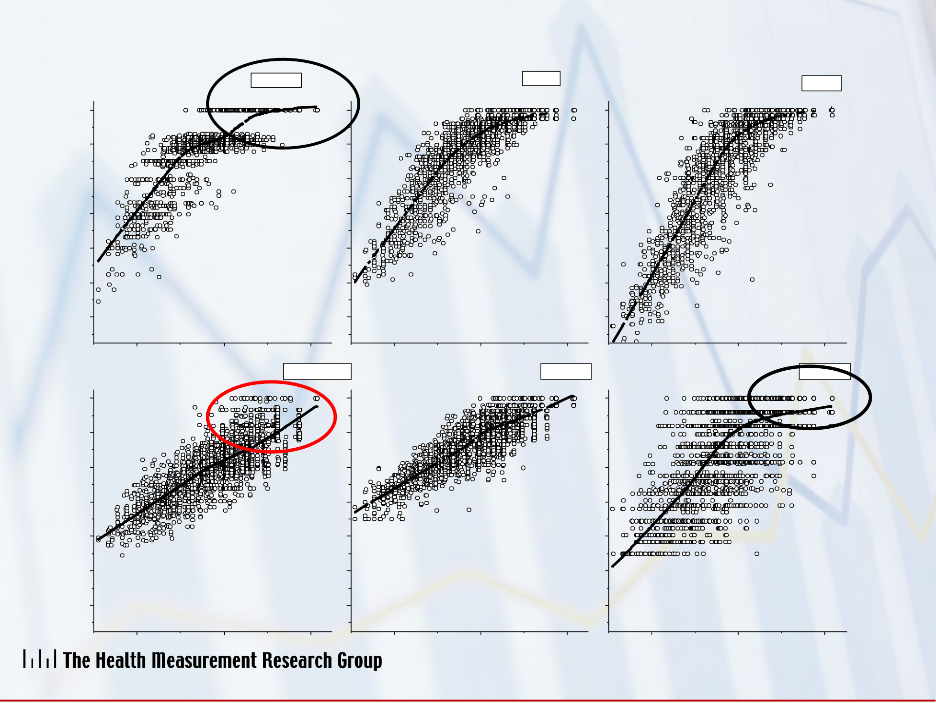
NHMS: Relation between summary health and 6 HRQoL indexes
EQ-5D
HUI2
HUI3
1.0
1.0
1.0
0.8
0.8
0.8
0.6
0.6
0.6
Index Score
0.4
0.4
0.4
0.2
0.2
0.2
0.0
0.0
0.0
-0.2
-0.2
-0.2
-2
0
2
-2
0
X Axis Title
2
-2
0
X Axis Title
2
QWB-SA
SF-6D
HALex
1.0
1.0
1.0
0.8
0.8
0.8
0.6
0.6
0.6
Index Score
0.4
0.4
0.4
0.2
0.2
0.2
0.0
0.0
0.0
-0.2
-0.2
-0.2
-2
0
2
-2
0
2
-2
0
2
8
8
8
www.healthmeasurement.org

Slide 32
Summary
Surrogate markers are not health outcomes. Sometimes they offer misleading guidance.
Common metrics are needed to make comparisons between studies and between competing approaches to improve health outcomes
  Prevention vs treatment
  Investments in medical treatment vs social determinants
Many generic measures appear to capture the same or very similar information
We need more effort to identify standardized approaches to health status measurement
www.healthmeasurement.org

Slide 33
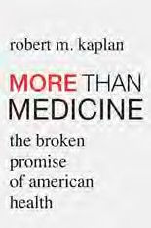

Released Today by Harvard University Press
www.healthmeasurement.org

Slide 34
EXTRA SLIDES
www.healthmeasurement.org

Slide 35
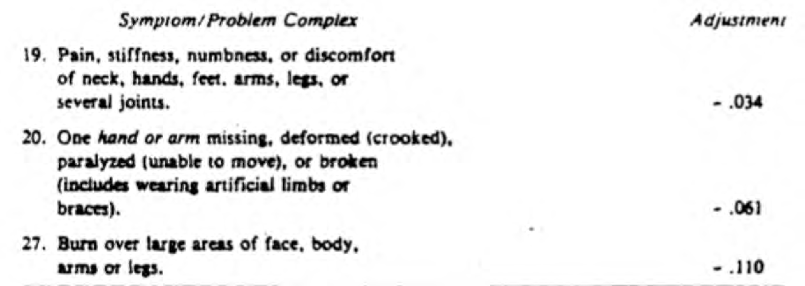
Examples of Symptom/Problem Complexes and Linear Weights to Adjust
www.healthmeasurement.org

Slide 36
Evolution
Items used in RAND Health Insurance Experiment
– Evolved into SF-36/SF-12/VF-12
Similar structure used for EQ-5D
Provided basis for PROMIS
www.healthmeasurement.org

