Slide 1

Validity of Social Health Screening Tools
Moderator:
Alex Krist, MD, MPH - Virginia Commonwealth University
Cara Lewis, PhD - Kaiser Permanente WA Health Research Institute
Megan Sandel, MD, MPH - Boston University Arvin Garg, MD - Boston University
Panelists:

Slide 2

Word cloud
Go to menti.com and enter 98 82 58
Alternative: Point your smartphone camera at the QR code in your program
Share your response to this question:
“What is one word that comes to mind when you think about social health screening?”

Slide 3

3
What Would It Take for the US Preventive Services Task Force (USPSTF) to Recommend Routine Screening for Social Determinants of Health?

Slide 4
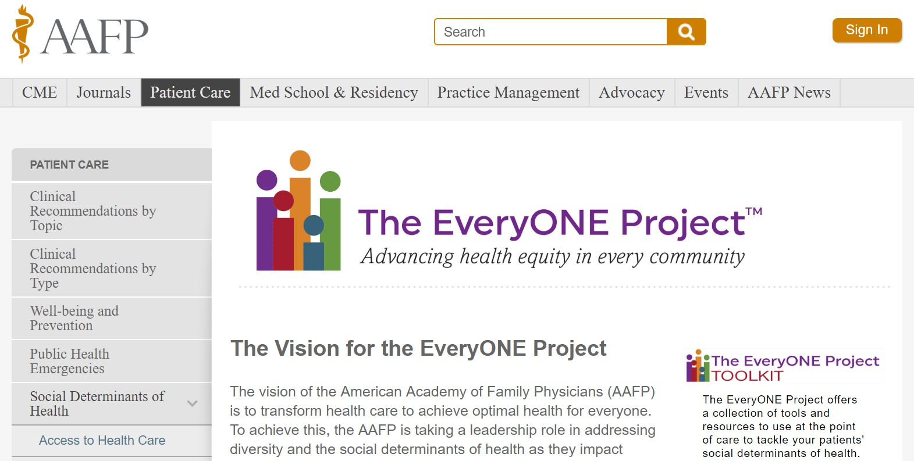

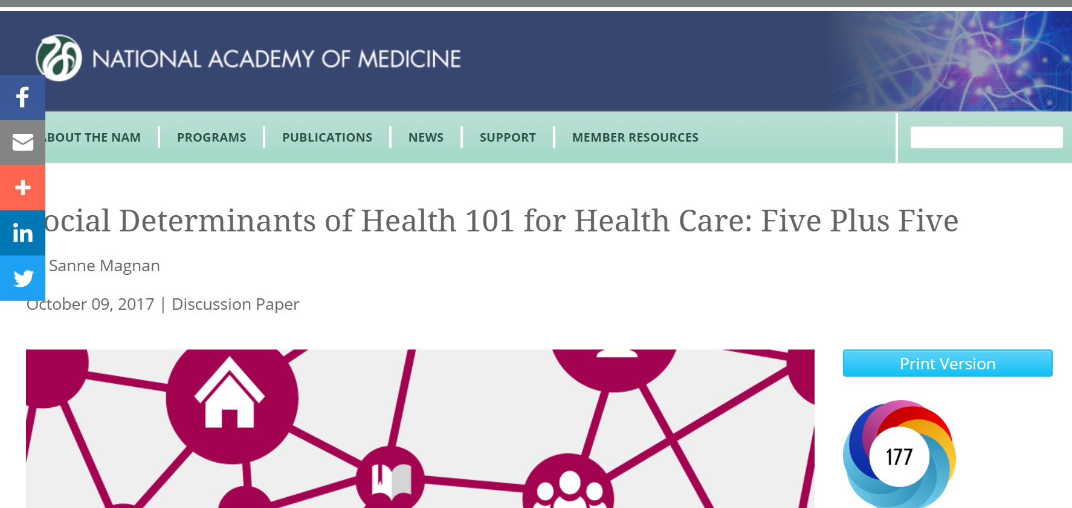
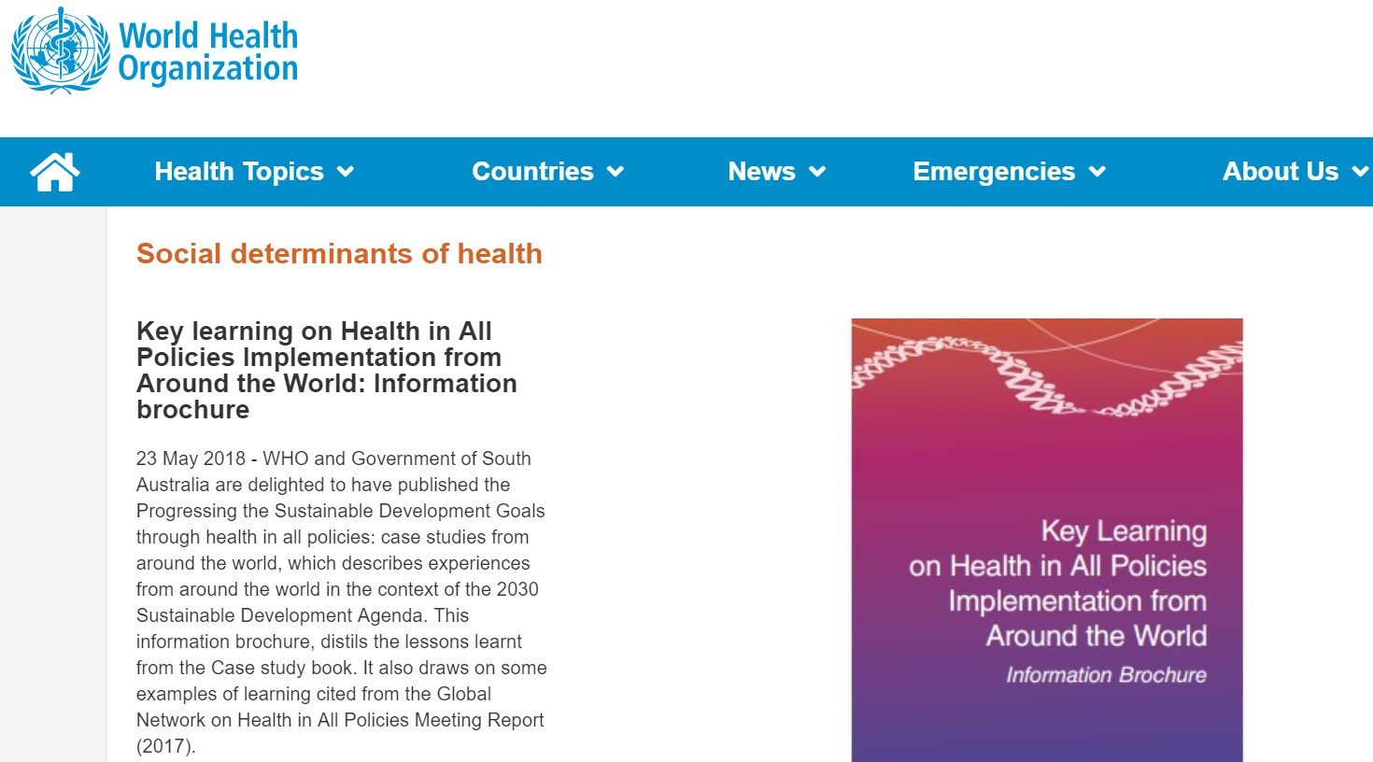
Multiple Calls to Address SDoH in Primary Care
4

Slide 5
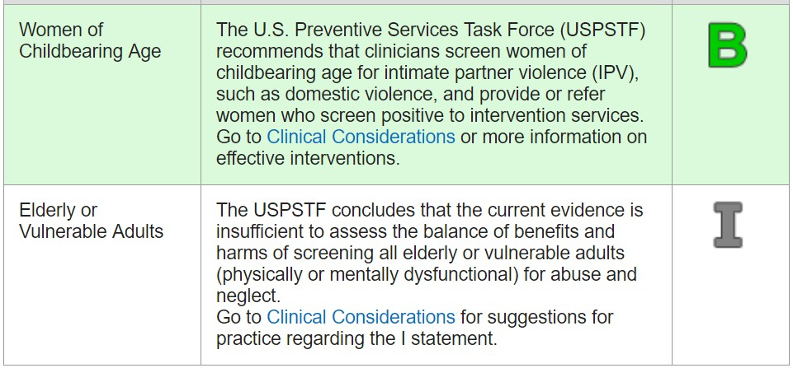
USPSTF Recommendations: Intimate Partner Violence
5

Slide 6
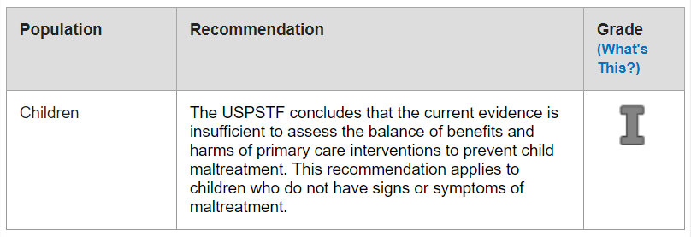
USPSTF Recommendations: Screening for Child Maltreatment
6

Slide 7
USPSTF Recommendations for Screening for “Other DoH”
7
Screening and Behavioral Counseling Interventions to Reduce Unhealthy
Alcohol Use in Adolescents and Adults (B recommendation in 2013)
Screening for Drug Use in Adolescents and Adults, Including Pregnant Women (I recommendation in 2008)
Primary Care Behavioral Interventions to Reduce Illicit Drug and Nonmedical Pharmaceutical Use in Children and Adolescents (I recommendation in 2014)
Behavioral and Pharmacotherapy Interventions for Tobacco Smoking Cessation in Adults, Including Pregnant Women (A recommendation in 2015)
Primary Care Interventions to Prevent Tobacco and Nicotine Use in Children and Adolescents (B recommendation in 2013)

Slide 8
USPSTF Recommendations for Screening for “Other DoH”
8
Behavioral Counseling to Promote a Healthful Diet and Physical Activity for Cardiovascular Disease Prevention in Adults with Cardiovascular Risk Factors (B recommendation in 2014)
Behavioral Counseling to Promote a Healthful Diet and Physical Activity for Cardiovascular Disease Prevention in Adults Without Known Risk Factors (C recommendation in 2017)
Behavioral and Pharmacotherapy Weight Loss Interventions to Prevent Obesity-Related Morbidity and Mortality in Adults (B recommendation in 2018)
Screening for Obesity in Children and Adolescents (B recommendation in 2017)

Slide 9
No USPSTF Recommendations for Most Social Needs
9
Transportation
Food insecurity
Dental Care
Social Connections
Education
Financial Situation
Safety
Learning
Work
Overall Health
Housing
No recommendation ≠ a recommendation against

Slide 10
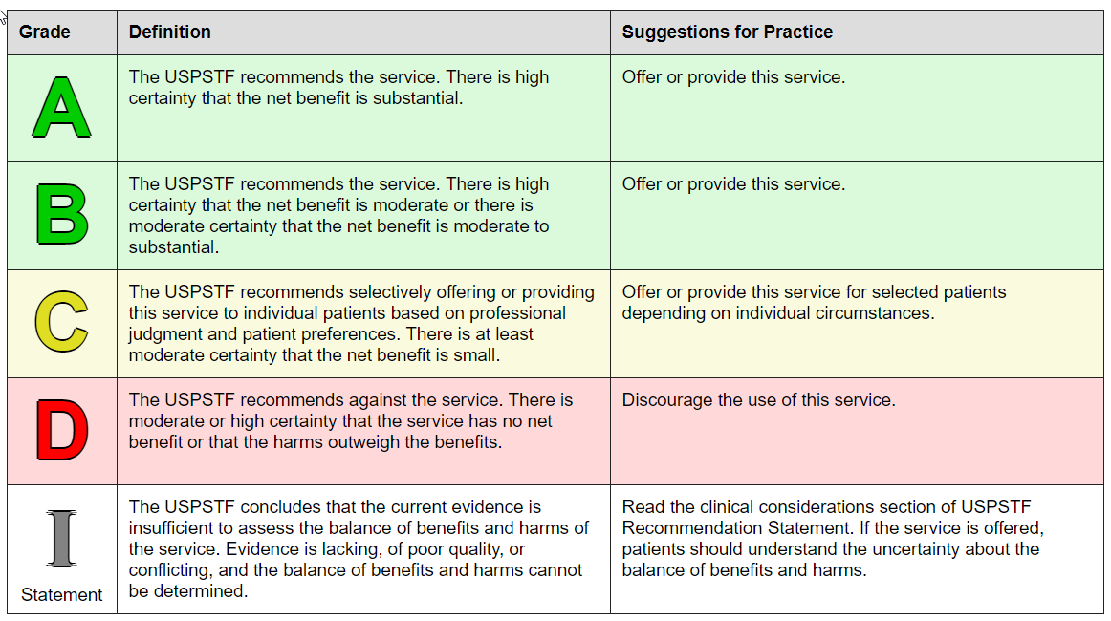
What the Grades Mean and Suggestions for Practice
10

Slide 11
Practice Perspective: Implications of Recommending Routine Screening
11
Expectation to assess everyone
Need to use validated tools for screening
Need to figure out how often to screen
Becomes a covered benefit
Becomes a quality alert in your electronic medical record
Becomes a quality measure to judge clinicians

Slide 12
What the Letter Grades Mean to the USPSTF
12
Certainty of Net Benefit | Magnitude of Net Benefit
 | Substantial | Moderate | Small | Zero/Negative
High | A | B | C | D
Moderate | B | B | C | D
Low | I—insufficient evidence

Slide 13
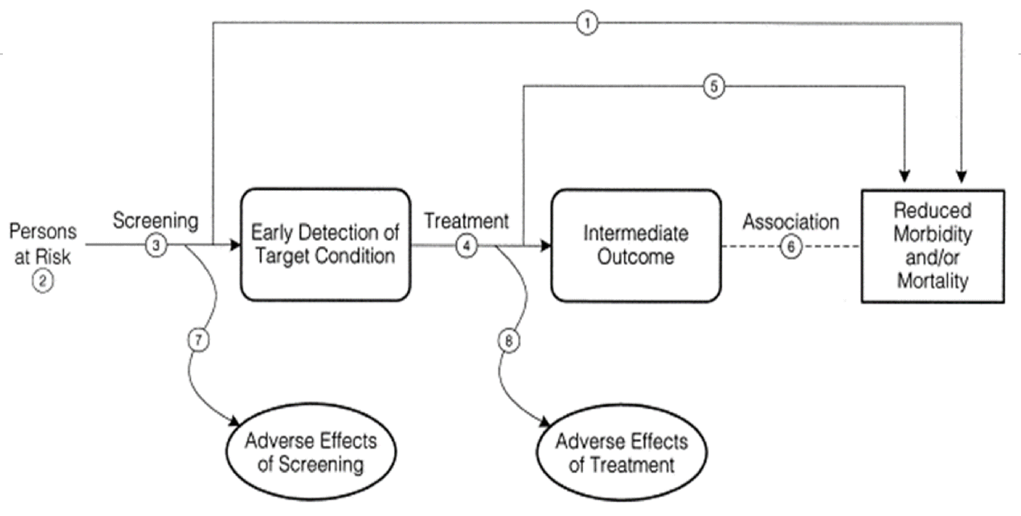
Example Analytic Framework for Screening
13

Slide 14
USPSTF Considerations for Social Determinants Screening
14
Is there a health care intervention to address social needs? (KQ 4)
Can we demonstrate an improved health outcome?
What improvements are we looking for?
Is there benefit with screening everyone versus case finding?
Does finding the social need earlier make a difference (lead time bias)?

Slide 15
Health Outcome vs. Intermediate Outcome
15
Health outcome – outcomes that patients can experience or feel and affect how long a patient lives or the quality of life or both
Intermediate outcome – outcomes that may be influenced by a preventive service, but are not health outcomes in and of themselves; they are pathologic, physiologic, psychologic, social, or behavioral measures
  Examples include blood pressure, serum cholesterol, vitamin levels, viral levels, and physical activity measures
What is a “health outcome” for social needs?

Slide 16

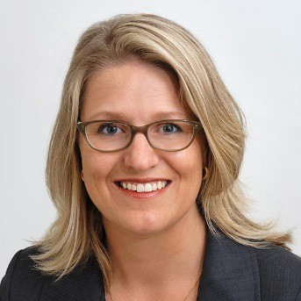
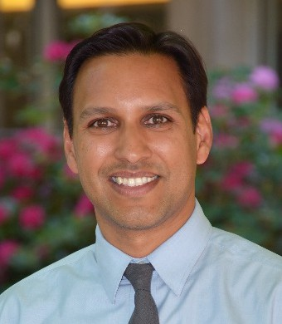
Speakers
16
Cara Lewis, PhD, Associate Investigator, Kaiser Permanente Washington Health Research Institute
  Think about what are we screening for – social needs or a social need
Megan Sandel, MD, MPH, Associate Director, GROW Clinic, Boston Medical Center; Principal Investigator, Children’s Health Watch; Associate Professor of Pediatrics, Boston University Schools of Medicine and Public Health
  Think about state of evidence for specific domains (housing / food)
Arvin Garg, MD, MPH, Associate Professor of Pediatrics, Assistant Dean for Student Affairs, Boston University School of Medicine
  Think about if this is screening or universal treatment

Slide 17
Small Group Discussion
17
Introduce yourself
Briefly share your experiences and your work
Develop 3-5 priority research questions that the group thinks need to be answered to help move USPSTF to an A to B screening recommendation
  Large group – share priority research domains/questions

