Slide 1


CommunityRx
An Asset Based, Community Engaged Approach to Implementing a Community E-prescribing System
Stacy Tessler Lindau, MD, MAPP
Professor of Ob/Gyn and Medicine-Geriatrics The University of Chicago
SIREN State of the Science on Medical and Social Care Integration Portland, OR
February 5, 2019
© ST Lindau, UChicago, 2019. Please contact slindau@uchicago.edu for re-use.

Slide 2
Disclosures
Under the terms of Grant Number 1C1CMS330997-01-00 (Lindau, PI) from the Department of Health and Human Services, Centers for Medicare & Medicaid Services we were expected to develop a sustainable business model which will continue and support the model that we tested after award funding ends.
Dr. Stacy Lindau is the founder and owner of a social impact company NowPow, LLC and president of MAPSCorps, 501(c)(3).
The contents of this presentation are solely the responsibility of the authors and do not necessarily represent the official views of or imply endorsement by the U.S. Department of Health and Human Services or any of its agencies.
Neither the University of Chicago nor UChicago Medicine is endorsing or promoting NowPow or its business, products, or services.
Other current funding sources for work presented here include:
AHRQ Evidence Now Healthy Hearts in the Heartland 5R18HS023921-03 (A Kho, PI) NIA 5R01AG047869-05 (ST Lindau, PI)
NIH CTSA Pilot 4UL1TR000430-10 (ST Lindau, PI)
© ST Lindau, UChicago, 2019. Please contact slindau@uchicago.edu for re-use.

Slide 3
WE CO-DEVELOPED THE IMPLEMENTATION FRAMEWORK
© ST Lindau, UChicago, 2019. Please contact slindau@uchicago.edu for re-use.

Slide 4
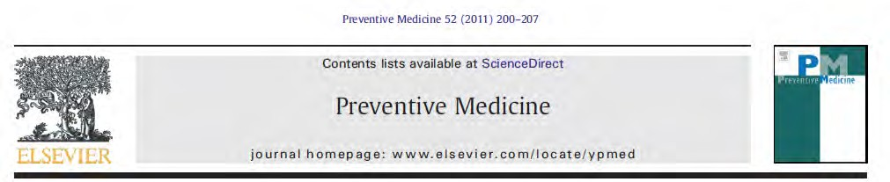
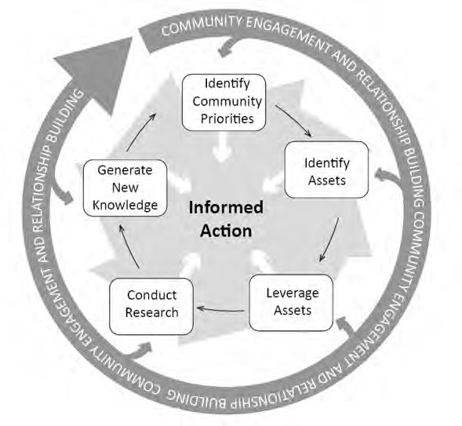
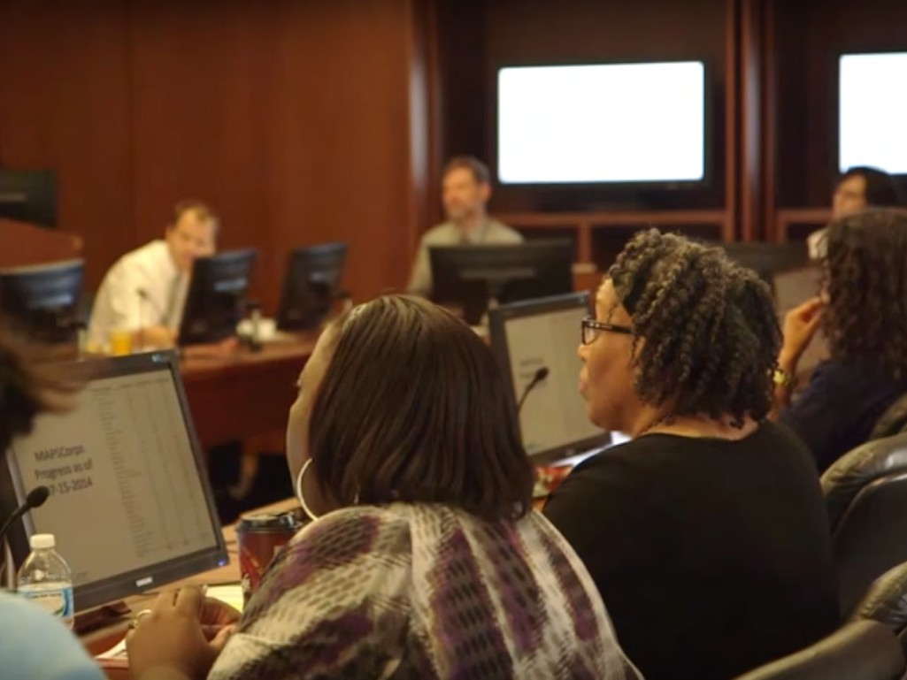
Lindau ST, Makelarski JA, Chin MH, Desautels S, Johnson D, Johnson WE Jr, Miller D, Peters S, Robinson C, Schneider J, Thicklin F, Watson NP, Wolfe M, Whitaker EE. Prev Med, 2011.
© ST Lindau, UChicago, 2019. Please contact slindau@uchicago.edu for re-use.

Slide 5
Community: anyone who cares about and has something to contribute to health and vitality
Assets/resources: business and organizations and the goods, programs and services they provide to the public
Health: a state of complete physical, mental and social well-being and not merely the absence of disease or infirmity (WHO 1948)
© ST Lindau, UChicago, 2019. Please contact slindau@uchicago.edu for re-use.

Slide 6
WE ITERATED THE DATA COLLECTION STRATEGY
© ST Lindau, UChicago, 2019. Please contact slindau@uchicago.edu for re-use.

Slide 7

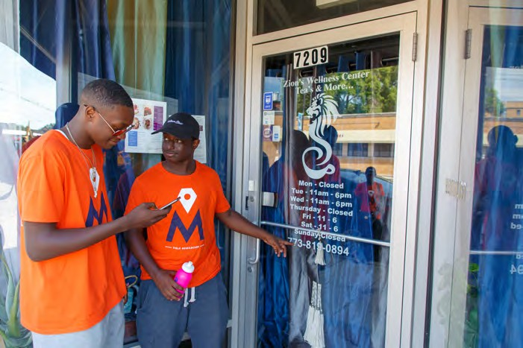
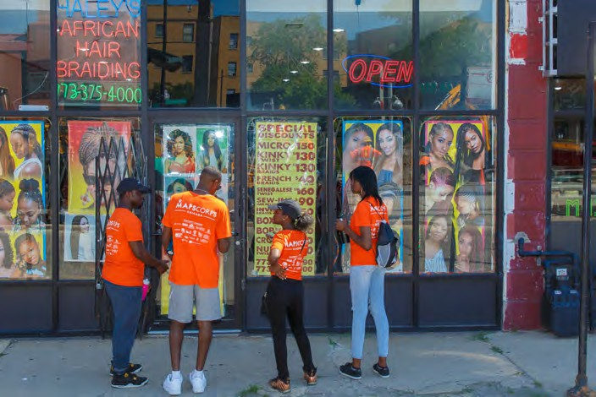
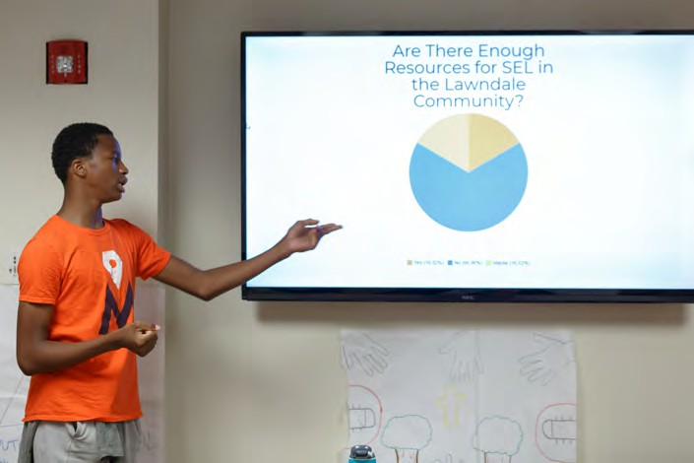
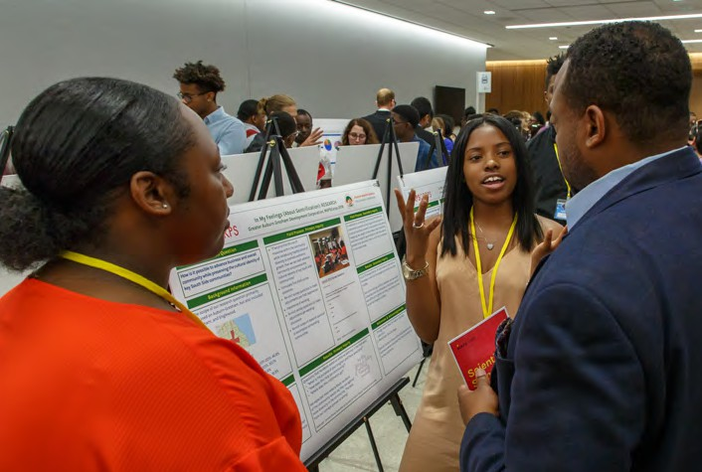
© ST Lindau, UChicago, 2019. Please contact slindau@uchicago.edu for re-use.

Slide 8
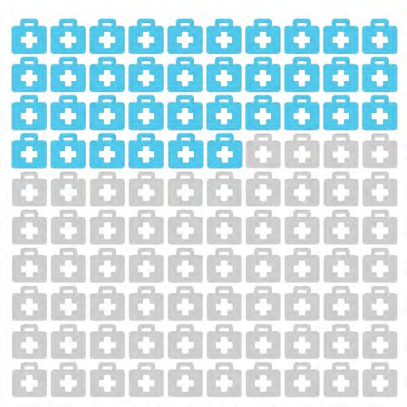
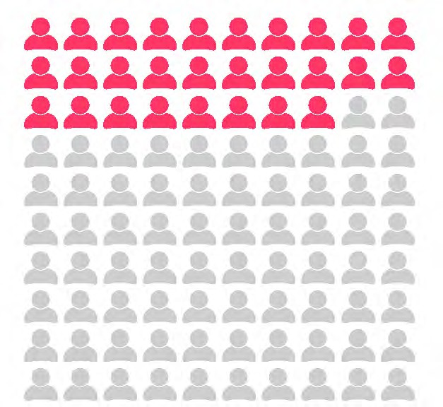
Makelarski et al. (2012.) Journal of Urban Health.
*Secondary data from Dun & Bradstreet, National Center for Charitable Statistics, governmen blue pages, City of Chicago, University of Chicago campus directory
28%
of Human Services assets discovered by MAPSCorps*
36%
of Health Services assets discovered by MAPSCorps*
© ST Lindau, UChicago, 2019. Please contact slindau@uchicago.edu for re-use.

Slide 9
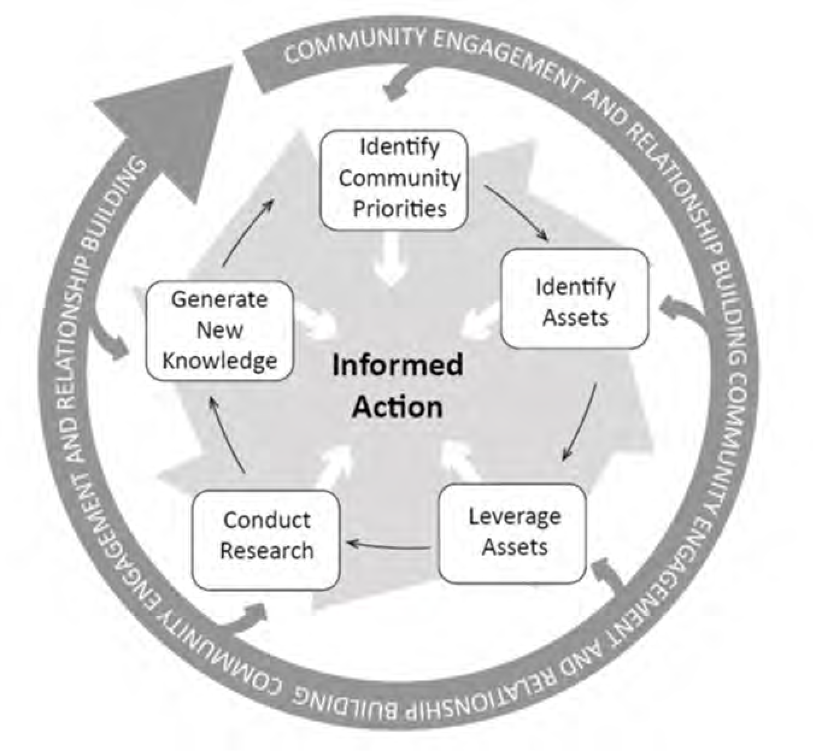
WE LEVERAGED EXISTING ASSETS
© ST Lindau, UChicago, 2019. Please contact slindau@uchicago.edu for re-use.

Slide 10
Self Management Framework^{1,2}
Facilitators, Barriers
Processes
Proximal Outcomes
Intermediate Outcomes
Distal Outcomes
Self-Management Behaviors
“I will use this new resource to lose weight”
Caring Behaviors
“I will use this new resource information to help others.”
Community assets
HealtheRx
Delivery of personalized information about resources
Knowledge “I have knowledge
about resources in my community”
Beliefs
“I have enough resources in my
community to manage health”
Health and well-being
of geographic population
Confidence
“I am confident in my ability to get
the resources I need”
Mental and Physical Health SF-12 MCS and PCS
Healthcare cost
¹ Grey M, Schulman-Green D, Knafl K, Reynolds NR. A revised self-and family management framework. Nurses Outlook. 2015
² Andersen, R.M. Revisitng the behavioral model and access to medical care: does it matter? J Health and Social Behavior. 1995
© ST Lindau, UChicago, 2019. Please contact slindau@uchicago.edu for re-use.

Slide 11
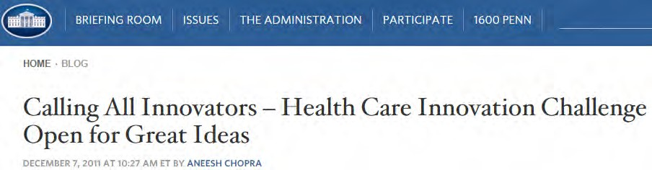

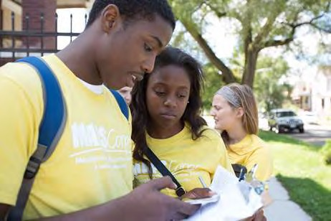
Better Health
Better Health Care
Lower Costs
Promote the workforce of the future
Sustainable business model
© ST Lindau, UChicago, 2019. Please contact slindau@uchicago.edu for re-use.

Slide 12
WE USED RAPID CYCLE ITERATION
© ST Lindau, UChicago, 2019. Please contact slindau@uchicago.edu for re-use.

Slide 13
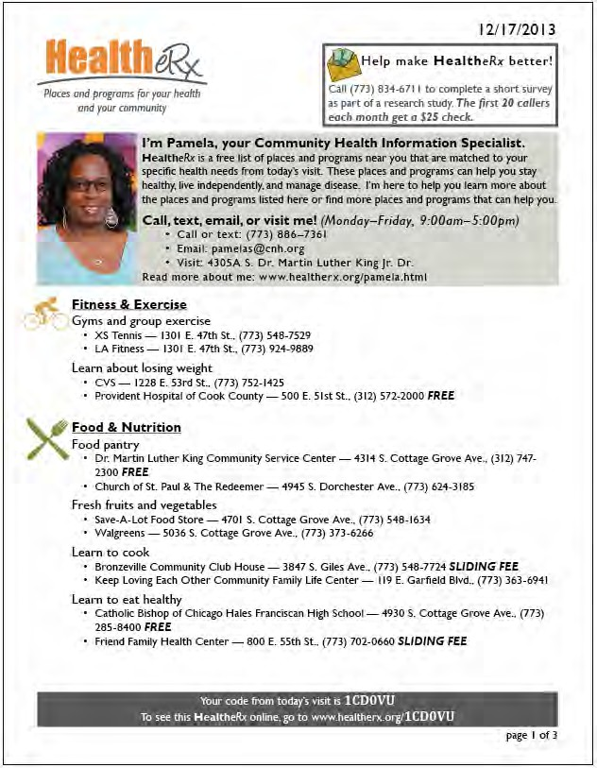
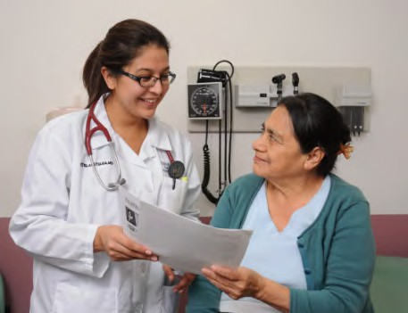
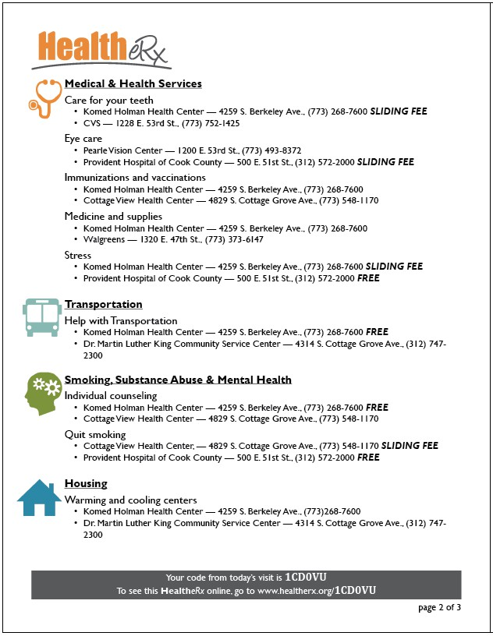

© ST Lindau, UChicago, 2019. Please contact slindau@uchicago.edu for re-use.

Slide 14

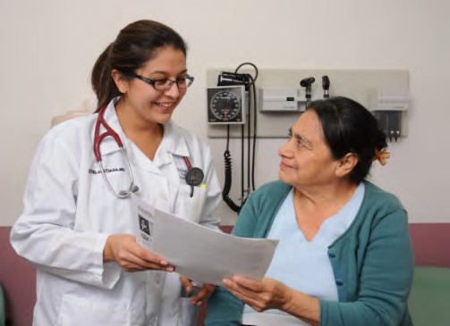







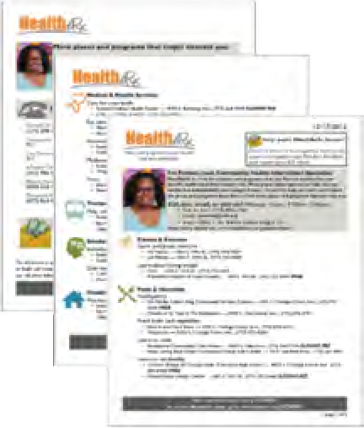
37 condition algorithms linked
3 EMR platforms to CommunityRx database at 33 health care sites
288 local youth employed to generated data for 19,589 places
>113K participants received >253K personalized HealtheRx >7,000 community resources
Respite Care
Counseling
MOVIES
Businesses and organizations serving the community have more demand
19% went to community resource found on HealtheRx
49% told someone else about HealtheRx
© ST Lindau, UChicago, 2019. Please contact slindau@uchicago.edu for re-use.

Slide 15

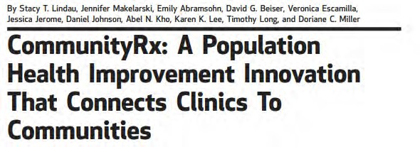
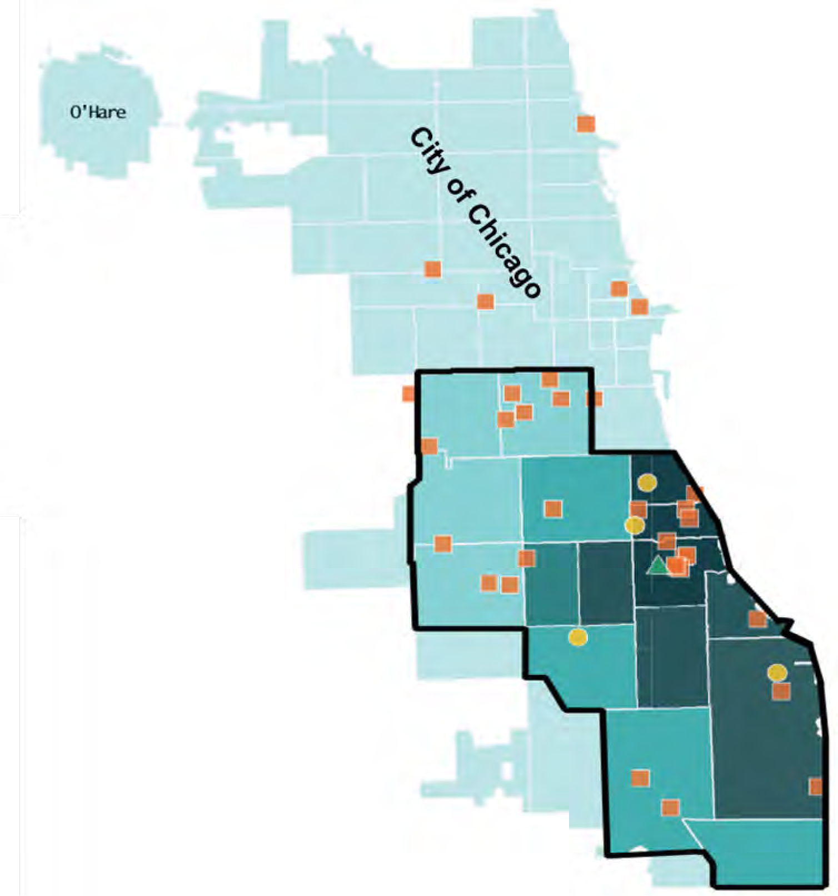
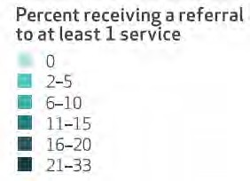
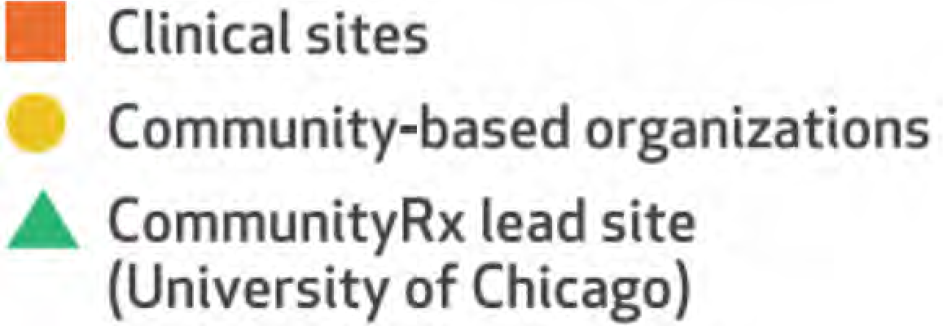
© ST Lindau, UChicago, 2019. Please contact slindau@uchicago.edu for re-use.

Slide 16
ADOPTION DYNAMICS LED TO NEW SCIENTIFIC DISCOVERY
© ST Lindau, UChicago, 2019. Please contact slindau@uchicago.edu for re-use.

Slide 17
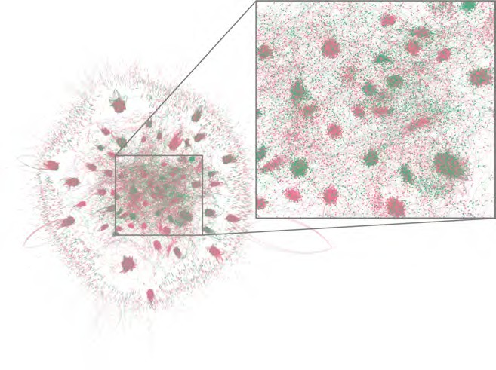

Agent ages
16-25
65+
Image created using Gephi (gephi.org) by Jonathan Ozik, PhD, 2018.
© ST Lindau, UChicago, 2019. Please contact slindau@uchicago.edu for re-use.

Slide 18
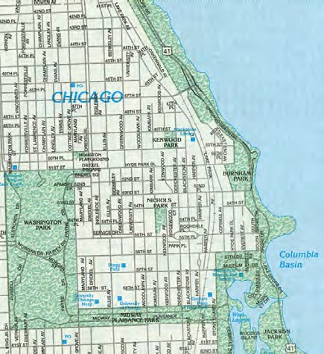

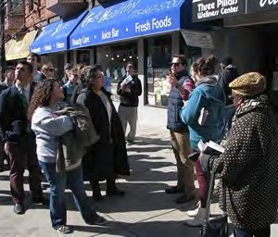
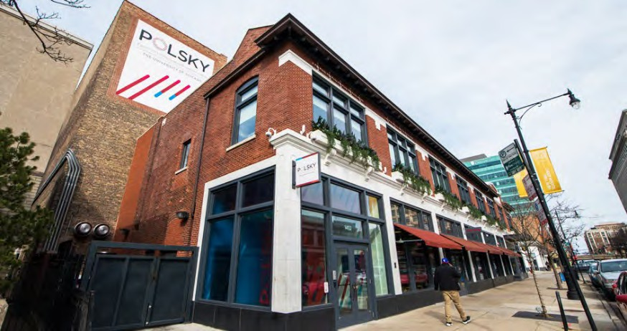
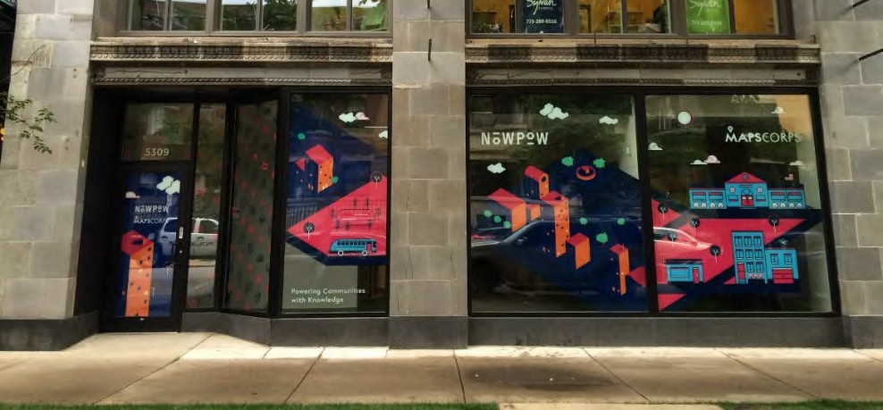
WE IMPLEMENTED A SUSTAINABLE BUSINESS MODEL IN THE COMMUNITY
© ST Lindau, UChicago, 2019. Please contact slindau@uchicago.edu for re-use.

Slide 19

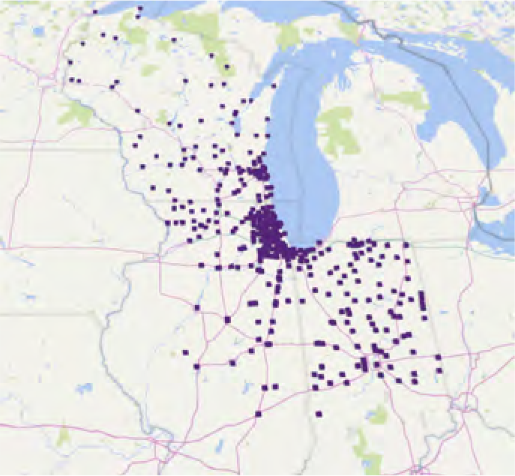





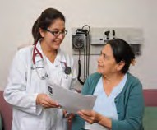
Healthy Hearts in the Heartland
Health Outcomes
112 practices
POINT OF CARE (POC)
Practice Facilitator
114 practices
POINT OF CARE (POC) + POPULATION MANAGEMENT (PM)
CommunityRx-H3
© ST Lindau, UChicago, 2019. Please contact slindau@uchicago.edu for re-use.
ONBOARDING
Fall 2015; Winter 2016;
Spring 2016; Fall 2016
FACILITATION
Months 0-12
MONITORING
Months 12-18
Ciolino et al (2018) Contemporary Clinical Trials.

Slide 20










Translation to Practice of CommunityRx versus Hypothetical New Drug
CommunityRx
Adoption into practice
Enters market
Enters market
New Drug
0
Grant funding begins
3
6
9
12
15
Years
Tech transfer
Chong et al. (2007) Nature.
© ST Lindau, UChicago, 2019. Please contact slindau@uchicago.edu for re-use.

Slide 21
Sustainable Business Model
Barriers
Lack of institutional experience with IT tech transfer
Angst about shifting partners from grant-funded solution to fee-funded solution
“Dirty scientist” problem
Intra-institutional communication failure
Facilitators
Expectation of HCIA funding from outset
IP sharing plan at outset
Entrepreneur in residence
Sustainability work stream started day 1
Community partners given opportunity to own sustainability
© ST Lindau, UChicago, 2019. Please contact slindau@uchicago.edu for re-use.

Slide 22
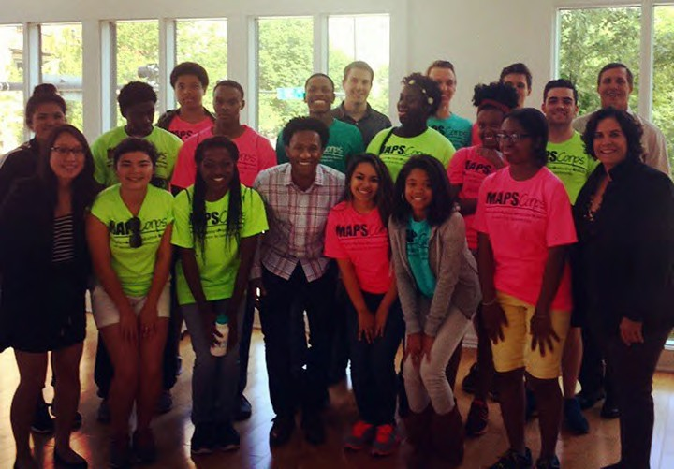
2016 MAPSCorps team visits NowPow team to learn about how NowPow obtains and uses MAPSCorps data to e-prescribe community. >1600 youth employed to date. @mapscorps.org
© ST Lindau, UChicago, 2019. Please contact slindau@uchicago.edu for re-use.

Slide 23

Acknowledgements
Lindau Lab
Emily Abramsohn, MPH Kelly Boyd
Megan DePumpo, AM Leilani Douglas Jessica Jerome, PhD
Jennifer Makelarski, PhD, MPH Chenab Navalkha
Kelsey Paradise
CommunityRx Collaborators
David Beiser, MD, MS, Emergency Medicine Nicholas Collier, PhD, Engineer
Chia-Hung Chou, PhD, HSR
Mihai Giurcanu, PhD, Biostatistics Elbert Huang, MD, MPH, GIM, HSR
Chaitanya Kaligotla, PhD, Systems Science*
Abel Kho, MD, Internal Medicine, Informatics
Charles Macal, PhD, Systems science Jonathan Ozik, PhD, Systems Science
Fred Rachman, MD, Pediatrics, Informatics Phil Schumm, MA, Biostatistics
Kate Thompson, MD, Geriatrics
Elizabeth Tung, MD, MS, GIM, Population Science*
*trainees
www.mapscorps.org @stacylindau
slindau@uchicago.edu

