Slide 1

Transforming the Healthcare Response to Intimate Partner Violence
Brigid McCaw, MD, MPH, MS, FACP
Medical Director, Family Violence Prevention Program Kaiser Permanente
State of the Science: National Research Meeting on Medical and Social Care Integration
February 5, 2019

Slide 2

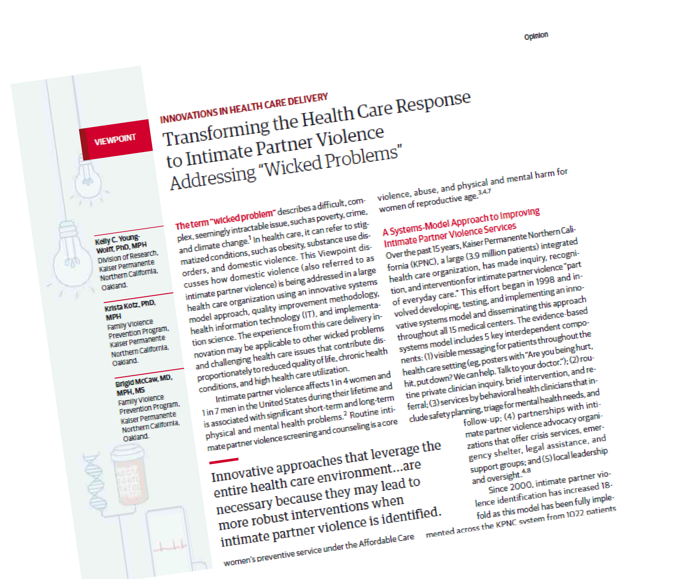

Slide 3

Beyond Screening for Domestic Violence: a Systems Model Approach in a Managed Care Setting. Am J Prev Med, 2001
Inquiry and Referral
On-site Services
Leadership and Oversight
Supportive Environment
Community Linkages

Slide 4


Supportive Environment
Awareness and Information
What is it?
Information: restrooms, exam rooms, on-line, podcasts, health ed classes
Posters: “Let us know, we can help”
Reaching patients everywhere they contact the health care system
Engaged and informed workforce
© 2015, The Permanente Medical Group, Inc. All rights reserved. Family Violence Prevention Program.

Slide 5


Supportive Environment
Private Rooming
Rooming Alone
Private rooming allows for discussions
of sensitive issues, including relationship
violence.
© 2015, The Permanente Medical Group, Inc. All rights reserved. Family Violence Prevention Program.

Slide 6
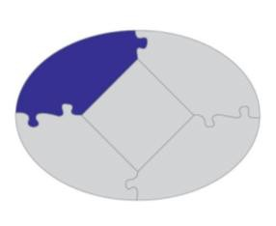
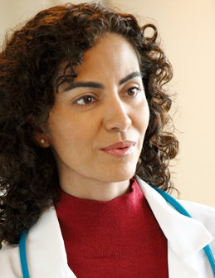

Inquiry and Referral
Must A
Patient
ddress Clinician AND
Concerns
Must address patient AND clinician concerns
The doctor:
How do I ask about IPV?
What do I do when the answer is “yes”?
How can I offer an intervention that is caring, effective, and efficient?
The patient:
If I disclose, what will happen?
Will I be judged?
How will this help me?
Am I ready to take the next step?
© 2015, The Permanente Medical Group, Inc. All rights reserved. Family Violence Prevention Program.

Slide 7

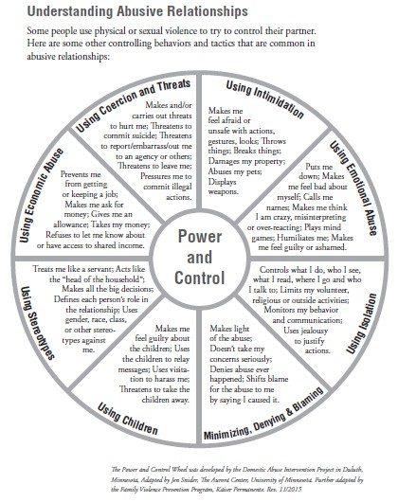

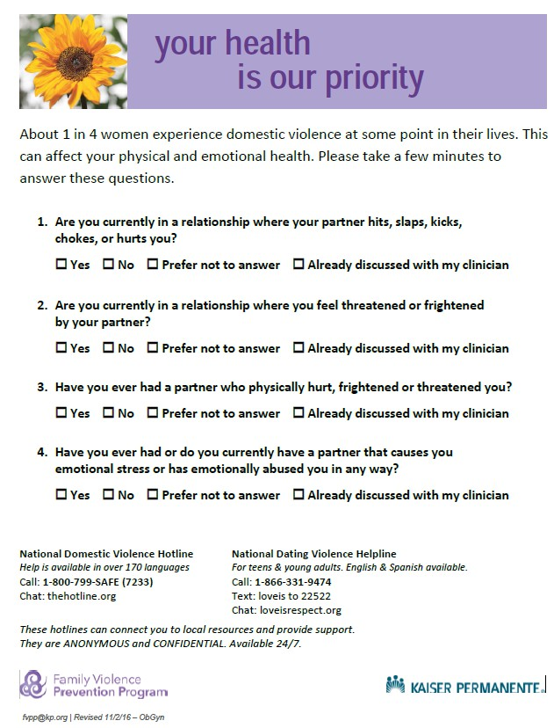
Inquiry and Referral
Patient Informed Screening Tool

Slide 8
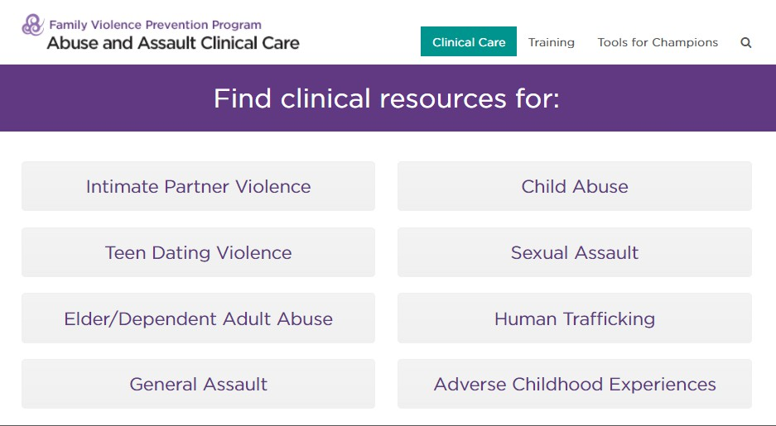
Inquiry and Referral
Using Technology to Improve Care

Slide 9
Contributions from Research Collaborations
Learnings about IPV+ Patients
Women Referred for On-site Domestic Violence Services in a Managed Care Organization. (2002) Women & Health
  Reasons that women accepted physician referral to MH services
Mental Health Services Utilization Among Women Experiencing Intimate Partner Violence. (2010) Am J Managed Care
  Electronic referral improved connection to MH services
  Characteristics of women who were referred but didn’t use services
Domestic Violence and Abuse, Health Status, and Social Functioning. (2007) Women & Health
  Self reported health & social functioning (SF-2) – a future outcome measure?

Slide 10
Contributions from Research Collaborations
Learnings from EHR & Call Center data
A Predictive Model to Help Identify Intimate Partner Violence Using Diagnoses and Phone Calls. (2011) Am J Prev Med
  Patterns of diagnosis and health service utilization
  Clinical profile
A Description of Midlife Women Experiencing Intimate Partner Violence using Electronic Medical Record Information. (2016) J Womens Health.
  Patterns of diagnosis for mid-life and older women with IPV

Slide 11

KP IPV Performance Improvement Measures
Uses automated EHR database
Qualitative and quantitative measures
Actionable and makes sense clinically
Establishes IPV as a quality goal
© 2018, The Permanente Medical Group, Inc. All rights reserved. Family Violence Prevention Program.

Slide 12
Qualitative and Quantitative Measures
Implementation team- every medical center
  Physician champion, multi-disciplinary team, referral protocol
Total IPV Identification
  How many of our members received an IPV Dx?
IPV Identification Rate
  What percent of our women members who are experiencing IPV are we identifying?

Slide 13

Improvement Over Time
2001
2002
2003
2004
2005
2006
2007
2008
2009
2010
2011
2012
2013
2014
2015
2016
2017
2018*

Slide 14
Matching the Performance of the Best
2017
2018
A
B
C REG D
E

Slide 15
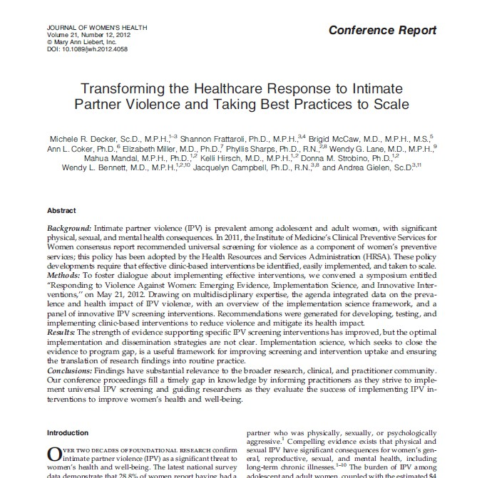
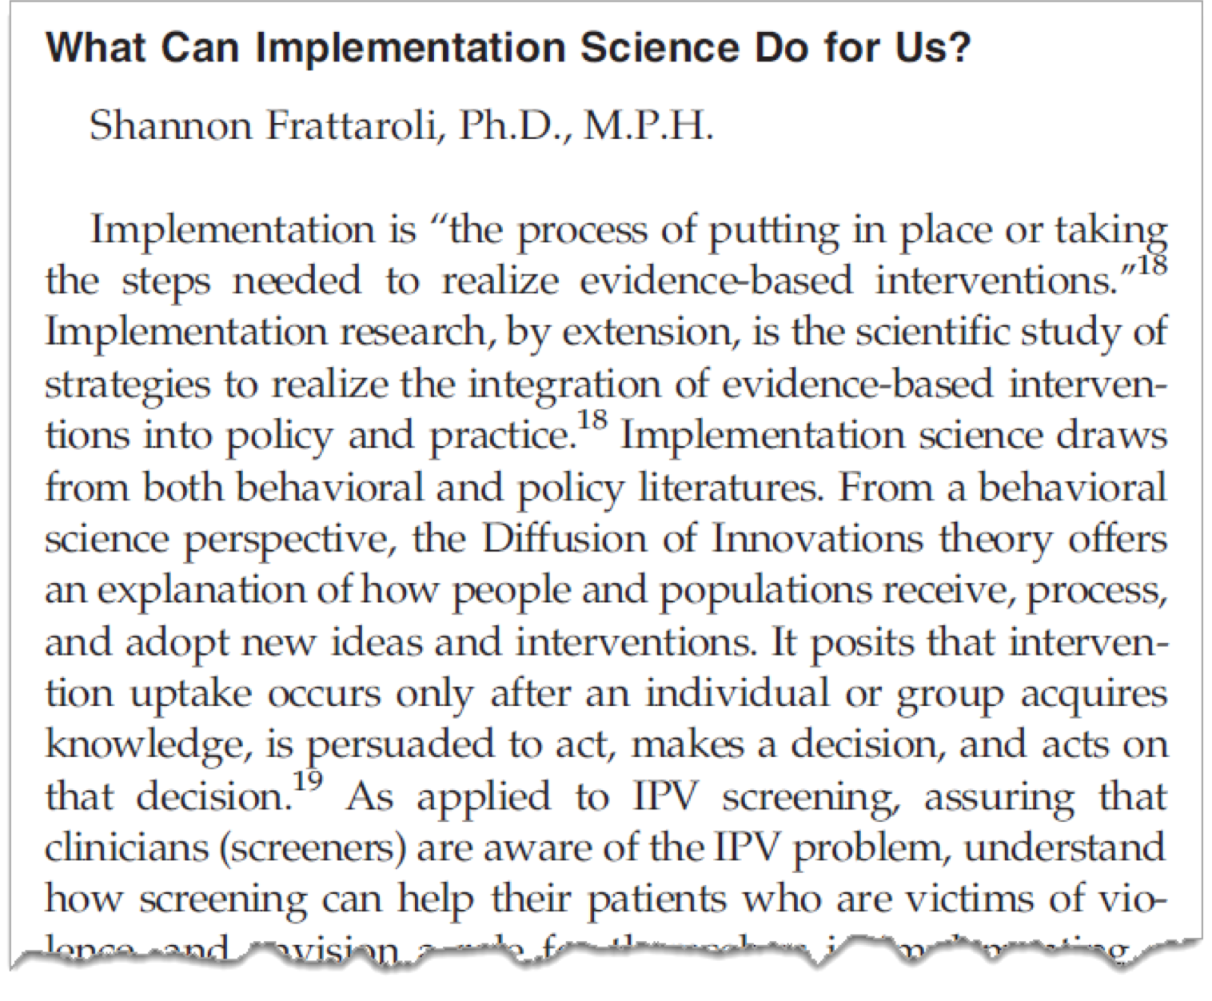
Dissemination & Implementation Science Helps

Slide 16
Process of “spread”
Pilot Site
Seven Clinics
All Medical Centers
1 year
2 years
10 years
Pilot with robust evaluation
Implement, gather data, revise, measure
Disseminate & sustain

Slide 17
Rapidly Spreading What Works…
…and Sustaining It
Infrastructure & sponsorship at each medical center
Tools for clinician-led implementation teams
  Champion & Team roles
  Templates for referral pathway
  Clinician & patient education
Step-wise implementation
Regular communication with & between teams
Performance improvement measures that are meaningful

Slide 18



Implementation of IPV Services Underway in Every KP Region
Northwest
Northern California
Colorado
Mid-Atlantic
Southern California
Georgia
Hawaii

Slide 19


Contact Information
Brigid McCaw, MD, MS, MPH, FACP
Medical Director, Family Violence Prevention Program Kaiser Permanente
@BrigidMcCaw Brigid.McCaw@kp.org
© 2018, The Permanente Medical Group, Inc. All rights reserved. Family Violence Prevention Program.

Slide 20

Looking toward the future
“Meaningful inquiry” replaces “Screening”
  Importance of context and choices for disclosure
  Integration of inquiry with immediate education and resources
  Prioritizing opportunity for “2 Gen” interventions
Considering more than “risk factors”
  Resilience, hope and protective factors
Moving beyond silos
  Social, medical, mental health, AND current/ past trauma
  Cross-dept collaborations and services

Slide 21
Appendix

Slide 22
Step-wise Implementation
Step 1
Form a local multi-disciplinary team with clinician champion
Develop protocol for urgent & non-urgent situations
Identify community resources and develop partnerships
Step 2
Visible patient education materials
Ensure that on-site services are in place
Choose quality measures and annual goals
Stakeholder communication and engagement
© 2018, The Permanente Medical Group, Inc. All rights reserved. Family Violence Prevention Program.

Slide 23
Step-wise Implementation
Step 3
Clinician training - brief, frequent. Include tools and stories.
Trend progress over time
DV resources for employees
Step 4
Leadership training for champion and teams
Link to other initiatives - EMR, chronic conditions
Sustain partnerships with community advocacy
Highlight ‘promising practices’
Stakeholder communication and engagement
© 2018, The Permanente Medical Group, Inc. All rights reserved. Family Violence Prevention Program.

Slide 24


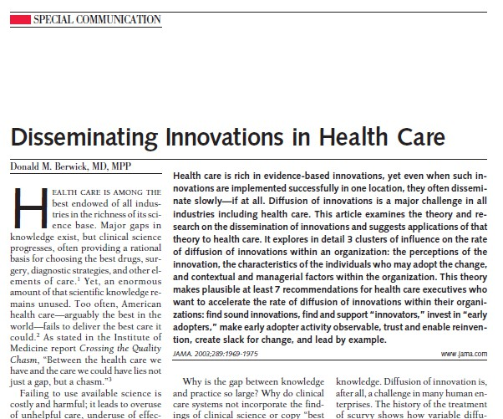
Implementation & Dissemination Science
SWITCH:
How to Change Things When
Change is Hard
Chip Heath & Dan Heath
© 2018, The Permanente Medical Group, Inc. All rights reser
ved. Family Violence Prevention Program.

Slide 25

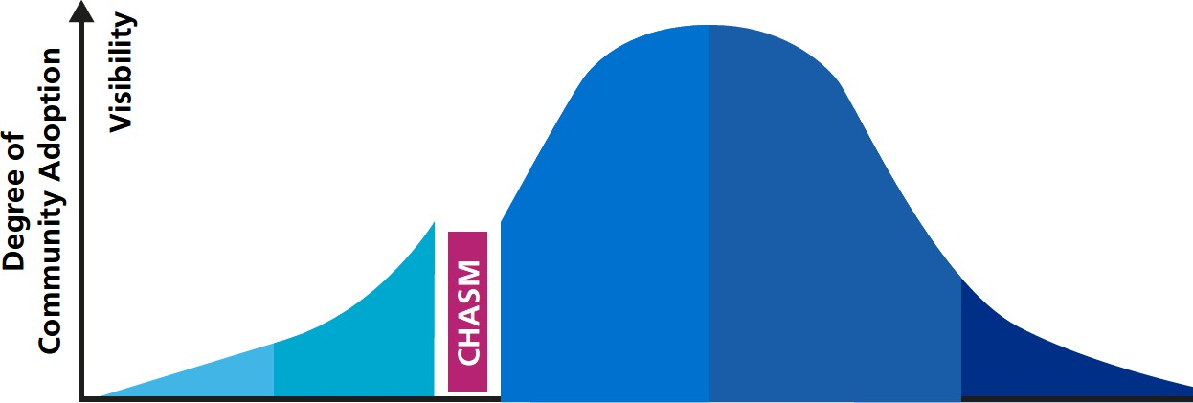
Diffusion of Innovation
Innovators
Early Adopters
Early Majority
Late Majority
Laggards
© 2018, The Permanente Medical Group, Inc. All rights reserved. Family Violence Prevention Program.

Slide 26
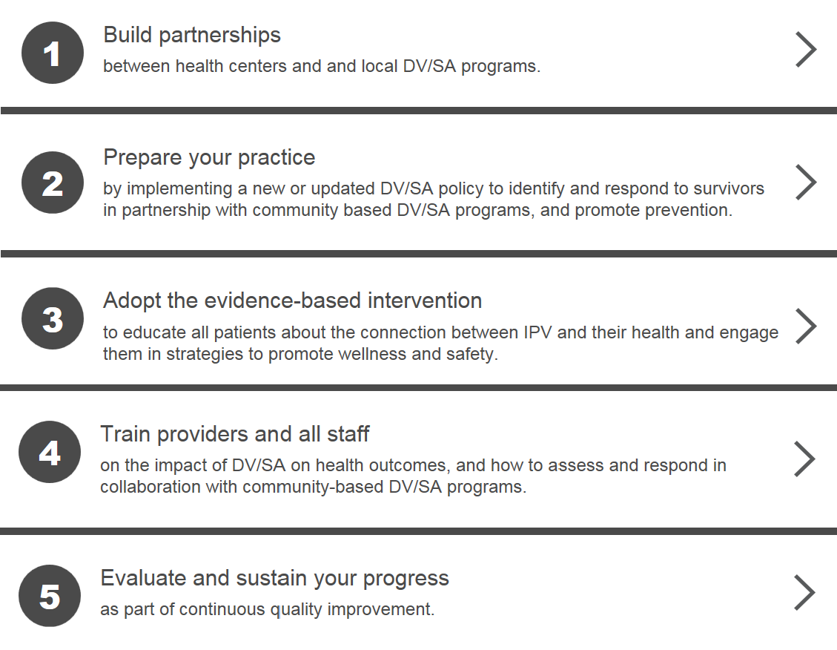
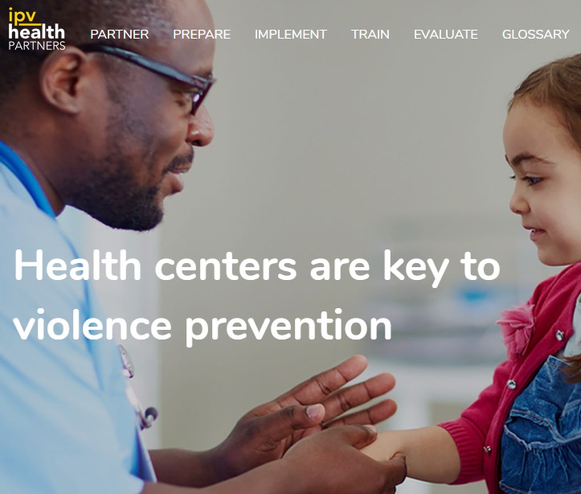
Futures Without Violence IPV Virtual Toolkit
IPVHealthPartners.org
© 2018, The Permanente Medical Group, Inc. All rights reserved. Family Violence Prevention Program.

Slide 27

DV Interventions that use new technology …
myPlan – I
- Interactive Decision Aid for Survivors
Responding to intimate partner violence: Healthcare providers' current practices and views on integrating a safety decision aid into primary care settings. Research in Nursing and Health (2018).
The Longitudinal Impact of an Internet Safety Decision Aid for Abused Women. American Journal of Preventive Medicine (2017)

Slide 28
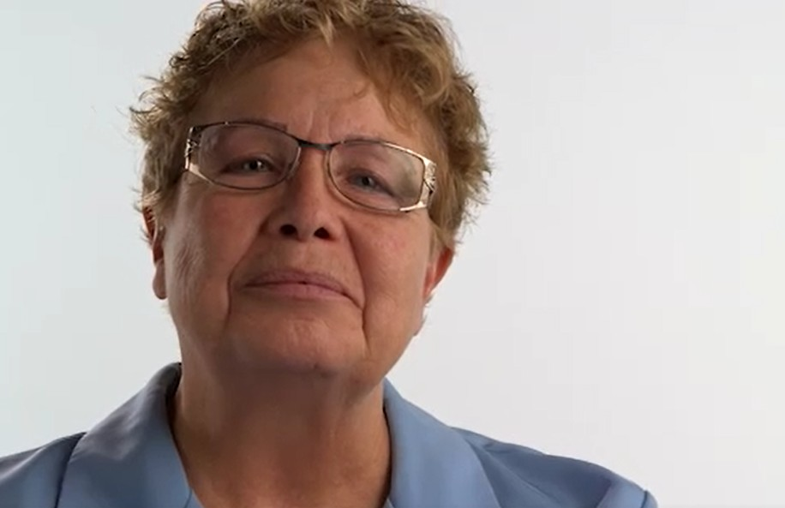
A Survivor’s Voice: Lucy (Spanish/English)
I saw my mother being battered and abused by my father. So in my mind, I thought that was part of marriage.
[Now] I’m safe! Nobody can abuse me. Nobody can touch me without my permission. It’s amazing!
Pero hermanas, si se puede! Si podemos! Vamos para adelante siempre. (But sisters, it is possible! Yes we can! Let’s move forward, always.)
https://youtu.be/2OtqHiWaMPM
© 2018, The Permanente Medical Group, Inc. All rights reserved. Family Violence Prevention Program.

Slide 29
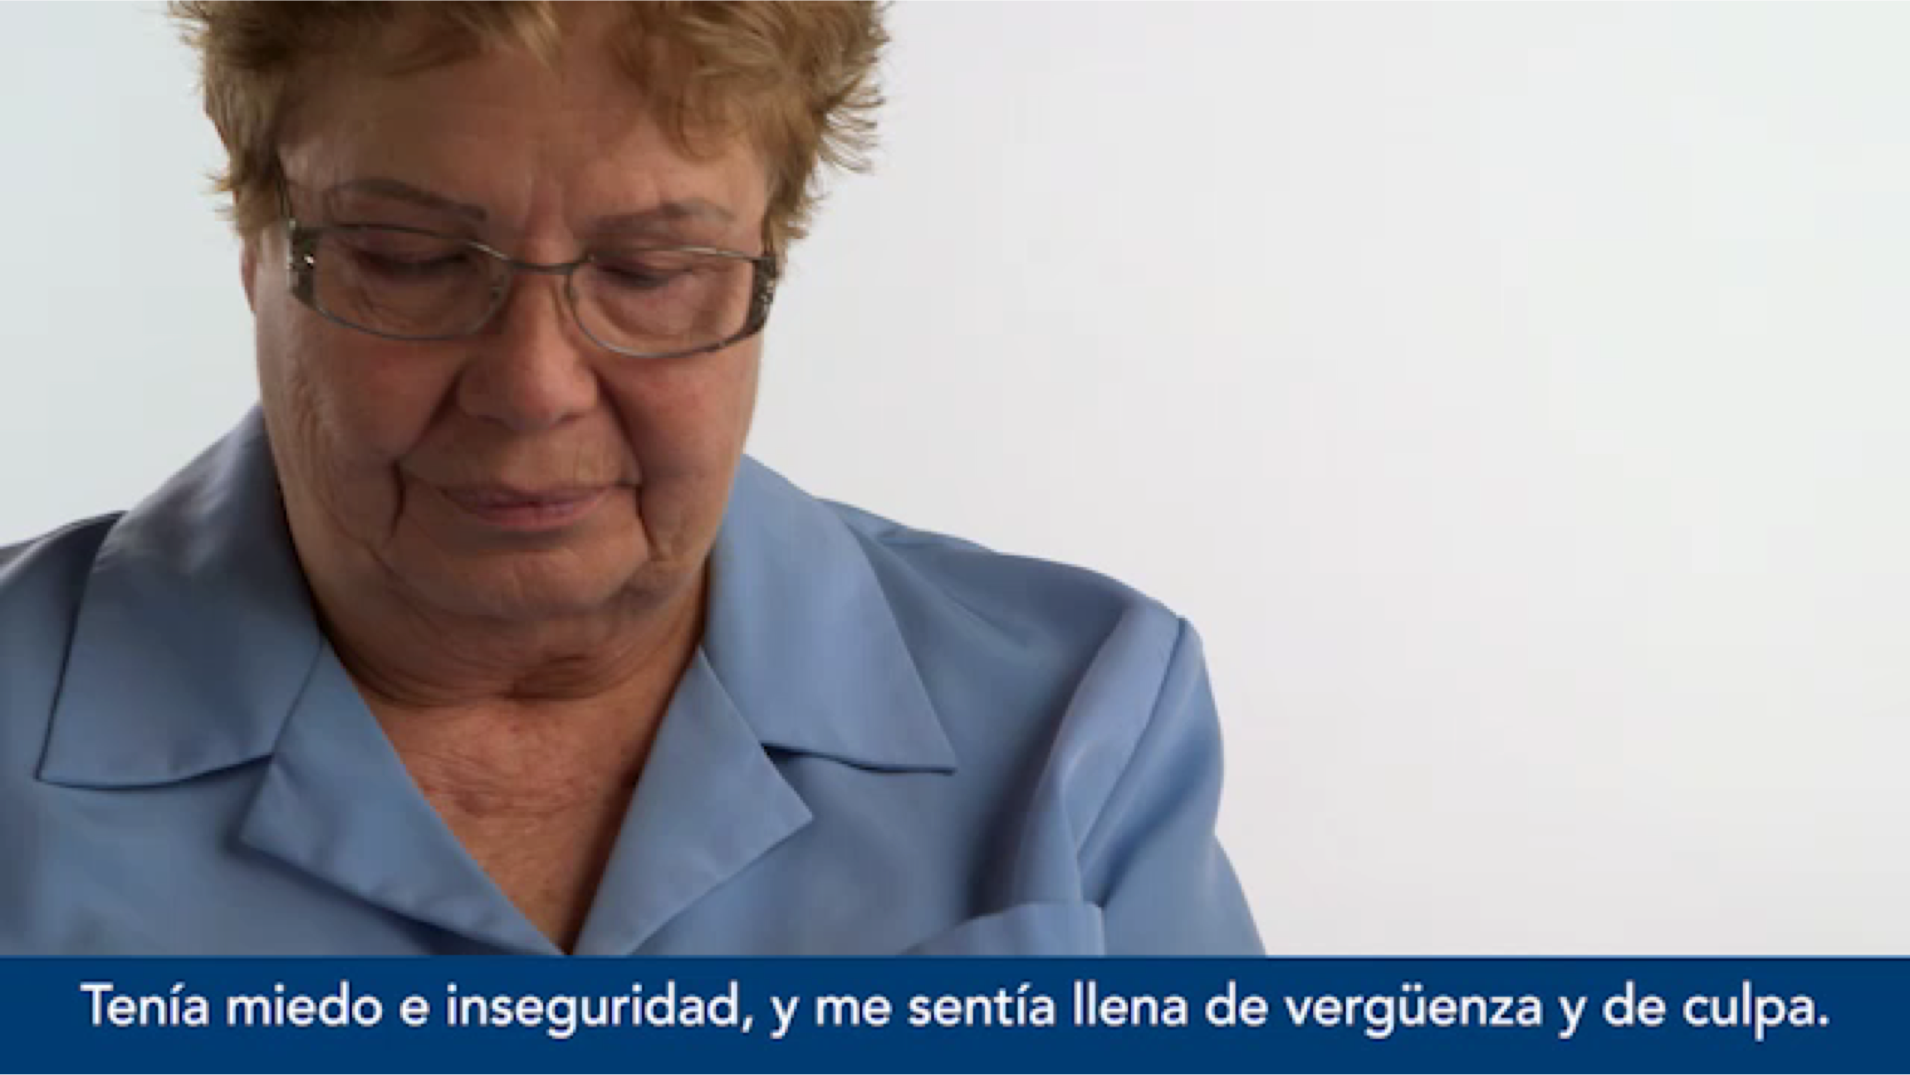

Slide 30
Referral Protocols
Builds on existing MH & social service resources
Clinician training
Inquiry and Referral
On-site Services
EHR & HIT
Tools
Leadership and Oversight
Supportive Environment
Community Linkages
establish & promote community resources
educational materials
private rooming

Slide 31





Learnings from transforming the healthcare response to family violence
Systems Model Approach
Meaningful Measures Research partners, D & I Science

