Slide 1

BIOMARKERS OF STRESS
…..are we there yet?
SIREN 2019
NEETA THAKUR, MD MPH
Neeta.Thakur@ucsf.edu

Slide 2




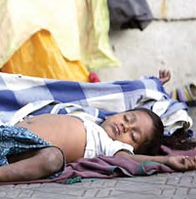


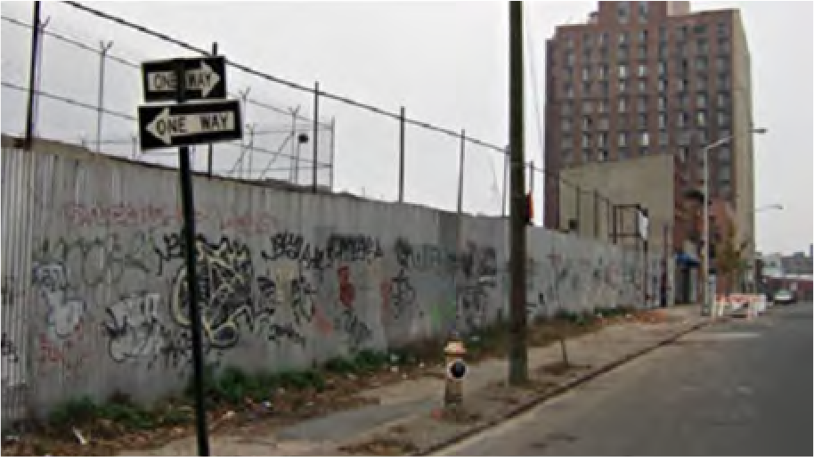

Time
Socioeconomic Status
Where you live Type of work Access

Slide 3


SOCIO-ECOLOGICAL MODEL OF HEALTH
Socio-economic, Cultural, and Environmental Conditions
Living and Working Conditions
Social and Community Networks
Individual Level Factors
Host Level Factors
Dahlgren and Whitehead 1991

Slide 4
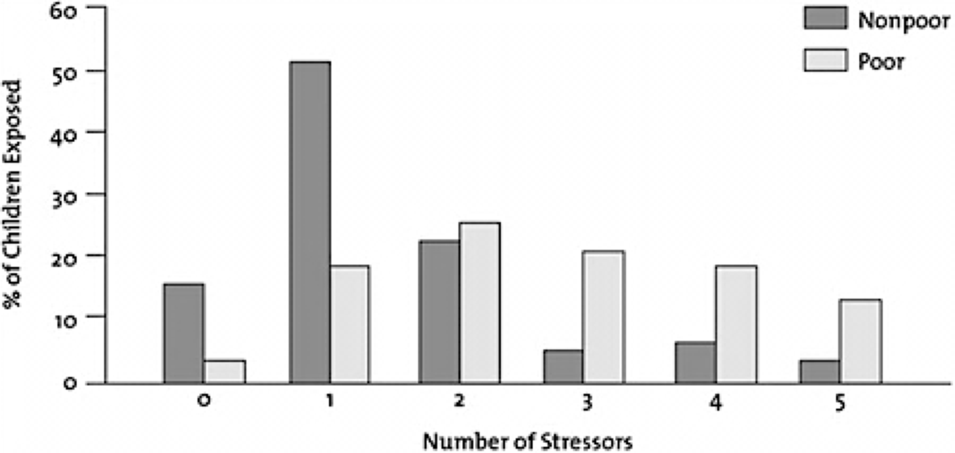
Number of Stressors for Poor vs. NonPoor Children
Evans Developmental Psychology 2007

Slide 5

LONG TERM EFFECTS OF SOCIAL AND ENVIRONMENTAL STRESS
Cumulative Effects Over Time
Socio-economic, Cultural, and Environmental Conditions
Living and Working Conditions
Disease Risk
DISEASE
Susceptibility and Morbidity
Biology-Environment Interactions
Physiological Adaptation and/ or Disruption
ASTHMA:
Social and Community
Networks
Individual Level Factors
Host Level Factors
Biological Embedding
Thakur Race and Ethnicity in Respiratory Health Disparities (Ed. Celedon) 2016, Adapted from Halfon et al Life Course Health Development Model and from the biodevelopmental framework.

Slide 6
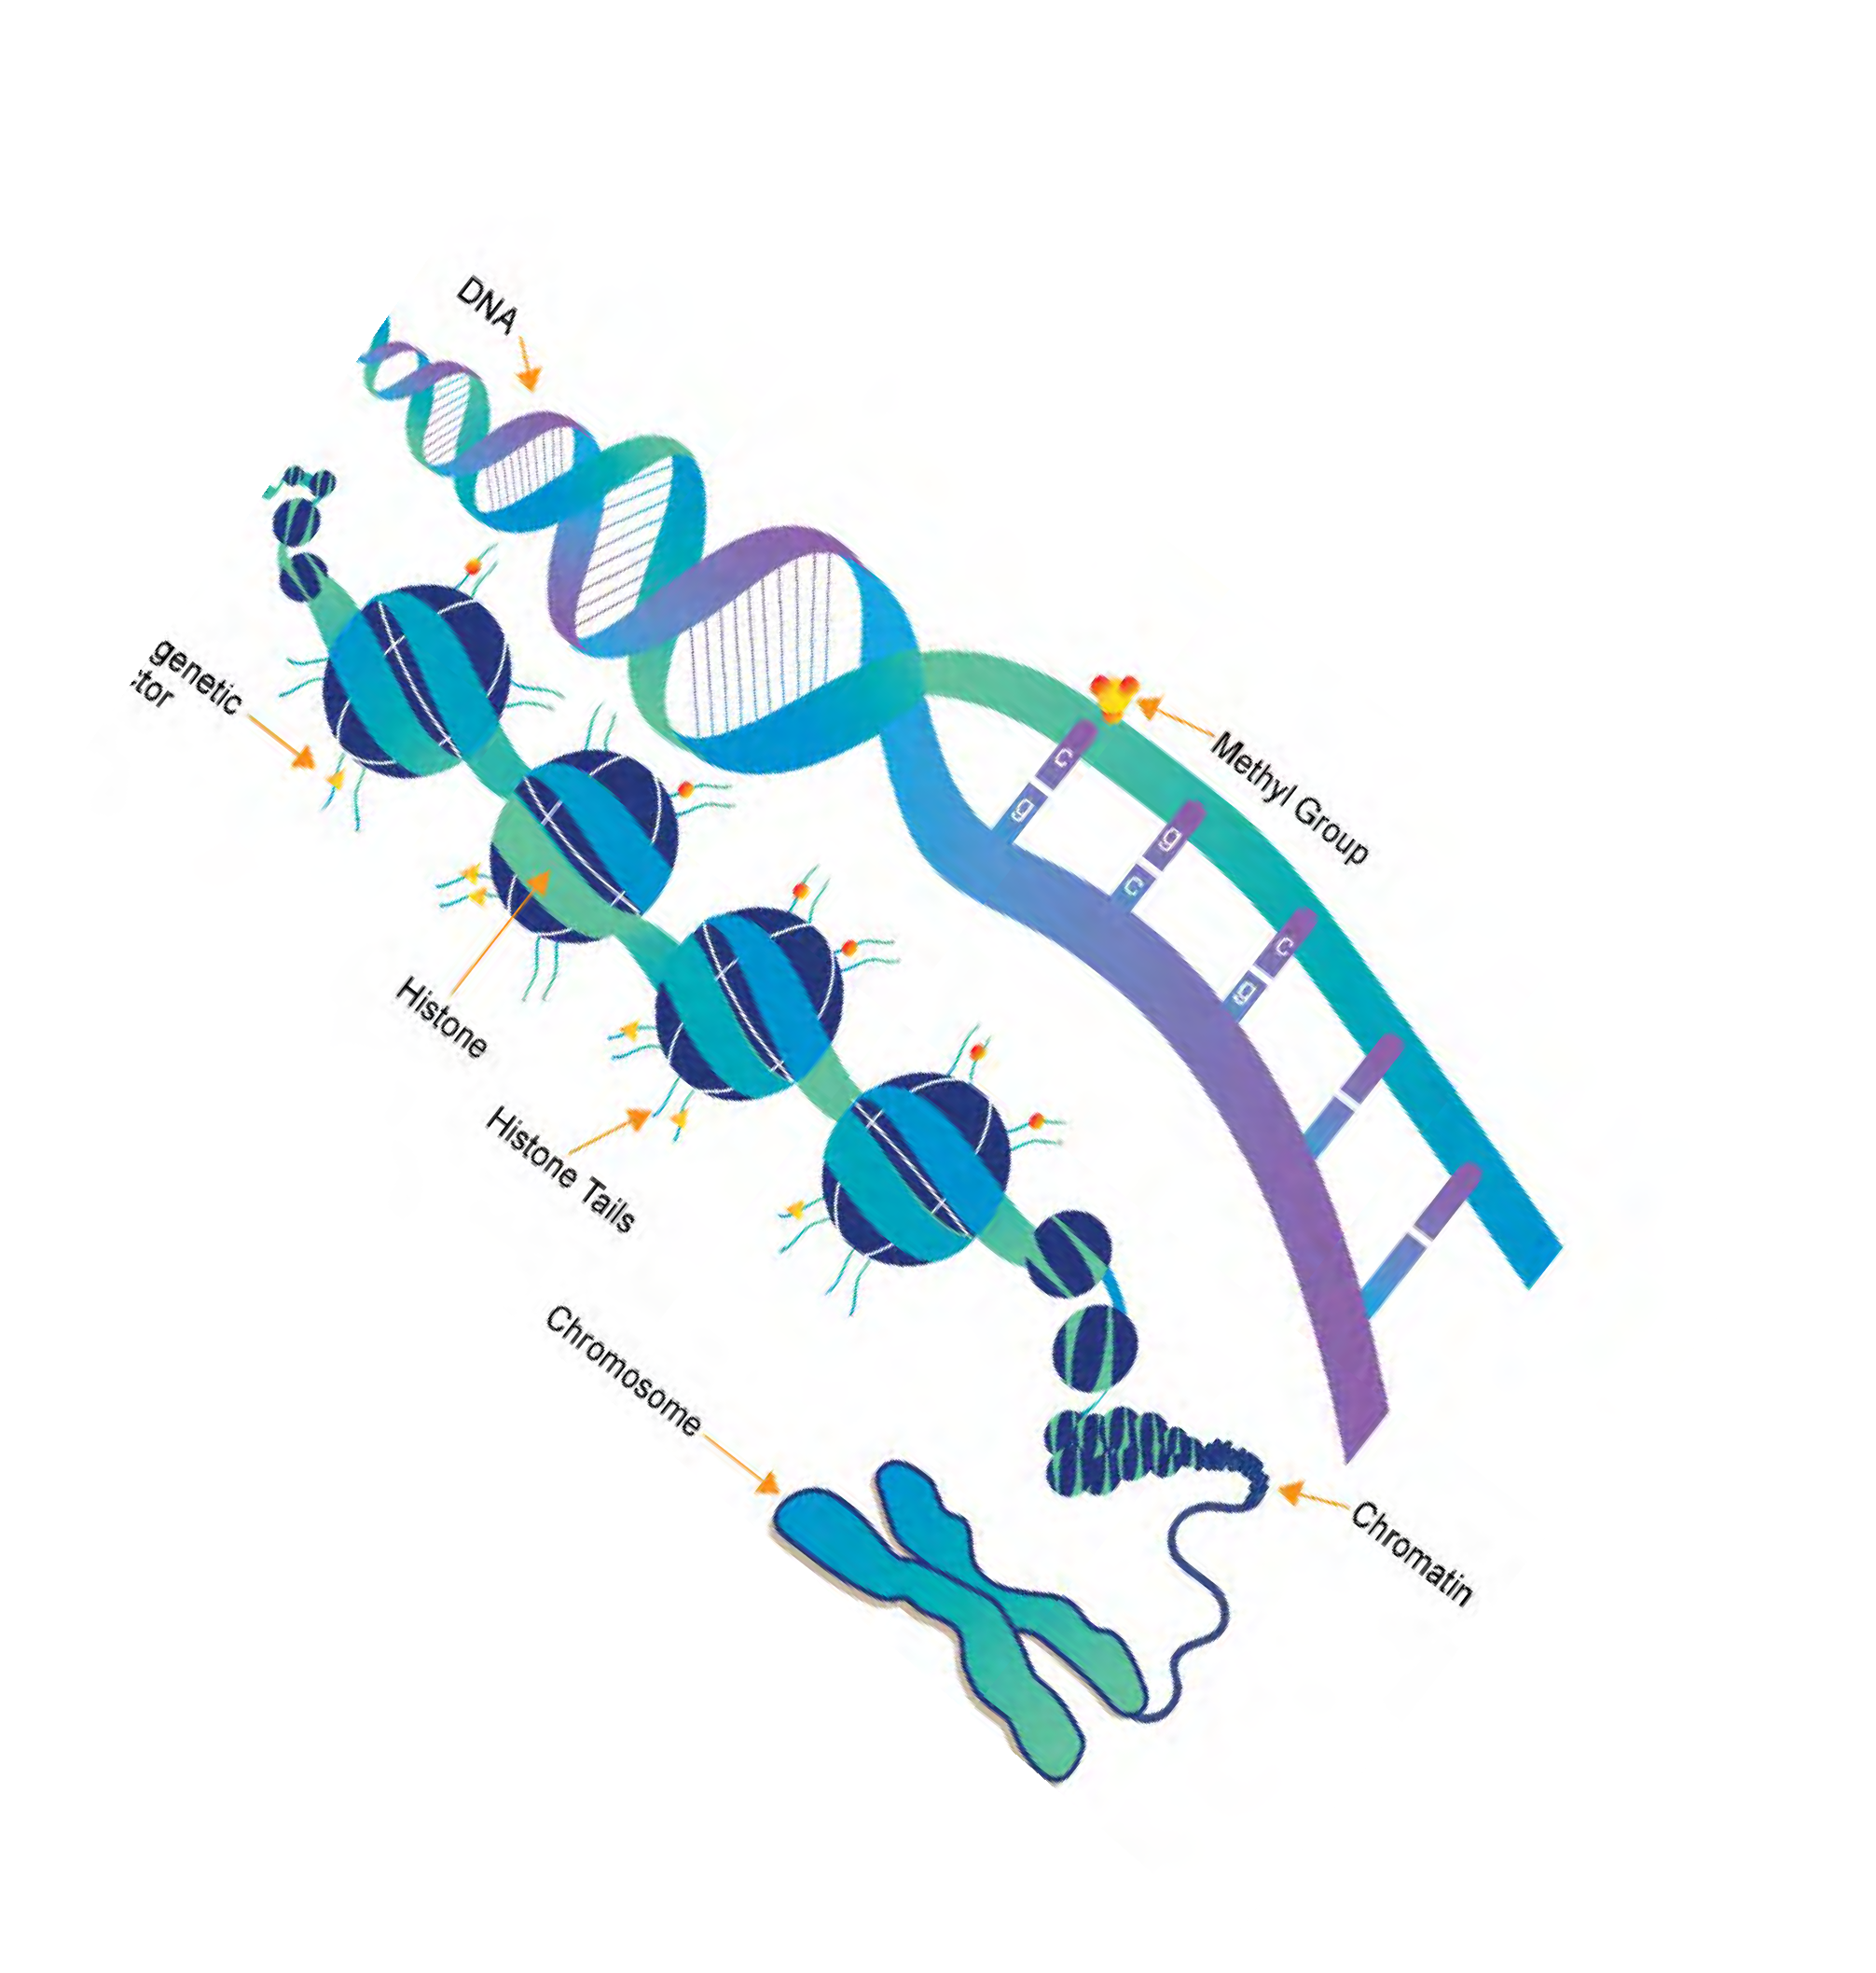

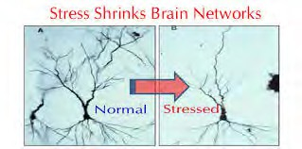
TYPES OF BIOLOGICAL RESPONSE
Neuro-hormonal and Inflammatory
Genetic
Neuroplasticity
Poverty Shrinks Brain Networks
GxE Epigenetic Microbiome
Allostatic Load

Slide 7
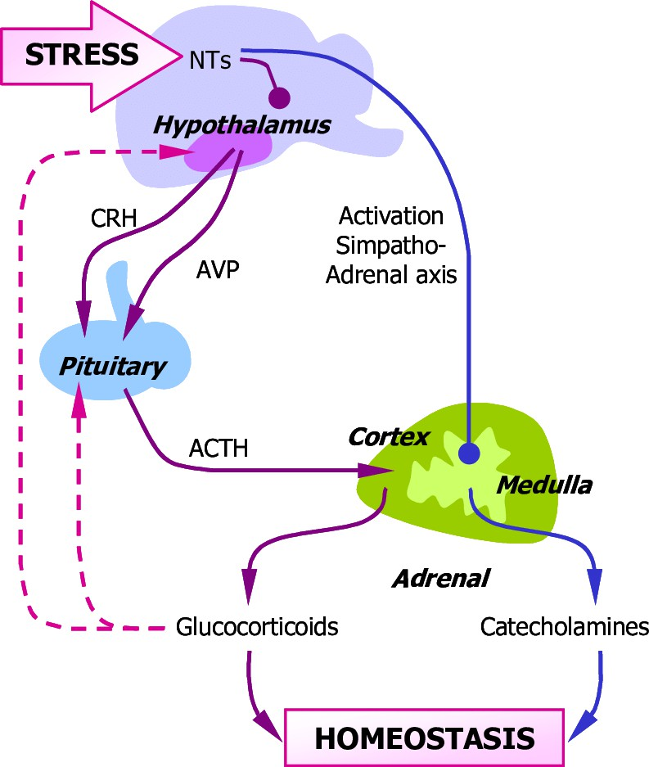
ALLOSTATIC LOAD
Primary Outcome
“Fight or Flight Response”
Catecholamines
HPA (cortisol)
Secondary Outcome
Tissue/Organ specific
e.g. blood pressure, lipid metabolism, and inflammation
Adapted from Matteri, Carroll & Dyer, 2000

Slide 8
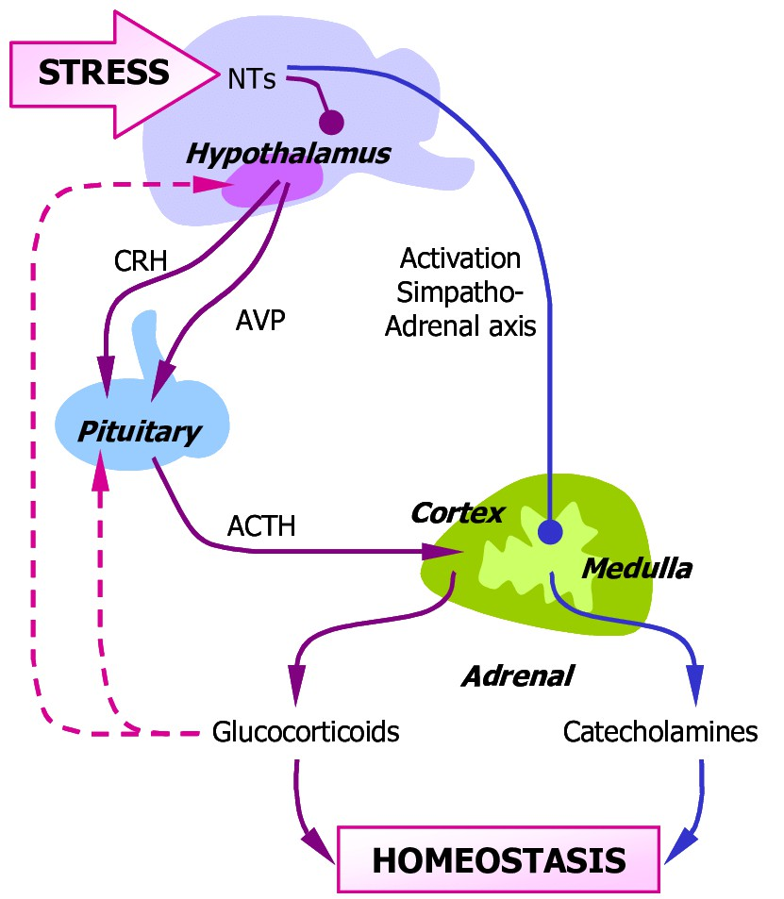
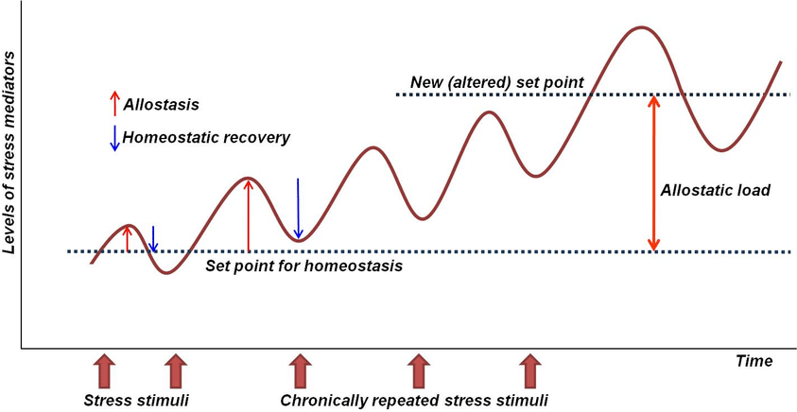
ALLOSTATIC LOAD
Cumulative Effect over time leads to new set point.
Adapted from Matteri, Carroll & Dyer, 2000

Slide 9
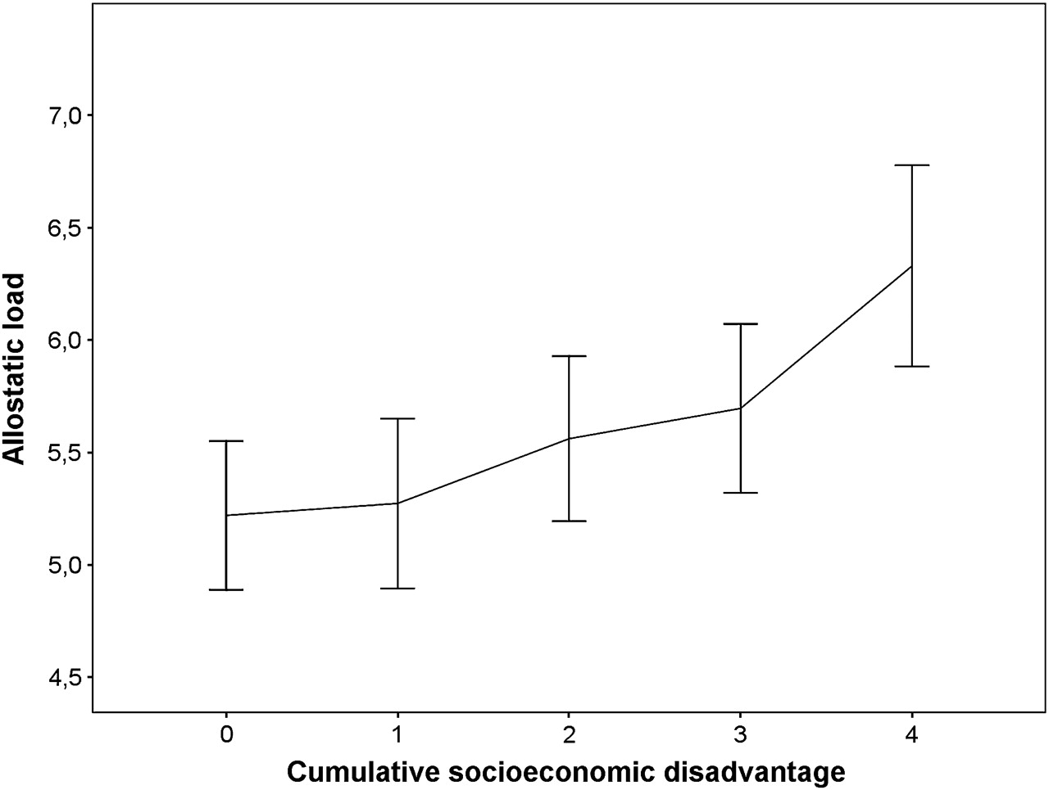
ALLOSTATIC LOAD AND SOCIOECONOMIC STATUS
Cardiovascular Metabolic Immune Response HPA Axis Respiratory
Parasympathetic Nervous System
+ Kidney/Liver Function
Allostatic Load Index
Gustafsson J Epidemiology Health 2011, Johnson Social Science & Medicine 2017

Slide 10
ALLOSTATIC LOAD
Candidate Stress-Related Biomarkers
Cardiovascular | Physiologic: Blood pressure, heart rate, ankle-brachial index Biomarker: Myeloperoxidase, endothelin-1,VEGF-A
Metabolic | Physiologic: Waist-hip circumference/BMI Biomarker: Lipids, HA1C, insulin, leptin
Immune System | Biomarker: CRP, fibrinogen, cytokines (IL-6,TNF-a), white count
HPA Axis | Biomarker: hair cortisol, DHEA-S, epinephrine, norepinephrine
Respiratory | Physiologic: Spirometry, bronchodilator response
Parasympathetic Nervous System | Physiologic: Heart beat variation
Kidney/Liver Function | Biomarker: Creatinine

Slide 11
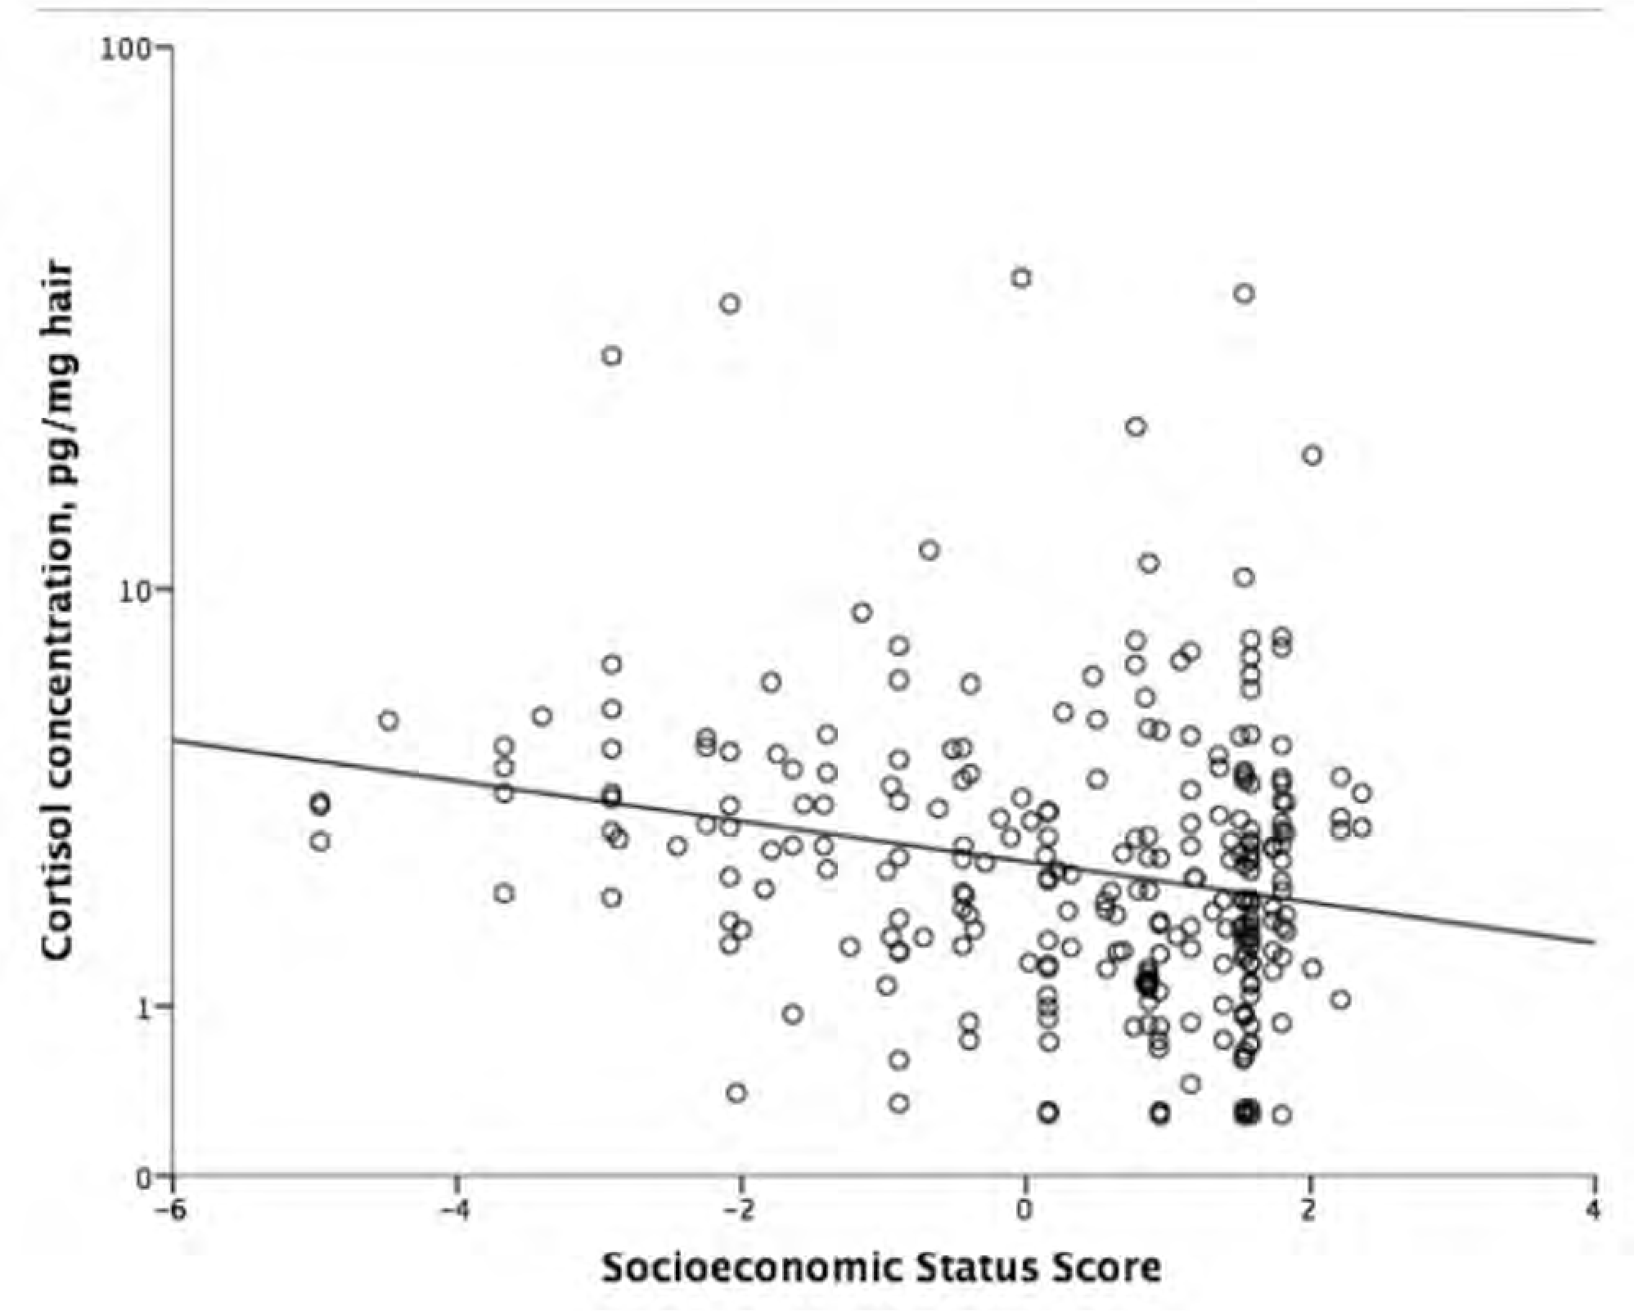
CORTISOL REGULATION
CHANGE WITH INTERVENTION?
Hair Cortisol consistently associated with low SES
Change in levels seen with interventions targeted at:
Intense parenting interventions
Nutrition focused
Time frame: Months
Cortisol Concentrations, pg/mg hair
Neighborhood Socioeconomic Score
Vliegenthart Psychoneuroendocrinology 2016

Slide 12
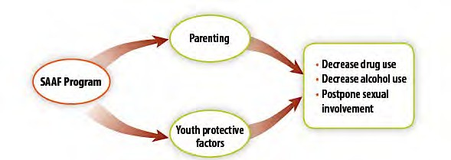
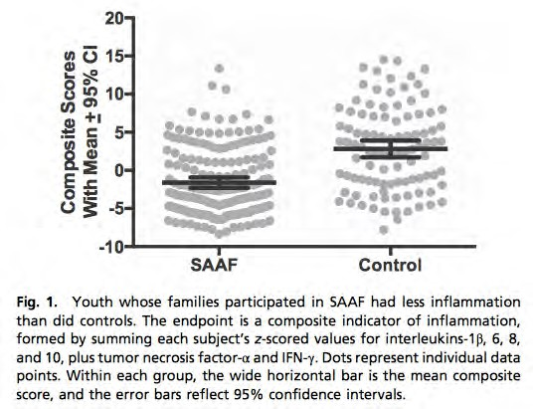
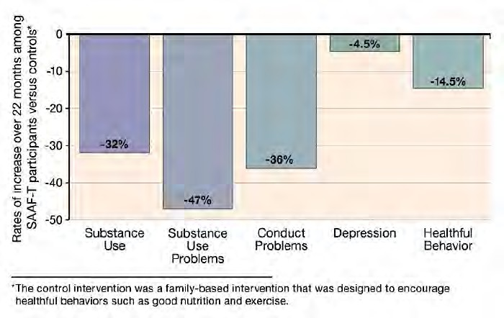
CHANGE WITH INTERVENTION?
STRONG AFRICAN AMERICAN FAMILY
Not ready for PRIME time
Brody Pediatrics 2012, Miller PNAS 2014

Slide 13
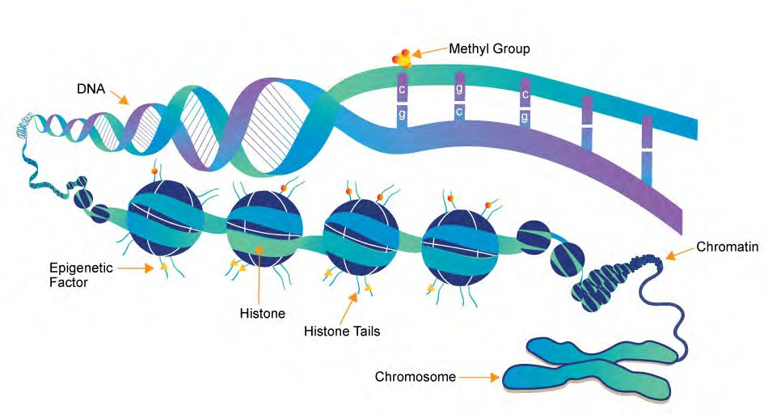
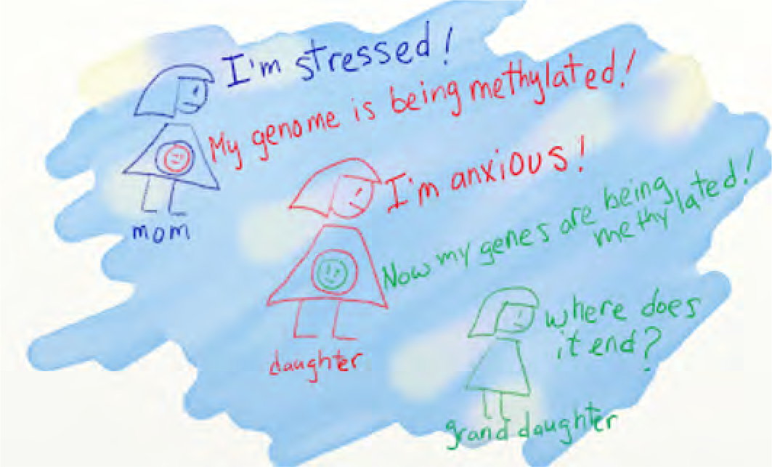



GENETICS: EPIGENETIC CHANGES
Telomere Length
DNA Methylation
Methyl Group
Telomere
https://www.whatisepigenetics.com/fundamentals/

Slide 14
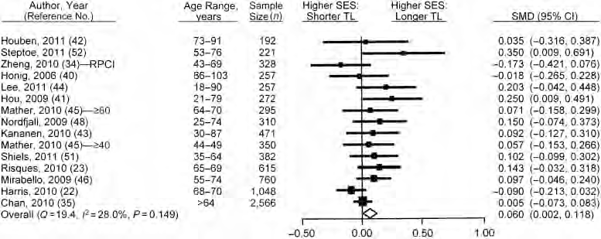
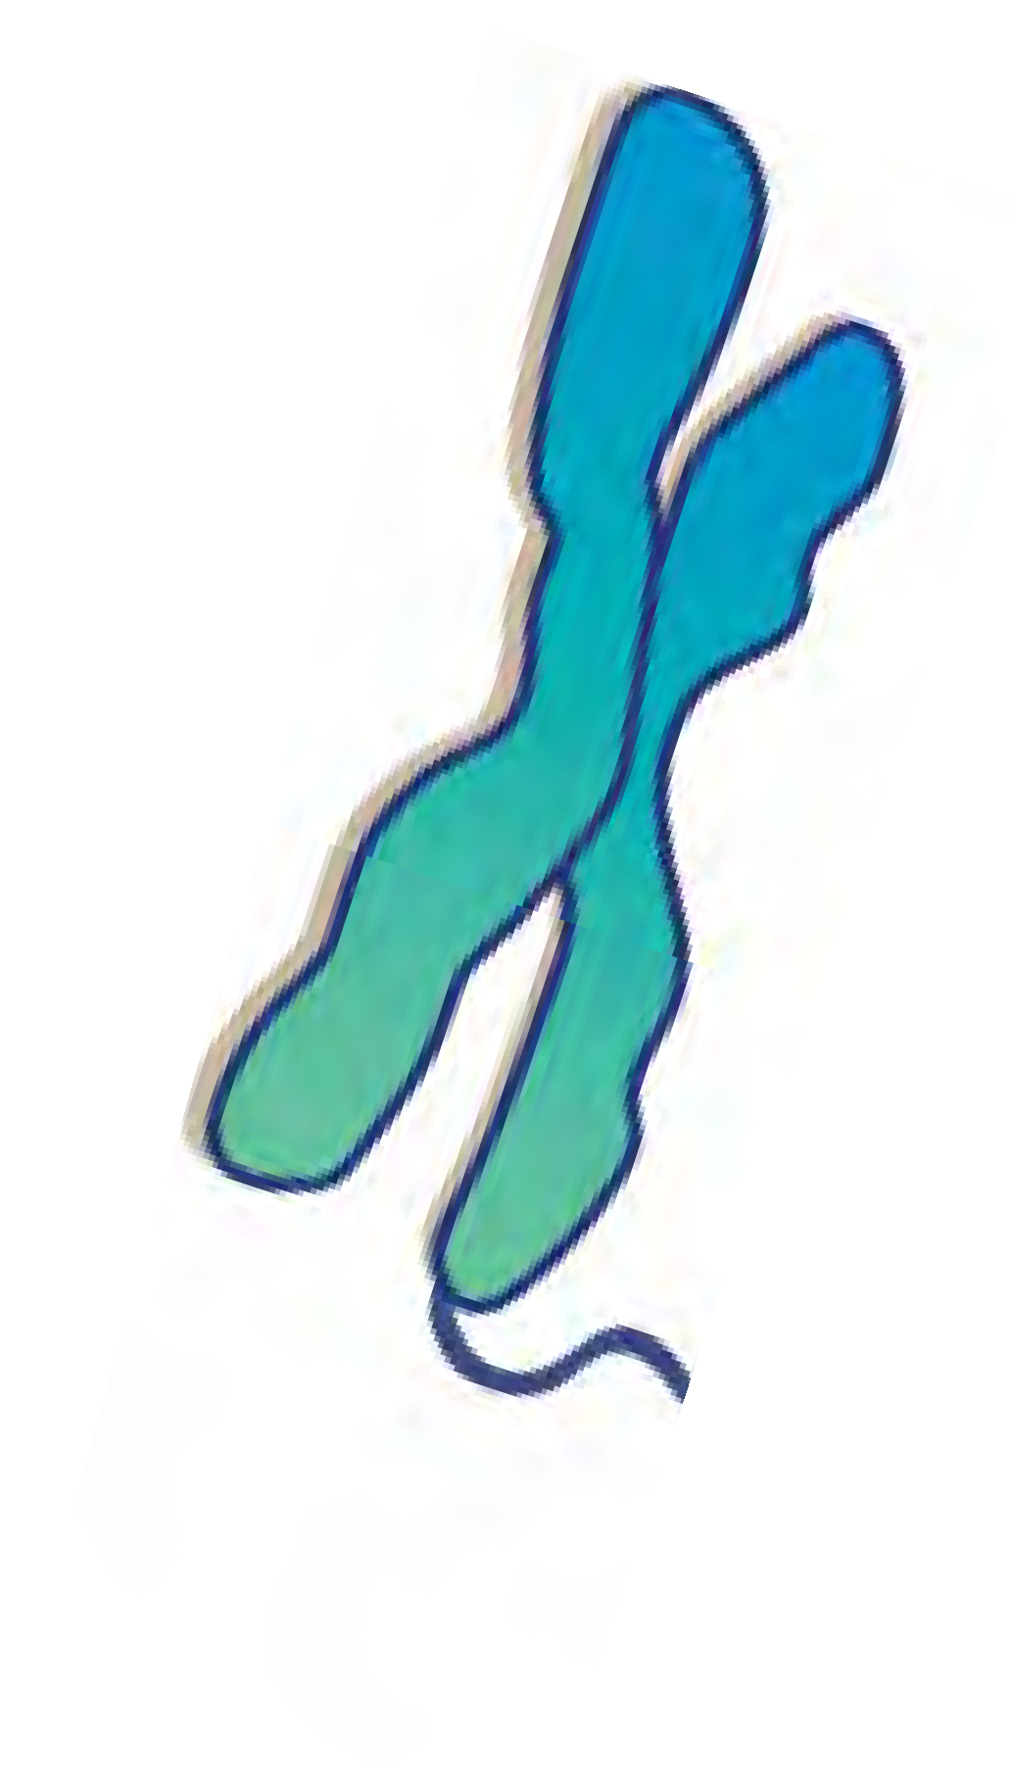



TELOMERE LENGTH
Strong evidence with perceived stress….
Telomere
Robertson Epidemiologic Reviews 2012

Slide 15
TELOMERE LENGTH
Building evidence with education, less evidence with other measures of socioeconomic status
Telomere
Robertson Epidemiologic Reviews 2012

Slide 16
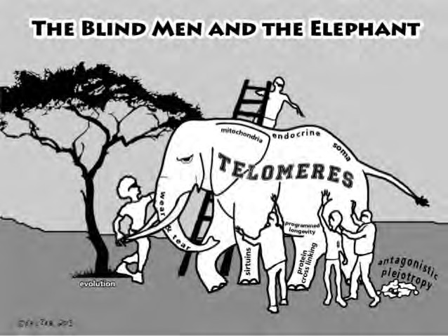
TELOMERE LENGTH AND INTERVENTION
CHANGE WITH INTERVENTION?
Change seen with interventions targeted at ‘stress’
Meditation
Exercise
Lifestyle change
Timeframe: months to 1 year
Difficult to extrapolate

Slide 17
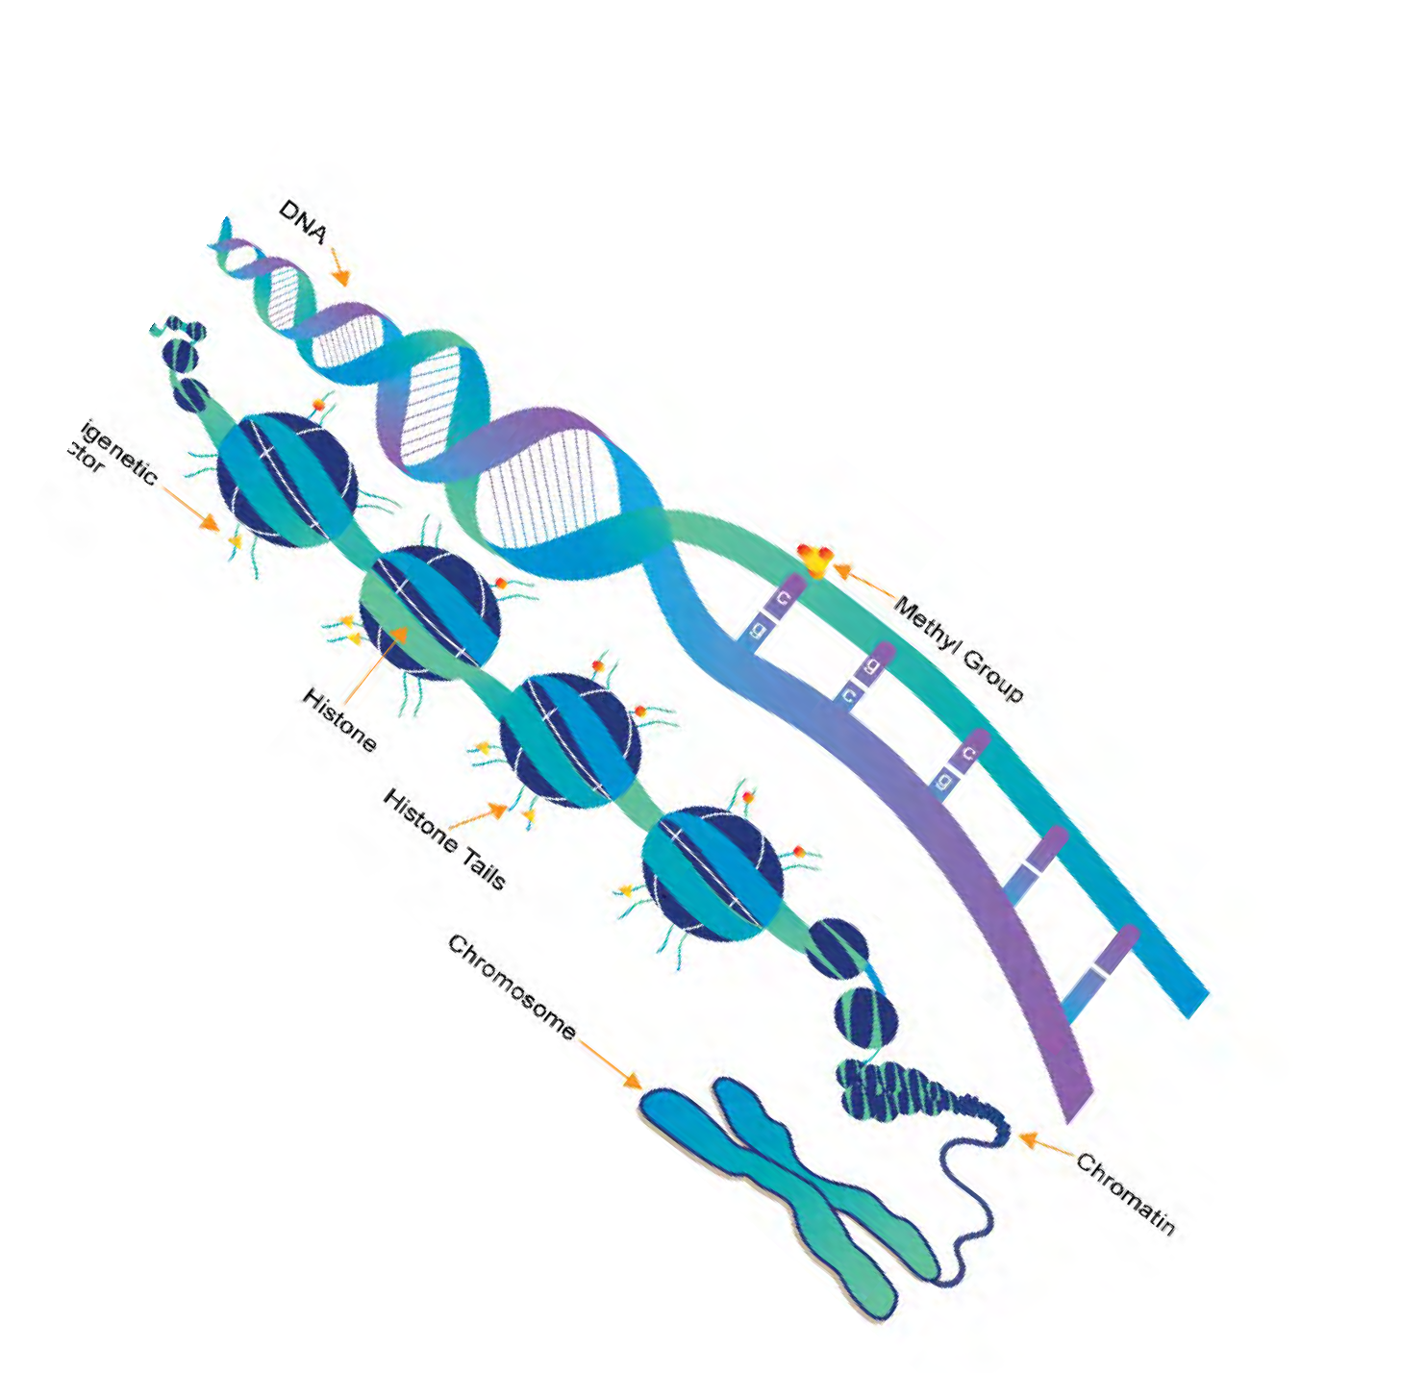

TAKE HOME
Biomarkers are helpful at establishing baseline effects
  Candidate biomarkers: Allostatic Load, Hair Cortisol,Telomere Length
More Research Needed
  Do biomarkers change with intervention?
  Does the change in biomarkers equate change in the health outcome of interest?
Neuro-hormonal and Inflammatory
Genetic
Neuroplasticity
Poverty Shrinks Brain Networks
GxE Epigenetic Microbiome
Allostatic Load

Slide 18
TAKE HOME
Lasting thought:
Can biomarkers be used to identify individuals at high risk for poor outcomes?
If elevated at baseline, would these individuals benefit the most from intervention?
  Help with allocating resources in low-resource settings
  Help reduce negative studies
Neuro-hormonal and Inflammatory
Genetic
Neuroplasticity
Poverty Shrinks Brain Networks
GxE Epigenetic Microbiome
Allostatic Load

Slide 19
QUESTIONS?

Slide 20
EXTRA SLIDES

Slide 21

Positive stress
Brief increases in heart rate
Mild elevations in stress hormones
Tolerable stress Serious, temporary stress responses
Buffered by supportive relationships
Toxic stress
Prolonged stress response activation
Absence of protective relationships
J Shonkoff Harvard University Center on the Developing Child

Slide 22


Stressors
Trauma, Access, Demographics
Violence, Neighborhood deprivation, Air pollution
Nature of stressor
Positive stress
Brief increases in heart rate
Mild elevations in stress hormones
Tolerable stress Serious, temporary stress responses
Buffered by supportive relationships
Toxic stress
Prolonged stress response activation
Absence of protective relationships
J Shonkoff Harvard University Center on the Developing Child

Slide 23




Stressors
Trauma, Access, Demographics
Violence, Neighborhood deprivation, Air pollution
Nature of stressor
Positive stress
Brief increases in heart rate
Mild elevations in stress hormones
How stressor is perceived
Individual Characteristics Sex, genes, development, experience, behavior
Tolerable stress Serious, temporary stress responses
Buffered by supportive relationships
Ability to cope
Toxic stress
Prolonged stress response activation
Absence of protective relationships
J Shonkoff Harvard University Center on the Developing Child

Slide 24


Stressors
Trauma, Access, Demographics
Violence, Neighborhood deprivation, Air pollution
Nature of stressor
Positive stress
Brief increases in heart rate
Mild elevations in stress hormones
How stressor is perceived
Individual Characteristics Sex, genes, development, experience, behavior
Tolerable stress Serious, temporary stress responses
Buffered by supportive relationships
Ability to cope
Biologic Response
Neuro-endocrine and humoral response, epigenetics, GxE interaction, microbiome
Toxic stress
Prolonged stress response activation
Absence of protective relationships
Physiologic response
J Shonkoff Harvard University Center on the Developing Child

