Slide 1
Measuring Patient Health with PROMIS®:
Applications for Social Integration
Research and Care
Ashley Wilder Smith, PhD, MPH Chief, Outcomes Research Branch, NCI, NIH NIH Chief Science Officer, HealthMeasures
February 4, 2019 SIREN Research Meeting

Slide 2
1. Discuss need for robust and feasible health outcome data collection for research on social interventions in healthcare
Presentation Goals
2. Consider standard approach to capture patient health information directly from patients
3. Describe a unique patient-reported outcome assessment system for physical, mental, and social health

Slide 3
Research on Social Factors and Health
Meta-analyses of social determinants of health (SDOH) and mortality are robust
socioeconomic status (Stringhini et al., 2017)
income inequality (Kondo, 2012)
social relationships (Holt-Lunstad et al., 2010)
Mechanisms to explain impact of SDOH on health have been explored
environmental toxin exposure, risky health behaviors, chronic stress, epigenetic processes (Braveman & Gottlieb, 2014)
undertreatment among unmarried patients (Aizer et al., 2013)
When conducting interventions in healthcare delivery settings, we need to examine proximal outcomes, such as symptoms and functioning
Are there standard ways to capture patient health from patients?

Slide 4













Understanding patient’s health from patients

Slide 5
Patient Reported Outcomes (PROs)
PROs typically fall into three categories: physical, mental, and social health, based on WHO identified domains of quality of life
PRO measures critically inform clinical research and clinical care; may also inform care quality
PROs can bring direct experience of patients into clinic to better understand the effect of health conditions and treatments on daily life
5

Slide 6


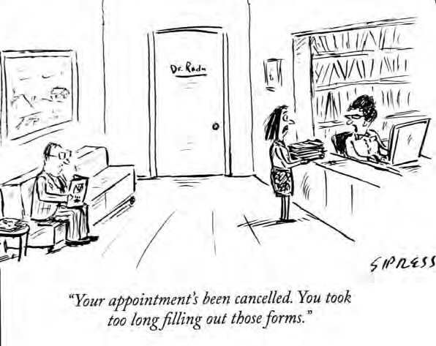
Challenges for PRO Assessment
Historically:
Clinical research suffered from a lack of comprehensive tools
Response burden for fixed questionnaires
Generic vs. disease-specific tools
NIH Vision for Measurement:
Brief, precise, valid, flexible tools
Comparisons across diseases
Shared electronic platforms
Pediatric and adult
Low patient-burden
Three waves of NIH Funding over 15 years

Slide 7

Patient Reported Outcomes Measurement Information System®
Components: brief, precise, valid, reliable fixed or tailored tools for patient-reported health status in physical, mental, and social well-being domains for adult and pediatric populations
Advantages: Disease-agnostic, Domain-based, Flexible, Adaptable, Low burden, Comparable, Accessible
Short Forms (“Ready made” or “Make your own”)
Individually tailored electronic questionnaires via computer adaptive tests (Next item depends on previous answer)
Standardized: Item Response Theory (IRT) for construction; One metric (T-score, Mean=50, SD=10; ref=US population)

Slide 8


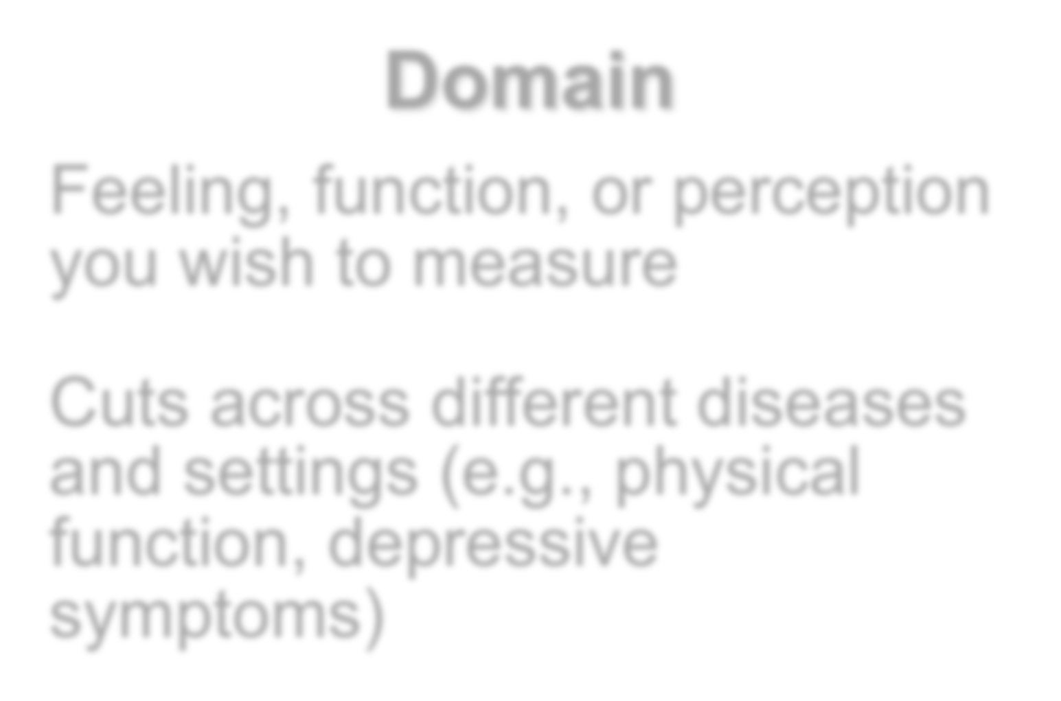

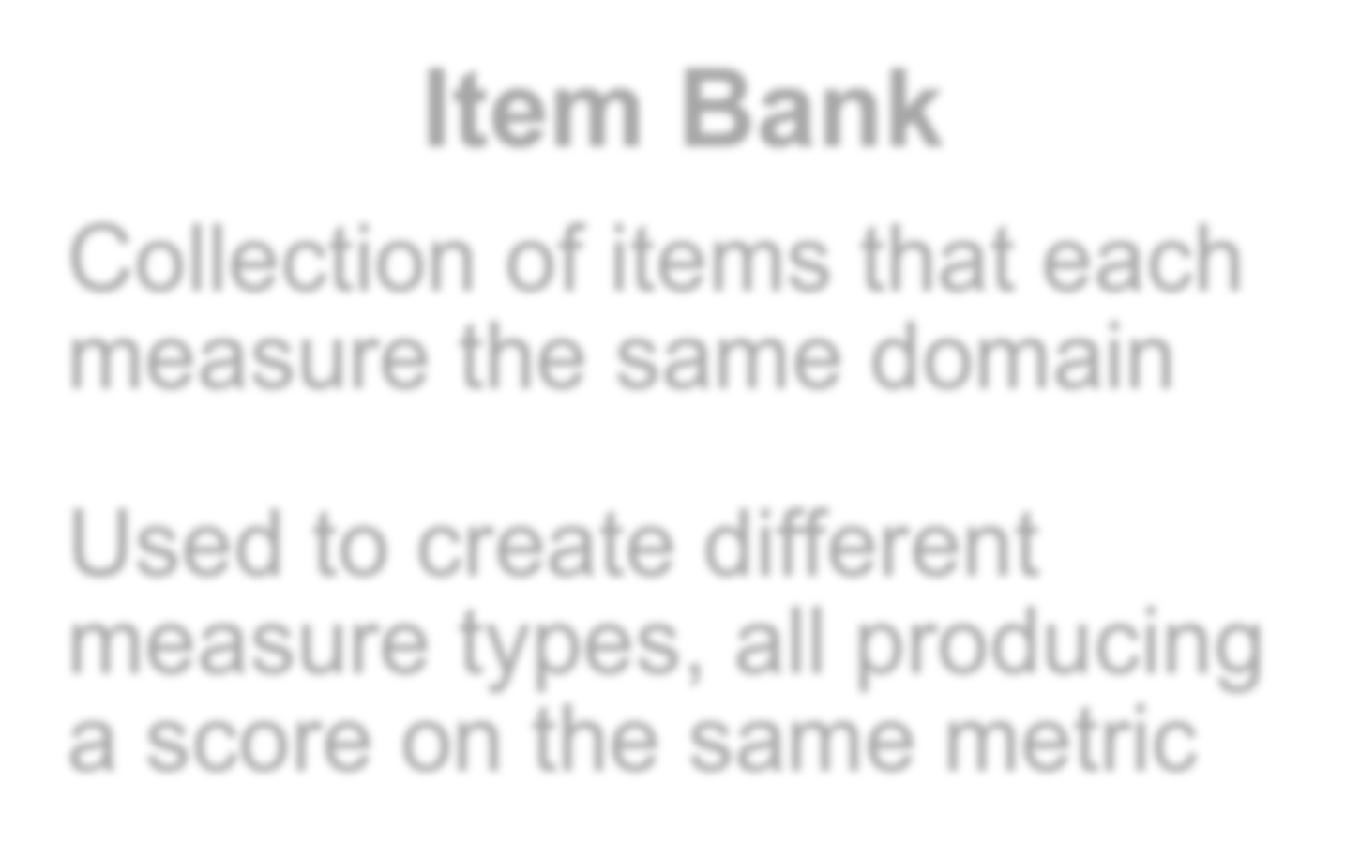

PROMIS Essential Components
Domain
Feeling, function, or perception you wish to measure
Cuts across different diseases and settings (e.g., physical function, depressive symptoms)
Item Bank
Collection of items that each measure the same domain
Used to create different measure types, all producing a score on the same metric
Computer Adaptive Testing (CAT): All items from bank can be used, Next item depends on response to prior item
8

Slide 9
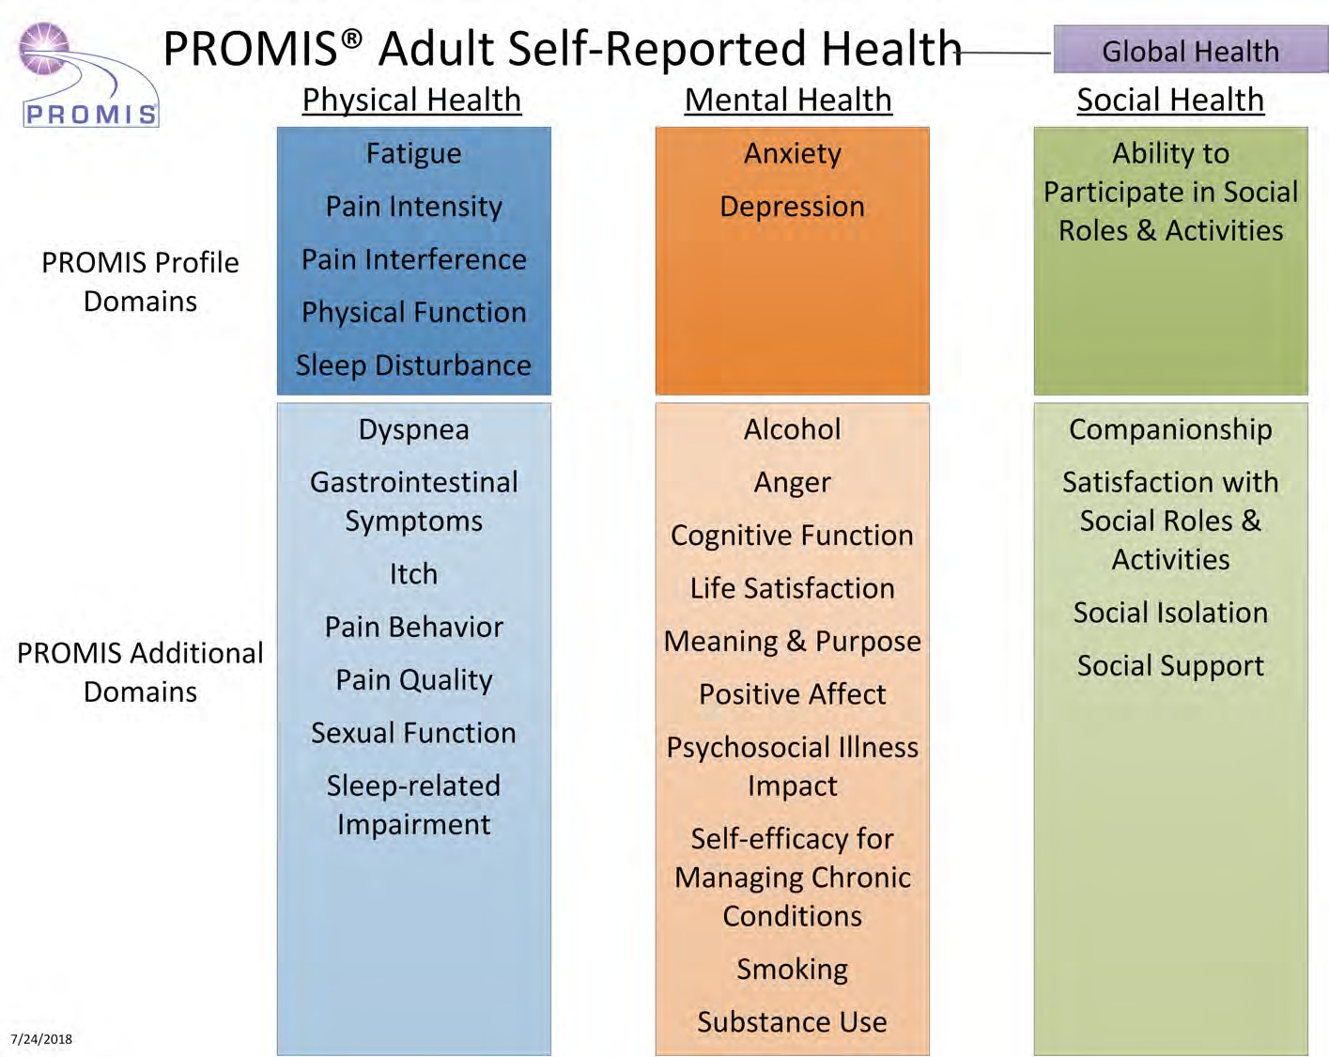

Slide 10
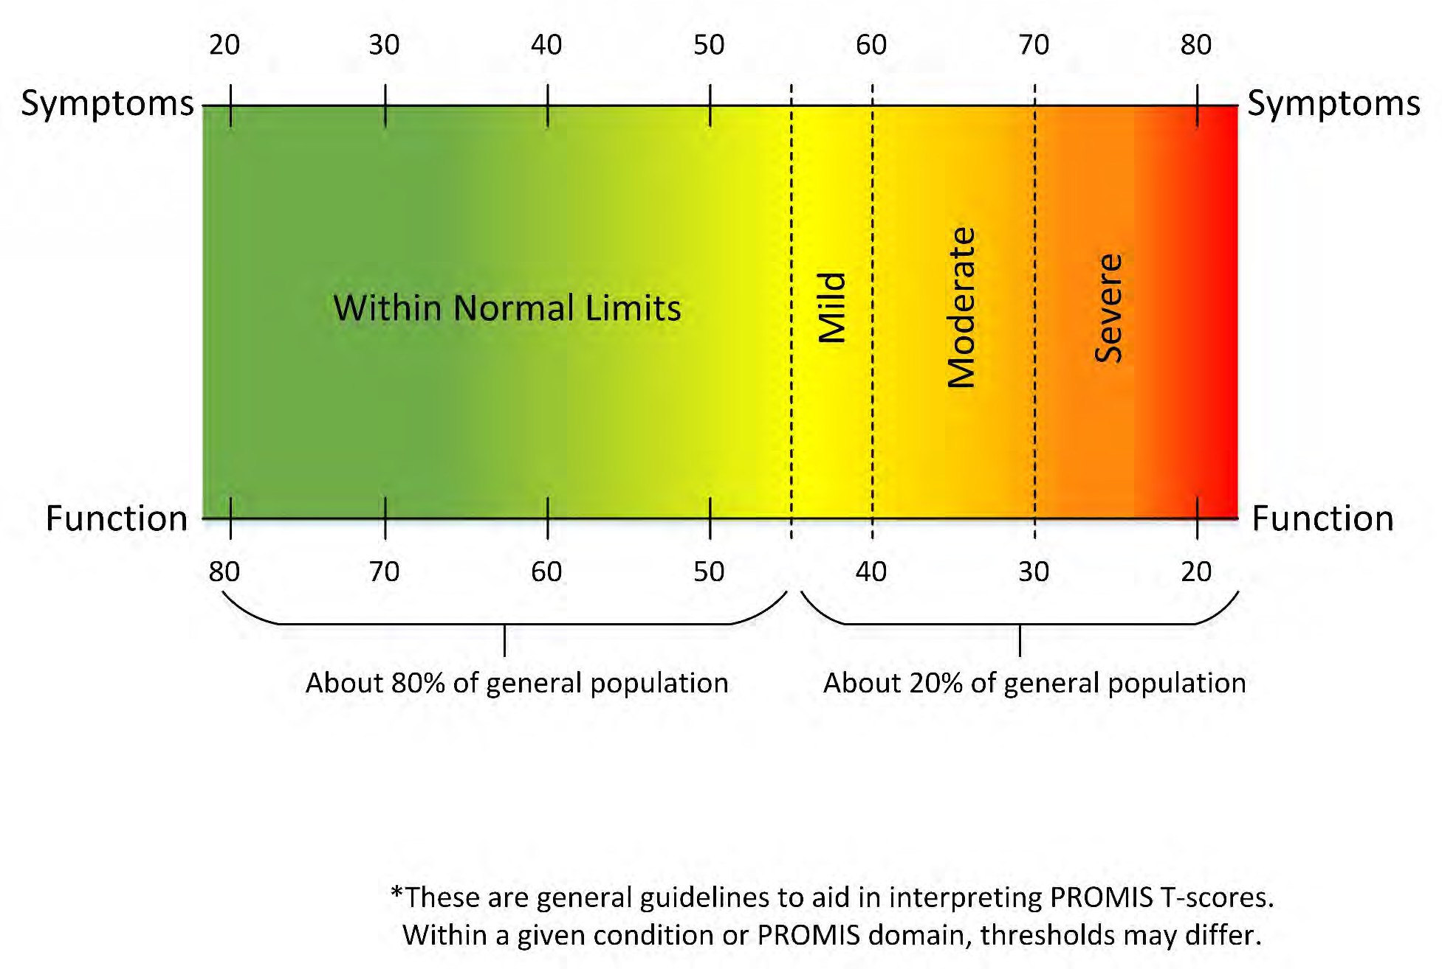
Interpretability: All Scores, One Scale

Slide 11




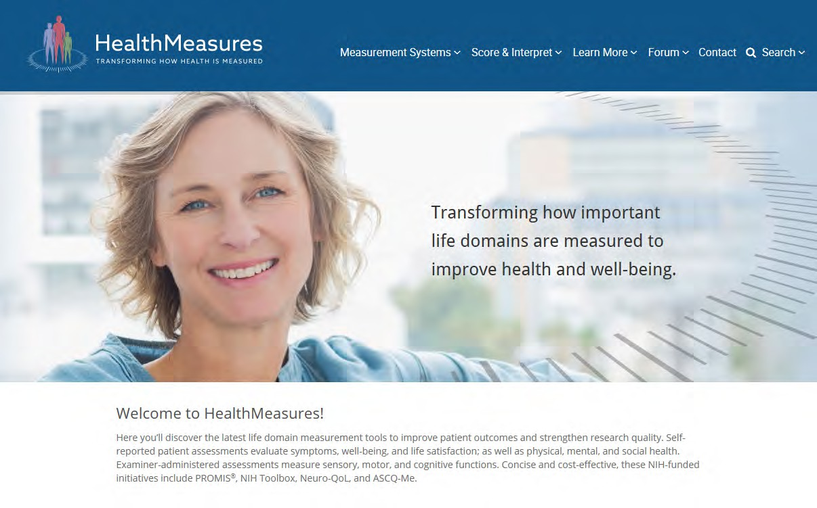






Available via HealthMeasures
Trans-NIH Cooperative Agreement
14 NIH Contributors
NCI, NINDS, NIA, NHLBI, NCCAM, NIAMS, NIDDK, NIDCD, ORWH, OBSSR, NIMH, NIDA, NINR, NCMRR
Integration, Dissemination, Sustainability
Curate and provide four systems
Infrastructure and scientific standards
Funding decrease: transition to independence
www.healthmeasures.net

Slide 12

What does it provide?
E
Automated use of four state-of-the-science measurement systems and the ability to combine with other tools
Supports, administers, and provides integrated platforms for self-report or performance-based measures
Include self-reported quality of life and measures of function
  Reports: Physical, mental, social health; symptoms, well-being
  Performance-based measures: sensory, motor and cognitive function
Applications: outcome measurement, process measurement, prediction, case identification, and population surveillance, monitoring in clinical practice
12

Slide 13

PROMIS Data Collection
E
HealthMeasures Application Program Interface (API)
iPad App (NIH Toolbox and PROMIS)
Research Electronic Data Capture (REDCap)
  For Clinical Trials and Research, free to consortium members
Epic: Short-forms available, CAT available since 2016 release
  400 assessments, English, Spanish
  via MyChart (appointment based, recurring, Ad Hoc: patient/clinic-driven)
EHR Access to Seamless Integration of PROMIS (EASI-PRO)
  Scalable implementation in Epic, Cerner, Smart on FHIR, others
13

Slide 14
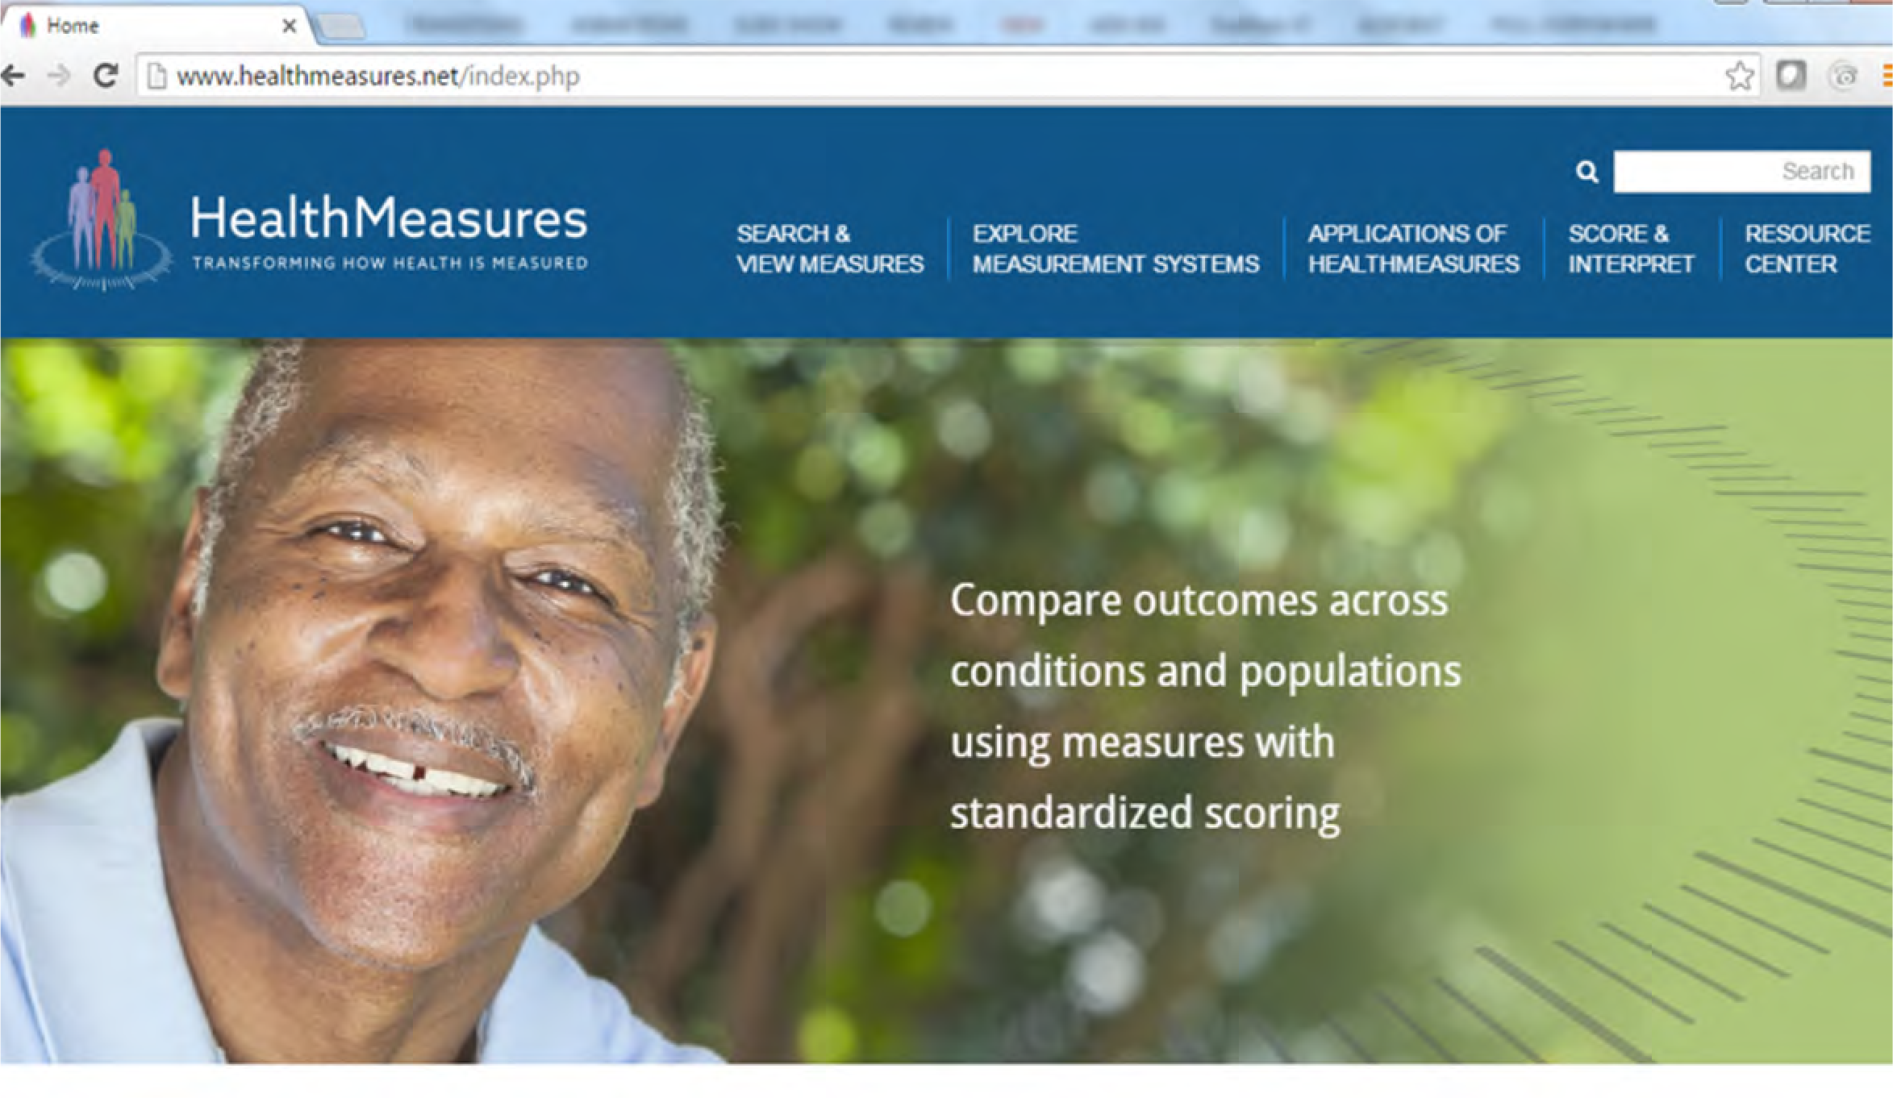
Information for Accessing PROMIS Tools
Search & View Measures
Download free, respondent-ready PDF short forms.
Applications of HealthMeasures
Free guides to help select measures for use in research, clinical care, and care quality.

Slide 15
Summary and Future Needs
E
Current tools with advanced methods are available to capture patient health with low burden on patient and system
Future research examining social care interventions in healthcare delivery settings could benefit from standard approaches to allow comparisons across studies
PROMIS is one option for a standard way to assess PRO data (symptoms and functioning) for mental, physical, and social health
15

Slide 16
Questions?
Ashley.Smith@nih.gov

Slide 17
Extra Slides

Slide 18
Fixed Questionnaires vs. Computerized Adaptive Tests (CAT)
high physical function
3
2
2
Questionnaire with high precision but small range
1
1
Questionnaire with a wide range but low precision
0
- 1
low physical function
- 2
- 3

Slide 19















Fixed Questionnaires vs. Computerized Adaptive Tests (CAT)
high physical function
3
Question #2
Question #3
2
2
2
1
1
1
Question #1
0
0
- 1
Questionnaire with high precision AND a wide range
- 2
low physical function
- 3

Slide 20





Precise, flexible, comprehensive measurement systems
Brief and psychometrically sound patient-centered health tools for ages 3 to 85
Flexible administration – computer adaptive tests (CATs), short forms, and interactive tests For use in clinical research, clinical practice, quality improvement, and educational settings
Self- and parent-report
Global, physical, mental, and social health
Adults and children
General population, those with a chronic condition
Self- and proxy-report
Physical, mental, and social health
Adults and children
Those living with a chronic condition
Self-report
Physical, mental, and social health
Adults
Those living with sickle cell disease
Performance tests
Cognitive, motor, sensory function, emotion
Adults and children
General population, those with a chronic condition
www.HealthMeasures.net
www.healthcaredelivery.cancer.gov/healthmeasures

Slide 21



Translation Science Continuum for Measurement Development
I: Basic Methods / Tool Development
Create tools using modern psychometrics
Item identification/development
Qualitative studies
Test in clinical samples and general population
Analysis, interpretation, refinement
PROMIS I
PROMIS II “PROMIS III”
II. Translation
Validate in clinical samples
Measure adaptation for language, literacy
Finalize standards for use
Develop outside partnerships
Use in observational studies
Use in clinical trials
Methods to allow for clinical application
III. Implementation & Adoption
Widespread use in extramural
studies and trials
Outcomes/Comparative effectiveness research
Payment mechanisms to ensure sustained adoption
Incorporated into training and education curricula
Dynamic evaluation to inform provider practices
Methods figure Adapted from: Mitchell SA, Fisher, C, Hastings C, Silverman, L, Wallen G. (2010). Nursing Outlook, 58 (6), 287-300.

Slide 22

PROMIS Development
PROMIS I
PROMIS II
NIH Roadmap 2004-2008
6 Research Centers
1 Coordinating Center
Began development of PROMIS domain framework and item banks
Developed and tested physical, mental, social health domains in several clinical samples and settings
Primarily Adult
Sustainability: PHO established
2009-2014 NIH Common Fund
12 Research Centers
3 Network Centers
Expanded the development of PROMIS with additional domains
Large-sample validation in adult cancer patients
Expanded pediatrics
Sustainability: Public/Private Partnerships, PHO expansion

Slide 23




NIH Mission
To seek fundamental knowledge about the nature and behavior of living systems and the application of that knowledge to enhance health, lengthen life, and reduce illness and disability
23

