Slide 1


EVALUATING CLINICAL-COMMUNITY INTEGRATION
THROUGH A SYSTEMS & POLICY LENS: WASHINGTON’S ACH MODEL
Bill J. Wright, PhD
Director
STATE OF THE SCIENCE
A National Research Meeting on
Medical & Social Care Integration
Feb 5, 2019
CORE – Center for Outcomes Research & Education Providence St Joseph Health System

Slide 2
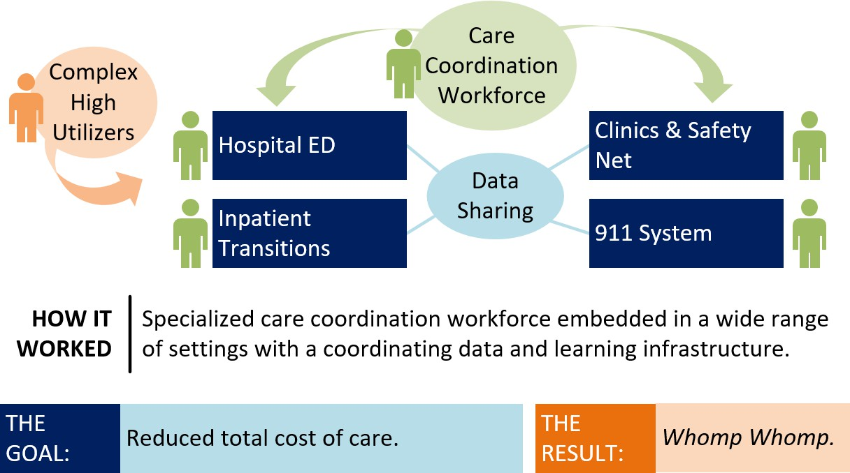
PART 1. BETTER CARE COORDINATION WILL SAVE US ALL.
Tri-County Care Collaborative: Super Care Coordination for Complex High Utilizers

Slide 3
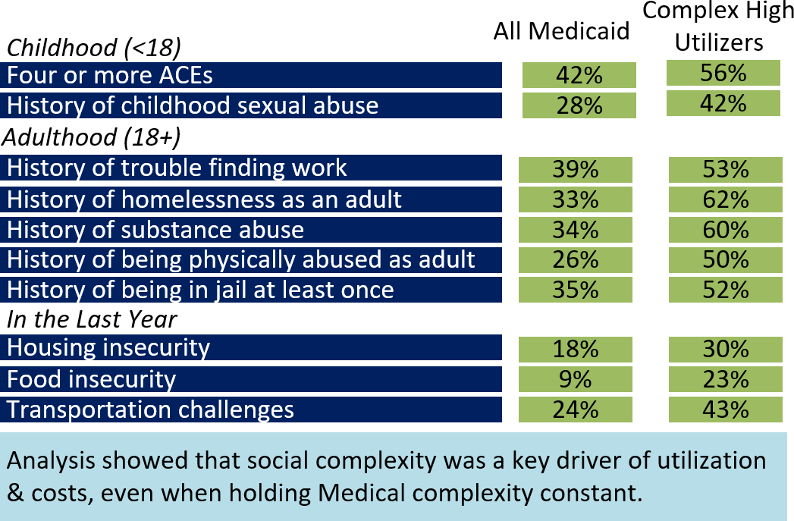
PART 2. WAIT, IT’S NOT JUST ABOUT US?
..So we turned our evaluation toward learning why we weren’t seeing cost savings.
WHAT WE LEARNED:
Triple aim outcomes are driven by “total complexity” across the entire continuum of health.
If we don’t better integrate clinic and community, we don’t have a prayer.

Slide 4
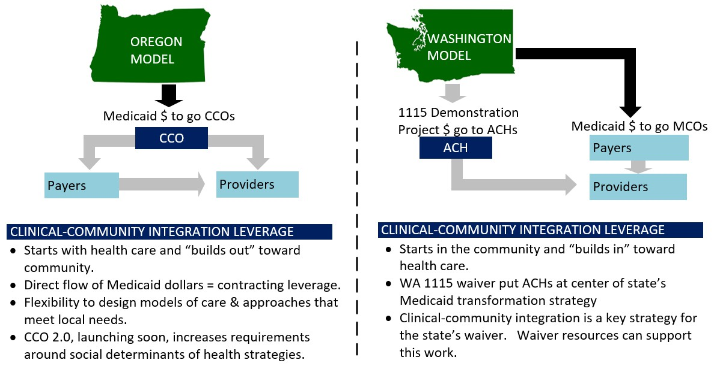
PART 3. IT’S ABOUT MORE THAN PROGRAMMATIC INTEGRATION.
MAKING CLINICAL-COMMUNITY CONNECTIONS THROUGH POLICY & SYSTEMS CHANGE

Slide 5
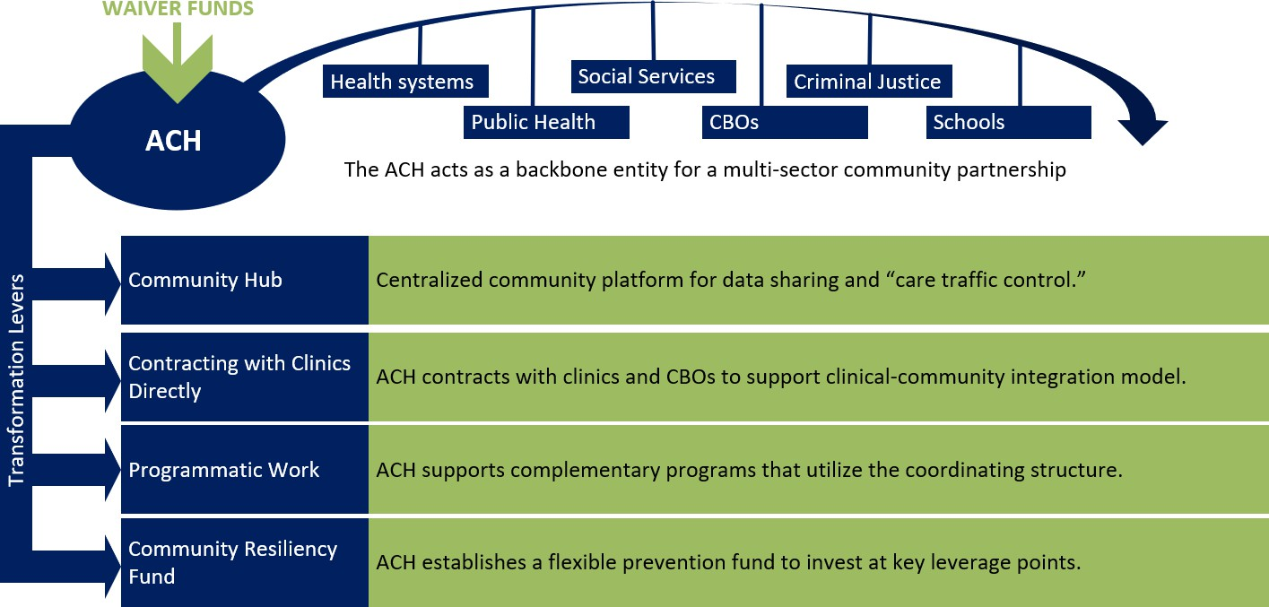
PART 4. BUILDING INTEGRATION THROUGH CROSS-SECTOR PARTNERSHIPS
HOW THE WA ACH MODEL SUPPORTS CLINICAL-COMMUNITY INTEGRATION

Slide 6
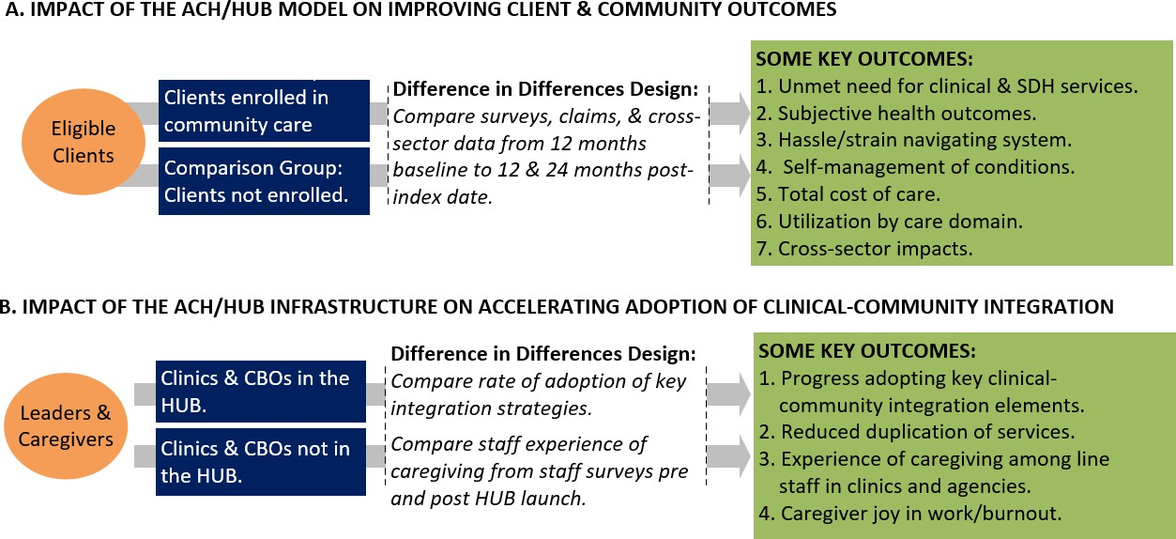
PART 5. BUILDING AN EVIDENCE BASE.
EVALUATING THE IMPACT OF A POLICY & SYSTEMS CHANGE APPROACH TO CLINICAL-COMMUNITY INTEGRATION
We are launching a 3.5 year comparative evaluation study across four different regions:

Slide 7
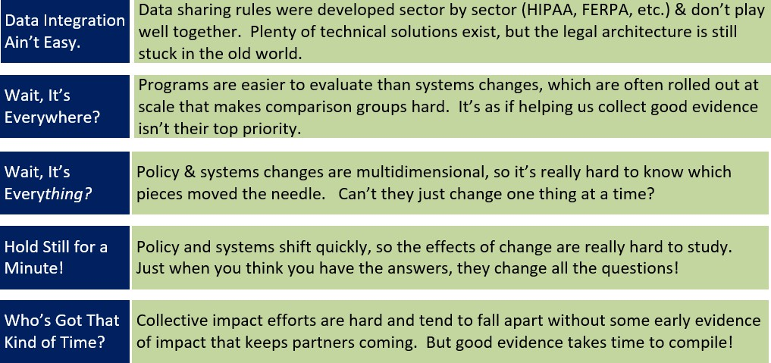
PART 6. NOTHING IS EVER EASY.
THE KEY CHALLENGES OF BUILDING EVIDENCE FOR SYSTEMS INTEGRATION VS PROGRAMMATIC INTEGRATION

Slide 8
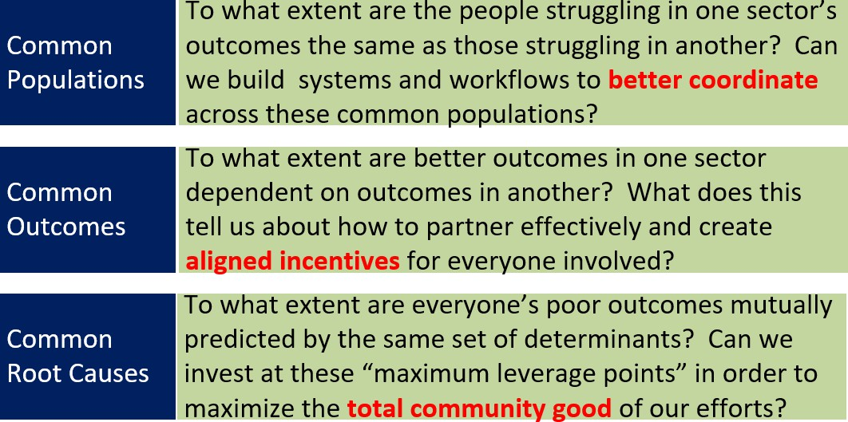
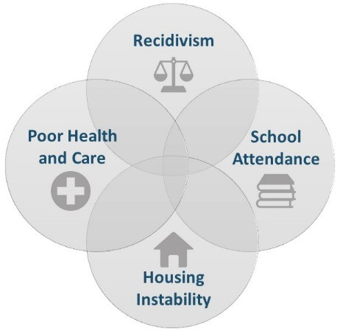
PART 7. BUT IT JUST MIGHT BE WORTH IT!
THE EXTRAORDINARY OPPORTUNITY THIS WORK REPRESENTS -- IF WE CAN PULL IT OFF.
If we can convincingly demonstrate how populations, outcomes, and root causes are interconnected, we can support, sustain, and catalyze systems change.
We intuitively know this. To boost transformation, we need to understand it empirically.

