Slide 1




The Social Interventions Research and Evaluation Network (SIREN)
CMMI’s Accountable Health Communities Social Screening Tool Webinar
9.25.17
siren

Slide 2


siren

Slide 3

Online resource hub
siren

Slide 4

Searchable Evidence Library
siren

Slide 5

Consultation and Collaboration Opportunities
siren

Slide 6


Today’s Speakers
Alex Billioux, MD, DPhil Division of Population Health Incentives & Infrastructure CMS CMMI
Katherine Verlander, MPH Division of Population Health Incentives & Infrastructure CMS CMMI
siren

Slide 7



Accountable Health Communities
CMS Health-Related Social Needs (HRSN) Screening Tool
Presenters Alexander Billioux, MD, DPhil Katherine R. Verlander, MPH
11

Slide 8
Accountable Health Communities Model Overview & Structure
11

Slide 9
Why the Accountable Health Communities Model?
Many of the largest drivers of health care costs fall outside the clinical care environment.
Social and economic determinants, health behaviors and the physical environment significantly drive utilization and costs.
There is emerging evidence that addressing health-related social needs through enhanced clinical-community linkages can improve health outcomes and impact costs.
The AHC model seeks to address current gaps between health care delivery and community services.
11

Slide 10
What Does the Accountable Health Communities Model Test?
The Accountable Health Communities Model is a 5-year model that tests whether systematically identifying and addressing the health-related social needs of community-dwelling Medicare and Medicaid beneficiaries impacts total health care costs and utilization.
11

Slide 11
Health-Related Social Needs
Core Needs | *Supplemental Needs
Housing Instability | Family & Social Supports
Utility Needs | Education
Food Insecurity | Employment & Income
Interpersonal Violence | Health Behaviors
Transportation
* This list is not inclusive
11

Slide 12
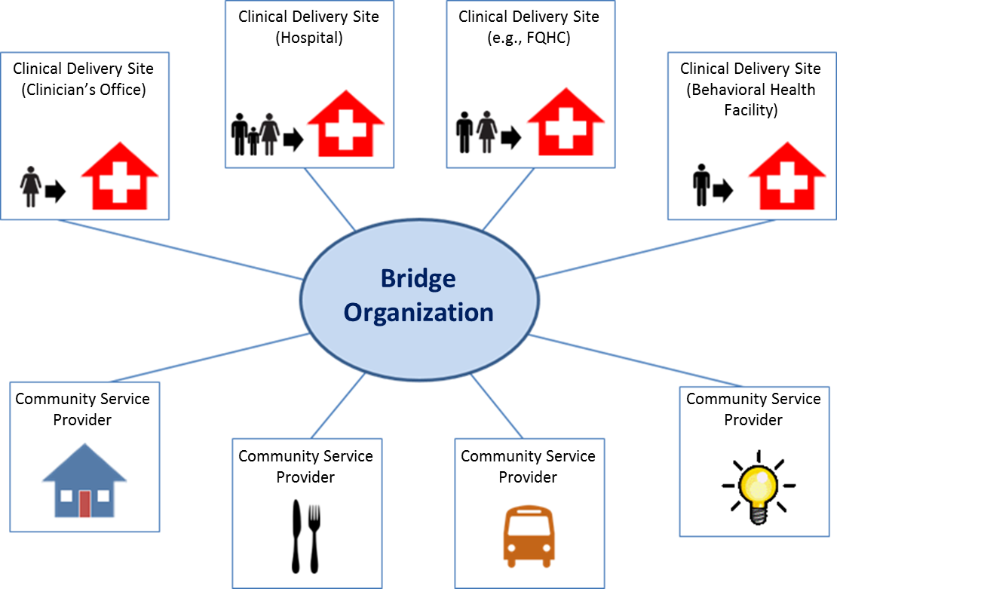
Accountable Health Communities Model Structure
11

Slide 13
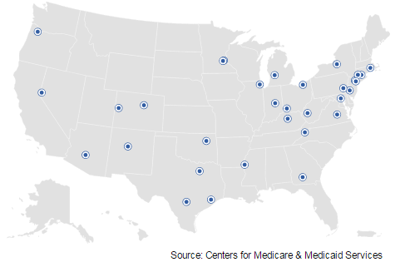
Overview of Bridge Organizations in Assistance & Alignment Tracks
32 communities across 24 States
6 in the Northeast
7 in the Midwest
11 in the South
8 in the West
Urban and rural

Slide 14
AHC Bridge Organizations
Assistance Track | State
Alexian Brothers Network | Illinois
Allina Health System | Minnesota
CHRISTUS Santa Rosa | Texas
Community Health Network Foundation | Indiana
Hackensack University | New Jersey
Mountain States Health Alliance | Virginia
Nevada Primary Care | Nevada
Partners in Health, Inc. | West Virginia
St. Josephs Hosp. Health Ctr. | New York
Tift County Hosp. Authority | Georgia
UT Health Sciences Center | Texas
Yale-New Haven Hospital | Connecticut
Alignment Track | State
Baltimore City Health Department | Maryland
Camden Coalition of Healthcare Providers | New Jersey
Care New England Health System | Rhode Island
Danbury Hospital | Connecticut
Delta Health Alliance, Inc. | Mississippi
Denver Regional Council of Governments | Colorado
Dignity Health dba St. Joseph's Hospital & Medical | Arizona
Health Net of West Michigan | Michigan
MyHealth Access Network, Inc. | Oklahoma
Oregon Health & Science University | Oregon
Parkland Center for Clinical Innovation | Texas
Presbyterian Healthcare Services | New Mexico
Reading Hospital | Pennsylvania
Rocky Mountain HMO | Colorado
The Health Collaborative | Ohio
The New York and Presbyterian Hospital | New York
United Healthcare Service Inc. | Hawaii
United Way of Greater Cleveland | Ohio
University of Kentucky Research Foundation | Kentucky
VHQC dba Health Quality Innovators | Virginia

Slide 15
AHC Model Timeline
Assistance Track
Start-Up Period
May 2017-January 2018
Finalizing relationships with clinical delivery sites
Developing SOPs for screening, referral, randomization, and navigation
Hiring and training staff
Implementation Period February 2018-April 2022
Offering universal screening to beneficiaries at participating sites
Providing community referrals and navigation services to those eligible
Alignment Track
Start-Up Period
May 2017- April 2018
Finalizing relationships with clinical delivery sites
Developing SOPs for screening, referral, and navigation
Hiring and training staff
Establishing Advisory Board
Implementation Period May 2018- April 2022
Offering universal screening to beneficiaries at participating sites
Providing community referrals and
navigation services to those eligible
15

Slide 16
AHC HRSN Screening
Bridge organizations will:
Screen in at least one of each of the following types of clinical delivery sites: a hospital (including the Emergency Department and Labor and Delivery unit); a primary care provider or practice; and a provider of behavioral health services.
Use the screening questions provided by CMS to screen for core health-related social needs
Choose an appropriate method to administer the screening tool
Systematically submit all information, including beneficiary identifiers, received through this screening tool to CMS or its contractors
Make the tool available to all beneficiaries regardless of language, literacy level, or disability status

Slide 17
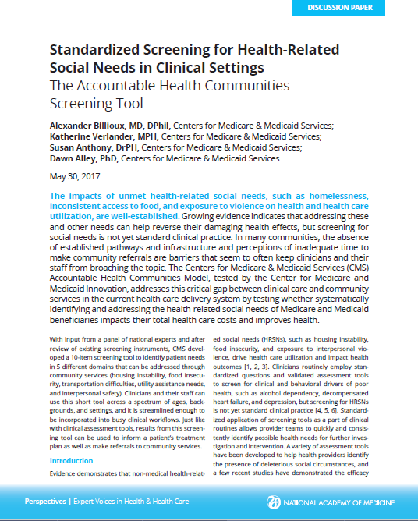

Slide 18
CMS HRSN Screening Tool Development
Process
Background research
Meetings with Technical Expert Panel
CMS finalization and permissions
Guiding principles for tool development:*
Consistently identify broad set of needs
Short, accessible, consistent, and inclusive
Evidence-based and practically informed
* Billioux, A., K. Verlander, S. Anthony, and D. Alley. 2017. Standardized screening for health-related social needs in clinical settings: The accountable health communities screening tool. Discussion Paper, National Academy of Medicine, Washington, DC. https://nam.edu/wp-content/uploads/2017/05/ Standardized-Screening-for-Health-Related-Social-Needs-in-Clinical-Settings.pdf .
18

Slide 19
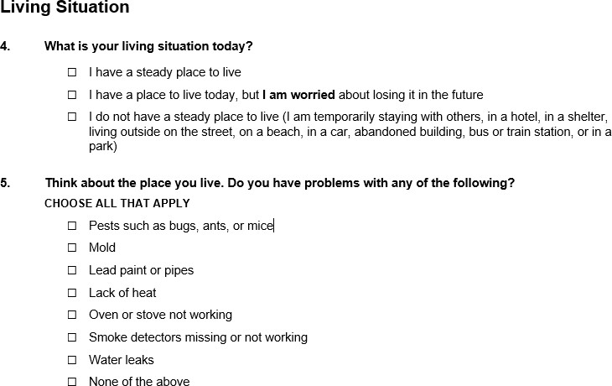
CMS HRSN Screening Tool

Slide 20
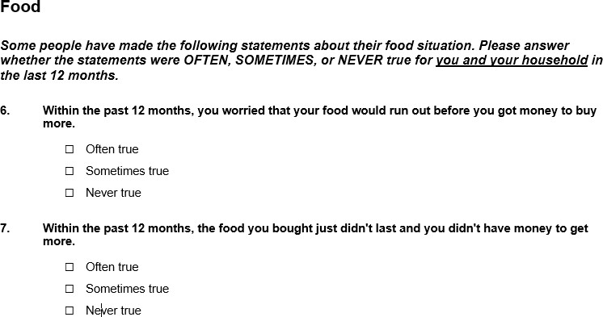
CMS HRSN Screening Tool

Slide 21
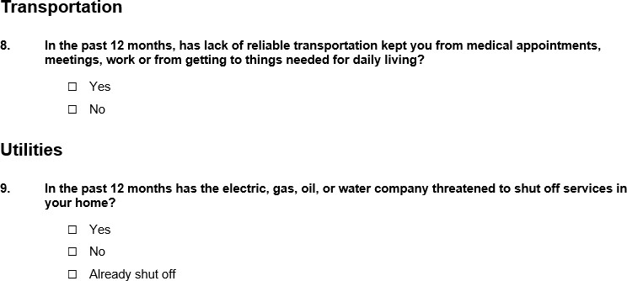
CMS HRSN Screening Tool

Slide 22
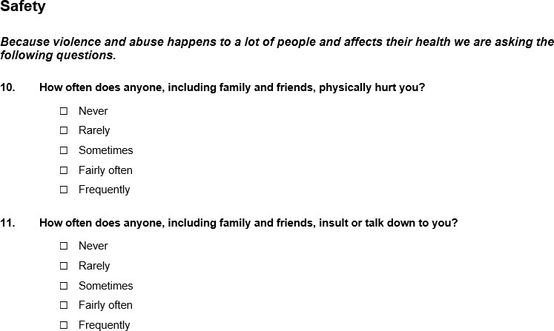
CMS HRSN Screening Tool

Slide 23
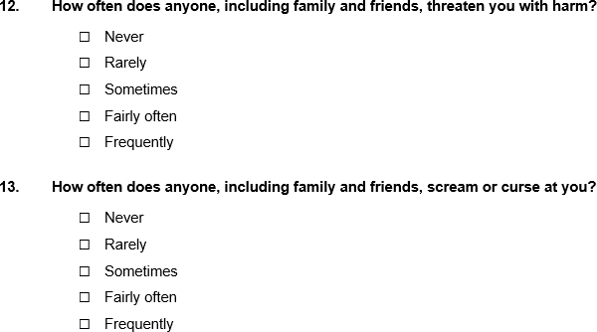
CMS HRSN Screening Tool

Slide 24
CMS HRSN Screening Tool
CMS is currently clearing questions recommended by the TEP for the following supplemental social need domains:
Financial Strain
Employment
Education
Family and Community Support
Physical Activity
Substance Use
Mental Health
Disabilities

Slide 25
Next Steps for the Tool
Assistance Track will begin implementing the tool in February 2018
Alignment Track will begin implementing in May 2018
CMS will monitor the use of the tool and solicit feedback from AHC award recipients
CMS will weigh evaluation impacts when considering any modifications to the tool

Slide 26


Slide 27
Important Accountable Health Community Model Web Links
For important updates and more information on the Accountable Health Communities Model visit: https://innovation.cms.gov/initiatives/ahcm

Slide 28
How to connect with SIREN
Website: Email: Twitter: LinkedIn:
sirenetwork.ucsf.edu siren@ucsf.edu @SIREN_UCSF
Social Interventions Research &
Evaluation Network @SIRENetwork
Facebook:
siren

