Slide 1



Exploring New Social Care Quality Measures: How Do We Define and Measure Social Needs and High-Quality Social
Care?
January 26, 3:00 to 4:00 p.m. ET
Please stand by--the webinar will begin shortly.
A grantee of the Robert Wood Johnson Foundation
https://sirenetwork.ucsf.edu/
www.shvs.org

Slide 2

Exploring New Social Care Quality Measures: How Do We Define and Measure Social Needs and High-Quality Social
Care?
January 26, 2023
A grantee of the Robert Wood Johnson Foundation
https://sirenetwork.ucsf.edu/
www.shvs.org

Slide 3

About State Health and Value Strategies
State Health and Value Strategies (SHVS) assists states in their efforts to transform health and healthcare by providing targeted technical assistance to state officials and agencies. The program is a grantee of the Robert Wood Johnson Foundation, led by staff at Princeton University’s School of Public and International Affairs. The program connects states with experts and peers to undertake healthcare transformation initiatives. By engaging state officials, the program provides lessons learned, highlights successful strategies, and brings together states with experts in the field. Learn more at www.shvs.org.
Questions? Email Heather Howard at heatherh@Princeton.edu.
Support for this webinar was provided by the Robert Wood Johnson Foundation. The views expressed here do not necessarily reflect the views of the Foundation.

Slide 4
About the Social Interventions Research & Evaluation Network (SIREN)
SIREN’s mission is to improve health and health equity by advancing high quality research on healthcare sector strategies to improve social conditions. To achieve this goal, SIREN funds, conducts, and translates research on policies, practices, and programs designed to better integrate health and social care services. The network also plays a national convening role to bring together diverse stakeholders investing in this field. SIREN is supported by Kaiser Permanente and the Robert Wood Johnson Foundation and housed at the Center for Health and Community at the University of California, San Francisco.
Learn more at https://sirenetwork.ucsf.edu/
Questions? Email SIREN at SIREN@ucsf.edu.

Slide 5
Housekeeping Details
All participant lines are muted. If at any time you would like to submit a question, please use the Q&A box.
After the webinar, the slides and a recording will be available at www.shvs.org and https://sirenetwork.ucsf.edu/.

Slide 6

Agenda
Introduction (5 mins)
Panelist Introductions and Presentations (20 mins)
Discussion (25 mins)
SIREN and SHVS | 6

Slide 7
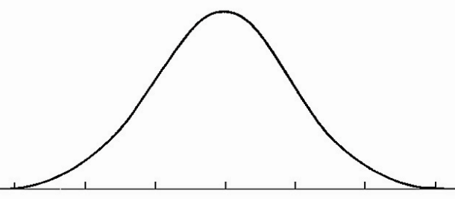







Introduction: The Bell Curve of Social Care Integration
Researchers
Policymakers
Early Adopters
siren

Slide 8
Introduction: The Bell Curve of Social Care Integration
Researchers
Policymakers
Early Adopters
siren

Slide 9

Introduction: Social Care Policymaking
Policymakers
QUALITY MEASURES
siren

Slide 10
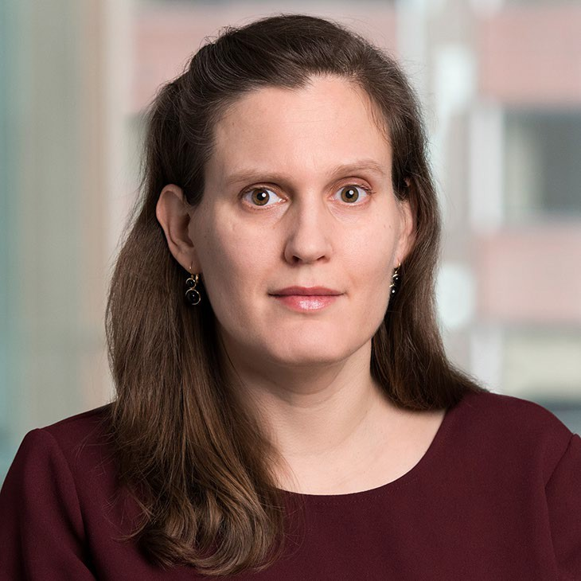


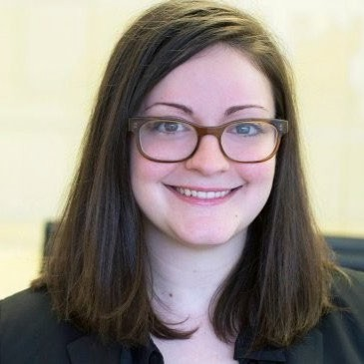
Today’s Panelists
Taressa Fraze, PhD Assistant Professor Department of Family and Community Medicine University of California, San Francisco
Emily Carrier, MD Senior Advisor Manatt Health
Chris DeMars, MPH Director, Delivery System Innovation Oregon Health Authority
Sarah Paliani, MPH Senior Research Associate
National Committee for Quality Assurance (NCQA)

Slide 11

Overview: NCQA
Agency/Org (program) | NCQA (HEDIS) | Details
Description | Social Need Screening and Intervention | % of members screened at least once for each domain. % of those with an identified need who received a corresponding intervention, by domain. Reported using electronic clinical data systems.
Population | All ages | All members continuously enrolled during the measurement period, excluding members in hospice, I-SNPs or long-term care.
Setting | Health plans | Medicare, Medicaid and commercial plans
Domains | Food, housing, & transportation security | Housing encompasses housing instability, homelessness or housing adequacy.
Intervention | Intervention by 30 days post screening | Intervention may include assistance, assessment, coordination, counseling, education, evaluation of eligibility, provision or referral.
Instruments | Pre-specified list of instruments | Gravity Project-identified instruments, with terminology available.

Slide 12
Overview: CMS Programs
Agency/Org (program) | CMS Programs | Details
Description | % of patients screened for 5 HRSN; some programs also include % of screened who screen positive for each risk | Measures are based on approach used in Accountable Health Communities intervention
Population | Adults 18+ who do not opt out of screening and who are able to (or have a guardian who is able to) complete the screen | Participants are expected to report data for their entire adult population, not only Medicare-enrolled individuals
Setting | MIPS: Eligible outpatient providers (voluntary) IQR: Hospitals (voluntary for 2023, mandatory for 2024) | MIPS programs require only screening; HIQR program also requires reporting of positive screens. Measures are under consideration for ESRD QIP, Inpatient Psychiatric Facility PPS and PPS-Exempt Cancer Hospital Quality Reporting Programs in current MUC cycle.

Slide 13
Overview: CMS Programs Continued
Agency/Org (program) | CMS Programs | Details
Domains | Food, housing, transportation, & utilities security and interpersonal violence | Because different screening programs may use varying instruments, type/degree of need captured by positive screen may vary as well
Intervention | None required | Measures capturing connection to a community service provider and resolution of at least one health need are under consideration for MIPS in the current MUC cycle
Instruments | None specified

Slide 14
Overview: Oregon Health Authority (OHA)
Agency/Org (program) | OHA | Details
Description | Coordinated care organization (CCO) self-attestation: screening, referrals, data collection; % screened, % positive, % positive who received a referral | Multi-year build-up to full population data collection. CCO self-attestation includes policy and practices for screening, referral, and data collection (starts year one). Quantitative data collection as sample with eventual move to full population (starts year two).
Population | All ages | Member with a CCO for 180 days or more
Setting | Health plans | CCO: Oregon’s Managed Medicaid Organizations
Domains | Food, housing, and transportation | Screening required for the three domains
Intervention | Referral | Does not require closed-loop referral
Instruments | Pre-specified list of screening instruments | Approved screenings by domain and age group

Slide 15
Overview: Three Quality Measure Sets
Agency/Org (program) | NCQA (HEDIS) | CMS IQR | Oregon Health Authority
Description | % of members screened at least once; % of those with need who received intervention, by domain | % of patients screened for 5 HRSN; % of screened who report risk | % of members screened, % positive, % positive who received a referral (multi-year phase-in)
Population | All ages | Adults 18+ | All ages
Setting | Health plans | IQR: Hospitals | Health plans
Domains | Food, housing, & transportation security | Food, housing, transportation, & utilities security and interpersonal violence | Food, housing & transportation
Intervention | Intervention by 30 days post screening (inc. referral) | None required | Referral
Instruments | Pre-specified list of screening instruments | None specified | Pre-specified list of screening instruments

Slide 16


Getting Started
--Be pragmatic
--What can you leverage?
--Where are your touch-points?

Slide 17

Scaffolding
--Increasing accountability over time with support and coaching

Slide 18

Delicate balance
--Resource intense for everyone
--Competing priorities

Slide 19
Discussion
Note that the slides and a recording of the webinar will be available at www.shvs.org and https://sirenetwork.ucsf.edu/ after the webinar.
SIREN and SHVS | 19

Slide 20
Thank You
Laura Gottlieb, MD, MPH
Co-director, Social Interventions Research and Evaluation Network (SIREN) Professor, Department of Family and Community Medicine
University of California, San Francisco https://sirenetwork.ucsf.edu/
Heather Howard, JD
Director
State Health and Value Strategies heatherh@Princeton.edu
609-258-9709
www.shvs.org
SIREN and SHVS | 20

