Slide 1


Social Needs Screening During Pediatric Emergency Department Visits:
Language Differences in Reported Needs
Natalie J Tedford, MD
Pediatric Emergency Medicine & Global Health Fellow
DIVISION OF PEDIATRIC EMERGENCY MEDICINE

Slide 2
Presenting Author Disclosure Information
I have no relevant financial relationships with the manufacturer(s) of any commercial product(s) and/or provider(s) of commercial services discussed in this CME activity.
Research Support:
AAP CATCH Implementation Grant 2021-22
NIH-funded R01 Grant Project #1R01NR019944-01 (PI −Wallace) 2021-2025
I do not intend to discuss an unapproved/investigative use of a commercial product/device in my presentation.
DIVISION OF PEDIATRIC EMERGENCY MEDICINE

Slide 3
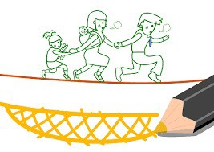
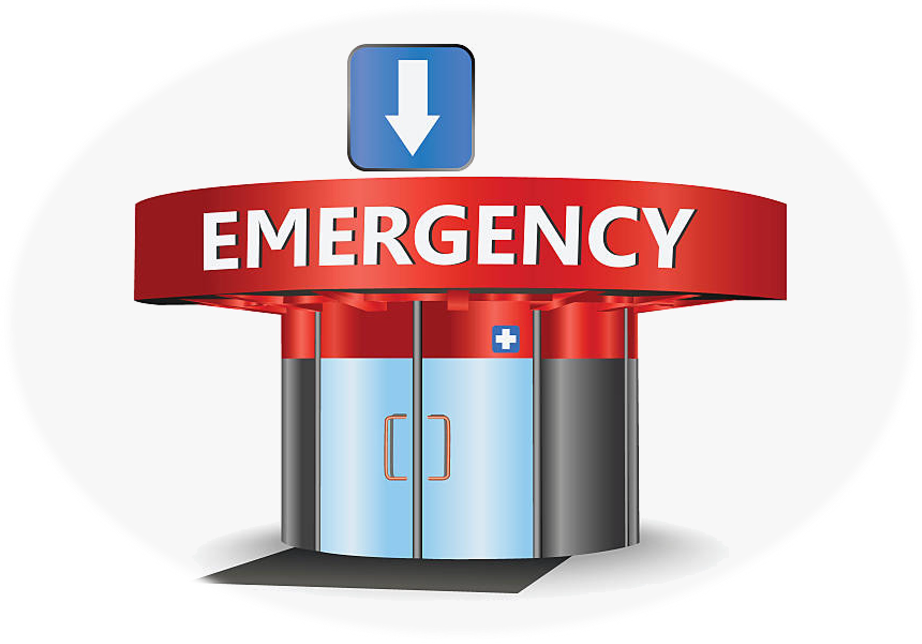
Background
https://www.istockphoto.com/vector/risk-guarantee-family-gm518780301-49293598 https://www.pngitem.com/middle/iohwhxR_emergency-building-vector-art-illustration-transparent-clip-art/
DIVISION OF PEDIATRIC EMERGENCY MEDICINE

Slide 4
Objectives
What is the prevalence of unmet social needs (USN) in our pediatric emergency department (PED) patient population?
What are the disparities and differences in USN by self-selected language and patient demographics?

Slide 5
Methods
Cross-sectional, descriptive analysis
Of a convenience sample of English- & Spanish-speaking caregivers Who completed the p-SINCERE survey
@ the University of Utah | Primary Children’s Hospital Emergency Department

Slide 6
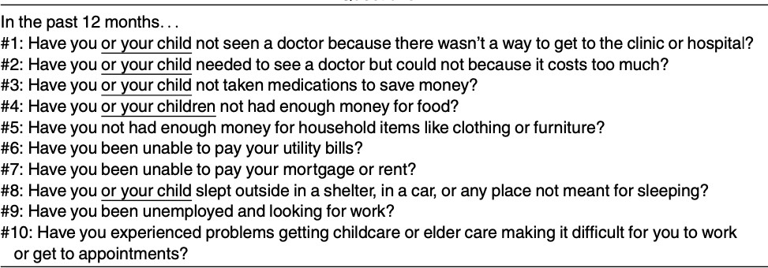
p-SINCERE Questions

Slide 7
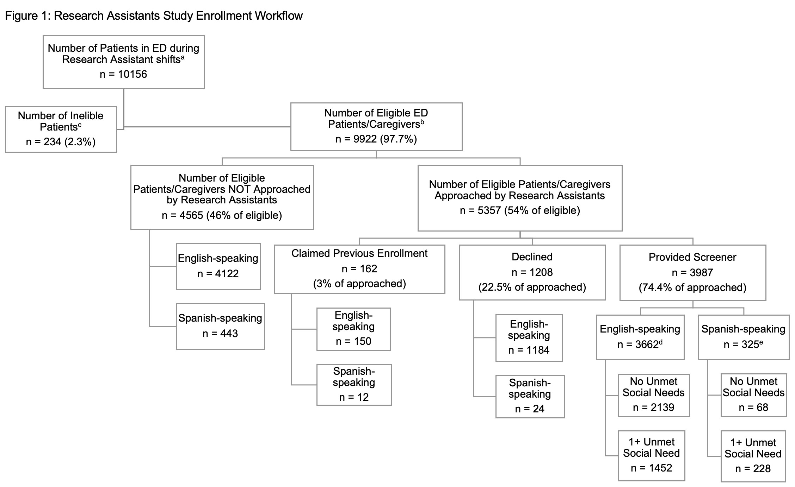
Results

Slide 8
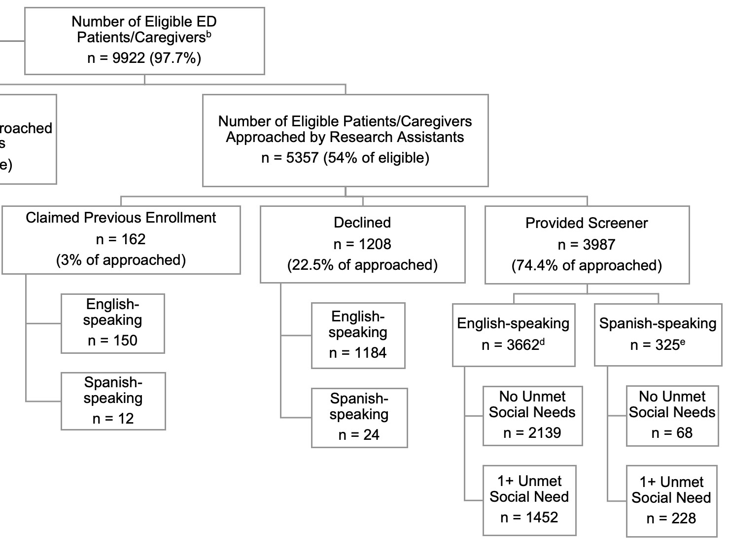
Results

Slide 9




Results
ENGLISH-SPEAKING CAREGIVERS (N=3662)
SPANISH-SPEAKING CAREGIVERS (N=325)
At least 1 USN 40%
At least 1 USN 70%

Slide 10
Reported “YES” on p-SINCERE
English
40.0%
35.0%
Spanish
30.0%
25.0%
20.0%
15.0%
10.0%
5.0%
0.0%
#1
#2
#3
#4
#5
#6
#7
#8
#9
#10

Slide 11
Reported “Decline to Answer” on p-SINCERE
English
20.0%
18.0%
Spanish
16.0%
14.0%
12.0%
10.0%
8.0%
6.0%
4.0%
2.0%
0.0%
#1
#2
#3
#4
#5
#6
#7
#8
#9
#10

Slide 12
Conclusions
Screening for social needs in our PED revealed:
  Significant levels of unmet social needs
  Disparities related to:
    Caregiver’s language preference
    Racial/ethnic identity of child
    Insurance status of child
  Differences in how English- & Spanish-speaking caregivers responded to our screener

Slide 13
Next Steps
Focus group investigation to:
  Gather qualitative information on differences observed between English- & Spanish-speaking caregivers
  Validate: p–SINCERE screener and Spanish translated tool
Implementation work to increased PED social needs screening and linkage to community resources

Slide 14
References
For more information on this subject, see the following publications:
Tedford NJ, Keating EM, Ou Z, Holsti M, Wallace AS, Robison JA. Social Needs Screening During Pediatric Emergency Department Visits: Disparities in Unmet Social Needs. Acad Pediatr. 2022 May 7:S1876-2859(22)00236-4. doi: 10.1016/j.acap.2022.05.002. Epub ahead of print. PMID: 35537675.
Wallace AS, Luther BL, Sisler SM, Wong B, Guo JW. Integrating social determinants of health screening and referral during routine emergency department care: evaluation of reach and implementation challenges. Implement Sci Commun. 2021 Oct 7;2(1):114. doi: 10.1186/s43058-021-00212-y. PMID: 34620248; PMCID: PMC8499465.
Wallace AS, Luther B, Guo JW, Wang CY, Sisler S, Wong B. Implementing a Social Determinants Screening and Referral Infrastructure During Routine Emergency Department Visits, Utah, 2017-2018. Prev Chronic Dis. 2020 Jun 18;17:E45. doi: 10.5888/pcd17.190339. PMID: 32553071; PMCID: PMC7316417.
Guo JW, Wallace AS, Luther BL, Wong B. Psychometric Evaluation of the Screener for Intensifying Community Referrals for Health. Eval Health Prof. 2021 Jul 8:1632787211029360. doi: 10.1177/01632787211029360. Epub ahead of print. PMID: 34235988; PMCID: PMC8741833.
Lowe JT, Monteiro KA, Zonfrillo MR. Disparities in Pediatric Emergency Department Length of Stay and Utilization Associated With Primary Language. Pediatr Emerg Care. 2022 Apr 1;38(4):e1192-e1197. doi: 10.1097/PEC.0000000000002545. PMID: 34570076.
Gottlieb L, Hessler D, Long D, Amaya A, Adler N. A randomized trial on screening for social determinants of health: the iScreen study.
Pediatrics. 2014 Dec;134(6):e1611-8. doi: 10.1542/peds.2014-1439. Epub 2014 Nov 3. PMID: 25367545.
Flores G, Abreu M, Tomany-Korman SC. Limited english proficiency, primary language at home, and disparities in children's health care: how language barriers are measured matters. Public Health Rep. 2005 Jul-Aug;120(4):418-30. doi: 10.1177/003335490512000409. PMID: 16025722; PMCID: PMC1497749.

Slide 15
Thank you!
Questions?
Please feel free to contact me at: natalie.tedford@hsc.utah.edu

