Slide 1


The Importance of Policy Assessment to Dismantle the Impact of Racism on Availability and Effectiveness of Social Care
Nefertiti OjiNjideka Hemphill, PhD, MS
Muhammad Khanan Chaudhry, BA

Slide 2
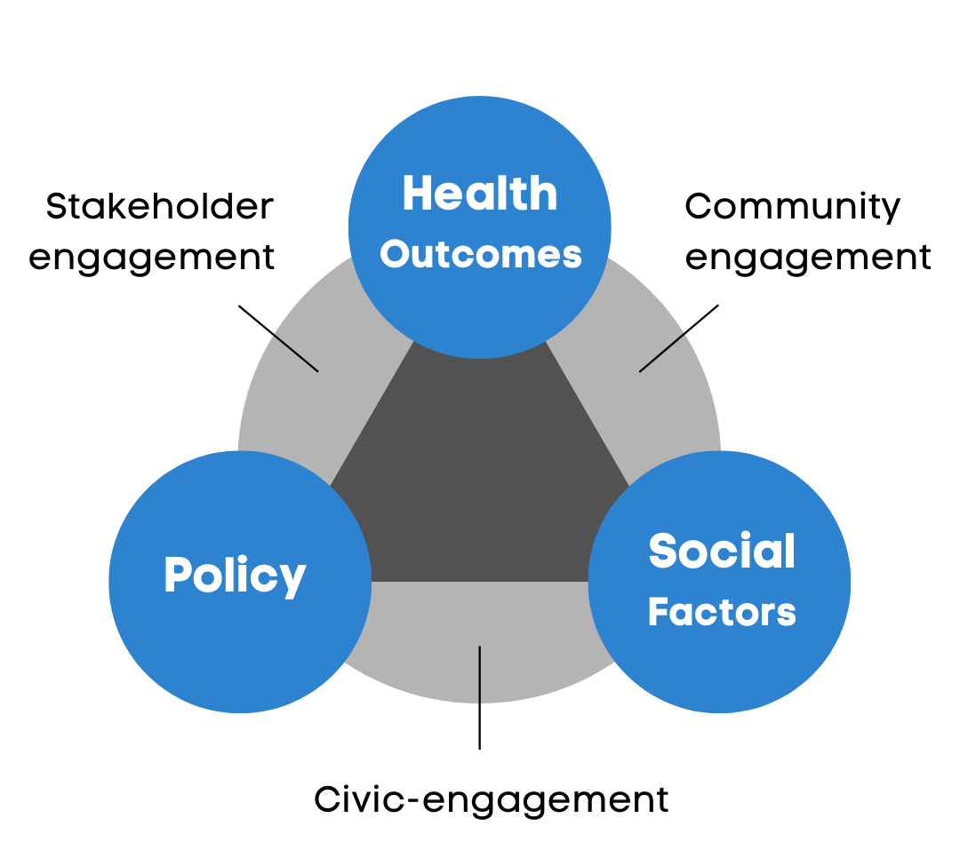
Policy & Public Health

Slide 3
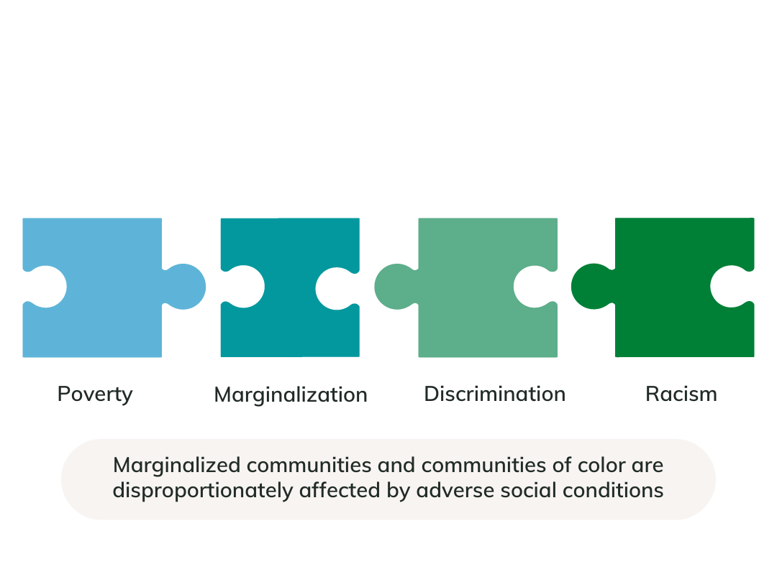
Social Conditions

Slide 4
Mental Health within Communities of Color
Impact of negative social conditions on mental health:
Black youth suicide rates rose by 30% from 2014-2019 (Ramchand et al., 2021).
AAPI women between the ages of 65-84 have the highest rates of suicide among any racial group (Liu et al., 2022)
Approximately 13.7% of Native Hawaiian adults living in Hawaii met the diagnostic criteria for depressive disorders (González et al., 2010).
Across religious groups, 7.9% of Muslim (n=809), 5.1% of Protestant (n=314), 6.1% of Catholic (n=245), and 3.6% of Jewish (n=415) respondents reported an lifetime suicide attempt (Awaad et al., 2021).

Slide 5

Factors Influencing Mental Health
Exposures
Examples include: Poverty Violence Media Discrimination Racism Poor access to care
Risk Factors
Protective Factors
Examples include:
Adverse childhood events
Trauma
Poor family support
Bullying
Seclusion
Examples include:
Self-esteem
Strong family support
Belonging
Social awareness
Positive ethnic identity

Slide 6


What is Policy?
A law, regulation, procedure, administrative action, incentive or voluntary practice of governments and other institutions. Within the context of public health, policy development includes advancing and implementing public health law, regulations, or voluntary practices that influence systems development, organizations change, and individual behavior to promote improvements in health.

Slide 7
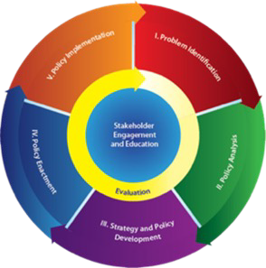
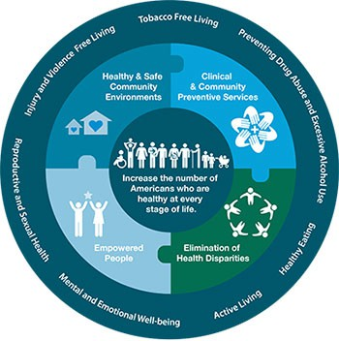
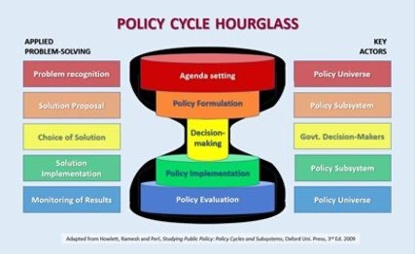
Current Policy Frameworks
Policy Cycle Hourglass
CDC Policy Process Cycle
CDC Health in All Policies

Slide 8
Policy Evaluation vs. Assessment
Policy evaluation is NOT the same as policy assessment
Policy Evaluation
Evaluation determines whether a policy does what it was designed to do
For example, does a red-light traffic law reduce the number of accidents in a neighborhood area
Policy Assessment
Assessing the impact of a policy on specific outcome
For example, does a red-light traffic law impact a specific health outcome such as mental health in a neighborhood area
Current policy frameworks are evaluation tools and are not designed for policy assessment

Slide 9
Our Policy Framework Model for BYMH
In conjunction with the U.S. Department of Health & Human Services Office of Minority Health:
We developed the Black Youth Mental Health (BYMH) Policy Assessment Framework Model and BYMH Policy Assessment Tool for Promoting Behavioral Health Among Black Youth.
Both the model and tool are designed to address the gaps of other policy frameworks as it relates to mental wellness among Black youth.
Draft model currently under review.

Slide 10
Our Policy Assessment Tool for BYMH
The BYMH Policy Assessment Tool is comprised of three phases:
Phase 1: Policy Identification
Identify the relevant policy
Phase 2: Policy Assessment
Appraisal
Scoring
Feasibility
Phase 3: Strategic Reform & Implementation
Develop a Strategy for Policy Reform & Implementation
BYMH Policy Assessment Tool for Promoting Behavioral Health Among Black Youth developed for U.S. Department of Health & Human Services Office of Minority Health in conjunction with ATW Health Solutions.
Draft tool under review.

Slide 11
Conclusion
The policy assessment process can be used to examine the impact of policies on marginalized communities and those hardest hit by health disparities
Researchers play an important role in policy assessment by generating evidence to understand a policy’s impact
Partnering with marginalized communities and communities of color is an essential component of effective policy assessment and research

Slide 12


Thank you!
Let’s Stay in Touch
Nefertiti OjiNjideka Hemphill, PhD, MS
Nefertiti.O.Hemphill@atwhealth.com
Khanan Chaudhry, BA
Khanan.Chaudhry@atwhealth.com
312.858.6800 (phone)
312.858.7464 (fax)
www.atwhealth.com (web)
™

Slide 13






About ATW Health Solutions
”Raising Healthcare’s Standard through quality, safety and health equity.”
™
Quality Improvement and Healthcare Transformation
Person and Family Engagement / Stakeholder Engagement / Consumer Engagement
Disparities and Health Equity
Education / Learning and Dissemination
Health Services, Payers, Systems and Delivery

Slide 14
References
Awaad, R., El-Gabalawy, O., Jackson-Shaheed, E., Zia, B., Keshavarzi, H., Mogahed, D., & Altalib, H. (2021, July 21). Suicide Attempts of Muslims Compared With Other Religious Groups in the US. Jama Network. Retrieved September 15, 2022, from https://jamanetwork.com/journals/jamapsychiatry/article-abstract/2782161
González, H. M., Tarraf, W., Whitfield, K. E., & Vega, W. A. (2010). The epidemiology of major depression and ethnicity in the United States. Journal of psychiatric research, 44(15), 1043–1051. https://doi.org/10.1016/j.jpsychires.2010.03.017
Liu, C. Z., Wang, E., Nguyen, D., Sun, M. D., & Jumreornvong, O. (2022). The Model Minority Myth, Data Aggregation, and the Role of Medical Schools in Combating Anti-Asian Sentiment. Academic medicine : journal of the Association of American Medical Colleges, 97(6), 797–803.
Ramchand, R., Gordon, J. A., & Pearson, J. L. (2021). Trends in Suicide Rates by Race and Ethnicity in the United States. JAMA network open, 4(5), e2111563. https://doi.org/10.1001/jamanetworkopen.2021.11563

