Slide 1



The Health Equity Assessment Tool(HEAT)
A standardized tool to objectively assess the health equity impact of health transformation interventions
Nicole Pereira, MPH
Blue Shield of California
Presentation for SIREN National Research Meeting: Racial Heath Equity in Social Care

Slide 2











































































We are transforming the healthcare system
Shared Decision Making
Payment Models
Community Health Advocates
Pharmacy Care
Real Time Claims Settlement
Behavioral Health
Health @ ‘home’
yer
Advanced Analytics
Virtual Care
Integrated Medical Record
Health Reimagined
Enterprise Transformation
Technology Infrastructure
Blue Shield of California
2

Slide 3
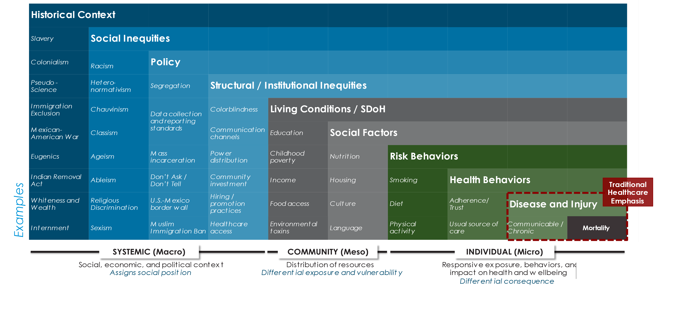
Health equity is a crucial part of our strategy
Drivers of Health Equity
Historical realities to contemporary health injustices
Sources: CDPH, OHE,WHO, Socioecological Model, and BAR HII Conceptual Framework
Blue Shield of California
3

Slide 4




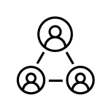







Developing the Health Equity Assessment Tool
Why did we develop the Health Equity Assessment Tool (HEAT)?
To address health inequities across and within CA communities
To measure progress towards building health equity into design, implementation, and evaluation
To track health equity impact across time and broadly throughout the organization
What informed the HEAT design?
Review of peer-reviewed and grey literature
How will we administer the HEAT?
Questionnaire with intervention implementation and design teams
Additional data collection for the HEAT
Internal and external subject matter experts
Designed to be implemented at least twice during an intervention
Refinement from testing with stakeholders
Implementation
Follow-up (full) HEAT
Target audience: Intervention team
Content: 6 domains, 15 Likert response questions
Analysis: Weighted average domain score
Design
Initial (pre) HEAT
Target audience: Intervention team
Content: 4 domains, 11 Likert response questions
Analysis: No score at this phase
Post-Implementation
Follow-up (full) HEAT
Target audience: Intervention team
Content: 6 domains, 15 Likert response questions
Analysis: Weighted average domain score
Blue Shield of California

Slide 5
Domains and indicators in the Health Equity Assessment Tool
Domain
Definition
Indicator
Assess the intervention’s relationship to Blue Shield’s overall health equity approach
1-1
Engagement and application
1-2 Quality of application of
1
of elements of Blue Shield’s health
the Health Equity Action Lens
Getting Rooted
equity approach (e.g., the HEAL framework)
framework
Assess the data informing design and implementation and the data collected through the intervention that would enable measurement of impact on health equity
2-1
Collection of race/ethnicity
2-2
Collection of additional
2-3
Consideration of potential biases
2-4
Tracking members
data related to the intervention
patient- or community-level
in data collected and extent to which
exposed to the
2
Using Data
data to inform health equity or impacts of the intervention for different groups
alternate sources are explored
intervention, including demographic data
Assess how much the
3-1
Specification of an explicit
3-2
Identification of who is
3
Reducing Inequities: Process
intervention aims to reduce purpose of addressing inequities or
included/excluded from the
racial/ethnic and other inequities a way to ensure that the
intervention and efforts to "over" sample or target resources to specific groups
intervention does not create or perpetuate disparities
Reducing
Assess the degree to which the intervention has different
4-1 Observed differences in outcomes within and between
4-2 Evidence of narrowing equity gaps
₄ Inequities:
_{Impact} impacts on different subgroups subgroups at micro, meso, and
macro levels
Domain 4 not included in Pre-HEAT
Integrating
Assess how the intervention
5-1 Individuals who experience 5-2 Input from the groups
5
Diverse Perspectives: Engagement
incorporates insights from those with lived experiences related to inequities
inequities engaged in intervention
experiencing inequities
implementation and evaluation phases
incorporated in each phase
Integrating
Assess how findings are shared
6-1 Stakeholders engaged via a 6-2 Evidence of including
Domain 6 not included in Pre-HEAT
6-3 Feedback process to improve
_{6 Pe} Diverse _{s:} and with whom mechanism that facilitates greatest health equity learnings in an identification of stakeholders and
rspective access (e.g., webinars, listserv evaluation deliverable (i.e., communication approaches
^{Dissemination} messages, etc.) brief/deck)
Blue Shield of California

Slide 6





Health Equity Assessment Tool dashboard example
Intervention Name | Health Reimagined Initiative
Practice/Site and Location | Urban area in Southern and Northern CA Testing Phase (6mo, 1 year, 2 years?)
How long was the intervention implemented before the HEAT was applied?
intervention X’s weighted HEAT score
0%
100%
69%
Domain | Definition |  | How did intervention X address this domain? | Interpreting intervention X’s HEAT Score
1. Getting Rooted | How did the intervention assess the intervention’s relationship to Blue Shield’s overall health equity approach? |  | 3 | The overall score shows that health equity principles are integrated in your intervention.
2. Using Data | What data did the intervention team use to inform design and implementation and did the intervention collect data that would enable measurement of impact on health equity? |  | 2.8 | Key Performance Drivers
3. Reducing Inequities: Process | How did the intervention aim to reduce inequities? |  | 3 | This intervention’s overall score was strengthened by achievements in the areas of Domains 1, 2, and 3. The intervention performed particularly strongly due to the data collected to measure the intervention’s impact on
4. Reducing Inequities: Impact | What was the intervention’s impact on different subgroups? |  | 1.5 | health equity, integration of stakeholders and data to understand the problem(Domain1) and processes to measure impact(Domain 3)
5. Integrating Diverse Perspectives: Engagement | How did the intervention incorporate insights from those with lived experiences related to inequities? |  | 2 | Key areas for improvement include Domains 4, and 6. The intervention would benefit from increasing opportunities to share learning with
6. Integrating Diverse Perspectives: Dissemination | How were findings shared and with whom? |  | 1 | this domain.
community partners. See the following slides for specific tips to strengthen
Heat Map Color Key:
Health equity principles are…
0-33%
34-66%
67-100%
Absent
Emergent
Integrated
Note: Domains are weighted to give slight weight to domains 2, 3, and 4
Blue Shield of California

Slide 7
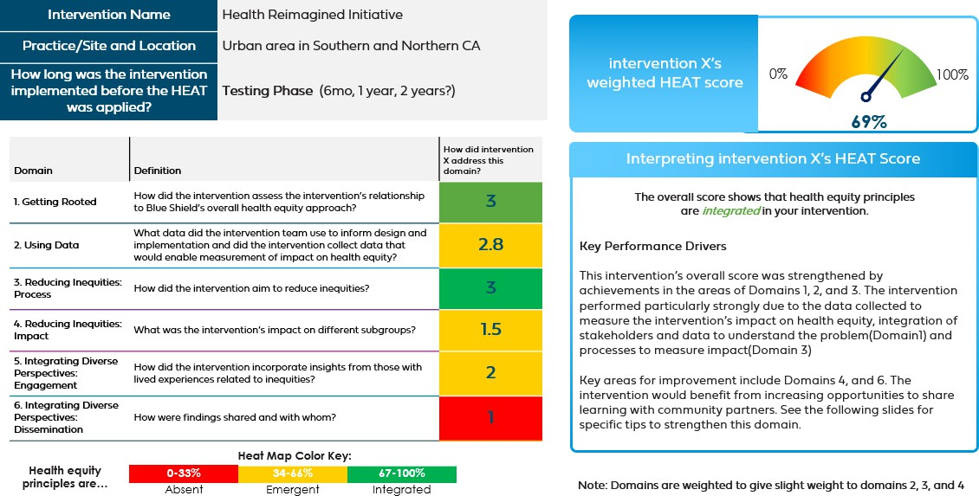
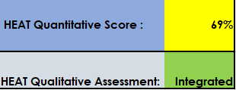
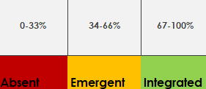
Breaking down the content of the dashboard
Context of the intervention and the phase of development
Responses to Likert-scale questions comprise the domain scores
Average all domain scores
Weight average scores to create an overall score
Interpret the score – percent distribution and qualitative assessment
Develop feedback content for communication
Blue Shield of California

Slide 8
Considerations for application
At any stage of an intervention, the Health Equity Assessment Tool is framed as a collaborative learning tool to advance health equity principles and assess progress towards those principles
  Avoid framing as a test that interventions must “pass”
Organizations/researchers looking to develop their own health equity measurement tools should consider:
Applicability of domains and elements of the Health Equity Assessment Tool
The intended audience for sharing results
Integrating perspectives from partners & community members
Accountability for results/information gleaned from the tool
Blue Shield of California

Slide 9

Questions?

Slide 10
Thank you

Slide 11
Contact
HEAT team contact information:
Nicole Pereira – Nicole.Pereira@blueshieldca.com Sara Pittman – Sara.Pittman@blueshieldca.com
Krystal Johnson– Krystal.Johnson@blueshieldca.com
Authors: Eva Durazo, PhD, MPH; Sara Pittman, MPH; Nicole Pereira, MPH; Krystal Johnson, MA, PhD; Eden Mussie, MBA; Shannon Cosgrove, MHA; Baylis Beard, MBA; Jackie Ejuwa, PharmD, MHL; Mahima Ashok, PhD, MS
Blue Shield of California

Slide 12
Disclosures
The authors are all employees of Blue Shield of California.
There are no other financial disclosures to report.
HEAT represents Health Equity Assessment Tool in this deck.
Blue Shield of California

Slide 13

Blue Shield of California is an independent member of the Blue Shield Association

