Slide 1


Uncovering intersecting forms of discrimination during a social risk screening and care program in Rhode Island
Elizabeth Pfeiffer and Sara Mendez, Rhode Island College
SIREN National Research Meeting
September 15, 2022, Zoom Meeting
Proprietary & Confidential | Not for Distribution

Slide 2

Background & Setting:
Providence, Rhode Island
43.3% Hispanic
33.1% White/not Hispanic
16.8% Black
6% Asian
4.7% More than one ethnicity
Large immigrant community
28.73% of residents born outside US 48% of households Spanish-speaking

Slide 3
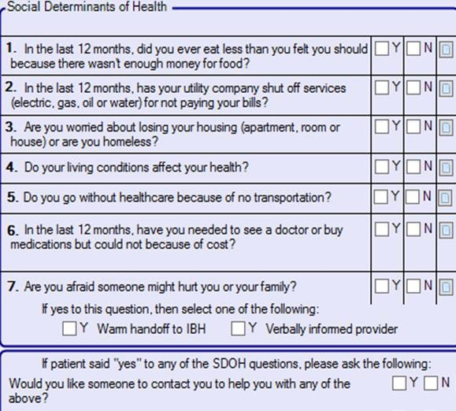
Background & Setting:
PCHC Patient Demographics (N=60,000)
39% White
15% Black
3% Asian
14% more than one ethnicity 28% not reported
49% speak language other than English as
their primary language
65% are under the 200% poverty level &
65% on Medicaid
39,730 patients screened for social needs; with 10% having unmet social needs and 36% of patients accepting assistance

Slide 4
Research Objective and Aims:
To explore, understand, and describe why it is that people who report social risks during clinic screenings but decline social care assistance—from the perspectives of:
Patients;
Staff; and
Social Care Providers

Slide 5
(Remote) Methods (2020-2021)
Telephonic Phone Interviews with 26 Patients
Zoom Focus Groups with 6 Patients and 8 Clinic Staff Zoom Focus Group with Leaders of Social Service Agencies
Participant Characteristics (N=42)
32 Patients: 24 Female; 8 Spanish Speaking; 22 Declined Assistance
8 Staff Members: 7 Female; 7 Latina and 1 Black/African
2 Social Care Service Agency Leaders: White females

Slide 6
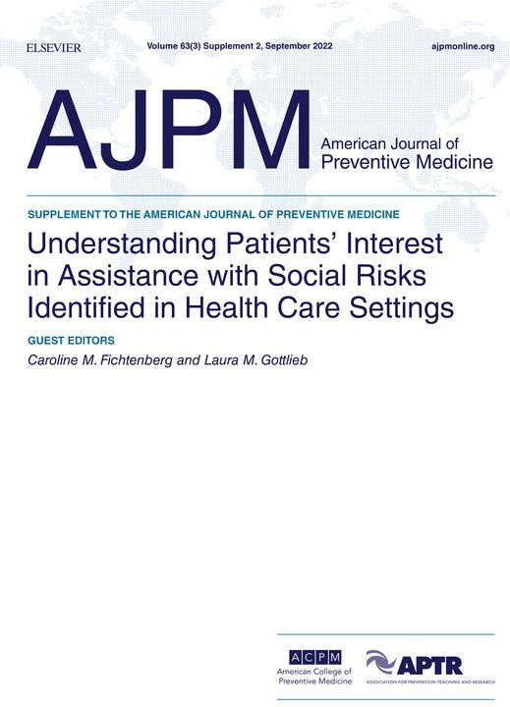
THEMES: Why do patients’
decline social assistance?
Wording of questions & Time Constraints; Patient knowledge of limited resources; Lack of understanding;
Shame/Pride; Fear/Mistrust; and
Stigma & Discrimination

Slide 7
To explore, in greater depth, how racism—
or discrimination enacted
towards people because of culture, language, or legal/immigration status—shaped experiences with and perceptions of the screening and social care program and identify potential ways that it inadvertently reproduced inequalities and various forms of racism.
Participant Characteristics
(N=42)—Secondary Analysis: How does racism and racialized disadvantage impact social care?
32 Patients: 24 Female; 8 Spanish Speaking; 22 Declined Assistance
8 Staff Members: 7 Female; 7 Latina and 1 Black/African
2 Social Care Service Agency Leaders: White females
Racial Equity Lens

Slide 8
To explore, in greater depth, how racism—
or discrimination enacted
towards people because of culture, language, or legal/immigration status—shaped experiences with and perceptions of the screening and social care program and identify potential ways that it inadvertently reproduced inequalities and various forms of racism.
As we discuss these data, please take notes of the possible ways that social risk screening and social care programs might change to ensure racial equity.
Racial Equity Lens

Slide 9
Individual Racial Stigma and Discrimination
“The way that they treat people [who request social care] …it really, really, hurts people's feelings. I mean, when you [an] immigrant you feel down when someone discriminate[s] your race and
your language, you know… You know, what happens is when people go to ask for even an application they- the person who's at the front
desk-- they also talk to you with body language. This is what I feel
when I went to places like that, with another person for translation or help. They [staff] are acting up with body language [that says], ‘What are you doing here?’”
– 58 year old, Spanish speaking female

Slide 10
Institutional Discrimination: Language & Translations
"They're [the social risk screening questions] really hard for our patients to understand, especially …people that have a language barrier...it's not just asking questions, it's explaining what the question mean[s]." – Staff Member Focus Group Participant
“I think it [the social risk screening tool] should be translated in the language [dialects] …[so that] we have the exact verbiage to us because you know I’m Puerto Rican, so my Spanish is …like not fancy Spanish. So, I think we all have a different understanding of the language so in order for us to not run into issues it'd be nice to have an already…have an option to read it in [different dialects of] Spanish.” –Staff Member Focus Group Participant
"I was pretty much told the verbiage is not going to change because it's tied into paperwork that brings in money. So those questions are money-related, not people related." – Staff Member Focus Group Participant
The social risk screening tool—used in a clinic setting with time constraints—discriminates against patients whose first language is anything other than English because it disregards problems with translations and differences in dialects that make it difficult to ensure that patients understand.

Slide 11
Structural Racism: Qualifying for Social Care
[Patients who are] "undocumented and uninsured...don't qualify to apply for public housing or
Section 8."
"Just like specific to our [clinic] community. Like, you know, we're dealing with predominantly the underserved community and predominately black and brown bodies. And also, a lot of like undocumented or the legal status is like unofficial. So, they are … sometimes when you ask these probing questions, it could turn them off from actually having a need [and wanting help with it]."
“A huge problem I ran into, or I’ve run into all the time as these questions are being asked to someone that is undocumented and uninsured, right? So now you're asking about Housing Um… yeah you're asking about housing to a person that has been struggling with housing since they've been in this country. And now you need to tell them that they don't qualify to apply for public housing or Section 8. And now I’m calling you and I have to …you screen them, so that I could tell
them the bad news… again. That you don’t qualify for housing, but… I bet you knew that already!.”

Slide 12
Structural Racism: Qualifying for Social Care
[Patients] "don't qualify for Section 8 if [they] have a criminal record."
“Another thing that we have a big problem, and I don't even know if this is going to ever be resolved nation-wide. Is with the people that are released from jail. There's a lot of people that are incarcerated and the reason why they have been incarcerated is not necessarily something that… it was a misunderstanding, something, and then that follows them for life! …So I used to see a lot of
patients …a lot of them had criminal history, so you will hear all kinds of stuff. All kinds of stuff. So, I had one that was not qualifying for housing because he beat up this man that was trying to abuse his daughter. And because he was trying to defend his daughter he now doesn't qualify for housing. So, he was living off his car. … But, I'm really concerned about people that [were] in prison”.
–Staff Member, Focus Group 2
Requirements to qualify for the social care programs exclude patients that are undocumented,
uninsured, and have a history of incarceration.
  Black and Hispanic populations are overrepresented in RI jails and prisons, according to the RI department of correction and US 2020 census data.

Slide 13
Structural Racism: Housing & Gentrification
"But we all know that there's still such a shortage of housing, you know and with the College kids coming back...what little that was out there is dried up because landlords made sure they raised the rent so high that the locals can't get the apartments but the college kids can...I still would rather see the permanent residents get some decent housing and not be priced out of the housing."
Rhode Island, much like other parts of
the country, is facing a housing crisis.
College students from a
local private university, often seek off-campus housing in the Providence area.
People worried that their neighborhoods are facing gentrification, which research suggests especially disadvantages and negatively impacts communities of color (Hwang and Ding 2020).

Slide 14
Availability of Resources
"What's in the food box...folks in the Hispanic community, they don't like a lot of canned goods...it's a child box with macaroni and cheese, peanut butter and jelly."
"...I am asking if you have had problem eating in the last 12 months…the reality is yes! I have been eating-- my refrigerator is full-- but not with what I need if I have diabetes!"
Resource availability is incompatible
with the social and health-related needs of patients.
  The populations receiving the food donations do not typically eat or enjoy this kind of food.
  Moreover, the food given out is not beneficial for people with health risks. According to the American Diabetes Association, diabetes is more prevalent in Black and Hispanic populations.

Slide 15
American Ideologies, Beliefs, & Assumptions
"They didn’t have anything and that's why we’ll come back tomorrow like she said. Okay, I'm starving today but I'll see where else I can go. And then, if you go to too many places they're like oh, weren’t you at such and such or, you know. So it's like are you trying to beat the
system by going to all the different places? No, I'm trying to get enough food so my family can eat...you don't want your face to be seen too often because then they go back to this, oh here
she comes again type thing. Like, people want to go shopping at a food bank- nobody wants to go shopping at a food bank. They go because they need the food, because if you have money to really go shopping you wouldn't be there.“ –Black Focus Group Participant
Patients felt as though they were being judged and shamed by the staff for seeking out help. Staff imply that patients are trying to overuse their resources.
American culture values individualism to the point of shaming and blaming others
for utilizing the government assistance that they need.

Slide 16
These data demonstrate that social care is
impacted by …
racism that intersects with other forms of discrimination, including language, socioeconomic, immigration, and legal statuses.
Our data suggest that various forms of racism were built into the social risk screening and care programs in both direct and indirect ways and thus inadvertently reproduced the social determinants of health, such as poverty, discrimination, interactions with biomedical and social service agency professionals, and equal access to safe housing, transportation, food security, and quality healthcare in the US.

Slide 17
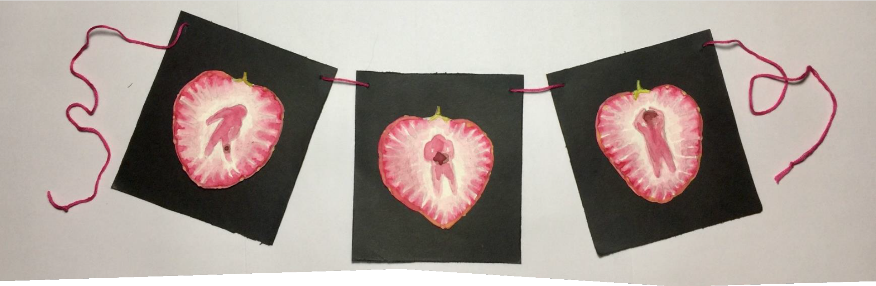

Uncovering intersecting forms of discrimination during a social risk screening and care program in Rhode Island
Special thanks to our study participants, PCHC, and SIREN, with funding from the Robert Wood Johnson Foundation for supporting this work!
Elizabeth Pfeiffer and Sara Mendez
“Violence and the Social Determinants of Health.” Artwork by Andrea
Van Dexter, Medical Anthropology Student, RIC

Slide 18
Suggestions for Reducing Racial Discrimination in Social Care
Policies at the federal level to change wording of questions
Cultural & structural changes
Democratic participation- going out into the community and asking what resources people actually want/need
Training staff to be more mindful of bias and body language
Other Suggestions?

Slide 19
References Cited
American Diabetes Association. Statistics About Diabetes. https://diabetes.org/about-us/statistics/about-diabetes#sthash.F8fRkPqd.dpuf#:~:text=Diabetes%20by%20Race%2FEthnicity.%20The%20rates%20of%20diag nosed%20diabetes,of%20non-Hispanic%20blacks.%2015.1%25%20of%20American%20Indians%2FAlaskan%20Natives. Published 2022.
Hwang, Jackelyn and Lei Ding. “Unequal Displacement.” American Journal of Sociology 126:2. Published 2020.
State of Rhode Island, Department of Corrections. Planning and Research Unit. https://doc.ri.gov/news-info/research-data#:~:text=What%20is%20the%20racial%20breakdown,race%20rather%20than%20an%20ethnicity. Published 2022.
US Census Bureau. QuickFacts: Providence City, Rhode Island. https://www.census.gov/quickfacts/providencecityrhodeisland#qf-headnote-a. Published 2021.
US Census Bureau. Rhode Island: 2020 Census. https://www.census.gov/library/stories/state-by-state/rhode-island-population-change-between-census-decade.html. Published 2021.

