Slide 1


Using human-centered design principles to enhance cross-sector partnerships that address the social drivers of health
2022 National Research Meeting

Slide 2
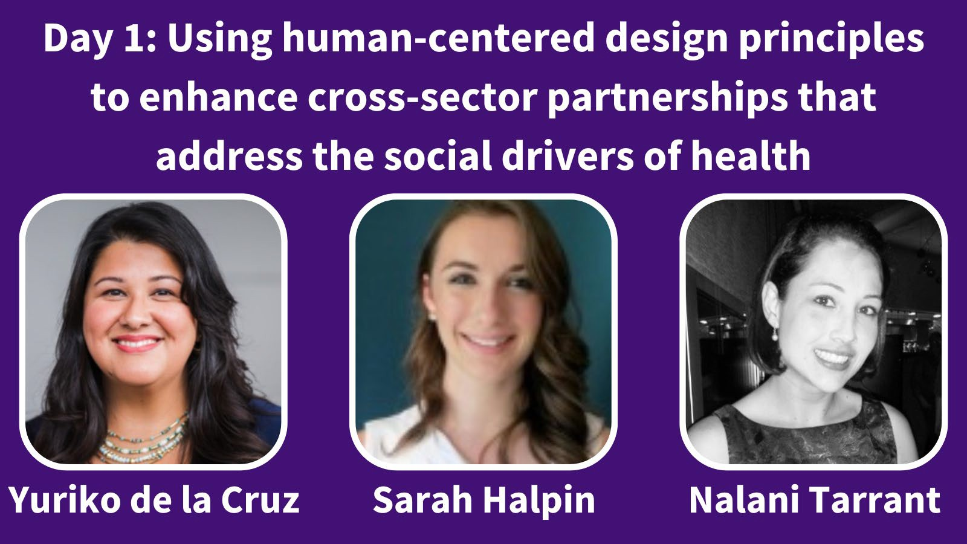
2022 National Research Meeting

Slide 3
Agreements for a safe and brave meeting
Practice active, judgement-free, and empathetic listening
Respect each other’s differences and backgrounds
Agree to disagree – but seek understanding. We are here to learn!
Honor the difference between unsafe and uncomfortable
Be curious about intentions but recognize that impact is more important than intentions
Welcome being called in as a gift and an invitation to learn
Be mindful of positionality and power dynamics
Acknowledge judgments and assumptions (including our own – we all have biases)
Use inclusive language and avoid using derogatory or stigmatizing language
Release control, privilege, and notions of being right
Accept that things may remain unresolved; we might not feel a sense of closure
2022 National Research Meeting
Agreements adapted from Sharon Washington Consulting and those used in the AHRQ Health Equity Summit, as well as internal development

Slide 4
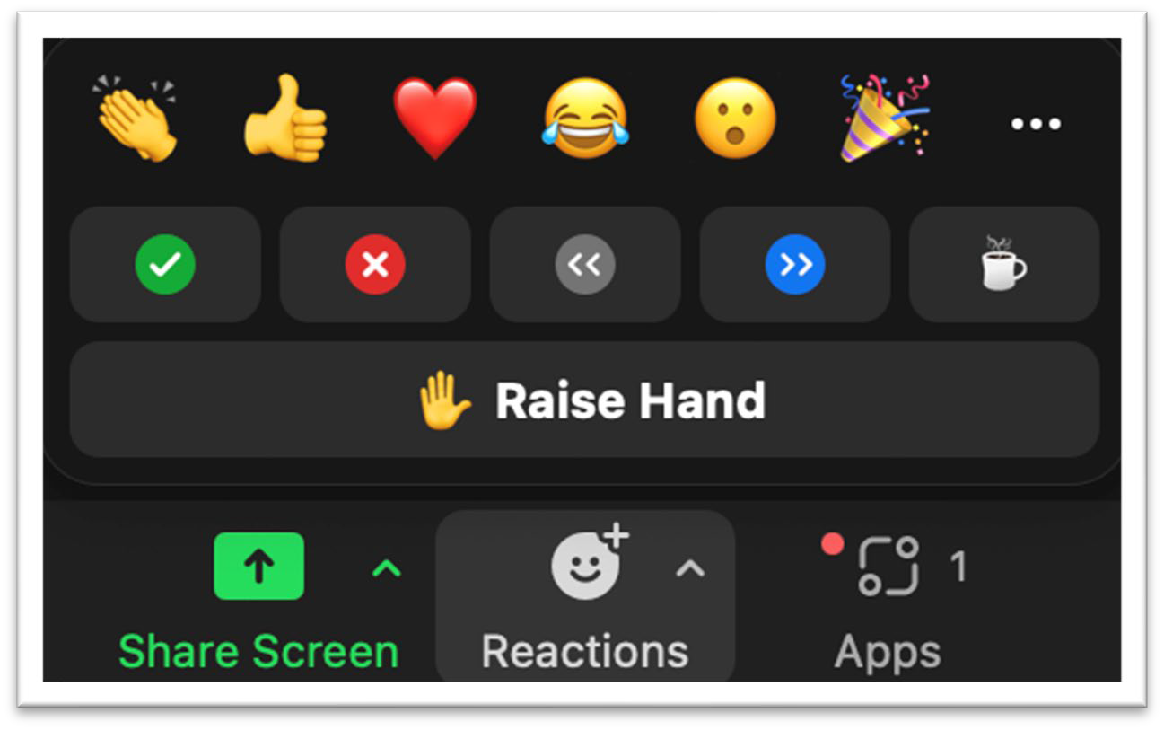

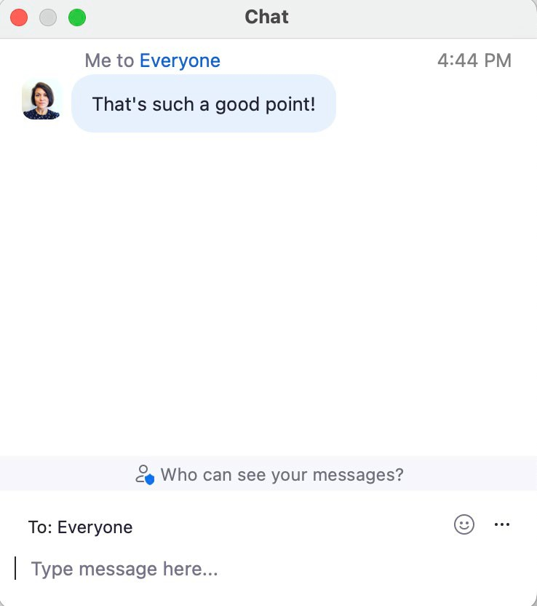


3 Ways to Engage in the Room
Reminder: This session is being recorded. Recordings and slides will be available after the meeting.
2. Emoji Reactions
1. Chat Window
…and on Twitter!
3. Audio and Video
(We encourage you to keep your camera on during the session)
#SIRENRacialEquity @SIREN_UCSF
2022 National Research Meeting

Slide 5














Using human-centered design
principles to enhance cross-sector partnerships that address the
social drivers of health
SIREN 2022 National Research Meeting: Racial Health Equity in Social Care, Day 1 September 15, 2022
Acknowledgement:
Support for this program was provided by a grant from the Robert Wood Johnson Foundation®

Slide 6
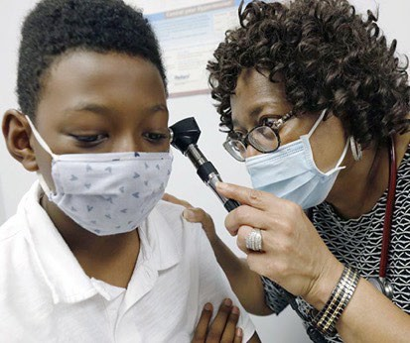
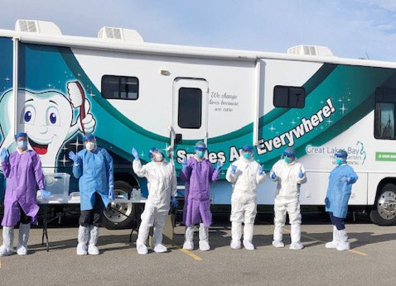
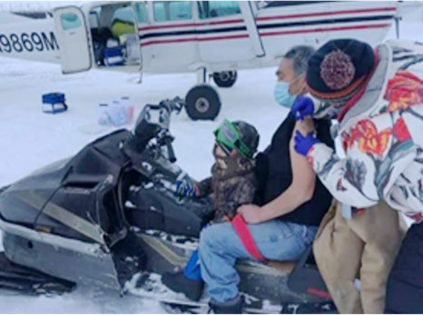

THE NACHC MISSION
America’s Voice for Community Health Care
The National Association of Community Health Centers (NACHC) was founded in 1971 to promote efficient, high quality, comprehensive health care that is accessible, culturally and linguistically competent, community directed, and patient centered for all.

Slide 7












NACHC’s STRATEGIC PILLARS
Equity and Social Justice
Empowered Infrastructure
Skilled and Mission-driven Workforce
Reliable and Sustainable Funding
Improved Care Models
Supportive Partnerships
Center everything we do in a renewed commitment to equity and social justice
Strengthen and reinforce
the infrastructure for leading and coordinating the Community Health Center movement, notably consumer boards and
NACHC itself
Develop a highly skilled, adaptive, and mission-driven workforce reflecting the communities served
Secure reliable and sustainable funding to meet increasing demands for Community Health Center services
Update and improve care models to meet
the evolving needs of the communities served
Cultivate new and strengthen existing mutually beneficial partnerships to advance the shared mission of improving
community health
To learn more about NACHC’s Strategic Pillars visit https://www.nachc.org/about/about-nachc/
www.nachc.org
@NACHC

Slide 8



Learning objectives
Describe how human-centered design principles can be applied specifically to problems of racial inequities in social care and upstream efforts that improve the health of structurally marginalized communities.
Understand the importance of integrating community voice including racial and ethnic groups in health equity initiatives to improve systems of care.
Practice a human-centered design skill, so that they can learn experientially.
@NACHC

Slide 9
Poll 1
How familiar are you with the design sprint framework?
Not familiar
Somewhat familiar
Moderately familiar
Very familiar
Extremely familiar
www.nachc.org

Slide 10
Poll 2
How comfortable are you with incorporating community voice within racial health equity efforts?
Not comfortable
Somewhat comfortable
Moderately comfortable
Very comfortable
Extremely comfortable
www.nachc.org

Slide 11
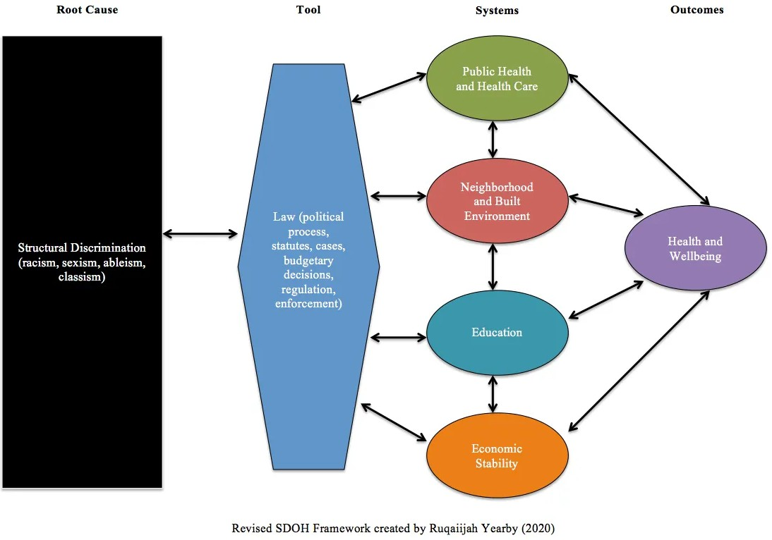
Our Path Forward
“Structural racism describes the way our systems are structured to produce racial inequalities between white [populations] and racial and ethnic minorities in the SDOH, leading to racial health disparities” (Yearby, 2020)
Ruqaiijah Yearby, JD, MPH,
Center for Health Law Studies of St. Louis University, Executive Director and Co-Founder, Institute for Healing Justice and Equity

Slide 12
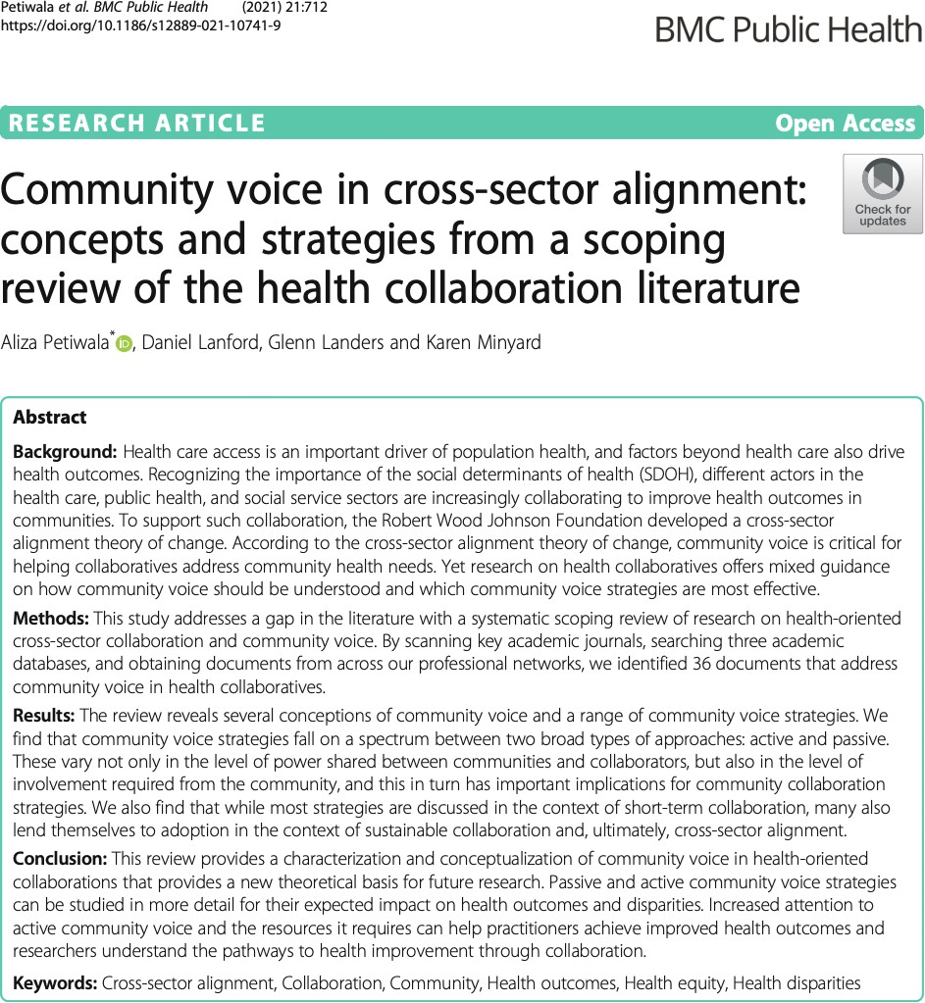
Incorporating Community Voice in Cross-Sector Alignment
Recognize need for cross-sector collaborative efforts to be sustainable
“Community voice” or “community engagement” can be defined in many ways
  Working collaboratively with respect to issues affecting wellbeing
  Shared decision-making, accountability, community agency
  Working with community members and organizations to build awareness, gain insight, develop community capacity
What does it mean to have “meaningful” or “authentic” collaboration with those you’re aiming to serve?
Petiwala, A., Lanford, D., Landers, G. et al. Community voice in cross-sector alignment: concepts and strategies from a scoping review of the health collaboration literature. BMC Public Health 21, 712 (2021). https://doi.org/10.1186/s12889-021-10741-9

Slide 13
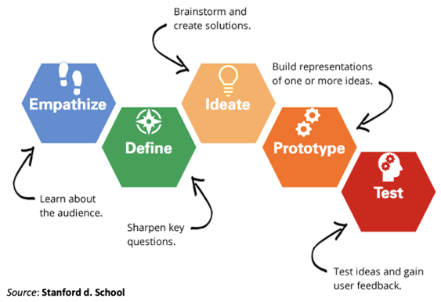
Why Design Sprints
Started in late 2020-2021 under work supported by RWJF
Needed a way to foster an environment to build cross sector partnerships to address SDOH during the height of COVID
YouTube: https://www.youtube.com/watch?v=a7sEoEvT8l8
13

Slide 14
Goals and Objectives
Generate and test concrete ideas for addressing the strategic alignment needs of health centers and their cross-sector partners to address health equity, including racial, economic, and social justice.
Build an energetic and knowledgeable community around the goal of improving health equity for patients with complex and unmet social needs.
Foster a mindset of creativity, resourcefulness, and experimentation in participants.
Teach participants concrete design tools that they can use in their daily work at the health centers, their partner organizations, and community engagement level.
Build community commitment and capacity
for sustainable, cross-sector partnerships.
Assess how cross-sector partnerships can best respond to SDOH needs that have been impacted by COVID-19.
Assess how cross-sector partnerships can best respond to new and emerging SDOH needs.
Prioritize health equity by elevating community voices and reducing health disparities for those with complex health and social needs that have emerged due to structural racism and inequality.

Slide 15
Design Sprint Process
Application period with a release webinar
Requirements
  FQHC
  Community Partner
  Dedicate the time to participate in all Design Sprint activities
Design Sprint Experience included:
  Virtual Design Sprint Workshops
  Monthly Huddles
  Pre and Post Assessment
  Reflection Session “Storytelling and Community Celebration”
  Dedicated Coach
  Training and Technical Assistant as needed
  Peer to Peer learning

Slide 16
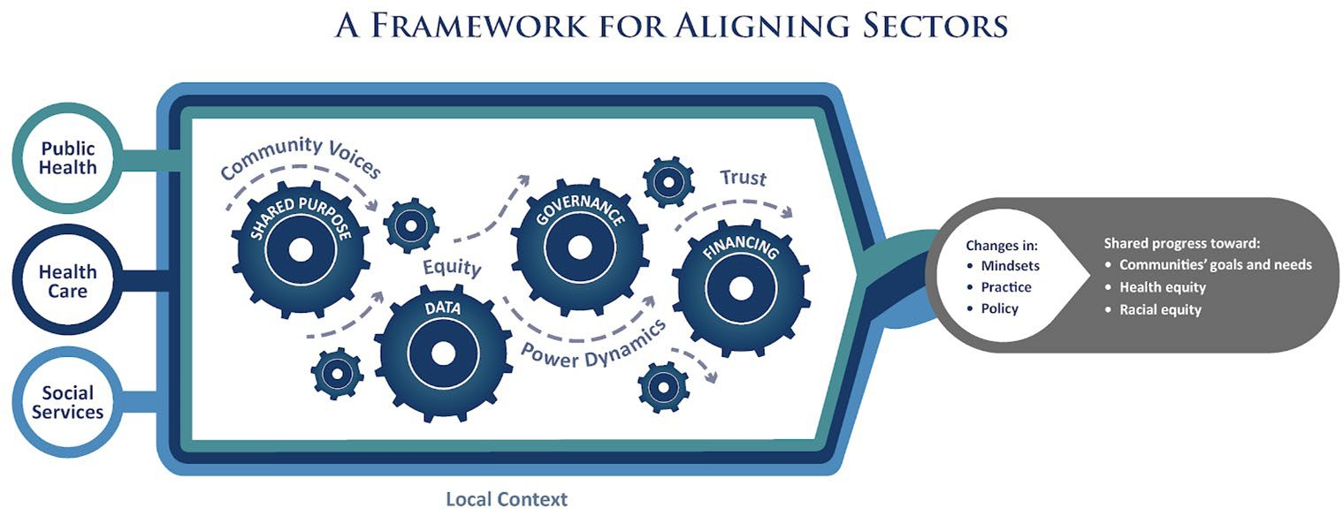
Design Sprint Cohort Composition 2021
4 cohorts with 4 teams
Each cohort focused on a pillar for the RWJFs Theory of Change
Each cohort: 3-month design sprint process
Time Committed: 15 hours minimum
Zoom and Mural
Worked with AAPCHO
Link: https://www.alignforhealth.org/framework/
16

Slide 17
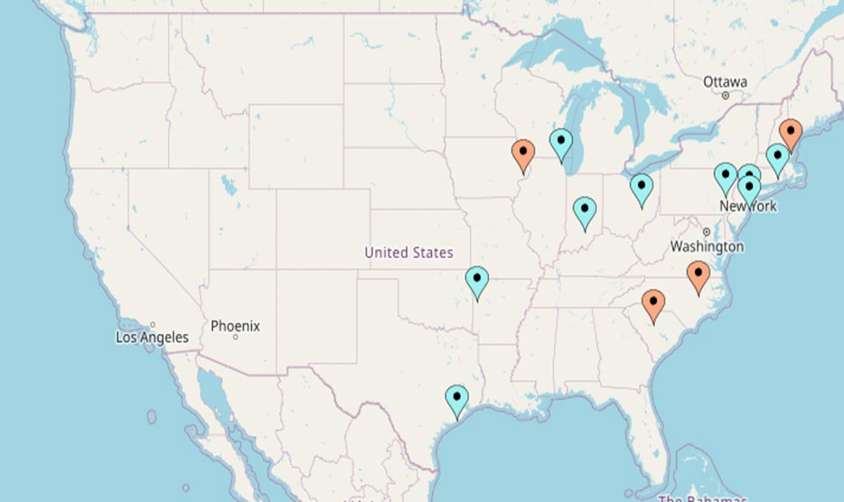
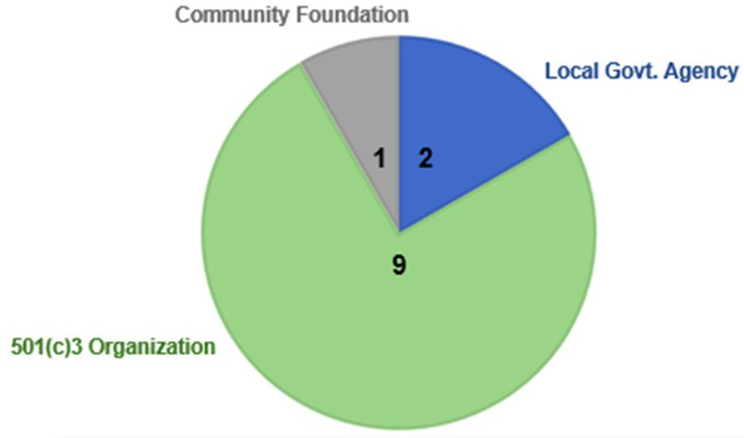
Team Locations and Partnerships
www.nachc.org
| 17

Slide 18
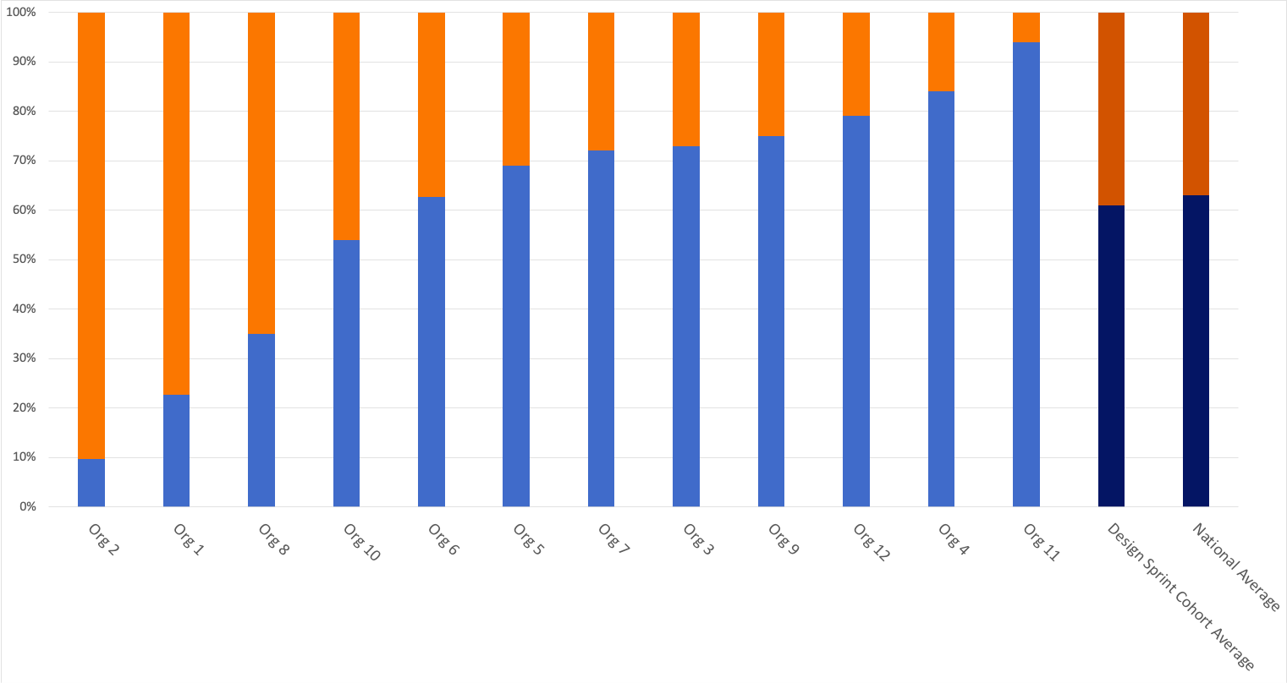
Diversity Across Organizations
TOTAL KNOWN RACIAL AND/OR ETHNIC MINORITY AND NON-MINORITY PATIENTS AT PARTICIPATING HEALTH CENTERS
Participating Health Center Average is 61% as compared to 63% nationally for Racial & Ethnic Minority Patients
39%
37%
% of Patients
61%
63%
Participating Health Center Average is 39% compared to 37% nationally for Non-Minority Patients
Source: 2019 UDS Data

Slide 19
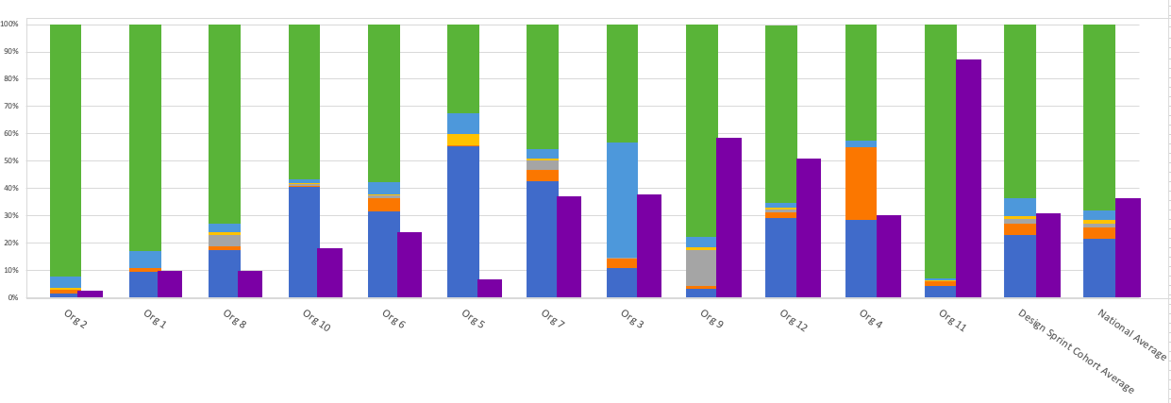

Race & Ethnicity of Patients Served
KNOWN RACE & ETHNICITY OF PATIENTS ACROSS ORGANIZATIONS
% of Patients Who Identify with Each Race/Ethnicity
At 4 HCs Majority of patients are best served in a language other than English
At 1 HC, patients speak a range of 92 languages
At 2 HCs around 50% of patients served are children
At 3 HCs serve large refugee populations including communities from Nepal, Bhutan, and Burma
1 HC serves as a Refugee Health Assessment Site
Source: 2019 UDS Data

Slide 20
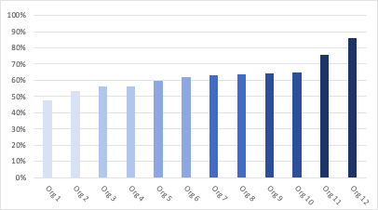
Income Data
PATIENTS LIVING AT OR BELOW 100% FPL
Nationally, on average, 68% of HC patients live at or below 100% FPL
63% of patients at participating HCs live at or below 100% FPL (average)
% of Patients
Source: 2019 UDS Data

Slide 21
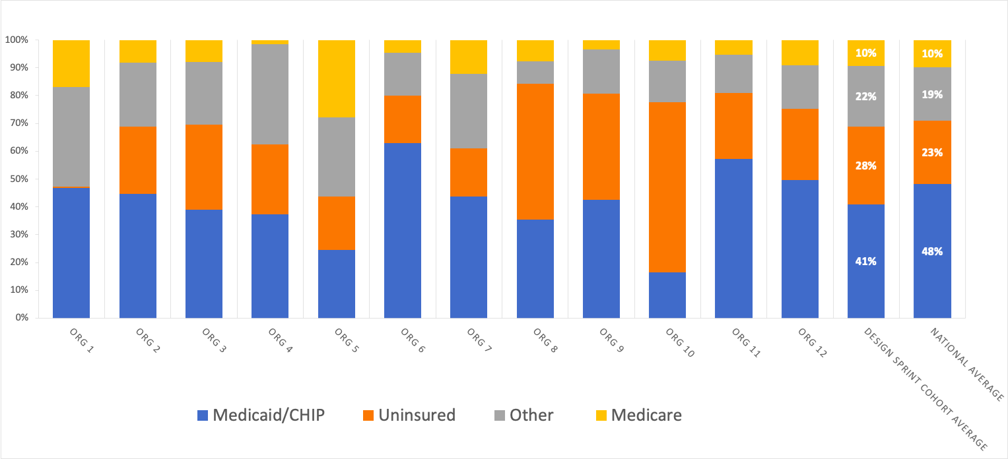
Health Insurance Mix
% of Patients with Each Insurance Type
Source: 2019 UDS Data

Slide 22




Challenge Focus Areas
APPLICATION THEMES
Address acute and long term SDOH needs
Better understand community SDOH needs
Build workflow to support SDH needs
Education
Food insecurity
Housing
Improve access to care
Improve support for individuals with complex medical needs
Improve culturally aware and
respectful healthcare and social care
Increase community visibility of services
Increase screening capabilities
Increase & improve referral capabilities
Increase self-sufficiency
and self-advocacy of the community
Medicaid enrollment
assistance
New Americans/Growing populations
Older adults
Racial inequities
Social isolation/ social connectedness services
Transportation
Women-focused healthcare
Youth-focused programs
Identify Priority Needs of the Community
Address Specific, Identified Health & Social Needs
Build Infrastructure and capacity to identify and address SDOH Community Needs
Bold Text are the areas that were noted more commonly throughout all applications
@NACHC

Slide 23


Story from the field
Affinity Health Center & Habitat for Humanity – Rock Hill, SC
Leveraged resources and relationships within the community to host several COVID-19 vaccination clinics in predominantly African-American/Black communities; expanded partnerships with faith-based organizations and neighborhood groups
Joint activities helped staff from each partner organization to understand the resources and services available as well as the needs of the community
Established partnership with local HBCU to focus on equity issues
In the future, would like to
  Improve health outcomes and housing opportunities in target communities
  Utilize data driven strategies to develop equitable funding streams

Slide 24


Story from the field
Community Clinic of Northwest Arkansas and Marshallese Educational Initiative – Springdale, AK
A new and forming Community Health Center & Community-Based Organization partnership focused on the Marshallese community
Progress to-date:
  Feedback from Marshallese women in focus group
  Marshallese option on Community Clinic’s phone menu
  Women’s Health Night with group education and individual visits
Future plans: CC received a women's health/contraception grant that will allow for this partnership to have some funds for group health education; CHW Workforce Program Grant

Slide 25


Story from the field
Crescent Community Health Center and Community Foundation of Greater Dubuque – Dubuque, IL
CCHC and CFGD utilized culturally appropriate educational engagement around SDOH components as a means to empower Pacific Islander youth.
The program involved equipping Pacific Islander students with PRAPARE data and other SDOH information, and then providing them with resources and a platform so that they can take a leadership role and use their natural talents to initiate projects aimed at helping their community.
Included partners at schools, colleges, churches, nonprofits, and local government.
Engaged with Pacific Islander elders, whose involvement is crucial for preserving the spirit and culture of our local Pacific Islander community.
Future plans include local employers and businesses, and there is also an interest in using this project to help build a coalition with other Pacific Islander communities around the nation.

Slide 26


Story from the field
Sixteenth Street Community Health Centers & VIA – Milwaukee, WI
Focused on cultivating a stronger partnership, rooted in effective use of data, to address housing and other SDOH needs among Latino population in Milwaukee
  Developing Empathy & Resources
    Created shared resources to better understand each organization's available services and resources
    Community walking tour
Sharing data
  Identifying communities and individuals served by both organizations
  Facilitating smoother referrals
  Expanding SDOH (PRAPARE) screening
    Assessing partnership impact
In the future, would like to
Provide means of sharing data collected through partnership(s) with community to identify roots and appropriate next steps
Share collective data with other CBOs and community leaders to expand efforts
Leverage data for advocacy

Slide 27
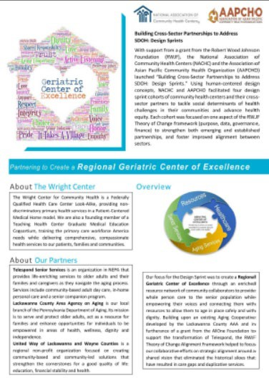


Additional Cross-Sector Partnership Stories Available
30-Minute Webinars Available for Streaming on the PRAPARE Website
15-20 Minute Podcasts Available on the PRAPARE Podcast Channel
Brief Summaries Available on the PRAPARE
Website

Slide 28

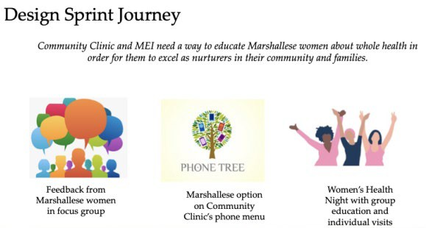
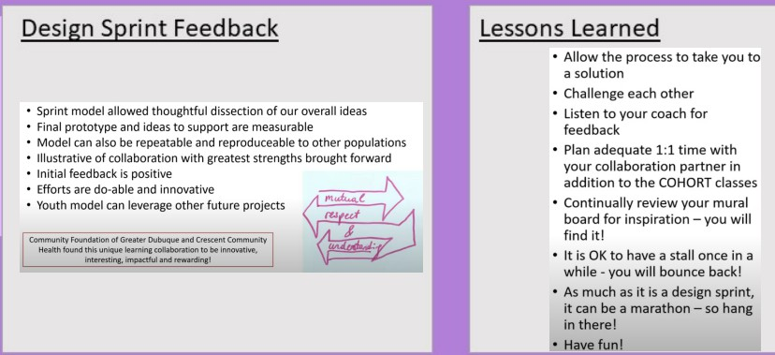
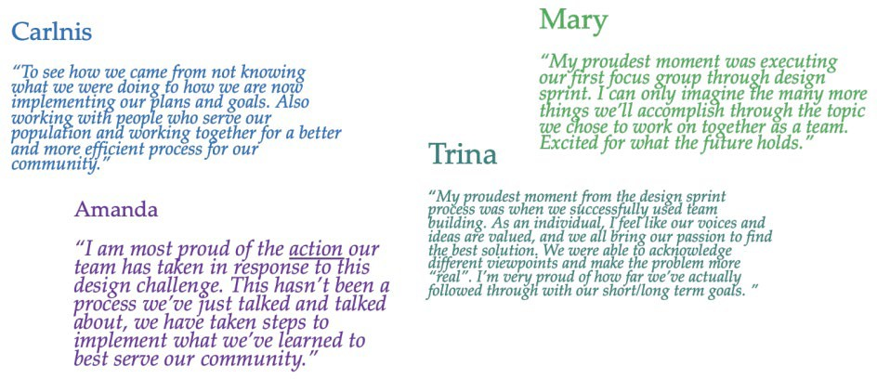
2021 Design Sprint Journey
28
@NACHC

Slide 29

Design Sprint Activity: Empathize

Slide 30
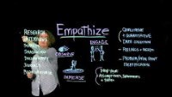
Video: Overview of “Empathize” Phase in Design Sprints
Video link: https://www.youtube.com/watch?v=q654-kmF3Pc&t=0s
www.nachc.org
@NACHC
| 30

Slide 31
Scenario
Your organization working with Feeding America
Geographic service area
Suburban area – previously considered rural; however, area has gone through significant changes with 2 factories opening and small businesses growing. Economic growth is disparate.
Recent influx of new community members from neighboring states and immigrants from other countries.
Population
Race: 8% African American/Black; 2% Asian; 4% Mixed/Biracial; 2% Native Americans;
6% Other; 78% white
Ethnicity: 15% Latinx/Hispanic
@NACHC

Slide 32
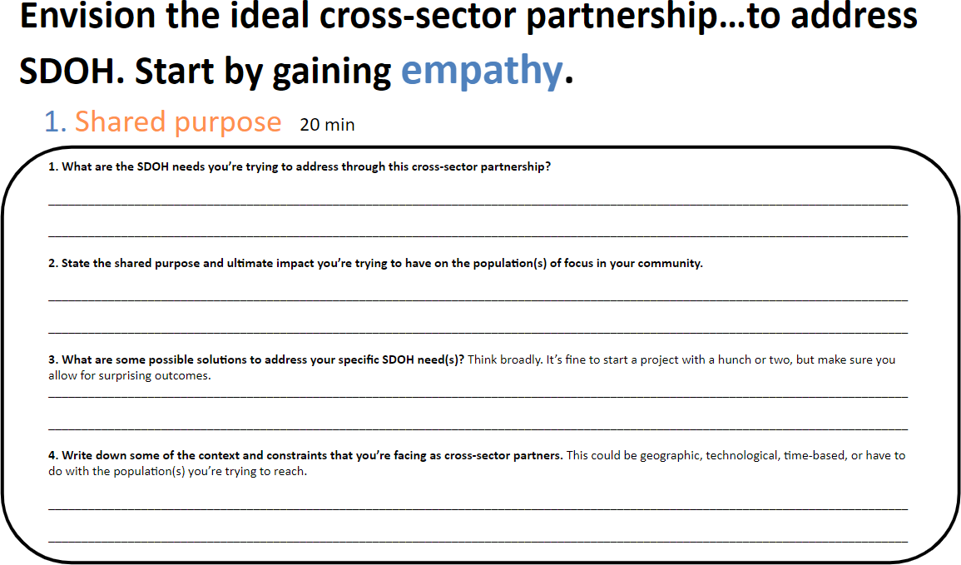
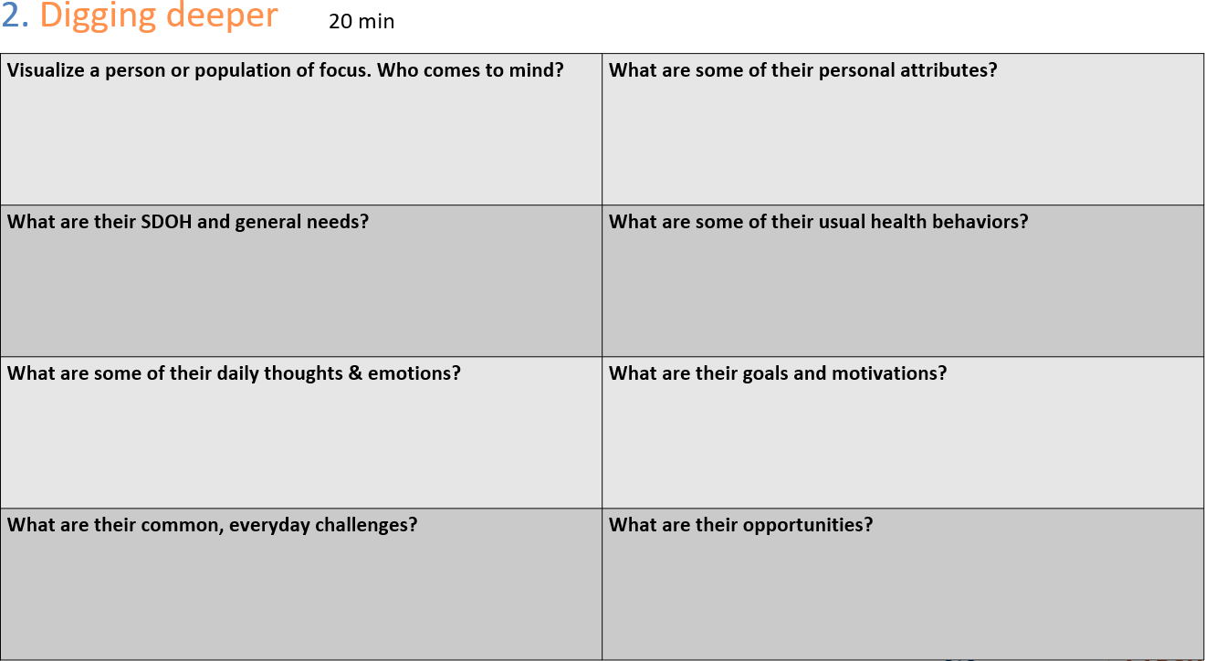
Empathize – 10 minutes
Learn about community and target population
www.nachc.org

Slide 33
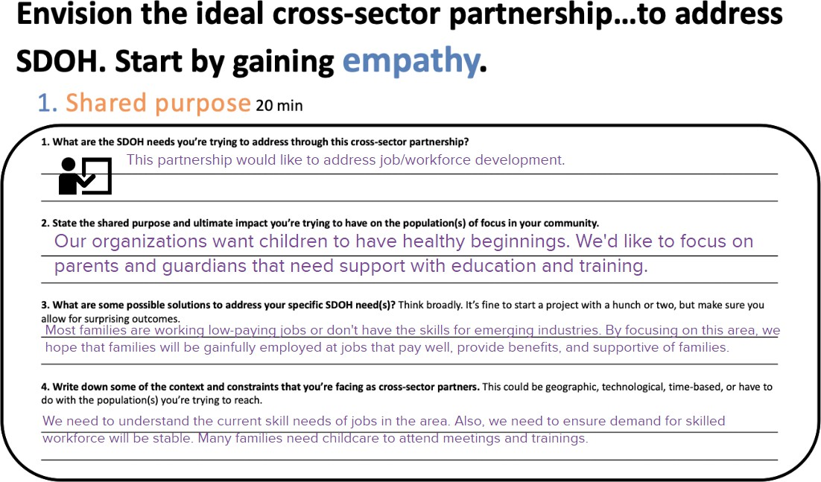
Example of “Shared Purpose” Mural board
www.nachc.org

Slide 34
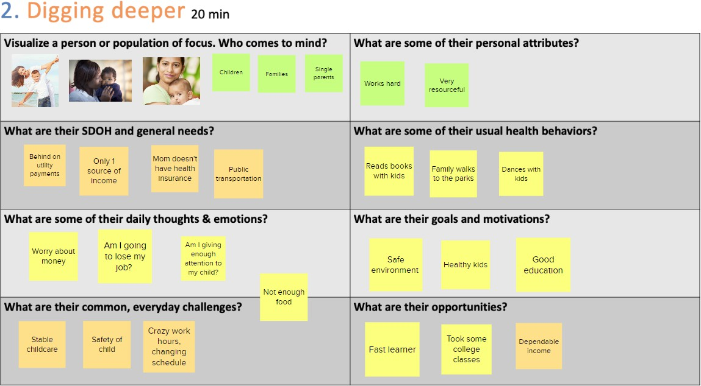
Example of “Digging Deeper” Mural board
www.nachc.org

Slide 35

Discussant Perspective and Participant Q&A
www.nachc.org

Slide 36

Thank you!
Nalani Tarrant, Deputy Director, Social Drivers of Health ntarrant@nachc.org
Sarah Halpin, Program Specialist, Social Drivers of Health shalpin@nachc.org
Yuriko de la Cruz, Program Manager, Social Drivers of Health ydelacruz@nachc.org
PLEASE VISIT US ONLINE
nachc.org

Slide 37



Twitter.com/NACHC
Facebook.com/nachc Instagram.com/nachc
Linkedin.com/company/nachc YouTube.com/user/nachcmedia

