Slide 1



Addressing Patients’ Social Needs: Opportunities and
Tensions in Community-based Organization-Health Care Collaborations
September 24, 2019
siren

Slide 2
Upcoming Events
National Academies Public Webinar Report Release: Integrating Social Care into the Delivery of Health Care: Moving Upstream to Improve the Nation's Health
September 25, 8am – 9am PT/11am – 12pm ET
This event will present the new National Academies report, Integrating Social Care into the Delivery of Health Care: Moving Upstream to Improve the Nation’s Health. The webinar will include an overview of the report and discussion of the report’s findings, recommendations, and key messages.
SIREN & America’s Essential Hospitals: Interventions to Decrease Food Insecurity
October 28, 11am – 12pm PT/2pm – 3pm ET
This webinar will explore ways to help meet patients’ food insecurity needs. This event will feature SIREN’s own Emilia DeMarchis, MD, who will present the results of a
systematic review of health-care based food security interventions. She will be joined by
Larry Atlier of Lee Health who will share a firsthand account of experience delivering a food security intervention.
siren

Slide 3







Moderator
Tricia McGinnis, MPP, MPH Center for Health Care Strategies Vice President and Chief Program Officer
Speakers
Hugh Alderwick
The Health Foundation
Assistant Director of Strategy and Policy
Elena Byhoff, MD, MSc Tufts Medical Center Assistant Professor
siren

Slide 4















Medicaid’s Focus on Social Determinants
Addressing beneficiaries’ social service needs is a key Medicaid strategy for:
» Tackling immediate health-related needs of patients with complex needs
» Managing care for rising risk individuals
» Upstream prevention for kids and healthy adults
Value-based payment and care models for complex patients are key program drivers
Federal regulations, waivers, and messaging are supporting state innovation and experimentation
1

Slide 5



Medicaid Regulatory and Policy Context
2016 managed care regulations clarified that manage care organizations (MCOs) can pay for SDOH-related activities, including:
»Community care coordination
»Value-added services
»In-lieu-of services
1115 Waivers enable Medicaid to “waive” specific federal program rules
State Medicaid levers can foster partnerships among providers, plans, and community-based organizations (CBOs), including:
»MCO contracts
»Delivery system program requirements
»Financial incentives/value-based payment
»Quality measurement
»Rate setting
2

Slide 6
















MCO Contracts and Waivers: Trends in CBO Partnerships
Most common MCO contract requirements center around screening and referrals
 | MCO SDOH contract language is flexible rather than prescriptive
 | 23 state contracts require MCO relationships with social service agencies or CBOs to address social needs
Seven delivery system reform 1115 demonstrations build partnerships with CBOs: CA, MA, NY, NH, NC, RI, and WA
3

Slide 7













State Examples: CBO Partnerships
Contract (Michigan) 1115 (New York)
MCO must enter into agreement with CBOs to “coordinate Population Health improvement strategies[…] which address the socio-economic, environmental, and policy domains; as well as provide services such as care coordination and
intensive care management[.]”
Advanced value-based payment arrangements must include one SDOH intervention and one partnership with a CBO.
MCOs must support SDOH intervention with a funding advance.
4

Slide 8
















What Does the Future Hold?
Continued innovation to test the right mix
of incentives, funding, requirements, technical support, and flexibility needed to advance CBO partnerships
Research on which state levers are most effective in promoting CBO partnerships
New federal opportunities and guidance Evolving roles of MCOs and providers
5

Slide 9

Medicaid investments and partnerships to address patients’ social needs
Hugh Alderwick
September 2019

Slide 10
Study context and methods

Slide 11

Medicaid reforms in Oregon and California
The image part with relationship ID rId2 was not found in the file.
Oregon Coordinated care organizations (CCOs) responsible for improving care and reducing costs | California Whole Person Care (WPC) pilots to coordinate health care, behavioral health and social services
Alternative payment models for providers—eg capitation for community health centers | County partnerships of health care, local government, and community based organizations

Slide 12
Study methods
The image part with relationship ID rId2 was not found in the file.
Aim: understand how Medicaid $s support interventions to address social needs under reforms in Oregon and California
Sites: 6 geographically-based communities—3 in each state
Data: 55 in-depth interviews with:
  Medicaid payers
  Government agencies
  Health care delivery organizations
  Community-based organizations (CBOs)

Slide 13
Study methods
The image part with relationship ID rId2 was not found in the file.
Aim: understand how Medicaid $s support interventions to address social needs under reforms in Oregon and California
Sites: 6 geographically-based communities—3 in each state
Data: 55 in-depth interviews with:
Medicaid payers
Government agencies Focused on…
Health care delivery organizations
Community-based organizations (CBOs)
Intervention content
Medicaid funding
Collaboration processes
Contextual factors

Slide 14
Findings
Interventions and funding

Slide 15
Types of social needs interventions delivered
The image part with relationship ID rId2 was not found in the file.
Direct services |  | Capacity building
Care coordination |  | Staff training and new roles
(general and intensive) | Supported by | (eg CHWs and peer support)
Housing supports |  | Strengthening CBOs
Food supports |  | Community engagement
Legal services |  | Data sharing systems
Post-incarceration services |  | Case management systems
For: high health care utilizers, high utilizers of multiple services, homeless clients, behavioral health patients

Slide 16
Partnering with CBOs to deliver services
The image part with relationship ID rId2 was not found in the file.
Direct services

Slide 17
Partnering with CBOs to deliver services
The image part with relationship ID rId2 was not found in the file.
Referrals to CBOs Eg—referrals to food banks or housing supports
Direct services

Slide 18
Partnering with CBOs to deliver services
The image part with relationship ID rId2 was not found in the file.
Referrals to CBOs Eg—referrals to food banks or housing supports
Direct services
Contracting with CBOs
Eg—social service providers reimbursed for care coordination

Slide 19
Partnering with CBOs to deliver services
The image part with relationship ID rId2 was not found in the file.
Referrals to CBOs Eg—referrals to food banks or housing supports
Direct services
Contracting with CBOs
Eg—social service providers reimbursed for care coordination
Cross-sector governance structures

Slide 20
Supporting CBOs as organizations
The image part with relationship ID rId2 was not found in the file.
Capacity building

Slide 21
Supporting CBOs as organizations
The image part with relationship ID rId2 was not found in the file.
Supporting existing work Eg—contributing to costs of local shelter or family relief nursery
Capacity building

Slide 22
Supporting CBOs as organizations
The image part with relationship ID rId2 was not found in the file.
Supporting existing work Eg—contributing to costs of local shelter or family relief nursery
Capacity building
Strengthening CBO capabilities Eg—investing in new infrastructure, support for managing contracts

Slide 23
Medicaid funding options
The image part with relationship ID rId2 was not found in the file.
Conventional options (eg covered benefits, in-lieu of services, MAA) | Alternative models (eg WPC bundled payments, APM in OR) | Savings (from Medicaid contracts—eg managed care or WPC)
Less flexible |  | More flexible
Eg—connections with housing supports | Eg—intensive care coordination, on-site supports, expenses | Eg—new supportive housing units, ongoing rental subsidies

Slide 24
Findings
Health care-CBO partnerships

Slide 25
Five broad themes
The image part with relationship ID rId2 was not found in the file.
1
2
3
4
5
Support for collaboration | …but levels of partnership in
Differences in language, aims, approaches | practice varied:
Resource and capability issues | “[we’re] right at the beginning of figuring out how to partner with CBOs”
Unintended consequences
Risk of medicalization | —Health care interviewee

Slide 26
Five broad themes
The image part with relationship ID rId2 was not found in the file.
1 | Support for collaboration | “we don't need to create 20 new [community health workers]. I have 20. How do I get them credentialed and how do I get them money? […] How do I get […] you to understand that's who they are?”
2 | Differences in language, aims, approaches
3 | Resource and capability issues
4 | Unintended consequences
5 | Risk of medicalization | —CBO interviewee

Slide 27
Five broad themes
The image part with relationship ID rId2 was not found in the file.
1 | Support for collaboration | “They are small organizations with, you know, small HR departments and small finance departments and all of a sudden there, they have these really complicated government contracts”
2 | Differences in language, aims, approaches
3 | Resource and capability issues
4 | Unintended consequences
5 | Risk of medicalization | —Health care interviewee

Slide 28
Five broad themes
The image part with relationship ID rId2 was not found in the file.
1 | Support for collaboration | “So, it cost about $5,000 to get them certified […]. I can't keep spending $5,000 for people to leave […]. I train them, and then they go to work for public entities for more pay and twice the benefits”
2 | Differences in language, aims, approaches
3 | Resource and capability issues
4 | Unintended consequences
5 | Risk of medicalization | —CBO interviewee

Slide 29
Five broad themes
The image part with relationship ID rId2 was not found in the file.
1 | Support for collaboration | “I also really don’t believe that the medical system is an efficient one. So it’s not like we want to medicalize poverty and start solving it through our clinics and hospitals.”
2 | Differences in language, aims, approaches
3 | Resource and capability issues
4 | Unintended consequences
5 | Risk of medicalization | —Health care interviewee

Slide 30
Discussion

Slide 31
Discussion
The image part with relationship ID rId2 was not found in the file.
Medicaid reforms offer opportunities to fund social interventions and support community partnerships
Partnerships are complex—and they aren’t always successful. Theory can help researchers understand partnership benefits and risks
Studying impacts beyond the health care system is critical
Partnerships operate within wider social policy context
Need to recognize value of CBOs, but also their fragility

Slide 32
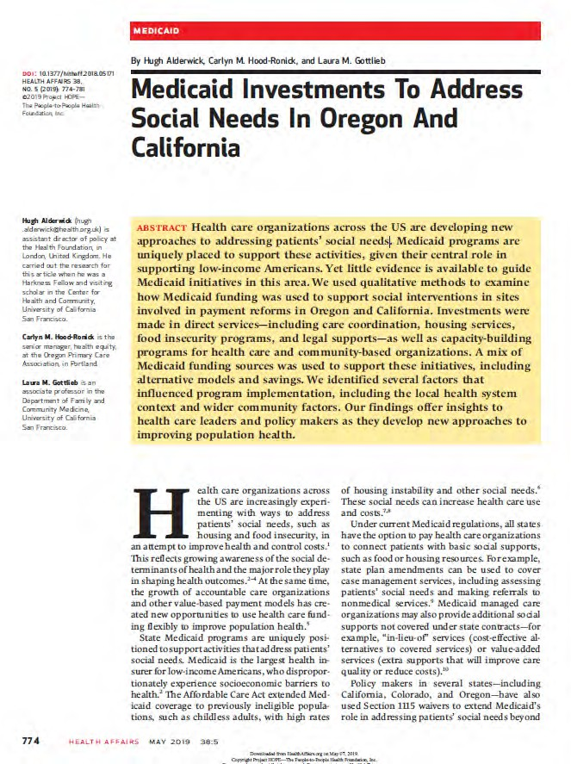
Acknowledgements
The image part with relationship ID rId2 was not found in the file.
Co-authors: Carlyn M Hood-Ronick, senior manager, Oregon Primary Care Association; Laura M Gottlieb, associate professor, Department of Family and Community Medicine, UCSF
Funders: the research presented here was funded by the Commonwealth Fund and the Blue Shield of California Foundation, and carried out while Hugh was a Harkness Fellow at UCSF.

Slide 33

You Can’t Scale Unicorns:
Community Based Organizations’ Perspectives on Health Care’s Entry into Social Determinants of Health Programming
Elena Byhoff, MD MSc
September 24, 2019

Slide 34


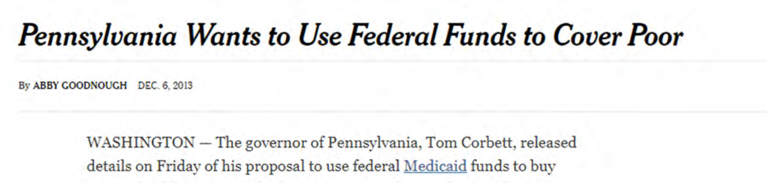
National & state policy trend to align health care and social services

Slide 35
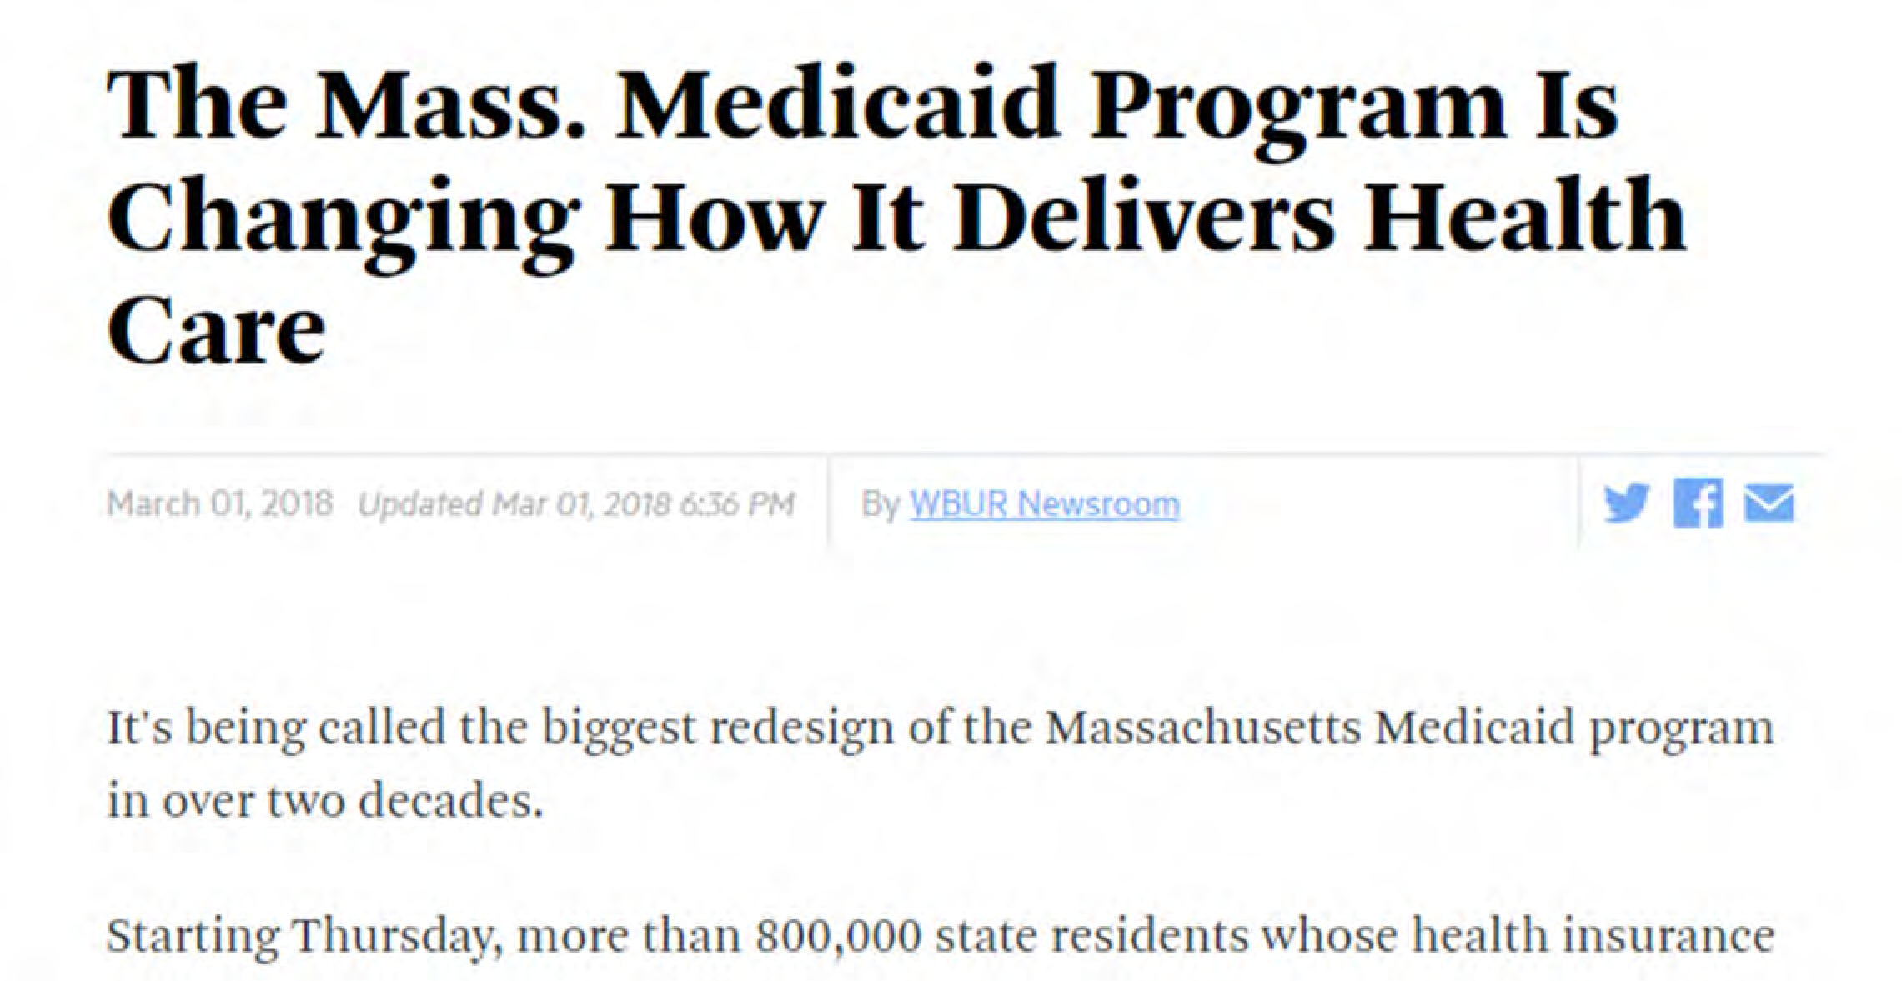

Massachusetts Medicaid Redesign

Slide 36

Partnership Literature to Date

Slide 37
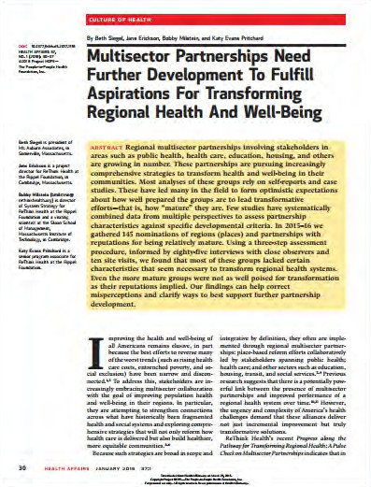
Partnership Literature to Date

Slide 38
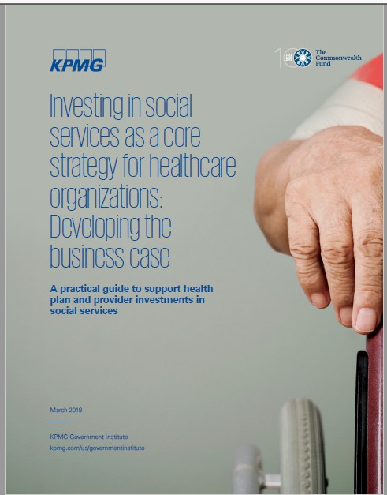
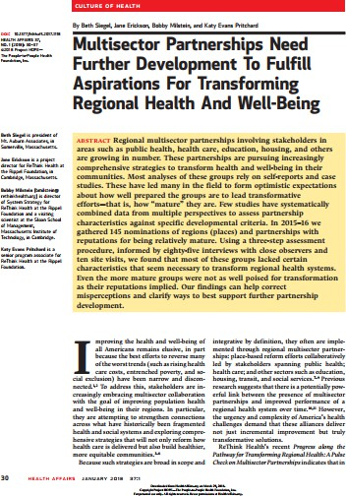
Partnership Literature to Date
Community based organization perspective?

Slide 39
Research Question
How are community based organizations (CBOs) perceiving and responding to health care’s entry into social determinants of health (SDOH) programming?

Slide 40
Operational Definitions
Community Based Organization (CBO)
Nonprofit groups that work at a local level to improve life for residents and are not focused primarily on health care promotion or delivery.
Social Determinants of Health (SDOH)
Upstream environmental/social factors that influence health (housing, food, employment, safety, etc.)

Slide 41
METHODS

Slide 42
Sampling Frame: Social Service Delivery
Social service delivery organizations
(homeless shelters, food pantries, community centers etc.)
Umbrella social service organizations
(professional associations, feeder organizations etc.)

Slide 43
Methods
Sampling frame & strategy
Semi-structured interviews (n=47) with CBO leadership
Purposive sample with snowball strategy

Slide 44
Methods
Sampling frame & | Data collection &
strategy | analysis
Data collection from October 2017 to March 2018
Grounded theory approach, comparative coding

Slide 45
Methods
Sampling frame & strategy
Data collection & analysis
Advisory board meetings
Advisory Board Members: CBO leadership Public Health Health Care

Slide 46
Resulting Sample
Community Based Organization (CBO) Sector | No of People Interviewed
Food | 6
Housing | 16
Community centers | 8
Legal services | 2
Multi-service centers | 7
Transportation | 1
Workforce development | 5
Domestic violence | 1
Early childhood education | 1
Total | 47

Slide 47
FINDINGS

Slide 48
1
Health care and CBOs have different values
2
How CBOs perceive health care SDOH strategy
Five Emergent Themes
3
Policy is moving the right direction
4
CBOs position themselves to partner with health care
5
Fears, risks or unintended consequences

Slide 49


Outcomes that matter
The Department of Housing and Urban Development (HUD) measures the city on number of new people into homelessness. [So] I don't want Hospital A or Hospital B or anybody sending people here that aren't genuinely homeless. One of the things we worry about is driving our numbers up, inadvertently.

Slide 50
Outcomes that matter
The Department of Housing and Urban Development (HUD) measures the city on number of new people into homelessness. [So] I don't want Hospital A or Hospital B or anybody sending people here that aren't genuinely homeless. One of the things we worry about is driving our numbers up, inadvertently.
Scale vs. flexibility
I think that the one thread that runs through everything we do is relationship, and I think that the idea of scaling and relationships are at odds.

Slide 51


Motivated by funding, ROI
We thought 5 to 10 years ago that it was time to talk to healthcare institutions and it was way too early. They weren't ready yet. Nor was it really in their financial interest. Now it's starting to be.

Slide 52
Motivated by funding, ROI
We thought 5 to 10 years ago that it was time to talk to healthcare institutions and it was way too early. They weren't ready yet. Nor was it really in their financial interest. Now it's starting to be.
“Not at the table”
Honestly my fear right now, we are so late as a community. Like, quality metrics at MassHealth are being finalized right now. We were not invited to the party.

Slide 53

C_{C}o_{o}n_{d}c_{e}e_{s}ptual rationale
It's moving in the right direction. This idea of fracturing a person into medical care, and social care, is ridiculous. It doesn't make common sense, and it's not working. People need this service, and it should be just a part of holistic, patient-centered care.

Slide 54

Measuring work in terms of health
…we are changing our metrics. We’ve gone from pounds of food…more towards healthy meals. When we do that…our numbers change and it’s going to take a while for people to understand…that pounds doesn’t really capture what we’re doing.

Slide 55
Creating service line menus
[Health Centers] all have different strengths and infrastructure, so when we offer this three prong program, we do it as a menu of options. We say, “Hey these are the three things that we can offer you, where are you guys at?”

Slide 56

“Trapped and vaporized”
My concern is that it’s a money grab… That there won’t be dollars for the services people on the ground need to have positive lived experiences… The medical industry will absorb the resources.

Slide 57

Loss of intrinsic value; medicalization of CBOs
I'm concerned that health care will want to make this into tight compartments …they'll want to define it, encapsulate it, put borders and boundaries around it and [it] will no longer be a social determinant. It will be a new service line.

Slide 58
IMPLICATIONS

Slide 59

Conclusions
Potential for loss of some intrinsic value of CBOs:
community organizing & development
cultural attentiveness
pursuit of long-run outcomes
attention to uninsured/ marginal groups

Slide 60
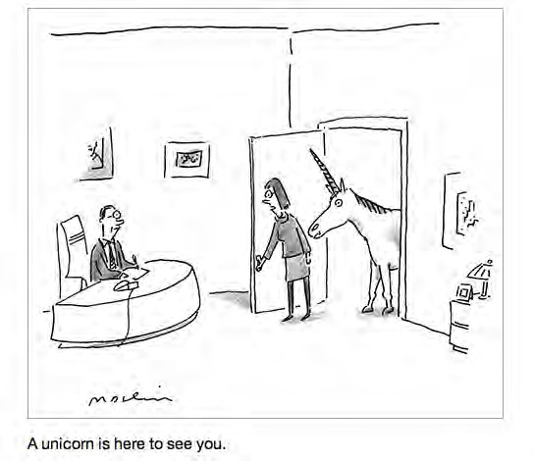
Conclusions
The social service workforce that's going to be partnered with health care… they need to be some special people. I call my team unicorns and I know you can't scale unicorns too well.

Slide 61


Policy Strategies
Policy & grant flexibility
Common measures

Slide 62



Acknowledgements
Co-Investigator
Lauren Taylor MPH MDiv, Harvard Business School
Funder
Blue Cross Blue Shield of MA Foundation Kaitlyn Kenney Walsh & Jessie Gottsegen
Advisory Board
Robert Torres, Lisa Schorr Kaplan, Paul Hattis, Chris Sieber, Jean Terranova, Megan Sandel, Joanne Hilferty

Slide 63

Questions?
Follow up: ebyhoff@tuftsmedicalcenter.org
@elenabyhoff

