Slide 1
Designing EHR Tools for Collecting, Summarizing, & Acting on Patient-Reported SDH, in CHCs:
A Stakeholder-Driven Process
Rachel Gold, PhD, MPH (PI)
Erika Cottrell, PhD (PD)

Slide 2
Study Team
  Dr. Rachel Gold, Principal Investigator, Kaiser Permanente Center for Health Research (CHR) and OCHIN, Inc.
  Dr. Erika Cottrell, site Principal Investigator, OCHIN
  Arwen Bunce, Qualitative Lead, CHR
  Celine Hollombe, Project Manager, CHR
  James Davis, Research Associate, CHR
  Marla Dearing, Epic Project Manager, OCHIN
  Katie Dambrun, Research Associate, OCHIN
  Stuart Cowburn, Biostatistician, OCHIN
  Mary Middendorf, Epic Application Specialist, OCHIN
  Ned Mossman, Quality Improvement Advisor, OCHIN

Slide 3
Act on Social Determinants using EHR tools in Safety Net Settings for Diabetes Outcomes (ASSESS & DO)
Specific Pilot Study Aims:
Learn how to systematically collect, document Social Determinants of Health (SDH) data, and track SDH referrals, in CHCs’ EHR
Create ‘SDH Data Tools’
Evaluate tool uptake in 3 pilot CHCs
Funding: National Institutes of Diabetes and Digestive and Kidney Diseases (NIDDK) - R18DK105463
Study period: Two year pilot (9/1/15 – 8/31/17)

Slide 4
Background
Few approaches to capturing / presenting SDH data in CHCs’ EHRs have been developed or tested
The PRAPARE project, led by the National Association of CHCs, created preliminary approaches to SDH screening
  Based (in part) on IOM-recommended SDH screening measures
Next, we developed EHR-based strategies for collecting, presenting and acting on patient-reported SDH data in CHCs

Slide 5
Consider these questions during this talk ...
IOM list may be TMI – can we boil it down?
How to identify which patients
  Have SDH needs
  Want help with them (and what kind)
Implementation / workflows
  Paper vs electronic primary collection
  Ensuring correct staff know the tools are there (and can access them, and use them)
Next steps with these tools? How to improve?

Slide 6
Study context: OCHIN
A non-profit, full service HIT provider for CHCs
1 centrally managed Epic EHR
+ help with reporting, decision support, QI
Research at OCHIN since 2007
>100 member organizations, >480 member clinics (including >440 CHCs) in 18 states; >1,700,000 patients in last 3 years

Slide 7
OCHIN network of CHCs
3
1
2
3
1
6
1
1
3
OCHIN Epic
(94 total members)
37
3
35
249
35
1
12
8
4
4
Oregon Medicaid Meaningful Use Technical Assistance Program (OMMUTAP)
(37 total members)
1
12
3
21
2
1
1
2
2
12
OCHIN Billing Services
(24 total members)
1
2
5
5
2
2
2
3
1
1
OCHIN Broadband
Network Services
(258 total connections)
21
2
1
(DC)
2
1
2
1
Acuere QOL
(23 total states)
1
2
OCHIN Research
(20 active partnerships)
1
1
1
1
This map is a representation of the overall products and services provided to OCHIN members and their clinics. (160622)

Slide 8
Methods: SDH Tool Development Process
Engaged CHC stakeholders to:
  Decide which SDH domains to include (IOM, PRAPARE, other?)
  Design EHR-based SDH tools that let care teams collect, summarize, review patient SDH data
  Design EHR-based SDH tools that help care teams identify, make, track referrals to community resources (3 pilot CHCs)

Slide 9

CHC stakeholders
ASSESS&DO study pilot sites
  Urban CHC in Portland, Oregon
  Rural CHC in Southern Oregon
  Rural CHC in Southwest Washington
OCHIN Primary Care Clinical Operations Review Committee (PC-CORC)
  Workgroup: clinical staff from OCHIN member organizations
  Engaged membership: 12-25 participants from diverse geographic regions, practice types
  Provides input on any changes to OCHIN EHR
Also conferred with PRAPARE, Kaiser Permanente, Epic©, SDH experts

Slide 10
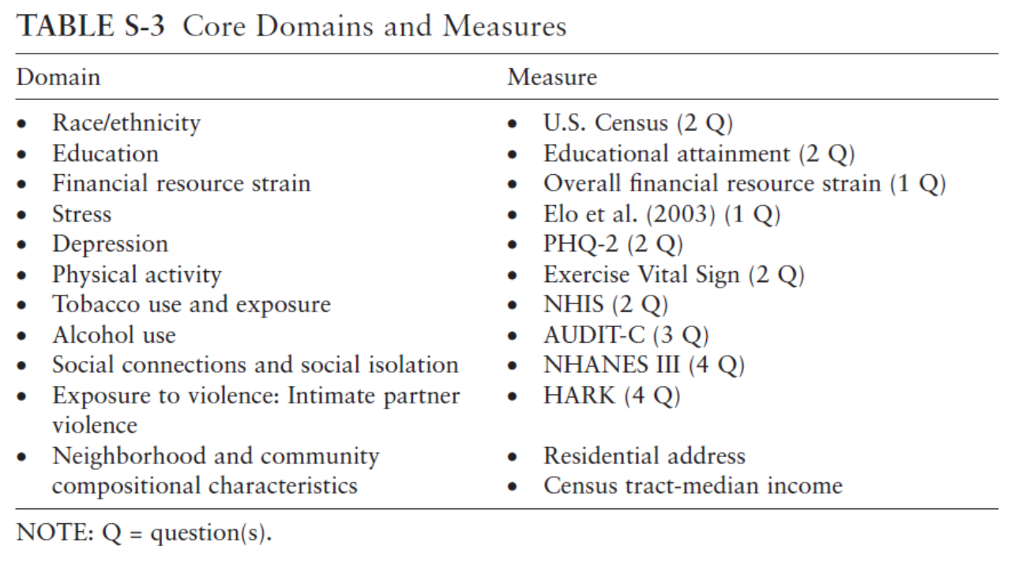
Q1: Which SDH Domains?
Considered:
What SDH data already collected?
What did IOM recommend?
What did PRAPARE recommend?
What did KP use?
Differences in wording?
Process: Multiple meetings over 6 months
Decided to include:
1. Alcohol use*
2. Race and ethnicity*
3. Tobacco use / exposure *
4. Depression*
5. Education**
6. Financial resource strain
7. Intimate partner violence
8. Physical activity
9. Social connections / isolation
10. Stress
11. Sexual orientation / gender identity
12. Housing**
13. Food insecurity**
*=already routinely collected in EHRs
**=prioritized by OCHIN CORC
Notes:
We asked stakeholders to prioritize SDH domains and questions:
IOM-recommended SDH domains
the PRAPARE tool, and
other resources.
The PC-CORC used the IOM domain list as a starting point for deciding which measures to add.
Met with the PC-CORC 5 times over 6 months until consensus was reached – first on the domains, then on the wording used for each.

Slide 11
Q2: Tools for Collecting, Summarizing SDH Data?
Mocked-up tools based on commonly-used EHR functions (e.g., flowsheets, preference lists)
Presented to CORC and pilot CHCs, sought feedback
  Multiple meetings over 6 months
  Epic programmer advised on feasibility of suggested changes
Revised tools based on stakeholder feedback
Verified that revisions addressed feedback (follow-up meetings, calls)

Slide 12
Q3: Tools for Making, Tracking SDH Referrals?
Wanted SDH referrals to work like clinical referrals, as possible
Pilot CHCs identified SDH domains for which they wanted community resource referral lists:
  Housing, food, transportation, intimate partner violence
Considered existing services like 211, Purple Binder, etc.
  All had downstream costs or other limitations
Created “preference lists” with current local resources
  built on local knowledge of relevant services
How to maintain these?

Slide 13
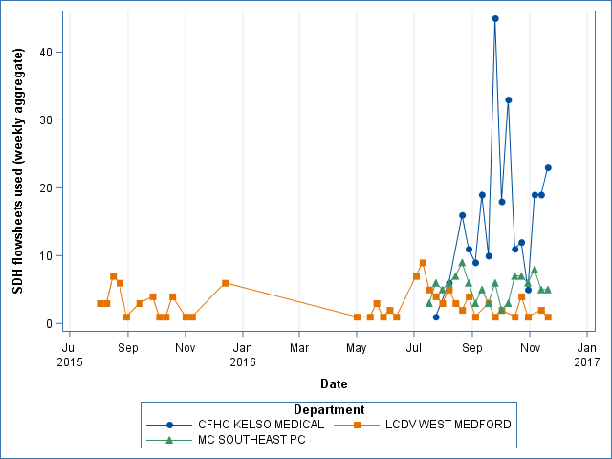
Preliminary Results
(6/24/16 - 11/16/16)
Pilot CHC | Patients screened | % screened who were referred via preference lists*
1 (K) | 257 | 49%
2 (M) | 108 | 3%
3 (S) | 102 | 38%
*Some barriers to preference list use have been identified

Slide 14
Lessons and challenges
Which SDH measures?
Many CHC patients have financial hardship; granular SDH data needed to ID specific needs
Added question on preferred learning style (reading, listening, pictures)
How many Qs? Which most important? Minimum?
What counts as a positive screen? Says who?
Other considerations:
How to avoid duplicate data entry? Manage conflicting data?
How to adapt to local needs, while supporting national standardization?

Slide 15
Lessons and challenges
Collecting SDH data:
Workflows! Whose job is it?
Preferred: SDH data collection, referrals done by support staff, not clinicians
Must enable SDH data collection by diverse care team members (to fit various workflows)
Paper versions: must be hand-entered into EHR → timing issues (but is what people are used to!)
  Sometimes data never entered into EHR
Considered using tablets: too complex / costly? Considered portal signup on the spot: led to impractical multi-step workflow
More research needed on mechanisms / technologies for getting SDH data directly into the EHR
Screening reminder options?

Slide 16
Lessons and challenges
Ordering referrals:
Can’t schedule appointments, as you might with some clinical referrals
What does an SDH “referral” involve? How much staff ‘touch’?
Impact on work burden: created a new referral option → ‘no follow-up needed’
Support staff must be trained / authorized to use referral tools (may involve programming!)
Referrals may be part of outreach (between visits) – how to ID which patients should be called?
Tracking past referrals:
Requires use of the preference lists / ICD10 codes, or can’t be tracked
  Which codes???
HARD to monitor referral outcomes

Slide 17
More Lessons and Challenges
Coding for SDH needs – not yet standardized
  See Gottlieb 2016 Health Affairs
Don’t want to add to problem list complexity
  Create an SDH ‘box’ within the problem list?
Not all patients with SDH needs want them addressed
  BUCKETING
  SEGMENTATION
  Do you want help? What kind of help? → How can EHR tools facilitate this?
Avoid implying that the clinic can help with any / all SDH needs
Modularity of tools?
Notes:
Consider ensuring that the appropriate care team members can access all aspects of the tools. Most or all of the work associated with SDH data collection and follow-up is conducted by clinical support staff, not clinicians

Slide 18
Next steps
Proposal submitted fall 2016: Test approaches to helping CHCs implement SDH-related workflows, data collection, action
Planned proposals:
  Merck: Partner with Oregon Food Bank
  Other research on connecting to community resources
  Gottlieb / Hessler: Provider / patient activation methods?
  Community vital signs
    On their own? As a complement? Instead of patient-reported?
  What else???? Ideas?

Slide 19
Discussion questions / current challenges
How many / which SDH questions are essential?
Optimal workflows?
Better methods for patient-led data entry?
How to take action / make referrals?
How to know if patients want SDH help from their care team, and if so, what kind???? How can EHR help?
Implementation strategies?
Orienting correct staff to tool use (wait, there’s a summary page?)

Slide 20

Thank You!
Rachel Gold, PhD, MPH
Investigator
Rachel.Gold@kpchr.org

